Slide 1
MUSCLES INVOLVED IN RESPIRATION
Dr. Ahmed Fathalla Ibrahim
&
Dr. Zeenat Zaidi

Slide 2
OBJECTIVES
At the end of the lecture, students should be able to:
Describe the components of the thoracic cage and their articulations.
Describe in brief the respiratory movements.
List the muscles involved in inspiration and in expiration.
Describe the attachments of each muscle to the thoracic cage and its nerve supply.
Describe the origin, insertion, nerve supply of diaphragm.

Slide 3
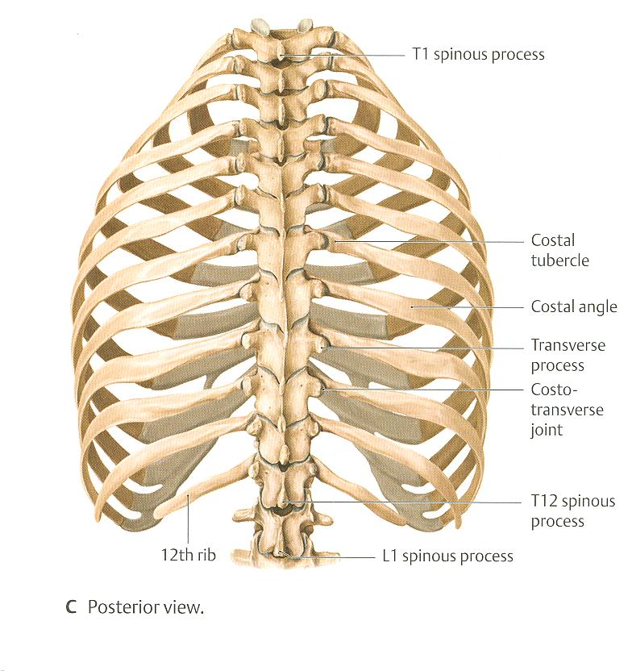
THORACIC CAGE
Conical in shape
Formed of:
Sternum & costal cartilages: anteriorly
Twelve pairs of ribs: laterally
Twelve thoracic vertebrae: posteriorly
Has 2 apertures (openings):
Superior (thoracic outlet): narrow, open, continuous with neck
Inferior: wide, closed by diaphragm

Slide 4
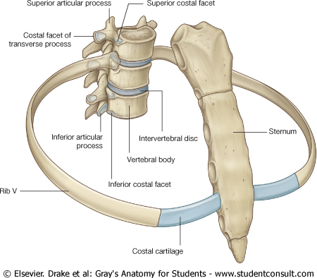
Articulations
Manubriosternal
(fibrocartilagenous J.)
Small angular
Movement possible
Costovertebral
(Synovial joint)
Costochondral
(cartilagenous J.)
no movements
possible
Sternocostal
(synovial), mobile EXCEPT first, which is cartilagenous & fixed
Xiphisternal
(fibrocartilagenous J.)
no significant
movements

Slide 5
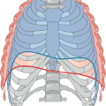
Respiratory Movements A- Movements of Diaphragm
Inspiration
Contraction (descent) of diaphragm
Increase of vertical diameter
of thoracic cavity
Expiration
Relaxation (ascent)
of diaphragm)

Slide 6
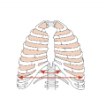
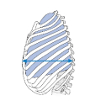
Respiratory Movements B- Movements of Ribs
PUMP HANDLE MOVEMENT
Elevation of ribs
Increase in antero-posterior diameter of thoracic cavity
BUCKET HANDLE MOVEMENT
Elevation of ribs
Increase in lateral diameter of thoracic cavity

Slide 7
Inspiratory Muscles
Diaphragm (most important muscle)
External intercostal muscles Rib elevators:
Accessory muscles (only used during forced inspiration):
Scalene muscles: Muscles attaching cervical vertebrae to first & second rib:
Pectoralis major: Muscle attaching thoracic cage to upper limb:

Slide 8
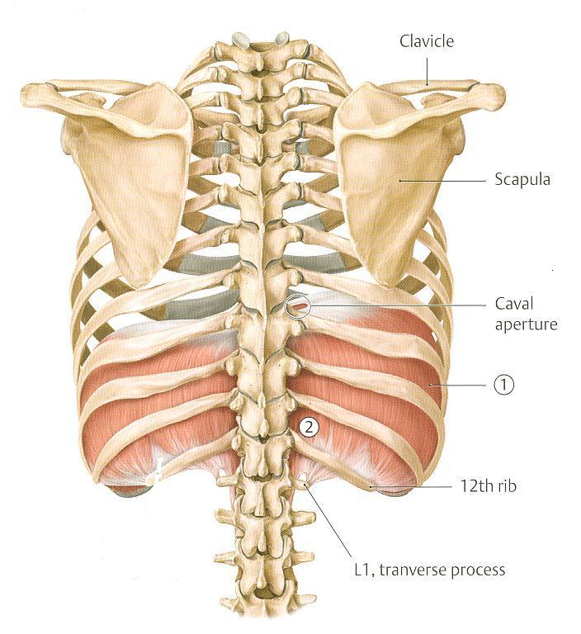
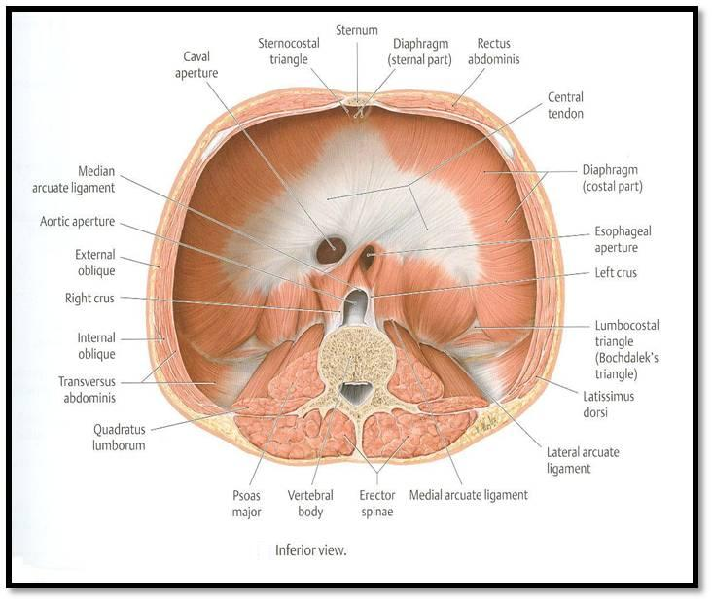
DIAPHRAGM
A musculotendinous partition between thoracic & abdominal cavity
Convex toward thoracic & concave toward abdominal cavity
Origin:
Sternal: xiphoid process of sternum
Costal: lower 6 costal cartilages & 12th rib
From medial & lateral arcuate ligaments
Vertebral: as right crus from upper 3 lumbar vertebrae & left crus from upper 2 lumbar vertebrae
1
2
Left crus
Right crus
4
3
Lateral arcuate lig.
Medial arcuate lig.

Slide 9
Insertion: Fibers converge to join the central tendon
Nerve supply: phrenic nerve (C3,4,5), penetrates diaphragm & innervates it from abdominal surface
Action: contraction (descent) of diaphragm increases vertical diameter of thoracic cavity (essential for normal breathing)

Slide 10
EXTERNAL INTERCOSTAL
Attachments: from lower border of rib above to upper border of rib below
Direction of fibers: downward & medially
Nerve supply: intercostal nerves
Action: rib elevators (inspiratory)

Slide 11
SCALENE MUSCLES
Three muscles:
Scalenus anterior
Scalenus medius
Scalenus posterior
Origin: cervical vertebrae
Insertion: 1st & 2nd ribs
Action: elevate 1st & 2nd ribs (inspiratory)
Cervical vertebrae
2
1
3
1st rib
2nd rib

Slide 12
PECTORALIS MAJOR
Origin: sternum + costal cartilages
Insertion: humerus
Action: increases antero-posterior diameter of thoracic cavity, when arm is fixed (inspiratory)

Slide 13
Expiratory Muscles
Act only during forced expiration
Rib depressors:
Internal intercostal
Innermost intercostal
Subcostals
Transversus thoracis
Anterior abdominal wall muscles:
External oblique
Internal oblique
Transversus abdominis
Rectus abdominis

Slide 14
RIB DEPRESSORS
1. Internal intercostal
2. Innermost intercostal
Direction: upward & medially
3. Subcostal
4. Transversus thoracis
Nerve supply: intercostal nerves (ventral rami of T1-T11)
3
1
2
4

Slide 15
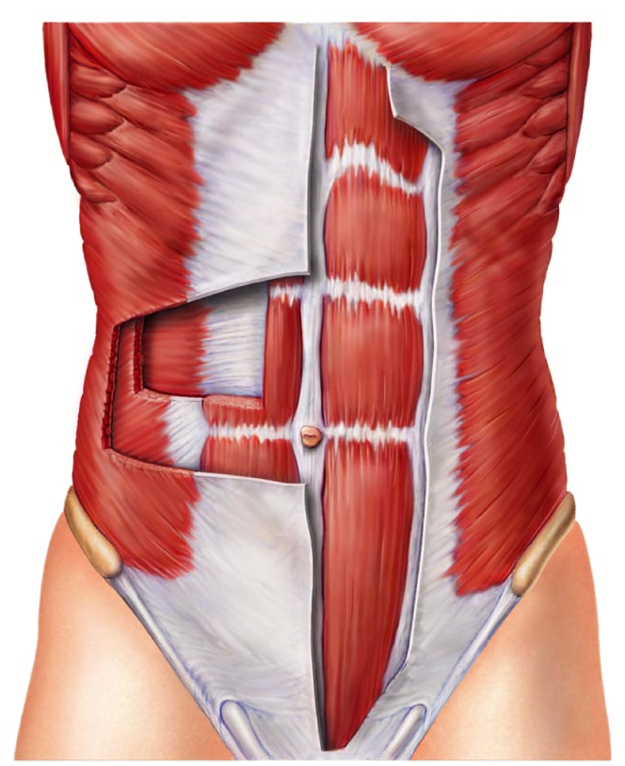
Anterior abdominal wall
Is formed of 3 layers of muscles of fibers running in different directions (to increase strength of anterior abdominal wall)
The 3 muscles form a tendinous sheath in which a fourth muscles lies (rectus abdominis)
Muscles are attached to: sternum, costal cartilages and ribs + hip bones
The aponeurosis of the 3 muscles on both sides fuse in the midline to form linea alba
Action (during forced expiration): Compression of abdominal viscera to help in ascent of diaphragm
Nerve supply: lower intercostal nerves (T7 – T11), subcostal nerve (T12) and first lumbar nerve.
Linea
alba
EO
TA
RA
IO

Slide 16
Anterior abdominal wall Muscles
External oblique (outer layer)
Direction: downward & medially
Internal oblique (middle layer)
Direction: upward & medially
Linea
alba

Slide 17
Transversus abdominis (inner layer)
Direction: transverse
Rectus abdominis
Direction: vertical

Slide 18
THANK YOU

