Slide 1
بسم الله الرحمن الرحيم

Slide 2
Phospholipid Compounds of Physiological Importance
By
Reem M Sallam, M.D.; Ph.D.

Slide 3
Objectives
Selected members of phospholipids
Physiological importance of phospholipids
Plospholipases:
Phospholipases A1, A2, C and D
Lysosomal phospholipase: Sphingomyelinase

Slide 4
Functions of Phospholipids
Membrane-bound phospholipids: Structural: Predominant lipids of cell membranes Anchoring: Attaching some proteins to membranes Signaling: Source of PI3 and DAG
Myelin sheath: insulator and speeds up transmission of nerve impulses

Slide 5
Functions of Phospholipids
CONT’D
(B) Non-membrane-bound phospholipids: Easy re-inflation of alveoli by air: Lung surfactant Detergent effect: Essential component of bile Solubilize cholesterol, preventing gall stones Emulsifying lipids, helping lipid digestion Structural: Coat of lipoproteins

Slide 6
Background: Lipid Compounds
Heterogeneous group
Relatively water-insoluble (? Exception)
Soluble in non-polar solvents

Slide 7
Lipid Compounds:
Heterogeneous Group
A. Simple Lipids:
Fatty acids
Ketone bodies
Triacylglycerol
Cholesterol
B. Complex Lipids:
Phospholipids
Lipoproteins
Glycolipids

Slide 8
Phospholipids
A. Glycerophospholipids
Glycerol-containing phospholipids
B. Sphingo-phospholipids:
Sphingosine-containing phospholipids

Slide 9
Phospholipids
A. Glycerophospholipids:
1. Phosphatidylcholine (Lecithin)
e.g., Surfactant (Dipalmitoylecithin)
2. Phosphatidylinositol (Signaling and anchoring molecule)

Slide 10
Phospholipids:
A. Glycerophospholipids
Members:
Phosphatidylcholine
(Lecithin)
e.g., Surfactant
(Dipalmitoylecithin)
Parent Compound
Phosphatidic acid

Slide 11
Phospholipids:
Glycerophospholipids
DipalmitoylLecithin (Lung surfactant)
Synthesis and secretion: by granular pneumocytes
Major lipid component of lung surfactant
Lung surfactant is made out of:
Dipalmitolylecithin (65%)
Other phospholipids, cholesterol & proteins (35%)

Slide 12
Phospholipids:
Glycerophospholipids
DipalmitoylLecithin (Lung surfactant), continued…
Surfactant decreases surface tension of fluid layer lining of alveoli→↓the pressure needed for their inflation by air→ preventing alveolar collapse (atelectasis)
Congenital Respiratory distress syndrome (RDS):
Insufficient production of lung surfactant
(especially in pre-term babies) → neonatal death

Slide 13
Congenital RDS
Diagnosis
Pre-natal diagnosis by:
Lecithin/sphingomyelin (L/S) ratio in amniotic fluid:
Ratio of 2 or above indicates lung maturity and no RDS (i.e., shift from sphingomyelin to lecithin synthesis by pneumocytes that normally occurs by 32 weeks of gestation)
Low L/S Ratio (< 2): RDS

Slide 14
Congenital RDS
Prevention & Treatment
Prevention of RDS:
Glucocorticoids to the pregnant mother with low L/S ratio shortly before delivery
Treatment:
Intratracheal administration of surfactant to pre-term infants with RDS

Slide 15
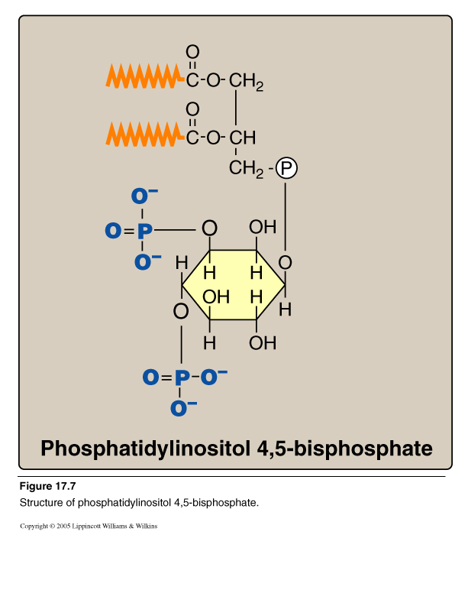
Phospholipids:
Glycerophospholipids
Phosphatidylinositol 4,5 bisphosphate
2. Phosphatidylinositol 4,5 bisphosphate (PI)

Slide 16
Calcium/Phosphatidylinositol System
Diacylglycerol
(DAG)
Inositol Trisphosphate
(IP₃)
Phospholipase C

Slide 17
Phosphatidylinositol System
Signal: Hormones or neurotransmitters
e.g., Acetylcholine, antidiuretic hormone (V1- receptor) and catecholamines (α₁ actions)
Receptor: G-protein coupled receptor
Effects: *Activation of phospholipase C Hydrolysis of phosphatidylinositol 4,5-bisphosphate Production of IP3 ( Ca²⁺) and DAG
Activation of protein kinase C
Phosphorylation of cellular proteins
* Please refer to activation of adenylyl cyclase and guanylyl cyclase for production of second messengers in other G-protein coupled signaling pathways
Response: Biological responses to hormones

Slide 18
*
*
Acetylcholine Antidiuretic hormone (ADH) Catecholamines
Intracellular Signaling by Inositol trisphosphate

Slide 19
PI- Protein Anchoring
Anchoring of proteins to membranes
via
Carbohydrate-Phosphatidylinositol
Bridge
Examples of anchored proteins:
1. Alkaline phosphatase
(to the surface of small intestine)
2. Acetylcholine esterase (to postsynaptic membrane)
These proteins can be cleaved from
their attachment to the membranes
by phospholipase C

Slide 20
Phospholipids: B. Sphingo-phospholipids
Sphingosine-containing phospholipids:
e.g., sphingomyelin (Myelin sheath)

Slide 21
Phospholipids: B. Sphingo-phospholipids
Sphingomyelin
CH₃ (CH₂)₁₂ CH CH CH CH CH₂O
Phosphorylcholine
OH
NH
CH₃
(CH₂)_{n}
C
O
Long Chain Fatty acid

Slide 22
Sphingosine
CH₃ (CH₂)₁₂ CH CH CH CH CH₂OH
OH
NH₂
Long chain, unsaturated amino alcohol

Slide 23
Ceramide: Parent Sphingolipid Compound
CH₃ (CH₂)₁₂ CH CH CH CH CH₂OH
OH
NH
CH₃
(CH₂)_{n}
C
O
Long Chain Fatty acid

Slide 24
Sphingomyelin
CH₃ (CH₂)₁₂ CH CH CH CH CH₂O
Phosphorylcholine
OH
NH
CH₃
(CH₂)_{n}
C
O
Long Chain Fatty acid

Slide 25
Structure & Function of Myelin Sheath
Glycolipids (mainly)
Myelin structure: Lipids (80%)
Sphingomyelin
Proteins (20%)
Myelin sheath insulates the nerve axon to avoid signal leakage
and greatly speeds up the transmission of impulses along axons
Direction of nerve impulse

Slide 26
Lipoprotein Structure
Outer part (coat):
Apoproteins or apolipoproteins
Phospholipids (Why?)
Free cholesterol
(Relatively hydrophilic, allowing transport of lipid particles of the core in the aqueous plasma)
Inner part (core):
According to the type of lipoproteins
Different lipid components in various combinations

Slide 27
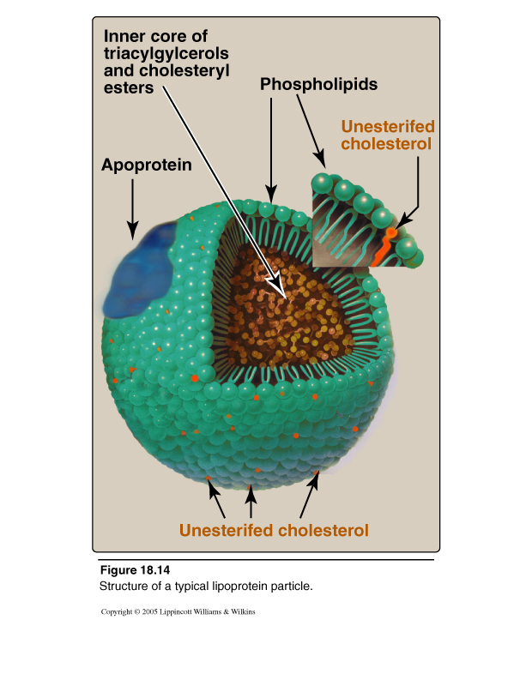
Lipoprotein Structure

Slide 28
Phospholipases
(1) For glycerophospholipids:
Phospholipases A1, A2, C and D
Present in all tissues and pancreatic juice
Present in snake venoms and bacterial toxins
(2) For sphingophospholipids:
Lysosomal phospholipase
Sphingomyelinase
Sphingomyelin Ceramide + Phosphocholine

Slide 29
Glycero-phospholipases

Slide 30
Functions of Phospholipases
(1) Degradation of phospholipids
Production of second messengers
Digestion of phospholipids by pancreatic juice
Pathogenic bacteria degrade phospholipids of membranes and causing spread of infection
(2) Remodeling of phospholipids:
Specific phospholipase removes fatty acid from phospholipid
Replacement of fatty acid by alternative fatty acid using fatty acyl CoA transferase
e.g., Binding of 2 palmitic acids in: Dipalmitoylphosphatidylcholine (DPPC)
Binding of arachidonic to carbon 2 of PI or PC

Slide 31
Take Home Message
Phospholipids are Complex lipids
Phospholipids have important physiological functions: A. Membrane-bound: Structural Signalling & anchoring: e.g., PI Myelin sheath: e.g., sphingomyelin
B. Non-membrane bound:
Structural: Lipoprotein coat Alveolar re-inflation: Lung surfactant Detergent effect: Phospholipids of bile

Slide 32
Take Home Message
CONT’D
Phospholipases: Phospholipases A1, A2, C and D Lysosomal Phospholipase: Sphingomyelinase
Function of phospholipases:
Degradation of phospholipids e.g., production of second messengers
Remodeling of phospholipids
e.g., production of DPPC (lung surfactant)

Slide 33
THANK YOU

