Slide 1
Tobacco Use: Problems & Solutions
Dr. Ali Al-Hazmi
Family and Community Medicine
KSU College of Medicine

Slide 2
Headlines
Magnitude of the problem
What is in tobacco ? is smoking addictive ?
Consequences of tobacco use
Why do we smoke ?
Prevention and control efforts
Can we quit ?

Slide 3
Magnitude of the Problem

Slide 4
Tobacco’s Deadly Toll
5 million deaths world wide each year
10 million deaths estimated by year 2030
WHO estimates, there are approximately 1.1 billion smokers in the world

Slide 5
Consequences of Tobacco-Use: Preventable Causes of Death
Smoking 400,000
Accidents 94,000
2nd Hand Smoke 38,000
Alcohol 45,000
HIV/AIDS 32,600
Suicide 31,000
Homicide 21,000
Drugs 14,200
Notes:
Coincides with BB presentation: use script from original Tobacco 101 presentation
“If you add smoking and SHS, it equals 438,000. If you add up all the non tobacco-related causes, it equals ½ of the people from tobacco-related. Given these numbers, helping people quit or reduce SHS exposure needs to be a health priority. Half of all teens who start to smoke will die of tobacco-related disease.”

Slide 6
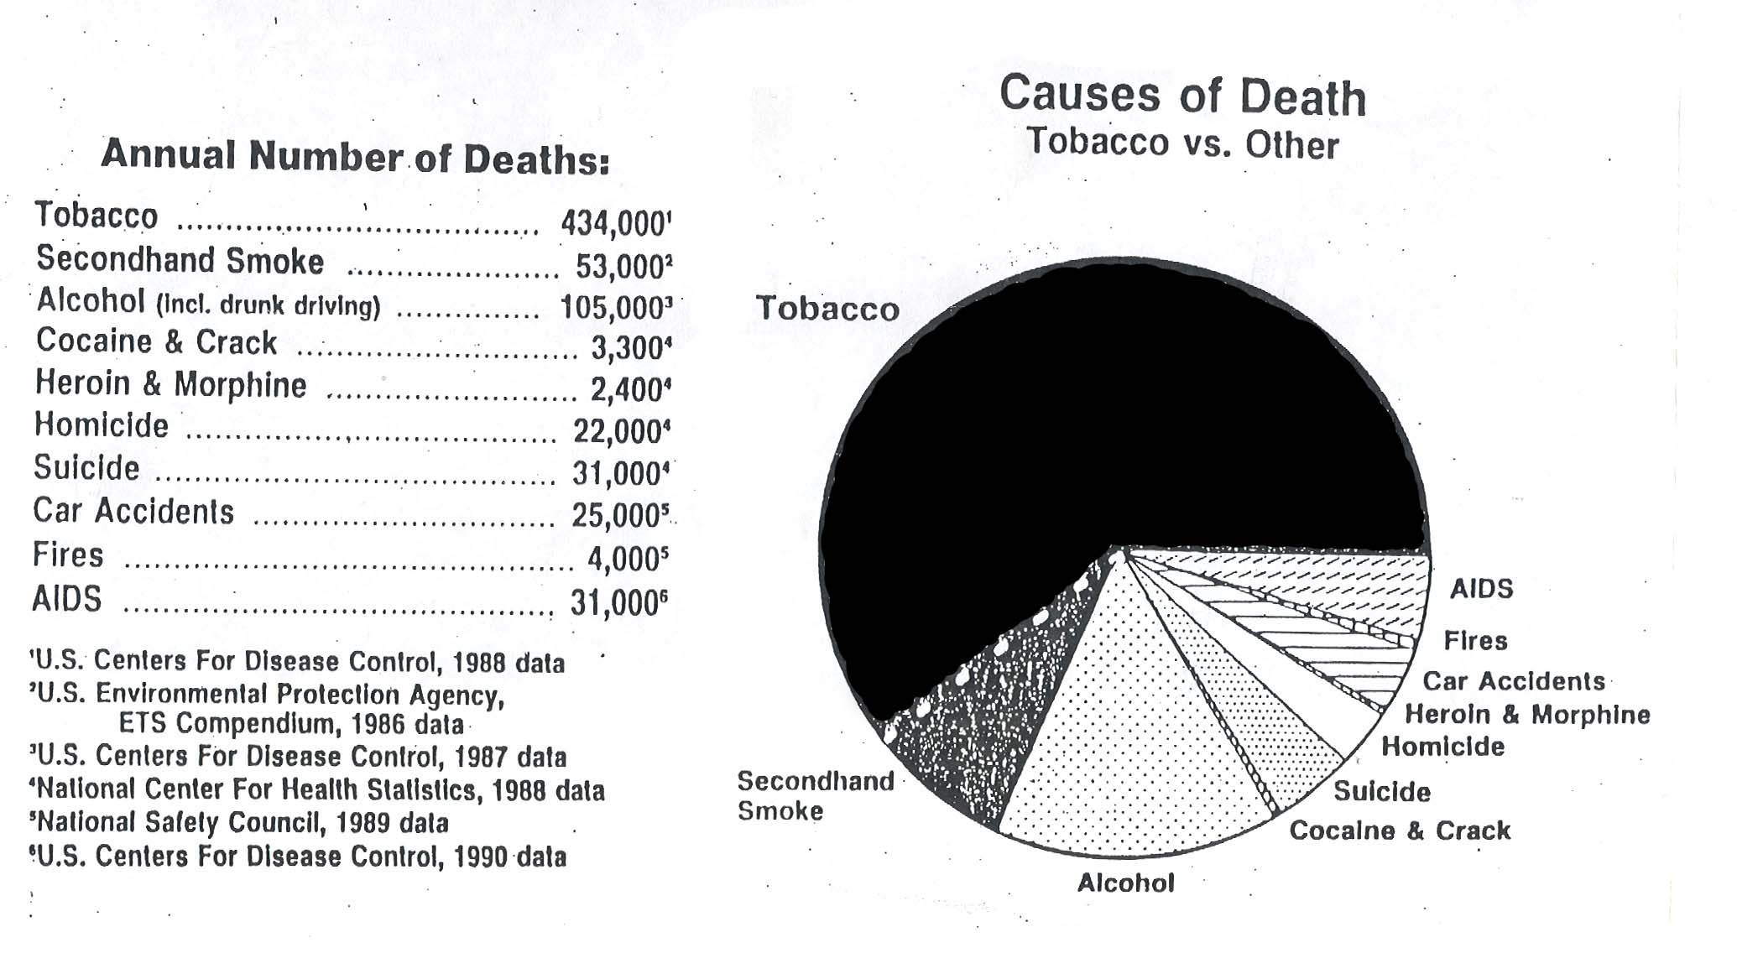
Tobacco Kills More Americans Each Year Than Alcohol, Cocaine, Crack, Heroin, Homicide, Suicide, Car Accidents, Fires and AIDS combined:
(Chart of health effects- to be scanned in)
Notes:
Causes of death chart

Slide 7
Smoking in KSA
The prevalence of current smoking in Saudi Arabia ranges from .4-52.3% (median = 17.5%).
The prevalence of smoking in males up to 38% , while in females its up to 16%.
63.8% started shisha smoking at ages of 16 to 18 years.
Bassiony MM, Smoking in Saudi Arabia, 2009 Jul;30

Slide 8
Smoking in KSA
The mean age at which smoking started was 16 ± 2. years,
More than half of the students who smoked were cigarette smokers,
while 43.2% were shisha smokers.
Bassiony MM, Smoking in Saudi Arabia, 2009 Jul;30

Slide 9
Smoking in KSA:
30% population of Saudi Arabia
nearly six million people expose themselves to death is inevitable
http://www.sha.org.sa

Slide 10
Smoking in KSA: Global Health Professions Student Survey (GHPSS)
The KSA medical students WHO-GHPSS was a school-based survey of 3rd year medical students attending the 13 medical schools conducted in 2006. Student response rate was 62.6 %, n = 481 students
Results: 11.6% currently smoke cigarettes (Males = 13.1%, Females = 9.6%); 12.8% currently use any form of tobacco other than cigarettes (Males = 13.9%, Females = 11.3%)

Slide 11
Smoking in KSA: Global Youth Tobacco Survey (GYTS)
The KSA school-based WHO-GYTS was conducted in 2010. A two-stage cluster sample design was used to produce representative data. Student response rate was 83.4 % (n = 1,797 school children aged 13-15)
Results: 14.9 % currently use any tobacco product (boys = 21.2 %, girls = 9.1%) ; 8.9 % currently smoke cigarettes (boys = 13.0 %, girls = 5.0%); 9.5 % currently smoke shisha (boys = 13.3 %, girls = 6.1%)

Slide 12
Smoking in KSA: Global Youth Tobacco Survey (GYTS)
The KSA school-based WHO-GYTS was conducted in 2010. A two-stage cluster sample design was used to produce representative data. Student response rate was 83.4 % (n = 1,797 school children aged 13-15)
Results: 14.9 % currently use any tobacco product (boys = 21.2 %, girls = 9.1%) ; 8.9 % currently smoke cigarettes (boys = 13.0 %, girls = 5.0%); 9.5 % currently smoke shisha (boys = 13.3 %, girls = 6.1%)

Slide 13
What is in tobacco ?

Slide 14
Tobacco Myths
Myth: water-pipes and cigars are safe
Myth: It’s OK to smoke as long as it’s a “natural” cigarette
Myth: It’s OK to be next to a smoker in one room
Myth: Low tar-nicotine cigarettes are OK
Myth: Smoking is more a habit, rather than addiction
Notes:
Fact 1: Clove cigarettes have been marketed as natural, but are far more dangerous than cigarettes. They contain nearly twice the tar, nicotine, and carbon monoxide of regular cigarettes. The health hazards of clove cigarettes include
* Lung bleeding and coughing up blood
* Chest pain and vomiting
* Severe and fatal lung infections
Fact 2: Cigar smokers have 5-10 times as much mouth and throat cancer. Cigar smoke in teens slows lung growth and reduces athletic performance.
Fact 3: So-called “Indian” or “New Age” cigarettes have most of the same chemicals as the others. According to the Rural Indian Health Board, tobacco was offered and held in the hand and not smoked in its traditional use. They also say that using tobacco (even free of additives) causes cancer. The Native American spiritual belief is that your body is a gift and a temple to be kept in good health to serve the planet and the great sprit, and the nontraditional use of tobacco violated this belief. You are not supporting Native Americans by purchasing these products – you are supporting the tobacco industry.

Slide 15
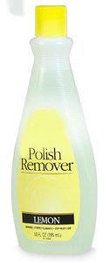
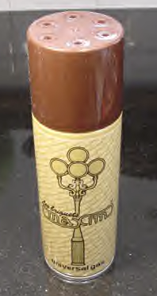
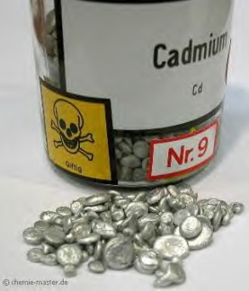
What is in tobacco
More than 4,000 substances, including:
Tar: black sticky substance used to pave roads
Nicotine: Insecticide
Carbon Monoxide: Car exhaust
²¹⁰ Polonium: radio-active substance
Acetone: Finger nail polish remover
Ammonia: Toilet Cleaner
Cadmium: used batteries
Ethanol: Alcohol
Arsenic: Rat poison
Butane: Lighter Fluid
Notes:
There are over 4,000 chemicals in cigarette smoke. These chemicals irritate the throat and cause cancer, lung and heart disease. Chemicals are added to: Make tobacco burn smoothly; Make the paper burn evenly Enhance the flavor; Boost the nicotine (ammonia); Kill the tobacco slugs Make sure the cigarette doesn’t go out in the ashtray when not puffing on it. Other chemicals found in tobacco include:
Benzene: found in moth balls
Denatured alcohol: used to keep cigarettes burning
Toluene: now illegal to put in top coat solution for polishing your nails.
DDT: Insecticides
Arsenic: found in rat poison
Formaldehyde: dead body preserver
Tar: a pack a day smoker would accumulate 1 quart of tar a year In their lungs. Contains most of the cancer-causing agents of tobacco smoke.
“Activity”:
Show each chemical & read warning label of each (benzene, denatured alcohol, toluene, acetone)

Slide 16
Is smoking addictive
All tobacco products contain nicotine
Nicotine has been clearly recognized as a drug of addiction
tobacco dependence has been classified as a mental and behavioral disorder according to the WHO International Classification of Diseases, lCD-l0 (Classification F17.2).

Slide 17
A Golden Opportunity
http://www.cdc.gov/tobacco/campaign/tips/
Notes:
As part of its efforts to educate the public about the health effects of tobacco use, the CDC is currently conducting a national media campaign.
This high-profile campaign presents a golden opportunity for health professionals to help their patients who smoke to quit.
Survey data indicate that many smokers and young people greatly underestimate the health risks of smoking. This campaign addresses this knowledge gap.
The campaign also partially offsets the more than $1 million an hour that the tobacco industry is spending on making its products look appealing.
Now we’ll take a look at one of these ads. You may wish to go to CDC’s website, www.cdc.gov/tobacco/campaign/tips/, to view the other ads.

Slide 18
Is smoking addictive
Smoking typically begins in adolescence
if a person remains smoke-free throughout adolescence, it is highly unlikely that he or she will ever begin smoking
intensive efforts be made to help young people stay smoke-free.

Slide 19
Water-Pipe:
Not safer than regular tobacco smoke.
Causes the same diseases
Raises the risk of lip cancer, spreading infections like tuberculosis.
Users ingest about 100 times more lead from hookah smoke than from a cigarette.
Notes:
The water pipes known as hookahs, narghiles, sheeshas, or hubble-bubbles have been around for centuries and they are attracting new and younger audiences all over the world who desire “the glamour of being on the cusp of a trend.”
Not safer than regular tobacco smoke. It causes the same diseases as other tobacco smoking including oral, esophageal, and lung cancer as well as heart disease, emphysema, heart disease, chronic bronchitis, and of course, nicotine addiction.
Even though hookah smoke is water-cooled and filtered; furthermore, hookah smoke contains the same cancer-causing particulates found in secondhand smoke.
Hookah smoke is classified as clastogenic, capable of causing breakage of chromosomes, and genotoxic, damaging to DNA and thereby capable of causing mutations or cancer, for human beings.
The charcoal used in the tobacco heating process produces a toxin known as carbon monoxide; the carbon monoxide hazard is as high with hookah smoking as with cigarette smoking.

Slide 20
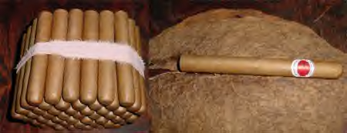
What is a cigar?
Has larger amounts of tobacco than a cigarette
Is tobacco rolled up in a tobacco leaf
Does not have a filter

Slide 21
Consequences of Tobacco Use

Slide 22
Different Consequences of Smoking
Health (short term, long term)
Economic (individual, family, community)
Social (family, community)
Development (community)
Religious (individual, community)
Premature dealth

Slide 23
Health Effects
Causes more than 25 different diseases
Affects different body-systems, especially:
Gastro-intestinal system
Respiratory tract
Cardio-vascular system
Urinary system
Others

Slide 24
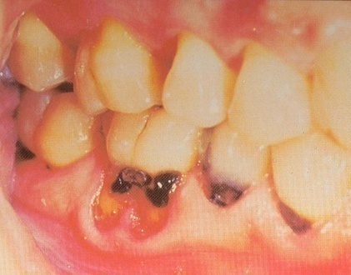
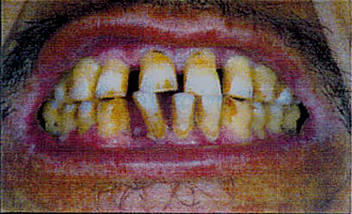
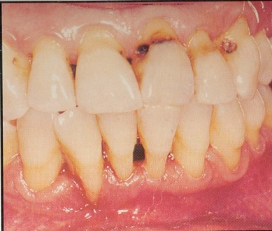
Oro-dental Problems:
Stained teeth
Gum inflammation
Black hairy tongue
Oral cancer
Delayed healing of the gums
Above: Cavities
Below: Gingivitis
Overall poor oral health
Notes:
Gum diseases such as gingivitis and periodontitis cause the gums to swell and bleed easily. Pockets of plaque between the teeth and gums can cause tooth decay and lead to tooth loss. People who smoke lose more teeth than people who don’t smoke. Teens who smoke are three times more likely to develop gum disease by the time they are 25 than people who do not smoke.

Slide 25
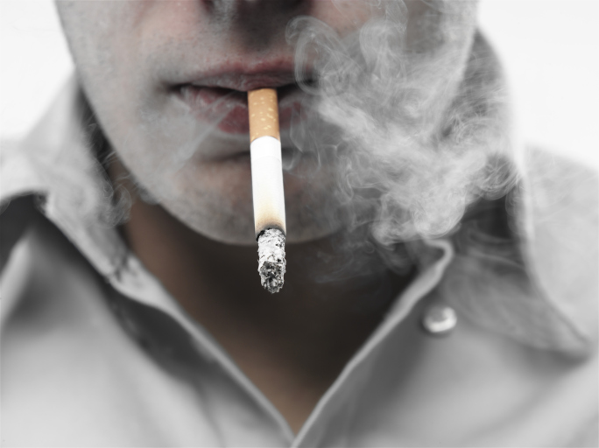
Secondhand Smoke Exposure
I don’t smoke. Why should I be concerned about being around someone who does?
Secondhand smoke is dangerous.
Secondhand smoke is a mixture of gases and fine particles that includes
Smoke from a burning cigarette, cigar, or pipe tip
Smoke that has been exhaled or breathed out by the person or people smoking
Notes:
25

Slide 26
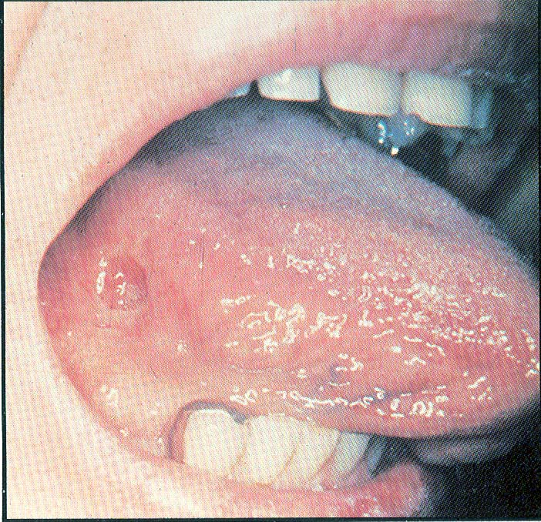
Consequences of chewing tobacco:
Leukoplakia
Oral cancer
Notes:
Leukoplakia is a condition which, in the mouth, can develop into cancer. Cigarette smoke – and smokeless tobacco – can cause this dangerous condition. The photo shows leukoplakia as the white patch on the inside of the cheek, between the teeth.
Oral cancer occurs in or on the mouth, lips, tongue, and lining of the cheek. Oropharyngeal cancer occurs in the throat, or oropharynx. This includes the tonsils, base of the tongue, and the back of the throat. Around 90% of all cases of these types of cancer are directly related to the use of tobacco products. These cancers can be treated, but the surgery to remove the tumors often leaves the patient disfigured. As many as 25% of all oral cancer patients die due to late detection and treatment.
The sore on the tongue on the right hand side photo is cancer. It will spread unless it is removed.

Slide 27
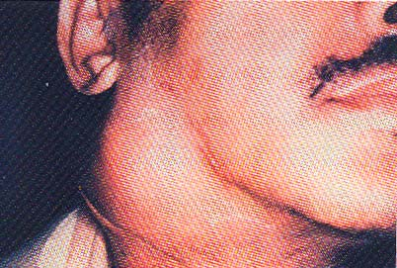
Laryngeal Cancer
Symptoms:
Persistent hoarseness
Chronic sore throat
Painful swallowing
Pain in the ear
Lump in the neck
Over 80% of deaths from laryngeal cancer are linked to smoking
Notes:
The larynx – or voice box – is located above the esophagus. Not only is the larynx necessary for speaking, but is also protects the lungs. Advanced cases of laryngeal cancer sometimes require surgical removal of the larynx; patients are then fitted with an electronic voice box. Depending on how much a person smokes, the risk of laryngeal cancer is up to 35 times higher for a smoker than a nonsmoker.
As cigarette smoke is breathed in, it passes down the throat, through the larynx (voice box) into the lungs. This exposes the voice box to poisons in the smoke, poisons that can cause cancer. If cancer develops in the voice box, the voice box must be removed. The upper left photo shows a voice box with cancer as the bumpy area in the middle.

Slide 28
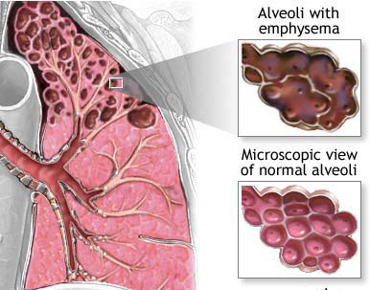
Emphysema:
Healthy lung
Emphysema lung
Symptoms Include
Shortness of breath; chronic cough;
wheezing; anxiety; weight loss; ankle, feet and leg swelling; fatigue, etc
Notes:
Your lungs have thousands of delicate air sacs- alveoli (air sacs). tiny, soft structures surrounded by very small blood vessels. In these air sacs, carbon dioxide gases from the body are exchanged for fresh air from the outside. Emphysema damages these delicate air sacs, and they lose their ability to exchange air. With damaged air sacs, you cannot get enough air to breathe, and always feel that you cannot catch your breath. Emphysema takes years to develop, but the damage cannot be undone. Cigarette smoke is the most common cause of the disease. The photo on the left shows a clean lung. The black specks are from having breathed smoggy air. Compare the smooth surface of this lung with the rough, ugly surface of the lung with emphysema, on the right. Note the hollow bubbles in what was once healthy lung tissue. Are cigarettes worth this kind of permanent damage to your lungs?
Tars in cigarette smoke cause irritation and reduce elasticity in the alveoli. As a result, the lungs lose their ability to transfer oxygen to the bloodstream- a condition called emphysema. People with emphysema cannot completely expel air, causing chronic shortness of breath. Although some treatments can ease the symptoms of emphysema, there is no cure and the damage is irreversible. Question: Is smoking worth this permanent type of damage to your lungs?
Activity #1: Straw Activity
Tell the group that to help demonstrate how hard it is with someone with emphysema to breathe, you are going to pass around STRAWS. (Pass straws around). When you get your straw use one hand to hold it in your mouth while you squeeze your nose shut. Take at least ten breaths. As you can see, breathing becomes very difficult. Imagine not being able to remove the straw, to not even be able to climb a flight of stairs without losing your breath. Again, is smoking really worth the risk?
Activity #2: Pass lungs around
Point out the small holes caused by hot air entering the lungs and popping the delicate, tiny air sacks within the lung, called the alvioli. POP BUBBLE WRAP TO DEMONSTRATE HOW THESE LITTLE, IMPORTANT AIR SAKCS GET POPPED WITH THE INHALATION OF ANY HOT SMOKE INTO THE LUNGS. When this happens, it’s very, very difficult to get enough air to breathe.

Slide 29
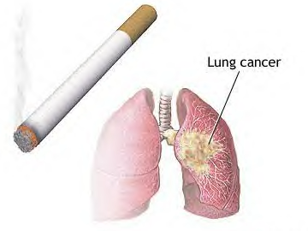
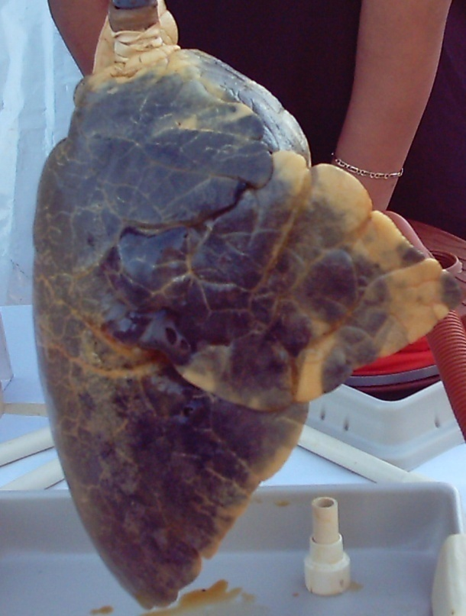
Lung Cancer: The uncontrolled growth of abnormal cells in one or both lungs
Lung cancer kills more people than any other type of cancer
Notes:
Smoking causes more than 80% of all cases of lung cancer. While a tumor in the lung sometimes causes symptoms such as coughing up blood or difficulty breathing, there are often no symptoms of lung cancer until it is advanced. By the time it is detected, lung cancer often has spread to other places in the body, including the bones, liver, brain, and adrenal glands. The photo on the far left is a model of a cancerous lung. Pictured on the far right is a real lung, with the grayish-white bumps on and in the lung being cancerous growths. It is the tars and carcinogens in cigarette smoke that cause tumors to develop.

Slide 30
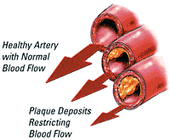
Arteriosclerosis & Atherosclerosis:
Healthy artery
Damaged artery
Notes:
Nicotine affects fatty acids in the blood, increasing the overall blood cholesterol level. When cholesterol is too high, a hard substance called plaque builds up on the inside walls of the blood vessels. This condition is known as atherosclerosis. Plaque can clog the blood vessels, forcing the heart to pump harder. Smoking also constricts the arteries, leading to arteriosclerosis, or hardening of the arteries. These conditions greatly increase the risk for heart attacks or strokes.
Arteriosclerosis (hardening of the arteries) is a major cause of heart attack and stroke. Smoking speeds up the development of arteriosclerosis. The lower left photo shows the smooth inside surface of a normal blood vessel. The photo to the right of it shows the rough inside surface of a diseased artery. The upper right photo shows an artery clogged with a fatty substance.

Slide 31
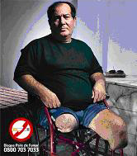
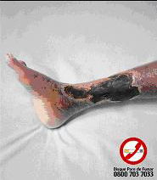
Peripheral Vascular Disease
Notes:
Peripheral vascular disease, or PVD, is caused by the gradual narrowing of the arteries in the arms and legs. Smoking greatly increases the risk and severity of this disease by contributing to atherosclerosis in these tiny arteries. PVD causes painful cramping during exercise, numbness and tingling, and weakness in the affected limbs. Disability may result as the risk of infection or amputation increases. The narrowing of the arteries that causes PVD also causes impotence, wrinkles and dental problems.

Slide 32
Heart Attack:
Smokers are twice as likely as Nonsmokers to have a heart attack
Quitting smoking rapidly reduces the risk of coronary heart disease
Torn heart wall: Result of over-worked heart muscle
Notes:
A heart attack is when the heart is damaged by a sudden lack of blood flow to the heart muscle. This happens because the arteries to the heart muscle become narrowed or blocked. Nicotine in cigarette smoke causes blood vessels to become narrow, reducing the oxygen supply to the heart muscle. This may be why smokers are more likely to have heart attack than nonsmokers.
Nicotine increases a smoker’s heart rate minutes after he or she first inhales. Nicotine also causes the arteries to become narrower every time a person smokes, contributing to high blood pressure. The carbon monoxide found in cigarette smoke reduces the amount of oxygen in the blood, causing the heart to work harder and provide the body with a sufficient oxygen supply. Carbon monoxide also strains the heart by damaging the linings of the blood vessels and contributing to arteriosclerosis. An increased heart rate combined with higher blood pressure can lead to a fatal heart attack
This arrow points to a hole in the heart wall. Smoking weakens the heart and increases blood pressure while contributing to clogged and constricted arteries. Severe damage like this may occur.

Slide 33
Stroke:
This brain shows stroke damage, which can cause death or severe mental or physical disability
Notes:
A stroke occurs when an artery becomes clogged or bursts. Strokes can cause paralysis, brain damage, or death. Hardened arteries, high blood pressure, and clotting problems- all of which can be cause by smoking – increase the risk for strokes. The dark red area in the photo is where bleeding occurred.

Slide 34
Fetal Smoking Syndrome:
Birth defects
Premature stillbirth
Low birth weight
Lowered immune capacity
Proneness to Sudden Infant Death Syndrome (SIDS)
Notes:
During pregnancy, everything a mother takes into her body is shared with the fetus- including tobacco smoke. Carbon monoxide in the tobacco smoke prevents the fetus from getting enough oxygen. Women who smoke during pregnancy have an increased risk of pregnancy complications, stillbirth, and miscarriage. Babies who are born to women who smoke have an increased risk of birth defects, premature birth, low birthweight, and are more prone to sudden infant death syndrome (SIDS). Maternal smoking weakens the child’s lungs and can lead to an increase in illness. Even after infancy, children whose mothers smoked while pregnant are more likely to have conduct or learning disorders, lack self-control, or be hyperactive.

Slide 35
Secondhand smoke (Passive Smoking)
Notes:
Both smokers and non-smokers experience eye irritation, sore throats, headaches, nausea, and dizziness when exposed to cigarette smoke. Exposure to secondhand smoke can also cause nonsmokers to experience the same devastating health effects as smokers- including cardiovascular disease, lung cancer, and COPD. Secondhand smoke contains twice as much tar and nicotine as that which is inhaled by the smoker and is responsible for over 63,000 deaths among nonsmokers every year in the United States. One of the most significant actions we can take to reduce the consequences from second hand smoke exposure is to set up rules to not allow smoking in our homes or in our cars.
Discussion:
How many people here have family or friends who allow smoking in their home or their car?
How many people have family or friends who allow smoking around children?

Slide 36
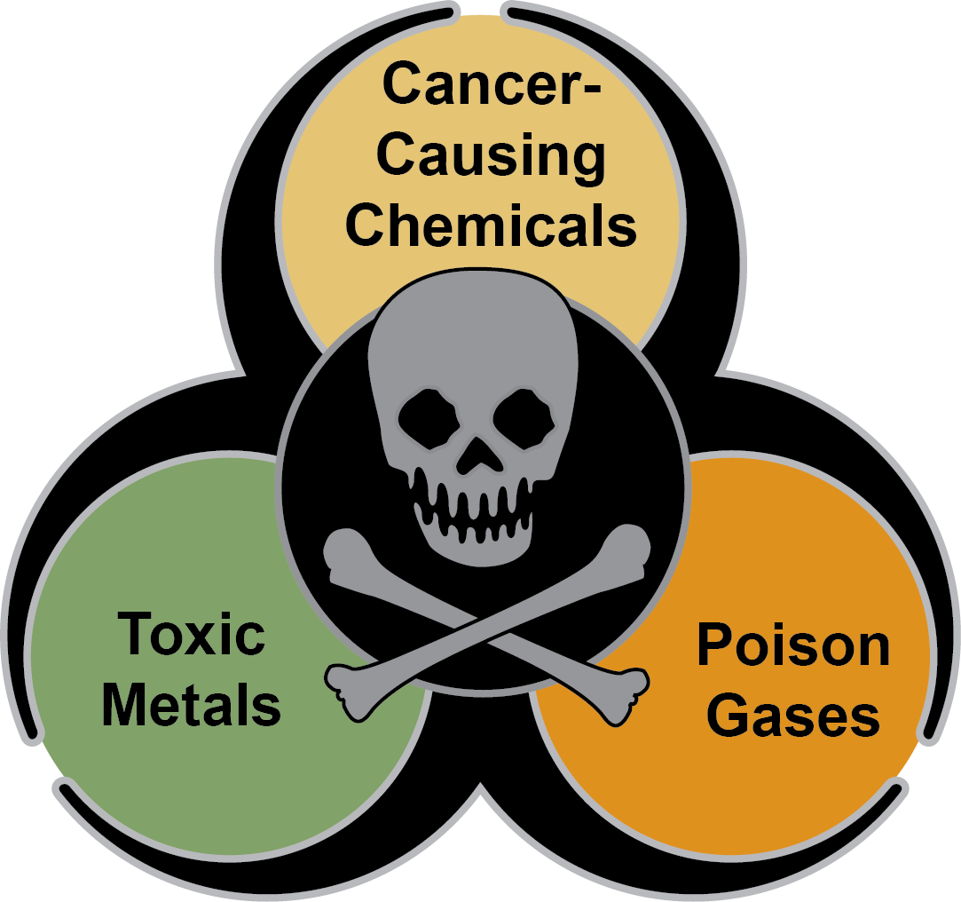
Secondhand Smoke Exposure
Is secondhand smoke toxic?
Secondhand smoke contains poisons.
You breathe in more than 4,000 chemicals when you are around someone who is smoking.
The chemicals found in secondhand smoke hurt your health, and many are known to cause cancer.
Permission needed
Notes:
36

Slide 37
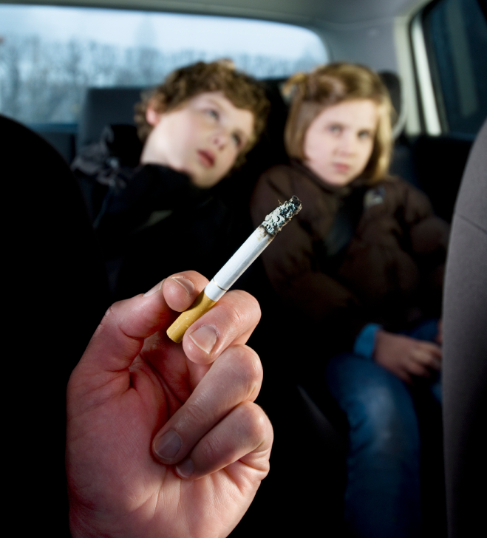
Secondhand Smoke Exposure
What problems does secondhand smoke create for youth?
Secondhand smoke harms children.
Children who are around smoke are more likely to have the following:
Lung problems
Ear infections
Severe asthma
Notes:
37

Slide 38
If smoking is so bad for us, why do we start ?
Notes:
Gather audience responses, write on a board. Ask people to call out the brands they, their friends or family smoke. This will undoubtedly include Marlboro, Camel, Newport, Kool. The single greatest contributor to starting smoking is advertising. None of us want to believe that we are influenced by advertising, but if we weren't, the tobacco industry wouldn't find it cost effective to spend $12.5 billion dollars a year promoting their products in the US. If they stopped advertising for just today and gave us the money ($34 million dollars), we could each walk out of here with: Number of people/ $34 million. Who would agree to that?

Slide 39
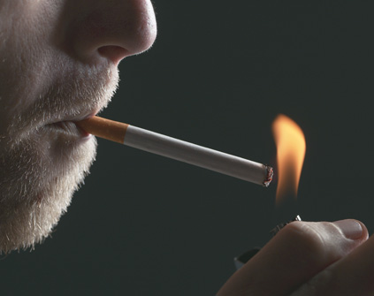
There’s no single reason why people begin to smoke.
It Has been estimated that 80% of Adult smokers start smoking as children, and 30% of children have tried smoking by the age of 11.

Slide 40
Social Factors
Parental influences
friendship groups
Influence of peer
Low socioeconomic status
The need to fit In.
It looks cool.

Slide 41
Individual influence
Wrong personal beliefs and values about smoking
Self esteem
Curiosity

Slide 42
Environmental influence
Availability
Accessibility
Price
Media
Tobacco industry intensive advertising

Slide 43
Why targeting youth ?
Philip Morris executive: "hitting the youth can be more efficient even though the cost to reach them is higher, because they are willing to experiment.
They have more influence over others in their age group than they will later in life, and they are far more loyal to their starting brand."
The younger the age when smoking begins, the longer the smoking cycle.
Young persons are also more vulnerable because they are likely to be less aware of the addictive nature of nicotine and the harmful effects of tobacco consumption.

Slide 44
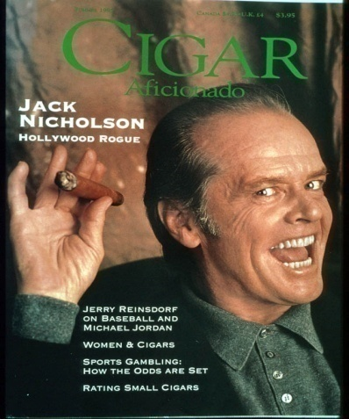
Targeting youth through activities and media
These principles also work for:
Sports
Concerts
Parties
Movies
Other media
Notes:
Other tobacco promotions oriented towards young adult activities achieve the same ends: to build associations between brand images and certain lifestyles, activities, and values, and to integrate smoking with adult activities.

Slide 45
Industry attempts to make more socially acceptable cigarettes
“You’re clearly someone who considers others. That’s why Superslim Capri is the choice for you…great tobacco flavor, but less smoke for those around you.”
Notes:
The tobacco industry has been trying to develop more socially acceptable cigarettes for years. For example, this is a Capri direct mail promotion from 2001 for a cigarette claiming less secondhand smoke, aimed at smokers concerned about secondhand smoke.
Source: http://www.trinketsandtrash.org/trendytrash/otcapricoup1a.htm

Slide 47
Solutions: Prevention & Control

Slide 48
Remember that Tobacco use is: The single largest cause of preventable death A long-term tobacco user has a 50% chance of dying prematurely from tobacco-related diseases..
Notes:
Tobacco use is the single largest cause of preventable death. Every person who begins smoking is guaranteed to experience negative health consequences- from reduced lung function to premature death. Worldwide, smoking causes an estimated 5 million deaths from the following conditions every year:

Slide 49
Prevention & Control
Globally: governed / advised by the Framework Convention on Tobacco Control FCTC (ratified by KSA in 2005); WHO-MPOWER (first launched in 2008)
Nationally: coordinated by Ministry of Health - Tobacco Control Program in KSA (TCP); other agencies’ efforts
Conceptually:
Primary prevention = tobacco use [smoking] prevention
Secondary prevention = tobacco use [smoking] cessation (quitting smoking)
Tertiary prevention = dealing with its consequences

Slide 50
WHO-MPOWER
Monitoring tobacco use and prevention policies
Protecting people from tobacco smoke
Offering help to quit
Warning of dangers of tobacco
Banning tobacco advertising, promotion and sponsorship
Increasing taxing on tobacco

Slide 51
Primary Prevention
Strengthening religious beliefs / “fatwas”
Legislations for banning smoking in public places
Banning advertising, especially to youngsters
Increasing taxation on tobacco products
Public health education through:
Health warning labeling on tobacco products
Using mini and mass media
Banning smoking in drama

Slide 52
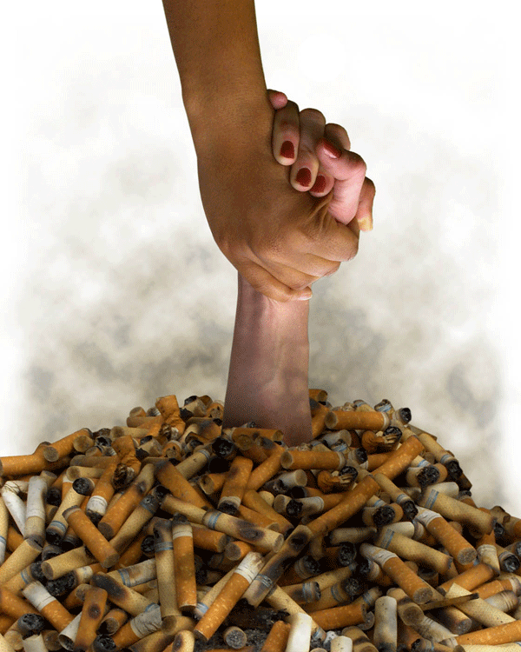

Slide 53
Smoking Cessation
dramatically reduces the risk of most smoking-related diseases.
One year after quitting, the risk of coronary heart disease decreases (CHD) by 50%.
Within 15 years, the relative risk of dying from CHD for an ex-smoker approaches that of a lifetime non-smoker.

Slide 54
Smoking Cessation
No amount of tobacco use is safe
Moreover, the relative risks of developing lung cancer, chronic obstructive lung diseases and strokes also decrease, but more slowly
Smoking cessation also shows a beneficial effect on pulmonary function, particularly in younger subjects, and the rate of decline among former smokers returns to that of those who have never smoked.

Slide 55
Smoking Cessation Thinking about quitting
Picking a quit date
Keeping a record of why, when, where and with whom you smoke
Getting support and encouragement from your family, friends, and health providers.
Joining a quit group
Getting individual counseling
Quitting Clinics available at: KSU; MoH-TCP; Naqa’ (Charitable Society for Tobacco Control), others

Slide 56
Smoking Cessation The Quitting Plan
Treating oneself well
Drinking lots of water
Changing routines
Reducing stress
Deep breathing
Regular exercise
Doing something enjoyable every day
Increasing non-smoking social support

Slide 57
KSA Tobacco Control Program Website: http://www.sa-tcp.com/newsite/

Slide 58
References
World Health Organization (WHO): www.who.int/tfi
Centers for Disease Control and Prevention: www.cdc.gov/
Tobacco Control Journal. www.tobaccocontrol.com
WHO-MPOWER: http://www.who.int/tobacco/mpower/2008/en/index.html
Machen MB. Tobacco. City of Berkeley Tobacco Prevention Program , USA
Ling P, Glantz SA. Why and how the tobacco industry sells cigarettes to young adults. University of California San Francisco, USA

