Slide 1
Respiratory Block PATHOLOGY L1
Pathology of bronchial asthma
Dr. Maha Arafah
2013, Feb

Slide 2
Objectives
At the end of this lecture, the student should be capable of:
Understanding asthma as an episodic, reversible bronchoconstriction caused by increased responsiveness of the tracheobronchial tree to various stimuli.
Knowing that asthma is divided into two basic types: extrinsic or atopic allergic and intrinsic asthma.
Understanding the morphological changes seen in the lungs in cases of severe asthma
Listing clinical presentation in cases of asthma
Listing the complications of asthma: superimposed infection, chronic bronchitis and pulmonary emphysema
Definition and manifestations of status asthmaticus

Slide 3
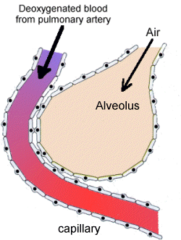
Introduction: Anatomy

Slide 4
Chronic Obstructive Pulmonary Disease
Bronchiectasis
Emphysema
Chronic Obstructive Pulmonary Disease
Chronic Bronchitis
Asthma

Slide 5
Disorders Associated with Airflow Obstruction
Signs/Symptoms | Etiology | Major Pathologic Changes | Anatomic Site | Clinical Term
Cough, sputum production | Tobacco smoke, air pollutants | Mucus gland hyperplasia, hypersecretion | Bronchus | Chronic bronchitis
Cough, purulent sputum, fever | Persistent or severe infections | Airway dilation and scarring | Bronchus | Bronchiectasis
Episodic wheezing, cough, dyspnea | Immunologic or undefined | Smooth muscle hyperplasia, excessive mucus, inflammation | Bronchus & terminal bronchioles | Asthma
Dyspnea | Tobacco smoke | Airspace enlargement, wall destruction | Acinus | Emphysema

Slide 6
bronchial asthma animation
http://link.brightcove.com/services/player/bcpid236059233?bctid=347806802
http://www.youtube.com/watch?NR=1&v=7EDo9pUYvPE&feature=endscreen

Slide 7
Chronic obstructive pulmonary diseases
Bronchial asthma
Asthma is a chronic inflammatory disorder of the airways that causes:
recurrent episodes of wheezing, breathlessness, chest tightness, and cough
particularly at night and/or early in the morning.

Slide 8
Bronchial asthma
This clinical picture is caused by:
repeated immediate hypersensitivity
late-phase reactions in the lung
Those changes give rise to the triad of:
intermittent and reversible airway obstruction
chronic bronchial inflammation with eosinophils
bronchial smooth muscle cell hypertrophy and hyperreactivity

Slide 9
Primarily targets:
the bronchi and terminal bronchioles
Most common chronic respiratory disease in children
More common in children than adults
Majority (50-80%) develop symptoms before 5 years of age
Two types

Slide 10
Extrinsic "atopic 70%
CLASSIFICATION OF ASTHMA
Intrinsic 30%
Initiated by type 1 hypersensivity reaction induced by exposure to extrinsic antigen.
Personal or family history of allergic reaction
Develop early in life
Serum IgE is increased
skin tests against the offending antigens are positive
Initiated by diverse, non-immune mechanisms, including ingestion of aspirin, pulmonary infections, cold, inhaled irritant, stress and exercise.
No personal or family history of allergic reaction.
occurs in older patients
Serum IgE levels are normal
skin tests are negative.

Slide 11
Bronchial asthma "airway remodeling."
The structural changes in the bronchial wall that occur in asthma
These changes include:
hypertrophy of bronchial smooth muscle
deposition of subepithelial collagen.
Until recently, airway remodeling was considered a late, secondary change of asthma
the current view suggests that it may occur over several years before initiation of symptoms.

Slide 12
Extrinsic Asthma
Atopic (allergic) asthma is the most common form, begins in childhood
Other allergic manifestation: allergic rhinitis, urticaria, eczema.
Other family member is also affected
Skin test with antigen result in an immediate wheel and flare reaction

Slide 13
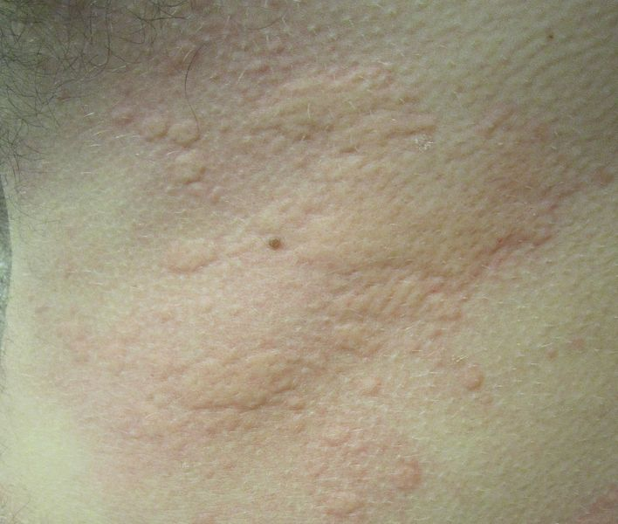
wheel and flare reaction

Slide 14
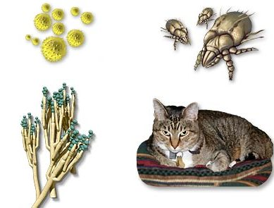
Inhaled Allergens
potentially any antigen is implicated
Pollen
House Dust Mites
Mold
Animal Hair and Dander
Food products

Slide 15
Pathogenesis of Bronchial Asthma
EXAGGERATED BROCHOCONTRICTION
Two components:
1. Chronic airway inflammation.
2. Bronchial hyperresponsiveness.
The mechanisms have been best studied in atopic asthma.
http://www.youtube.com/watch?NR=1&v=7EDo9pUYvPE&feature=endscreen

Slide 16
Pathogenesis of Atopic Asthma
A classic example of type 1 IgE-mediated hypersensitivity reaction.
In the airway – initial sensitization to antigen (allergen) with stimulation of TH2 type T cells and production of cytokines (IL-4, IL- 5, and IL-13).

Slide 17
Pathogenesis of Atopic Asthma
IgE-mediated reaction to inhaled allergens elicits:
1. acute response (within minutes)
2. a late phase reaction (after 4-8 hours)

Slide 18
Pathogenesis of Atopic Asthma
Acute-phase response
Begin 30 to 60 minutes after inhalation of antigen.
Mast cells on the mucosal surface are activated.
Mediator produced are :
Leukotrienes C4, D4 & E4 (induce bronchospasm, vascular permeability & mucous production)
Prostaglandins D2, E2, F2 (induce bronchospasm and vasodilatation)
Histamine ( induce bronchospasm and increased vascular permeability)
Platelet-activating factor (cause aggregation of platelets and release of histamine)
Acetylcholine: released from intrapulmonary motor nerves, resulting in airway smooth muscle constriction by direct stimulation of muscarinic receptors
Mast cell tryptase (inactivate normal bronchodilator).

Slide 19
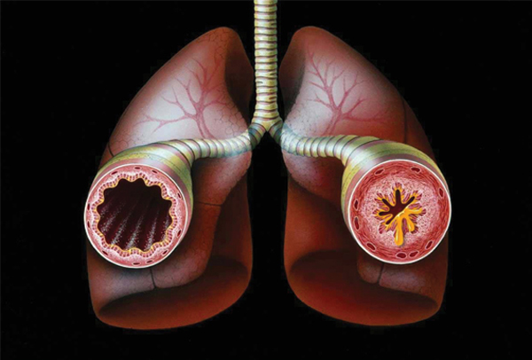
Acute, or immediate, response
This occurs within minutes after stimulation
It consists of:
Bronchoconstriction
edema (due to increased vascular permeability),
and mucus secretion.

Slide 20
Pathogenesis of Atopic Asthma
Late phase reaction
Recruitment of leukocytes mediated by product of mast cells:
1. Eosinophil and neutophil chemotactic factors
2. IL-4 & IL-5 and induceTH2 subset ofCD4+ T cells
3. Platelet-activating factor
4. Tumor necrosis factor.

Slide 21
Pathogenesis of Atopic Asthma
Late phase reaction:
The arrival of leukocytes at the site of mast cell degranulation lead to:
1. Release of more mediators to activate more mast cells
2. Cause epithelial cell damage

Slide 22
Eosinophils produce major basic protein, eosinophilic cationic protein and eosinophil peroxidase ( toxic to epithelial cells).
Activated eosinophils are also a rich source of leukotrienes, especially leukotriene C₄, which contribute to bronchoconstriction.
These amplify and sustains injury without additional antigen.

Slide 23
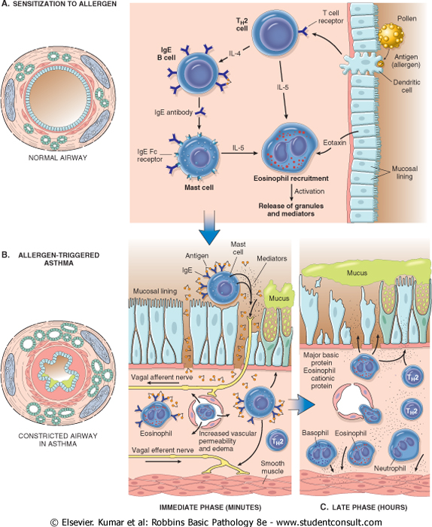
Cytokines from T cell promote:
1. IgE production by B cell (IL4)
2. Growth of mast cells (IgE)
3. Growth and activation of eosinophils (IL5)
4. mucous secretion (IL13)

Slide 25
Non-Atopic Asthma
Non immune
Positive family history is uncommon.
Serum IgE – normal.
No other associated allergies.
Skin test – negative.
Hyperirritability of bronchial tree (Stress, exercise, cigarette smoke)
Triggered by respiratory tract infection including
viruses (Examples-rhinovirus, parainfluenza virus, respiratory syncytial virus)
inhaled air pollutants (e.g. sulfur dioxide, ozone)
Subtypes:
1. Drug-induced asthma (Aspirin or nonsteroidal drug sensitivity)
2. Occupational asthma ( fumes, dusts, gases)

Slide 26
Non-Atopic Asthma
The ultimate humoral and cellular mediators of airway obstruction (e.g., eosinophils) are common to both atopic and non-atopic variants of asthma, and hence they have similar morphology and are treated in a similar way.

Slide 27
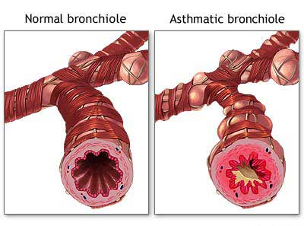
Morphology of Asthma
Grossly
lung over distended (over inflation)
occlusion of bronchi and bronchioles by thick mucous.

Slide 28
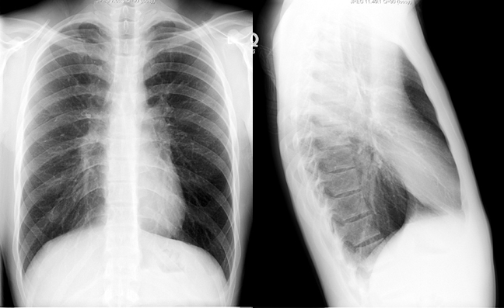
Hyperinflated lung

Slide 29
Morphology of Asthma
Histologic finding:
Thick Basement membrane
Edema and inflammatory infiltrate in bronchial wall.
Submucosal glands increased.
Hypertrophy of the bronchial wall muscle.
Mucous contain Curschmann spirals, eosinophil and Charcot-Leyden crystals.

Slide 30
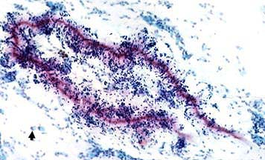
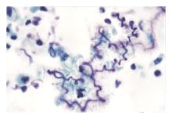
Curschmann spirals
Coiled, basophilic plugs of mucus formed in the lower airways and found in sputum and tracheal washings

Slide 31
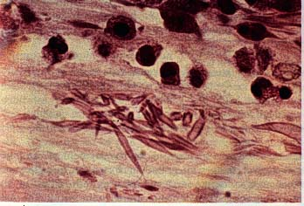
Charcot-Leyden crystals.
Eosinophilic needle-shaped crystalline structures from eosinophil proteins seen in sputum of pt. with severe bronchial asthma

Slide 32
Clinical findings
(1) Episodic expiratory wheezing (inspiratory as well when severe)
(2) Nocturnal cough
(3) Increased anteroposterior diameter
Due to air trapping and increase in residual volume
wheezing : http://www.youtube.com/watch?v=YG0-ukhU1xE&feature=related

Slide 33
Clinical Coarse
Classic asthmatic attack – dyspnea, cough, difficult expiration, progressive hyperinflation of lung and mucous plug in bronchi. This may resolve spontaneously or with Rx
Attacks of asthma are usually of short duration and reverse completely.
Complications:
May progress to emphysema or chronic bronchitis
Superimposed bacterial infection may occur
Rarely, they may be severe and prolonged (status asthmaticus), and may lead to acute ventilatory failure and even death.

Slide 34
Status asthmaticus
Severe cyanosis and persistent dyspnea for days and weeks
Does not respond to therapy
Hypercapnia, acidosis, sever hypoxia
May be fatal
In fatal cases, grossly, the lungs are overdistended because of overinflation, and there may be small areas of atelectasis.
The most striking macroscopic finding is occlusion of bronchi and bronchioles by thick, tenacious mucus plugs.

Slide 35
Laboratory findings
(1) Initially develop respiratory alkalosis
(a) Patients work hard at expelling air through inflamed airways.
(b) May progress into respiratory acidosis if bronchospasm is not relieved
Normal pH or respiratory acidosis is an indication for intubation and mechanical ventilation.
(2) Eosinophilia, positive skin tests for allergens

Slide 36
Contents
1] Definitions of asthma as one of the chronic obstruction airway diseases.
2] Types and pathogenesis of extrinsic (immune) asthma and extrinsic (non-immune) asthma.
3] Clinical presentation and pathological changes seen in the bronchial tree in cases of asthma.
4] Complications of asthma: superimposed infection, chronic bronchitis and pulmonary emphysema.
5] Definition and manifestations of status asthmaticus.

