Slide 1
Restrictive lung diseases
RESPIRATORY BLOCK
Pathology L3
Dr. Maha Arafah

Slide 2
OBJECTIVES
At the end of this lecture, the student should be able to:
Understand the structure and constituents of the lung interstitium as well as the restrictive changes which occur in these diseases and lead to the development of symptoms of progressive breathlessness and cough in affected patients.
Appreciate the pathogenesis of interstitial lung diseases regardless of their type. This pathogenesis include the influx of inflammatory cells into the alveoli and alveolar walls, distortion of the normal structure of alveoli, release of chemical mediators and promotion of fibrosis (honey-comb lung).
Become aware of the classification of interstitial lung diseases.

Slide 3
Lung Interstitium

Slide 4
Chronic restrictive lung disease Definition
Are a heterogenous group with little uniformity regarding terminology and classification.
Many entities are of unknown cause and pathogenesis.
Similar clinical signs, symptoms, radiographic alterations and pathophysiologic changes.
Account for about 15% of non-infectious diseases.

Slide 5
Pathogenesis of interstitial lung diseases
Influx of inflammatory cells into the alveoli and alveolar walls
Distortion of the normal structure of alveoli
Release of chemical mediators
Promotion of fibrosis

Slide 6
Restrictive lung diseases
Characterized by reduced compliance of the lung.
Important signs and symptoms:
- Dyspnea.
- Hypoxia.
- With progressive severe hypoxia, respiratory failure and cor pulmonale.
It can be:
- Acute.
- Chronic.

Slide 7
Acute (Adult) respiratory distress (syndromes (ADRS
ARDS is produced by diffuse alveolar damage with resultant increase in alveolar capillary permeability, causing leakage of protein-rich fluid into alveoli.
Characteristics include the formation of an intra-alveolar hyaline membrane composed of fibrin and cellular debris.
The result is severe impairment of respiratory gas exchange with consequent severe hypoxia

Slide 9
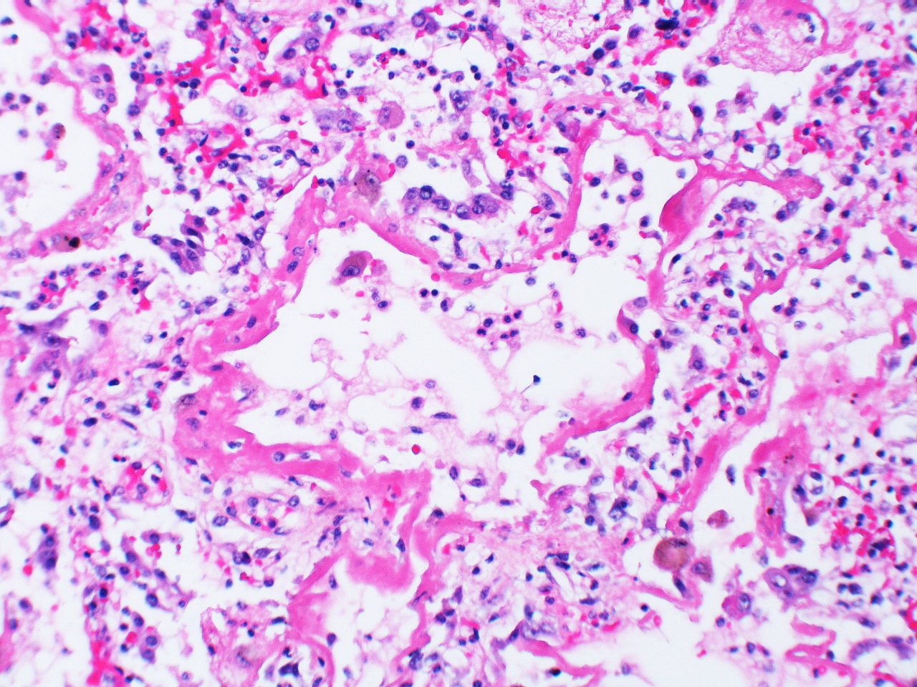
intra-alveolar hyaline membrane

Slide 10
Acute respiratory distress syndromes ADRS
Causes include a wide variety of mechanisms:
Shock
Sepsis
Trauma
Uremia
Aspiration of gastric contents
Acute pancreatitis
Inhalation of chemical irritants such as chlorine
Oxygen toxicity
Overdose with street drugs such as heroin or therapeutic drugs such as bleomycin
ARDS can be a manifestation of the severe acute respiratory syndrome (SARS). The SARS virus is a coronavirus that destroys the type II pneumocytes and causes diffuse alveolar damage.

Slide 11
Acute respiratory distress syndromes ADRS
ARDS is initiated by damage to alveolar capillary endothelium and alveolar epithelium and is influenced by the following pathogenetic factors:
(a) Neutrophils release substances toxic to the alveolar wall.
(b) Activation of the coagulation cascade is suggested by the presence of microemboli.
(c) Oxygen toxicity is mediated by the formation of oxygen-derived free radicals.

Slide 12
NEONATAL RESPIRATORY DISTRESS SYNDROME (HYALINE MEMBRANE DISEASE)
Neonatal respiratory distress syndrome is the most common cause of respiratory failure in the newborn is the most common cause of death in premature infants.
This syndrome is marked by dyspnea, cyanosis and tachypnea shortly after birth.
It results from a deficiency of surfactant, most often as a result of immaturity.
Predisposing factors:
Prematurity.
Maternal diabetes mellitus and delivery by cesarean section.

Slide 13
Chronic restrictive lung disease

Slide 14
Chronic restrictive lung disease
Major Categories of Chronic Interstitial Lung Disease
- Fibrosing:
Pneumoconiosis
Usual interstitial pneumonia (idiopathic pulmonary fibrosis)
Associated with collagen vascular diseases
Drug and Radiation Reactions
- Granulomatous: Sarcoidosis
Hypersensitibity pneumonitis
- Others:
Goodpasture syndrome
Eosinophilic granuloma
Smoking related: Desquamative interstitial pneumonia
Respiratory bronchiolitis-associated interstitial lung disease

Slide 15
Pneumoconiosis
Non-neoplastic lung reaction to inhalation of mineral dusts.
Most common dusts are coal dust, silica, asbestos and beryllium.
The development of pneumoconiosis is dependent on:
1-The amount of dust retained in the lung and airways.
a. Concentration of the dust in the ambient air.
b. Duration of the exposure.
c. Effectiveness of the clearance mechanisms.
2-The size (1-5μ) shape.
3-Their solubility and physiochemical activity.
4-The possible additional effects of other irritants, tobacco
smoking.
The particles are impacted at alveolar duct macrophage, accumulate inflammatory response fibrosis.

Slide 16
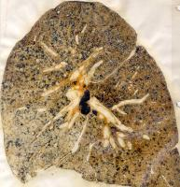
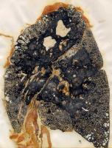
Coal worker’s pneumoconiosis (CWP)
The simple form
The complicated form
Focal aggregations of coal dust-laden macrophages (coal macules)
Patients have slight cough and blackish sputum.
Occurs after many years of underground mine work.
fibrous scarring appears (complicated CWP) also callled progressive massive fibrosis PMF

Slide 17
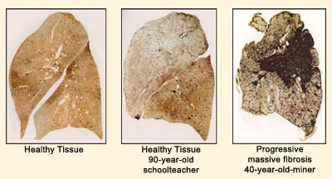

Slide 18
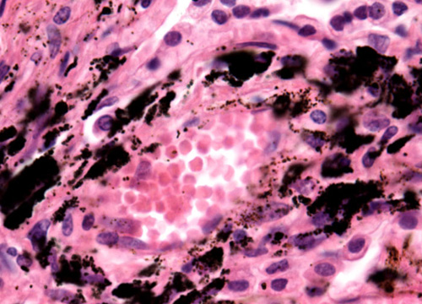
Coal worker pneumoconiosis
Morphology:
Simple CWP:
- Focal black pigmentations (macules), 1-2 mm up to 5 mm are scattered through the lung.
- Mostly in the upper zones of the lower and upper lobes of the lungs.
- Macules are composed of aggregations of coal dust-filled
macrophages in close proximity to alveolar ducts.

Slide 19
Coal worker pneumoconiosis
Morphology
Complicated CWP:
- Black scars exceed 2 cm in diameter some times up to 10 cm
- It consists of dense collagen and carbon pigments.
- Cor pulmonale.
- Miners who have rheumatoid arthritis and PMF are called Caplan’s syndrome.

Slide 20
Silicosis
Long exposure to silica particles.
Encountered in a diversity of industries: mining of gold, tin, copper and coal, sandblasting, metal grinding, ceramic manufacturing.
Silicosis does not predispose to lung cancer.
Pathogenesis:
Crystalline silica is highly fibrogenic.
Scattered lymphocytes and macrophages are drawn rapidly with fibrosis.
Some particles are transported to lymph nodes.

Slide 21
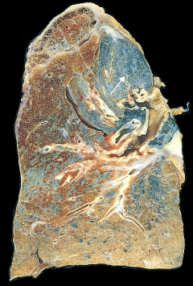
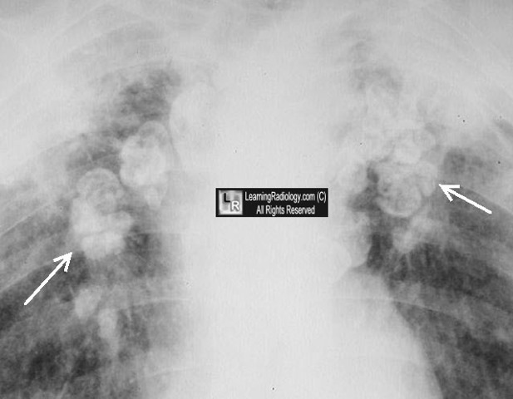
Morphology of Silicosis
Tiny collagenous nodules that enlarge forming stony-hard large fibrous scars usually in the upper lobes.
Calcifications may appear (eggshell calcification) .
Similar collagenous nodules within the lymph nodes.
Fibrous pleural plaques may develop.

Slide 22
Morphology of Silicosis
Micro:
-Hyalinized collagen fiber surround an amorphous center (fibrous nodules).
- Scarring progress to PMF.
-Scarring extending and encroching the pulmonary arteries.
-Cor pulmonale.
Silicosis is associated with increased susceptibility to tuberculosis; the frequent concurrence is referred to as silicotuberculosis.

Slide 23
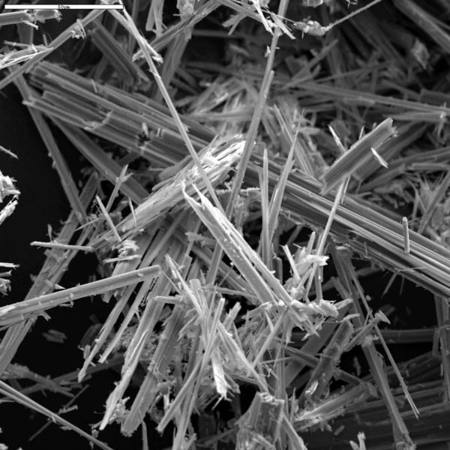
Asbestosis
All types of asbestos (crocidolite and amosite) are fibrogenic
but the crocidolite is the most carcinogenic.
Asbestosis occurs decades after exposure has ended.
Characterized by scarring containing asbestos bodies.

Slide 24
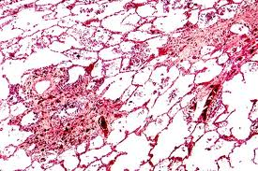
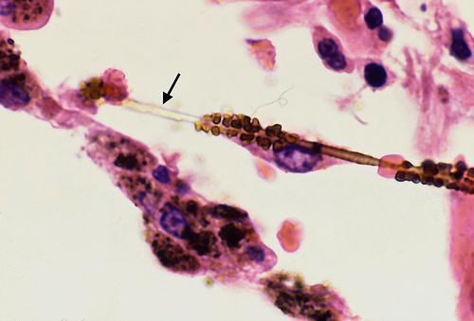
scarring containing asbestos bodies.

Slide 25
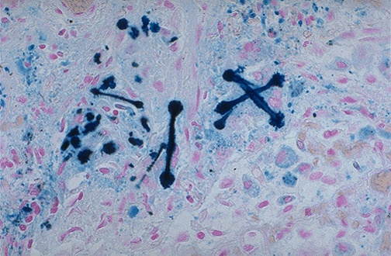
ferruginous bodies which are yellow-brown, rod-shaped bodies with clubbed ends that stain positively with Prussian blue; these arise from iron and protein coating on asbestos fibers.

Slide 26
Asbestosis
Inhalation of asbestos leads to:
- Asbestos pneumoconiosis: characterized by scarring containing asbestos bodies.
- Pleural effusion.
- Pleural adhesions.
- Parietal pleural fibrocalcific plaques.
- Increased incidence of mesothelioma, bronchogenic carcinoma, other cancer.
In asbestosis, pt. develop progressively worsened dyspnea with cough and sputum progressing to cor pulmonale and death.

Slide 27
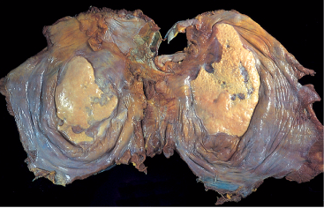

Slide 28
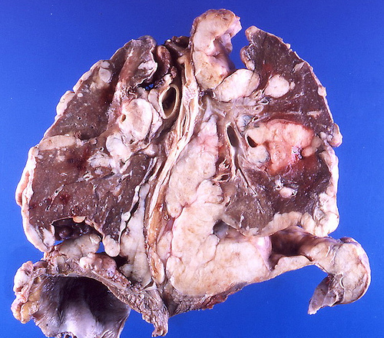
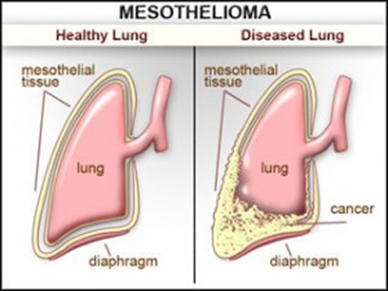
Asbestosis
Both bronchogenic carcinoma and mesothelioma develop in workers exposed to asbestos.
The risk of bronchogenic carcinoma is fivefold and for mesothelioma is 1000 fold greater

Slide 29
Hypersensitivity pneumonitis
An immunologically mediated inflammatory lung disease that primarily affects the alveoli and is therefore often called allergic alveolitis.
Hypersensitivity to inhaled antigens in the form of organic substance such as: moldy hay, e.g. farmer’s lung, humidified lung or pigeon breeder’s lung.
May present either as an acute reaction with fever, cough, dypsnea and constitutional complains 4 to 8 hours after exposure
or as a
chronic disease with insidious onset of cough, dyspnea, malaise and weight loss.

Slide 30
Hypersensitivity pneumonitis
Acute syndromes result from the combination of:
- A direct irritant effect.
- Activation of the alternate complement pathway.
- Immune complex.
The chronic form of the disease is mediated by delayed hypersensitivity reactions.

Slide 31
Hypersensitivity pneumonitis
Mononuclear cell infiltrates in the alveoli and alveolar walls and around terminal bronchioles.
Interstitial non-caseating granulomas reflecting type IV hypersensitivity reaction are present in more than two thirds of cases.
Diffuse interstitial fibrosis.
Clinical course is variable.

Slide 32
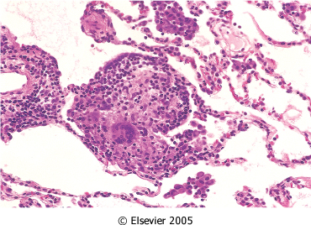
Morphology of hypersensitivity pneumonitis
Pneumonitis with ill-defined giant cell granulomas in alveolar walls
Mononuclear cell infiltrates
non-caseating granulomas
Diffuse interstitial fibrosis.
Clinical course is variable

Slide 33
Goodpasture syndrome
Rare disease characterized by intra-alveolar hemorrhage and glomerulonephritis.
A cytotoxic antibody against glomerular and alveolar basement membrane is responsible for the injury.
By activating complement, the antibody causes damage to glomerular and alveolar basement membrane.
Male sex
Age: 20 to 30 years or 60 to 70 years

Slide 34
Goodpasture syndrome
Clinical Features
Pulmonary complaints consist of hemoptysis and dyspnea.
Hematuria, proteinuria, red cell casts and renal failure are results of glomerulonephritis.
Antiglomerular basement membrane antibody can be detected in serum.
The treatment of Goodpasture's syndrome is plasmapheresis and immunosuppression. The disease is fatal if left untreated.

Slide 35
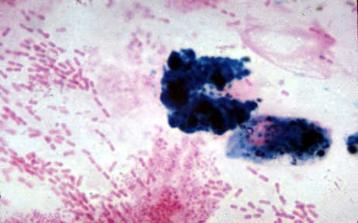
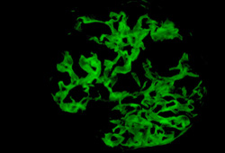
Goodpasture syndrome
Iron stain in sputum
Immunofluorescence of renal biopsy staining for IgG in a linear pattern in patient with anti-glomerular basement membrane (anti-GBM) disease

Slide 36
Eosinophilic granuloma Langerhan's Cell Histiocytosis
A rare disease involving clonal proliferation of Langerhans cells.
Clinically, its manifestations range from isolated bone lesions to multisystem disease.
It occurs almost exclusively in cigarette smokers
Some patients recover completely but others develop pulmonary fibrosis and pulmonary hypertension

Slide 37
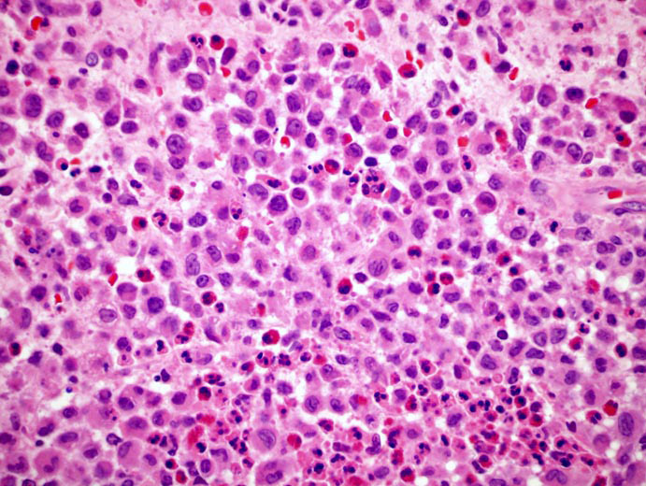
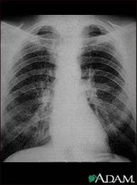
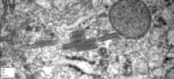
Eosinophilic granuloma Langerhan's Cell Histiocytosis

Slide 38
Usual interstitial pneumonia (idiopathic pulmonary fibrosis) (cryptogenic fibrosing alveolitis) UIP
A clinicopathologic syndrome with characteristic radiologic, pathologic and clinical features.
Characterized histologically by diffuse interstitial fibrosis and inflammation.

Slide 39
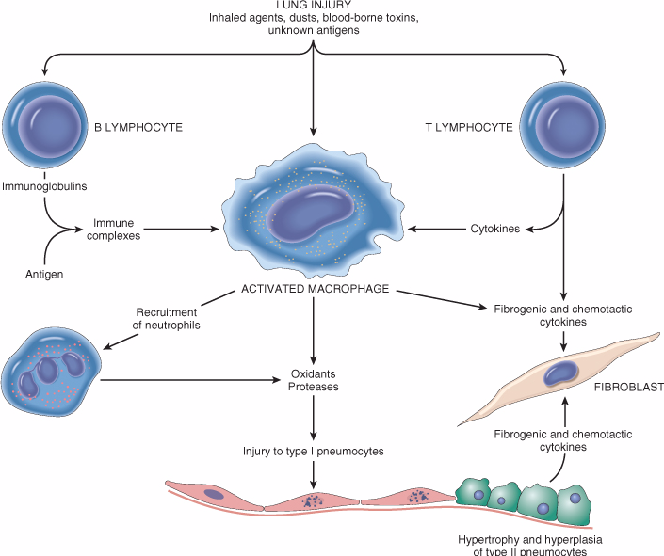
Pathogenesis
Some form of alveolar wall injury result in interstitial edema and alveolitis.
Type I pneumocyte is more susceptible to injury.
Type II pneumocyte hyperplasia (regenerate).
Fibroblast proliferation with progressive fibrosis of intra-alveolar exudate and interalveolar septa.
IgG deposits are seen in alveolar wall.
FGF, TGF-β, PDGF
IL-8 leukotriens

Slide 40
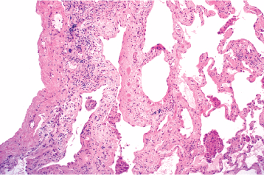
Morphology of IPF
Gross -The lungs are firm.
-Pulmonary edema.
The morphologic changes vary according to the stage of the disease.

Slide 41
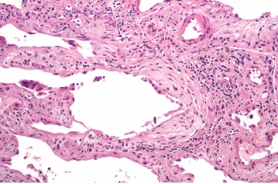
Morphology of IPF
Advancing disease:
-Thickening of the alveolar septa owing to fibrosis and variable amounts of inflammation.
-Alternating areas of fibrosis and normal tissue.
- Geographic variation
- Temporal variation
In the end, the lung consists of spaces lined by cuboidal or columnar
epithelium separated by inflammatory fibrous tissue (honeycomb lung).

Slide 42
Clinical features of IPF
Males are affected more often than females.
Most patients are between 40 &70 years old.
Gradual onset of dyspnea with respiratory difficulty.
Hypoxemia and cyanosis.
Cor pulmonale and cardiac failure may result.
The progression in individual cases is unpredictable.
The median survival is about 3 to 5 years.

Slide 43
Sarcoidosis
An inflammatory condition of the tissues, most noted for originating in the lymph nodes or the lungs
affecting all races
affecting both sexes equally

Slide 44
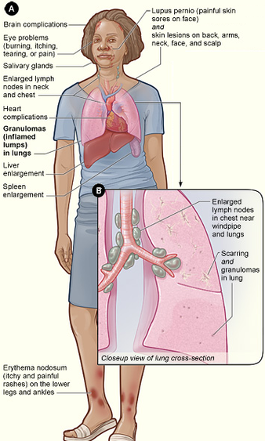
Sarcoidosis
A granulomatous disease of unknown aetiology

Slide 45
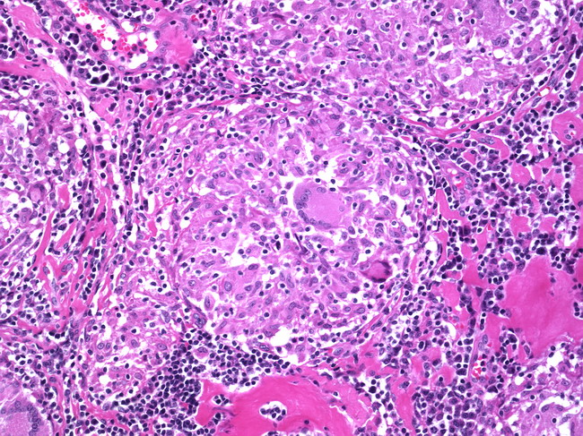
Sarcoidosis
GRANULOMA

Slide 46
CONTENTS
Definition and causes of restrictive pulmonary diseases.
Pathogenesis of restrictive pulmonary diseases which include abnormalities in the chest wall or neuromuscular diseases that restrict lung expansion or conditions leading to interstitial accumulations of cells or non-cellular substances.
Brief account on the clinicopathological features of:
Adult and neonatal respiratory distress syndromes.
Anthracosis and coal worker's pneumoconiosis.
Silicosis and asbestosis.
Hypersensitivity pneumonitis (extrinsic allergic alveolitis).
Goodpasture syndrome.
Eosinophilic granuloma.
Idiopathic pulmonary fibrosis.
Sarcoidosis.

