Slide 1
Respiratory block TUBERCULOSIS
Pathology L5
Dr. Maha Arafah
Associate Professor in Pathology Office phone number: - 01-4671067 Available office hours for students: 10 till 12 daily
Feb, 2013

Slide 2
OBJECTIVES AND KEY PRINCIPLES TO BE TAUGHT:
Define tuberculosis.
List organs that are commonly affected by tuberculosis.
Epidemiology
Recognize the morphology of Mycobacteria.
In regard to Mycobacterial lung infection: Compare and contrast the following in relation to their gross and histologic lung pathology:
Primary tuberculosis (include a definition of the Ghon complex).
Secondary or reactivation tuberculosis.
Miliary tuberculosis.
Know the basis and use of tuberculin skin (Mantoux) test.
List the common clinical presentations of tuberculosis.
List the complications and prognosis of tuberculosis.

Slide 3
Tuberculosis
Tuberculosis is a communicable chronic granulomatous disease caused by Mycobacterium tuberculosis.

Slide 4
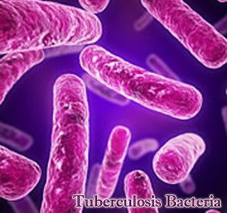
Mycobacterium tuberculosis
Mycobacteria are slender rods that are acid fast (i.e., they have a high content of complex lipids that readily bind the Ziehl-Neelsen [carbol fuchsin] stain and subsequently stubbornly resist decolorization).
M. tuberculosis hominis is responsible for most cases of tuberculosis; the reservoir of infection is usually found in humans with active pulmonary disease.

Slide 5
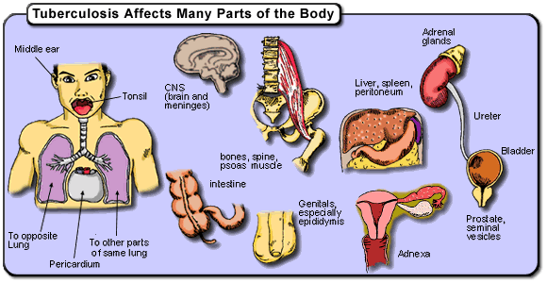
Tuberculosis
It usually involves the lungs but may affect any organ or tissue in the body.
Typically, Epitheloid granuloma in which the centers of tubercular granulomas undergo caseous necrosis.

Slide 6
Epidemiology
Worldwide; a third of the world's population is infected with this organism
A total of 8.8 million new cases each year and 2 million deaths
Disease most common in Southeast Asia, sub-Saharan Africa, and Eastern Europe
Humans are the only natural reservoir
Person-to-person spread by infectious aerosols

Slide 7
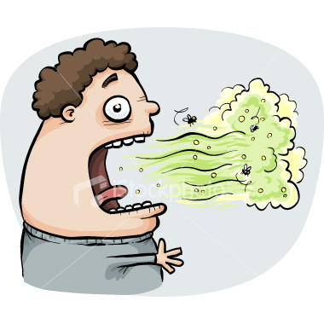

Slide 8
Epidemiology
Populations at greatest risk for disease are:
individuals exposed to diseased patients
People with poverty, crowding, and chronic debilitating illness
drug or alcohol abusers and homeless persons
Infected cases at greatest risk for progressive disease are:
immunocompromised patients (particularly those with HIV infection)
Certain disease states :
diabetes mellitus, Hodgkin disease, chronic lung disease (particularly silicosis), chronic renal failure, malnutrition, alcoholism, and immunosuppression.

Slide 9
Other types of Mycobacteruim
Mycobacterium bovis …..intestinal TB
M. leprae (Hansen bacillus) ..Leprosy
M. kansasii, M. avium, M. intracellulare …………….Atypical mycobacterial infections
M. ulcerans …………….Buruli ulcer

Slide 10
Mycobacterium tuberculosis
Virulence
Capable of intracellular growth in unactivated alveolar macrophages
Disease primarily from host response to infection
infection Vs disease

Slide 11
Pathogenesis of granuloma
natural resistance-associated macrophage protein 1

Slide 12
TB Pathogenesis
Bacterial entry
Macrophages.
T Lymphocytes.
Epitheloid cells.
Proliferation.
Giant cell formation
Central Necrosis.
Fibrosis.
Chronic granulommatous inflammation
with caseation necrosis

Slide 13
Pathogenesis of TB:
Infection - Immunity
Infection with M. tuberculosis typically leads to the development of delayed hypersensitivity, which can be detected by the tuberculin (Mantoux) test.

Slide 14
If the bacilli enter the body……
The bacilli have 4 potential fates:
(1) They may be killed by the immune system
(2) they may multiply and cause primary TB
(3) they may become dormant and remain asymptomatic
(4) they may proliferate after a latency period (reactivation disease)
If immunosuppressed > Primary Progressive Miliary TB

Slide 15
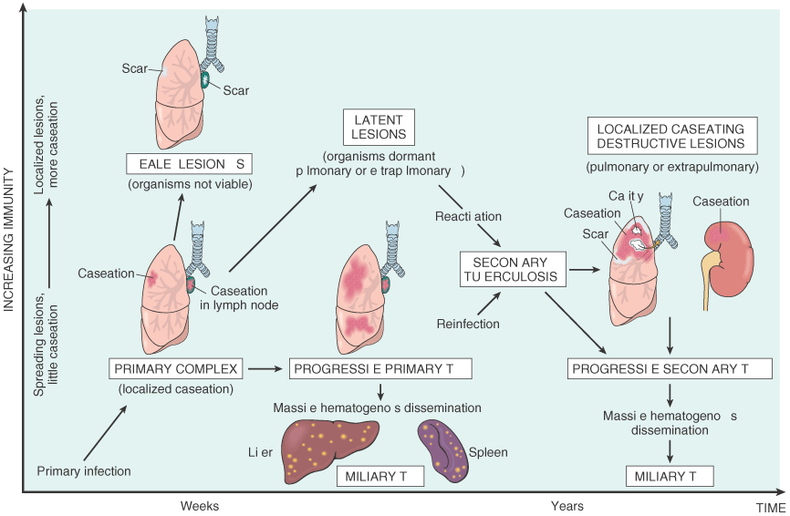
If the bacilli enter the body……

Slide 16
Primary TB
[initial infection]
Secondary TB
[re-activation or re-infection]
Tuberculosis
MILIARY TB

Slide 17
Primary TB or Ghon’s Complex
initial infection
non immunized individual
3week…granuloma
5 to 8 weeks – healing
subpleural zone…. Ghon focus
+ lymph node → Ghon complex

Slide 18
Primary TB
Early changes may produce no significant symptoms
The outcome of the infection will depend on:
the balance between the host response to disease
the virulence and number of organisms

Slide 19
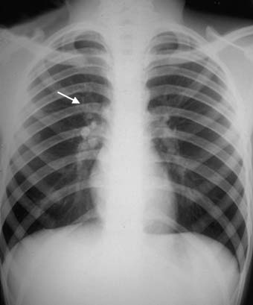
Primary TB
A child with peripheral subpleural parenchymal lesion with enlarged hilar lymph nodes

Slide 20
Primary TB progression
Tuberculous pleurisy
Bronchial spread produces tuberculous bronchopneumonia
Bloodstream spread of organisms produces miliary TB
If immunity is low as in Pt. with HIV infection, the disease advance to
Progressive Primary Tuberculosis

Slide 21
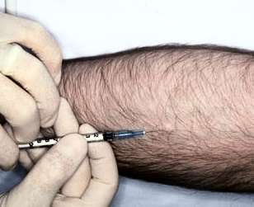
Tuberculin skin testing (Mantoux test, PPD)
After infection patient develop immunity – Mantoux positive [ PPD ]
PPD result after – 72 hours
Intradermal injection of purified protein derivative ( PPD).
The response is measured as the amount of induration at 48-72 hours.
The size of induration, rather than erythema, is diagnostic.
BCG gives + result

Slide 22
Secondary Tuberculosis:
Post Primary in immunized individuals.
Reactivation or Reinfection
Cavitary granulomatous response.
Apical lobes or upper part of lower lobes – O₂
Caseation, cavity - soft granuloma
Pulmonary or extra-pulmonary
Local or systemic spread / Miliary
Vein – via left ventricle to whole body
Artery – miliary spread within the lung

Slide 23
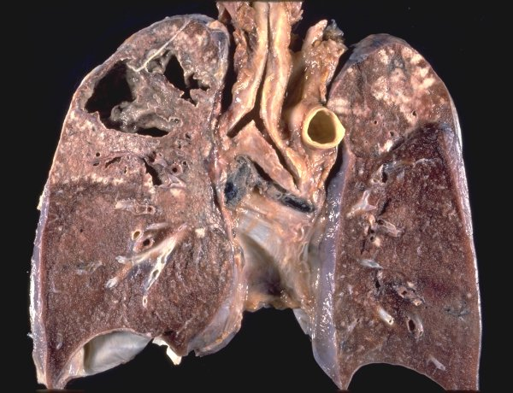
Secondary Tuberculosis:
cavitary lesions in the lung apices
Cough, sputum, Low grade fever, night sweats, fatigue and weight loss.
Hemoptysis or pleuritic pain = severe disease

Slide 24
Secondary Tuberculosis:
when infective foci in the lungs seed the pulmonary venous return to the heart; the organisms subsequently disseminate through the systemic arterial system
Systemic miliary tuberculosis
Almost every organ in the body may be seeded. Lesions resemble those in the lung.
Miliary tuberculosis is most prominent in the liver, bone marrow, spleen, adrenals, meninges, kidneys, fallopian tubes, and epididymis

Slide 25
Miliary TB
Millet like – grain.
Low immunity
blood or bronchial spread
Pulmonary or Systemic types.

Slide 26
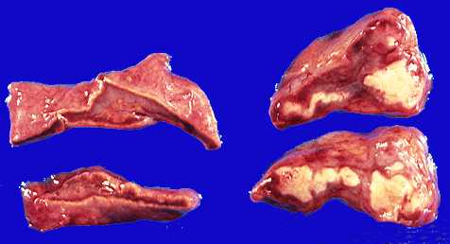
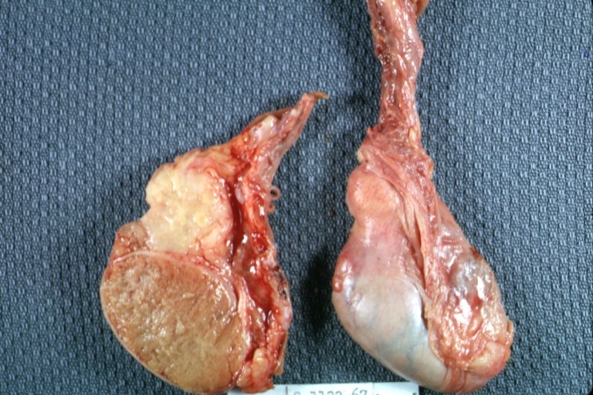
Adrenal TB - Addison Disease
Testes TB Orchitis

Slide 27
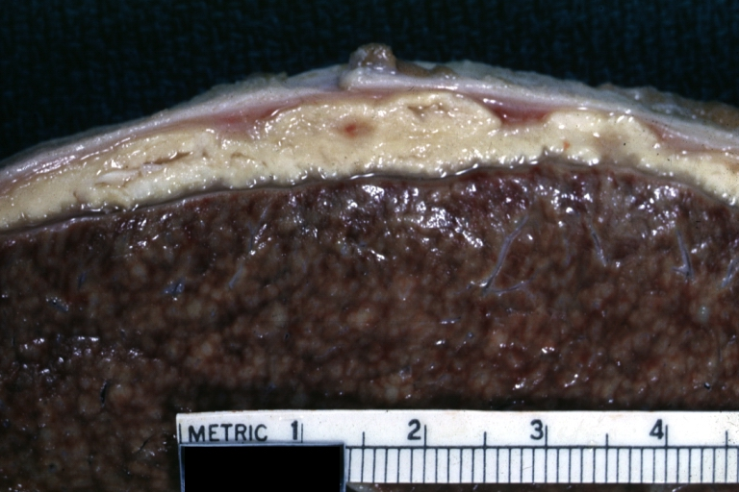
TB Peritonitis liver Miliary TB

Slide 28
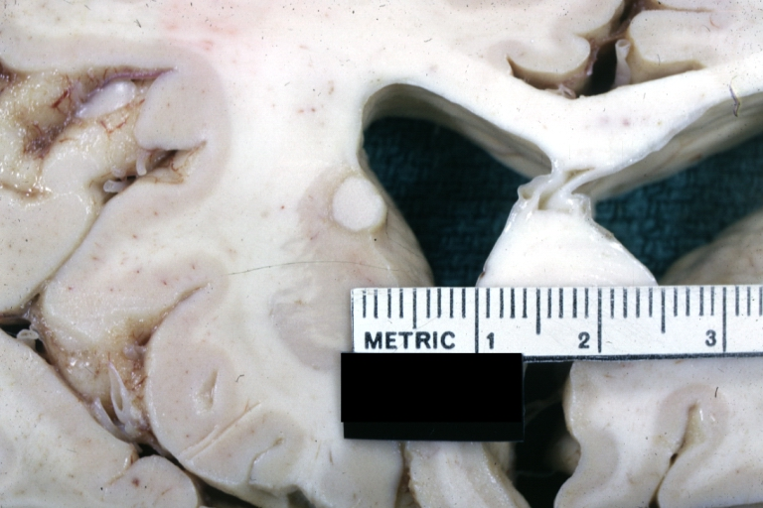
TB Brain – Caudate n.

Slide 30
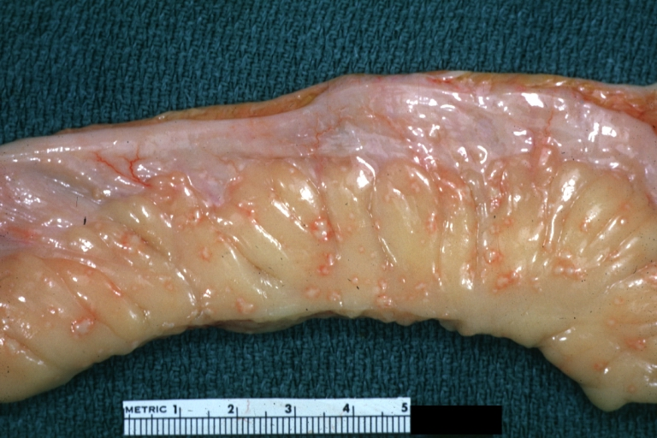
TB Intestine any part can be affected ileum

Slide 31
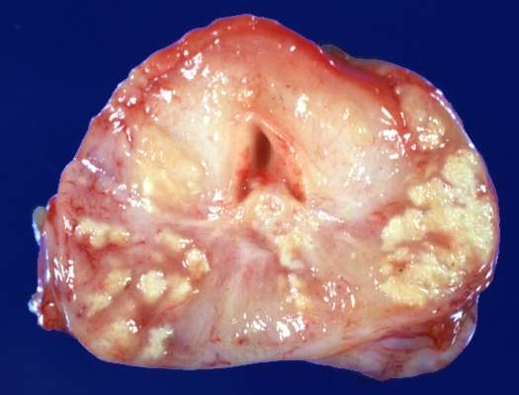
Prostate TB

Slide 32
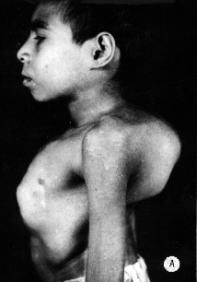
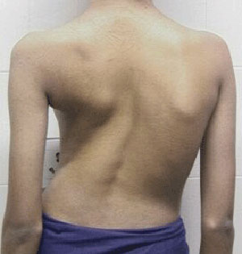
Spinal TB - Potts Disease

Slide 33
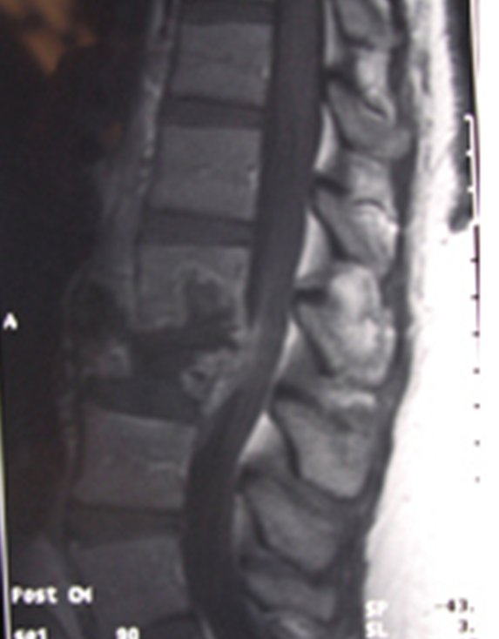
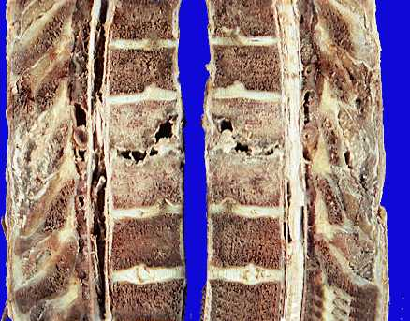
Spinal TB - Potts Disease

Slide 34
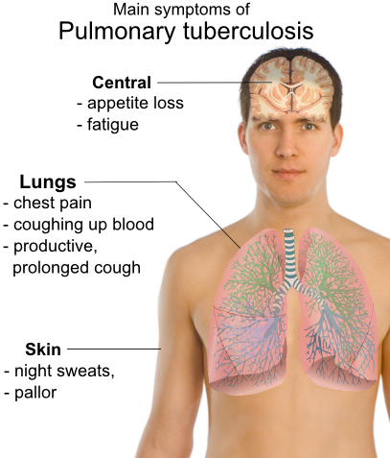
Diagnosis of TB
Clinical features
Depend on organ involved.
Pulmonary tuberculosis
productive cough, fever, and weight loss, night sweats.

Slide 36
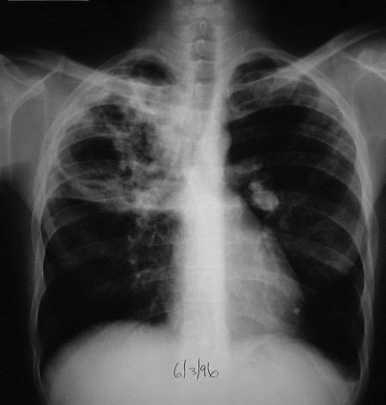
Investigations
Patients suspected of having tuberculosis (TB)
Tuberculin skin testing (Mantoux test, PPD)
Sputum, bronchial wash or biopsy
Acid fast smear ( ZN stain )
cultures require weeks for growth and identification
Newer technologies, including ribosomal RNA probes or DNA polymerase chain reaction, allow identification within 24 hours.
Chest radiographs
patchy or nodular infiltrate.
may be found in any part of the lung, but upper-lobe involvement
is most common

Slide 37
What is your action after diagnosis ?
Patients with TB should remain in isolation until sputum becomes smear-negative.
Rx:
RIPE—Rifampin, Isoniazid (INH), Pyrazinamide, and Ethambutol daily for eight weeks
followed by INH and rifampin for an additional 16 weeks.
Give vitamin B6 to prevent INH-associated neuropathy.

Slide 38
Prognosis of tuberculosis
It is generally favorable if infections are localized to the lungs
but it worsens significantly when:
the disease occurs aged, debilitated, or immunosuppressed persons( who are at high risk for developing miliary tuberculosis, and in those with MDR-TB)
Amyloidosis may appear in persistent cases.

Slide 39
HIV & TB

Slide 40
Atypical features of TB in HIV+
These make the diagnosis of tuberculosis particularly challenging: Why?
an increased frequency of sputum-smear negativity for acid-fast bacilli compared with HIV-negative controls
(This is because the incidence of cavitation and endobronchial damage is more in immunocompetent individuals and therefore induced sputum elicits more AFB)
the absence of tissue (bronchial wall) destruction due to suppressed type IV hypersensitivity results in fewer bacilli in the sputum (despite the higher tissue bacillary load).
false-negative PPD (because of tuberculin anergy)
the lack of characteristic granulomas in tissues, particularly in the late stages of HIV infection.

Slide 41
TAKE HOME MESSAGES:
Mycobacterium tuberculosis is the causative organism of tuberculosis (TB) in the lungs and elsewhere.
Mycobacterium tuberculosis gains access to the lung by inhalation and causes pulmonary TB.
A granuloma in TB, termed a 'tubercle', is composed of activated macrophages, Langhans’ giant cells with surrounding lymphoid cells and fibroblasts with central caseation necrosis.
Primary tuberculosis is the form of disease that develops in a previously unexposed, and therefore unsensitized, person.
Secondary (reactivation) tuberculosis arises in previously exposed individuals when host immune defenses are compromised, and usually manifests as cavitary lesions in the lung apices.
Both progressive primary tuberculosis and secondary tuberculosis can result in systemic seeding, causing life-threatening forms such as miliary tuberculosis and tuberculous meningitis.
The outcome of tuberculosis depends on the adequacy of the host immune response.

Slide 42
