Slide 1
Tumors of the Lung and Upper Respiratory Tract
Respiratory block
Pathology L6
Dr. Maha Arafah
Associate Professor in Pathology
Office phone number: - 01-4671067
Available office hours for students: 10 till 12 daily
Feb, 2013

Slide 2
At the end of this lecture, the student should be able to:
A] Understand the incidence, age group of affected patients and predisposing factors of bronchogenic carcinoma.
B] Is aware of the classification of bronchogenic carcinoma which include: squamous carcinoma, adenocarcinoma, small cell and large cell (anaplastic) carcinomas.
C] Understands the clinical features and gross pathology of bronchogenic carcinoma.
D] Have a basic knowledge about neuroendocrine tumours with special emphasis on small cell carcinoma and bronchial carcinoid.
E] Be aware that the lung is a frequent site for metastatic neoplasms.

Slide 3
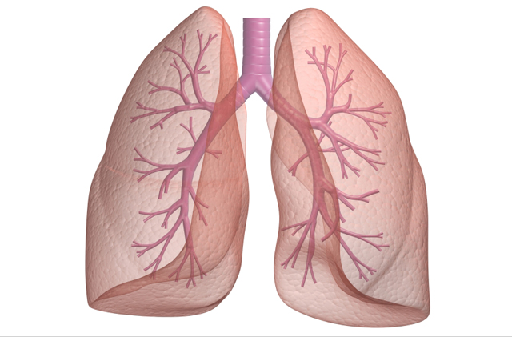
Lung Tumors
Lungs are frequently the site of metastases.
Primary lung cancer is a common disease.
95% of primary lung tumors arise from the bronchial epithelium.
5% are miscellaneous group.
The most common benign lesions are hamartomas.

Slide 4
Bronchogenic carcinoma
Bronchogenic carcinoma is the leading cause of death from cancer in both men and women. It is increasing in incidence, especially in women and in parallel with cigarette smoking.
Accounting for about one third of cancer deaths in men.
In 1950 (USA), death rate in male – 19.9/100,000
death rate in female-4.5/100,000
In 1997 (USA), death rate in male – 74/100,000
death rate in female-31/100,00
(13% of all cancer deaths in men and women).
The incidence rate is declining significantly in men, from a high of 86.5 per 100,000 in 1984 to 69.8 in 1998.
In the 1990s, the increase among women reached a plateau, with incidence in 1998 at 43.4 per 100,000.
Occurs between ages 40 and 70 years.

Slide 5
The Cancer Letter • Jan. 25, 2013
Female smokers have a much greater risk of death from lung cancer and chronic obstructive lung disease in recent years than female smokers 20 or 40 years ago, reflecting changes in smoking behavior according to an article published in New England Journal of Medicine.
Female smokers today smoke more like men than women in previous generations, beginning earlier in adolescence and, until recently, smoking more cigarettes per day.

Slide 6
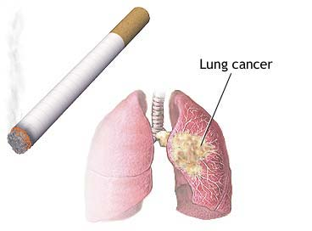
Etiology of bronchogenic carcinoma
1. Tobacco smoking:
Positive relationship between tobacco smoking and lung cancer.
Statistical association between the frequency of lung cancer and:
1. Amount of daily smoking.
2. Tendency to inhale.
3. The duration of smoking habit.
Increased risk becomes 20 times greater among habitual heavy smokers.
Cessation of cigarette smoking for at least 15 years brings the risk down.
Passive smoking increases the risk to approximately twice than non-smokers.
Progressive alterations in the lining epithelium.
Experimental evidence – more than 1200 carcinogenic and promoter substances.

Slide 7
Etiology of brochogenic carcinoma
2. Industrial hazards:
Certain industrial exposures increase the risk of developing lung cancer.
  All types of radiation may be carcinogenic.
  Uranium miners (4x)
  Uranium miners and smoking (10x).
  Asbestos worker (5x).
  Asbestos worker and smoking (50-90x).
  Others: persons who work in nickel, chromates, coal, mustard gas, arsenic, iron and in newspaper workers.

Slide 8
Etiology of bronchogenic carcinoma
3. Air pollution:
May play some role in increased incidence.
Indoor air pollution especially by radon.
4. Scarring:
Due to old infarcts, wounds, scar, granulomatous infections are associated with adenocarcinoma.

Slide 9
Precursor Lesions.
Three types of precursor epithelial lesions are recognized:
  (1) squamous dysplasia and carcinoma in situ
  (2) atypical adenomatous hyperplasia
  (3) diffuse idiopathic pulmonary neuroendocrine cell hyperplasia.
  It should be noted that the term "precursor" does not imply that progression to invasion will occur in all cases.

Slide 10
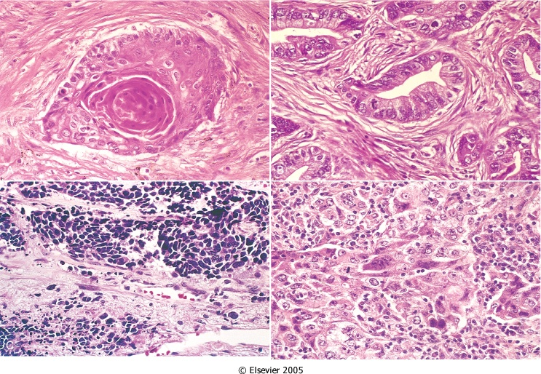
Classification of brochogenic carcinoma
Histologic classification of bronchogenic carcinoma and
approximate incidence:
1. Squamous cell (epithelium) carcinoma (25%-40%)
2. Adenocarcinoma, including bronchioloalveolar carcinoma
(25%-40%).
3. Large cell carcinoma (10%-15%).
4. Small cell lung carcinoma (SCLC) (20%-25%).
5. Combine patterns (5%-10%).
- Most frequent patterns:
- Mixed squamous cell ca
and adenocarcinoma.
- Mixed squamous cell ca
and SCLC.

Slide 11
Among the major histologic subtypes of lung cancer, squamous and small-cell carcinomas show the strongest association with tobacco exposure.

Slide 12
Classification of brochogenic carcinoma
For therapeutic purposes, bronchogenic carcinoma are classified into:
  Non- Small cell lung carcinoma (NSCLC)
  Small cell lung carcinoma (SCLC)
  (includes squamous cell, adenocarcinomas, and large-cell carcinomas).

Slide 13
Bronchogenic carcinoma
Arise in the lining epithelium of major bronchi.
All are aggressive.
All varieties have the capacity to synthesize bioactive products.
Small mucosal lesions, firm and gray-white, form intraluminal masses, invade into adjacent lung parenchyma, central necrosis, areas of hemorrhage, extend to the pleura, invade the pleural activity.
Spread to trachial and mediastinal lymph nodes.

Slide 14
Morphology of bronchogenic carcinoma
Spread of bronchogenic carcinoma
Lymphatic spread.
* successive chains of nodes (scalene nodes).
* involvement of the supraclavicular node
(Virchow’s node).
Extend into the pericardial or pleural spaces. Infiltrate the superior vena cava. May invade the brachial or cervical sympathetic plexus (Homer’s Syndrome).
Distant metastasis to liver (30-50%), adrenals (>50%), brain (20%) and bone (20%).

Slide 15
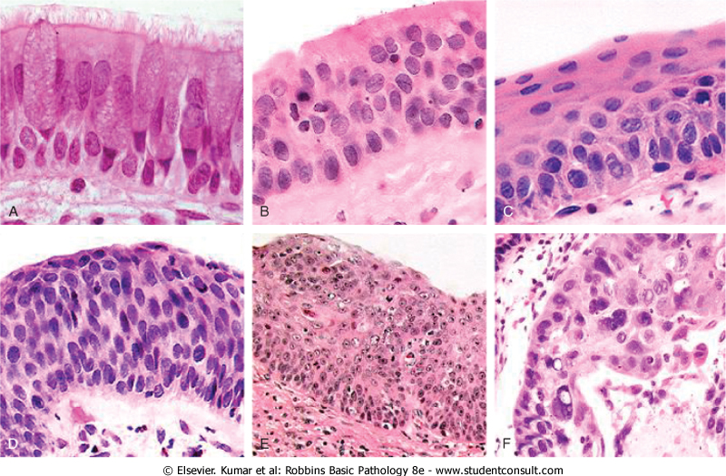
Morphology of bronchogenic carcinoma
Squamous cell carcinoma(SCC)
More common in men and closely correlated with smoking.
Arise centrally in major bronchi.
Preceded
for years
by atypical
metaplasia
or dysplasia

Slide 16
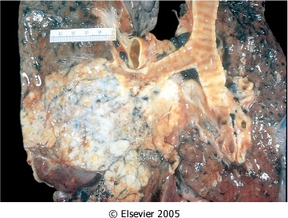
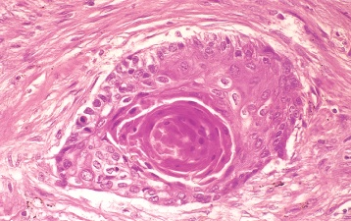
Morphology of bronchogenic carcinoma
Squamous cell carcinoma (SCC)
Appears as a hilar mass and frequently results in cavitation; may be marked by inappropriate parathyroid hormone (PTH) like activity with resultant Hypercalcemia.
Histologically, these tumors range from well-differentiated squamous cell neoplasm to poorly differentiated neoplasm.

Slide 17
Morphology of bronchogenic carcinoma
Adenocarcinomas
Two forms:
Bronchial – derived carcinoma.
Bronchioloalveolar carcinoma
  Peripheral
  Develops on site of prior pulmonary inflammation or injury (scar carcinoma); less clearly linked to smoking.
  Tend to metastasize widely at an early stage.
  Involve peripheral parts as a single nodule or more often as multiple diffuse nodules.
  Less clearly related to smoking; columnar to cuboidal tumor cells line alveolar walls and multiple densities on x-ray. The disease often mimicks interstitial pneumonia

Slide 18
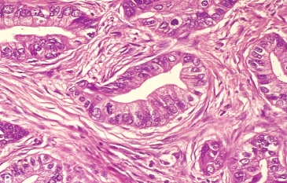
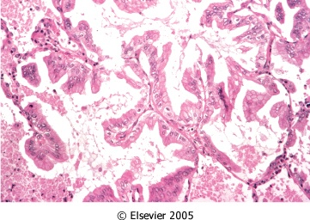
Bronchial – derived
adenocarcinoma
  Histologically, they assume a variety of forms, including typical adenocarcinoma with mucus secretion and papillary or bronchioloalveolar patterns.
Bronchioloalveolar carcinoma
Malignant cells spread along alveolar wall

Slide 19
Morphology of bronchogenic carcinoma
Small cell carcinomas (oat cell carcinoma)
Highly malignant tumor, rarely resectable.
More common in men.
Strongly associated with cigarette smoking.
Appear as pale gray, centrally located masses with extension into the lung parenchyma.
Early involvement of the hilar and mediastinal nodes.

Slide 20
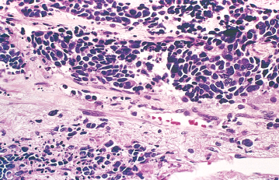
Small cell carcinomas (oat cell carcinoma)
Composed of small, dark, round to oval, lymphocyte-like cells.
Derived from neuroendocrine cells of the lung.
EM dense-core neurosecretory granules.
Ability to secrete a host of polypeptide hormones (ACTH), calcitonin, gastrin-releasing peptide and chromogranin.

Slide 21
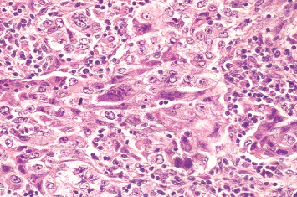
Morphology of bronchogenic carcinoma
Large cell carcinoma
Anaplastic carcinoma with large cells probably represent SCC or adenocarcinoma.
Poor prognosis.

Slide 22
Morphology of bronchogenic carcinoma
Secondary pathology
Partial obstruction – emphysema.
Total obstruction – atelectasis and chronic bronchitis.
Pulmonary abscess.
Pleuritis.

Slide 23
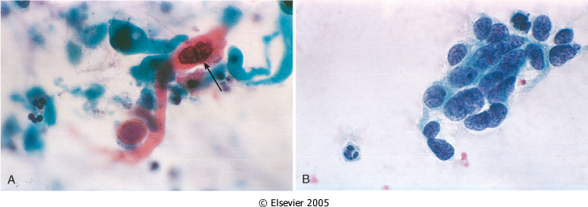
Dx
Cytology
Biopsy

Slide 24
Clinical course of bronchogenic carcinoma
Silent, insidious lesions, chronic cough with expectoration and hemoptysis.
Hoarseness, chest pain, superior vena cava syndrome, pericardial or pleural effusion.
Symptoms due to metastatic spread.
NSCLC have a better prognosis than SCLC.
Outlook is poor for most patients.

Slide 25
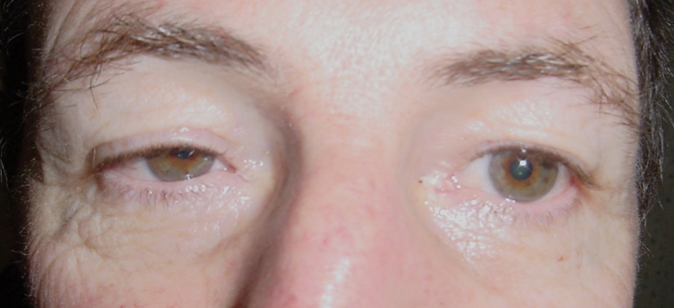
Clinical features of bronchogenic carcinoma
Apical neoplasms may invade the brachial or cervical sympathetic plexus to cause severe pain in the distribution of the ulnar nerve or
to produce Horner syndrome (ipsilateral enophthalmos, ptosis, miosis, and anhidrosis).
Such apical neoplasms are sometimes called Pancoast tumors, and the combination of clinical findings is known as Pancoast syndrome.

Slide 26
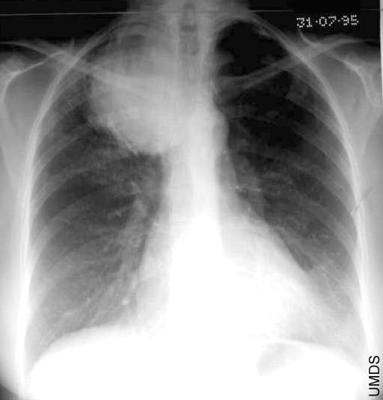
Pancoast tumor

Slide 27
Paraneoplastic syndrome
3% to 10% develop overt paraneoplastic syndromes.
Neuromuscular syndromes.
Clubbing of the fingers.
Hematologic manifestations.
Endocrine

Slide 28
Paraneoplastic syndrome
Antidiuretic hormone (ADH), inducing hyponatremia
Adrenocorticotropic hormone (ACTH), producing Cushing syndrome
Parathormone, parathyroid hormone-related peptide, prostaglandin E, and some cytokines, all implicated in the hypercalcemia often seen with lung cancer
Calcitonin, causing hypocalcemia
Gonadotropins, causing gynecomastia
Hypercalcemia due to parathyroid hormone-related peptide is most often encountered with squamous cell neoplasms
the hematologic syndromes with adenocarcinomas
The remaining syndromes are much more common with small-cell neoplasms
Serotonin and bradykinin, associated with the carcinoid syndrome

Slide 29
Neuroendocrine tumors
Bronchial carcinoid
Tumor with neuroendocrine differentiation arising from Kulchitsky cells in the bronchial mucosa.
Appear at an early age (mean 40 years) with equal sex incidence.
1-5% of all pulmonary neoplasms.
Often resectable and curable.
No relation with cigarette smoking or other environmental factor.
Carcinoid syndrome ( intermittent attacks of diarrhea, flushing, and cyanosis)

Slide 30
Other carcinomas of the lung:
Carcinoid
  Low malignancy, spreading by direct extension into adjacent tissues, may result in carcinoid syndrome. Arises from neuroendocrine cells.
Carcinoma, metastatic to the lung.
  Higher incidence than primary lung cancer. Characterized by the presence of multiple nodular densities on X-ray. Origin could be GIT, breast or genitourinary systems or other sites.

Slide 31
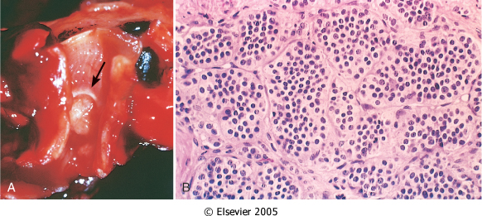
Morphology of Neuroendocrine tumors
Originate in mainstem bronchi.
Composed of uniform cuboidal cells that have regular round nuclei with few mitoses and little or no anaplasia.

Slide 32
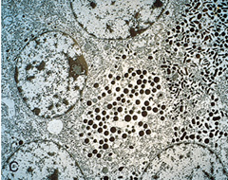
E/M of Neuroendocrine tumors

Slide 33
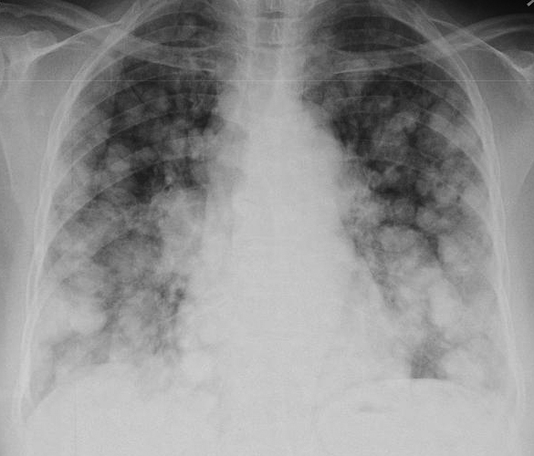
Metastatic Carcinoma to the Lung
Higher incidence than primary lung cancer.
Characterized by the presence of multiple nodular densities on X-ray
Origin could be GIT, breast or genitourinary systems or other sites.

Slide 34
DISEASES OF THE PLEURA
Can be divided for practical purposes into:
A] Inflammatory conditions (pleuritis)
B] Neoplastic lesions of the pleura
which can be acute or chronic and is often caused by:
pyogenic organisms
tuberculosis causing empyema, pleural effusions and adhesions.
which can be caused by
direct spread of a bronchogenic carcinoma
metastases from other parts of the body (secondaries)
a primary neoplasm called mesothelioma.

Slide 35
Primary tumours of the pleura
are rare except after exposure to asbestos. After exposure, there may be a latent period of up to 50 years before development of the tumour. Patients usually present with chest pain and breathlessness and there is commonly a pleural effusion.

Slide 36
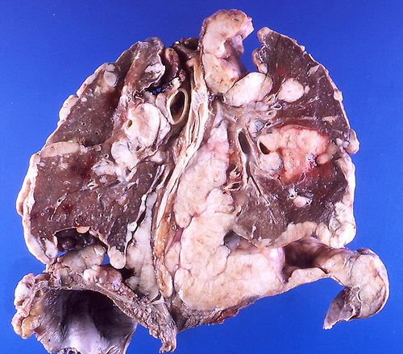
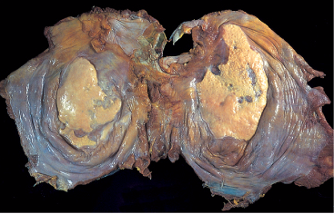
Mesothelioma
  Mesotheliomas are highly malignant tumours that spread to adjacent structures like the pericardium and lung and death usually occur 10 months after diagnosis, although metastases are rare.
  Exposure to asbestos also causes development of benign collagenous thickening of the pleura termed pleural plaques.

Slide 37
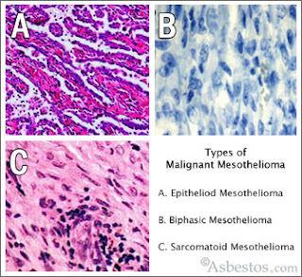
Mesothelioma
Histologically, mesotheliomas may have spindle cells (sarcoma like) and glandular patterns.

Slide 38
Diagnosis of pleural diseases
in general is made by radiological investigations, cytological and histological assessments (cytological examination of pleural fluid and also pleural biopsies)

Slide 39
CONTENTS:
1] Bronchogenic carcinoma: aetiology, epidemiology, clinical features including superior Vena Cava syndrome, pancoast tumour, hoarseness, pleural effusion and paraneoplastic endocrine syndromes.
2] Types, location and clinicopathological characteristics of squamous cell carcinoma, adenocarcinoma, bronchioloalveolar carcinoma, small cell carcinoma, large cell carcinoma, carcinoid tumour and metastatic carcinoma to the lung.
3] Primary and secondary tumours of the pleura.

