Slide 1
Respiratory practical II
11-2-13

Slide 2
TWO TYPES of lung carcinoma
NON-SMALL CELL CARCINOMA
SQUAMOUS CELL CARCINOMA
ADENOCARCINOMA
LARGE CELL CARCINOMA
SMALL CELL CARCINOMA
Notes:
The NON-small cell cancers behave and are treated similarly, the SMALL cell carcinomas are WORSE than the non-small cell carcinomas, but respond better to chemotherapy, often drastically!

Slide 3
SYSTEMIC effects of LUNG CANCER
(PARA-NEOPLASTIC SYNDROMES)~ 5%
ADH (hyponatremia)
ACTH (Cushing)
PTH (Hyper-CA)
CALCITONIN (Hypo-CA)
GONADOTROPINS
SEROTONIN/BRADYKININ
Notes:
Any one of the histologic types of tumours may occasionally produce any one of the hormones, but tumours that produce ACTH and ADH are predominantly small cell carcinomas, whereas those that produce hypercalcemia (PTH) are mostly sqamous cell carcinomas .

Slide 4
7-Squamous cell carcinoma of the lung

Slide 5
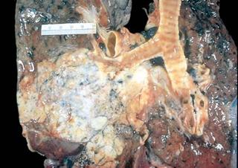
The classical squamous cell carcinoma starting in a large bronchus centrally, with bronchial obstruction.
Adenocarcinomas tend to be more peripheral and sometimes associated with scar

Slide 6
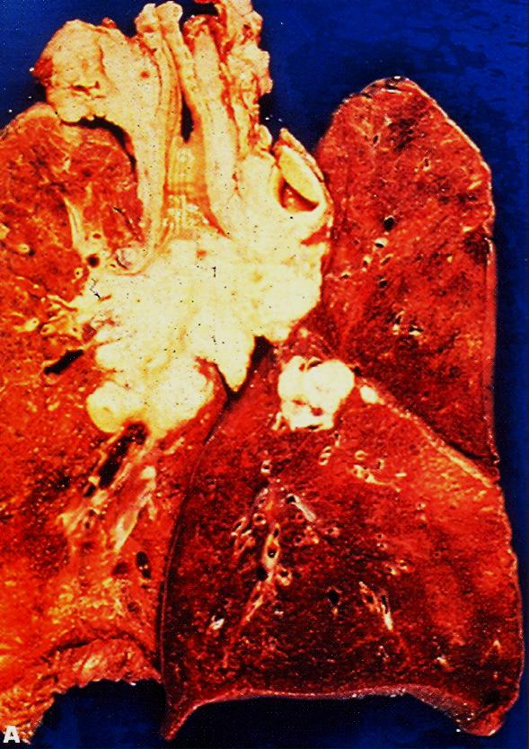

Slide 7
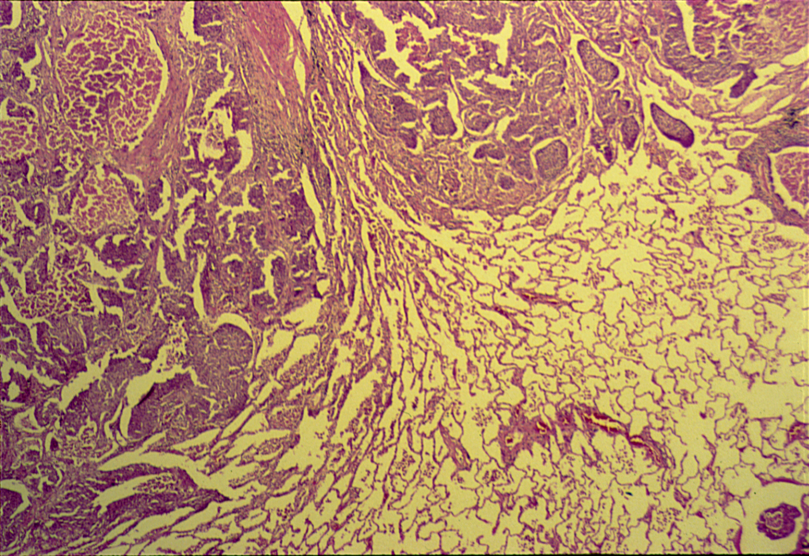

Slide 8
Notes:
Malignant squamous cells , keratin , mitoses , pleomorphism
Sqamous cell carcinoma may produce hypercalcemia by the secretion of PTH.

Slide 9
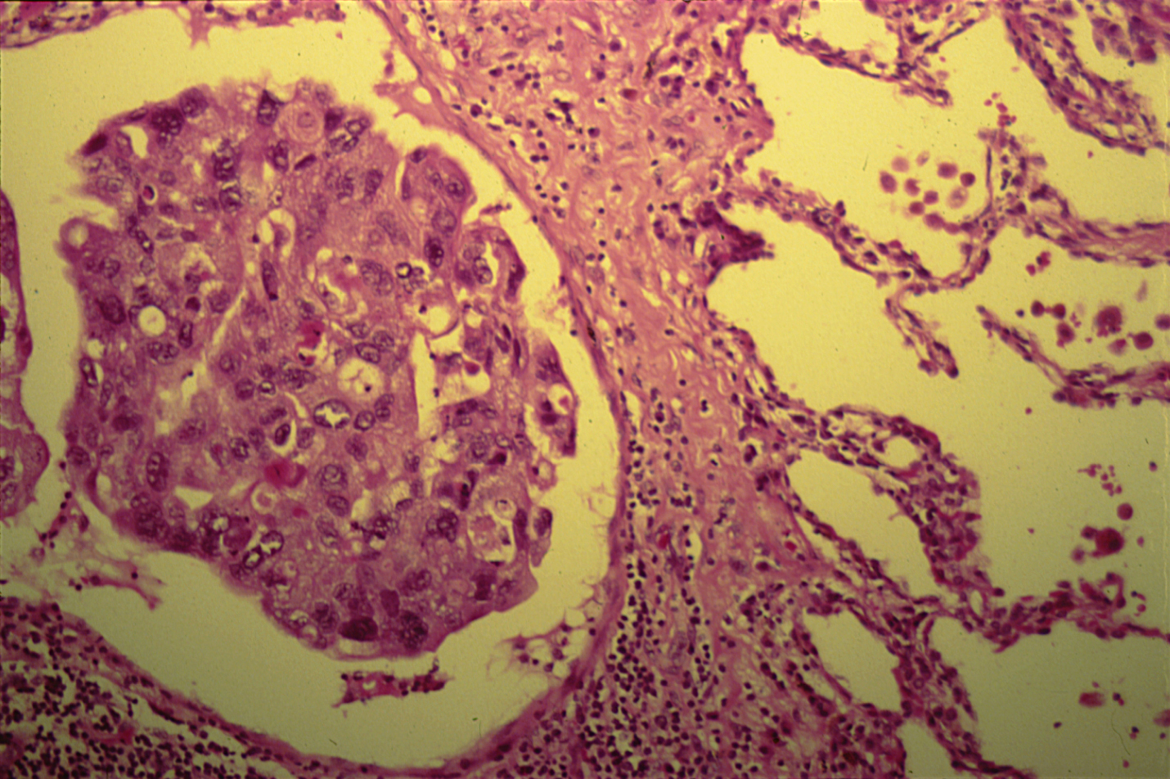
Notes:
Lympho-vascular invasion

Slide 10
Squamous cell carcinoma of the lung: Section of the lung shows one small bronchus and tumour masses:
Tumour consists of trabeculate and sheets of moderately differentiated squamous cells with little connective tissue stroma.
Neoplastic squamous cells show pleomorphism, hyperchromasia, individual cell keratinization, mitoses and areas of necrosis.
Peribronchial and perivascular lymphatics are occluded by tumour cells.

Slide 11
8-Adenocarcinoma of the lung

Slide 12
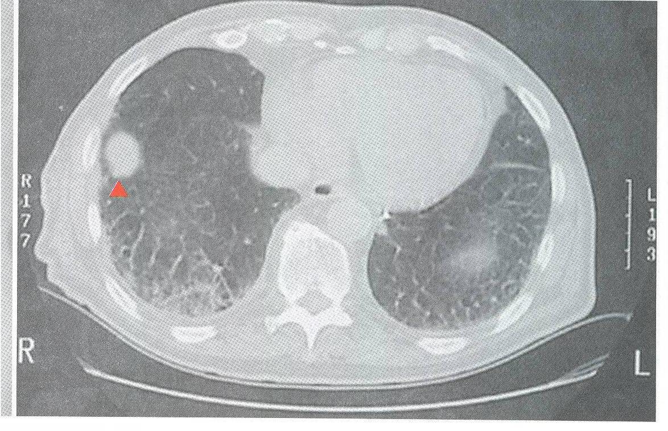
Adenocarcinoma, CT image

Slide 13
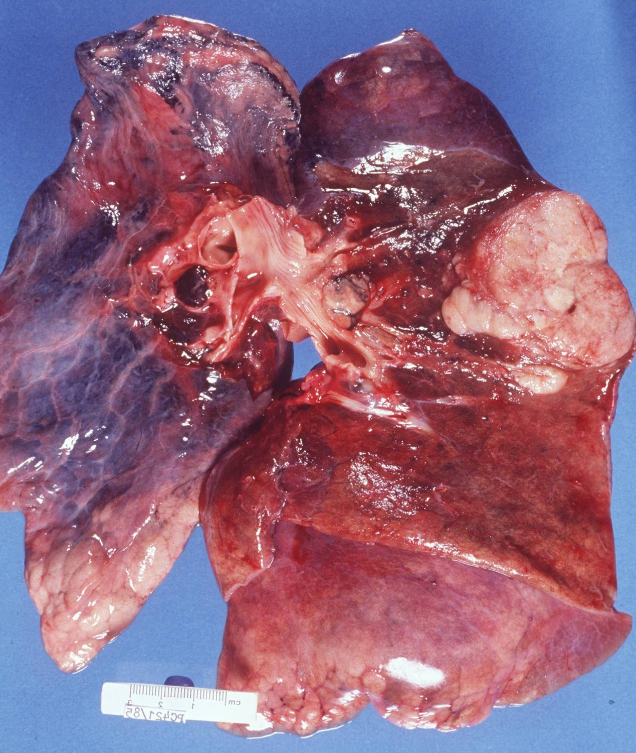
Adenocarcinoma

Slide 14
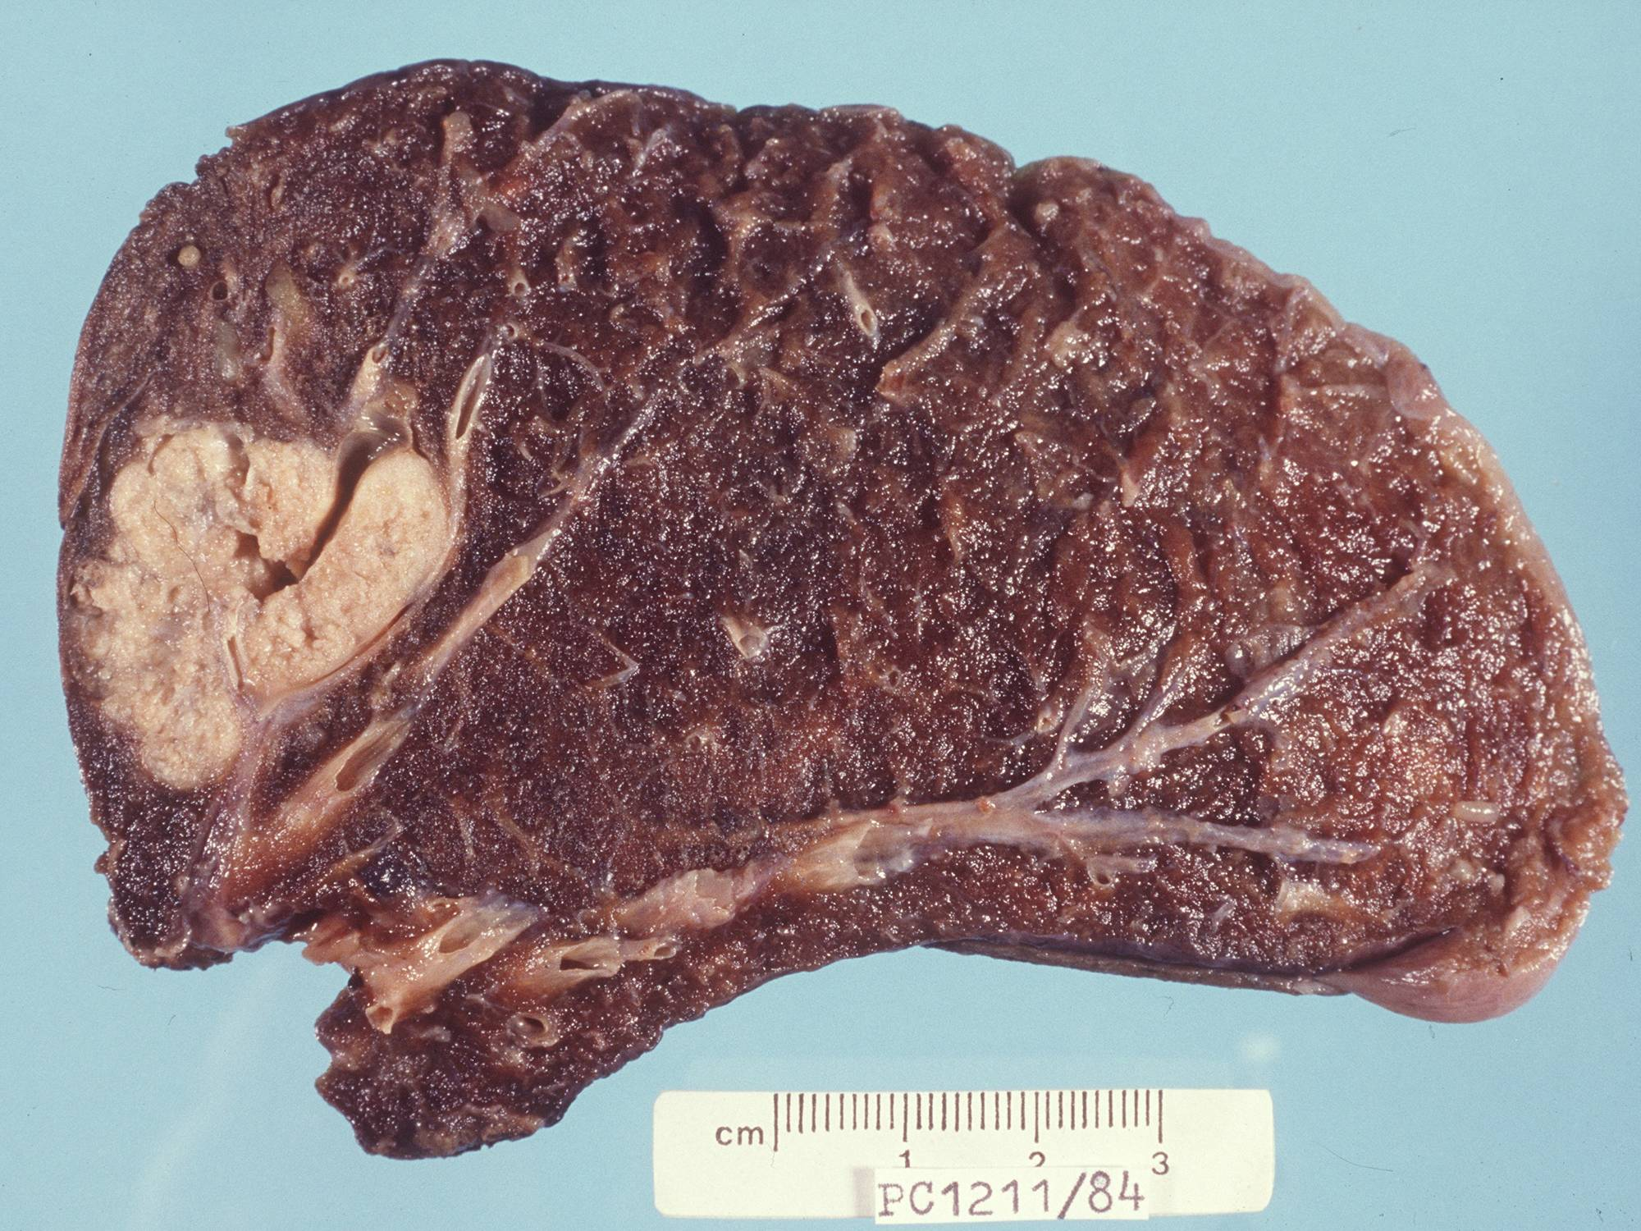
Adenocarcinoma

Slide 15
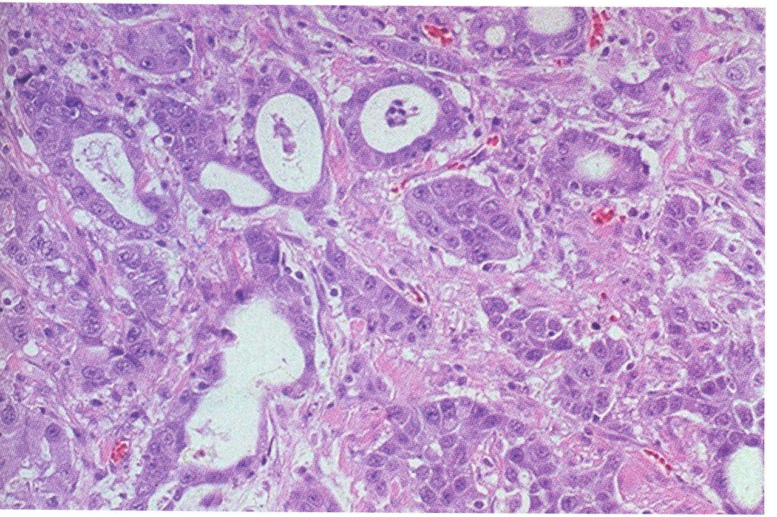
Adenocarcinoma, microscopic

Slide 16
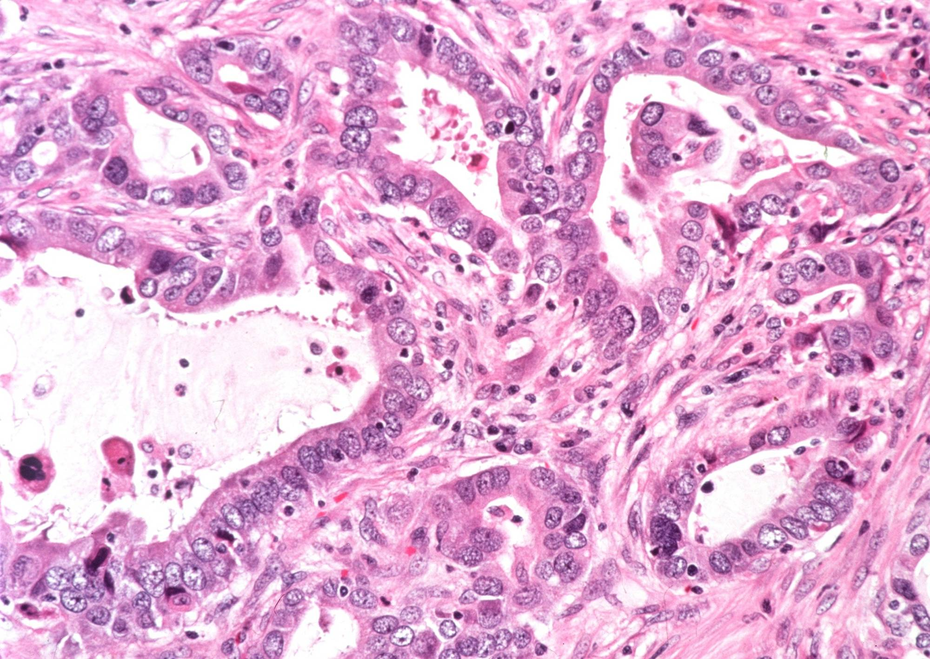
Adenocarcinoma
Section of the tumour shows moderately differentiated malignant glands lined by pleomorphic and hyperchromatic malignant cells showing conspicuous nucleoli . Note the presence of tissue desmoplasia around the neoplastic glands .

Slide 17
9-Small cell carcinoma of the lung

Slide 18
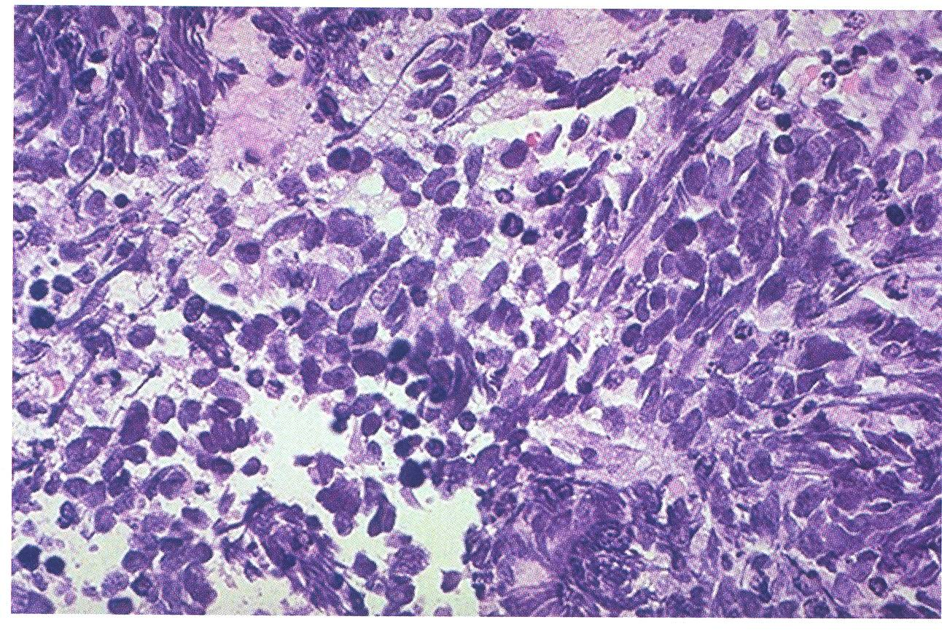
Small-cell carcinoma, microscopic

Slide 19
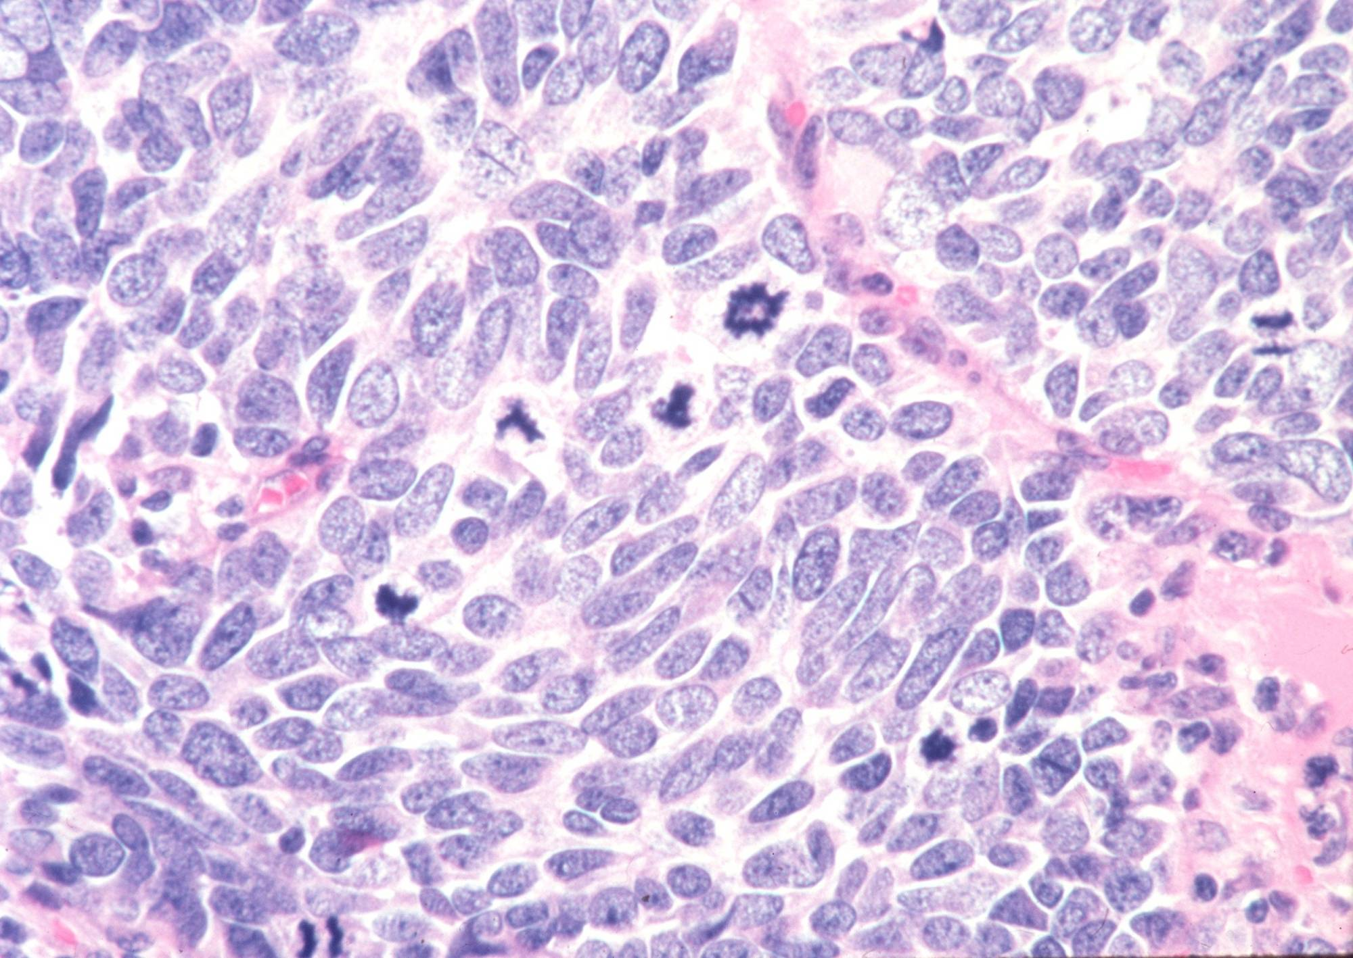
Small cell carcinoma
Section of the tumor shows clusters of malignant cells which are small , round , oval or spindle shaped with prominent nuclear molding , finely granular nuclear chromatin (salt and pepper pattern ) , high mitotic count.
Notes:
.

Slide 20
10-Metastatic tumors of the lung

Slide 21
METASTATIC TUMORS
LUNG is the MOST COMMON site for all metastatic tumors, regardless of site of origin
It is the site of FIRST CHOICE for metastatic sarcomas for purely anatomic reasons!

Slide 22
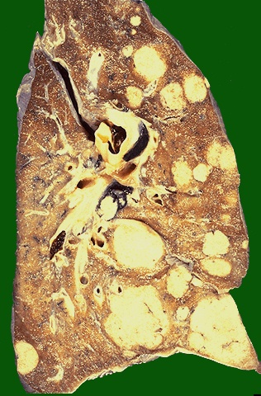
Metastases
Here are larger but still variably-sized nodules of metastatic carcinoma in lung
Notes:
Here are larger but still variably-sized nodules of metastatic carcinoma in lung

Slide 23
