Slide 1
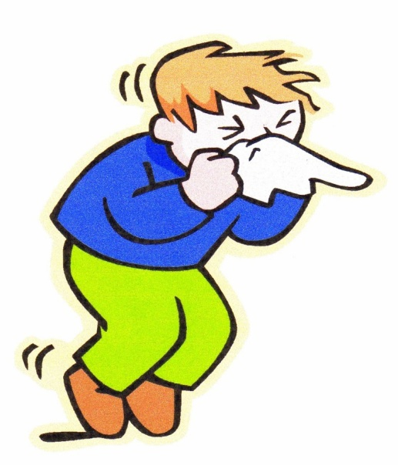
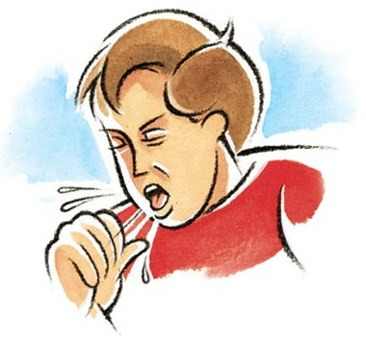
TREATMENT OF
RHINITIS & COUGH
ILOs
Classify types & causes of rhinitis
Specify preventive versus pharmacotherapeutic strategies
Expand on the pharmacology of different drug groups used in treatment as antihistamines, anti-allergics, corticosteriods, decongestants and anti-cholinergics
Differentiate between productive versus dry irritant cough
Compare pharmacology of different expectorants & mucolytics drugs used in treatment of productive cough
Contrast between peripherally and centrally acting antitussives

Slide 2
TREATMENT
OF RHINITIS
Irritation &/or inflammation
of the mucous membranes
inside the nose
Environment ,
Drug induced,
Dietary factors,
Sexual / Hormonal /
Emotional triggers
Foreign body / Trauma /
Structural Derangement
Viruses,
Bacteria,
Fungal, Systemic dis.
Allergens
Non-Allergic
Allergic
Non - Inflammatory
Inflammatory
Runny nose (rhinorrhea)
Stuffy Blocked nose
Sneezing
Nasal congestion
Post-nasal drip
Itching
Catarrh (other m. memb)……
+
Systemic
Manifestations

Slide 3
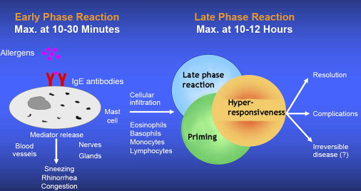
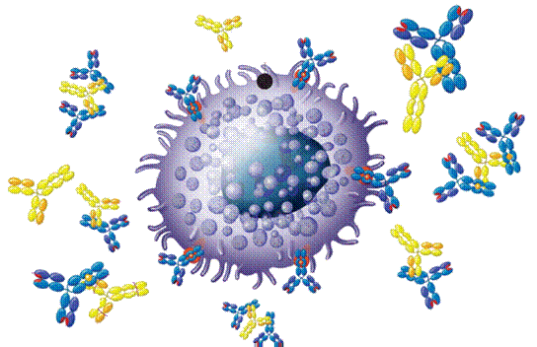
TYPES
NON-ALLERGIC RHINITIS
ALLERGIC RHINITIS
INFECTIOUS
NON-ALLERGIC / NON-INFECTIOUS
Environmental;
Airborne irritants; Smoke/ Strong odors/ Certain gases, Industrial pollution [ Occupational ]
Non-irritants; cold / dry / air conditions parasympathetic stimulationchange blood flow Vasomotor
Drug-inducedRh. Medicamentosa
Excess long term use of decongestants & nasal corticosteroid sprays 
rebound congestion
Use of anti-hypertensives, anti-inflam matory, anti-anxiety, …
Food; Gustatory
Hormonal
Structural Derangement
Seasonal
Perennial
HAY FEVER
1st exposure to a drug
Sensitization
IgE production
Second / Repeated exposures
HYPERSENSITIVITY REACTION
ACUTE RHINITIS (7- 14 DAYS)
CHRONIC RHINITIS (> 6 WEEKS)

Slide 4
RHINITIS
TREATMENT
PREVENTIVE THERAPY
1- Environmental Control
2- Allergen Immunotherapy
PHARMACOTHERAPY
1- H₁ receptor antagonists; Antihistamines
2- Anti-allergics
Mast Cell Stabilizer; Cromolyn
Leukotriene receptor antagonists; Montelukast
3- Corticosteroids
4- Decongestants; α-Adrenergic agonists
5- Anticholinergics
6- Antibiotics
7- Mycolytics…..
In infection, with chronicity & more if it is rhinosinusitis

Slide 5
1- ANTIHISTAMINES
H₁ receptor blockers
CLASSIFICATION [Chemical / Functional] USES vs ADVERSE EFFECTS
First GENERATION Second GENERATION Third GENERATION
1) ALKYLAMINES Chlorpheniramine 2) ETHANOLAMINES Dimenhydrinate Diphenhydramine 3) ETHYLENEDIAMINES Antazoline` 4) PHENOTHIAZINES Promethazine 5) PIPERAZINE Cyclizine Cetirizine Levocetirizine
6) PIPERIDINES Azatidine Astemazole, Terfenadine Fexofenadine
Loratidine Desoloratidine
Ketotifen 7) MISCELLANEOUS Cyproheptadine
Short duration
Longer duration = better control
Interactions; with enzyme inhibitors
[ macrolides, antifungals, calcium antagonists]
ADRs due to additive pharmacodynamic actions
No drug interactions & minimal ADRs
All are used systemic or topical

Slide 6
ANTIHISTAMINES
First GENERATION Second GENERATION Third GENERATION
1) ALKYLAMINES Chlorpheniramine 2) ETHANOLAMINES Dimenhydrinate Diphenhydramine 3) ETHYLENEDIAMINES Antazoline` 4) PHENOTHIAZINES Promethazine 5) PIPERAZINE Cyclizine Cetirizine Levocetirizine
6) PIPERIDINES Azatidine Fexofenadine
Loratidine Desoloratidine
Ketotifen 7) MISCELLANEOUS Cyproheptadine
ANTIHISTAMINIC ACTION Non-selective Selective More Selective
Lipophylic Non-lipophylic Non-lipophylic
Cross BBB poor cross BBB not cross BBB
SEDATING NON - SEDATING NON - SEDATING
> efficacy +ANTIALLERGIC > > efficacy>ANTIALLERGIC
Little / Major side effects Rare side effects
Insomnia
Sleep aid
Vertigo
Anxiety
In Children
Excitation
Agitation
Convulsions
+ Itching
Allergies
Are “drying agents”;  secretions & localized inflammation
Act more on Upper and of limited effect on lower airway
N.B. It is either applied for Therapeutic Use or avoided for Side Effects

Slide 7
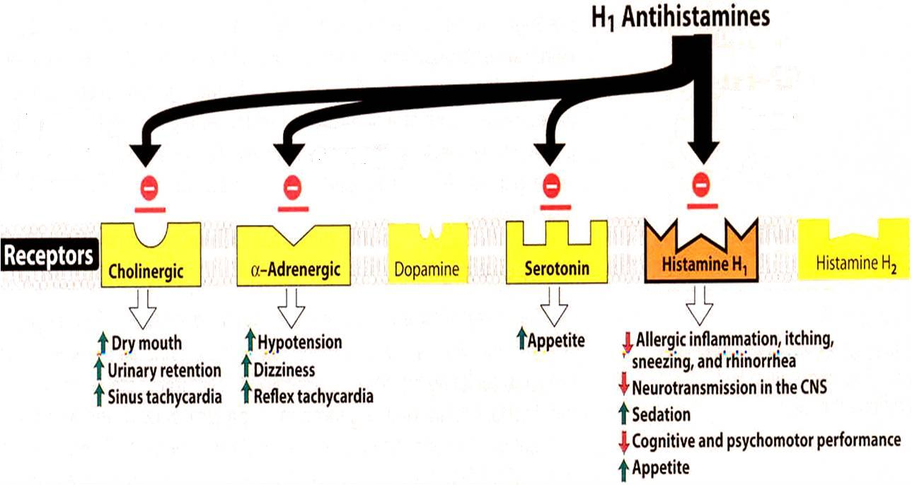
GOOD CONTROL of Rhinitis, Conjunctivitis, Urticaria, Flu (cough & sneezing)
ALLERGIES
POOR CONTROL of Asthma, Otitis, Anaphylaxis, Sinusitis, Atopic dermatitis
INDICATIONS linked to H1 block
ITCHING
Even
non-allergic
INDICATIONS not linked to H1 block
ANTIHISTAMINES
Others
Insomnia
Sleep aid
Vertigo
Anxiety
Side Effects
Interactions
Side Effects
Interactions
Side Effects
Interactions

Slide 8
ANTIHISTAMINES
OTHER ACTIONS; not linked to H₁ block
Vertigo & Motion sickness ; Dimenhydrinate, Diphenhydramine, Promethazine
◉ firing from internal ear to vomiting center
Anti-emetic ; Promethazine
◉ firing to vomiting center + Anticholinergic
Anticholinergic; Chlorpheniramine, Dimenhydrinate , Promethazine
◉ Extra-pyramidal effect [Antiparkinsonism]
Vasoconstriction [non-inflammatory Rhinitis]
α-Adrenergic Block Promethazine
Orthostatic hypotension
5-HT modulation Cyproheptadine
Appetite [Increase Appetite]
Sedation
Prophylactic for Migraine
Na-Channel blocker Promethazine , Antazoline`
Local anesthetic action / Anti-arrhythmic?

Slide 9
2-ANTI-ALLERGICS
CROMOLYN & NEDOCROMYL
◉ Histamine release [mast cell stabilizer by inhibiting Cl channels] i.e. can act only prophylactic but once released it does not antagonize its action
Used more in children for prophylaxis of perennial allergic rhinitis [ nasal drops] > than allergic or exercise induced asthma [as inhaled powder or neubilized solution]
Should be given on daily base and never stop abruptly.
Can induce cough, wheezes, headache, rash, …etc.
LEUKOTRIENE RECEPTOR ANTAGONISTS
Block leukotriene actions
For prophylaxis of lower respiratory [i.e perennial allergen, exercise or aspirin-induced asthma] > upper respiratory allergies [chronic rhinosinusitis]
ADRs; as in asthma
3-CORTICOSTERIODS
Anti-inflammatory blocks phospholipase A₂ 
arachedonic a. synthesis   prostaglandins & leukotrienes
Topical; steroid spray; beclomethasone, budesonide, & fluticasone
Given if severe intermittent or moderate persistent symptoms
ADRs; Nasal irritation, fungal infection, hoarseness of voice

Slide 10
4. DECONGESTANTS
α-Adrenergic agonists
For treatment of nasal stuffiness
SYSTEMIC
TOPICAL
PSEUDOEPHEDRINE
PHENYLETHYLAMINES
IMIDAZOLINE
Phenylephrine
Methoxamine
Naphazoline
Oxymetazoline HCI
Xylometazoline HCI
Can cause nervousness, insomnia, tremors, palpitations, hypertension.
Better avoided in hypertension, heart failure, angina pectoris, hyperthyroidism glaucoma
But can cause Rebound nasal stuffiness (repeated administration (10 days -2 weeks)
5. ANTICHOLINERGICS
Ipratropium
Given as nasal drops to control rhinorrhea (excess nasal secretion & discharge) So very effective in vasomotor rhinitis (watery hyper-secretion).
Its indication as bronchiodilator in asthma and ADRs  see asthma

Slide 11
Effectiveness of different drug groups in controlling symptoms of RHINITIS
Drug Groups | Main Symptom
 | Sneezing | Blockage Stuffiness | Secretions Rhinorrhea
Anti-histamines | ++ | - | +
Anti-allergics (cromolyns) | + | + | +
Topical corticosteroids | ++ | ++ | ++
Decongestant | - | ++ | -
Anticholinergics | - | - | ++

Slide 12
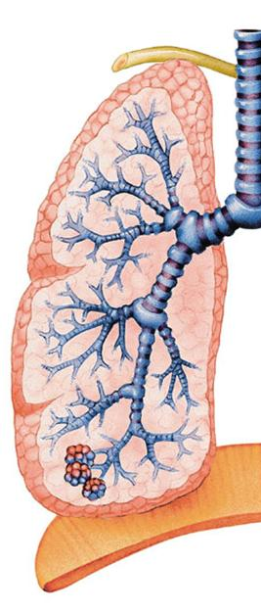
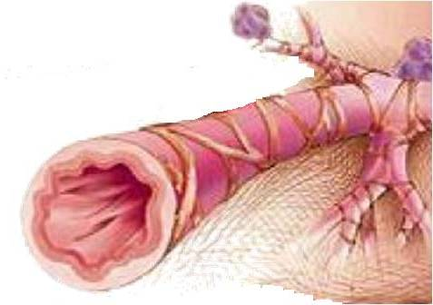
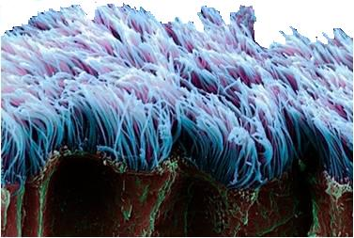
DRUGS USED
IN TREATMENT OF COUGH

Slide 13
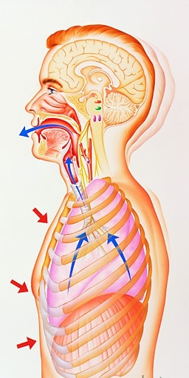
is protected mainly by
The respiratory tract
1. MUCOCILIARY CLEARANCE  Competent mechanisms ensuring optimum tracheobronchial clearance by forming sputum (in optimum quantity & viscosity ) that is exhaled out by the movement of the ciliated epithelium.
2. COUGH REFLEX  that is meant to exhale sputum out, if not optimally removed by the mucociliary clearance mechanisms
Coughing is a sudden expulsion of air from the lungs through the epiglottis at an amazingly fast speed (~100 miles/ hr) to rid breathing passageways of unwanted irritants. So abdominal & muscles contract, against the closed epiglottis  pressure   air is forcefully expelled to dislodge the triggering irritant.
Cough is meant to be useful “wet or productive”
May not be useful & annoying 2ndry to irritant vapors, gases, infections, cancer “dry or irritant”
EXPECTORANTS
MUCOLYTICS
For Productive
TREATMENT
ANTITUSSIVE AGENTS
For Non-productive (dry)

Slide 14
EXPECTORANTS
Act by removal of mucus through
Reflex stimulation
Irritate GIT  stimulate gastropulmonary vagal reflex  loosening & thinning of secretions  Guaifenesin
ADRs ; Dry mouth, chapped lips, risk of kidney stones(uric a. excretion)
Direct stimulation
Stimulate secretory glands   respiratory fluids production  Iodinated glycerol, Na or K iodide / acetate , Ammonium chloride, Ipecacuahna
ADRs; Unpleasant metallic taste, hypersensitivity, hypothyroidism, swollen of salivary glands( overstimulation of salivary secretion), & flare of old TB.
INDICATIONS
Final outcome is that cough is indirectly diminished
Common cold
Bronchitis
Laryngitis
Pharyngitis
Influenza
Measles
Chronic paranasal sinusitis
Pertussis

Slide 15
MUCOLYTICS
Act by altering biophysical quality of sputum becomes easily exhaled by mucociliary clearance or by less intense coughing
MECHANISM OF ACTIONS
Mucolysis occurs by one or more of the following;
◉ Viscoelasticity by water content; Hypertonic Saline & NaHCO₃
◉ Adhesivness; Steam inhalation
Breakdown S-S bonds in glycoproteins by its reducing SH Gp  less viscid mucous; N-Acetyl Cysteine
Synthesize serous mucus (sialomucins of smaller-size) so it is secretolytic + activate ciliary clearance & transport; Bromohexine & Ambroxol
Cleavage of extracellular bacterial DNA, that contributes to viscosity of sputum in case of infection; rhDNAase (Pulmozyme)
INDICATIONS
Most mucolytics are used as adjuvant therapy in COPD, asthma, bronchitis, …etc. (in excessive &/or thick mucus production)
In COPD  exacerbations, rate of hospitalization, cough severity & chest discomfort but do not show improvement in lung functions
In bronchiectasis, pneumonia & TB  are of partial benefit
N.B little benefit in cystic fibrosis & severe infections  Give rhDNAase

Slide 16
1. N-Acetylcysteine
 as dissolved powder taken orally.
A mucolytic & a free radical scavenger  used in acetominophin overdose
ADRs; Bronchospasm, stomatitis, rhinorrhea, rash, nausea & vomiting
2. Bromhexine & its metabolite Ambroxol
 as tablets or nebulized solution.
As mucolytic  immuno defence mechanism   dis. duration
Long-term use   antibiotics used for treatment of exacerbation.
Ambroxsol is also  very potent inhibitor of neuronal Na channels   pain in acute sore throat (fast onset & long duration)
ADRs; Rhinorrhea, lacrymation, gastric irritation, hypersensitivity

Slide 17
3. Pulmozyme (Dornase Alpha or DNAse)
 Is a recombinant human deoxyribo-nuclease-1 enzyme.
inhalation via neubilizers,
Full benefit appears within 3-7 days
Particularly used in cystic fibrosis (CF) & is sever respiratory infections.
This is because the viscosity of infected sputum then, is more due to nucleic acids of bacterial infection rather than mucopolysaccharides
In CF  it  pulmonary exacerbations & rate of deterioration of lung function  is currently the only mucolytic with proven efficacy in CF
ADRs;
Voice changes, pharyngitis, laryngitis, rhinitis, chest pain, fever, rash

Slide 18
ANTITUSSIVE AGENTS
Stop or reduce cough by acting either primarily on the peripheral or CNS components of cough reflex.
Peripherally acting  suppress different stretch receptors
Central {opioid & nonopioid}  suppress cough centers
PERIPHERALLY ACTING ANTITUSSIVES
A. Inhibitors of airway stretch receptors
In Pharynx  Use Demulcents  form a protective coating
Given as soothing pastilles, lozenges, gargles & syrups of acacia, licorice, glycerin, honey, and wild cherry syrups
In Larynx  Use Emollients  form a protective coating
Given as syrup or as soothing spray of menthol & eucalyptus.
In Tracheobronchial Airway Use aerosols or inhalational hot steam alone or medicated with tincture benzoin compound & eucalyptol
During bronchoscopy or bronchography  Use local anaesthetic aerosols, as lidocaine, benzocaine, and tetracaine

Slide 19
B. Inhibitors of pulmonary stretch receptors in alveoli
Benzonatate   sensitivity (numbing) of receptors by local anesthetic action. Also has a central inhibitory effect
Given orally as softgel capsules  it slowely release medication in intestine because it is potent & toxic .
ADRS; drowsiness, dizziness, dysphagia, allergic reactions
Overdose  mental confusion, hallucination, restlessness & tremors
CENTRALLY ACTING ANTITUSSIVES
A. OPIOIDS
They act directly on cough centre in the medulla by inhibiting release of excitatory neuropeptides via activating µ opioid receptors
e.g. Codeine (methyl-morphine) & Pholcodine
Morphine , only in bronchogenic carcinoma, because of its many side effects
ADRs; Constipation, Inhibition of mucociliary clearance (thick sputum ), drowsiness & mild respiratory depression, dependence……etc

Slide 20
CENTRALLY ACTING ANTITUSSIVES
B. NON-OPIOIDS
Sedating H₁-blockers
Diphenhydramine, Chlorphenaramine
Dextromethorphan
Mechanism
Multiple non-selective mechanisms; 5HT reuptake inhibition, σ receptor agonist & NMDA receptor antagonist.
As antitussive; it  threshold for coughing centrally & has benefits of being;
1. As potent as codeine.
2- But no drowsiness.
3- Less constipating
4- No respiratory depression.
5- No inhibition of mucociliary clearance.
6- No addiction.
ADRs
Nausea, vomiting, dizziness, rash & pruritis in normal doses
In high doses, hallucinations + opiate like side effects on respiration & GIT

Slide 21
GOOD LUCK

