Slide 1
Upper Respiratory Tract Infection URTI
Dr Ali Somily

Slide 2
Objection
To learn the epidemiology and various clinical presentation of URT
To identify the common etiological agents causing these syndromes
To study the laboratory diagnosis of these syndromes
To determine the antibiotic of choice for treatment

Slide 3
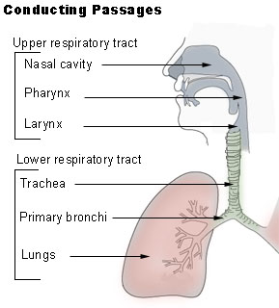
Definition
Pharyngitis
Otitis Media
Sinusitis
Epiglottitis

Slide 4
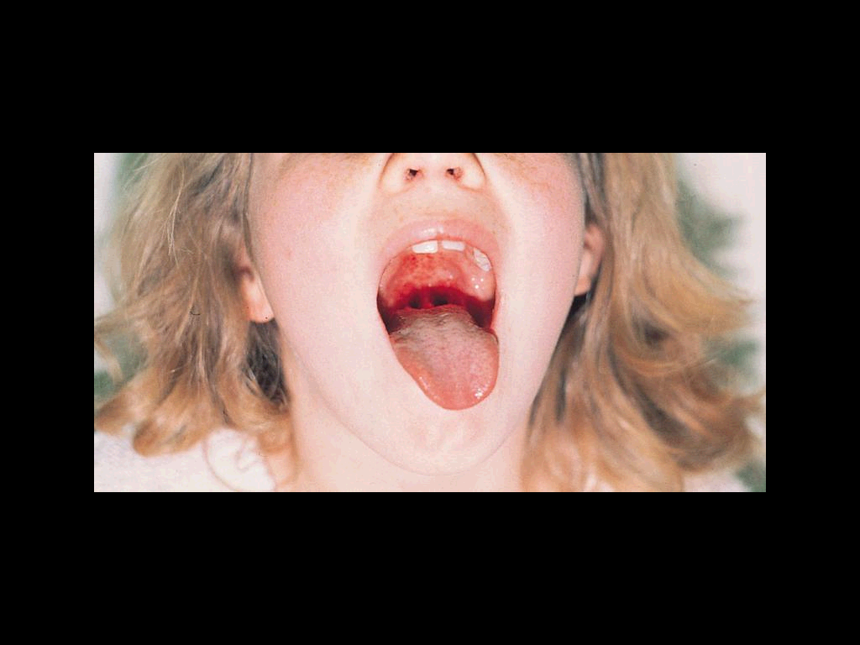
Pharyngitis
Late fall, winter, early spring
5 to 15 years
erythema, edema, and/or exudates
Tender, enlarged >1 cm lymph nodes
Fever 38.4 to 39.4º C
No signs and symptoms of viral infections

Slide 5
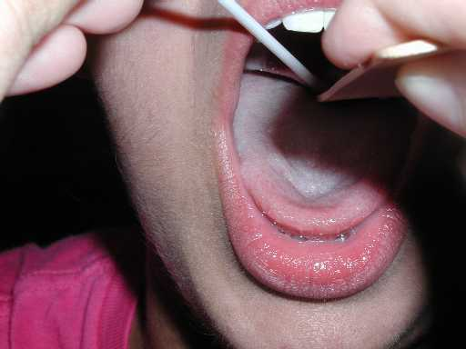
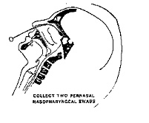
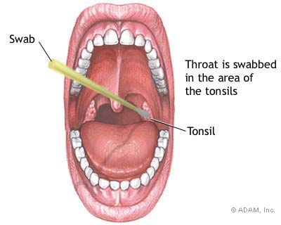
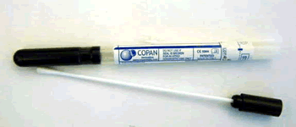
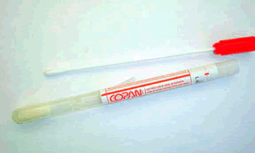
Pharyngitis
Etiology
Viral is the most common i.e Enterovirus, HSV, EBV, HIV, Respiratory viruses
Bacterial Group A streptococcus
Neisseria gonorrhoeae
Anaerobic bacteria i.e Lemierre's syndrome
Corynebacterium diphtheriae

Slide 6
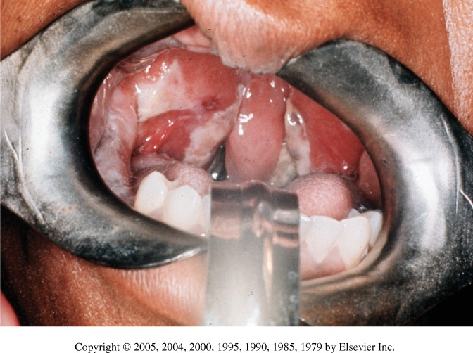
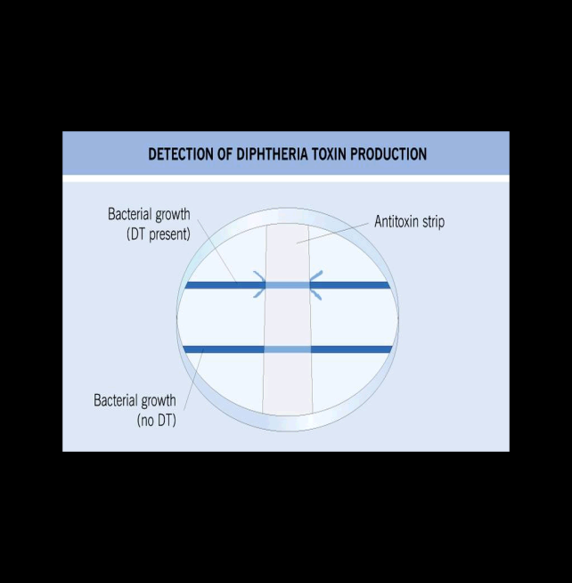
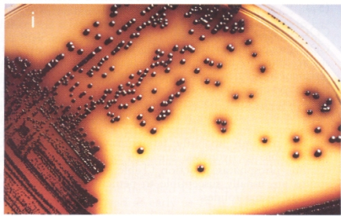
Corynebacterium diphtheriae
One of the most common causes of death in unvaccinated children 1-5yrs.
Toxin mediated disease
Rapid progression tightly adhering gray membrane in the throat
Tinsdale media
ELIK’s Test for confimation
Penicillin or erythromycin

Slide 7
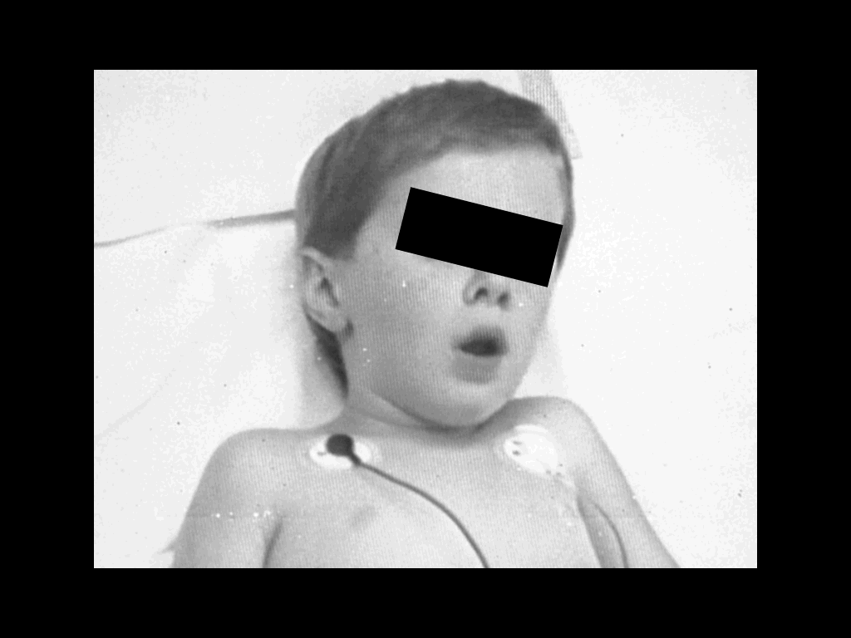
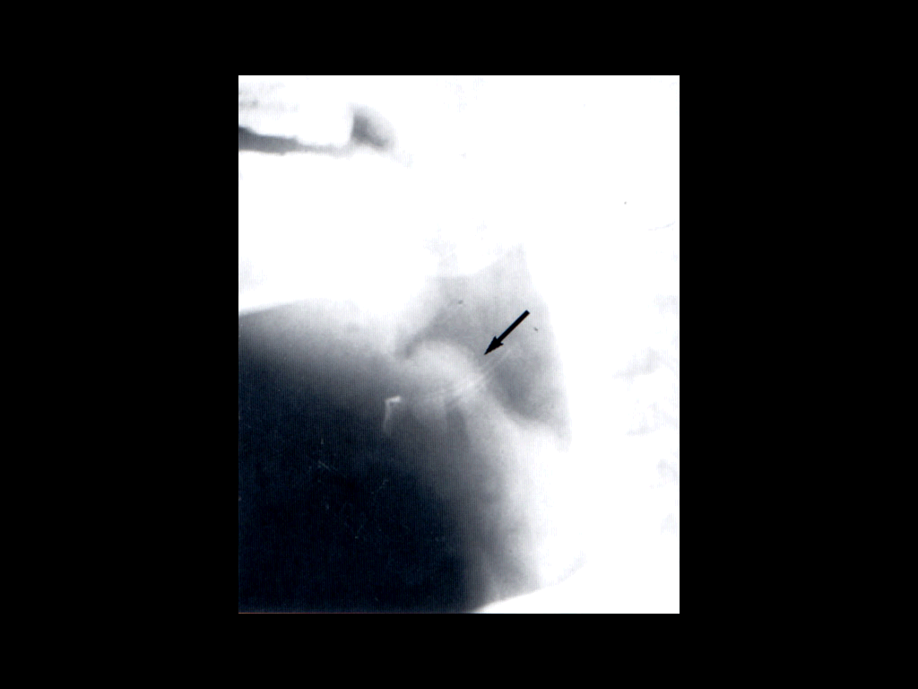
Epiglottitis
Usually young unimmunized children presented with dysphasia, drooling, and distress
H.influenzae Type b
S.pneumonae
S.aureus or Beta hemolytic streptoccus
Viral or candida
Ceftriaxone

Slide 8
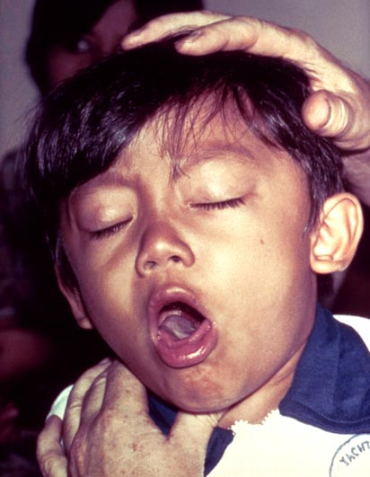
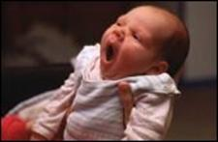
Pertussis (whooping cough)
Bordetella pertussis (GNB)
Pertussis toxin (PT )*
Filamentous hemagglutinin (FHA
Pertactin (PRN)
Incubation period 1 to 3 wks
Catarrhal Stage 1-2 weeks
Paroxysmal Stage 1-6 weeks
Convalescent Stage 3-6 weeks
Leukocytosis with lymphocyte predominance
Nasopharyngeal (NP) swabs
Charcoal-horse blood T media
Regan-Lowe, Bordet-Gengou
Treatment erthromycin and
prevention vaccination

Slide 9
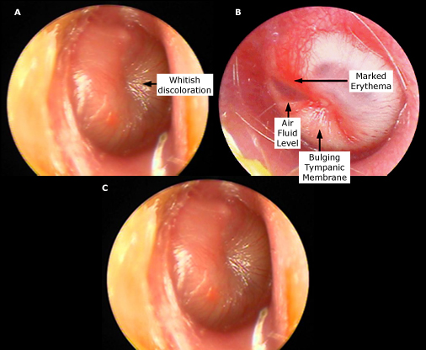
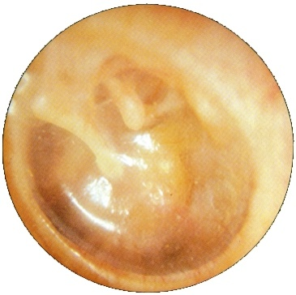
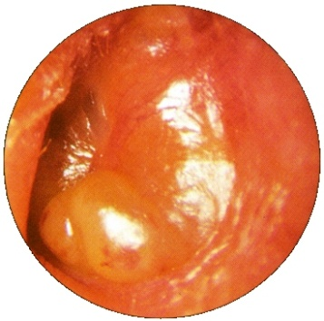
Acute otitis media
S. pneumoniae
H. influenzae
GAS
S. aureus
Moraxella catarrhalis
Viral and fungal
Tympanocentesis
Complication mastoiditis chr o m , meningitis
Amoxicillin or AMC
Mastoiditis treat for 2 wks

Slide 10
Bacterial sinusitis
Acute sinusitis
Children
Mainly clinical diagnosis
Aspiration in case Immunocompramized , treatment failure
Diagnosis X-rays CT/MRI
Periorbital cellulitis R/O sinusitis by CT/MRI
Post-septal involvement treat as meningitis
Chronic sinusitis
Less local symptoms
Mimic allergic rhinitis
Dx Image less useful than acute (changes persist after TTT) and to R/O tumor
Obtain odontogenic X-rays if maxillary sinus
Notes:
Microbiology and treatment of acute bacterial sinusitis in children Author Ellen R Wald, MD Section Editors Sheldon L Kaplan, MD Ellen M Friedman, MD Robert A Wood, MD Deputy Editor Mary M Torchia, MD Last literature review version 17.2: May 2009 | This topic last updated: May 24, 2009 (More)
INTRODUCTION — Acute sinusitis is a disease that results from infection of one or more of the paranasal sinuses. A viral infection associated with the common cold is the most frequent etiology of acute sinusitis, more properly called viral rhinosinusitis. Approximately 6 to 13 percent of viral rhinosinusitis in children is complicated by acute bacterial sinusitis (ABS).
Uncomplicated viral rhinosinusitis usually resolves without treatment in 7 to 10 days. Although untreated ABS also may resolve without treatment, treatment with antibiotics hastens recovery and may decrease the risk for orbital and intracranial complications. Distinguishing between acute viral rhinosinusitis and ABS is important so that antibiotics, which are ineffective in uncomplicated viral rhinosinusitis, can be used judiciously.
The treatment of ABS in children will be discussed here. The clinical features and diagnosis of ABS in children and acute sinusitis and rhinosinusitis in adults are discussed separately. (See "Clinical features; evaluation; and diagnosis of acute bacterial sinusitis in children" and see "Acute sinusitis and rhinosinusitis in adults").
MICROBIOLOGY — Streptococcus pneumoniae, Haemophilus influenzae (non-typeable), and Moraxella catarrhalis are the predominant causes of ABS [1-3]. Few data regarding the microbiology of acute sinusitis in children have been generated since 1986 [4]. However, because of the similarity of the pathogenesis and microbiology of acute otitis media (AOM) and ABS, it is acceptable to regard data generated from cultures of middle ear fluid, obtained by tympanocentesis, from children with AOM as a surrogate for cultures of the paranasal sinuses [5,6].
The microbiology of AOM in the United States is changing. Since the mid-1990s there has been an increasing prevalence of penicillin-resistant S. pneumoniae. Many isolates of H. influenzae (35 to 50 percent), and M. catarrhalis (55 to 100 percent) also are beta-lactamase producing and resistant to penicillin [7,8]. In addition, perhaps related to the near universal immunization of infants with the pneumococcal conjugate vaccine in the United States, there has been a slight decrease in isolates of S. pneumoniae and an increase in isolates of H. influenzae recovered from middle ear aspirates [9]. However, an increase in the recovery of serotype 19A S. pneumoniae (a multiply-antibiotic resistant non-vaccine strain of pneumococcus) from tympanocentesis isolates of AOM has been reported in several case series [10,11]. Similar changes can be presumed to occur in the paranasal sinuses. (See "Resistance of Streptococcus pneumoniae to beta-lactam antibiotics" and see "Acute otitis media in children: Epidemiology, pathogenesis, clinical manifestations, and complications", section on Microbiology).
ANTIBIOTIC THERAPY — The goals of antibiotic therapy of ABS are to hasten recovery and prevent suppurative complications [12]. Successful antibiotic treatment depends upon administration of an appropriate antibiotic, in adequate doses, for a sufficient period of time [3].
Most children with ABS can be treated as outpatients. Those with severe symptoms, underlying immunodeficiency (primary or secondary), or potential orbital or intracranial complications should be hospitalized for intravenous antibiotic therapy and/or specialty or surgical care (show figure 1) [3].
Efficacy — There is some controversy in the literature regarding the effectiveness of antibiotics in the treatment of ABS. Some have argued that the difficulty in distinguishing viral rhinosinusitis from ABS and the high spontaneous cure rate of ABS obviate the need for antibiotics [13,14], whereas others are of the opinion that antimicrobial therapy is the cornerstone of management [12]. (See "Clinical features; evaluation; and diagnosis of acute bacterial sinusitis in children").
The data regarding antibiotic therapy for the treatment of ABS in children are unsatisfactory. Nonrandomized studies in adults have suggested that appropriate antibiotics at appropriate doses are effective in eradicating or reducing bacterial growth [1,15]. However, there have been no randomized, placebo-controlled trials of antibiotic treatment for ABS that have used pre- and post-treatment sinus aspirate culture as the standard for diagnosis and cure. Studies that use clinical and/or radiologic criteria for diagnosis and outcome may underestimate the benefit of antibiotic therapy because they are likely to include at least some patients with self-limited uncomplicated viral URI.
Only two prospective placebo-controlled studies regarding the efficacy of antibiotics in the treatment of ABS have been performed in children since 1986 [4,13].
The first study was published in 1986, before the widespread development of antibiotic-resistant pneumococci. In this study, 136 children (mean age 6 years) with radiologically confirmed clinical ABS (nasal discharge or daytime cough, or both of 10 to 30 days' duration) were randomly assigned to treatment with amoxicillin (40 mg/kg per day), amoxicillin-clavulanate (40 mg/kg per day of the amoxicillin component), or placebo. They underwent clinical assessment at 3 and 10 days [4]. Children with throat cultures positive for group A Streptococcus (n=28) and who did not complete their medication (n=15) were excluded from analysis. More children in the treatment groups than in the placebo group were cured or improved on days 3 and 10 of therapy (83 versus 51 percent and 79 versus 60 percent, respectively). The overall cure rates were 67 percent, 64 percent, and 43 percent for amoxicillin, amoxicillin-clavulanate, and placebo, respectively.
The second study was published in 2001. In this study 188 children (aged 1 to 18 years, mean age 8 years) from community pediatric practices who had 10 to 28 days of persistent sinus symptoms were randomly assigned to receive amoxicillin (40 mg/kg/day), amoxicillin-clavulanate (45 mg/kg per day of the amoxicillin component) or placebo [13]. The rate of improvement (79 to 81 percent), relapse (12 to 13 percent), recurrence (9 to 13 percent), and adverse effects (10 to 19 percent) were similar among groups. The lack of benefit with antibiotic therapy in this study may have been related to the use of a relatively low dose of amoxicillin in an era of potentially resistant S. pneumoniae, the exclusion of more seriously ill children (temperature >39ºC or facial pain), and a relatively older population [12,14,16].
A meta-analysis of six randomized controlled trials that compared antibiotics versus placebo or standard therapy in 562 children with rhinosinusitis for ≥10 days (eg, acute, subacute, and chronic sinusitis) found that antibiotics decreased overall clinical failure, defined as nasal discharge at follow up or no substantial improvement (risk ratio of 0.75 [95% CI, 0.63 to 0.92]), without significantly increasing adverse effects [17].
Whether treatment of ABS prevents serious complications has not been adequately studied [18].
Choice of antibiotic — Antibiotics that are used to treat ABS must provide antibacterial coverage for S. pneumoniae, H. influenzae, and M. catarrhalis. Additional factors to be considered include the severity of clinical illness, recent exposure to antibiotics, and other factors that increase the likelihood of infection with a resistant bacterial species.
Because of its general effectiveness, safety, low cost, and narrow spectrum, amoxicillin, with or without clavulanate, generally is considered to be the first line agent for the treatment of ABS in children [12,19].
There are few adequately powered studies that compare the efficacy of various antibiotics in the treatment of ABS. Guidelines for antibiotic therapy provided by the Sinus and Allergy Health Partnership used a mathematical model based on the best available evidence for pathogen distribution in ABS, pharmacokinetic and pharmacodynamic data, mechanisms of antimicrobial resistance, and antimicrobial resistance surveillance data [20-22]. Similarly, guidelines published by the American Academy of Pediatrics (AAP) developed suggestions for antimicrobial therapy based on theoretical calculations rather than on existing evidence [12]. They conclude that in the absence of any risk factors for resistant organisms, approximately 80 percent of children with ABS will respond to amoxicillin.
Outpatient therapy — We agree with the AAP guideline for the management of ABS in children (show figure 1) [12], and make the following recommendations for outpatient therapy:
For children with uncomplicated ABS that is of mild to moderate severity, who do not attend day care, and have not been treated with an antimicrobial in the preceding 90 days, we suggest one of the following regimens:
Amoxicillin (45 to 90 mg/kg per day in two divided doses), or
Amoxicillin-clavulanate (45 to 90 mg/kg per day of the amoxicillin component in two divided doses)
The dose range permits some individual judgment [12,23]. As an example, a lower dose may be used for a child who has his or her first sinus infection in October (when the rate of antibiotic resistance is low) [24]; later in the viral respiratory season, a higher dose (90 mg/kg per day) may be more appropriate.
For children who have uncomplicated ABS of at least moderate severity, have received an antimicrobial agent in the preceding 90 days, or who attend day care, we suggest one of the following regimens (show figure 1):
Amoxicillin-clavulanate (80 to 90 mg/kg per day of amoxicillin and 6.4 mg/kg per day of clavulanate in two divided doses), or
Cefdinir (14 mg/kg per day in 1 or 2 doses), or
Cefuroxime (30 mg/kg per day), or
Cefpodoxime (10 mg/kg per day once daily)
A single dose of ceftriaxone (at 50 mg/kg per day), given either intravenously or intramuscularly, can be used in children with vomiting that precludes administration of oral antibiotics [12]. Therapy with an oral antibiotic should be initiated 24 hours later, provided the vomiting has resolved.
Children with allergy to penicillins — Regimens for children with non-type 1 hypersensitivity reactions to penicillin (show table 1) include (show figure 1):
Cefdinir (14 mg/kg per day in 1 or 2 doses), or
Cefuroxime (30 mg/kg per day), or
Cefpodoxime (10 mg/kg per day once daily)
In patients with type 1 hypersensitivity reactions to penicillins (show table 1), appropriate regimens include:
Clarithromycin (15 mg/kg/day in 2 divided doses), or
Azithromycin (10 mg/kg per day on day 1 followed by 5 mg/kg per day as a single dose for 4 days)
Clindamycin (30 to 40 mg/kg per day) is another alternative, but should be reserved for patients with type 1 hypersensitivity reactions to penicillin who are known to be infected with penicillin-resistant pneumococci [12].
(See "Allergy to penicillins" and see "Use of cephalosporins, carbapenems, and monobactams in penicillin allergic patients").
Hospitalized patients — Seriously ill children with ABS should be hospitalized for intravenous antibiotics. Empiric therapy should provide coverage for highly resistant pneumococci and penicillin resistant H. influenzae and M. catarrhalis. Appropriate regimens include:
Cefotaxime (100 to 200 mg/kg per day every divided every 6 hours), or
Ceftriaxone (100 mg/kg per day divided every 12 hours)
Therapy should be adjusted based upon clinical response and culture results.
Duration — The optimal duration of therapy for patients with ABS has not received systematic study. Empiric recommendations are typically made for 10, 14, 21, or 28 days of therapy. As an alternative, we suggest that antibiotic therapy be continued until the patient becomes free of symptoms and then for an additional seven days [12,25]. This strategy, which individualizes treatment for each patient, guarantees a minimum duration of 10 days of therapy and prolongs therapy in children in whom the response to antibiotics has been more sluggish.
Treatment failure — Most patients with ABS who are treated with an appropriate antimicrobial agent respond within 48 to 72 hours with a diminution of respiratory symptoms and an improvement in general well-being [4]. If a child fails to improve, either the antimicrobial is ineffective or the diagnosis of sinusitis is not correct [12]. Sinus imaging and/or sinus aspiration may be indicated to confirm the diagnosis and tailor therapy. Refractory sinusitis may be a clue to immune deficiency [26]. (See "Approach to the child with recurrent infections").
For children with mild to moderate symptoms who do not improve while receiving an adequate dose of amoxicillin, antibiotic therapy may be changed to one of the following regimens (show figure 1):
Amoxicillin-clavulanate (80 to 90 mg/kg per day of amoxicillin and 6.4 mg/kg per day of clavulanate in 2 divided doses), or
Cefdinir (14 mg/kg per day in 1 or 2 doses), or
Cefuroxime (30 mg/kg per day), or
Cefpodoxime (10 mg/kg per day once daily)
If patients with mild to moderate symptoms fail to improve with one of these regimens, a trial of intravenous therapy with ceftriaxone (100 mg/kg per day divided every 12 hours) or cefotaxime (100 to 200 mg/kg per day) may be initiated (show figure 1).
Sinus imaging (plain radiographs in anteroposterior, lateral, and occipitomental views) should be performed before initiation of intravenous therapy to confirm the diagnosis (for patients who were not previously imaged). Sinus imaging, with contrast enhanced computed tomography (CT), should be performed in patients with symptoms or signs of intracranial or orbital complications. Sinus aspiration also may be indicated to appropriately tailor antibiotic therapy. (See "Clinical features; evaluation; and diagnosis of acute bacterial sinusitis in children", section on Complications of ABS).
Failure to improve in hospitalized patients who are receiving empiric antibiotic therapy warrants additional evaluation. Contrast enhanced CT imaging should be obtained to exclude orbital and intracranial complications. Sinus aspirate cultures should be obtained if they were not obtained at the time of admission. Antimicrobial therapy should be modified according to results of sinus aspirate cultures as soon as the results are available. If sinus aspirate cultures are unavailable or if no pathogens are isolated in an ill child who has not improved despite therapy with a third generation cephalosporin, the addition of vancomycin with or without metronidazole may be warranted. Consultation with an infectious disease specialist and/or otolaryngologist is suggested.
INDICATIONS FOR REFERRAL — Children with uncomplicated ABS can usually be managed by their primary care provider. Consultation with a specialist (eg, infectious disease, otolaryngology, immunology) may be warranted in the following circumstances [18,27]:
Intracranial or orbital complications
Need for sinus aspiration
Isolation of resistant or rare pathogens from sinus aspirate
Diagnosed or suspected immunodeficiency
Recurrent ABS, particularly if it exacerbates underlying pulmonary conditions (eg, asthma)
ADJUNCTIVE THERAPY — Adjunctive therapies for ABS, which may be used to reduce or improve sinus drainage, include [12,28,29]:
Saline nasal irrigation
Decongestants (topical or systemic)
Antihistamines
Intranasal corticosteroids
There are limited data regarding the efficacy of these therapies in children with ABS [29,30]. Saline nose drops and/or saline nasal sprays may be helpful in preventing crust formation and liquefying sinus secretions. Although the potential benefits are unproven, saline nasal irrigation is unlikely to be harmful or impede recovery and is suggested.
Decongestants may reduce tissue edema, improve ostial drainage, and provide symptomatic relief [28]. However, these benefits may be offset by an increased viscosity of secretions and decreased blood flow to the nasal mucosa, which may impair delivery of antibiotics to the sinuses. Similarly, antihistamines have the potential to dry secretions and impair sinus drainage. There are no data to support the use of antihistamines in children with ABS who do not have an underlying allergic component [12,28].
The use of a combination antihistamine-decongestant in the treatment of children with presumed ABS was evaluated in a single prospective study [31]. Children (aged 1 to 18 years) with presumed ABS were randomly assigned to treatment with a decongestant-antihistamine or placebo in addition to amoxicillin. Symptoms improved in all children within three days of initiation of antibiotics; there were no differences in symptom scores between groups on days 1, 3, or 14 of therapy. We do not suggest the use of decongestants or antihistamines in children with ABS.
Nasal corticosteroids theoretically may decrease inflammation of the mucous membranes, which contributes to obstruction of the ostia and impaired mucociliary clearance [32]. Only one study has evaluated the benefits of intranasal corticosteroids in addition to antibiotics in young children with presumed ABS [33]. In this study 151 children (1 to 15 years) with clinical and radiographic sinusitis were treated with amoxicillin-clavulanate and randomly assigned to budesonide or placebo nasal spray for three weeks. At the end of therapy, symptoms in patients in both groups were improved from baseline. Intranasal budesonide had a modest effect on cough and nasal discharge, but the effect was only noted during the second week of therapy. A study of intranasal corticosteroids in patients >14 years with ABS demonstrated a similar marginal effect [34]. We do not suggest the use of intranasal corticosteroids in children with ABS.
SUMMARY AND RECOMMENDATIONS
Streptococcus pneumoniae, Haemophilus influenzae (non-typeable), and Moraxella catarrhalis are the predominant causes of uncomplicated acute bacterial sinusitis (ABS) in otherwise healthy children. (See "Microbiology" above).
Most children with ABS can be treated as outpatients. Hospitalization is indicated for those with severe symptoms, underlying immunodeficiency (primary or secondary), or potential orbital or intracranial complications. (See "Antibiotic therapy" above).
We suggest children with ABS be treated with antimicrobial therapy (Grade 2A). The choice of antibiotic is based upon the degree of severity of illness, recent exposure to antibiotics, and the likelihood of infection with a resistant bacterial species. (See "Choice of antibiotic" above).
Respiratory symptoms of children with ABS typically improve within three days of initiation of appropriate antimicrobial therapy. Children whose symptoms fail to improve within this time-frame may require sinus imaging and/or sinus aspiration to confirm the diagnosis and/or tailor antibiotic therapy. (See "Treatment failure" above).
We suggest antimicrobial therapy be continued for seven days after the child is free of symptoms. (See "Duration" above).
We suggest saline nose drops and/or saline nasal sprays for children with ABS (Grade 2C). We suggest not using decongestants, antihistamines, or nasal corticosteroids (Grade 2B). (See "Adjunctive therapy" above).

Slide 11
Bacterial sinusitis
Acute sinusitis
S.pneumoniae
H.infuenza
M.catarrhalis
Treatment
Quinolones or
Ceftriaxone
For 1-2 weeks
Chronic sinusitis
S.pneumoniae
H.infuenza
M.catarrhalis
Oral anaerobes
Treatment
Same as acute sinusitis
Duration
For 2-4 weeks

Slide 12
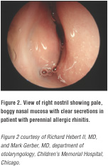
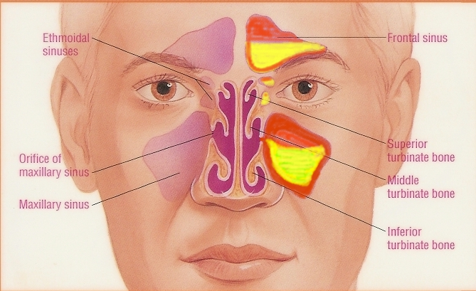
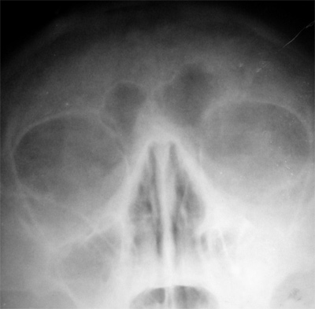
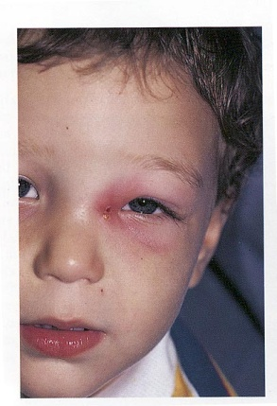
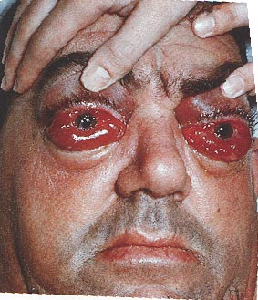
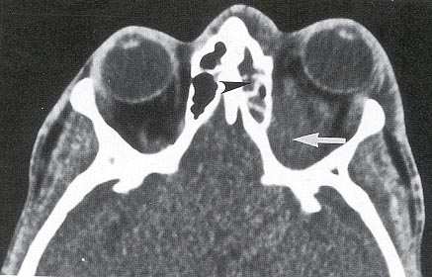
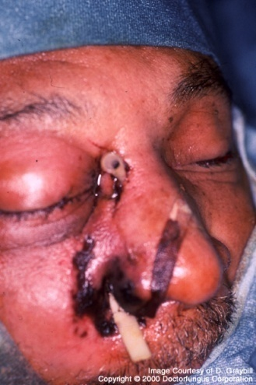
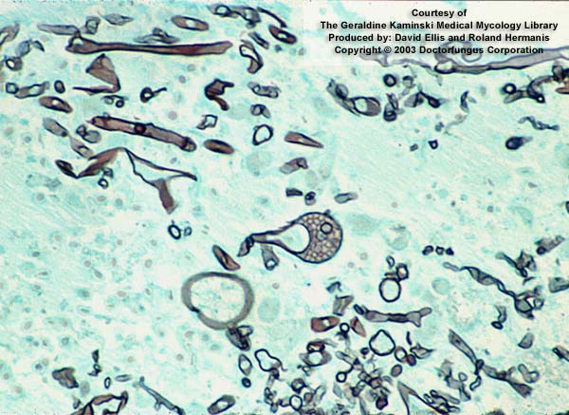
Clinical Presentations of Sinusitis
Notes:
Periorbital edema
Cellulitis
Nasal mucosa is reddened or swollen
Percussion or palpation tenderness over a sinus
Nasal discharge, thick, sometimes yellow or green
Postnasal discharge in posterior pharynx
Difficult transillumination
Swelling of turbinates
Boggy pale turbinates

Slide 13
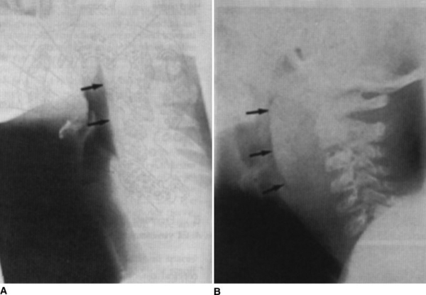
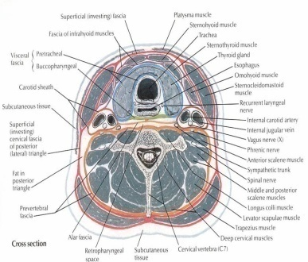
Deep neck space infections
Lateral pharyngeal, retropharyngeal or prevertebral space
Patients are toxic with unilateral posterior pharyngeal soft tissue mass on oral exam
Neck stiffness with retropharyngeal space infection/abscess
Retropharyngeal ( danger space) infection may extend to mediastinum and present as mediastinitis
Prognosis is poor without surgical drainage
Notes:
Deep neck space infections Author Anthony W Chow, MD, FRCPC, FACP Section Editor Stephen B Calderwood, MD Deputy Editor Anna R Thorner, MD Last literature review version 17.2: May 2009 | This topic last updated: August 18, 2008 (More)
INTRODUCTION — Deep neck space infections most commonly arise from a septic focus of the mandibular teeth, tonsils, parotid gland, deep cervical lymph nodes, middle ear, or the sinuses. These deep cervical "space" infections have become relatively uncommon in the postantibiotic era. Consequently, many physicians are unfamiliar with these conditions.
Furthermore, with widespread use of antibiotics and profound immunosuppression in some patients, the classic manifestations of these infections, such as high fevers, systemic toxicity, and local signs of erythema, edema, and fluctuance may be absent. However, since these infections often have a rapid onset and may progress to fatal complications [1], primary care physicians must be more aware of and must not underestimate the potential extent or severity of such infections.
The relevant anatomy, microbial etiology, salient clinical manifestations, diagnosis, and treatment of these conditions will be reviewed here. Odontogenic, middle ear, and sinus infections are discussed separately. (See "Epidemiology, pathogenesis, and clinical manifestations of odontogenic infections" and see "Acute otitis media in children: Epidemiology, pathogenesis, clinical manifestations, and complications" and see "Acute sinusitis and rhinosinusitis in adults").
ANATOMIC CONSIDERATIONS — Knowledge of the cervical compartments and interfascial spaces is essential to understand the pathogenesis, clinical manifestations, and potential routes of spread of infections involving these spaces.
Cervical fascia — The muscles, vessels, and visceral structures of the neck are enveloped by the cervical fascia, which has a superficial and deep component (show figure 1). The superficial cervical fascia consists of the subcutaneous tissues of the neck, which completely enclose it and are continuous with the platysma anteriorly.
The deep cervical fascia has three layers: superficial, middle, and deep, which can be thought of as defining a series of cylindrical compartments that extend longitudinally from the base of the skull to the mediastinum (show figure 1). The superficial or investing layer of the deep cervical fascia encloses all of the deeper parts of the neck, beginning at the nuchal line and extending anteriorly, dividing to enclose the trapezius, sternocleidomastoid, and strap muscles as well as the submaxillary and parotid glands.
The middle or pretracheal fascia encloses the cervical viscera including the pharynx, esophagus, larynx, trachea, thyroid, and parathyroid glands. The deep or prevertebral fascia arises from the nuchal ligament and encloses the vertebral column and muscles of the spine. All three layers of the deep cervical fascia contribute to the carotid sheath, which forms a neurovascular compartment that encloses the carotid artery, the internal jugular vein, and the vagus nerve.
Fascial spaces — There are three spaces between the planes of the deep cervical fascia that are of major clinical importance [2]:
The submandibular space
The parapharyngeal space
The retropharyngeal space
Submandibular space — The submandibular space lies within the submental and submandibular triangles between the mucosa of the floor of the mouth and the superficial layer of the deep cervical fascia. It is subdivided by the mylohyoid muscle into the sublingual space (which contains the sublingual gland, hypoglossal nerve, part of the submandibular gland, and loose connective tissue), and the submylohyoid space (which contains the submandibular salivary gland and lymph nodes) (show figure 2). The two divisions communicate posteriorly around the mylohyoid muscle.
Parapharyngeal space — Also known as the lateral or pharyngomaxillary space, the parapharyngeal space is located in the lateral aspect of the neck and is shaped like an inverted cone, with its base at the skull and its apex at the hyoid bone. It lies deep to the pharyngeal constrictor muscle, and is contiguous medially with the pretracheal fascia of the visceral compartment, and laterally with the superficial fascia (which invests the parotid gland), the internal pterygoid muscle, and the mandible (show figure 3).
The parapharyngeal space is divided into an anterior (prestyloid or muscular) compartment and a posterior (retrostyloid or neurovascular) compartment by the styloid process and its attached muscles, the stylomandibular ligament, and the insertion of these structures into the hyoid bone (show figure 3).
The anterior compartment contains no vital structures but rather only fat, lymph nodes, connective tissue, and muscle. It is the compartment most closely related to the tonsillar fossa and the internal pterygoid muscle. The posterior compartment contains the ninth to twelfth cranial nerves, the carotid sheath and its contents, and the cervical sympathetic trunk. The carotid sheath, which runs in the posterior aspect of the parapharyngeal space, pierces the cone at its apex to enter the mediastinum (show figure 3).
Infection of the lateral pharyngeal space may result from pharyngitis, tonsillitis, parotitis, otitis, or mastoiditis, as well as odontogenic infections, especially if the masticator space is involved. (See "Complications, diagnosis, and treatment of odontogenic infections").
Retropharyngeal, "danger", and prevertebral spaces — The retropharyngeal space is bound anteriorly by the constrictor muscles of the neck and posteriorly by the alar layer of the deep cervical fascia. It is situated behind the hypopharynx and the esophagus, and lies between the alar fascia posteriorly and the posterior aspect of the pretracheal fascia anteriorly (show figure 7). It communicates with the parapharyngeal space laterally where the carotid sheaths reside.
Posterior to this compartment is the "danger" space, which is bound by the alar fascia anteriorly and the prevertebral fascia posteriorly. It extends from the base of the skull and descends freely through the entire posterior mediastinum at the level of the diaphragm (T1 to T2) where the two fascial layers fuse. Thus, the retropharyngeal space provides the most important anatomic route for contiguous spread between the neck and the chest via the "danger" space.
The prevertebral space is bound by the prevertebral fascia, which originates posteriorly on the spinous processes and encircles the splenius, erector spinae, and semispinalis muscles. Prior to completing its circle anterior to the vertebral bodies, it fuses to the transverse processes. At this point, it is split into two layers: the more anterior alar fascia and the prevertebral fascia. The prevertebral space extends from the base of the skull to the coccyx, thus allowing organisms to spread as far down as the psoas muscle sheath.
Lymph nodes — The lymph nodes of the head and neck may be divided into 10 principal groups (show figure 4). Six of these (occipital, mastoid, parotid, facial, submandibular, and submental nodes) form a collar at the junction of the head and neck. Within this collar, the sublingual and retropharyngeal nodes lie near the base of the tongue. The anterior and lateral cervical nodes form a chain along the front and side of the neck, respectively. The lateral cervical chain serves as a common root for drainage. The final conduit from all lymphatics in the head and neck is the large deep chain situated along the carotid sheath. When inflamed, these nodes become adherent to the fascial sheath of the vessels; thus, a suppurative infection of the cervical lymph nodes may frequently invade the bloodstream.
In addition to the regional lymph nodes of the head and neck, both the nasopharynx and the oropharynx are richly endowed with mucosa-associated lymphoid tissues (MALT) similar to the bronchus (BALT) or the gut (GALT). In particular, the aggregation of lymphoid tissues surrounding the nasopharynx is known as the Waldeyer's ring and comprises the palatine, lingual, adenoidal, and tonsillar lymphoid tissues. Acute inflammation involving these tissues, such as during acute tonsillopharyngitis, croup, otitis media, retropharyngeal abscess or Epstein-Barr virus (EBV) mononucleosis, may result in acute airway compromise and constitutes a medical emergency [3,4].
Potential routes of spread — The deep cervical fascial spaces are normally bound together by loose connective tissue and intercommunicate to varied degrees. The potential pathways of extension from one space to another are illustrated in figure 5 (show figure 5). A thorough understanding of the potential anatomic routes of infection not only provides valuable information on the nature and extent of infection but also suggests the optimal surgical approach for effective drainage.
MICROBIAL ETIOLOGY AND PATHOGENESIS — Deep cervical fascial space infections are typically polymicrobial and represent the normal resident flora of the contiguous mucosal surfaces from which the infection originated. Due to the close anatomic relationship, the resident flora of the oral cavity, upper respiratory tract, and certain parts of the ears and eyes share many common organisms (show figure 6) [5].
Anaerobes generally outnumber aerobes at all sites by a factor of 10:1 [6]. Although as many as 50 to 100 bacterial species may be present on the oral or nasopharyngeal mucosal surface, the typical deep neck space infection on average, includes only five or six bacterial types [7,8]. Thus, most abscesses originating about the teeth harbor oral anaerobes, including Fusobacterium nucleatum, pigmented Prevotella species such as Prevotella melaninogenica (formerly Bacteroides melaninogenicus), Veillonella, and Peptostreptococcus species.
Actinomyces species are abundant on the dental plaque, and such organisms are frequently present in odontogenic cervical fascial space infections. The predominant species is Actinomyces israelii and less commonly Arachnia propionica, Actinomyces naeslundii, A. viscosus, and A. odontolyticus [9]. Actinobacillus actinomycetemcomitans, a fastidious capnophilic Gram negative coccobacillus, is commonly associated with the actinomyces [10,11].
In contrast to those of dental origin, infections arising from the pharynx frequently contain oral anaerobes and facultative streptococci, particularly Streptococcus pyogenes. (See "Complications of streptococcal tonsillopharyngitis").
While anaerobes are likely to be involved in most deep neck space infections, a small but significant proportion of cases will also contain other pathogens. Infections involving these additional organisms, such as Staphylococcus aureus and facultative Gram negative rods, including Pseudomonas aeruginosa, are more common in immunocompromised patients.
GENERAL CLINICAL MANIFESTATIONS — Deep neck space infections share some typical clinical features. Each of the major infections will also be discussed in greater detail below.
Symptoms — Patients with peritonsillar, parotid, parapharyngeal, and submandibular abscesses generally complain of sore throat or pain and trismus. Trismus (the inability to open the jaw) indicates pressure or infection of the muscles of mastication (the masseter and the pterygoids) or involvement of the motor branch of the trigeminal nerve.
Dysphagia and odynophagia are secondary to inflammation about the cricoarytenoid joints. Dysphonia and hoarseness are late findings in neck infections and may indicate involvement of the tenth cranial nerve; unilateral tongue paresis indicates involvement of the twelfth cranial nerve. Stridor and dyspnea may be manifestations of local pressure or spread of infection to the mediastinum.
Physical findings — In patients with peritonsillar, parotid, parapharyngeal, or submandibular abscess, findings on physical examination include swelling of the face and neck, erythema, and purulent oral discharge. There may be pooling of saliva in the mouth and asymmetry of the oropharynx. Lymphadenopathy is usually present. Because of the dense superficial layer of the deep cervical fascia and its musculofascial planes, a fluctuant mass is not readily appreciated in deep neck space infections. Palpation of the oral cavity (when possible) with a gloved hand may help in identifying such a mass or focal tenderness. The characteristic signs of deep pus are pitting or a doughy feeling on firm deep palpation.
SPECIFIC DEEP NECK SPACE INFECTIONS
Peritonsillar abscess (quinsy) — Peritonsillar abscess, also known as quinsy, is a suppurative complication of acute tonsillitis with extension into the peritonsillar space. The latter consists of loose areolar tissue overlying the tonsil and is surrounded by the superior pharyngeal constrictor muscle and the anterior and posterior tonsillar pillars. Peritonsillar abscesses may affect patients of all ages but are most common among young adults between the ages of 15 and 30 years. Peritonsillar abscess in children and adolescents is discussed separately. (See "Peritonsillar cellulitis and abscess in children and adolescents").
Clinical features — The patient appears ill with fever, sore throat, dysphagia, trismus, pooling of saliva, and a muffled voice. The abscess is usually unilateral and often associated with prominent tender cervical lymphadenitis. Examination of the pharynx in the majority of cases reveals swelling of the anterior pillar and the soft palate and, less commonly, the middle portion or lower pole of the tonsil (show picture 1).
Complications — The more serious complications include:
Airway obstruction, especially with bilateral disease or when laryngeal edema develops
Lateral dissection (usually from infections of the middle or lower portions of the tonsil) through the superior pharyngeal constrictor muscle to involve the parapharyngeal space (show figure 3).
Continued signs of sepsis after drainage of the peritonsillar space usually indicate concomitant, undrained parapharyngeal space infection. Fatalities associated with peritonsillar abscess (over 50 percent in the preantibiotic era) were largely due to this complication.
Treatment — Initially, needle drainage in the Trendelenburg position should be attempted and the patient closely monitored and managed with intravenous antibiotics alone. Failure to obtain pus is an indication for surgical incision and more formal exploration. Delays in drainage increase the risk of spontaneous rupture. Aspiration of purulent material is the main hazard, particularly in the sleeping patient.
Ideally, antibiotics should be tailored according to culture results of aspirated pus, but these cultures are infrequently performed. Results of surface cultures are unlikely to be helpful unless specimens are collected without oropharyngeal contamination and are transported in appropriate media.
Group A beta-hemolytic streptococci (often as part of a mixed flora containing anaerobes) are most commonly isolated. Occasionally, other beta-hemolytic streptococci, Haemophilus influenzae, S. aureus, or anaerobes alone are cultured.
Treatment failure, with penicillin monotherapy, due to the emergence of beta-lactamase production among oral anaerobes (eg, pigmented Prevotella spp. and Fusobacterium spp), has changed the preferred treatment of upper respiratory tract infections from penicillin monotherapy to broader spectrum antibiotics [12]. Ampicillin-sulbactam (2 g IV every four hours) provides extended coverage against oral anaerobes, including those that produce beta-lactamases, and is the treatment of choice. Penicillin G (2 to 4 MU IV every four to six hours) in combination with metronidazole (500 mg IV every six hours), an agent active against anaerobic Gram negative bacilli, is an alternative regimen. Penicillin allergic patients should be treated with clindamycin (600 mg IV every six hours).
Penicillin G (2 to 4 MU IV every four to six hours) is effective therapy in most cases, even though it does not cover all of these organisms. Bacteremia caused by Bacteroides species or Fusobacterium necrophorum may require the addition of metronidazole (500 mg IV every six hours) or clindamycin (600 mg IV every six hours) since penicillin resistance among these organisms is increasingly recognized. Alternative therapy with ampicillin-sulbactam (2 g IV every four hours) provides extended coverage against oral anaerobes, including those that produce beta-lactamases. Duration of treatment is usually for 10 days.
An evidence based review of the literature on surgery in peritonsillar abscess found that the quality of studies was generally lacking to make definitive recommendations [13]. Acute drainage via needle aspiration or incision and drainage appeared equally effective as tonsillectomy in small clinical trials [14].
The recurrence rate after a single episode of peritonsillar abscess in adults is 16 percent [15]. Interim antibiotic prophylaxis should be considered in high-risk cases. If tonsillectomy is required because of multiple recurrences, immediate tonsillectomy (quinsy tonsillectomy) is as safe as delaying the procedure [16].
Parotitis — Acute bacterial suppurative parotitis typically occurs in elderly postoperative patients who are dehydrated or intubated, although may also be seen in outpatients [17,18]. Other predisposing factors include: recent intensive teeth cleaning, use of anticholinergic drugs, and salivary calculi with obstruction. Salivary stasis permits retrograde seeding of the duct of Stensen with virulent oral flora [18].
Clinically, there is a sudden onset of firm, erythematous swelling of the pre- and postauricular areas that extends to the angle of the mandible. This is associated with exquisite local pain and tenderness with complaints of trismus and dysphagia. On examination, a fluctuant quality is generally not appreciated because of the dense parotid fascia that overlies the gland. Purulent material may be expressed from the orifice of the Stensen duct and should be examined by Gram stain and culture. Systemic findings of high fevers, chills, and marked toxicity are generally present.
Progression of the infection may lead to massive swelling of the neck, respiratory obstruction, septicemia, and osteomyelitis of the adjacent facial bone. Since the parotid space abuts on the parapharyngeal space (show figure 3), suppurative parotitis is an important source of parapharyngeal space infection (see below).
The microbiologic etiology of parotid space infections is most commonly polymicrobial. The most common pathogens associated with acute bacterial parotitis are S. aureus and anaerobic bacteria [19,20]. Gram negative organisms (Enterobacteriaceae, Eikenella corrodens and other Gram negative bacilli) are often seen in hospitalized patients [17,21].
The polymicrobial nature of parotid space infections was illustrated in a study of 32 patients with acute suppurative parotitis [20]. Cultures of aspirated pus grew only anaerobic bacteria in 13 (41 percent) specimens, aerobic or facultative bacteria in 11 (34 percent), and mixed aerobic and anaerobic bacteria in 8 (25 percent). The predominant aerobes were S. aureus and H. influenzae; the predominant anaerobes were pigmented Prevotella and Porphyromonas spp., Fusobacterium spp., and Peptostreptococcus spp.
Treatment includes hydration and intravenous antibiotics directed against staphylococci and mouth flora, with coverage adjusted in response to culture results.
Viral parotitis (eg, mumps, influenza, coxsackie) may be distinguished from bacterial parotitis by a prodromal period, followed by acute swelling of the involved gland which can last five to 10 days and is often bilateral. Serologic evaluation can establish the etiologic diagnosis. Treatment is primarily directed at supportive care and symptomatic relief.
Submandibular space infections (Ludwig's angina) — The prototypical infection of the submandibular space is known as Ludwig's angina. In 1836, von Ludwig described five patients with "gangrenous induration of the connective tissues of the neck which advances to involve the tissues that cover the small muscles between the larynx and the floor of the mouth". Although the term Ludwig's angina has been loosely applied to a heterogeneous array of infections involving the sublingual, submaxillary, and submandibular spaces, this diagnosis should be restricted to the following classical description:
The infection is always bilateral.
Both the submandibular and sublingual spaces are involved.
The infection is a rapidly spreading cellulitis without abscess formation or lymphatic involvement.
The infection begins in the floor of the mouth. It is characteristically an aggressive, rapidly spreading "woody" or brawny cellulitis involving the submandibular space.
Location of infection and mechanisms of spread — Although the submandibular space is further divided by the mylohyoid muscle into the sublingual space above and the submylohyoid space below, it can be considered as a single unit due to a direct communication around the posterior aspect of the mylohyoid muscle (show figure 2). Seventy to 85 percent of cases of Ludwig's angina follow infection of the second or third mandibular molar teeth. The submylohyoid space is initially involved, since the roots of these teeth are located below the attachments of the mylohyoid muscle to the mandible. (See "Epidemiology, pathogenesis, and clinical manifestations of odontogenic infections").
Medial spread of infection is facilitated because the lingual aspects of periodontal bone around these teeth are thinner. Infection extends contiguously to involve the sublingual and thus the entire submandibular space in a symmetrical manner. If infection were instead spread via the lymphatics, involvement would be unilateral instead of bilateral as is observed. An identical process, initially involving the sublingual space, can arise less commonly from infection of the premolars and other teeth or from trauma to the floor of the mouth.
Once established, infection evolves rapidly. The tongue may enlarge to two or three times its normal size and distend posteriorly into the hypopharynx, superiorly against the palate, and anteriorly out of the mouth. Immediate posterior extension of the process will directly involve the epiglottis. There exists a little regarded dangerous connection between the submandibular and parapharyngeal spaces known as the buccopharyngeal gap (show figure 2). This is created by the styloglossus muscle as it leaves the tongue and passes between the middle and superior constrictor muscles to attach on the styloid process. Thus, cellulitis of the submandibular space may spread directly into the parapharyngeal space and from there to the retropharyngeal space and the superior mediastinum.
Clinical features — Clinically, the patient is febrile and complains of mouth pain, stiff neck, drooling, and dysphagia, leaning forward to maximize the airway diameter. A tender, symmetric and indurated swelling, sometimes with palpable crepitus, is present in the submandibular area. The mouth is held open by lingual swelling.
As the illness progresses, respirations may become difficult; stridor and cyanosis are considered ominous signs. Radiographic views of the teeth may indicate the source of infection, and lateral views of the neck will demonstrate the degree of soft tissue swelling around the airway and possibly submandibular gas. The development of significant asymmetry of the submandibular area should be viewed with great concern since it may be indicative of extension to the parapharyngeal space. Surgical drainage will reduce the risk of spread to this space and subsequently to the superior mediastinum [22].
Treatment — The therapy of Ludwig's angina has undergone a number of modifications since its initial description [23]. While maintenance of an adequate airway is the primary concern and may necessitate urgent tracheostomy, most cases can be managed initially by close observation and intravenous antibiotics. If cellulitis and swelling continue to advance or if dyspnea occurs, artificial airway control should be gained immediately before the onset of stridor, cyanosis, and asphyxia, which would require tracheostomy under emergency conditions.
A recommended approach is to use a flexible fiberoptic scope to assess the airway and to aid in inserting an endotracheal tube. Blind oral or nasotracheal intubation is both traumatic and unsafe in advanced Ludwig's angina because of the potential for inducing severe laryngospasm. Tracheostomy is still the most widely recommended means of airway control, although cricothyroidotomy is advocated by some experts because of a lower complication rate. (See "Cricothyroidotomy (cricothyrotomy)").
Ampicillin-sulbactam is the antibiotic of choice in immunocompetent patients. Penicillin G plus metronidazole is an alternative regimen, particularly when P. melaninogenica, B. fragilis, or Fusobacterium spp., is suspected. Clindamycin is recommended in penicillin-allergic patients.
Empiric antibiotic treatment of immunocompromised patients requires broad spectrum antibiotics with activity against facultative Gram negative rods, beta-lactamase-producing anaerobes, and S. aureus. Extended-spectrum cephalosporins (eg, cefotaxime, ceftizoxime) have excellent activity against aerobic Gram negative bacilli and some anaerobes. Alternatively, a carbapenem (imipenem or meropenem) or a ureidopenicillin-beta-lactamase-inhibitor combination (eg, ticarcillin-clavulanate or piperacillin-tazobactam) may be used particularly in the immunocompromised host with sever infection. Treatment regimens include one of the following:
Cefotaxime (2 g IV every six hours)
Ceftizoxime (3 g IV every eight hours)
Imipenem (500 mg IV every six hours)
Meropenem (1 g every eight hours)
Ticarcillin-clavulanate (3.1 g every four hours)
Piperacillin-tazobactam (3.375 g or 4.5 g every six hours)
Early surgical decompression, much advocated in the preantibiotic era, is unlikely to locate pus and, at best, may only moderately improve the airway. Pus collections develop relatively late (not usually in the first 24 to 36 hours) and are sometimes difficult to detect clinically. If the patient is not responding adequately to antibiotics alone after this initial period, or if fluctuance is detectable, needle aspiration or a more formal incision and drainage procedure under general anesthesia should be performed. Preferably, this should be done with a cuffed tracheostomy in place. Additionally, the tooth implicated as the source of infection should be extracted. With the combined use of systemic antibiotics and aggressive surgical intervention, the mortality rate for Ludwig's angina has declined dramatically from over 50 percent in the preantibiotic era to 0 to 4 percent [24].
Parapharyngeal space infections — Parapharyngeal space infections are potentially life-threatening infections because of the possibility of involving the carotid sheath and its vital contents (eg, common carotid artery, internal jugular vein, vagus nerve), propensity for airway impingement, and bacteremic dissemination. Since most patients are already compromised by infection elsewhere, diagnosis of parapharyngeal space involvement is often delayed.
Infection of the parapharyngeal space may arise from different sources throughout the neck. Dental infections are most common, followed by peritonsillar abscess (postanginal sepsis), and rarely parotitis, otitis, or mastoiditis (Bezold's abscess). Infection of the anterior compartment is more common than the posterior compartment.
Clinical features — The cardinal clinical features, in order of importance, are:
Trismus
Induration and swelling below the angle of the mandible
Systemic toxicity with fever and rigors
Medial bulging of the pharyngeal wall
Dyspnea may be prominent as edema and swelling descend directly to involve the epiglottis and larynx. Swelling of the pharyngeal wall, if present, will be behind the palatopharyngeal arch and is easily missed. Suppuration may advance quickly to other spaces, particularly to the retropharyngeal and "danger" spaces, thus reaching directly to the mediastinum inferiorly or the base of the skull superiorly.
An abscess localized to the posterior neurovascular compartment of the parapharyngeal space causes sepsis and neurologic signs indicating cranial nerve involvement (eg, Horner syndrome, hoarseness, unilateral tongue paresis) but with minimal trismus. The posterior tonsillar pillar is displaced.
Swelling and displacement of the parotid gland usually occur with infection in either the anterior or posterior compartment.
Diagnosis and treatment — The source and extent of infection is best evaluated by computed tomography (CT) or magnetic resonance imaging (MRI). Treatment of parapharyngeal space infection initially depends upon whether local suppuration is present, but this is often difficult to determine. Careful needle aspiration or more definitive incision and drainage may be required. Internal drainage is contraindicated owing to the proximity of the great vessels.
Complications - carotid sheath involvement — Involvement of the carotid sheath is a dreaded complication because of the potential for carotid artery erosion and suppurative jugular thrombophlebitis. The carotid sheath abuts all three layers of deep cervical fascia. Thus, Infection may arise by spread from the parapharyngeal space, Ludwig's angina, or suppuration of the deep cervical lymph nodes [25]. (See "Suppurative (septic) thrombophlebitis").
There are no characteristic symptoms or signs of a carotid sheath infection. A history of sore throat, while usually present, is not invariable and may be mild or unilateral, and there may be a latent period of up to three weeks before obvious manifestations of a deep neck space infection develop. The patient presents either in a toxic condition or insidiously with a fever of undetermined origin. Trismus is absent, and signs of local suppuration may be subtle initially because of the tight connective tissue around and within the carotid sheath. In some patients, there is diffuse swelling along the sternocleidomastoid muscle with marked tenderness and torticollis to the opposite side.
Erosion of the carotid artery and rupture can be a devastating complication, with a mortality rate of 20 to 40 percent irrespective of treatment. This complication arises from an arteritis due to contiguous inflammation, resulting eventually in the formation of a false aneurysm, which may rupture. Erosion and rupture of the carotid artery may be heralded by recurrent small hemorrhages from the nose, mouth, or ear ("herald bleeds"). This is followed by hematoma formation in the surrounding tissues, a protracted clinical course, and eventually the onset of shock due to exsanguination. Ligation of the carotid artery may be necessary in cases of major hemorrhage, but the mortality rate remains high, and the risk of stroke is significant [1,26].
Complications - suppurative jugular thrombophlebitis — Suppurative jugular thrombophlebitis (also known as Lemierre's syndrome or postanginal sepsis) is the most common vascular complication of a parapharyngeal space infection [27-29]. (See "Suppurative (septic) thrombophlebitis").
Symptoms of jugular septic thrombophlebitis include pain in the neck made worse by turning the head away from the involved side. This motion causes the sternocleidomastoid muscle to compress on the inflamed mass. Dysphagia and dysphonia may also occur.
On examination, the tonsil is displaced medially. An indurated swelling of a few centimeters in length may be palpable behind the sternocleidomastoid muscle or may be found more deeply behind the palatopharyngeal arch. Trismus is minimal and may be absent.
Ipsilateral vocal cord paralysis or other neurologic signs representing lower cranial nerve involvement may be present. These signs may be transient and are frequently missed unless specifically sought. Thus, in 50 percent of cases, patients present with septicemia of obscure origin. Chills and sweats may indicate bloodstream infection.
Septic emboli from the jugular venous system travel to the lung, followed by hematogenous dissemination of infection to other organs [30]. There may be retrograde spread of infection with cerebral abscess or meningitis. Diagnosis and treatment of postanginal sepsis may be delayed because of the lack of an obvious source for the infection. In the absence of a demonstrable cause for sepsis, careful efforts should be made to elicit a history of pharyngitis.
Contrast-enhanced CT may show the presence of a normal common carotid artery and an adjacent enlarged jugular venous wall surrounding a more lucent intraluminal clot (show radiograph 1). Thrombosis of the jugular vein can also be demonstrated by MRI angiography.
The organisms most frequently involved in postanginal sepsis are anaerobic streptococci, Bacteroides (now including Prevotella) spp., and Fusobacterium spp. [27]. Less commonly isolated are alpha-hemolytic and group A beta-hemolytic streptococci, Streptococcus pneumoniae, S. aureus, and E. corrodens.
Most cases of postanginal sepsis with suppurative jugular thrombophlebitis can be managed medically without the need for ligation or surgical resection of the infected vein. Treatment with a prolonged course of intravenous antibiotics (three to six weeks) is required.
Treatment often requires broad spectrum antibiotics since anaerobic bacteremia caused by Bacteroides spp. or F. necrophorum is frequently present, and penicillin resistance among these organisms is increasingly recognized. Treatment regimens include either combination therapy with penicillin plus either metronidazole or clindamycin, or monotherapy with ampicillin-sulbactam, ticarcillin-clavulanate, piperacillin-tazobactam or imipenem.
Fever may be slow to resolve, even in cases successfully treated, particularly if there is metastatic septic involvement. Anticoagulants have sometimes been used in this setting, but efficacy is unconfirmed. Surgical ligation of the internal jugular vein, the only available therapeutic option in the preantibiotic era, is now required only in the rare patient who fails to respond to antibiotic therapy alone.
Retropharyngeal, "danger", and prevertebral space infections — Retropharyngeal abscesses are among the most serious of deep space infections, since infection can extend directly into the anterior or posterior regions of the superior mediastinum, or into the entire length of the posterior mediastinum via the "danger" space (show figure 1). Retropharyngeal infections can occur in both children and adults. Retropharyngeal infections in children are discussed separately. (See "Retropharyngeal infections in children").
Clinical features and diagnosis — Infection may reach the retropharyngeal space from either local or distant sites. Penetrating trauma (eg, from chicken bones or following instrumentation) is the usual source of local spread; in such cases, a sore throat or difficulty in swallowing or breathing may be the first indications of infection. More distant sources of infection include odontogenic sepsis and peritonsillar abscess (now a rare cause). Infection from these sources may often obscure the diagnosis because of associated trismus, which makes direct examination of the posterior pharyngeal wall difficult.
The differential diagnosis includes cervical osteomyelitis, Pott's disease, meningitis, and calcific tendonitis of the long muscle of the neck [31]. In this setting, CT and radiographic views of the lateral neck are especially helpful and may demonstrate cervical lordosis with swelling and gas collections in the retropharyngeal space, causing anterior displacement of the larynx and trachea (show radiograph 2). The radiograph should be evaluated for increased thickness of the prevertebral soft tissues, air or air-fluid levels, and the presence of foreign bodies. Radiographs may also help to differentiate retropharyngeal from prevertebral space sepsis arising from cervical vertebral osteomyelitis [32,33].
Treatment — Treatment consists of expeditious drainage of the abscess and high-dose penicillin (2 to 4 million units IV every 4 hours) plus metronidazole (500 mg IV every 8 hours) or ampicillin-sulbactam (2 g IV every 4 hours). Antibiotics should be adjusted as culture data become available, and oral therapy is continued to complete at least a 14 day course.
Complications — Acute necrotizing mediastinitis is the most feared complication of a retropharyngeal space infection. An abscess in the "danger" space between the alar and prevertebral fasciae may drain by gravity into the posterior mediastinum, resulting in mediastinitis and empyema [34]. In the past, 70 percent of cases of mediastinitis were the result of infection spread in this manner. However, with the introduction of antibiotics, mediastinal extension has become uncommon, and most cases of acute mediastinitis result from esophageal perforation [35].
Clinically, the onset of acute necrotizing mediastinitis is rapid and is characterized by the following:
Widespread necrotizing process extending the length of the posterior mediastinum, occasionally into the retroperitoneal space
Rupture of mediastinal abscess into the pleural cavity with empyema or development of loculations
Pleural or pericardial effusions, frequently with tamponade
Aspiration pneumonia can be observed in approximately 50 percent of cases and may be secondary to impairment of swallowing or spontaneous rupture of the abscess into the airway. The mortality of acute necrotizing mediastinitis in adults is high (25 percent), even when appropriate antibiotics are administered.
Early diagnosis and timely debridement are the mainstays of successful treatment. Mediastinal drainage may be attained by either the cervico-mediastinal or the transthoracic approach. Although the cervical approach may be effective in early mediastinitis, thoracotomy is generally indicated once the necrotizing process has entered the "danger" space. In patients who are recovering, it is important to restrict all oral intake until the swallowing impairment, which may have a prolonged course, has resolved completely.
RADIOLOGIC INVESTIGATIONS — The most expeditious study for detecting soft tissue swelling in the neck is the lateral cervical view of the plain radiograph, exposed for soft tissue detail. The soft tissues of the posterior wall of the hypopharynx are approximately 5 mm deep, less than one-third the diameter of the fourth cervical vertebra (C-4). The retrolaryngeal soft tissues should be approximately two-thirds the width of C-4, and the retrotracheal space slightly less. Dental films, specifically Panorex views, are indicated when a periapical abscess is suspected.
The axial imaging format of CT is particularly well suited to the head and neck. CT allows the critical evaluation of soft tissues and especially bone from a single exposure. Because CT can localize a process and define its extent, particularly extension into the mediastinum or into the cranial vault, it is also an invaluable tool for planning and guiding aspiration for culture or open drainage.
However, MRI has assumed the premier role in the radiologic evaluation of head and neck infection. MRI is more sensitive than CT and probably technetium scanning in detecting bone involvement [36,37]. T2-weighted images may identify and localize areas of pus for drainage or aspiration. Gadolinium enhancement is important to accurately define the soft tissue component. Finally, MRI is useful for imaging vascular lesions, such as jugular thrombophlebitis [38].
THERAPEUTIC RECOMMENDATIONS — In addition to surgical drainage, appropriate antibiotics are essential for a successful outcome of peripharyngeal fascial "space" infections (show table 1). Maximum doses of systemic antimicrobials should be administered in order to optimize tissue penetration. We suggest the following initial empiric antimicrobial regimens according to the site of infection:
Peritonsillar abscess — We prefer ampicillin-sulbactam (2 g IV every four hours) in the immunocompetent host. Acceptable alternative regimens are one of the following:
Penicillin G (2 to 4 MU IV every four to six hours) plus metronidazole (500 mg IV every six hours)
Clindamycin (600 mg IV every six hours)
Cefoxitin (1 to 2 g every six hours)
In the immunocompromised host, we suggest clindamycin (600 mg IV every six hours) plus one of the following: cefotaxime (2 g IV every six hours) or ceftizoxime (3 g IV every eight hours) or imipenem (500 mg IV every six hours) or piperacillin-tazobactam (3.375 g IV every six hours).
Parotid space infections — In the immunocompetent host, we suggest nafcillin (1.5 g IV every four to six hours) plus either metronidazole (500 mg IV every six hours) or clindamycin (600 mg IV every six hours).
Vancomycin should be substituted for nafcillin in the immunocompetent host with a history of intravenous drug use or in communities or hospitals where there is a substantial incidence of methicillin resistant S. aureus (MRSA).
In the immunocompromised host, we suggest vancomycin (1 g IV every 12 hours) plus one of the following: cefotaxime (2 g IV every six hours) or ceftizoxime (3 g IV every eight hours) or imipenem (500 mg IV every six hours) or piperacillin-tazobactam (3.375 g every six hours).
Parapharyngeal or retropharyngeal space infection — Treatment of these infections is based upon the probable site of origin in the immunocompetent host (odontogenic, from the teeth; rhinogenic, from the nose; or otogenic, from the ear).
Submandibular space infections (Ludwig's angina) or odontogenic source — We suggest one of the following regimens in the immunocompetent host:
Ampicillin-sulbactam (2 g IV every four hours)
Penicillin G (2 to 4 MU IV every four to six hours) plus metronidazole (500 mg IV every six hours)
Clindamycin (600 mg IV every six hours)
Rhinogenic or otogenic source — We suggest one of the following regimens in the immunocompetent host:
Ampicillin-sulbactam (2 g IV every four hours)
Ciprofloxacin (400 mg IV every 12 hours) plus clindamycin (600 mg IV every six hours)
Immunocompromised host — We suggest one of the following regimens for parapharyngeal or retropharyngeal space infections in the immunocompromised host, independent of the source of infection:
Cefotaxime (2 g IV every six hours)
Ceftizoxime (3 g IV every eight hours)
Imipenem (500 mg IV every six hours)
Piperacillin-tazobactam (3.375 g every six hours)
Suppurative jugular thrombophlebitis — We suggest one of the following regimens in the immunocompetent host:
Ampicillin-sulbactam (2 g IV every four hours)
Penicillin G (2 to 4 MU IV every four to six hours) plus metronidazole (500 mg IV every six hours)
Clindamycin (600 mg IV every six hours)
We suggest one of the following regimens in the immunocompromised host:
Cefotaxime (2 g IV every six hours)
Ceftizoxime (3 g IV every eight hours)
Imipenem (500 mg IV every six hours)
Piperacillin-tazobactam (3.375 g every six hours)
Prevertebral space infections — We suggest one of the following regimens in the immunocompetent host:
Ampicillin-sulbactam (2 g IV every four hours)
Penicillin G (2 to 4 MU IV every four to six hours) plus metronidazole (500 mg IV every six hours)
Vancomycin should be added in the immunocompetent host with a history of intravenous drug use or in communities or hospitals where there is a substantial incidence of methicillin resistant S. aureus (MRSA).
We suggest one of the following regimens in the immunocompromised host:
Vancomycin (1 g IV every 12 hours) plus one of the following:
- Cefotaxime (2 g IV every six hours) or - Ceftizoxime (4 g IV every eight hours) or - Imipenem (500 mg IV every six hours) or - Piperacillin-tazobactam (3.375 g every six hours)
General therapeutic comments — The final selection of antimicrobial therapy should be guided by culture results and susceptibility data, whenever possible.
Therapy should be continued for two to three weeks for parapharyngeal and retropharyngeal space infections. Intracranial extension of infection and vascular or osseous complications may require at least six to eight weeks of intravenous antibiotics.

Slide 14
Deep neck space infections treatment
Usual pathogens
Oral streptococci and anaerobes
TTT
Merpenem or
Pipracillin
Clindamycin
Duration
2 weeks

Slide 15
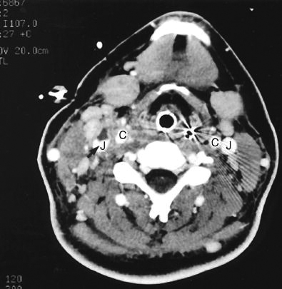
Other Infections
Lemierre’s syndrome
As a complication peritonsillar abscess or post-dental infection
Patient present with sore throat, fever and shock due IJV thrombophlebitis which leads to multiple septic emboli in the lung
Fusobacterium necrophorum
Medical TTT same as deep neck space infection
Venotomy if not respond to medical treatment

