Slide 1
Respiratory Fungal Infections-II
Dr. Ahmed Al-Barrag Asst. Professor of Medical Mycology School of Medicine and the University Hospitals King Saud University

Slide 2
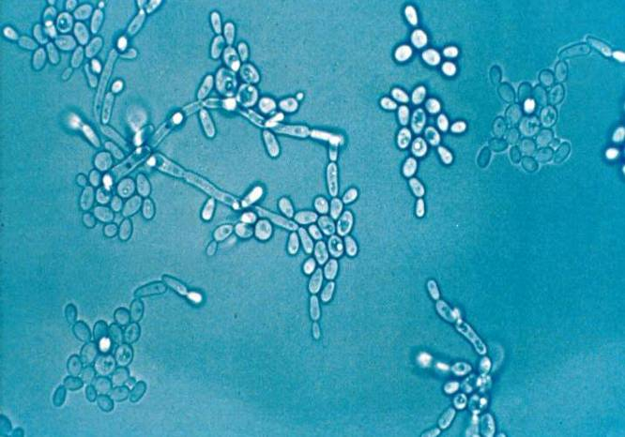
Candidiasis
Candidiasis refer to infection caused by any of the > 160 species of the genus Candida
Etiology: Candida species
Yeasts
Pseudohyphae
Candida albicans is commonly responsible for candidiasis.
Other species include:
Candida glabrata,
Candida tropicalis,
Candida parapsilosis,
Candida krusei

Slide 3
Candida
Part of the endogenous flora:
Skin
Gut
Mucosal surfaces
Most infections are due to person’s own flora
Portal of entry:
Breach in skin or mucosa by catheters, trauma, surgery
Endogenous source for majority of Candida infections
Exogenous transmission?

Slide 4
Candidiasis
High-risk patients
AIDS
Surgery
Malignancy
Burns
Premature infants
Exposures
ICU >7 days
CVCs
Antibiotics
TPN
Colonization

Slide 5
Candidiasis
Disease spectrum
Infections of the skin and nail
Gastrointestinal infections (oral cavity, esophagus)
Infections of genitalia (female)
Urinary tract infection (lower and upper UTIs)
Ocular infections (Keratitis, endophthalmitis)
Candidemia
CNS infection
Deep organ Candidiasis
Pneumonia
Endocarditis
Bone and joint infections
Chronic mucocutaneous candisiasis (CMC) (congenital, immunological defect)

Slide 6
Pulmonary Candidiasis
Primary pneumonia is less common and could be a result of Aspiration
Secondary pneumonia commonly seen with hematogenous candisiasis Immunocompromised patients
Diagnosis:
Isolation of Candida from sputum, BAL is not always significant
Radiology, clinical features
Lung biopsy
Other yeast causing Pulmonary infections
Trichosporon
Geotrichum

Slide 7
Candidemia
Increased colonization (endogenous or exogenous factors)
Damage in host barriers by catheters, trauma, surgery
Immunosuppression
Central venous catheters (CVC)
Disseminated candidiasis (envolment of any organ)
Septic shock
Meningitis
Ocular involvement (retinitis)

Slide 8
Candida- Nosocomial Bloodstream Infections
Candida is the fourth in causing nosocomial bloodstream infections (BSI)
 |  |  | % BSI |  |  | % Crude Mortality
Rank | Pathogen | BSI per 10,000 admissions | Total (n=20,978) | ICU (n=10,515) | Non-ICU (n=10,515) | Total | ICU | Non-ICU
1. | CoNS | 15.8 | 31.3 | 35.9 | 26.6 | 20.7 | 25.7 | 13.8
2. | S aureus | 10.3 | 20.2 | 16.8 | 23.7 | 25.4 | 34.4 | 18.9
3. | Enterococcus spp | 4.8 | 9.4 | 9.8 | 9.0 | 33.9 | 43.0 | 24.0
4. | Candida spp | 4.6 | 9.0 | 10.1 | 7.9 | 39.2 | 47.1 | 29.0
5. | E coli | 2.8 | 5.6 | 3.7 | 7.6 | 22.4 | 33.9 | 16.9
6. | Klebsiella spp | 2.4 | 4.8 | 4.0 | 5.5 | 27.6 | 37.4 | 20.3
7. | P aeruginosa | 2.1 | 4.3 | 4.7 | 3.8 | 38.7 | 47.9 | 27.6
8. | Enterobacter spp | 1.9 | 3.9 | 4.7 | 3.1 | 26.7 | 32.5 | 18.0
9. | Serratia spp | 0.9 | 1.7 | 2.1 | 1.3 | 27.4 | 33.9 | 17.1
10. | A baumannii | 0.6 | 1.3 | 1.6 | 0.9 | 34.0 | 43.4 | 16.3
Wisplinghoff H, et al. Clin Infect Dis. 2004;39:309-317.

Slide 9
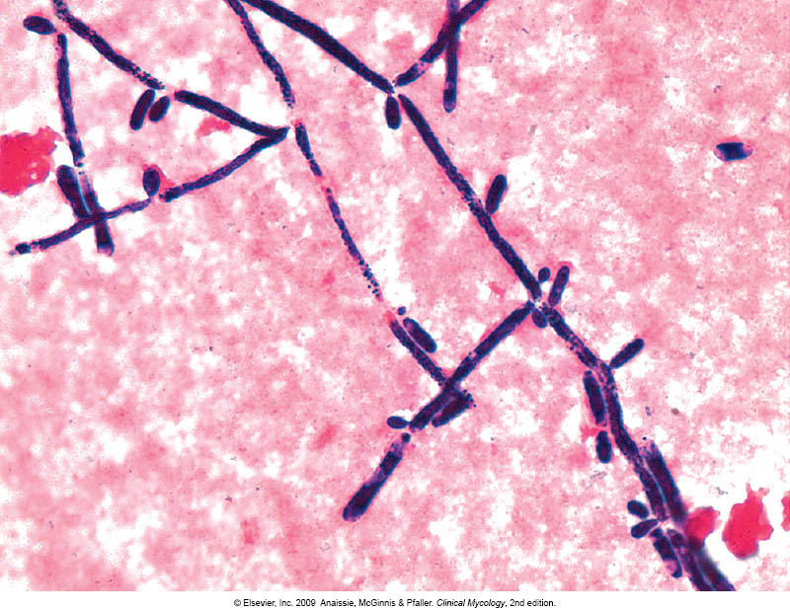
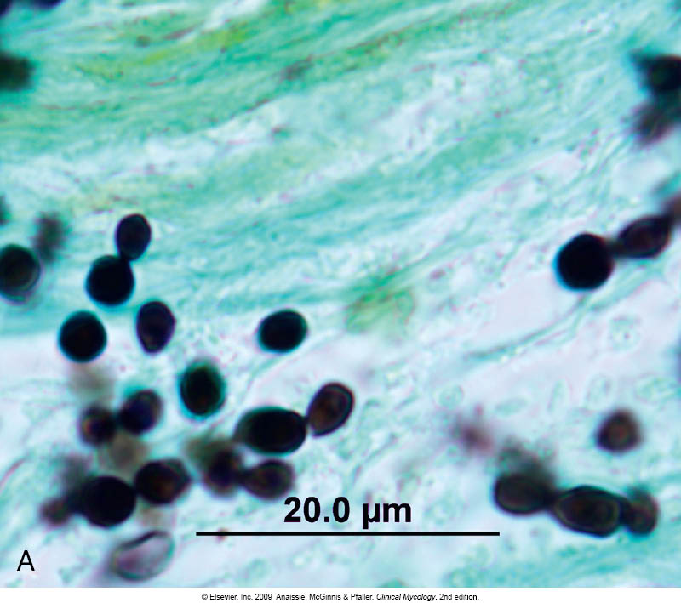
Candidiasis - diagnosis
Laboratory Diagnosis:
Specimen depend on the site of infection.
Swabs, Urine, Blood, Respiratory specimens, CSF, Blood for serology
Direct microscopy :
Gram stain, KOH, Giemsa, GMS, or PAS stained smears.
Budding yeast cells and pseudohyphae will be seen in stained smear or KOH.

Slide 10
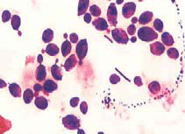
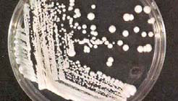
Candidiasis - diagnosis
Culture:
on SDA & Blood agar at 37ºC,
creamy moist colonies in 24 - 48 hours.
Blood culture

Slide 11
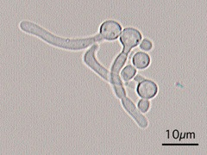
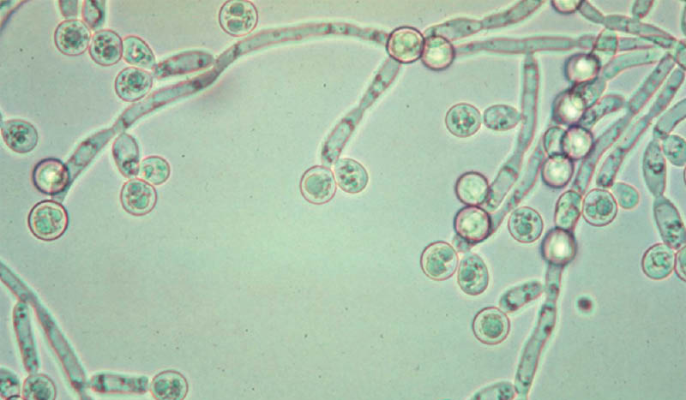
Candidiasis - diagnosis
Because C. albicans is the most common species to cause candidiasis
We do the following tests to identify C. albicans
1. Germ tube test
Formation of germ tube when cultured in serum at 37ᵒC
2. Chlamydospore production in corn meal Agar (CMA)
Germ tube test
3. Resistance to 500 μg/ml Cycloheximide (will grow on Mycobiotic Medium)
If these 3 are positive yeast is C.albicans,
If negative, then it could be any other yeast,
Use Carbohydrate assimilations and fermentation.
Chlamydospores of C. albicans in CMA
commercial kits available for this like: API 20C, API 32C
Culture on Chromogenic Media (CHROMagar™ Candida)

Slide 12
Candidiasis - diagnosis
Serology:
Patient serum
Test for Antigen , e.g. Mannan antigen using ELISA
Test for Antibodies
PCR

Slide 13
Treatment of Candidiasis
Systemic treatment of Candidiasis:
Fluconazole
Voriconazole
Caspofungin
Amphotericin
Candidemia:
Treat for 14 days after last positive culture and resolution of signs and symptoms
Remove all intravascular catheters, if possible

Slide 14
In Vitro Susceptibility of Candida spp.
Antifungal susceptibility testing in not done routinely in the microbiology lab.
Points to consider:
C. glabrata can be less susceptible or resistant to fluconazole
C. krusei is resistant to fluconazole

Slide 15
Pulmonary Cryptococcosis
Causative agent
Cryptococcus neoformans
C. gattii
A typical yeast with a thick capsule
Source of infection
Pigeon or birds droppings & contaminated soil
Pathogenesis
Human infection by inhalation
infections could be asymptomatic
May develop pneumonia, disseminate to CNS causing meningitis (immunological status of the host)

Slide 16
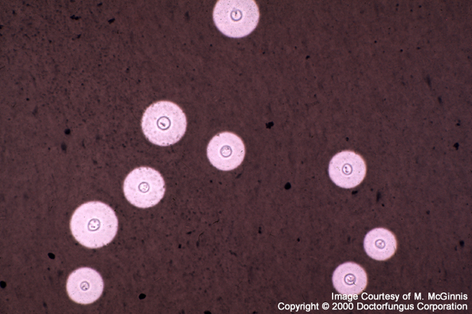
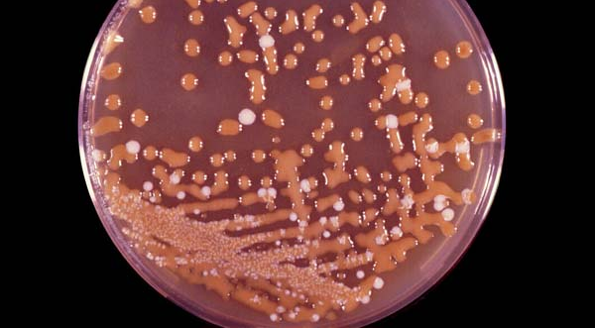
Cryptococcosis
Lab Diagnosis
1. India Ink preparation
Yeast cell with a thick capsule
2. Culture on SDA
Identify using API 20C , Urease +ve
Phenol oxidase +ve
3. Serology :
Capsular Antigen by latex agglutination
excellent sensitivity

Slide 17
Cryptococcosis
Treatment
Systemic fungal agents
Amphotericin B
Combination of Amphotericin B & flucytosine

Slide 18
Pneumocystosis (PCP)
Opportunistic fungal pneumonia
It is interstitial pneumonia of the alveolar area.
Affect compromised host
Especially common in AIDS patients.
Etiology:
Pneumocystis jiroveci
Previously thought to be a protozoan parasite.
It has been proven to be a fungus
Does not grow in laboratory media e.g. SDA
Naturally found in rodents (rats), other animals (goats, horses), Humans contract it during childhood.

Slide 19
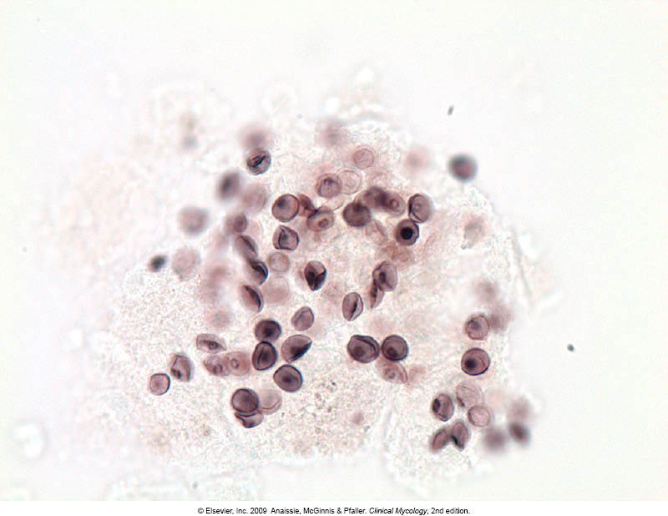
Pneumocystosis
Laboratory Diagnosis:
Patient specimen: Bronchoscopic specimens (B.A.L.), Sputum, Lung biopsy tissue.
Histology sections or smears stained by Silver stain (GMS).
better sensitivity)) Immunuofluorescence
If positive will see cysts of hat-shape, cup shape,
crescent
Treatment: Trimethoprim – sulfamethoxazole

Slide 20
Thank you

