Slide 2
O2 = 21 %
N2 = 79 %
CO2 = Negligible
O2 = 16 %
N2 = 80 %
CO2 = 4 %
Inspired Air
Expired Air
Alveolar Air
O2 = 14 %
N2 = 80 %
CO2 = 6 %
Percentage composition of Gases involved during breathing

Slide 6
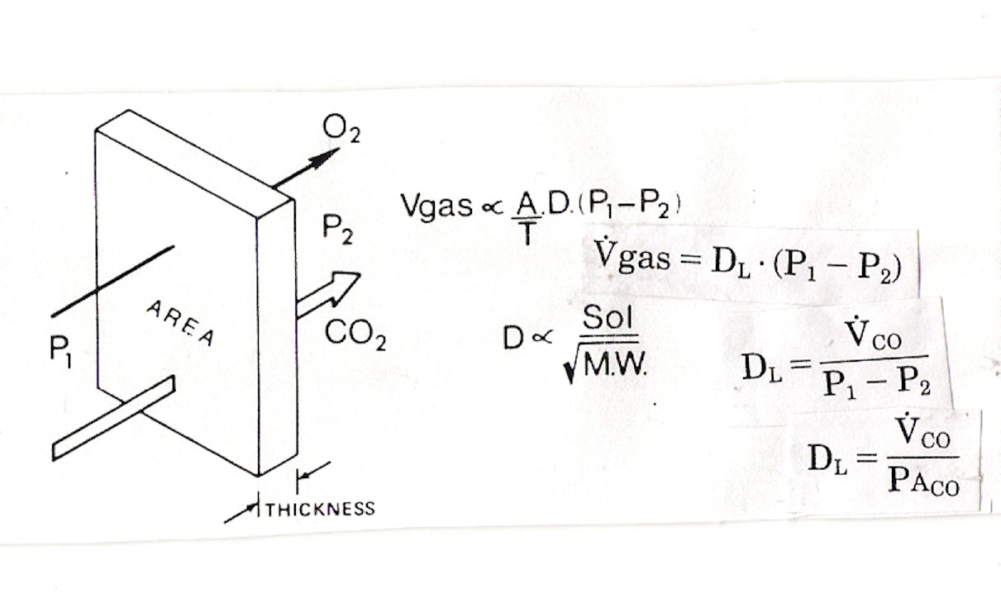

Slide 7
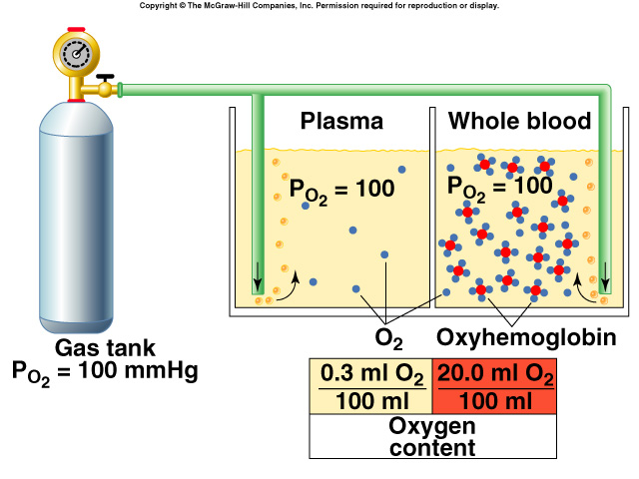
Hemoglobin and 0₂ Transport
280 million hemoglobin/RBC.
Each hemoglobin has 4 polypeptide chains and 4 hemes.
In the center of each heme group is 1 atom of iron that can combine with 1 molecule 0₂.
Insert fig. 16.32

Slide 13
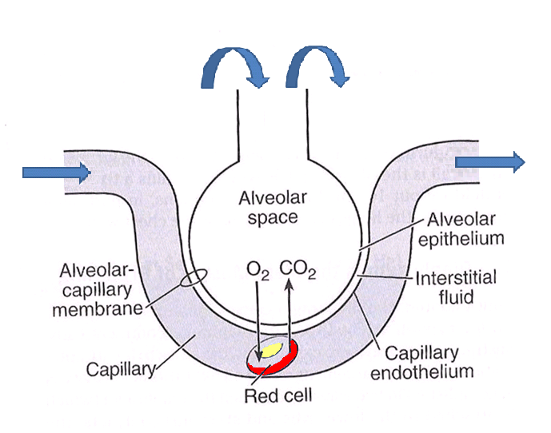
Venous End
Arterial End

