Slide 2
O2 Transport
Prof: Ashraf Husain

Slide 4
Venous end
Arterial end
pCO₂= 46mmHg
pO₂= 40mmHg
pCO₂= 40mmHg
pO₂= 95mmHg
100 mmHg
40 mmHg

Slide 5
O2 = 21 %
N2 = 79 %
CO2 = Negligible
O2 = 16 %
N2 = 80 %
CO2 = 4 %
Inspired Air
Expired Air
Alveolar Air
O2 = 14 %
N2 = 80 %
CO2 = 6 %
Percentage composition of Gases involved during breathing

Slide 6
TISSUE
O₂=37mmHg
CO₂=46mmHg
Arterial End
pO₂= 95mmHg
pCO₂= 40mmHg
% Sat of Hb= 97%
O₂ in plasma=0.3ml
O₂ in RBC= 19ml
Venous End
pO₂= 40mmHg
pCO₂= 46mmHg
% Sat of Hb= 75%
O₂ in plasma=0.12ml
O₂ in RBC= 15ml
O₂=95mmHg
CO₂=40mmHg

Slide 10
Oxyhemoglobin Dissociation Curve
Insert fig.16.34

Slide 11
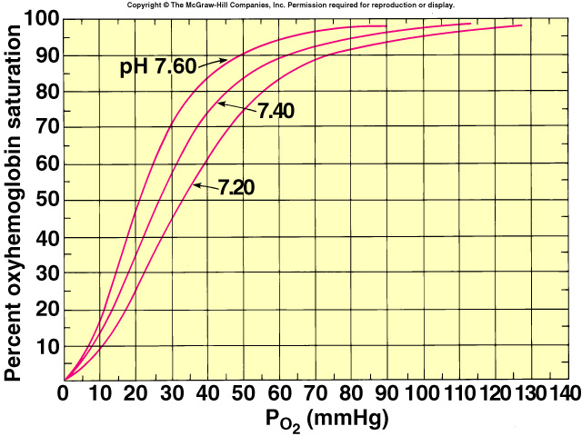
Effects of pH and Temperature
The loading and unloading of O₂ influenced by the affinity of hemoglobin for 0₂.
Affinity is decreased when pH is decreased.
Increased temperature and 2,3-DPG:
Shift the curve to the right.
Insert fig. 16.35

Slide 12
Effect of 2,3 DPG on 0₂ Transport
Anemia:
RBCs total blood [hemoglobin] falls, each RBC produces greater amount of 2,3 DPG.
Since RBCs lack both nuclei and mitochondria, produce ATP through anaerobic metabolism.
Fetal hemoglobin (hemoglobin f):
Has 2 γ-chains in place of the β-chains.
Hemoglobin f cannot bind to 2,3 DPG.
Has a higher affinity for 0₂.

Slide 13
Inherited Defects in Hemoglobin Structure and Function
Sickle-cell anemia:
Hemoglobin S differs in that valine is substituted for glutamic acid on position 6 of the β chains.
Cross links form a “paracrystalline gel” within the RBCs.
Makes the RBCs less flexible and more fragile.
Thalassemia:
Decreased synthesis of α or β chains, increased synthesis of γ chains.

Slide 14
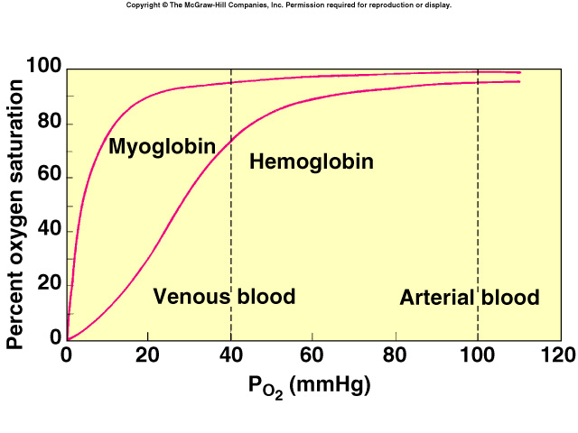
Muscle Myoglobin
Red pigment found exclusively in striated muscle.
Slow-twitch skeletal fibers and cardiac muscle cells are rich in myoglobin.
Have a higher affinity for 0₂ than hemoglobin.
May act as a “go-between” in the transfer of 0₂ from blood to the mitochondria within muscle cells.
Insert fig. 13.37
May also have an 0₂ storage function in
cardiac muscles.

Slide 15
C0₂ Transport
C0₂ transported in the blood:
HC0₃⁻ (70%).
Dissolved C0₂ (10%).
Carbaminohemoglobin (20%).
ca
H₂0 + C0₂ H₂C0₃
High PC0₂

Slide 16
Chloride Shift at Systemic Capillaries
H₂0 + C0₂ H₂C0₃ H⁺ + HC0₃⁻
At the tissues, C0₂ diffuses into the RBC; shifts the reaction to the right.
Increased [HC0₃⁻] produced in RBC:
HC0₃⁻ diffuses into the blood.
RBC becomes more +.
Cl⁻ attracted in (Cl⁻ shift).
H⁺ released buffered by combining with deoxyhemoglobin.
HbC0₂ formed.
Unloading of 0₂.

Slide 17
Carbon Dioxide Transport and Chloride Shift
Insert fig. 16.38

Slide 18
At Pulmonary Capillaries
H₂0 + C0₂ H₂C0₃ H⁺ + HC0₃⁻
At the alveoli, C0₂ diffuses into the alveoli; reaction shifts to the left.
Decreased [HC0₃⁻] in RBC, HC0₃⁻ diffuses into the RBC.
RBC becomes more -.
Cl⁻ diffuses out (reverse Cl⁻ shift).
Deoxyhemoglobin converted to oxyhemoglobin.
Has weak affinity for H⁺.
Gives off HbC0₂.

Slide 19
Reverse Chloride Shift in Lungs
Insert fig. 16.39

Slide 20
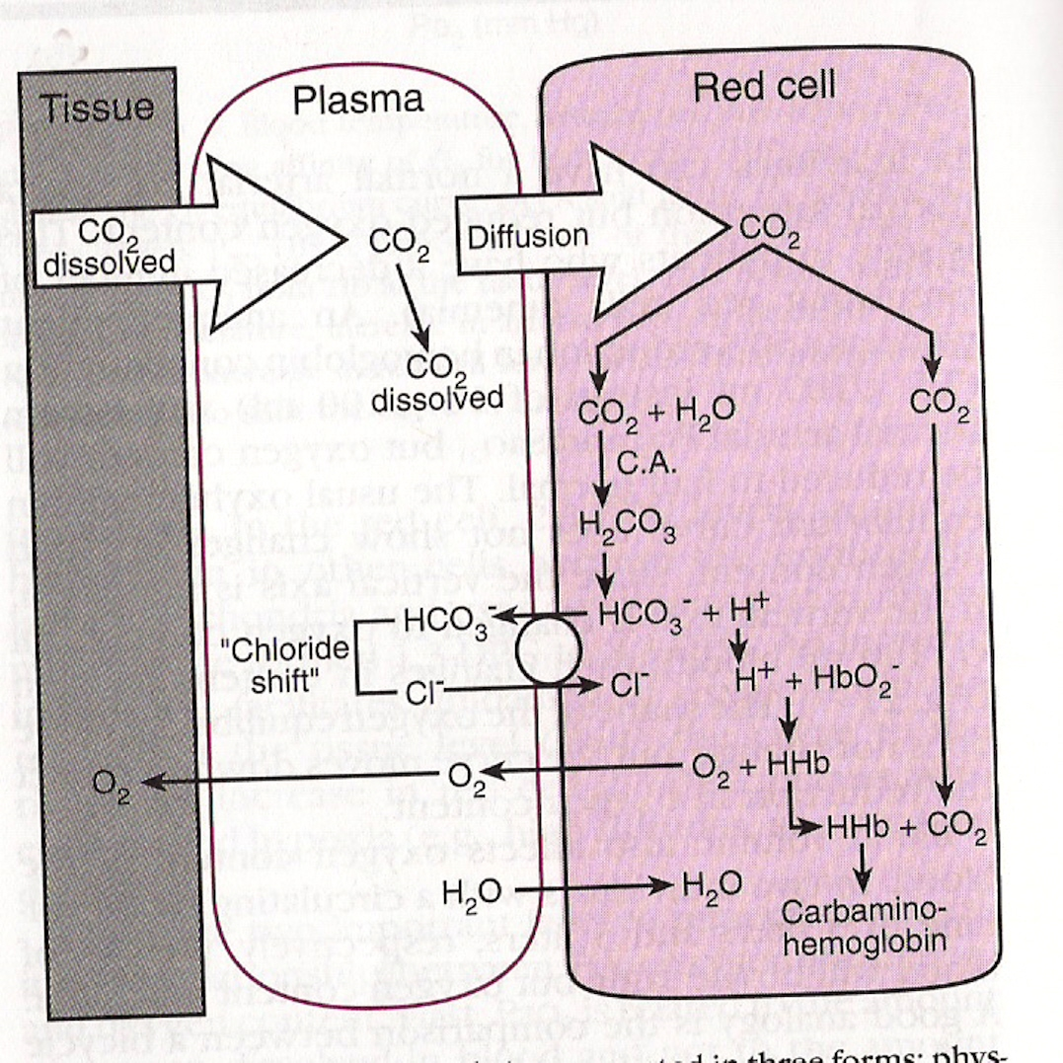

Slide 21
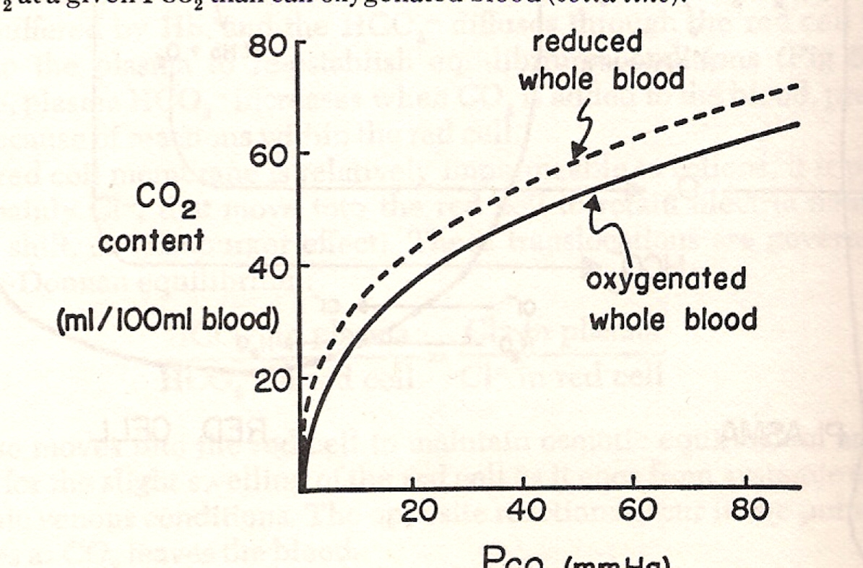

Slide 22
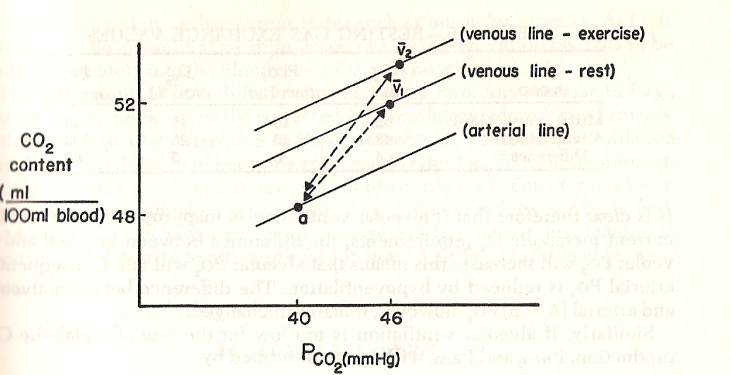

Slide 23
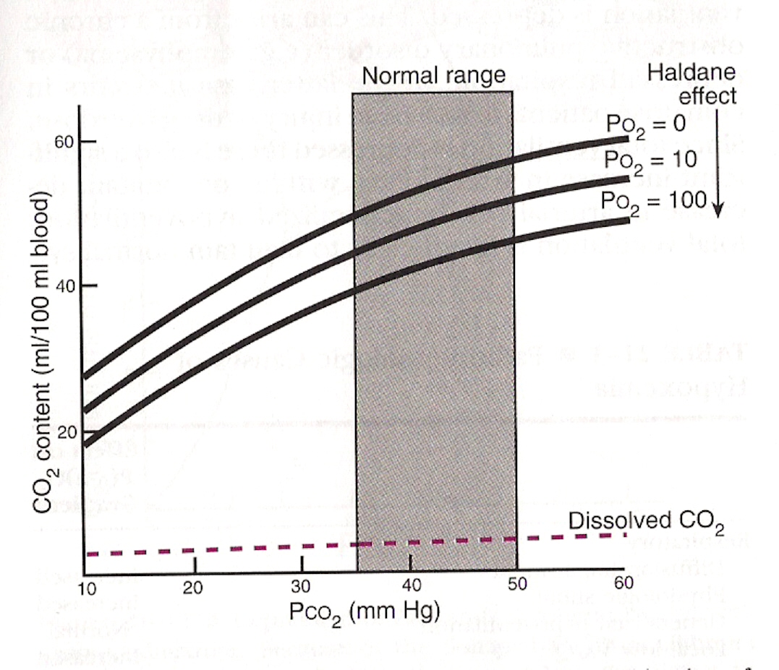

Slide 24
