Slide 1
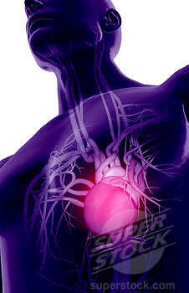
Major Blood Vessels
Khaleel Alyahya, PhD, MEd

Slide 2
Objectives
At the end of the lecture, the student should be able to:
Define the artery and veins, and understand the general principle of the arterial and venous system.
Describe the aorta and its divisions, and list the branches from each part.
Describe the superior & inferior Vena Cava and their tributaries.
List major arteries and their distribution in body.
List major veins and their tributaries in the body.
Describe the Portal Vein.
List main sites of arterial pulsation.
Define arterial anastomosis.
Describe the Portocaval Anastomosis.

Slide 3
General Principles of Arterial Supply
Arteries carry blood away from the heart.
All arteries, carry oxygenated blood
  except the pulmonary and umbilical arteries, which carry deoxygenated blood to the lungs and to the placenta respectively
The flow of blood depends on the pumping action of the heart
There are no valves in the arteries.
The branches of arteries supplying adjacent areas normally
  anastomose with one another freely providing backup routes for blood to flow if one link is blocked.

Slide 4
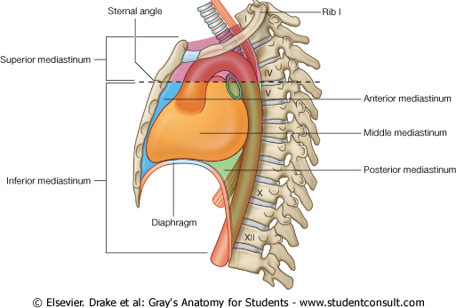
Aorta
It is the largest artery in the body.
Originates from the left ventricle.
It is divided into 4 parts.
It carries oxygenated blood to all parts of the body.

Slide 5
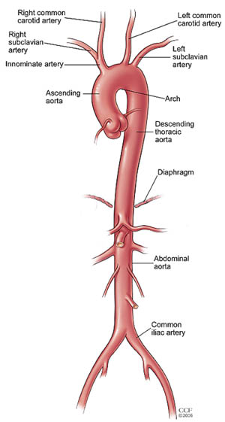
Division of Aorta
Ascending Aorta
Arch of Aorta
Descending
  Thoracic Aorta
  Abdominal Aorta

Slide 6
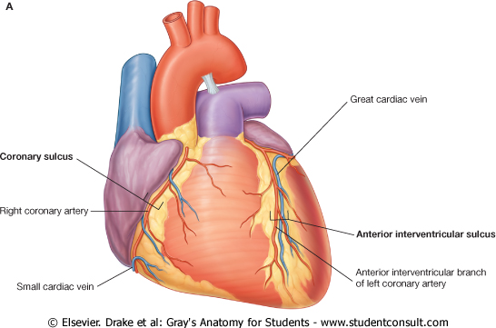
Ascending Aorta
Originates from left ventricle.
Continuous as aortic arch.
Branches:
  Right & Left coronary arteries
    arise from aortic sinuses

Slide 7
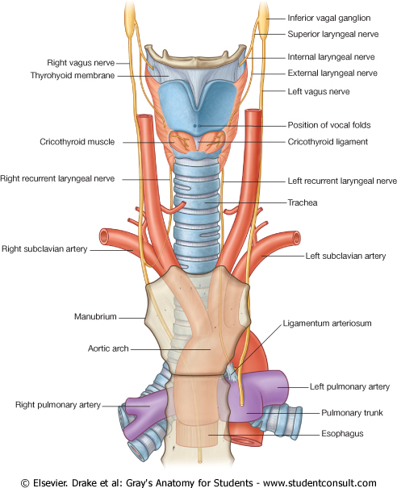
Arch of Aorta
Continuation of the ascending aorta.
Leads to descending thoracic aorta.
Located behind the lower part of manubrium sterni and on the left side of trachea.
Branches:
  Left Subclavian artery
  Left Common Carotid artery
  Brachiocephalic trunk

Slide 8
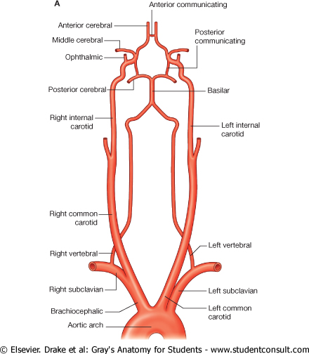
Common Carotid Arteries
The left common carotid arises from aortic arch.
The right common carotid arises from brachiocephalic trunk.
Each common carotid gives two branches:
  Internal carotid
  External carotid

Slide 9
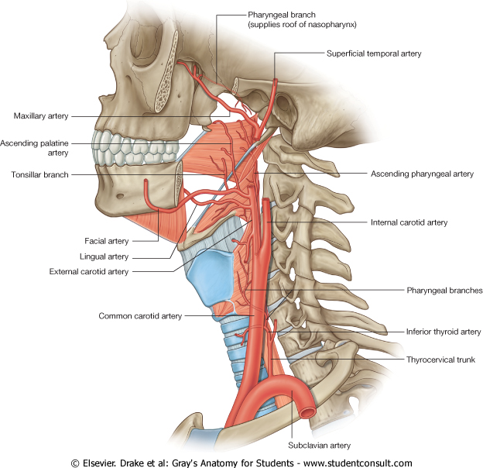
External Carotid Artery
It divides behind neck of the mandible into two 2 terminal branches:
  Superficial temporal
  Maxillary artery
It supplies:
  Scalp: Superficial temporal artery
  Face: Facial artery
  Maxilla: Maxillary artery
  Tongue: Lingual artery
  Glands: Superior thyroid artery

Slide 10
Internal Carotid Artery
Has no branches in the neck and enters the cranial cavity.
It Supplies:
  Brain
  Nose
  Scalp
  Eye

Slide 11
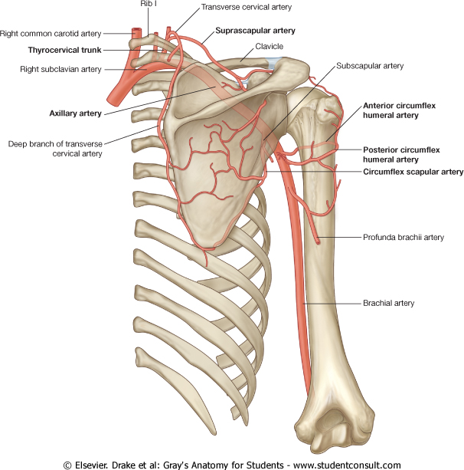
Subclavian Artery
Left subclavian arises from aortic arch
Right subclavian arises from brachiocephalic trunk
Main branches:
  Vertebral artery to supply CNS
  Internal thoracic artery to supply mammary gland & the thoracic wall.
At lateral border of the first rib, it is continuous in the axilla as the Axillary artery
  It is the source of the arterial supply of the upper limb.

Slide 12
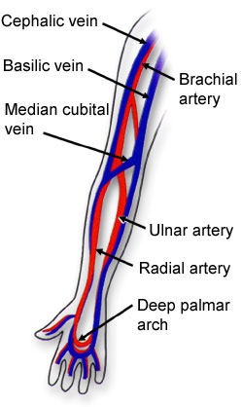
Upper Limb Arteries
Axillary
  It passes through the Axilla.
  It continues in the arm as the Brachial artery.
Brachial
  It descends close to the medial side of the Humerus
  It passes in front of the elbow joint (cubital fossa).
  At the level of neck of radius, it divides into two terminal branches
    Radial
    Ulnar
Ulnar
  The larger terminal branch
Radial
  The smaller terminal branch
Palmar Arches
  superficial & deep Palmar arches are formed by both Ulnar & Radial.

Slide 13
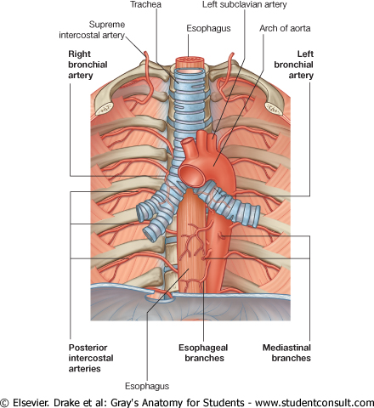
Descending Thoracic Aorta
It is the continuation of aortic arch
At the level of the 12th thoracic vertebra, it is continuous as the abdominal aorta which passes through the Diaphragm
Branches:
  Pericardial
  Esophageal
  Bronchial
  Posterior intercostal

Slide 14
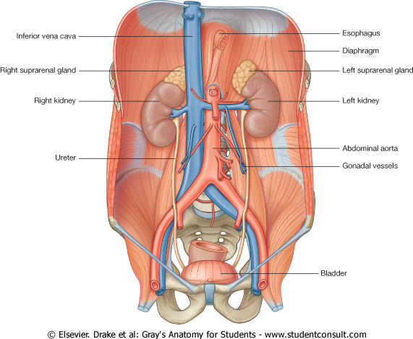
Descending Abdominal Aorta
It enters the abdomen through the aortic opening of diaphragm.
At the level of L4, it divides into two common Iliac arteries.
Branches:
  They are divide into single and paired branches.

Slide 15
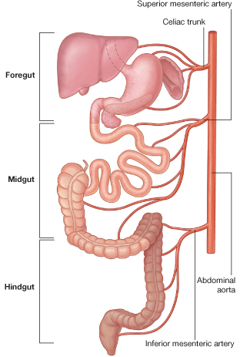
Single Branches
Celiac Trunk
    Left Gastric artery
      Stomach
    Hepatic artery
      Liver & Pancreas
    Splenic artery
      Spleen
Superior Mesenteric Artery
    Pancreas
    Small Intestine
      Duodenum, Jejunum & Ileum
    Large Intestine
    Right 2/3 of Transverse Colon
Inferior Mesenteric Artery
    Large Intestine
      left 1/3 of transverse colon & descending colon
    Rectum & Anal Canal

Slide 16
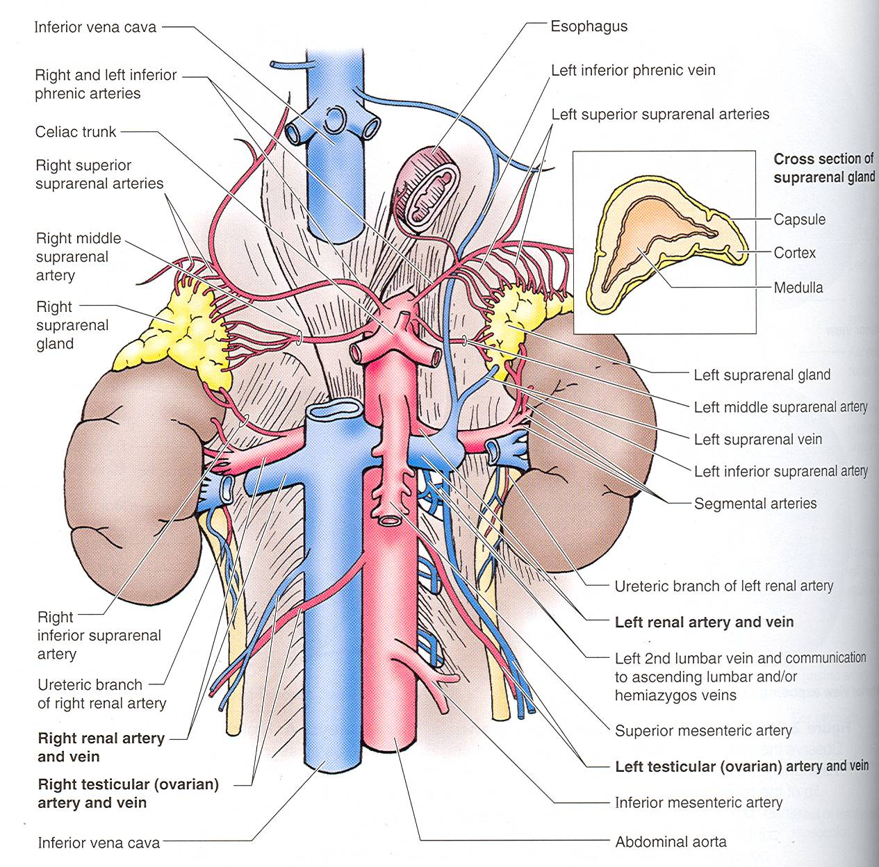
Paired Branches
Testicular or Ovarian
Renal
Suprarenal
Common Iliac

Slide 17
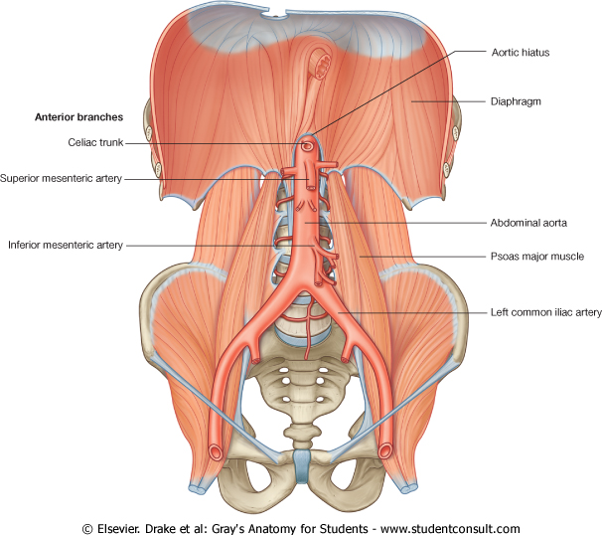
Common Iliac Artery
The Abdominal Aorta terminates, at the level of the 4th lumbar vertebra, into two common iliac arteries:
  Right & Left
Each divides into external & internal iliac arteries
  External supplies Lower Limb
  Internal supplies Pelvis

Slide 18
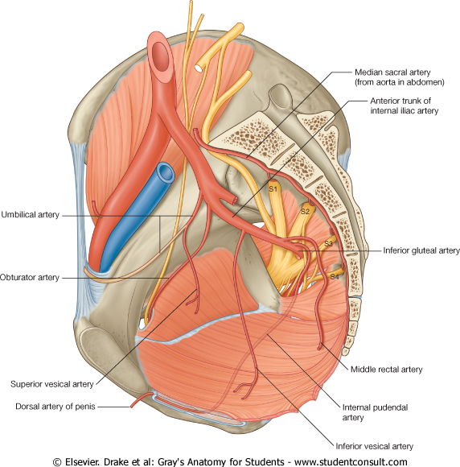
Internal Iliac Artery
Supplies:
  Uterus
  Vagina
  Pelvic Walls
  Perineum
  Rectum & Anal Canal
  Urinary Bladder

Slide 19
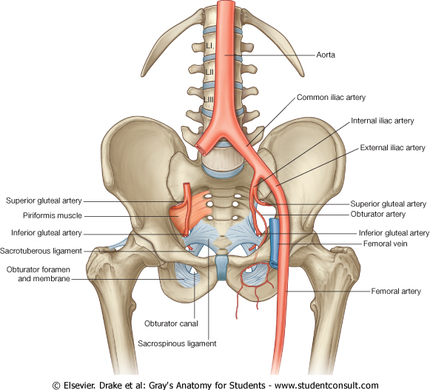
External Iliac Artery
The Source of arterial supply to the lower limb
Deep to the Inguinal Ligament it become the femoral artery

Slide 20
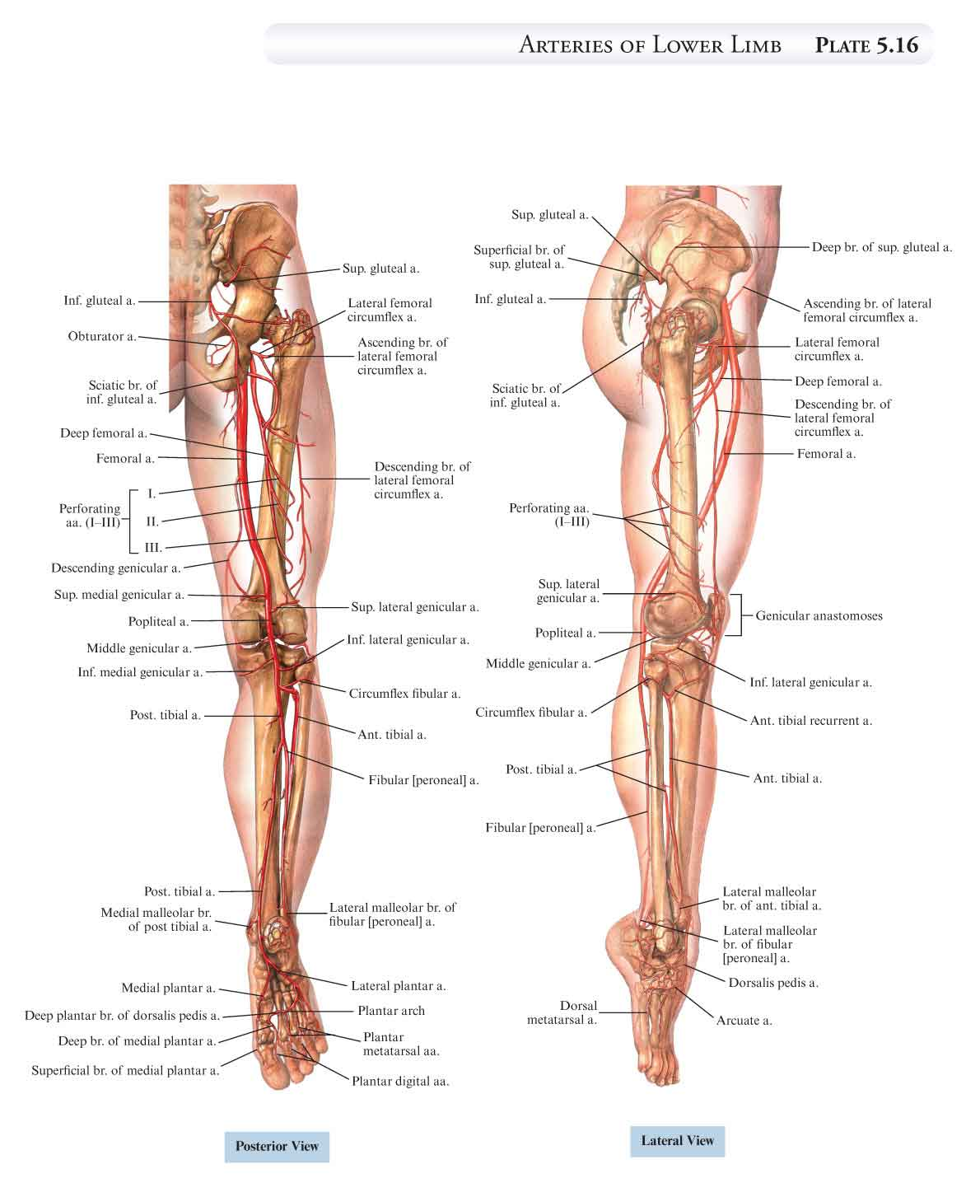
Arteries of Lower Limb
Femoral artery
Popliteal artery
Anterior tibial artery
Posterior tibial artery
Dorsalis pedis artery
Medial & Lateral planter arteries

Slide 21
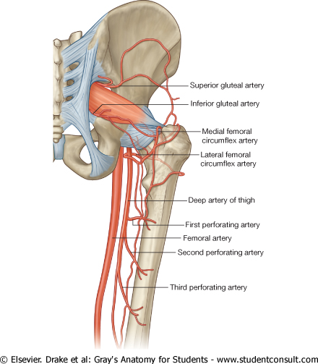
Arteries of Lower Limb
Femoral Artery
  Is main arterial supply to lower limb
  Enters the thigh behind the inguinal ligament
  It lies in a sheath with the femoral vein in the anterior components
  Ends at the lower end of the femur by entering the popliteal fossa.
Popliteal Artery
  Deeply placed in the Popliteal Fossa.
  It divides into Anterior & posterior tibial arteries.
Anterior Tibial Artery
  It is the smaller terminal branch
  It continues to the dorsum of foot as the Dorsalis Pedis artery
Posterior Tibial Artery
  It terminates by dividing into Medial & Lateral Planter arteries to supply the sole of the foot.

Slide 22
Arterial Anastomosis
Anastomosis is the connection of two structures.
Arterial anastomosis is the joining of branches of arteries supplying adjacent areas
What is the main reason for having an arterial anastomosis?
  To have multiple supply to a region (so in case one artery is blocked, the distal region is still perfused)

Slide 23
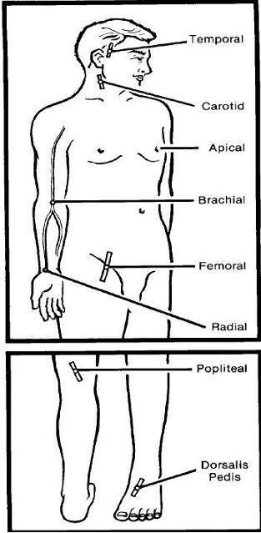
Sites for Arterial Pulsation (FYI)
Superficial Temporal Pulse in front of the ear.
Facial Pulse at the lower border of the mandible.
Carotid Pulse at the upper border of thyroid cartilage
Subclavian Pulse as it crosses the 1st rib
Radial Pulse in front of the distal end of the radius
Femoral artery midway between Anterior Superior Iliac spine & symphysis pubis
Popliteal artery in the depths of popliteal fossa
Dorsalis Pedis artery in front of ankle (between the 2 malleoli)

Slide 24
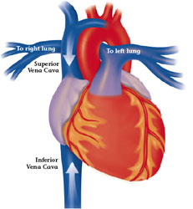
Veins
Veins are blood vessels that bring blood back to the heart.
All veins carry deoxygenated blood
  with the exception of the pulmonary veins and umbilical veins
There are two types of veins:
  Superficial veins: close to the surface of the body
    NO corresponding arteries
  Deep veins: found deeper in the body
    With corresponding arteries
Veins of the systemic circulation:
  Superior and inferior vena cava with their tributaries
Veins of the portal circulation:
  Portal vein

Slide 25
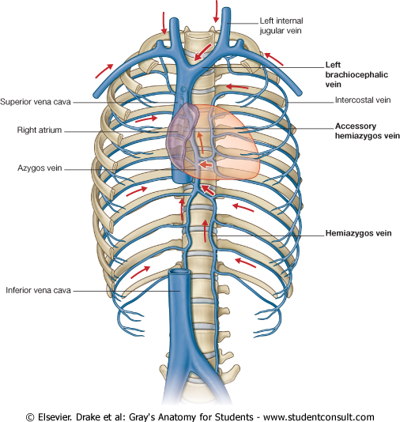
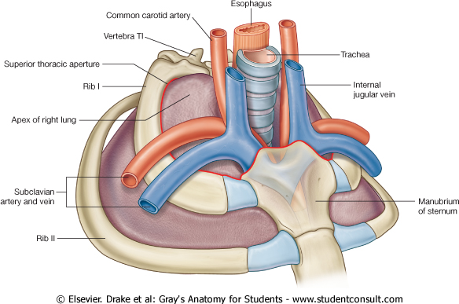
Superior Vena Cava
Formed by the union of the right and left Brachiocephalic veins.
  Brachiocephalic veins are formed by the union of internal jugular and subclavian veins.
Drains venous blood from:
  Head &neck
  Thoracic wall
  Upper limbs
It Passes downward and enter the right atrium.
Receives azygos vein on the posterior aspect just before it enters the heart.

Slide 26
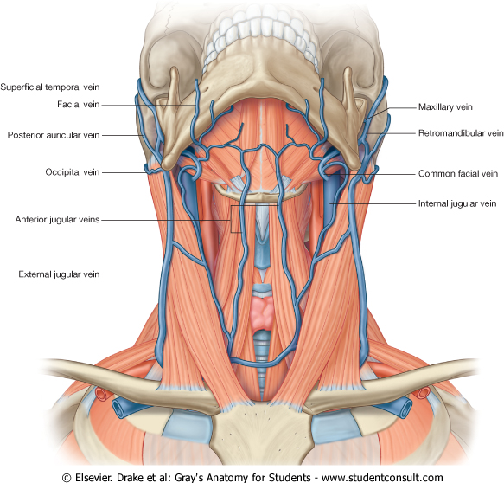
Veins of Head & Neck
Two divisions:
  Superficial Veins
    External Jugular veins
    Anterior jugular veins
  Deep Veins
    Internal Jugulars veins.

Slide 27
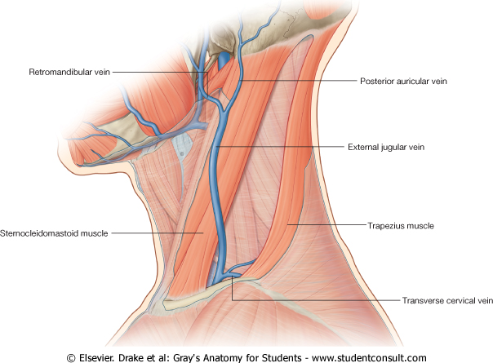
Superficial Veins of Head & Neck
External Jugular Veins:
  Lies superficial to the sternomastoid muscle
  It passes down the neck and it is the only tributary of the subclavian vein.
  It drains blood from:
    Outside of the skull
    Deep parts of the face.

Slide 28
Superficial Veins of Head & Neck
Anterior jugular veins:
  It begins in the upper part of the neck by the union of the submental veins.
  It descends close to the median line of the neck, medial to the sternomastoid muscle.
  At the lower part of the neck, it passes laterally beneath that muscle to drain into the external jugular vein.
  Just above the sternum the two anterior jugular veins communicate by a transverse vein to form the jugular arch.

Slide 29
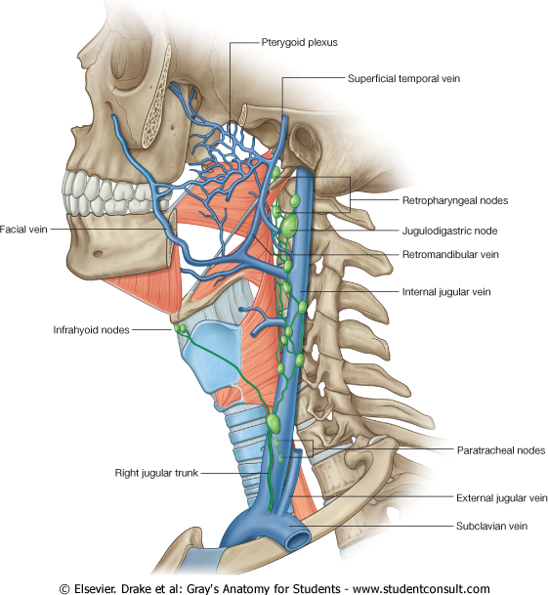
Deep Veins of Head & Neck
Internal Jugulars vein:
  Drains blood from the head, brain, face & neck.
  It descends in the neck along with the internal and common carotid arteries and vagus nerve, within the carotid sheath.
  Joins the subclavian vein to form the brachiocephalic vein.
  Tributaries:
    Superior thyroid
    Lingual
    Facial
    Occipital veins
    Dural venous sinuses

Slide 30
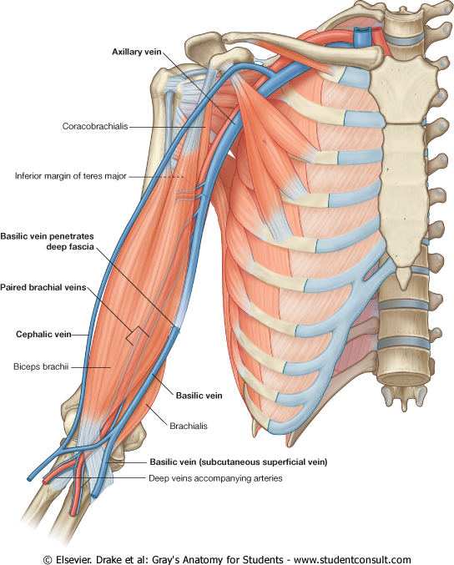
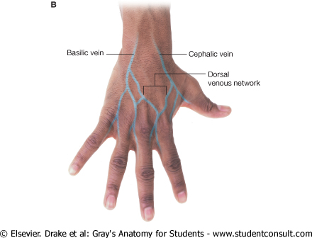
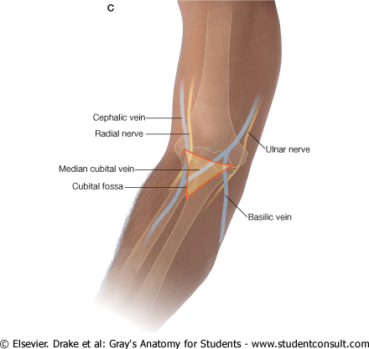
Veins of Upper Limbs
Two divisions:
  Superficial Veins
  Deep Veins

Slide 31
Veins of Upper Limbs
  Superficial Veins
  Cephalic vein
    Ascends in the superficial fascia on the lateral side of the biceps.
    Drains into the Axillary vein.
  Basilic vein
    Ascends in the superficial fascia on the medial side of the biceps.
    Halfway up the arm, it pierces the deep fascia
    At the lower border of the teres major it joins the venae comitantes of the brachial artery to form the Axillary vein.

Slide 32
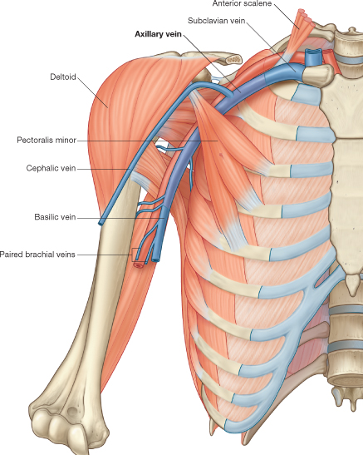
Veins of Upper Limbs
  Deep Veins
  Venae commitantes
    Which accompany all the large arteries, usually in pairs.
  Axillary vein
    Formed by the union of basilic vein and the venae comitantes of the brachial artery.

Slide 33
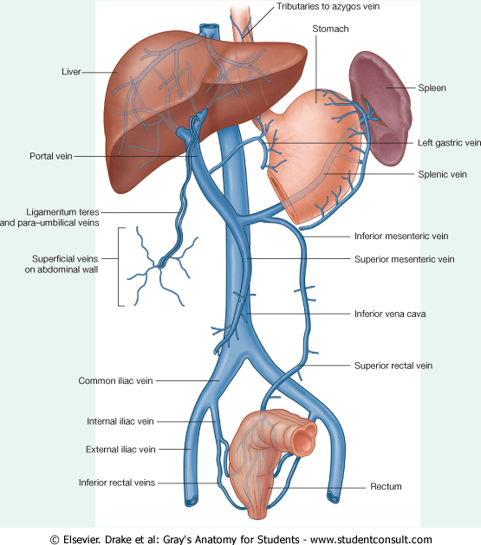
Inferior Vena Cava
Drains most of the blood from the body below the diaphragm to the right atrium.
Formed by the union of the 2 common iliac veins behind the right common iliac artery at the level of the 5th lumbar vertebra.
Ascends on the right side of the aorta
Pierces the central tendon of diaphragm at the level of the 8th thoracic vertebra.

Slide 34
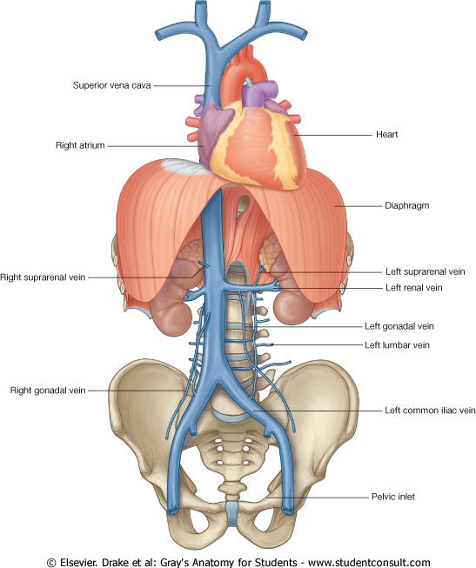
Tributaries of Inferior Vena Cava
Two common iliac veins
Median sacral vein
Four paired lumbar veins
Right gonadal vein
  the left vein drains into the left renal vein
Paired renal veins
Right suprarenal vein
  the left vein drains into the left renal vein
Hepatic veins
Paired inferior phrenic vein

Slide 35
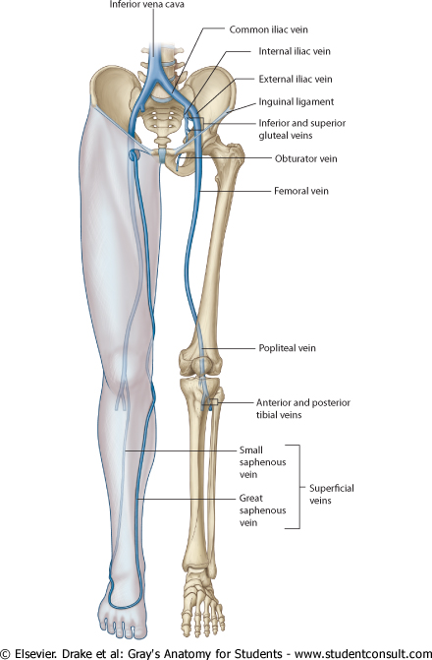
Veins of Lower Limbs
Two divisions:
  Superficial Veins
  Deep Veins

Slide 36
Veins of Lower Limbs
  Superficial Veins
  Form a network in the subcutaneous tissue
  Pattern is variable
  They are the tributaries of the:
    Great (long) saphenous vein
    Small (short) saphenous vein

Slide 37
Great Saphenous Vein
  The longest vein
  Begins from the medial end of the dorsal venous arch of the foot.
  Ascends obliquely upwards, and passes behind the knee and curves forward around the medial side of the thigh to join the femoral vein.
It is connected to the small saphenous vein by one or two branches that pass behind the knee.

Slide 38
Small Saphenous Vein
Arises from the lateral end of the dorsal venous arch.
Follows the lateral border of the tendocalcaneus and then runs up to the middle of the back of the leg.
  Pierces the deep fascia in the lower part of the popliteal fossa
  Drains into the popliteal vein
  Has numerous valves along its course.

Slide 39
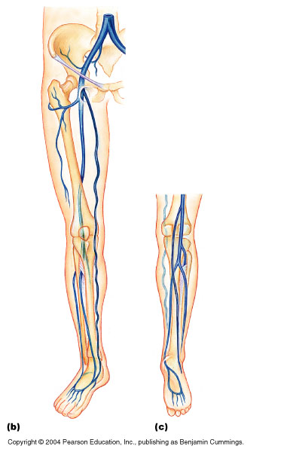
Veins of Lower Limbs
  Deep Veins
  Comprise the venae comitantes, which accompany all the small arteries, usually in pairs.
  Venae comitantes unite to form the popliteal vein, which continues as the femoral vein.
  Receive blood from superficial veins through perforating veins.
External iliac
vein
Femoral vein
Popliteal vein

Slide 40
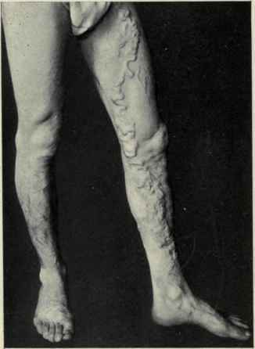
Mechanism of Venous Return from Lower Limb (FYI)
Much of the saphenous blood passes from superficial to deep veins through the perforating veins
The blood is pumped upwards in the deep veins by the contraction of the calf muscles (calf pump).
This action of ‘calf pump’ is assisted by the tight sleeve of deep fascia surrounding these muscles.
Vericose veins: If the valves in the perforating veins become incompetent, the direction of blood flow is reversed and the veins become varicosed. Most common in posterior & medial parts of the lower limb, particularly in old people.

Slide 41
Hepatic Portal Vein
Drains blood from the gastrointestinal tract and spleen
It is formed by the union of the superior mesenteric and splenic veins.
Immediately before reaching the liver, the portal vein divides into right and left that enter the liver.
Tributaries: Gastric and cystic veins

Slide 42
Portocaval Anastomosis
A portacaval anastomosis (also known as portal systemic anastomosis) is a specific type of anastomosis that occurs between the veins of portal circulation and those of systemic circulation.
The anastomotic channels become dilated (varicosed) in case of portal hypertension.

Slide 43
Sites of Portocaval Anastomosis (FYI)
Lower end of esophagus: left gastric vein & azygos vein
Lower part of rectum: (Hemorrhoids) superior and middle rectal veins & inferior rectal vein
Para umbilical region: (Caput Medusae) Para umbilical veins & superficial epigastric vein
Retroperitoneal: Veins draining colon & veins of the posterior abdominal wall
Patent ductus venosus:
Left branch of portal vein & inferior vena cava.

Slide 44

QUESTION?

