Slide 1
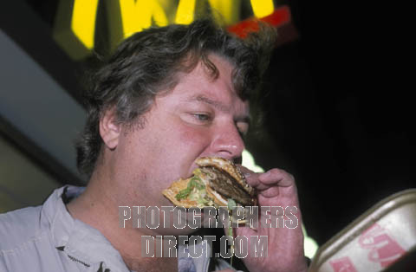

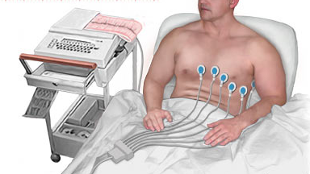

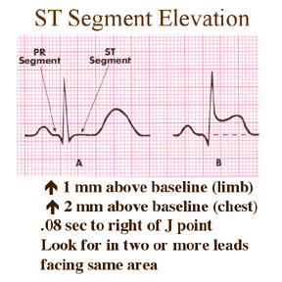

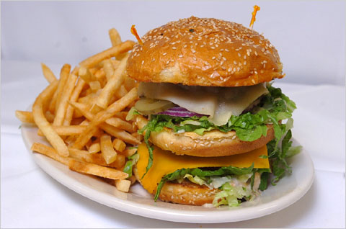
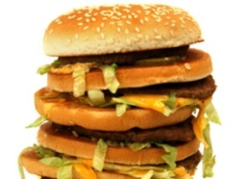
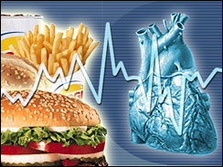



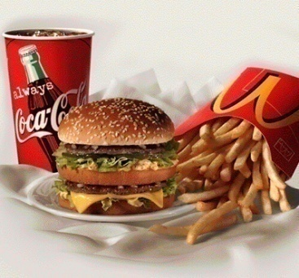



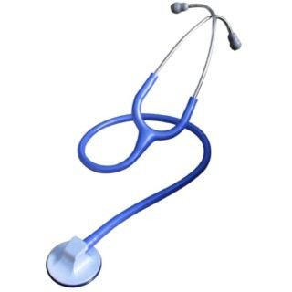
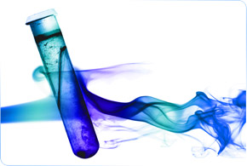
?
?
AMI
HEART ATTACK

Slide 2
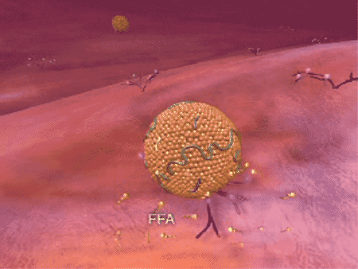
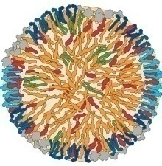
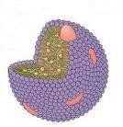

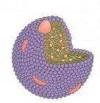
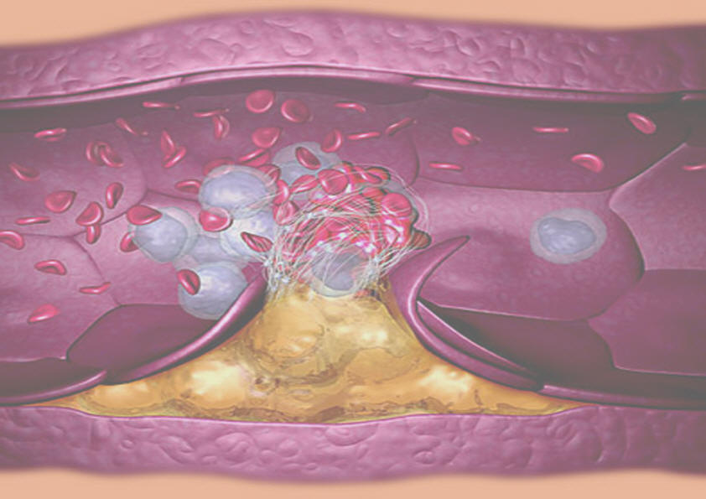
DRUGS IN HYPERLIPIDEMIA

Slide 3
DRUGS IN HYPERLIPIDEMIA
ILOs
By the end of those 2 lectures [23 slides for studing]
you will be able to:
Define hyperlipidemia vs normal lipid levels
Revise the cascade of lipoprotein remodeling, stressing on peripheral TGs
utilization and cholesetrol influx & outflux.
Relate such variables to the development & progression of atherogenesis
Classify lipid lowering agents targeting exogenous & endogenous pathways
Expand on the pharmacology of drugs related to each group and relate that
to their clinical relevance alone or in combinations
Hint on adjuvant drugs that can help in lipid lowering
Sum up the therapeutic approach attempting to target hyperlipidemia from
quantitative, qualitative and vasculo-protective perspectives

Slide 4
HYPERLIPIDEMIA ???
Is the most common form of dyslipidemia
Denotes abnormallyLEVELS of any or all LIPIDS &/or LIPOPROTEINS [LP] in blood
NORMAL Levels
TGs & C
TGs  < 220 mg/dl
C  < 200 mg/dl
LDL  < 130 mg/dl
HDL  > 50 mg/dl
Hypertriglyceridemia
Hyper-cholesterolemia
Mixed
If Above  Hyperlipidemia
◉
Familial Hyperlipoproteinemia
CM, VLDL, IDL, LDL, HDL
Hyperlipoprotienemia
* Denotes usually  LDL
* Unless specified in the
familial types
LProteinemia | LP | Lipids | Risk
Type I | CM | TGs | -
Type IIa | LDL | C | 
Type IIb | VLDL & LDL | TG & C | 
Type III | IDL | TGs & C | 
Type IV | VLDL | TGs | 
Type V | VLDL & CM | TGs & C | _

Slide 5
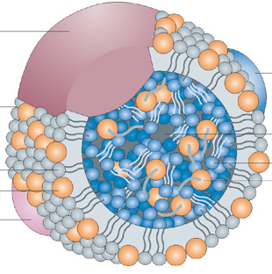
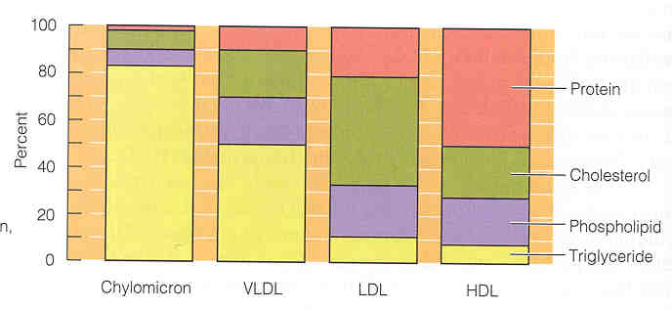
LP
Chylomicrons
[CM]
Very low Density lipoprotein
[VLDL]
Low Density lipoprotein
[LDL]
High Density lipoproteins
[HDL]
APOPROTEINS
OUTER Coat
INNER Core
Phospholipids Cholesterol
Triglycerides
Cholesterol esters
Hydrophilic Gps.
Lipophylic Gps.
% Lipid
Composition
C
TGs
Protein
Triglycerides
Cholesterol
Phospholipids

Slide 6
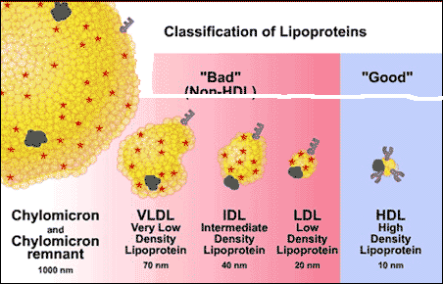
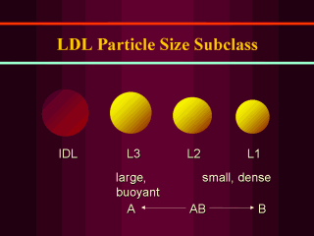
LP
Chylomicrons
[CM]
Very low Density lipoprotein
[VLDL]
Low Density lipoprotein
[LDL]
High Density lipoproteins
[HDL]
[IDL]
DENSITY
TYPE of
Apoprotein
B 48
B100
AI&II
Beta LP
Alpha LP
Non-HDL Cholesterol
HDL Cholesterol
ATHEROGENIC
ATHEROPROTECTIVE
?

Slide 7
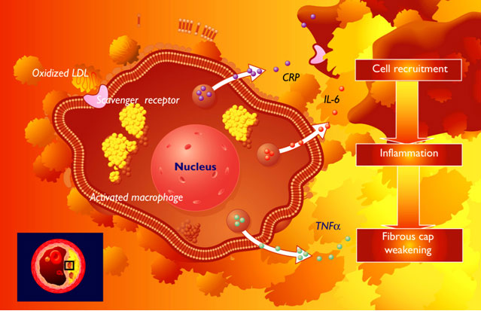
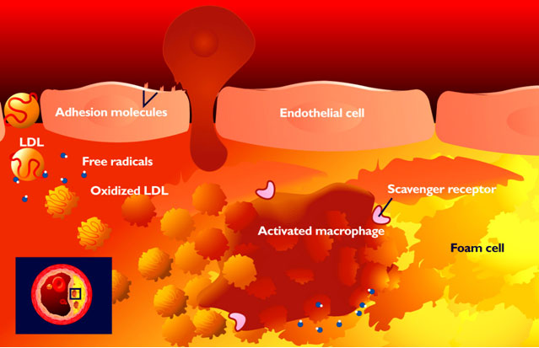
THE STORY OF ATHEROGENESIS
Begins as INFLAMMATORY REACTION triggered by;
Endothelial dysfunction + Dyslipidemia
Rolling
Scrolling
LDL leak
MC
Diapedesis
Expression
Dysfunction
Trapping
SR-A
Engulf Ox -LDL
No efflux
SR-A

Slide 8
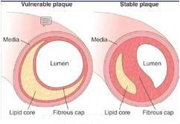
THE STORY OF ATHEROGENESIS
Progress as FIBRO-PROLIFERATIVE DISORDER
Fibrous cap
Lumen
Lipid
Core
Shoulder
Atheromatus Plaque
Rapidity of lipid accumulation & apoptosis
Intima
Proliferative (fibrous) vs Inflammatory (proteolysis)
Media
Elastic
laminæ
Internal
External
Divide into
> Lipid core
< fibrous cap (thin)
> Inflammatory cells

Slide 9
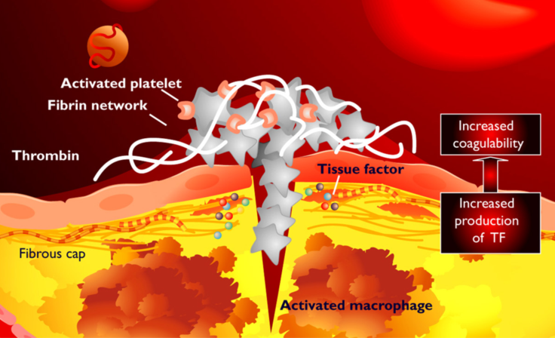
THE STORY OF ATHEROGENESIS
Switch into ATHER-THROMBOTIC INSULT at any stage of progression
= ACSs, Stroke, …etc.

Slide 10
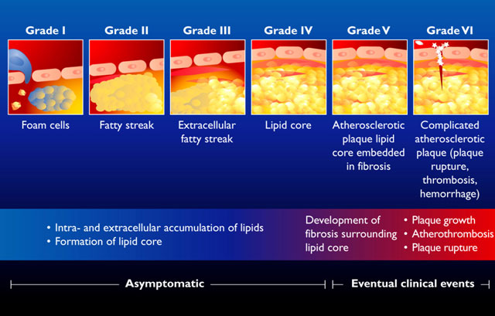
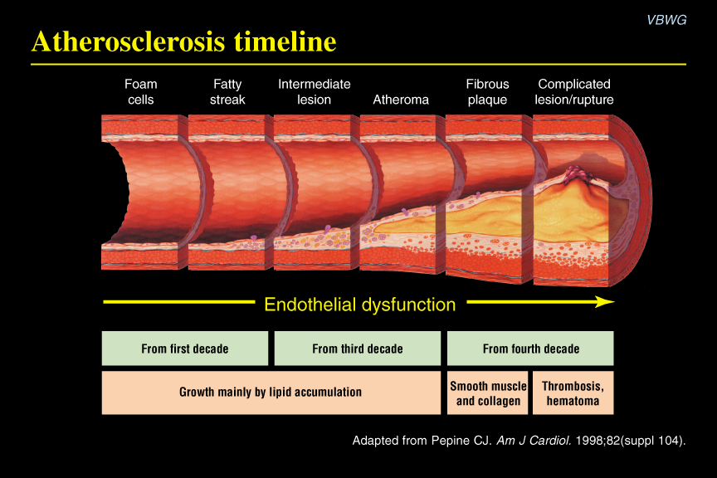
ATHEROGENESIS PROGRESSION ALONG AGE

Slide 11
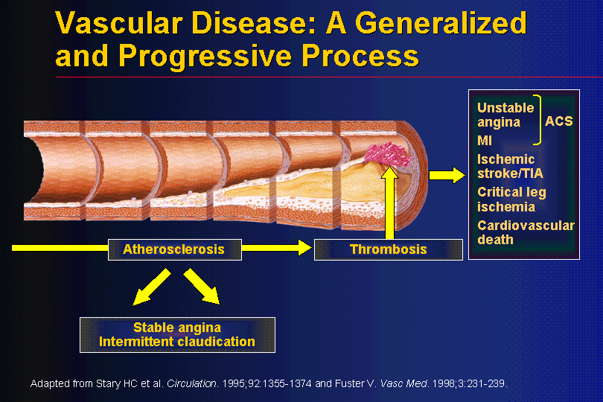
ATHEROGENESIS & CLINICAL EVENTS
DYSLIPEDEMIA
ENDOTHELIAL DYSFUNCTION
MORBIDITY & MORTALITY OUTCOMES
PREVENTED or DECREASED
By CONTROLLING DYSLIPIDYMIA

Slide 12
THERAPEUTIC STRATEGIES FOR TREATMENT OF HYPERLIPIDEMIA
THERAPEUTIC LIFESTYLE CHANGES
ANTIHYPERLIPIDEMIC AGENTS
1. Healthy diet; optimal Quantitative & Qualitative fat content:
Diet has <30% of calories as fat, <7% as saturated fat and <200mg cholesterol/day
Avoid trans-fatty acids & acute increase in CHO intake
Use better vegetable oils rich in unsaturated fatty acids: oleic acid, linoleic acid &
linolenic acids. Diet should also contain plant stanols or sterols & soluble fibers.
Eat food high in antioxidants vitamins
2.Regular exercise
3.Cessation of hazards habits; smoking, alcohol, …etc
4. Weight loss
Can achieve a fall in LDL-C of 8-15% … but long-term compliance is a problem

Slide 13
THERAPEUTIC STRATEGIES FOR TREATMENT OF HYPERLIPIDEMIA
THERAPEUTIC LIFESTYLE CHANGES
ANTIHYPERLIPIDEMIC AGENTS
1-Inhibits cholesterol absorption in the intestine
Ezetimibe
2-Sequester bile acids in the intestine
Exchange resins
3-Inhibits synthesis of cholesterol
Inhibitors of hydroxymethylglutaryl coenzyme A reductase (HMG-COA Reductase)
4-Alter relative levels & patterns of different plasma LPs
Fibrates, Nicotinic acids
ADJUVANT AGENTS
Omega-3-Fatty Acids, Stanols

Slide 14
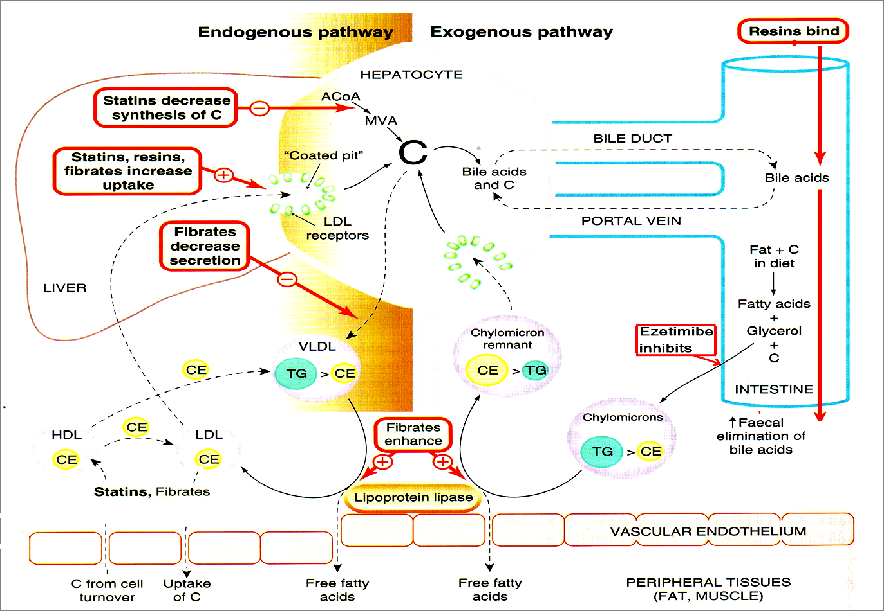
TARGETING ENDOGENOUS PATHWAYS
TARGETING EXOGENOUS PATHWAYS
Improve endothelial function

Slide 15
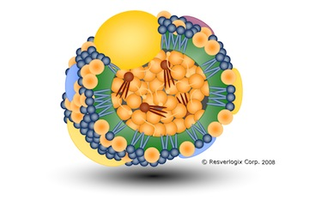

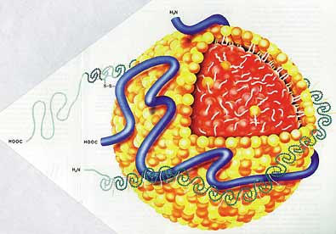
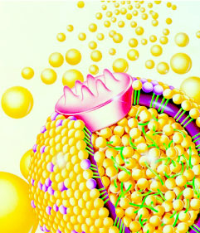
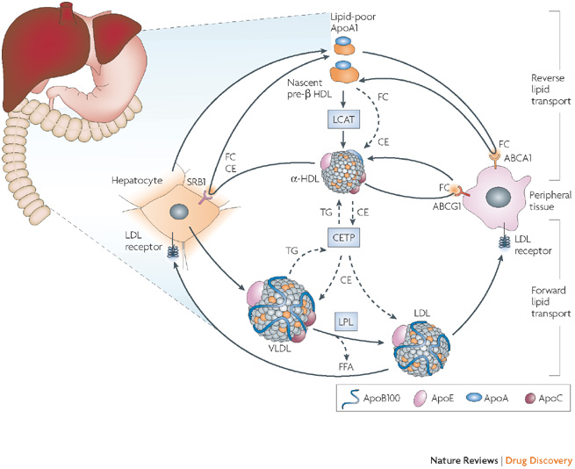
TARGETING EXOGENOUS PATHWAYS

Slide 16
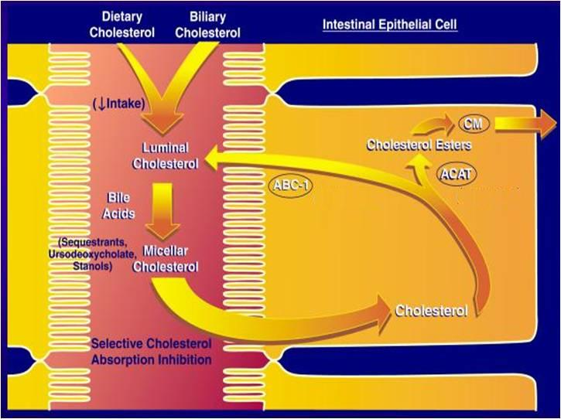
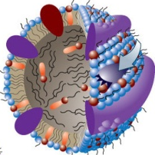
TARGETING EXOGENOUS PATHWAYS
1. Inhibition of Cholesterol Absorption in Intestine
Selective C Transporter Inhibitors; Ezetimibe
2. Sequester Bile Acids in Intestine
Sequestrants;
Colestipol, Colesevelam
& Cholestyramine
SEQUESTRANTS
NPC1L1
SELECTIVE CHOLESTEROL TRANSPORTER INHIBITORS

Slide 17
EZETIMIBE
Is a selective C absorption inhibitor
Mechanism
Blocks sterol transporter (NPC1L1) located on brush border of small intestine that is responsible for C translocation inside entrocytes to be esterified & incorporated in CMs  pool of cholesterol available to the liver upregulate LDL receptor, trapping more LDL particles from blood.
Pharmacological action
LDL 20% 54% of intestinal cholesterol + phytosterol absorption are blocked
◉ TG 8% ,  HDL 1-4% no effect on steroids, lipid-soluble vitamins, bile a.
Pharmacokinetics
Absorbed & conjugated in intestine to active glucuronide (> potent )
Reaches peak blood level in 12–14 hours
Its half-life is 22 hours
Undergoes enterohepatic circulation (prolong action of drug)
80% of the drug is excreted in feces
N.B. Drug level if with statins &  if with cholystyramine

Slide 18
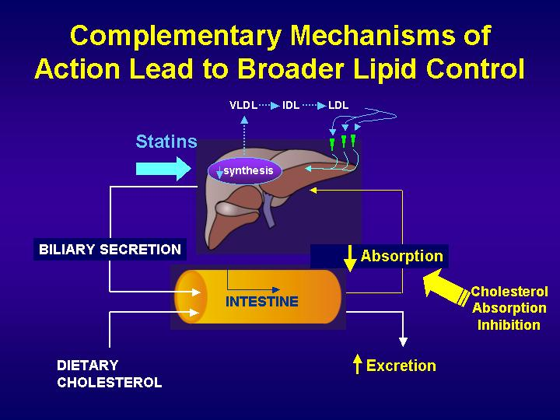
Indications
As Monotherapy;
Pry prevention of low risk of CHD i.e. need modestLDL
Statin-intolerant patients
As Combination Therapy; safe
With statins; synergistic
In moderate/severe  LDL
Or If must  statin dose because of side effects
Or With other lipid lowering drugs; As fibrates,
Ezatimibe
ADRs & Interactions
Not common.
GIT disturbance, headache, fatigue, artheralgia & myalgia.
Seldom reversible impairment of hepatic function

Slide 19
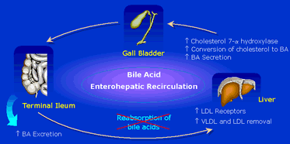
BILE ACID SEQUESTRANTS
Cholestyramine, Colestipol, Colesevelam
Are polymeric cation exchange resins
Mechanism
Bind bile acids [BA]preventing their enterohepatic recycling &  fecal excretion (10 folds). So in liver  BA will   C absorption & its hepatic breakdown  compensatory LDL R that will hepatic C uptake & plasma & tissue C  LDL. Liver tries to compensate by C synthesis but this is usually insufficient to overcome its  catabolism

Slide 20
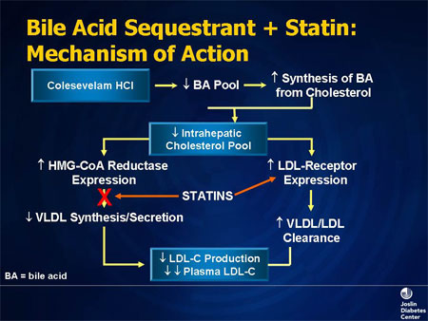
Pharmacological action
Cholestyramine
LDL 15-30%
 HDL 3-5%
 TG & VLDL
( initial & transient ) but show marked  in type IIb Hyperlipoproteinemia
Indications
A. In Hyperlipidemia
As Monotherapy;
Seldom if statin is contraindicated & levels are not high
As combination; with statins in type IIa Hyperlipoproteinemia.
Statins offsets the compensatory  in C synthesis by resins & potentiate  LDL R synergism
BA
N.B. Resins must be taken in 2-3 doses with meals / lack effect if between meals

Slide 21
B. Other Indications
  Pruritus due to biliary stasis
  Digitalis poisoning
ADRs
   GIT bloating, diarrhea, constipation, dyspepsia
  ◉ absorption of fat soluble vitamins ( A, D, E, K)
  Dry flaking skin
Contraindications
Biliary obstruction.
Diverticulitis
Chronic constipation.
Severe hypertriglyceridemia
Type IIb Hyperlipoproteinemia
Interactions
◉ absorption of some drugs; Digoxin, Thiazides, Frusemide, Propranolol,
L-thyroxin, Warfarin anticoagulant
N.B. So these drugs must be taken 1 hr before or 4 hrs after sequestrantes

Slide 22
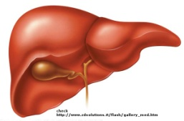
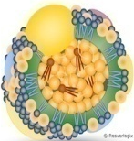
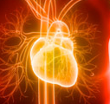
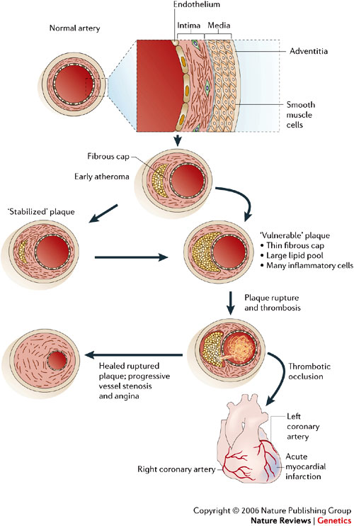
TARGETING ENDOGENOUS PATHWAYS

Slide 23
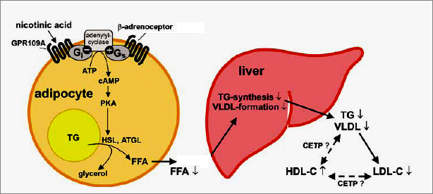
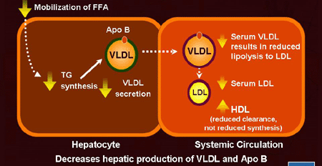
NICOTINIC ACID
Is known as Vit B₃. Its amide derivative nicotinamide has no lipid lowering effects
Mechanism
Bind to a specific receptors in adipose tissue (reverse effect of β-AR stimulation)   cAMP   PKA  -ve TGs breakdown  FFA to liver  TGs hepatic synthesis & VLDL formation
This eventually LDL &  HDL
In plasma: LPL activity  VLDL & CMs clearance
Nicotinic a.
Pharmacological actions
LDL 5-25%
 HDL 15-30%
◉ TG & VLDL 20-50%
◉ LP(a)
◉ Fibrinogen
Tissue plasminogen activator

Slide 24
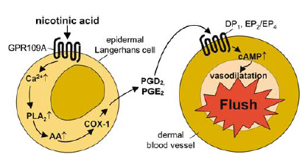
Indications
Mono or in combination with fibrate, resin or statin
      Type IIa hypercholestrolemia
      Type IIb hypercholesterolemia & any combined hyperlipidemia
      Patient with hypertriglyceridemia & low HDL-C.
      Hyperchylomicronemia.
ADRs
Sensation of warmth & flushing
(prostaglandin induced /
-ve by aspirin ½ h before niacin).
N.B Slow release formulations 
incidence of flushing !!!
Pruritus, rash, dry skin
Dyspepsia: nausea, vomiting, reactivation of peptic ulcer ( if taken after meal).
Reversible  liver enzymes hepatotoxicity.
Impairment of glucose tolerance  overt diabetes
 uric acid
Contraindications
Gout.
Peptic ulcer.
Hepatotoxicity.
Diabetes mellitus

Slide 25
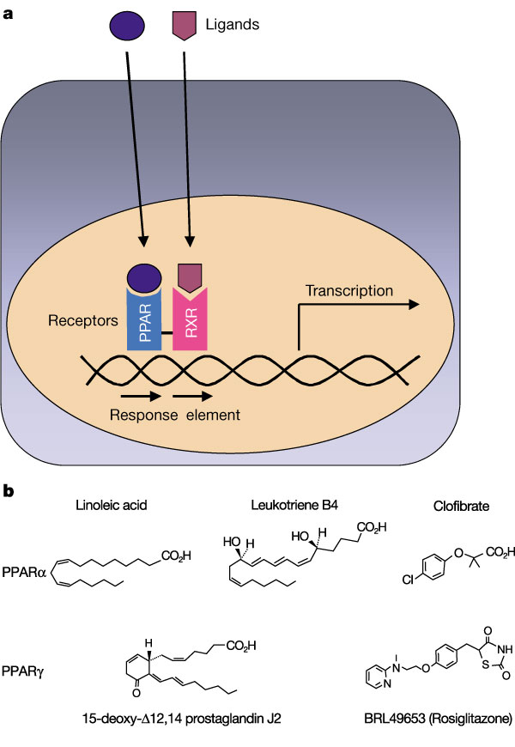
FIBRATES
Nuclear Transcription Factors
Peroxisome Proliferator Activator Receptor [PPARα ]
AGONISTS
Mechanism
Fibrates
Retinoic a.
Linolic a.
Bind & activate PPARα R
Dimerize with RXR
EXPRESS (Gene Transcription)
mRNA Translation
Protein Formation
Responsible
For
REPRESS (Shut Gene Transcription)
Responsible
For
◉ TGs
◉ VLDL
by liver
 HDL
 RCT
PPRE
  C synthetic
  pathways
◉ LDL

Slide 26
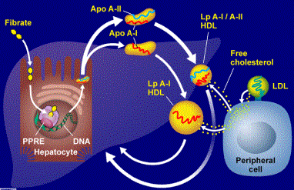
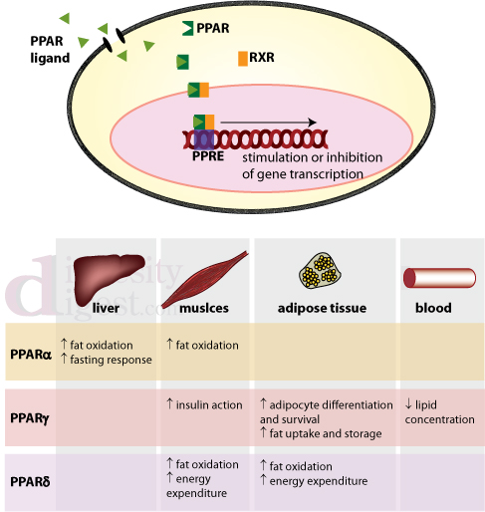
FIBRATES
Clofibrate (X)
Gall stones/ Cancer
Fenofibrate (F)
Bezafibrate
Gemfibrozil (G)
Share points of similarities & show some difference
Pharmacological actions
Fibrates
LDL 5-20%
 HDL 10-20% > (G)
◉ TG & VLDL 20-50%
◉ Fibrinogen
◉ Vascular inflammation > (G)
Improve glucose tolerance > (F)
No effect
inflammation ?
stabilization ?
N.B. Fenofibrate  uricosuric action  > if gout or in metabolic syndrome

Slide 27
Pharmacokinetics
 | Gemfibrozil | Fenofibrate
Protein binding | 95%, passes to placenta | 99%
Metabolism | Hepatic (CYP3A4) | Glucuronidation
t ½ | 1.5 hours | 20 hrs
Excretion | Renal 94% > | Renal 60%
Indications
As monotherapy; > (G)
Hypertriglcyredemia; Type IV lipoproteinemia
As Combined therapy with statins ; > (F)
1. Mixed dyslipidaemia; i.e type IIb & III lipoproteinemia
2. In  HDL, TGs + [~LDL] +  risk of atherothrombosis [Type 2 diabetes]
N.B. (F) used >(G) with statin (specially lipophylic) to  interaction on CYT P450
that leads to toxicity (myositis & rhabdomyolysis).
Also (F) used > uricosuric action in insulin resistance [metabolic syndrome]
As Combined therapy with other lipid lowering drugs ; in severe treatment-resistant dyslipidaemia.

Slide 28
ADRs
1. G.I.T upset, headache, fatigue, weight gain
2. Rash, urticaria, hair loss
3. Myalagia, Myositis, Rhabdomyolysis Acute renal failure  Occurs >
In alcoholics,
If combined with lipophylic statins (each –ve metabolism of other )
Or In impaired renal function
Contrindications
Renal or hepatic impairment
Pregnant or nursing women
Gall-bladder disease
In hypoalbuminaemia
In alcoholics
Interactions
They displace warfarin from their protein binding sites   bleeding
tendency  anticoagulant dose must be adjusted.
They  metabolism of lipophylic not hydrophilic statins  toxicity
 myalgia, myositis, …….etc. Give lower doses

Slide 29
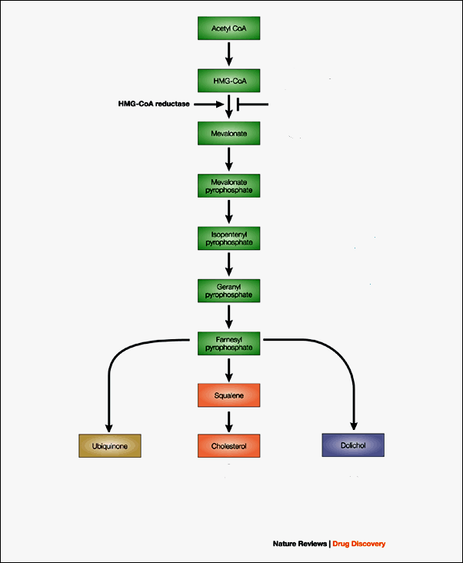
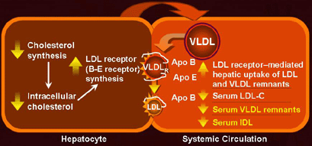
STATINS
HMGCoA Reductase INHIBITORS
specific, reversible, competitive
Mechanism
One of the enzymes in cholesterol synthetic pathways that controls the rate limiting step of conversion to mevalonate
1. LIPID LOWERING effects [In Liver]
hepatic C synthesis  hepatic intracellular C
1. synthesis of LDL receptors  clearance of LDL
2.  secretion of VLDL & uptake of non-HDL-C

Slide 30
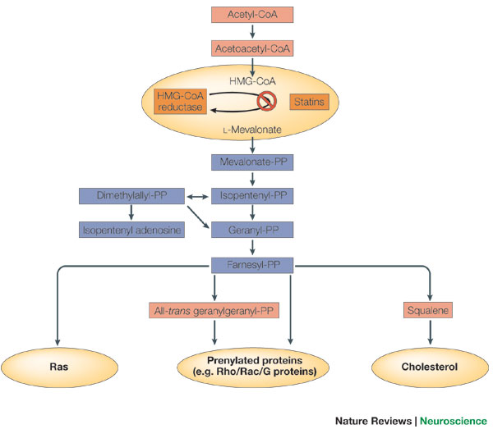
2. PLEIOTROPIC ANTIATHEROGENIC effects [> in Vessels]
Because it blocks cholesterol synthetic pathway it is also blocks signaling molecules responsible for progress of inflammation, vulnerability & athrothrombosis occuring 2^{ndry} to excess C accumulation in periphery
HMGCoA Reductase
STATINS
Improve endothelial function
vascular inflammation
Stabilization of atherosclerotic plaque
platelet aggregability
Antithrombotic actions
Enhanced fibrinolysis …etc

Slide 31
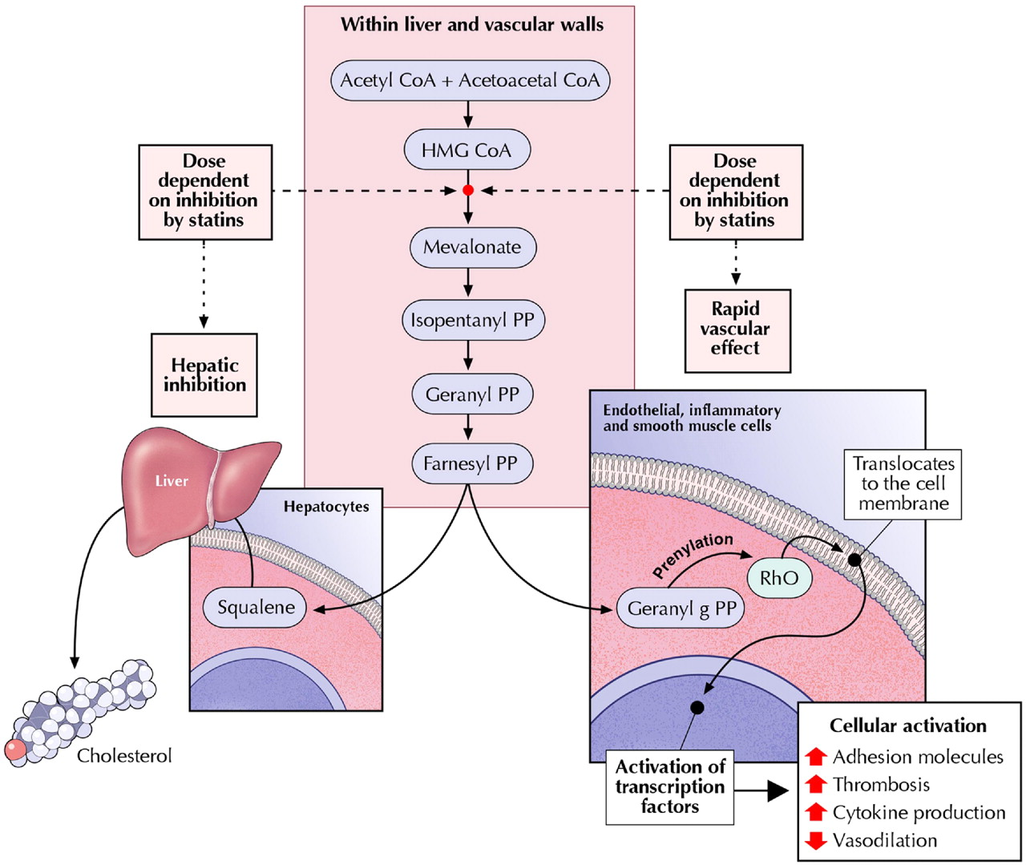
Because STATINS
-ve C Synthesis
&
Blocks
Signaling Molecules
So STATINS
Are Drugs of Choice in all Atherogenic
Hyper-lipidemia
LDL 18-55%
 HDL 5-10%
◉ TG & VLDL 10-30%

Slide 32
Classification of STATINS
PRODRUGS
ACTIVE DRUGS
Simvastatin / Lovastatin / Fluvastatin / Atorvastatin / Pravastatin / Rosuvastatin
Lipophylic
Hydrophilic
Partial
Fluorine-Containing
Weak
Strong
Super / Mega
Pharmacokinetics
Absorption varies (40-70%), fluvastatin almost completely
Absorption enhanced if taken with food, except pravastatin
All have high first-pass extraction by the liver, except pravastatin
Metabolized variably;
By CYP3A4  Simvastatin, Lovastatin, Atorvastatin
By CYP2C9  Fluvastatin, Rosuvastatin
By sulphonation  Pravastatin
Excreted in bile & 5–20% is excreted in urine, except pravastatin 80-90% urine
t½  Short 1-3 hrs  Simvastatin, Lovastatin, Fluvastatin
 14 hrs  Atorvastatin
 19 hrs  Rosuvastatin
Taken only in evening, Why?
Taken any time
Cholesetrol Synthesis > at night

Slide 33
Indications
As monotherapy;
2^{ndry} Prevention; In all ischemic insults [, stroke, ACSs up to AMI, …..etc.
So given from1st day of ischemic attack  stabilize plaques + help to limit
ischemic zone & to salvage preferential tissues
P^{ry} Prevention;
1. Patients with hyperlipidemia and with other risks for ischemic insults.
2. Type IIa Hyperlipoprotinemia.
If no control  combine (sequestrants / ezatimibe, niacine,.. ) to  C.
As Combination therapy;
1. Mixed dyslipidaemias; added to fenofibrates or niacine if necessary
2. In diabetics and patients with insulin resistance [metabolic syndrome] even if
only hypertriglyceridemia & low HDL without  in LDL Why ???
because these patients will possess small dense LDL (severely atherogenic)
+ evident endothelial dysfunction + increased thrombotic profile.
SO MUST TAKE STATINS
Contraindications
 In pregnancy and cautiously under age of 18 years

Slide 34
ADRs
serum transaminase  can progress to evident hepatotoxicity
So lab investigations recommended every 6 month  if levels  up to
3 folds at any time, statin must be stopped then dose adjusted.
 creatine kinase activity (index of muscle injury) 
Measured only if myalgia or myositis develops  if  3-5 folds  we;
◉ statin doses / change to hydrophilic statin / omit combination with
fibrates…..
If severe elevation + blood in urine  this is Rhabdomyolysis renal
failure could be fatal dialysis is needed
Others; ↑lenticular opacity, insomnia, rash, GIT disturbance
Interactions
Those metabolized by CYP3A4 [Simvastatin, Atrovastatin] show
◉ efficacy with INDUCERS (Phenytoin, rifampin, barbiturates,TZDs ….)
 toxicity with INHIBITORS (Macrolides, cyclosporine, ketoconazole….)
Those metabolized by CYP2C9 [Fluvastatin & Rosuvastatin] show
 toxicity with INHIBITORS (metronidazole, amiodarone, cimetidine… )

Slide 35
Adjuvants in hyperlipidemia

Slide 36
Omega -3-FA
found in fish oils containing highly unsaturated FA
Mechanism
Pharmacological Effects
◉ enzymes involved in TG synthesis
 beta-oxidation of FFA
◉ TGs
◉ platelet function
Prolongation of bleeding time
Reduction of plasma fibrinogen
Anti-inflammatory effects
Some vascular protection
Indications
Approved as adjunctive for treatment of very high TGs
β-Sitosterol
found in plants with structure similar to C
Mechanism &Pharmacological Effects
Compete with dietary & biliary C absorption  levels LDL levels +10%
Indications
Given as food supplement before meal in hypecholestrolemia

Slide 37
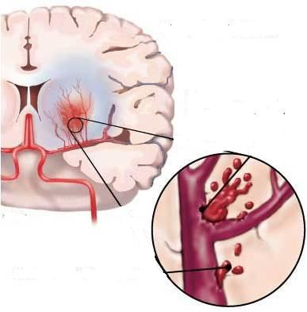




TARGETING BEYOND
What do we want to achieve ?
TARGETING DYSLIPIDEMIA
TARGETING BEYOUND

Slide 38

TARGETING DYSLIPIDEMIA  THE QUANTITY
WALKING / WALKING / WALKING
Hyperlipoproteinemia | Lipid Derangement | Treatment
Type IIa | C | Statins + Sequestrants / Ezitamibe / Niacin
Type IIb | TG & C | Fibrates + Statins / Niacin / Sequestrants

Slide 39

TARGETING DYSLIPIDEMIA  THE QUALITY
Addition of
Niacin > Fibrates !!!

Slide 40

TARGETING BEYOND
Reverse endothelial dysfunction
Plaque stabilization
Induce vasculoprotection
◉ Thrombotic insults
 Survival
FIBRATES
◉ progression of coronary lesions
◉ major coronary events
STATINS
◉ major coronary events
◉ CHD mortality
◉ coronary procedures
◉ Stroke
◉ Total mortality
NIACIN
◉ major coronary events
Possible  in total mortality
SEQUESTRANTS
◉ major coronary events
Possible  CHD mortality

Slide 41



Case
Notes:
Ergonovine test
performed if angina is thought to be caused by coronary artery spasm. The procedure is conducted during coronary angiography.
The artery-narrowing drug ergonovine (or, alternatively, acetylcholine) is injected to provoke coronary artery spasm.
If the individual experiences severe arterial spasm in response to ergonovine, he or she probably has variant angina.

Slide 42
Q1

Slide 43
Q2
Notes:
For the chronic treatment there are two possibilities, an oral calcium channel blocker, such as amlodipine or verapamil, or a long-acting nitrate preparation, such as the transdermal form of nitroglycerin given once a day at bedtime to prevent the early morning episodes. -Adrenoceptor blockers
are not used for patients with coronary vasospasm, as they may worsen the condition.

Slide 44
Q2
Notes:
For the chronic treatment there are two possibilities, an oral calcium channel blocker, such as amlodipine or verapamil, or a long-acting nitrate preparation, such as the transdermal form of nitroglycerin given once a day at bedtime to prevent the early morning episodes. -Adrenoceptor blockers
are not used for patients with coronary vasospasm, as they may worsen the condition.

Slide 45
DRUGS IN HYPERLIPIDEMIA
GOOD LUCK

