Slide 1
Drugs used for Treatment of Hypertension

Slide 2
Prof. Alhaider
Department of Pharmacology

Slide 3
OBJECTIVES
At the end of lectures , the students should :
Identify factors that control blood pressure
Identify the pharmacologic classes of drugs used in treatment of hypertension
Know examples of each class.

Slide 4
OBJECTIVES ( continue)
Describe the mechanism of action , therapeutic uses & common adverse effects of each class of drugs including :
Adrenoceptor blocking drugs ( β & α blocking drugs )
Diuretics
Calcium channel blocking drugs
Vasodilators

Slide 5
OBJECTIVES ( cont.)
Converting enzyme inhibitors
Angiotensin receptor blockers.
Describe the advantages of ARBs over ACEI

Slide 6
Factors controlling BP
Blood volume
Cardiac output (rate & contractility )
Peripheral resistance
Which one is the most influential factor?

Slide 7
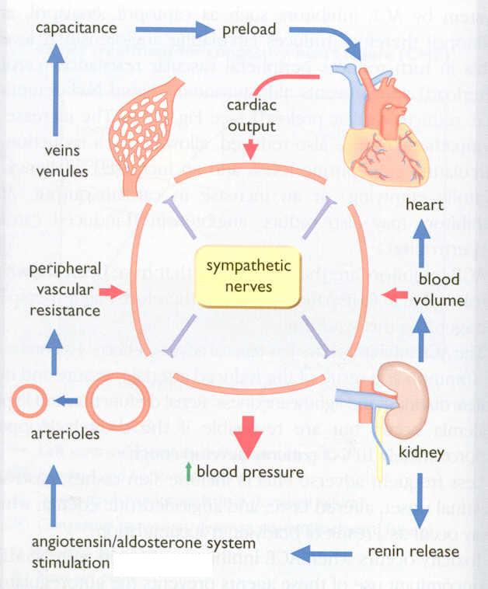
FACTORS IN BLOOD PRESSURE CONTROL

Slide 8
i

Slide 9
Hypertension
Major risk factor for
Cerebrovascular disease
Heart failure
Myocardial Infarction
Renal insufficiency
Asymptomatic until organ damages reaches a critical point.

Slide 10
Antihypertensive therapy
lifestyle changes , such as
Weight reduction, Smoking cessation,
Reduction of :
salt, saturated fat and alcohol intake
and Increased exercise

Slide 11
Indications for Drug Therapy
Sustained blood pressure elevations > 140/ 90 mmHg.
Elevated blood pressure is associated with other cardiovascular risk factors (smoking, diabetes, obesity, hyperlipidemia, genetic predisposition ).
End organs are affected by hypertension (heart, kidney , brain ).

Slide 12
Drug Management of Hypertension
Diuretics
Adrenoceptor blocking drugs
Beta- blockers
α- blockers
Calcium –channel blockers
Centrally acting sympathoplegic
Vasodilators
Drugs acting on renin-angiotensin aldosterone system (RAAS)

Slide 14
Diuretics
A – Thiazide group
( hydrochlorothiazide)
B-Indapamide (Natrilex^{R})

Slide 15
C. Potassium-sparing diuretics
Amiloride; spironolactone reduce potassium loss in the urine. Spironolactone has the additional benefit of diminishing the remodeling that occurs in blood vessels & in heart failure.

Slide 16
Mechanism of action
► cause sodium and water loss
therefore they:
decrease volume of blood and CO and most
important eliminate more sodium from the body
and Decrease SVR with a reduction of Blood
Pressure
►diuretics may be adequate in
mild to moderate hypertension

Slide 17
Adrenoceptor –Blocking Agents
β- adrenoceptor blockers
Mild to moderate hypertension.
Severe cases used in combination with other drugs.
Nadolol (non cardio selective) with long Half live
Bisoprolol, Atenolol, metoprolol ( cardio selective)
Labetalol , carvidalol ( α – and β blockers )

Slide 18
β-Adrenoceptor –Blocking Agents
lower blood pressure by
Decreasing cardiac output.
Decreasing renin release
Which one is the most important?

Slide 19
α-adrenoceptor blockers
Prazocin (Short t1l2) , Terazocin (Long t1l2)
Added to β- blockers for treatment of
Hypertension of pheochromocytoma and can be used for heart failure
Can be used for tretment of perepheral vascular disease
Note: The only antihypertensive agents that increase HDL

Slide 20
CALCIUM CHANNEL BLOCKERS

Slide 21
Classification
Dihydropyridine group (Nifedipine, nicardipine , amlodipine ) is more selective as vasodilator than a cardiac depressant. Used mainly for treatment of hypertension
Verapamil is more effective as cardiac depressant , is not used as antihypertensive agent .
Diltiazem .Used mainly for angina

Slide 22
Mechanism of action
❏ Block the influx of calcium through L-type calcium channels resulting in:
Peripheral vasodilatation
Decrease cardiac contractility & heart rate
Both effects lower blood pressure

Slide 23
Pharmacokinetics:
❏ given orally and intravenous injection
❏ well absorbed from G.I.T
❏ verapamil and nifedipine are highly bound to
plasma protiens ( more than 90%)
while diltiazem is less ( 70-80%)

Slide 24
(Cont’d):
❏ onset of action --- within 1-3 min --- after i.v.
30 min – 2 h --- after oral dose
❏ verapamil & diltiazem have active metabolites,
nifedipine does not
❏ sustained-release preparations can permit
once-daily dosing

Slide 25
Clinical uses
Treatment of chronic hypertension with oral preparation (e,g: Nifedipine (Adalat^{R}) and Amlodipine (Amlor^{R})
Nicardipine can be given by I.V. route & used in hypertensive emergency????

Slide 26
ADVERSE EFFECTS
Verapamil | Diltiazem | Nifedipine
Headache , Flushing , Hypotension | Headache, Flushing, Hypotension | Headache , Flushing, Hypotension
Peripheral edema (ankle edema) | Peripheral edema (ankle edema) | Peripheral edema (ankle edema)
Cardiac depression, A-V block , bradycardia | Cardiac depression , A-V block , bradycardia | Tachycardia as a reflux
Constipation

Slide 27
Centrally acting sympathoplegic drugs
Clonidine
α₂-agonist (works as a Direct α2 agonist)
Thus:
⬇sympathetic out-flow to the heart decreasing cardiac output
⬇sympathetic out-flow to the Blood vessels ➔vasodilation & reduced systemic vascular resistance, which decreases BP.

Slide 28
α methyl dopa
α ₂ agonist (acts as a False Neurotrasmitter)
Centrally diminish the sympathetic outflow .
Resulting in reduction in peripheral resistance, and ⬇ blood pressure.
Safely used in hypertensive pregnant women

Slide 29
Side effects of centrally acting sympathoplegic drugs
Depression
Dry mouth, nasal mucosa
Bradycardia
Impotence
Fluid retention & edema with chronic use
Sudden withdrawal of clonidine can lead to rebound hypertension How?

Slide 30
VASODILATORS

Slide 31
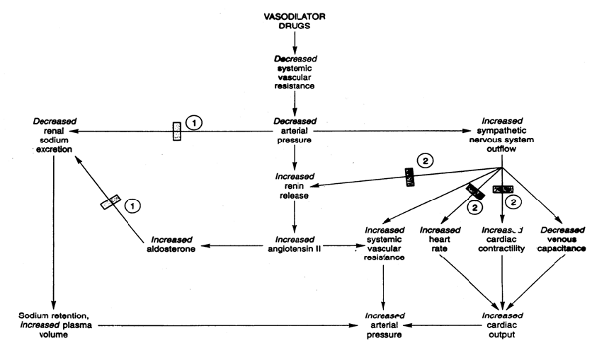
Compensatory Response to Vasodilators

Slide 32
Vasodilators
Na nitropruside | Diazoxide | Minoxidil | Hdralazine
Arterio & venodilator | Arteriodilator | Arteriodilator | Arteriodilator | Site of action
Release of nitric oxide ( NO) | Opening of potassium channels | Opening of potassium channels in smooth muscle membranes by minoxidil sulfate ( active metabolite ) | Direct | Mechanism of action
Intravenous infusion | Rapid intravenous | Oral | Oral | Route of admin.
Notes:
,

Slide 33
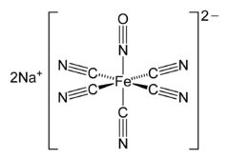
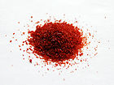
IUPAC name Sodium pentacyanonitrosylferrate(II)
Other names Sodium nitroprusside Sodium nitroferricyanide Sodium pentacyanonitrosylferrate SNP

Slide 34
Na nitropruside |  | Diazoxide | Minoxidil |  | Hdralazine | Continue Vasodilators
1.Hpertensive emergency |  | 1.Hypertensive emergency ( in the past ) | 1.Resitance –severe hypertension |  | 1.Moderate -severe hypertension. CHF | Therapeutic uses
 | 2.Treatment of hypoglycemia due to insulinoma |  | 2.correction of baldness | 2.Hypertensive pregnant woman

Slide 35
Na nitropruside | Diazoxide | Minoxidil |  | Hdralazine |  | Continue Vasodilators
Severe hypotension | Hypotension, reflex tachycardia, palpitation, angina, salt and water retention ( edema) |  |  |  |  | Adverse effects
1.Methemoglobinduring infusion 2. Cyanide toxicity 3. Thiocyanate toxicity | Inhibit insulin release from β cells of the pancreas causing hyperglycemia Contraindicated in diabetic |  | Hypertrichosis. Contraindicated in females |  | lupus erythematosus like syndrome (SLE) | Specific adverse effects

Slide 36
Give reason : β-blockers & diuretics are added to vasodilators for treatment of hypertension?

Slide 37
te

Slide 38
Mechanism of action of Angiotensin-converting enzyme inhibitors (ACEI)
Angiotensin I
(inactive)
Bradykinin
(active vasodilator)
ACE
inhibitors
angiotensin-
converting
enzyme
Angiotensin II
(active vasoconstrictor)
Inactive metabolites

Slide 39
Mechanism of action:
Converting enzyme inhibitors lower blood pressure by reducing angiotensin II, and also by increasing vasodilator peptides such as bradykinin.
Dilatation of arteriol → reduction of peripheral vascular resistance (afterload )
Increase of Na⁺ and decrease of K⁺ excretion in kidney
reduction of sympathetic activity
Inhibition of aldosterone secretion
Reduce the arteriolar and left ventricular remodelling that are
believed to be important in the pathogenesis of human essential
hypertension and post-infarction state

Slide 40
Pharmacokinetics
Captopril, enalapril , Lisonopril, ramipril .
Rapidly absorbed from GIT .
Food reduce their oral bioavailability.
Enalapril , ramipril are prodrugs, converted to the active metabolite in the liver
Have a long half-life & given once daily
Enalaprilat is the active metabolite of enalapril given by i.v. route in hypertensive emergency.

Slide 41
Phrmacokinetics
Captopril is not a prodrug
Has a short half-life & given twice /day
All ACEI are distributed to all tissues except CNS.

Slide 42
Clinical uses
Treatment of hypertension
Treatment of heart failure
Diabetic nephropathy

Slide 43
Adverse effects :
Acute renal failure, especially in patients
with bilateral renal artery stenosis
Hyperkalemia

Slide 44
(Cont’d):
Persistent cough
Angioneurotic edema ( swelling in the nose , throat, tongue, larynx)

Slide 45
(Cont’d):
( cough & edema due to bradykinin )
severe hypotension in hypovolemic
patients (due to diuretics, salt restriction or
gastrointestinal fluid loss)

Slide 46
(Cont’d):
Taste loss with captopril only due to SH group in its structure.
Skin rash, fever

Slide 47
Contraindications
During the second and third trimesters of pregnancy due to the risk of : fetal hypotension , anuria , renal failure &
malformations .
Bilateral renal artery stenosis or stenosis of a renal artery with solitary kidney.

Slide 48
Drug interactions
With potassium-sparing diuretics
NSAIDs reduce their hypotensive effects
by blocking bradykinin-mediated vasodilatation.

Slide 49
BLOCKERS OF AT₁ RECEPTOR
losartan, valosartan, irbesartan
- competitively inhibit angiotensin II at its AT₁
receptor site
most of the effects of angiotensin II - including vasoconstriction
and aldosterone release - are mediated by the AT₁ receptor
their influence on RAS is more effective because of selective blockade
(angiotensin II synthesis in tissue is not completely dependent only on renin release, but could be promote by serin-
protease -

Slide 50
angiotensinogen
renin
angiotensin I
nonrenin proteases
cathepsin
t-PA
chymase
CAGE
ACE
angiotensin II

Slide 51
Continue
They have no effect on bradykinin system
So Lacking the adverse effects { cough, wheezing , angioedema }

Slide 52
Losartan, valsartan , irbesartan Nowaday, most ARBs are combined with Diuretics like hydrochrothiazide. (eg. Co-diovan^{R} 80/12.5 or 160/12.5) Why?

Slide 53
Adverse effects
As ACEI except cough, wheezing , and angioedema.
Same contraindications as ACEI.

Slide 54
Drugs for treatment of hypertensive crisis
Labetalol
Hydralazine ( in pregnancy )
Sodium nitroprusside ( 2nd line )
General characters
Fast & short acting
Given by IV

Slide 55
THANK YOU

