Slide 1
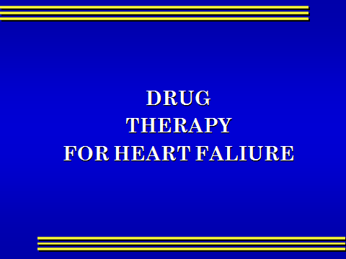

Slide 2

OBJECTIVES
At the end of lectures the students should
Describe the different classes of drugs used for treatment of acute & chronic heart failure

Slide 3
OBJECTIVES ( cont.)
Describe the mechanism of action , therapeutic uses , side effects & drug interactions of individual drugs used for the treatment of heart failure

Slide 4
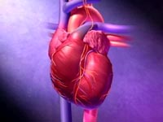
HEART FAILURE
?
Inability of the heart to maintain an adequate cardiac output to meet the metabolic demands of the body.

Slide 5
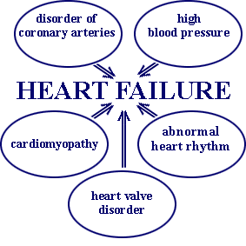
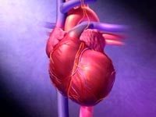
CAUSES OF HEART FAILURE

Slide 6
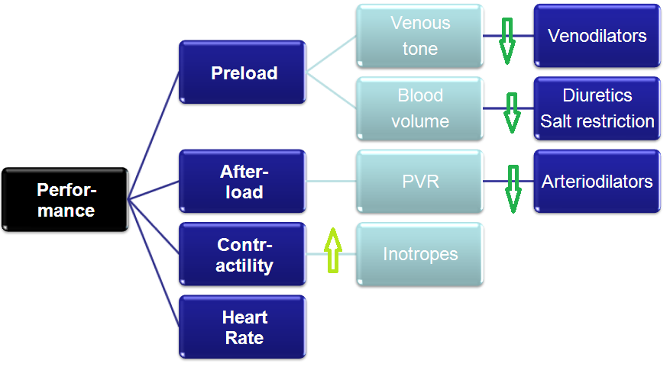

Slide 7
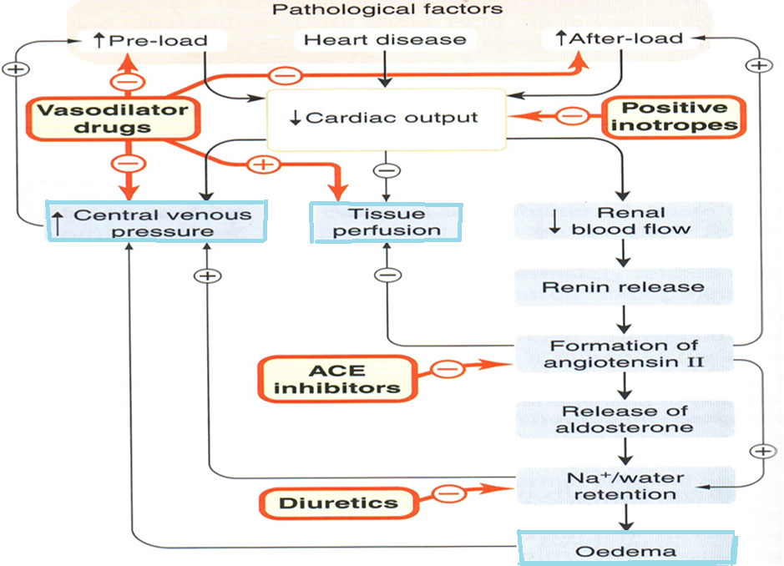

Slide 8

Heart failure symptoms
Tachycardia
Decreased exercise tolerance (rapid fatigue) .
Dyspnea ( pulmonary congestion)
Peripheral edema.
Cardiomegaly.

Slide 9

Drugs used in the treatment of heart failure
Drugs that increase contractility
  Cardiac glycosides
  Phosphodiesterase
  inhibitors
  β- adrenoceptor agonists

Slide 10
Drugs that decrease preload
Diuretics
Venodilators

Slide 11
Drugs that decrease afterload
Arteriolodilators

Slide 12
Drugs that decrease preload & afterload
Combined arteriolo- and venodiators:
Angiotensin converitng enzyme inhibitors
α₁-adrenoceptor antagonists
Directly-acting vasodilators

Slide 13
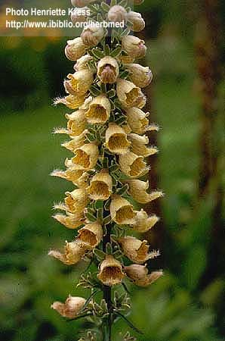
CARDIAC GLYCOSIDES
Digitalis Lanata
Digoxin / Digitoxin / Ouabain
Sugar &steroid like

Slide 14
CARDIAC GLYCOSIDES
Digoxin /
PHARMACOKINETICS
Drug has narrow therapeutic index
Absorption: orally : 40-80% leading to variable bioavailability
I.V. acts within 15 min-3hrs
Distribution & Metabolism: 25% protein bound, cumulative, metabolized in liver to cardioactive metabolite
Elimination; Slow, mainly renal , t_{1/2} 40 hrs

Slide 15
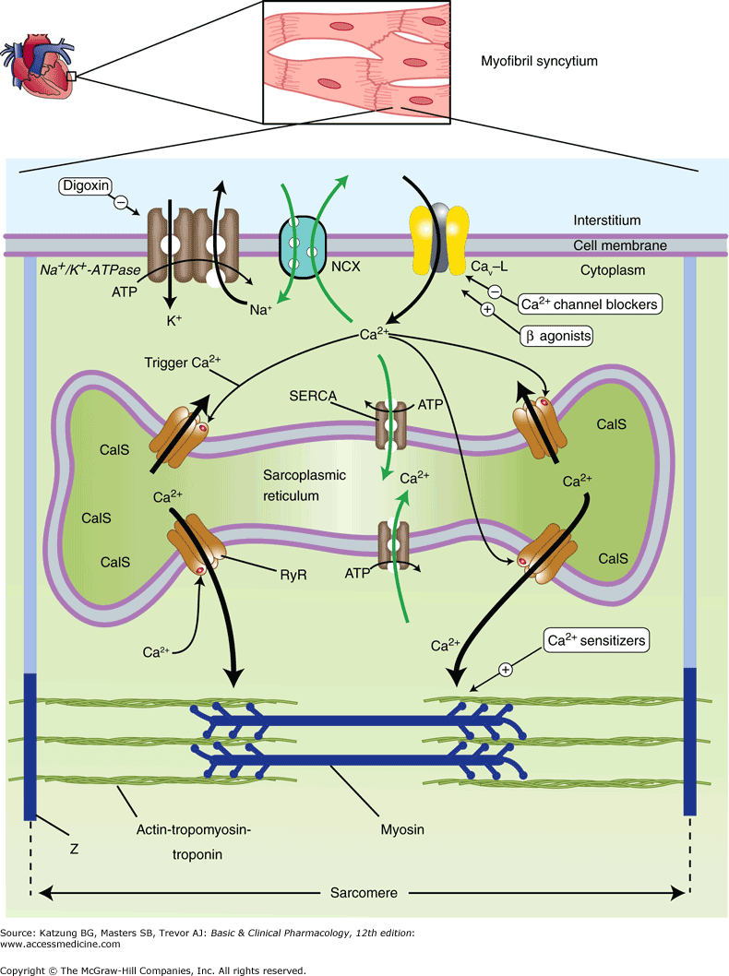

Slide 16
Mechanism of action
Inhibits Na⁺ / K⁺ ATP ase

Slide 17
CARDIAC GLYCOSIDES
PHARMACOLOGICAL ACTIONS:
CARDIAC:
1- The fundamental action is to increase the force of myocardial contraction ( +ve inotropic)
resulting in a marked increase in CO .

Slide 18
Continue
The second most important action is to slow heart rate ( negative chronotropic )
Mediated through effect on the vagus nerve.

Slide 19
Continue
The second most important action is to slow heart rate ( negative chronotropic )
Mediated through effect on the vagus nerve.

Slide 20

Therapeutic uses
Congestive heart failure
Atrial flutter / Atrial fibrillation
Supraventricular tachycardia

Slide 21
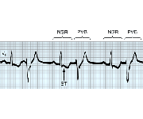
Cardiac adverse effects
digitalis-induced arrhythmias
can cause any type of arrhythmia especially:
- extrasystoles, coupled beats
- ventricular tachycardia or fibrillation
- A.V.block, cardiac arrest.

Slide 22
Extra -cardiac adverse effects
GIT : are common and among the earliest signs of toxicity :
(Anorexia ,nausea,vomiting, diarrhea)

Slide 23
C.N.S. :Headache,
visual disturbances,
drowsiness

Slide 24
Factors increasing digitalis toxicity
Small Lean body mass
Renal diseases
Hypothyroidism
Hypokalemia
Hypomagnesemia
Hypercalemia

Slide 25
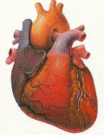
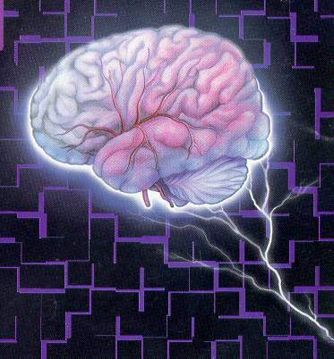

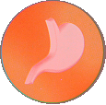
Treatment OF ADVERSE EFFECTS
HEART
CNS
Vision
GIT
???
Atropine
Antiarrythmics
K supplements
FAB fragments
Digoxin , diuretic

Slide 26
Drug interactions
Diuretics→ hypokalemia (arrhythmia)
Quinidine : ↑plasma level of digitalis

Slide 27

What is the preferred agent to combat extreme digoxin overdose?
A- K+
B-Mg++
C-Fab fragments
D-Phenytoin

Slide 28
If quinidine and digoxin are administered concurrently ,which of the following effects does quinidine have on digoxin?
A- absorption of digoxin is decreased
B-plasma concentration is increased
C-metabolism of digoxin is prevented
D-ability of digoxin to inhibit the sodium/potassium pump
is reduced

Slide 29
β-Adrenoceptor agonists
Dopamine :Acts on: α ,β₁ and dopamine receptors.
Used in: acute L.H.F. mainly in patients with impaired renal blood flow.
Dobutamine : Selective β₁ agonist
Used :in the treatment of acute heart failure
Cardiogenic shock

Slide 30
Phosphodiesterase Inhibitors
Bipyridines :(Amrinone ,Milrinone )
only available in parenteral form.
Half-life 3-6hrs.
Excreted in urine.

Slide 31
Mechanism of action
Inhibit phosphodiesterase isozyme 3 in cardiac & smooth muscles → :↑ cAMP
In the heart : Increase myocardial contraction
In the peripheral vasculature : Dilatation of both arteries & veins → ↓ afterload & preload.

Slide 32
Therapeutic uses
Used only intravenously for management of
acute heart failure

Slide 33
Adverse effects
Nausea ,vomiting
Arrhythmias (less than digitalis )
Thrombocytopenia
Liver toxicity
Milrinone less hepatotoxic and less bone marrow depression than amrinone.

Slide 34
The following drug is used for short term control of emergency heart failure but not for long term treatment of congestive heart failure:-
A-digoxin
B-captopril
C-dobutamine
D-theophylline

Slide 35
Amrinone is best used:-
A-in a patient of a mild CHF
B-in severe exacerbation of chronic heart failure.
C-For long-term therapy of CHF
D- to suppress digitalis- induced arrhythmias

