Slide 1
Phosphodiesterase Inhibitors
Bipyridines :(Amrinone ,Milrinone )
only available in parenteral form.
Half-life 3-6hrs.
Excreted in urine.

Slide 2
Mechanism of action
Inhibit phosphodiesterase isozyme 3 in cardiac & smooth muscles → :↑ cAMP
In the heart : Increase myocardial contraction
In the peripheral vasculature : Dilatation of both arteries & veins → ↓ afterload & preload.

Slide 3
Therapeutic uses
Used only intravenously for management of
Acute heart failure
Severe exacerbation of heart failure

Slide 4
Adverse effects
Nausea ,vomiting
Arrhythmias (less than digitalis )
Thrombocytopenia
Liver toxicity
Milrinone less hepatotoxic and less bone marrow depression than amrinone.

Slide 5
Reduction of preload
Diuretics
Venodilators

Slide 6
Diuretics
Are first-line agents in heart failure therapy. They are used to resolve the signs and symptoms of volume overload, which are pulmonary and/ or peripheral edema.
Reduce salt and water retention→↓ventricular preload and venous pressure.
Reduction of cardiac size →improve cardiac performance Frusemide, hydrochlorothiazide

Slide 7
Venodilators
Nitroglycerine is used for short term IV treatment of severe heart failure when the main symptom is dyspnea due to pulmonary congestion.
Dilate venous capacitance vessels and reduce preload.

Slide 8
Reduction of Afterload
Arteriolodilators
Selective arteriolodilators as hydralazine is used when the main symptome is rapid fatigue due to low cardiac output.
Reduce peripheral vascular resistance

Slide 9
Reduction of afterload & preload

Slide 10
ACE Inhibitors & Angiotensin Receptor Blockers
Along with diuretics are now considered as first –line drugs for heart failure therapy
e.g. captopril, lisinopril

Slide 11
Angiotensin converting enzyme inhibitors
MECHANISM OF ACTION
VASOCONSTRICTION
VASODILATATION
ALDOSTERONE
VASOPRESSIN
SYMPATHETIC
Angiotensinogen
RENIN
BRADYKININ
Angiotensin I
A.C.E.
Inhibitor
INACTIVATION
ANGIOTENSIN II

Slide 12
Angiotensin receptor blockers
Mechanism of action
- block AT₁ receptors
-decrease action of angiotensin II
e.g. losartan

Slide 13
Uses of converting enzyme inhibitors & angiotensin receptor blockers in heart failure
↓Peripheral resistance ( Afterload )
↓Venous return ( Preload)
↓sympathetic activity
↓remodeling ( cardiac & vascular) →↓mortality rate

Slide 14
Direct acting vasodilators
Sodium nitropruside
given I.V. in acute or severe refractory heart failure, acts immediately and effects lasts for 1-5 minutes.

Slide 15
Uses of β-adrenoceptor blockers in heart failure
Reduce catecholamine myocyte toxicity ( remodeling)
Decrease mortality rate
Decrease heart rate
Inhibit renin release
e.g. Metoprolol ,bisoprolol , carvedilol

Slide 16
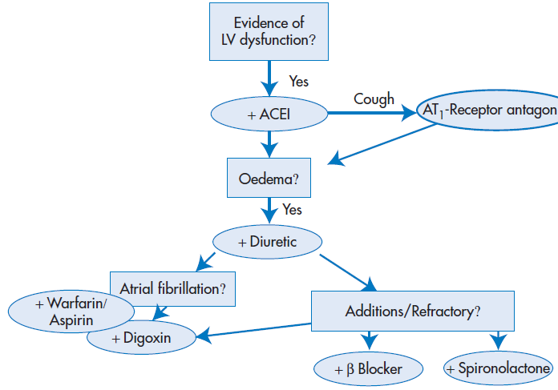
Management of chronic heart failure
Reduce work load of the heart
Limits patient activity
Reduce weight
Control hypertension
Restrict sodium
Diuretics
ACEI or ARBs

Slide 17
Management of chronic heart failure (Cont.)
Digitalis
β- blockers
Direct vasodilators

Slide 18
Management of acute heart failure
Volume replacement
Diuretics
Positive inotropic drugs
Vasodilators
Antiarrhythmic drugs
Treatment of myocardial infarction

Slide 20
1-Coment on the clinical findings?
2-What is the purpose of lisinopril?
3-How should the patient be counseled with regard to taking lisinopril for the first time?

Slide 22
Comment on the use of frusemide?

Slide 24
1-How do you respond to the GP?
2-What is the rational for the consultant’s new addition?

