Slide 1
PULSES
Carotid Arterial
Jugular Venous
Dr. Taj

Slide 2
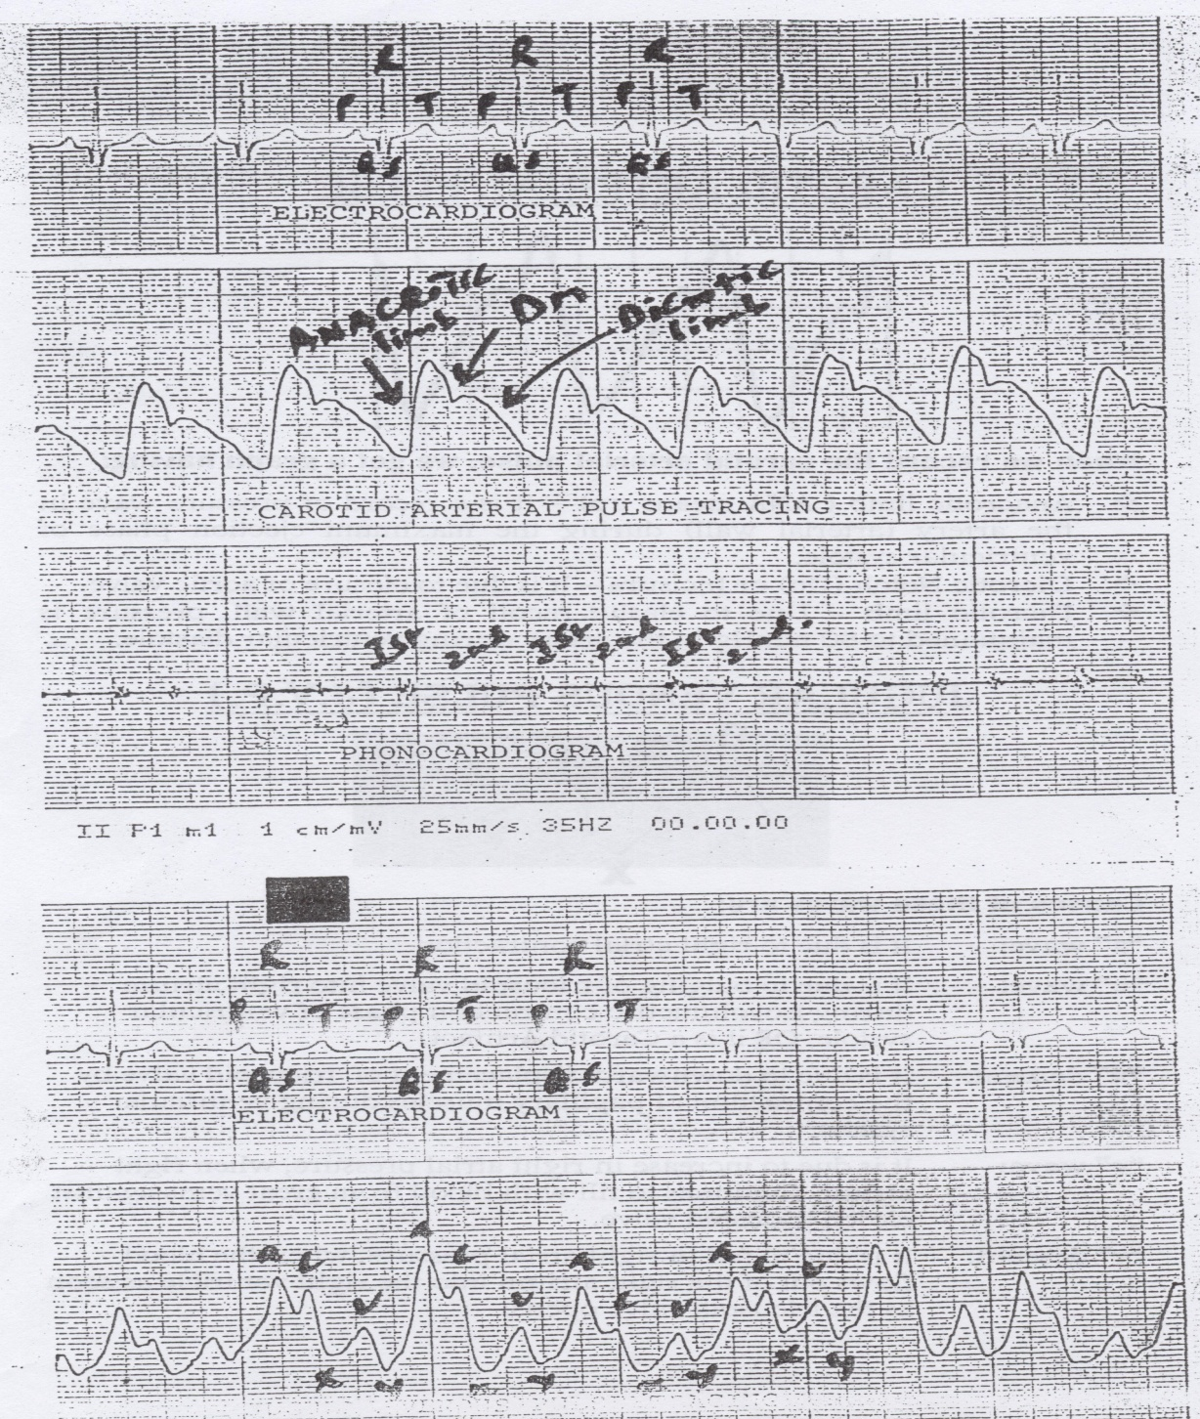
Pulses

Slide 3
Pulses

Slide 4
Pulses

Slide 5
Pulses

