Slide 1
Major arteries
of
the body

Slide 2
OBJECTIVES
At the end of the lecture, the student should be able to:
Define the word ‘artery’ and understand the general principles of the arterial system.
Define arterial anastomosis and describe its significance.
Define end arteries and give examples.
Describe the aorta and its divisions & list the branches from each part.
List major arteries and their distribution in the head & neck, thorax, abdomen and upper & lower extremities.
List main pulse points.

Slide 3
General principle of arteries
Arteries carry blood away from the heart.
All arteries, carry oxygenated blood, except the pulmonary and umbilical arteries, which carry deoxygenated blood to the lungs (postnatal) and to the placenta (prenatal) respectively
The flow of blood depends on the pumping action of the heart
There are no valves in the arteries.
The branches of arteries supplying adjacent areas normally anastomose with one another freely providing backup routes for blood to flow if one artery is blocked.
The arteries whose terminal branches do not anastomose with branches of adjacent arteries are called “end arteries or terminal arteries”. End arteries are of two types:
Anatomic (True) End Artery: When no anastomosis exists, e.g. artery of the retina
Functional End Artery: When an anastomosis exists but is incapable of providing a sufficient supply of blood, e.g. splenic artery, renal artery

Slide 4
Aorta
The largest artery in the body
Arises from the left ventricle of the heart
Carries oxygenated blood to all parts of the body
Is divided into 4 parts:
Ascending aorta
Arch of aorta
Descending thoracic aorta
Descending abdominal aorta
2
1
3
4

Slide 5
Ascending Aorta
Originates from left ventricle.
Continues as the arch of aorta
Has three dilatations at its base, called aortic sinuses
Branches:
Right & Left coronary arteries, arise from aortic sinuses
Aortic sinuses

Slide 6
Arch of Aorta
Continuation of the ascending aorta.
Leads to descending aorta.
Located behind the lower part of manubrium sterni and on the left side of trachea
2
1
3
Branches:
Brachiocephalic trunk.
Left common carotid artery.
Left subclavian artery

Slide 7
Common Carotid Artery
Origin:
Left from aortic arch.
Right from brachiocephalic trunk.
Each common carotid divides into two branches:
Internal carotid
External carotid
Right external carotid
Left external carotid

Slide 8
External Carotid Artery
Divides behind neck of the mandible into two terminal branches: Superficial temporal artery & Maxillary artery
Supplies structures in the head & neck through the following branches:
Superior thyroid a. (thyroid gland)
Ascending pharyngeal a. (Pharynx)
Lingual a. (Tongue)
Facial a. (Face)
Occipital a.
Posterior auricular a. (Scalp)
Superficial temporal a.
Maxillary a. (Maxillary & mandibular regions)

Slide 9
Internal Carotid Artery
Has NO branch in the neck
Enters the cranial cavity, joins the basilar artery (which is formed by the union of two vertebral arteries) and forms ‘arterial circle of Willis’ to supply the brain.
In addition, it supplies:
Nose
Scalp
Eye

Slide 10
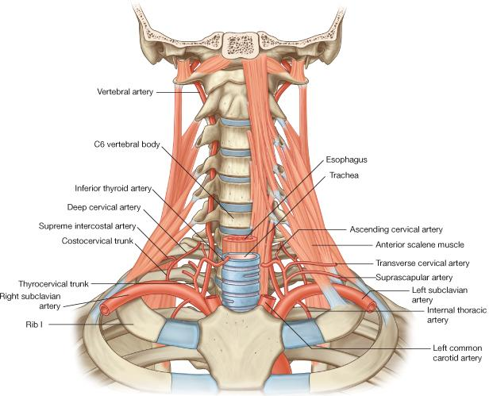
Subclavian artery
It is the main source of the arterial supply of the upper limb
Origin:
Left: from Arch of aorta
Right: from brachiocephalic trunk
Continuation: At lateral border of the first rib, it continues in the axilla as the axillary artery
Main branches:
Vertebral artery: supplies brain & spinal cord
Thyrocervical trunk: supplies thyroid gland & neck
Internal thoracic artery: supplies breast & thoracic wall
2
1
3

Slide 11
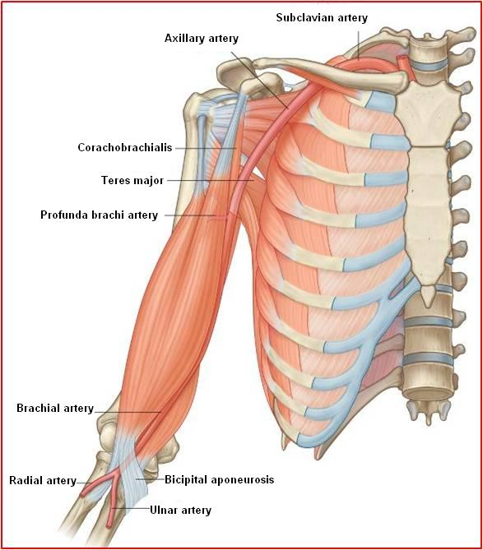
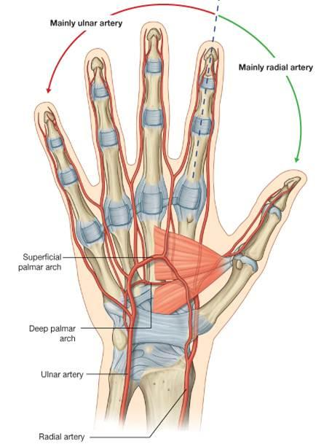
Upper limb arteries
Axillary artery
Begins at the lateral border of the first rib, as continuation of the subclavian artery, passes through the axilla and continues in the arm, at the lower border of teres major muscle, as the brachial artery.
Brachial artery
Descends close to the medial side of the humerus, passes in front of the elbow joint (cubital fossa). Divides, at the level of neck of radius, into two terminal branches: Ulnar & Radial. The ulnar & radial arteries descend in the forearm, enter the hand and form the palmer arches

Slide 12
Descending Thoracic Aorta
It is the continuation of aortic arch
At the level of the 12th thoracic vertebra, it passes through the diaphragm and continues as the abdominal aorta
Branches:
Pericardial
Esophageal
Bronchial
Posterior intercostal

Slide 13
Descending Abdominal Aorta
It enters the abdomen through the aortic opening of diaphragm (T12).
Terminates at the level of L4, by dividing into two common Iliac arteries.
Branches of abdominal aorta are divided into two groups:
Single branches
Paired branches

Slide 14
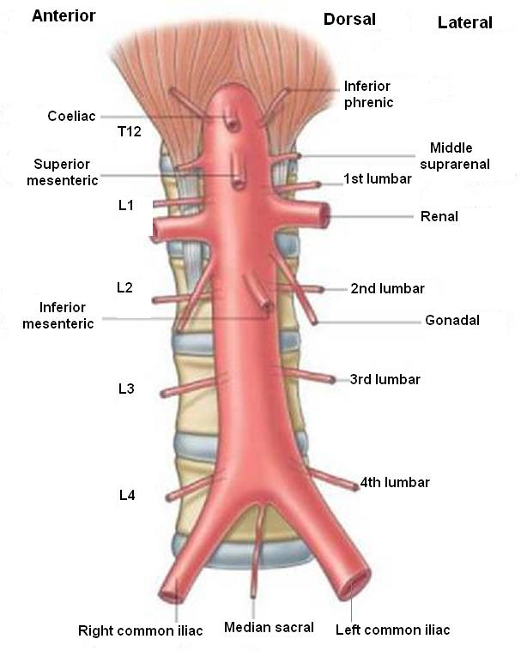
Main branches of Abdominal Aorta
Single branches
1
Paired branches
1
supply
gastrointestinal tract
2
Inferior phrenic
Suprarenal
Renal
Gonadal (Testicular or Ovarian)
Lumbar
Common iliac (Terminal branches)
2
3
Celiac Trunk
Superior mesenteric artery
Inferior mesenteric artery
3
4
5
6

Slide 15
Common Iliac Arteries
Each common iliac artery divides into:
External iliac artery: continues (at midpoint of inguinal ligament) as femoral artery the main supply for lower limb
Internal iliac artery: which supplies the pelvis & perineum
Internal iliac a.
External iliac a.
Inguinal ligament
Femoral a.

Slide 16
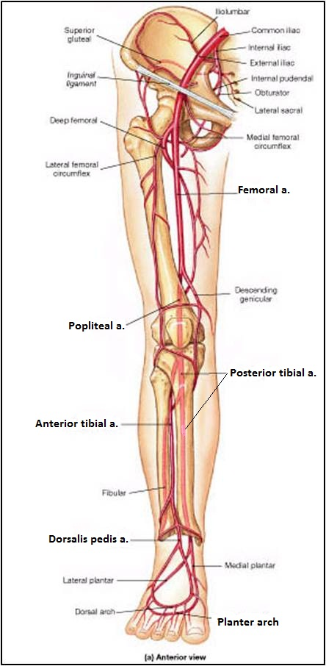
Arteries of Lower Limb
Femoral Artery
Is main arterial supply to lower limb
Enters the thigh behind the midpoint of the inguinal ligament
Passes through adductor hiatus enters the popliteal fossa and continues as the popliteal artery
Popliteal Artery
Deeply placed in the popliteal fossa, divides at lower end of popliteal fossa into:
Anterior tibial artery, continues as the dorsalis Pedis artery on the dorsum of foot
Posterior tibial artery supply the sole of foot

Slide 17
Pulse Points in Head & Neck

Slide 18
Pulse Points in Upper Limb

Slide 19
Pulse Points in Lower Limb

Slide 20
Thank you

