Slide 1
Hypertension
Hisham Al Khalidi/
Shaesta Naseem Zaidi

Slide 2
Blood pressure is the pressure exerted by circulating blood upon the walls of blood vessels
It is a function of cardiac output and peripheral vascular resistance
Notes:
Systemic and local tissue blood pressures must be maintained within a narrow range to prevent untoward consequences. Low pressures (hypotension) result in inadequate organ perfusion and can lead to dysfunction or tissue death. Conversely, high pressures (hypertension) can cause vessel and end-organ damage.

Slide 3
Hypertension
Common problem (25% of population)
Asymptomatic until late- Silent Killer – painless –
Leading risk factor of – MI & Stroke
Complications alert to diagnosis but late…

Slide 4
Hypertension Definition
No rigid definition
However, hypertension (HTN) is usually considered when there is :
A sustained diastolic pressure greater than 89 mm Hg
OR
A sustained systolic pressure in excess of 139 mm Hg

Slide 5
Hypertension Risk factors
Hereditary
Race : African-Americans
Gender: Men & postmenopausal women
Age
Obesity
Diet, particularly sodium intake
Other factors associated with HTN include:
Heavy alcohol consumption
Diabetes
Use of oral contraceptives
Sedentary or inactive lifestyle

Slide 6
Hypertension Types and causes
Essential (Primary) Hypertension (90-95%)
Secondary Hypertension
Notes:
Essential hypertension ( HTN of unknown etiology):
Causes are multifactorial and results from the combined effects of
multiple genetic polymorphisms &
interacting environmental factors

Slide 7
Causes of Secondary Hypertension
Renal:
Acute glomerulonephritis
Chronic renal disease
Polycystic disease
Renal artery stenosis
Renal vasculitis
Renin-producing tumours
Endocrine:
Adrenocortical hyper function
Exogenous hormones (glucocorticoids, estrogens )
Pheochromocytoma
Acromegaly
Hypo or hyperthyroidism
Pregnancy-induced
Notes:
Adrenocortical hyper function :Cushing syndrome, primary aldosteronism, congenital adrenal hyperplasia

Slide 8
Causes of Secondary Hypertension contd.
Cardiovascular:
Coarctation of aorta
Polyarteritis nodosa (or other vasculitis)
Increased intravascular volume
Increased cardiac output
Rigidity of the aorta
Neurologic
Psychogenic
Increased intracranial pressure
Sleep apnoea
Acute stress, including surgery

Slide 9
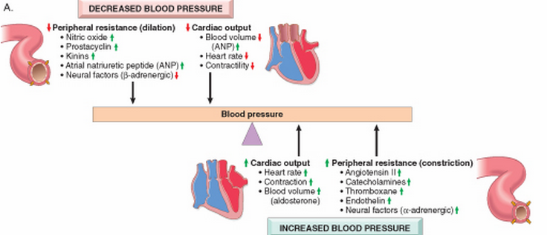
Blood pressure regulation
Blood pressure is a function of cardiac output and peripheral vascular resistance → two hemodynamic variables that are influenced by multiple genetic, environmental, and demographic factors

Slide 10
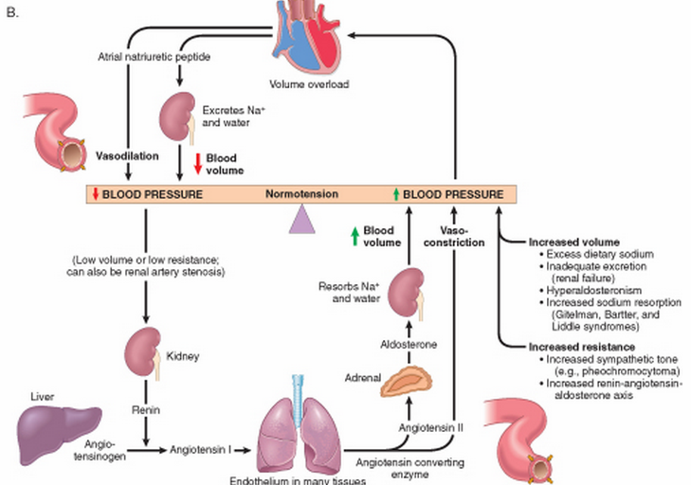
Renin-angiotensin-aldosterone and atrial natriuretic peptide rule

Slide 11
Postulated mechanisms of Essential Hypertension
1.Defect in sodium excretion (increased sodium resorption or decreased excretion)
2.Defect in cell membrane function:
-Na/Ca transport
-Increased vasoconstrictive response
3.Increased sympathetic response
Notes:
Liddle syndrome is caused by mutation of ENaC leading to hypertension causing increased distal tubular resorption of sodium induced by aldostrone.

Slide 12
Hypertension Remember!
Peripheral resistance is regulated predominantly at the level of the arterioles
Defective sodium excretion in the presence of normal arterial pressure is probably a key initiating event for the pathogenesis of most forms of hypertension

Slide 13
Hypertension Vascular pathology
Accelerate atherogenesis
Arteriosclerosis (particularly in the kidney), lead to thick wall and narrow lumen
It can be either:
Hyaline arteriosclerosis
Hyper plastic arteriosclerosis (in malignant HTN)
Notes:
.

Slide 14
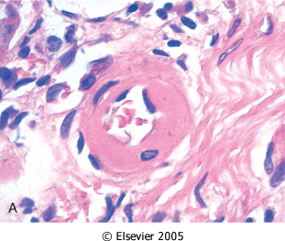
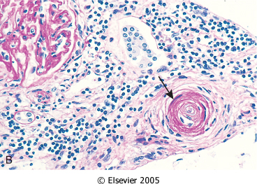
Hyaline arteriolosclerosis. : The arteriolar wall is thickened with increased protein deposition (hyalinized), and the lumen is markedly narrowed
Hyperplastic arteriolosclerosis (onion-skinning; arrow) causing lumenal obliteration (arrow).

Slide 15
Malignant Hypertension
B.P > 210/120 mm Hg
It leads to :
Rapidly progressive end organ damage.
Renal failure
Hypertensive encephalopathy.
Left ventricular failure.
Retinal hemorrhages and exudates, with papilledema
Leads to death in 1 or 2 years if untreated.
Notes:
It is a hypertensive emergency which can complicate any type of HTN

Slide 16
Hypertension Other major complications
Coronary heart disease
Cerebrovascular accidents
Cardiac hypertrophy and heart failure (hypertensive heart disease)
Aortic dissection
Renal failure
Retinopathy
Notes:
Reduction of blood pressure dramatically reduces the incidence and death rates from IHD, heart failure, and stroke

Slide 17
Cerebral Infarction (Stroke) :
Haemorrhagic
Necrosis

Slide 18
Systemic hypertensive heart disease
Criteria :
left ventricular hypertrophy (usually concentric) in the absence of other cardiovascular pathology
History or pathologic evidence of hypertension
The free LV wall is > 2cm and the weight of the heart is > 500 grams.
Long-term dilatation and wall thinning.
Treatment of HTN helps recovery
Notes:
Hypertensive heart disease (HHD) -> increased demands placed on the heart by hypertension->pressure overload and ventricular hypertrophy.
Although most commonly seen in the left heart as the result of systemic hypertension, pulmonary hypertension can cause right-sided HHD, or cor pulmonale

Slide 19
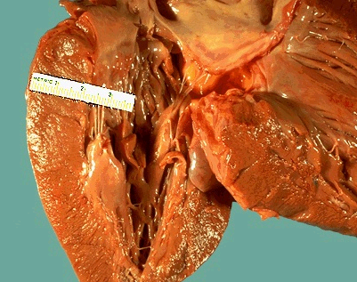
This left ventricle is very thickened (slightly over 2 cm in thickness), but the rest of the heart is not greatly enlarged.
This is typical for hypertensive heart disease.
The hypertension creates a greater pressure load on the heart to induce the hypertrophy.

