Slide 1
Cardiovascular practical Block
Practical II

Slide 2
Cardiovascular practical Block
8-Chronic venous congestion of the liver

Slide 3
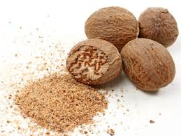
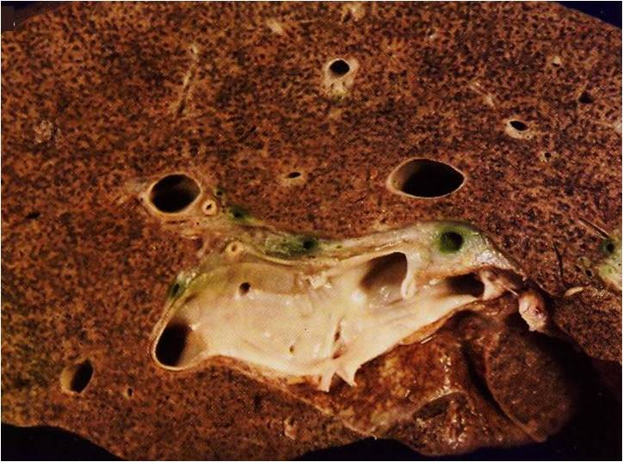
NUTMEG LIVER
Section of liver showing alternating pale and dark areas with a nutmeg like appearance possibly due to passive congestion secondary to right sided heart failure.

Slide 4
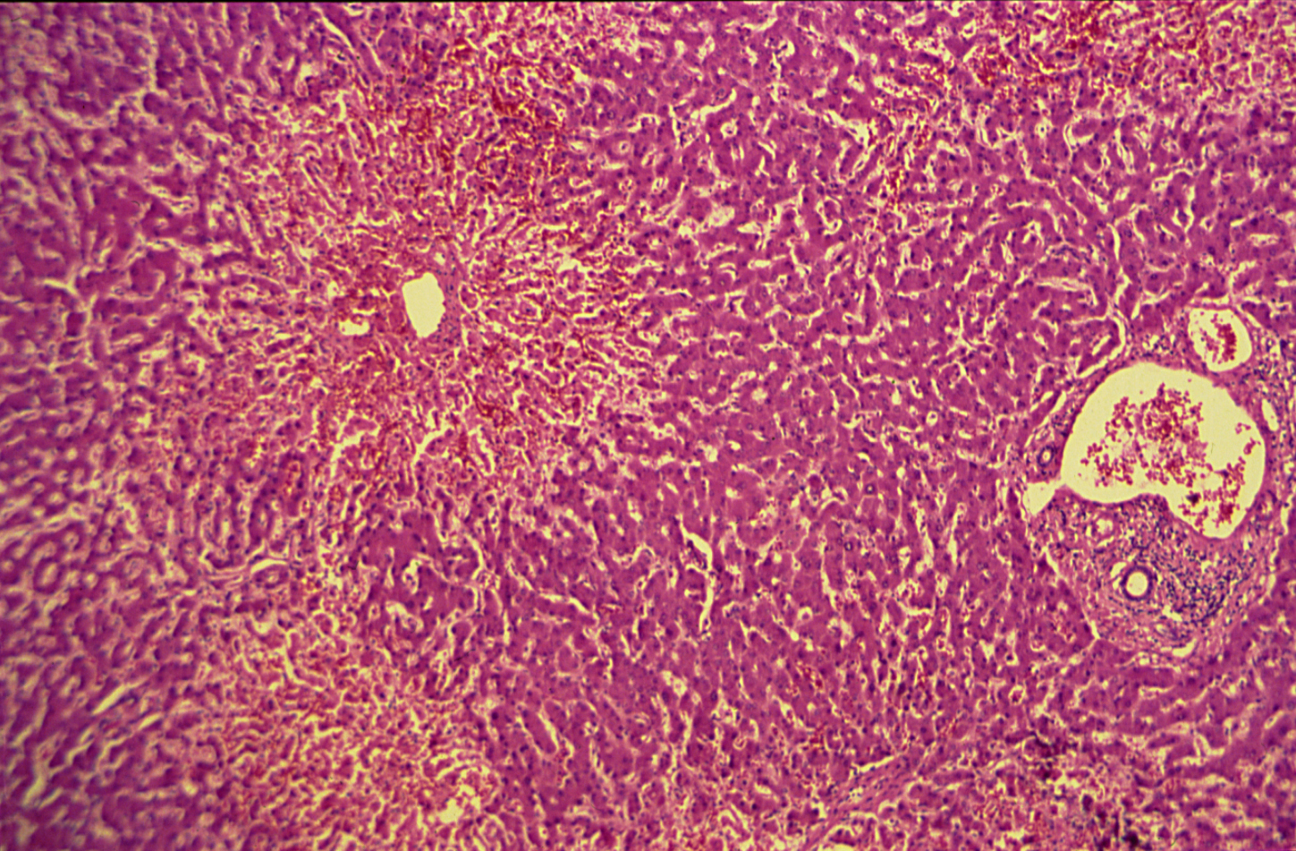
Cardiovascular Block

Slide 5
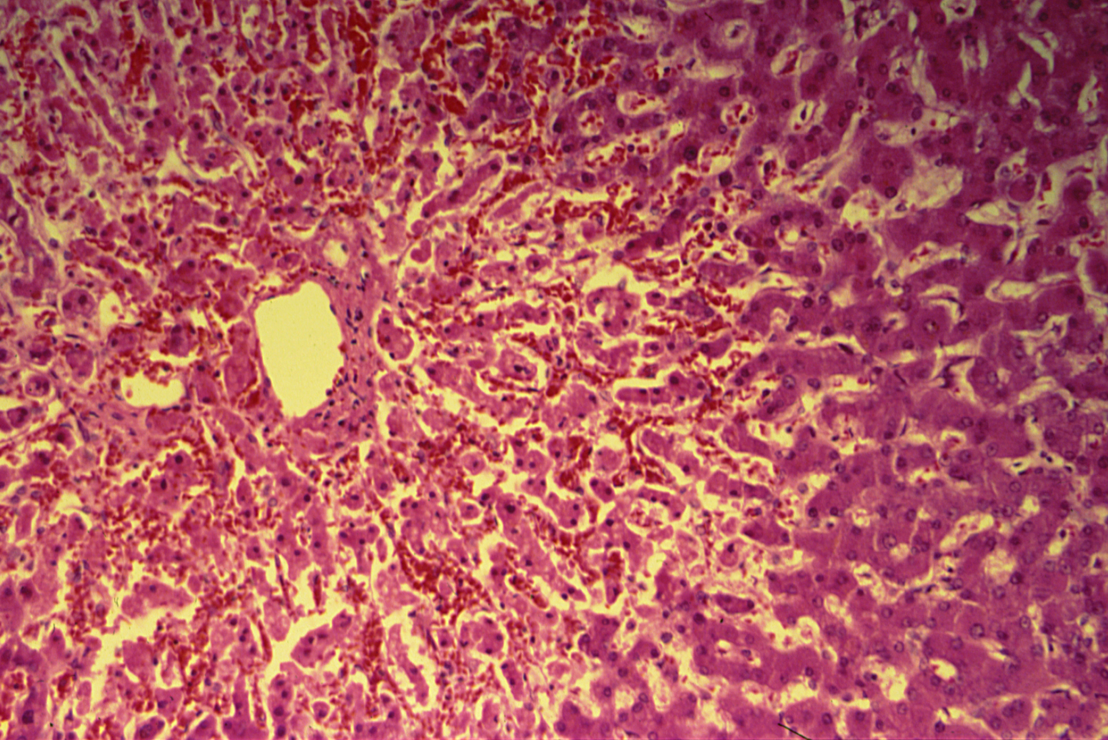
Cardiovascular Block

Slide 6
Chronic venous congestion of the liver: Section of liver shows:
The central portion of liver lobules shows:
Congestion and dilatation of central veins and blood sinusoids,
Atrophy and necrosis of liver cells.
Kupffer cells contain few brown haemosiderin pigment granules.

Slide 7
Cardiovascular practical Block
9-Chronic venous congestion of the lung

Slide 8
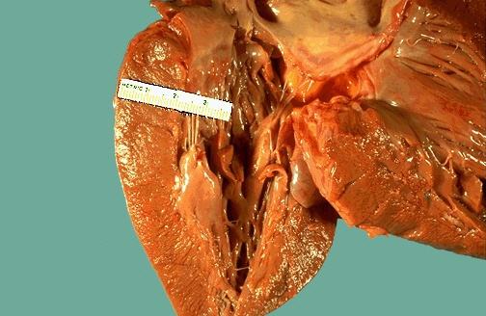
Left ventricular hypertrophy.
Thickened left ventricular wall most likely due to hypertension.

Slide 10
Chronic venous congestion of the lung: Section of lung shows:
The alveolar walls are thickened by dilated and engorged capillaries.
The alveoli are dilated and contain edema fluid, red blood cells and large alveolar macrophages (heart failure cells), which are filled with haemosiderin pigment derived from red cells breakdown.
The likely cause of CVC lung is Heart Failure.

Slide 11
Cardiovascular Block
10-Thromboangitis oblitrans (Buerger disease)

Slide 12
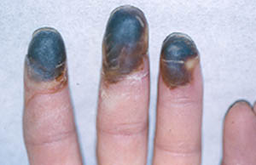
10-Thromboangitis oblitrans (Buerger`s disease)
Black discoloration of fingers consistent with early gangrene.

Slide 13
Thromboangiitis obliterans
Also known as Buerger's disease, is a recurring segmental thrombosing (clotting), acute and chronic inflammation of small and medium arteries and veins of the hands and feet.
It is strongly associated with use of tobacco products.

Slide 14
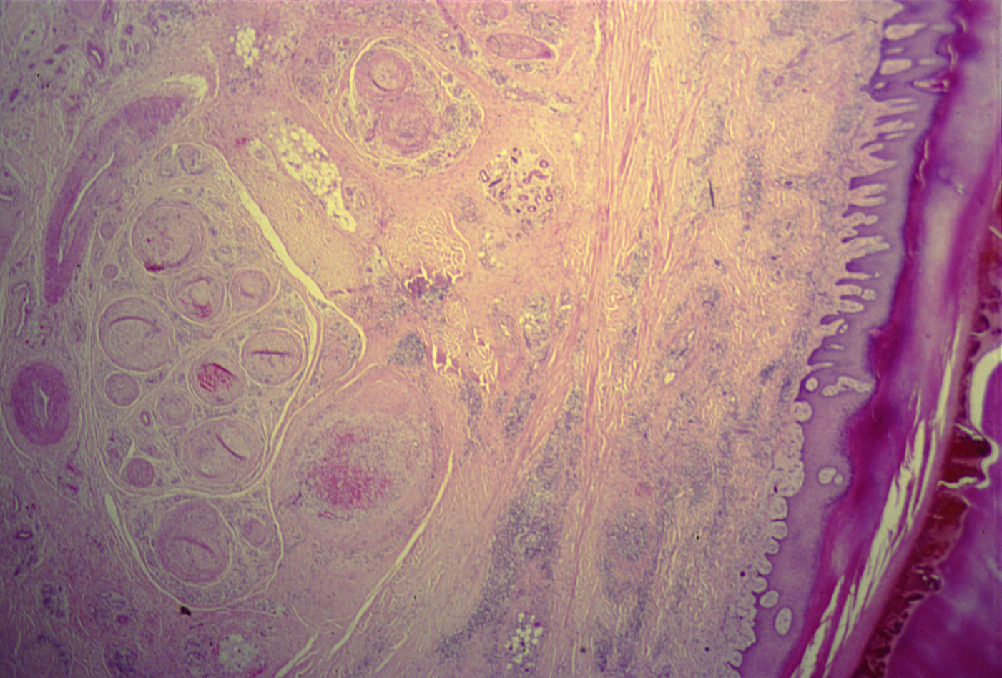
Cardiovascular Block

Slide 15
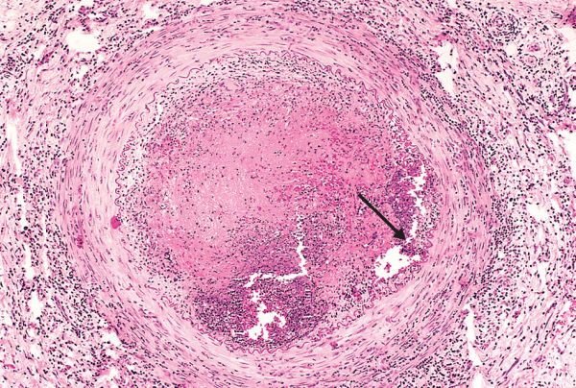
BUERGER’S DISEASE

Slide 16
Thromboagitis obliterans (Buerger’s disease):
Thrombosis and luminal obliteration of the blood vessels
Segmental inflammatory infiltration in the blood vessel wall (arteries and veins) comprising of mainly neutrophills

Slide 17
Cardiovascular practical Block
11-Giant cell ( temporal ) arteritis

Slide 18
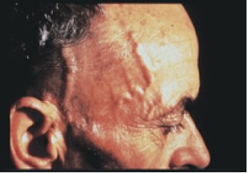
Giant cell arteritis
Tender and thickened scalp veins

Slide 19
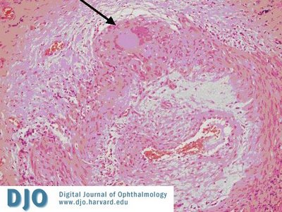
Giant cell arteritis
Superficial temporal artery biopsy - intimal thickening and medial damage, giant cells with inflammatory cell infiltration in the internal elastic lamina

Slide 20
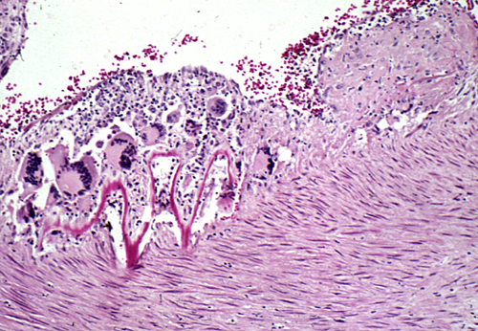
Giant cell (temporal) arteritis:
Disruptions of the elastic lamina with inflammation and giant cells.
Notes:
Segmental inflammatory lesions with intimal thickening , medial granulomatous inflammation with giant cells and chronic inflammatory cells and internal elastic lamina fragmentation .

Slide 21
Cardiovascular practical Block
12-Leukocytoclastic / hypersensitivity vasculitis ( microscopic polyangitis)/
Pauci immune vasculitis

Slide 22
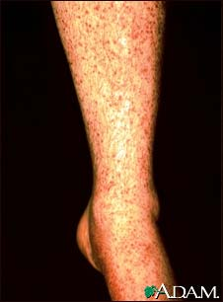
Notes:
This condition might be complicated by glomerulonephritis and hemoptysis due to pulmonary capillaritis .

Slide 23
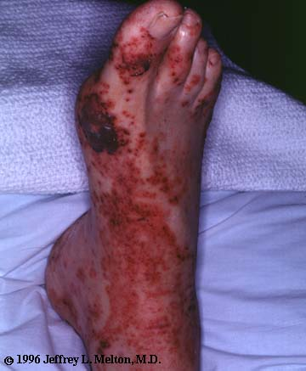
Leukocytoclastic vasculitis, foot. The purpuric eruption (Subcutaneous bleeding patches)
tends to be most pronounced on dependent areas.

Slide 24
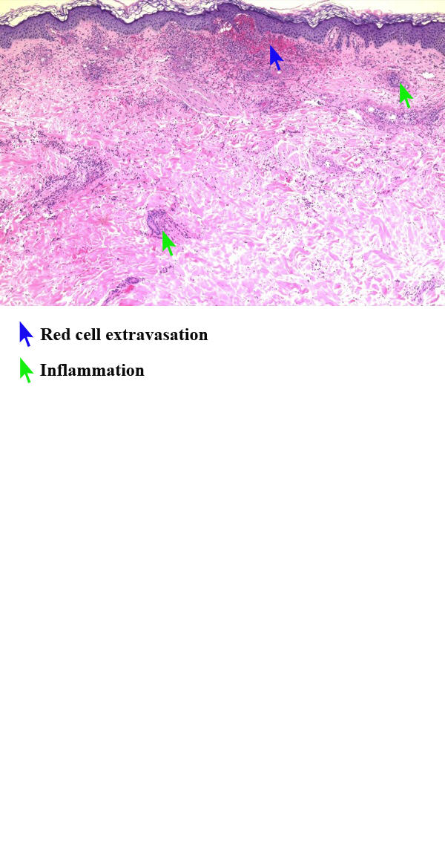
Vasculitis, leukocytoclastic, (low power)

Slide 25
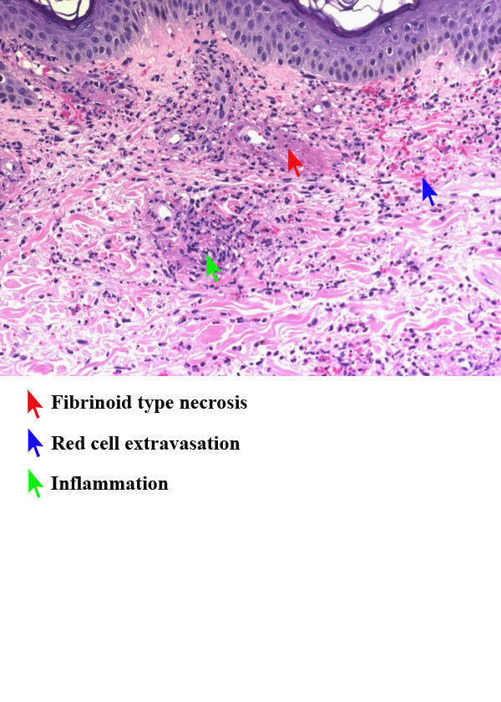
Notes:
Section of the skin shows fibrinoid necrosis of blood vessels with extravasation of RBCs , neutrphilic infiltration with debris (leukocytoclasis ) .

