Slide 1
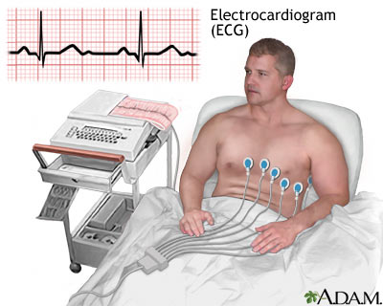
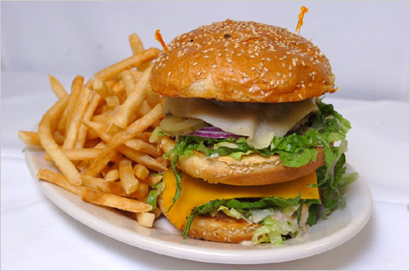
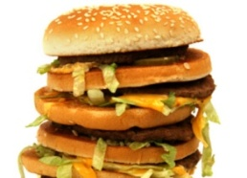
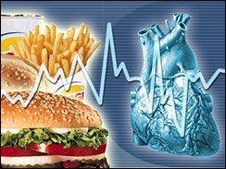
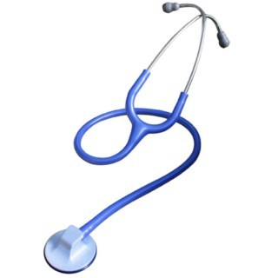
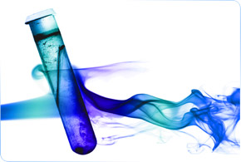
?
?
AMI
HEART ATTACK

Slide 2
HYPERLIPIDEMIA ???
Is the most common form of dyslipidemia
Denotes abnormallyLEVELS of any or all LIPIDS &/or LIPOPROTEINS [LP] in blood
NORMAL Levels
TGs & C
TGs  < 220 mg/dl
C  < 200 mg/dl
LDL  < 130 mg/dl
HDL  > 50 mg/dl
Hypertriglyceridemia
Hyper-cholesterolemia
Mixed
If Above  Hyperlipidemia
◉
Familial Hyperlipoproteinemia
CM, VLDL, IDL, LDL, HDL
Hyperlipoprotienemia
* Denotes usually  LDL
* Unless specified in the familial types
LProteinemia | LP | Lipids | Risk
Type I | CM | TGs | -
Type IIa | LDL | C | 
Type IIb | VLDL & LDL | TG & C | 
Type III | IDL | TGs & C | 
Type IV | VLDL | TGs | 
Type V | VLDL & CM | TGs & C | _

Slide 3
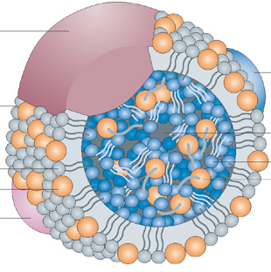
LP
Chylomicrons
[CM]
Very low Density lipoprotein
[VLDL]
Low Density lipoprotein
[LDL]
High Density lipoproteins
[HDL]
APOPROTEINS
OUTER Coat
INNER Core
Phospholipids Cholesterol
Triglycerides
Cholesterol esters
Hydrophilic Gps.
Lipophylic Gps.
% Lipid
Composition
C
TGs
Protein
Triglycerides
Cholesterol
Phospholipids

Slide 4
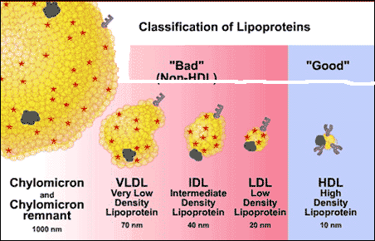
LP
Chylomicrons
[CM]
Very low Density lipoprotein
[VLDL]
Low Density lipoprotein
[LDL]
High Density lipoproteins
[HDL]
[IDL]
DENSITY
TYPE of
Apoprotein
B 48
B100
AI&II
Beta LP
Alpha LP
Non-HDL Cholesterol
HDL Cholesterol
ATHEROGENIC
ATHEROPROTECTIVE

Slide 5
LP REMODELING

Slide 6
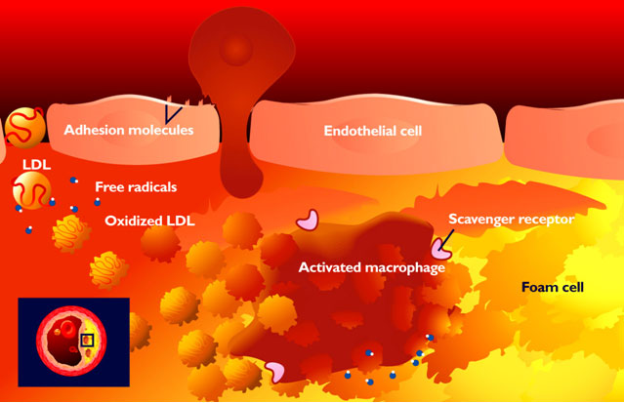
THE STORY OF ATHEROGENESIS
Begins as INFLAMMATORY REACTION triggered by;
Endothelial dysfunction + Dyslipidemia
Rolling
Scrolling
LDL leak
MC
Diapedesis
Expression
Dysfunction
Trapping
SR-A
Engulf Ox -LDL
No efflux
SR-A

Slide 7
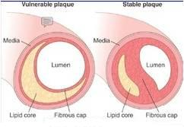
THE STORY OF ATHEROGENESIS
Progress as FIBRO-PROLIFERATIVE DISORDER
Fibrous cap
Lumen
Lipid
Core
Shoulder
Atheromatus Plaque
Rapidity of lipid accumulation & apoptosis
Intima
Proliferative (fibrous) vs Inflammatory (proteolysis)
Media
Elastic
laminæ
Internal
External
Divide into
> Lipid core
< fibrous cap (thin)
> Inflammatory cells

Slide 8
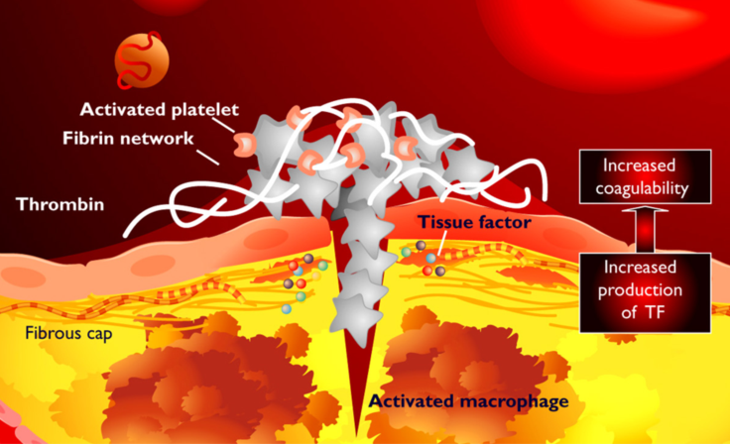
THE STORY OF ATHEROGENESIS
Switch into ATHER-THROMBOTIC INSULT at any stage of progression
= ACSs, Stroke, …etc.

Slide 9
ATHEROGENESIS PROGRESSION ALONG AGE

Slide 10
ATHEROGENESIS & CLINICAL EVENTS
DYSLIPEDEMIA
ENDOTHELIAL DYSFUNCTION
MORBIDITY & MORTALITY OUTCOMES
PREVENTED or DECREASED
By CONTROLLING DYSLIPIDYMIA

Slide 11
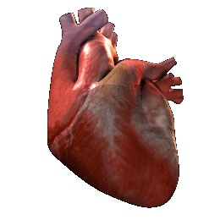
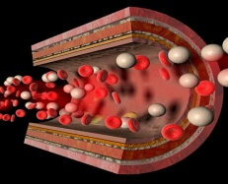
Coronary SUPPLY
Pumping  Cardiac Work DEMAND (O₂)
O₂
G
ATP
FFA
O₂
G
O₂
O₂
O₂
ATP
G
O₂
O₂
FFA
FFA
G
O₂
ATP
INCREASED DEMAND
IMPAIRED SUPPLY
ISCHEMIC HEART DISEASE [IHD]

Slide 12
Coronary SUPPLY
Pumping  Cardiac Work DEMAND (O₂)
IMPAIRED
INCREASED
Coronary Narrowing  by
Spasm
Atherosclerosis lesion
Cardiac Work
 Heart Rate
Load; i.e  BP…etc.
Force; Hypertrophy
CORONARY HEART DISEASES [CHD]
Coronary Filling (in diastole)  by
diastolic time
diastolic pressure …etc
?
?
?
ISCHEMIC HEART DISEASE [IHD]

Slide 13
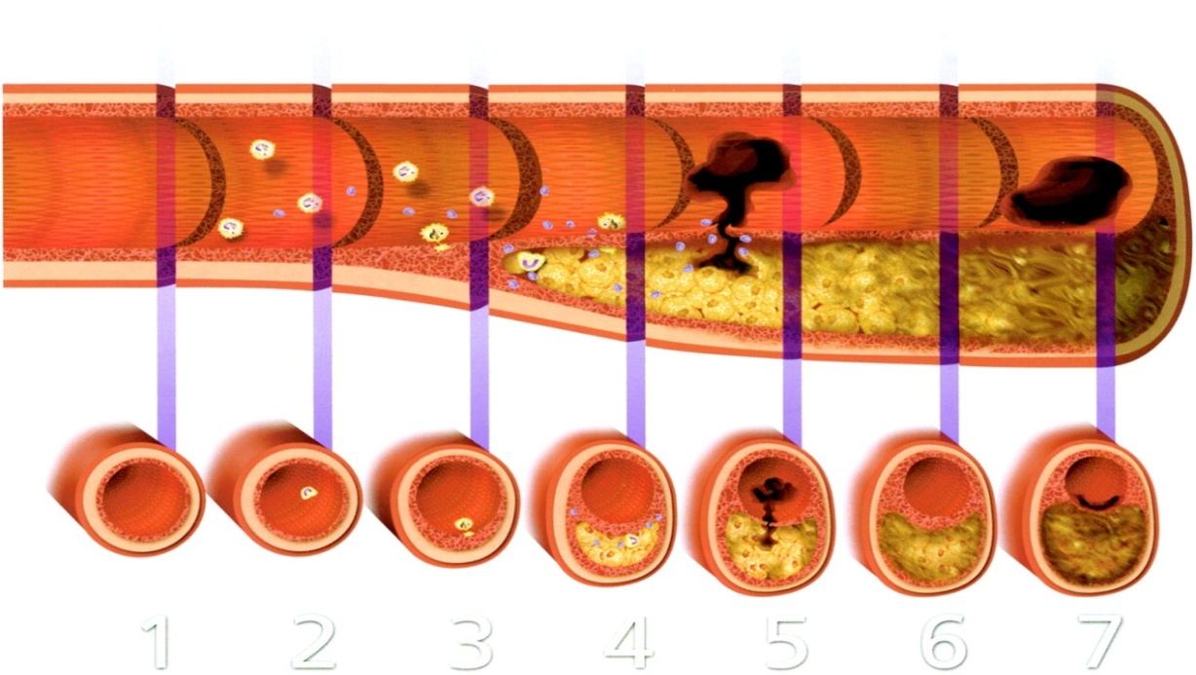
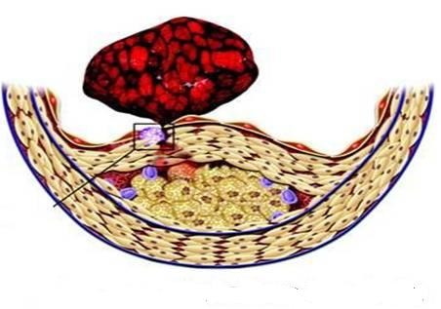
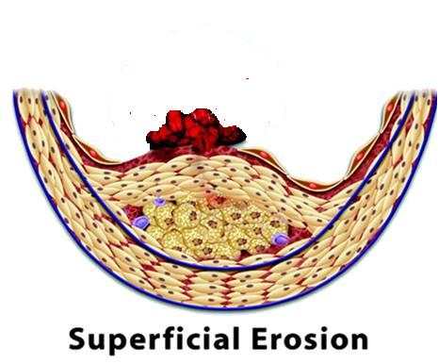
CORONARY HEART DISEASES [CHD]
FUNCTIONAL
STRUCTURAL
SPASM
ATHEROSCLEROTIC PLAQUE
Stabilized
Vulnerable
+ THROMBOSIS
Fissure at Classifications

Slide 14
CORONARY HEART DISEASES [CHD]
FUNCTIONAL
STRUCTURAL
SPASM
ATHEROSCLEROTIC PLAQUE
SPASTIC ANGINA
Prinzmetal’s Angina
Stabilized
Vulnerable
+ THROMBOSIS
ANGINA
STABLE ANGINA
Acute ~Subtotal / Total OCCLUSION
UNSTABLE ANGINA
MYOCARDIAL INFARCTION [AMI]
Sustained Spasm
ACUTE CORONARY SYNDROME [ACS]
ISCHEMIC HEART DISEASE [IHD]

Slide 15
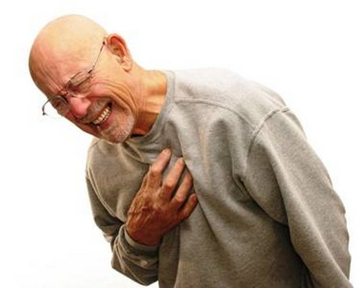
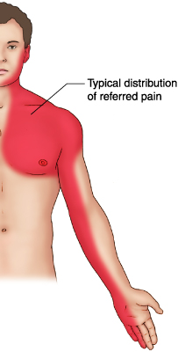
ANGINA Pectoris
By a Spasm or Stabilized Plaque
Chest pain (varying in severity) due to ischemia of heart muscle caused by obstruction or spasm of coronary arteries
Constricting & tight, oppressive, crushing
Starts in the centre behind the sternum or on left side of the front of chest & spread out to shoulder arm…..
Pain is due to (accumulation of metabolites K⁺, PGs, Kinins, Adenosine….) 2^{ndry} to the ischemia
Weak relationship between severity of pain & degree of O₂ deprivation in the heart muscle (i.e., severe pain can occur with little or no risk of a heart attack, and a heart attack can occur without pain).
Prinzmetal’s Angina
Stable Angina
Unstable Angina
Vulnerable Plaque
VARIANT ANGINA
EFFORT ANGINA
CRESCENDO ANGINA
Occurs at rest Cyclic (vasospasm) due to contraction of VSMC
>in younger women
Develops by exertion
Resolves at rest
Lasts ~5 min
Insidious onset
Occurs at rest / minimal exertion
Severe / Lasting >10 min; Either of;
* New onset (nothing for last 4–6 w)
* Crescendo pattern; getting > severe / prolonged / frequent than previous

Slide 16
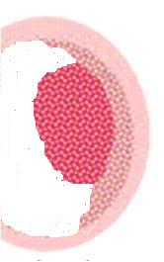
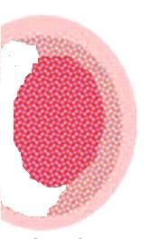
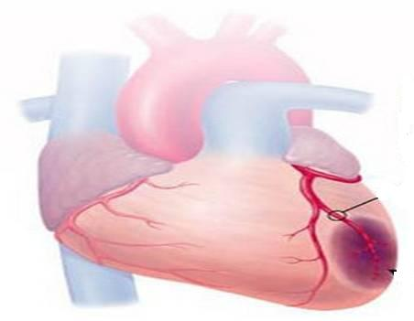
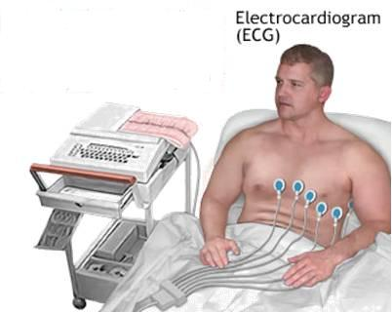
ACUTE CORONARY SYNDROMES [ACS]
Acute ~Subtotal / Total OCCLUSION
Umbrella term that covers a spectrum of acute clinical conditions ranging from
Unstable angina (38%)
NSTEMI (25%)
STEMI (30%)
ATP, Ion PumpsCa 
~~Action Potention, elect. Activities & functions
Inflam. Mediators, ROS TNFα, NF_{κ}B, ….
Apoptosis
Proteolysis, Membrane damage….
Cardiac Enzymes (Markers)
ECG CHANGES
Necrosis
Non ST – Elevation
ST – Elevation
-ve
+ve
Unstable Angina
AMI
AMI
NSTEMI
STEMI

Slide 17
A heart Attack

