Slide 1
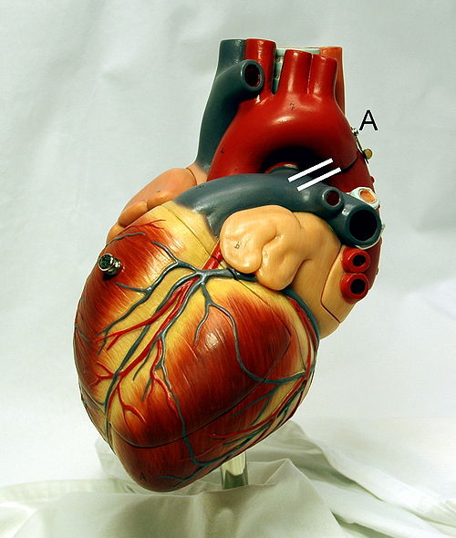
Cardiovascular System Block Contractile Mechanism in Cardiac Muscle (Physiology)
Dr. Mona Soliman, MBBS, MSc, PhD
Associate Professor
Department of Physiology
Chair of Cardiovascular Block
College of Medicine
King Saud University

Slide 2
Objectives
Define cardiac muscle contractility
Understand the phases of cardiac action potential and the ionic bases
Discuss the role of calcium ions in the regulation of cardiac muscle function
Describe the mechanism of excitation contraction coupling
Factors affecting cardiac contractility

Slide 3
Physiology of the Cardiac Muscle
Intercalated discs: cell membranes, separate individual cardiac muscle cells from one another
Gap Junctions: trans-membrane channel proteins, connecting the cytoplasm of the cells
Allow free diffusion of ions
Action potentials travel from one cardiac muscle cell to another

Slide 4
Physiology of the Cardiac Muscle
Cardiac Muscle is a Syncytium:
Stimulation of a single muscle fiber
→ the action potential spreads from cell to cell through the gap junctions
→ contraction of all the muscle fibers

Slide 5
Action Potential in Cardiac Muscle
Resting membrane potential -85 mV
Phases of Action Potential in Cardiac Muscle:
Rapid depolarization (+20 mV)
Partial repolarization (5-10 mV)
Action potential plateau (0 mV)
Repolarization (back to RMP)

Slide 6
Action Potential in Cardiac Muscle
Phases of cardiac Action Potential | Ionic changes
Rapid depolarization (+20 mV) | Fast sodium channels Na⁺ in
Partial repolarization (5-10mV) | K⁺ out
Action potential plateau (0 mV) | Slow calcium channels Ca²⁺ in
Repolarization (back to RMP) | K⁺ out

Slide 7
Action Potential in Cardiac Muscle
What causes the Plateau in the Action Potential?
Slow calcium channels: slow to open & remain open
→ Large quantity of calcium ions flow to the interior of the cardiac muscle fiber
Maintains prolonged period of depolarization
Causing the plateau in the action potential
Decreased permeability of the cardiac muscle membrane for potassium ions that result from the excess calcium influx
→decrease outflux of potassium ions during the action potential plateau

Slide 8
Refractory Period of Cardiac Muscle
Cardiac muscle is refractory to re-stimulation during the action potential
The refractory period of the heart: is the interval of time during which a normal cardiac impulse cannot re-excite an already excited area of cardiac muscle

Slide 9
Refractory Period of Cardiac Muscle
Absolute refractory period
Cardiac muscle cannot be excited while it is contracting … benefit?
Long ARP
Time: depolarization and 2/3 repolarization
Duration: 0.25- 0.3 sec
Relative refractory period
Cardiac muscle can be excited by strong stimulus
Time: repolarization
Duration: 0.05 sec

Slide 10
Excitation – Contraction Coupling
Excitation – Contraction Coupling: is the mechanism by which the action potential causes muscle contraction
Action potential spreads to the interior of the cardiac muscle fiber along the transverse (T) tubules

Slide 11
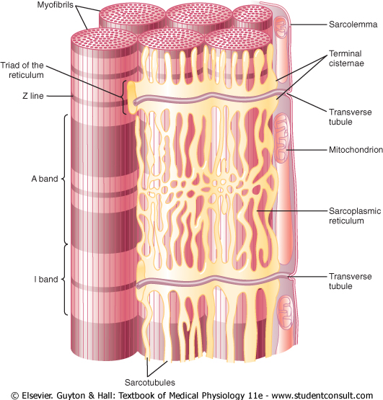
Transverse (T) tubule-sarcoplasmic reticulum system

Slide 12
Excitation – Contraction Coupling
Action Potential spreads along the T-tubules
1. Release of calcium ions from sarcoplasmic reticulum
into the sarcoplasm
2. Large quantity of extra calcium ions diffuses into the sarcoplasm from the T tubules

Slide 13
Excitation – Contraction Coupling
Calcium ions diffuse into the myofibrils
Ca²⁺ binds to troponin causing
sliding of actin and myosin filaments
Contraction of cardiac muscle

Slide 14
Excitation – Contraction Coupling
At the end of the Plateau of the action potential
→ calcium ions are pumped back into the sarcoplasmic reticulum and the T-tubules
→ contraction ends (repolarization)

Slide 15
Excitation – Contraction Coupling
The T tubules of cardiac muscle have a diameter 5 times as great as that of the skeletal muscle tubules.
The strength of contraction of cardiac muscle depends to a great extent on the concentration of calcium ions in the extracellular fluids

Slide 16
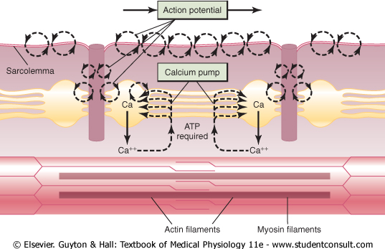
Excitation-contraction coupling in the muscle

Slide 17
Excitation-contraction coupling in the muscle
Each contraction involves the hydrolysis of an ATP molecule for the process of contraction and sliding mechanism
Cardiac muscle are continually contracting and require substantial amounts of energy
The energy is derived from ATP generated by oxidative phosphorylation in the mitochondria
The myocytes contain large numbers of mitochondria

Slide 18
The Contractilityof the Cardiac Muscle
Contractility is the force of contraction of the heart
It is essential for the pumping action of the heart
Ionotropic effect: mechanism that affect the contractility
Positive Ionotropic Effects: factors that increase the cardiac contractility
Sympathetic stimulation
Calcium ions
Negative Ionotropic Effects: factors that decrease the cardiac contractility
Parasympathetic stimulation
Acetylcholine
Vagal stimulation

Slide 19
For further readings and diagrams:
Textbook of Medical Physiology by Guyton & Hall
Chapter 9 (Heart Muscle)

