Slide 1
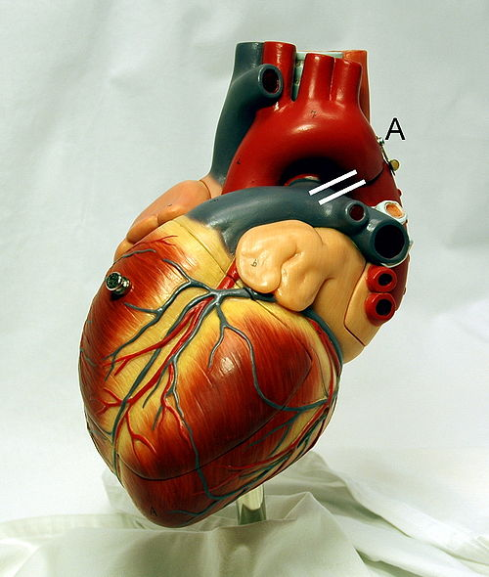
Cardiovascular System Block The Electrocardiogram (ECG)
Dr. Mona Soliman, MBBS, MSc, PhD
Department of Physiology
Chair of Cardiovascular Block
College of Medicine
King Saud University

Slide 2
Lecture Objectives
Identify waves of the normal ECG and the physiological cause of each
Define the normal intervals in the ECG trace
Determine the bipolar, unipolar and chest leads

Slide 3
The Normal Electrocardiogram (ECG)
The depolarization wave spread through the heart
↓
electrical currents pass into the surrounding tissue
↓
part of the current reaches the surface of the body
The electrical potentials generated by these currents can be recorded from electrodes placed on the skin opposite the heart

Slide 4
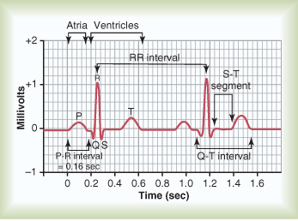
The Normal Electrocardiogram (ECG)
The Electrocardiogram (ECG) is a recording of the electrical activity of the heart

Slide 5
The Normal Electrocardiogram (ECG)
P wave: is caused by atrial depolarization
QRS complex: is caused by depolarization of the ventricles
T wave: repolarization of the ventricles

Slide 6
Voltage and Calibration of the ECG
The vertical calibration lines: Voltage(millivolt)
5 small lines = 1 mV
The horizontal calibration lines: Time (seconds)
1 inch(25 small lines) = 1 second
Each inch is divided by 5 dark vertical lines
The interval between the dark lines= 0.2 second
thin line=0.04 second

Slide 7
P-R interval
It is the time between the beginning of the P wave and the beginning of the QRS complex
It is the interval between the beginning of electrical excitation of the atria and the beginning of excitation of the ventricles
The P-R interval is about 0.16 second

Slide 8
Q-T interval
Contraction of the ventricles last from the beginning of the Q wave to the end of the T wave
Q-T interval is the time from the beginning of the Q wave to the end of the T wave
Q-T interval is about 0.35 second

Slide 9
Heart Rate
The heart rate is the repetition of the time interval between two successive heartbeats
If the interval between 2 beats is 1 second , the heart rate is 60 beats per minute

Slide 11
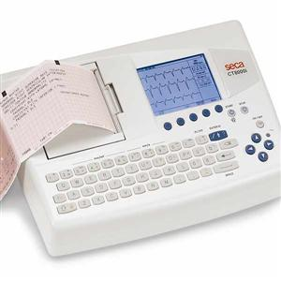
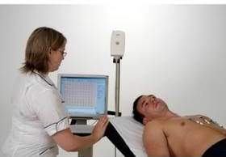
Methods for Recording Electrocardiograms
Computer-based and electronic display
Pen recorder and a moving sheet

Slide 12
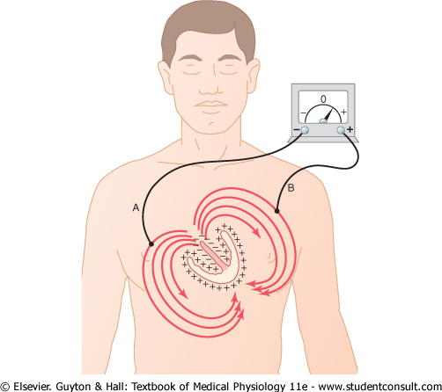
Flow of Electrical current in the Heart
In normal ventricles, current flows from negative to positive from the base of the heart toward the apex
The first area that depolarizes is the ventricular septum

Slide 13
Flow of Electrical current in the Heart
Current flows from the electronegative inner surface of the heart to the electropositive outer surface (from the base of the heart to the apex)
An electrode placed near the base of the heart is electronegative, and near the apex is electropositive

Slide 14
The ECG Leads
Lead: two wires and their electrodes to make a complete circuit
The Bipolar Limb Leads: (I, II, III)
Chest Leads: (V1, V2, V3, V4, V5, V6)
Augmented Unipolar Limb Leads (aVR, aVL, aVF)

Slide 15
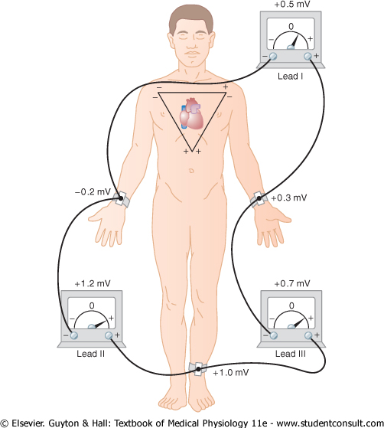
The Bipolar Limb Leads
Bipolar: means that the ECG is recorded from two electrodes
Lead I:
The right arm : –ve
The left arm: +ve
Lead II:
The right arm: -ve
The left leg: +ve
Lead III:
The left arm: -ve
The left leg: +ve

Slide 16
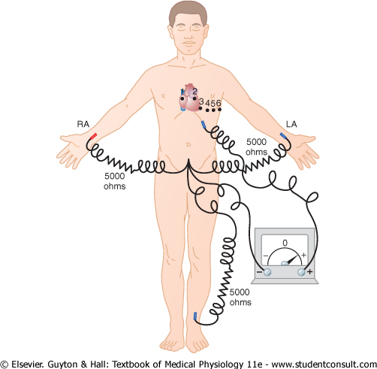
Chest Leads
Recorded from the anterior surface of the chest (V1, V2, V3, V4, V5, V6)
Positive electrode on the chest
The indifferent electrode is the negative electrode connected to the right arm, left arm, and left leg

Slide 17
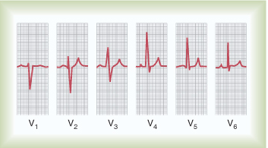
Chest Leads
V1 and V2: QRS are mainly negative because the chest leads are nearer to the base of the heart
V3,V4 and V6 are mainly positive because the chest electrode are nearer to the apex

Slide 18
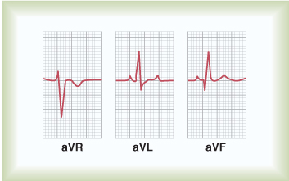
Augmented Unipolar Leads
The two limbs are connected to the negative terminal of the ECG, and the third limb is connected to the positive
When the positive terminal is on:
The right arm (aVR)
The left arm (aVL)
The left leg (aVF)
All are similar to the standard limb leads
aVR lead is inverted

Slide 19
Practical use of the ECG
Heart rate
Normal intervals
Rhythm
Regular
Single p-wave precedes every QRS complex
P-R interval is constant and within normal range
Cardiac axis Axis

Slide 20
Einthoven’s Triangle
Enthoven’s Triangle: is drawn around the area of the heart
The two apices at the upper part of the triangle represent the points at which the two arms connect electrically
The lower apex is the point at which the left leg connects

Slide 21
Einthoven’s Law
Einthoven’s Law: if the electrical potential of any two of the three bipolar limb leads are known, the third one can be determined mathematically by summing the first two (note the +ve and -ve signs)
The sum of the voltage in Lead I + Lead III= Lead II
Einthoven’s law

Slide 22
For further readings and diagrams:
Textbook of Medical Physiology by Guyton & Hall
Chapter 11 (The Normal Electrocardiogram)

