Slide 1
Cardiovascular practical Arterial blood pressure
By Dr. Asma M. Al yahya
Physiology dept
College of medicine
KSU

Slide 2
As a medical student are you ready for any emergencies ?
Its one of those nice Thursdays and your mother has invited some relatives for dinner, and you are helping her preparing for the party.
By 7 o’clock in the evening every body has come, and things are running smoothly.
Just before dinner one of the elderly guests complains of a severe headache.
Every body turns to you, as your are the only medical professional present.
How would you approach the situation.

Slide 3
What happened to poor aunt Norah?
Aunt Norah is a regular patient that comes to your clinic for check up, she is 70 years old and hypertensive. She comes in today for her routine check up, she has no complaints and her blood pressure is 120/80 on medication.
You ask her to go on the couch for examination, after you finish your examination, you tell her everything is fine.
While you are recording your notes, she gets up from the couch, but she feels dizzy and nearly falls; thank god you were there in the right moment to prevent a tragic fall. You help her to lie on the couch.
what do you think happened to poor aunt Norah and how would manage such a situation.

Slide 4
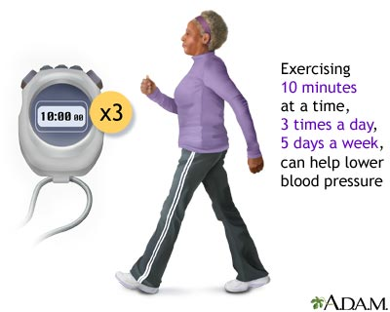
Objectives
To be capable of measuring BP
To recognize the effects of gravity and muscular exercise on BP

Slide 5
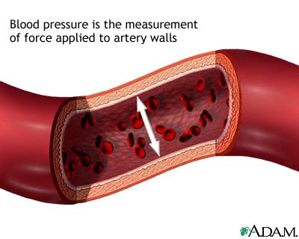
What is BP
Notes:
Blood Pressure: is measurement of the force exerted by blood against the walls of the arteries as the heart contracts and relaxes.

Slide 6
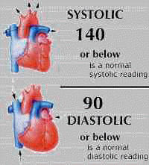
Systolic blood pressure
Notes:
The pressure in the large arteries when the heart is contracted

Slide 7
Diastolic Blood pressure
Notes:
The pressure in the large arteries when the heart is relaxed

Slide 8
What is the pulse pressure
Notes:
Pulse Pressure is most easily defined as being the amount of pressure required to create the feeling of a pulse.
Normal value 40
Narrow in decreased SV: shock, CHF
Wide: stiff art,AR,AV malformation, hyperthyroidism, anaemia,pregnancy,fever,exercise
A high resting pulse pressure is harmful and tends to accelerate the normal aging of body organs, particularly the heart, the brain and kidneys.

Slide 9
The mean arterial pressure (perfusion pressure)
Notes:
The mean pressure is given approximately by the sum of the diastolic pressure and one third of the pulse pressure
Normal:70-110
mAP< 60 ischemia

Slide 10
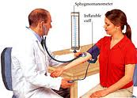
Methods for measuring arterial BP
Palpatory Auscultatory

Slide 11
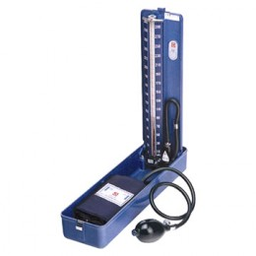
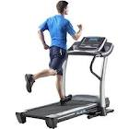
Equipment
Notes:
Stethoscope
Sphygmomanometer
Bicycle ergometer and /or treadmill

Slide 12
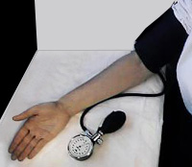
Palpatory method
Notes:
The relaxed subject sits on a chair.
The cuff of the sphygmo is wrapped firmly around the right arm above the elbow.
The lower arm should be resting on a bench.
The radial pulse is palpated with the fingers of the left hand.
The number of beats in 30 seconds is counted, and the heart rate in beats per minute is recorded.
The valve on the inflating bulb of the sphygmomanometer is closed.
The cuff is inflated slowly (10 mm Hg/sec) until the radial pulse is no longer felt.
The cuff is inflated further until the pressure is about 30 mm Hg higher.
The valve on the inflating bulb is opened slightly, allowing the pressure to drop slowly by about 5 mm Hg/sec.
At some point, one will be able to feel the radial pulse once again.
The pressure indicated on the gauge when the pulse reappears is noted.
This is the systolic pressure.
Now the pressure in the cuff is quickly released, so as not to cause undue discomfort to the subject.

Slide 13
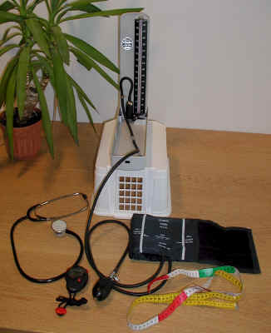
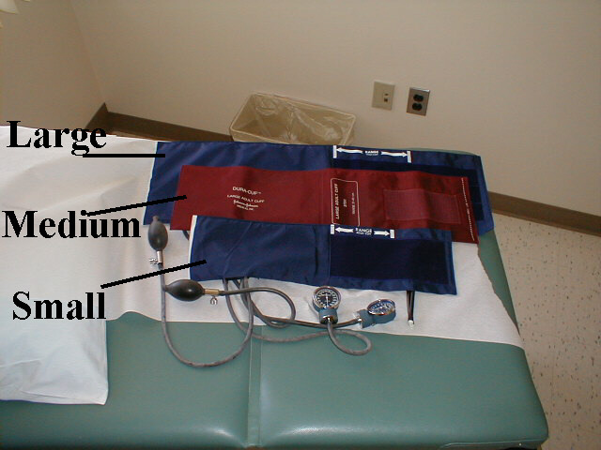
Auscultatory method
Notes:
Nancy and Sarah are now going to demonstrate the correct way to measure blood pressure, we will go over each step as they do it
Seated for 5 minutes
No smoking, caffeine or vigorous exercise for 30 minutes before
Patient Position
Sit straight, both feet flat on floor, arm at slightly more than 90 degree angle on table with crease in elbow level with heart
Expose Upper arm
Use the right arm- for accuracy and for consistency
Center of upper arm at heart level
Elbow slightly flexed, Forearm with the palm facing upwards and supported on flat surface

Slide 14
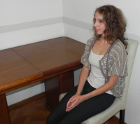
Auscultatory method, cont.
Notes:
Seated for 5 minutes
Patient Position
Expose Upper arm, cuff size
Center of upper arm at heart level

Slide 15
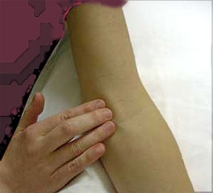
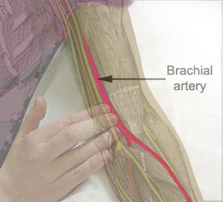
Auscultatory method, cont.
Locate brachial artery
Notes:
Locate brachial artery

Slide 16
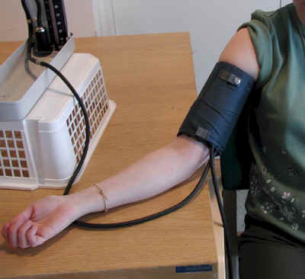
Auscultatory method cont.
Notes:
Make sure cuff is correct size
Cuff applied 1 inch above crease at elbow
Palpate radial pulse
Inflate cuff until pulse disappears

Slide 17
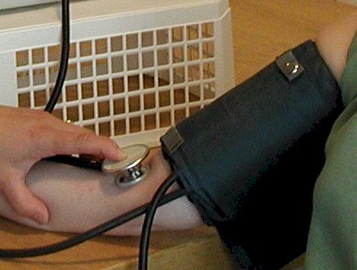
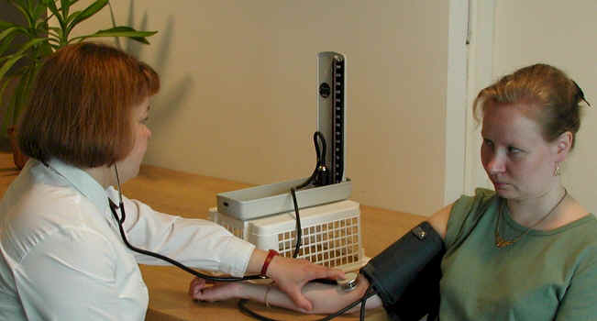
Auscultatory method cont.
Notes:
Place stethoscope on brachial artery
Pump up cuff to 20-30 above point of obliteration
20 for kids
30 for adults
Let air out at 2 mmHg per second

Slide 18
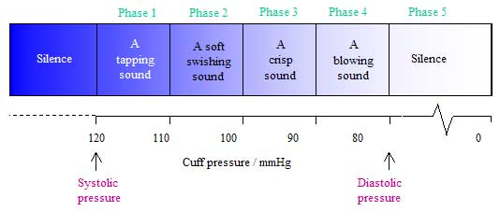
Auscultatory method cont.
Note 1st and 5th Korotkoff sounds

Slide 19
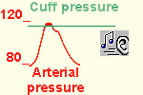
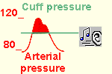
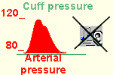
Auscultatory method cont.

Slide 20
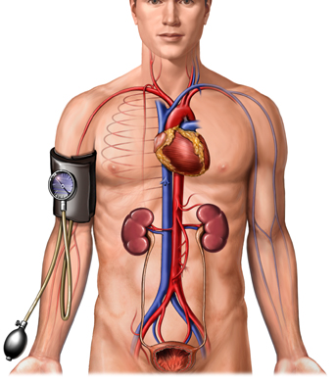
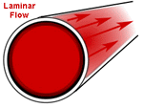
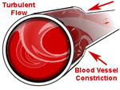
Auscultatory method Explanatory Notes
Notes:
The laminar flow that normally occurs in arteries produces little vibration of the arterial wall and therefore no sounds. However, when an artery is partially constricted, blood flow becomes turbulent, causing the artery to vibrate and produce sounds.
When measuring blood pressure using the auscultation method, turbulent blood flow will occur when the cuff pressure is greater than the diastolic pressure and less than the systolic pressure. The "tapping" sounds associated with the turbulent flow are known as Korotkoff sounds.

Slide 21
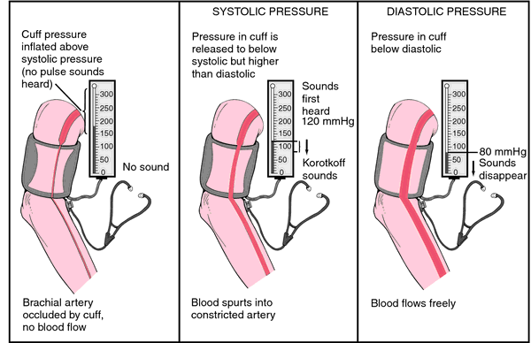
Summary of Auscultatory method
Notes:
Summary of the auscultatory method: Initially the cuff is inflated to a level higher than the systolic pressure. Thus the artery is completely compressed, there is no blood flow, and no sounds are heard. The cuff pressure is slowly decreased. At the point where the systolic pressure exceeds the cuff pressure, the Korotkoff sounds are first heard and blood passes in turbulent flow through the partially constricted artery. Korotkoff sounds will continue to be heard as the cuff pressure is further lowered. However, when the cuff pressure reaches diastolic pressure, the sounds disappear. Now at all points in time during the cardiac cycle, the blood pressure is greater than the cuff pressure, and the artery remains open.

Slide 22
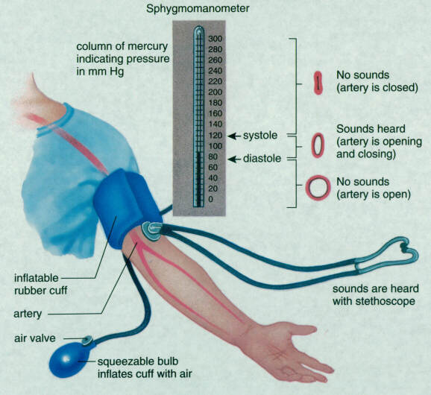
Summary of Auscultatory method

Slide 23
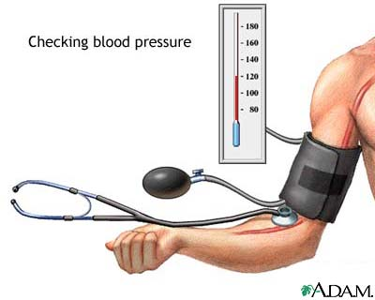
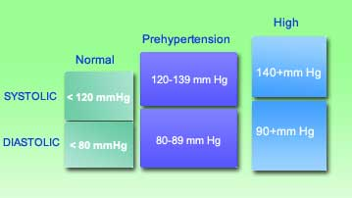
Normal BP Measurements

Slide 24
Errors in blood pressure readings
The cuff is not of the proper size
The cuff is positioned too loosely
The cuff is inflated slowly
If the cuff is re-inflated immediately after an initial reading (trying to re-check the reading
Notes:
if the cuff is too small the blood pressure readings may be artefactually high. If the cuff is too big, the readings may be artefactually low.
The cuff is positioned too loosely: the blood pressure may be artefactually high.
The cuff is inflated slowly: a slow inflation causes venous congestion, which in turn causes the Korotkoff sounds to be faint; this results in false readings with the systolic value being too low and the diastolic reading too high.
If the cuff is re-inflated immediately after an initial reading (trying to re-check the reading): a rapid re-inflation could cause venous distension, the Korotkoff sounds become more muffled. The initial Korotkoff sound may be missed so the systolic reading would be falsely low, and the diastolic reading would be falsely high because the last Korotkoff sounds could not be heard.

Slide 25
Factors effecting BP
Notes:
Atrial natriuretic peptide (ANP), is a powerful vasodilator, and a protein hormone secreted by heart muscle cells.
It is involved in the homeostatic control of body water, sodium, potassium and fat.
It is released by muscle cells in the (atria) of the heart (atrial myocytes), in response to high blood pressure.
ANP acts to reduce the water, sodium and adipose loads on the circulatory system, thereby reducing blood pressure.
When blood volume is low, juxtaglomerular cells in the kidneys secrete renin directly into circulation.

Slide 26
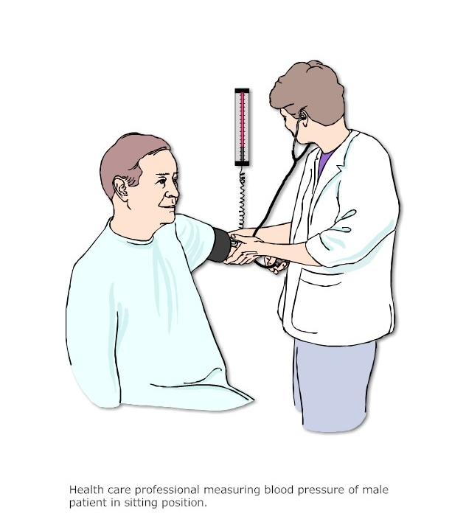
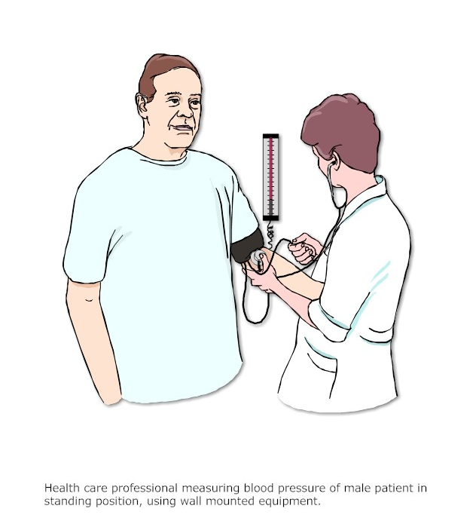
Effect of gravity on BP
Notes:
BP increases from supine to sitting to standing
Orthostatic hypotension: BP difference betw sit & stand
The decrease is typically greater than 20/10 mm Hg,^{[2]} and may be most pronounced after resting.
The incidence increases with age.
If you move from a seated or supine position to a standing position, there may be a momentary drop in your blood pressure. This drop occurs because your body experiences a temporary drop in blood volume as 300 to 800 mL of blood pools in your legs. However, special cells called baroreceptors sense this drop and signal the heart to beat faster. Blood vessels will then contract and increase pressure to pump the blood upward. Thus, after an initial drop, you experience a rise in blood pressure when moving from a supine position to standing.

Slide 27
Effect of exercise on BP
Notes:
systolic pressure increases during exercise due to increase in co
while the diastolic pressure generally remains unchanged.
Cardiac output, increase to satisfy blood flow needs to the working muscles.
Larger cardiac output as well as vasoconstriction around the body cause an increase in systolic pressure. After Exercise
Systolic blood pressure should progressively decline.
there may be a drop in diastolic BP following exercise because the blood vessels have widened slightly during exercise to allow for greater blood flow.

Slide 28
Effect of age
Notes:
Systolic blood pressure is largely determined by
the stiffness of the arteries and the amount of
blood pumped through them during a heart beat.
Many doctors once believed that as we got older
our bodies needed increased systolic blood pressure
to push blood through stiffened arteries. But
researchers now know that this increase is not
normal, and that high blood pressure at any age
significantly increases the risk of heart attack,
strokes, and kidney failure.

Slide 29
Thanks for your attention

Slide 30
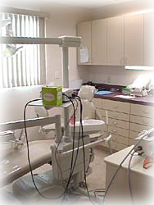
Are You Ready for a Medical Emergency in Your Practice?
It’s a wonderful day, you woke up happy and fresh. You have a clinic this morning . I love my job and I am going to make those smiles shine and glow.
You enter the clinic and ask the nurse to call the patient. While the patient is coming you check her file; her name is Maha, she is 17 years old and she is in good health.
The patient enters the clinic, you welcome her warmly, then you ask her what brought her to the clinic. She mentions some tooth problem. You examine her and find some cavities which need to be filled. You inform her .
While you are preparing your instruments, Maha is already clenching the sides of the dental chair looking pale, then she faints.
As a dentist how would you approach this situation.
Notes:
Case of syncope (vasovagal attack) hypotension + bradycardia
Treat: supine position, slight head down, ammonia

Slide 31
Are You Ready for a Medical Emergency in Your Practice?
Aunt Norah is a regular patient that comes to your clinic for checkup, she is 70 years old and hypertensive. She comes in today for her routine check up, she has no complaints and her blood pressure is 140/90 on medication. She takes her seat and is ready for her dental checkup, after you finish your examination, you tell her everything is fine.
While you are recording your notes, she gets up from the dental chair, but she feels dizzy and nearly falls; thank god you were there in the right moment to prevent a tragic fall. You help her to lie on the dental chair.
As a dentist what do you think happened to poor aunt Norah and how would manage such a situation.
Notes:
Case of orthostatic hypotension
Cause: old age,other causes hypovolemia
Treat:Standing up more slowly can give the blood vessels more time to constrict properly.

Slide 32
Which of the following can cause sounds to be heard down to zero mmHg?
Anemia
Vigorous exercise
Heavy pressure on the stethoscope
All of the above
Notes:
D

Slide 33
A cuff with a bladder too small for the patients arm will result in:
An inaccurately high reading
An inaccurately low reading
Sounds heard down to zero mmHg
Notes:
A

Slide 34
If the cuff is applied too loosely, the pressure reading will be:
Too low
Too high
Not affected
Notes:
B

Slide 35
Unless otherwise indicated, measure the blood pressure using the patient’s ____ arm.
Right
Left
Either arm is alright
Notes:
A

Slide 36
Common causes of errors in blood pressure measurement include:
Dirty mercury or dirty glass tube
Cuff applied over clothing
Leaks in the pressure bulb or tubing
Arm above or below heart level
All of the above
Notes:
E

Slide 37
Some factors that can alter blood pressure are:
Smoking
Anxiety and other emotional states
Talking
Full bladder
All of the above
B & D only
Notes:
E

Slide 38
When using the Auscultatory-Palpatory technique of blood pressure measurement, the pressure in the cuff should be raised:
20-30 mmHg higher than the point where the pulse disappeared.
30 mmHg higher than the systolic pressure
20 mmHg higher than the systolic pressure
Notes:
A

Slide 39
Which of the following will increase the loudness of Korotkoff sounds?
Have the patient open and close their fist 8-10 times after the pressure cuff has been inflated above systolic level.
Rapidly inflate the cuff
Raise the patient’s arm above heart level for several seconds- inflate the cuff above the systolic level while the arm is still elevated- lower the arm and proceed with the blood pressure measurement.
All of the above
A & C only
Notes:
D

Slide 40
Questions and problems
What are the ranges of normal arterial BP?
What is the effect of age on the arterial BP?
Explain how Korotkov sounds are produced?
Which factors are responsible for the normal variations in arterial BP?
Is the BP measured from the popliteal artery the same as that determined from the brachial artery?
What are the effects of muscular exercise on systolic and diastolic BP? What happens to the pulse pressure?

