Slide 1
Renal practical Revision
Dr Shaesta Naseem

Slide 2
Adult polycystic kidney disease
The gross picture shows
markedly enlarged kidney
replacement of the renal parenchyma by numerous cysts of variable sizes .
Slide 21.9
Notes:
The pattern of inheritance for adult form is autosomal dominant and for childhood form is autosomal recessive .
Gene which is mutated in this disorder: PKD-1 gene on the short arm of chromosome 16

Slide 3
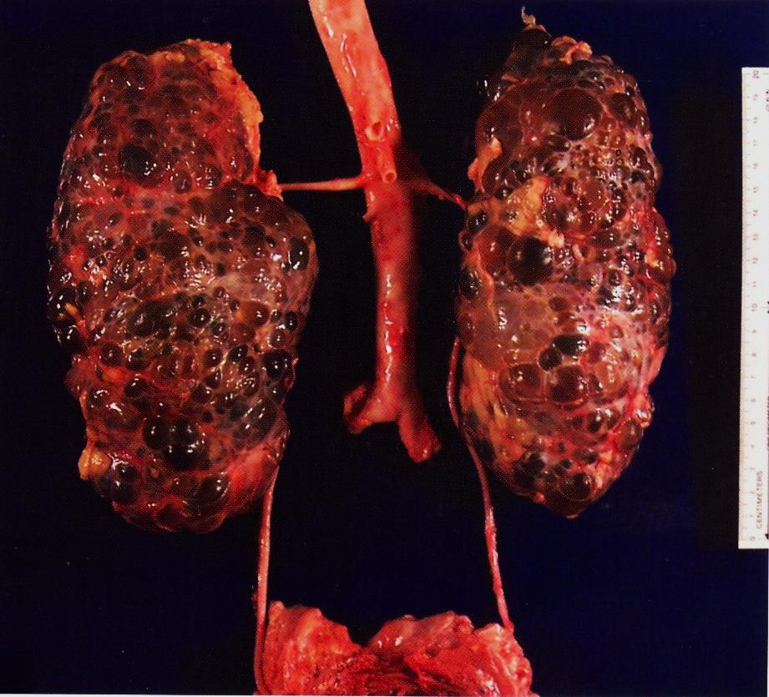
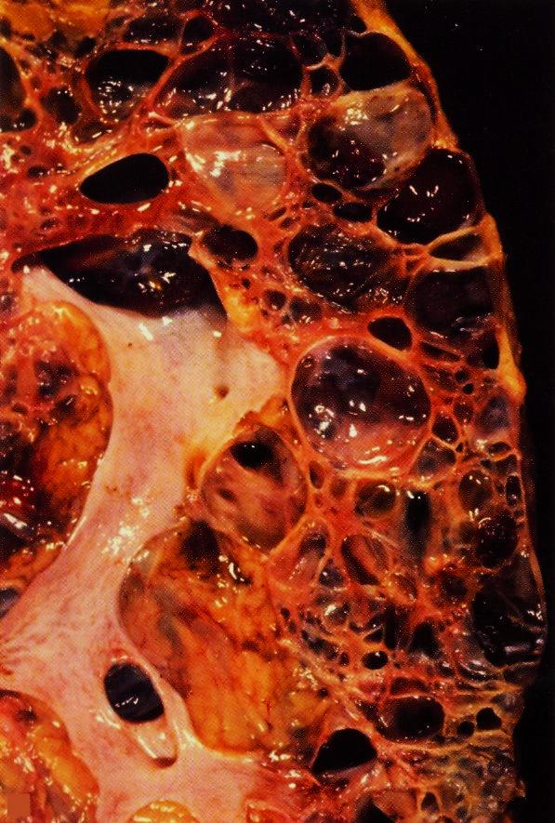

Slide 5
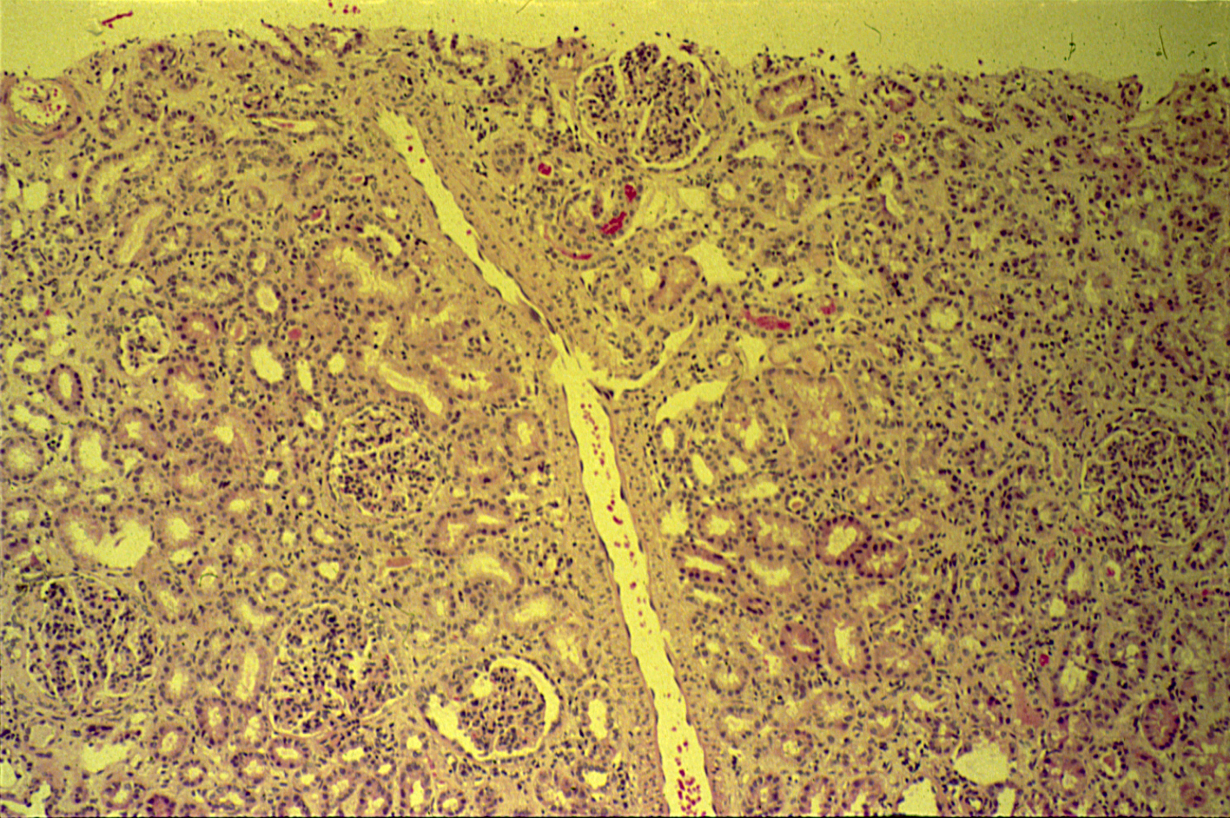
POSTSTREPTOCOCCAL GLOMERULONEPHRITIS

Slide 6
Post streptococcal
Glomerulonephritis
Normal glomerulus
Slide 21.22

Slide 7
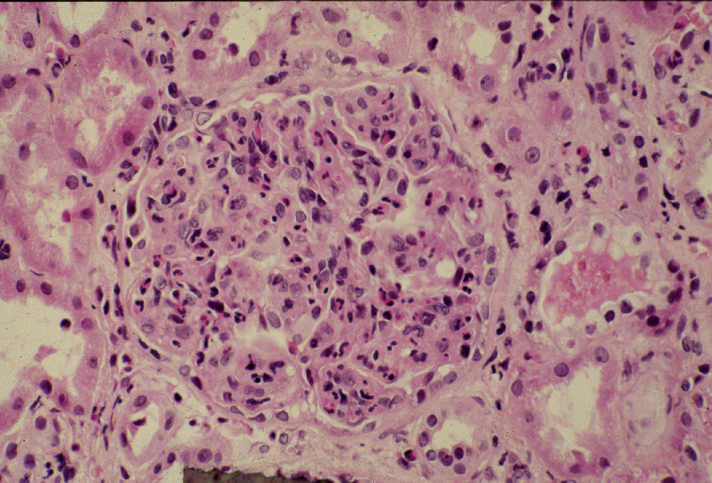
Post streptococcal glomerulonephritis:
Hypercellular glomerulus; numerous capillaries contain inflammatory cells, mostly neutrophils.
Notes:
Notice the red blood cells in a distal tubule, to the left of the glomerulus (arrow). H&E

Slide 8
Post streptococcal glomerulonephritis: Section of kidney shows:
The glomeruli are enlarged, lobulated and hypercellular with obliteration of capsular space.
Cellularity is due to proliferation of endothelial and mesangial cells with some neutrophils.
Many capillaries appear obliterated.
Tubules show degenerative changes.

Slide 10
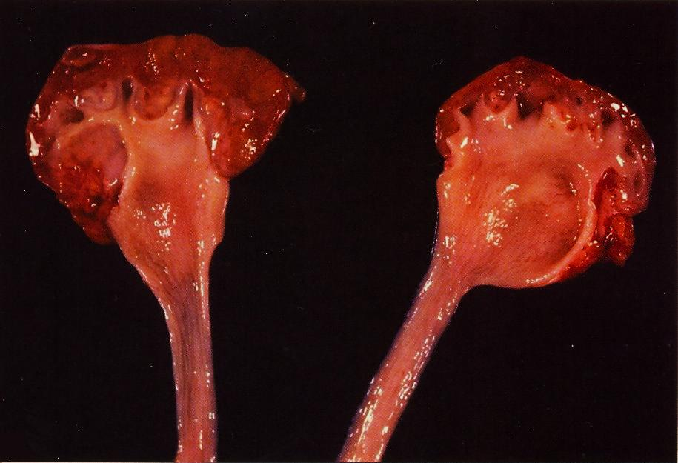
Hydronephrosis is the term used to describe dilation of the renal pelvis and calyces associated with progressive atrophy of the kidney due to obstruction to the outflow of urine

Slide 11
The picture shows markedly dilated renal pelvis and calyces with atrophic and thin renal cortex /parenchyma
Notes:
The most common causes for hydronephrosis are foreign bodies like calculi with obstruction, atresia of the urethra , spinal cord damage with paralysis of the bladder and normal pregnancy
Other causes includes: Benign prostatic hyperplasia ,carcinoma of the prostate and bladder tumours

Slide 12
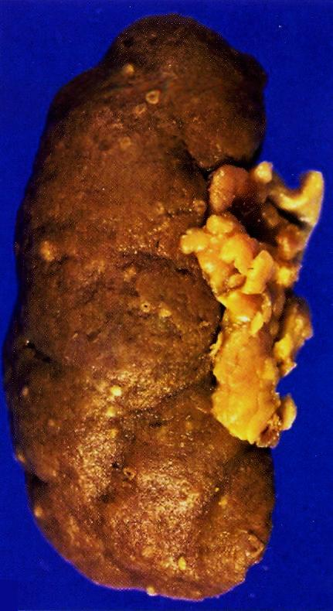
Pyonephrosis with small cortical abscesses
Pyonephrosis is seen when there is total or almost complete obstruction, particularly when it is high in the urinary tract.
The suppurative exudate is unable to drain and thus fills the renal pelvis, calyces, and ureter with pus

Slide 13
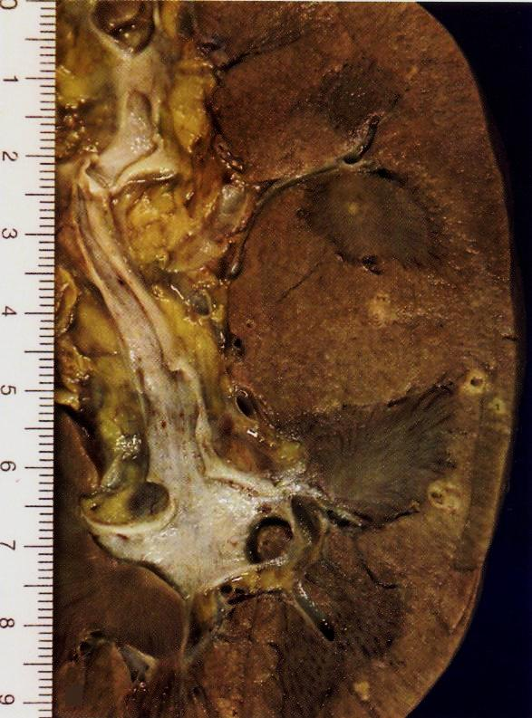
Renal cortical pyonephrosis with renal stone impacted within a calyx

Slide 14
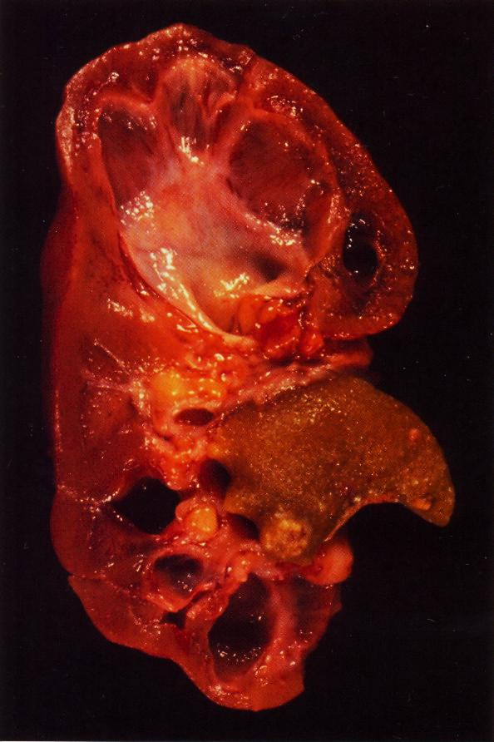
Focal hydronephrosis and pyonephrosis .

Slide 15
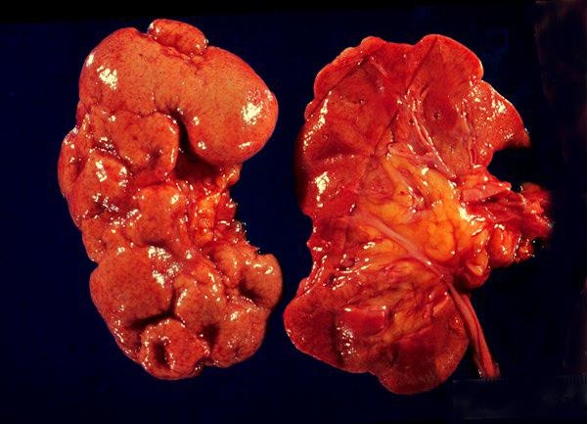
Chronic pyelonephritis
The picture shows slightly atrophic and deformed kidneys with cortical coarse scars .
It is a disorder in which chronic tubulo-interstitial inflammation and renal scarring are associated with pathologic involvement of the calyces and pelvis
Notes:
In children , the most common cause of chronic pyelonephritis is reflux associated nephropathy

Slide 16
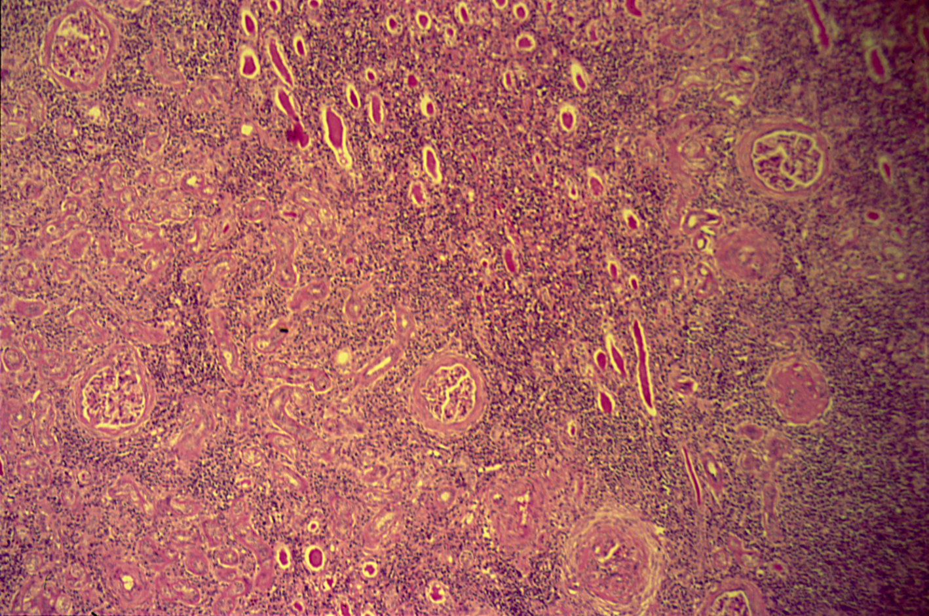
CHRONIC PYELONEPHRITIS
Low power

Slide 17
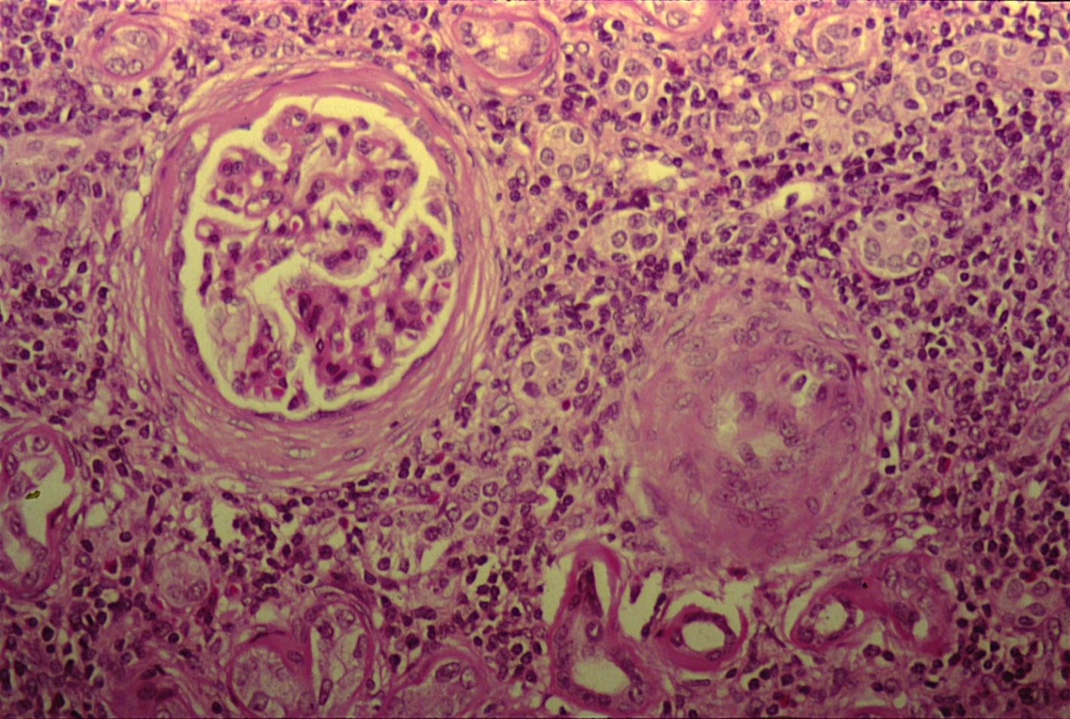
CHRONIC PYELONEPHRITIS
The higher magnification shows peri-glomerular fibrosis , glomerular sclerosis and hyalinization with marked chronic interstitial inflammation
Notes:
High power

Slide 18
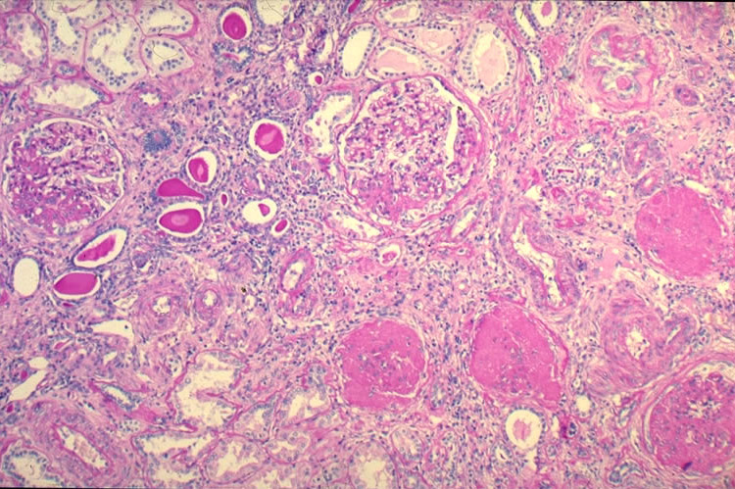

Slide 19
Chronic pyelonephritis: Section of kidney reveals that:
The glomeruli show varying degrees of sclerosis and periglomerular fibrosis.
The tubules show varying degrees of atrophy. Some tubules are dilated and filled with eosinophilic (pink) hyaline casts resembling colloid (thyroidization).
Interstitial tissue shows chronic inflammatory cells infiltrate and fibrosis.

Slide 21
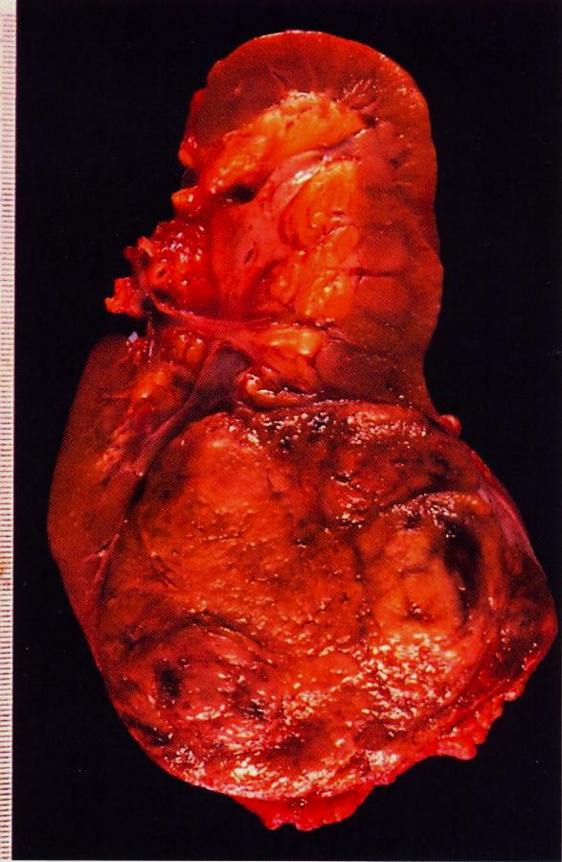
Renal cell carcinoma occupying the lower renal pole
Cross-section of kidney shows a well circumscribed yellowish tumor mass occupying lower pole of the kidney.
There is compression of the hilar blood vessels and renal pelvis (small arrow).
Notes:
Renal clear cell carcinoma may secrete erythropoietin hormone .

Slide 22
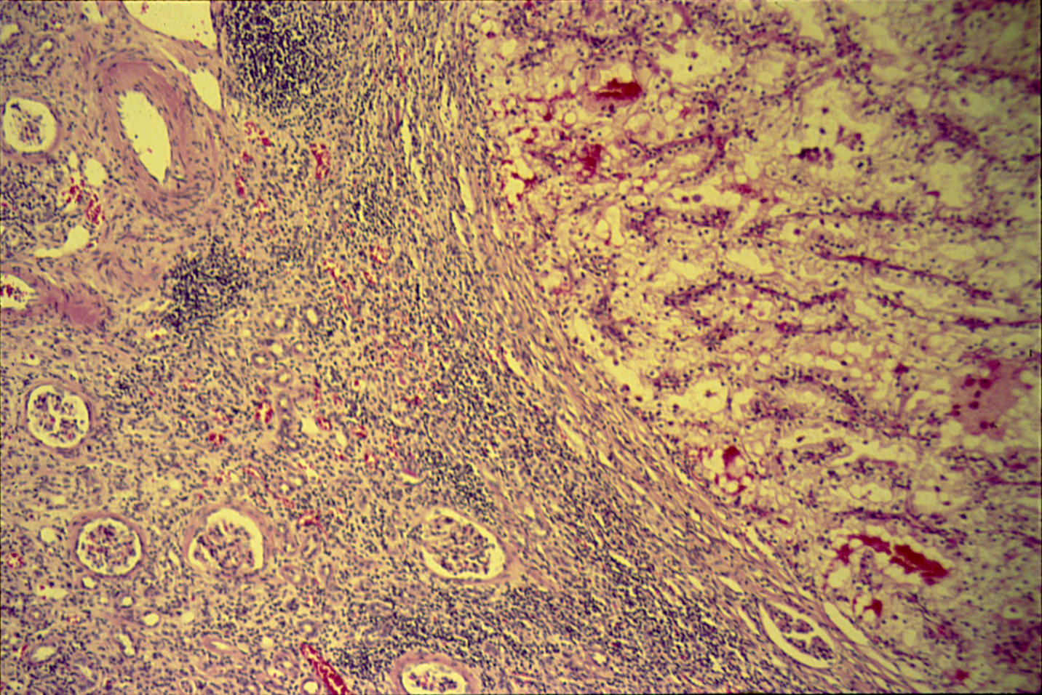
CLEAR CELL CARCINOMA (KIDNEY)
Notes:
Tumor is on the right side. Left side shows compressed renal tissue.

Slide 23
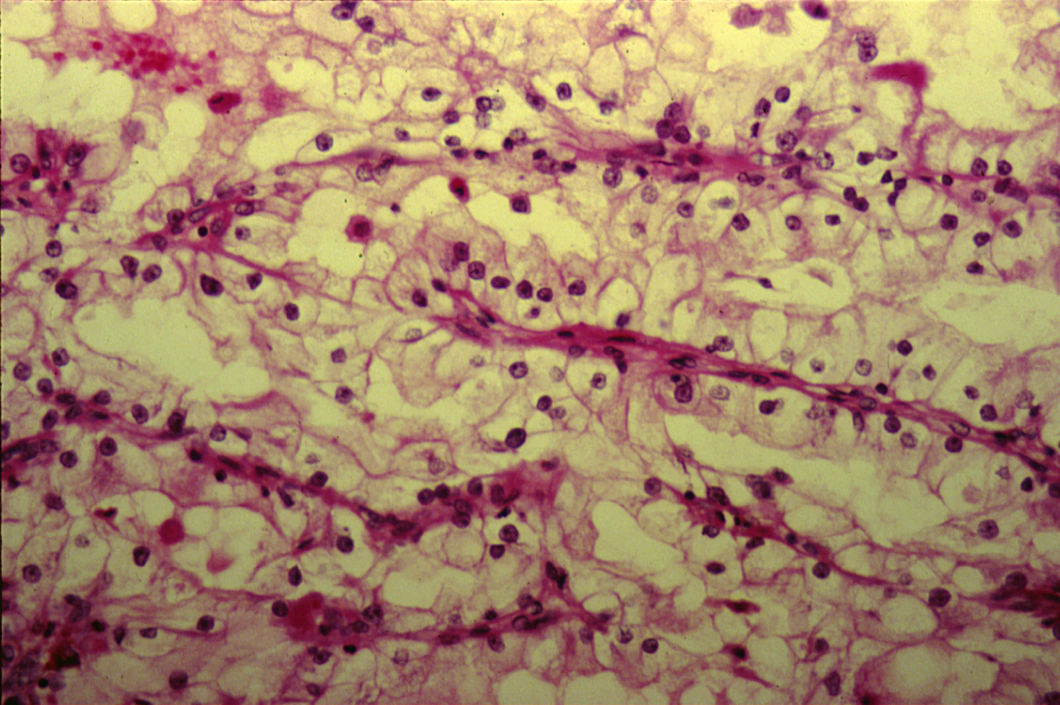
CLEAR CELL CARCINOMA (KIDNEY)

Slide 24
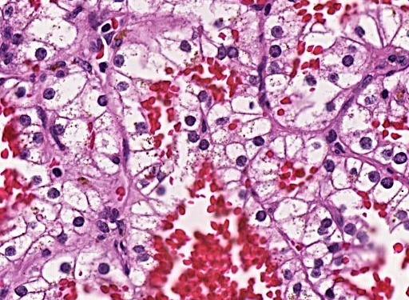
Section shows clear tumor cells with mild pleomorphic nuclei

Slide 25
Clear cell carcinoma of the kidney: Section of the kidney shows:
Compressed kidney tissue at the margin of the tumor masses.
Tumor cells are large polygonal with clear cytoplasm (dissolved glycogen and lipid) and pyknotic nuclei.
Cells are arranged as alveolar groups or tubules or papillary formations separated by thin fibro-vascular septae.
Cells show some pleomorphism and mitosis.
Areas of haemorrhage and necrosis can be seen.
Notes:
Extra-renal effects of this tumor are: Polycythemia, hypercalcemia, Cushing’s syndrome, fever.

Slide 26
Wilms Tumor
Gross picture shows partly pale and partly hemorrhagic solid tumour replacing almost the entire renal parenchyma and areas of necrosis also seen .

Slide 27
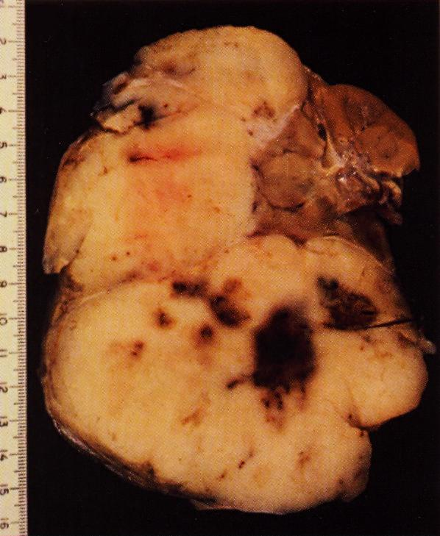
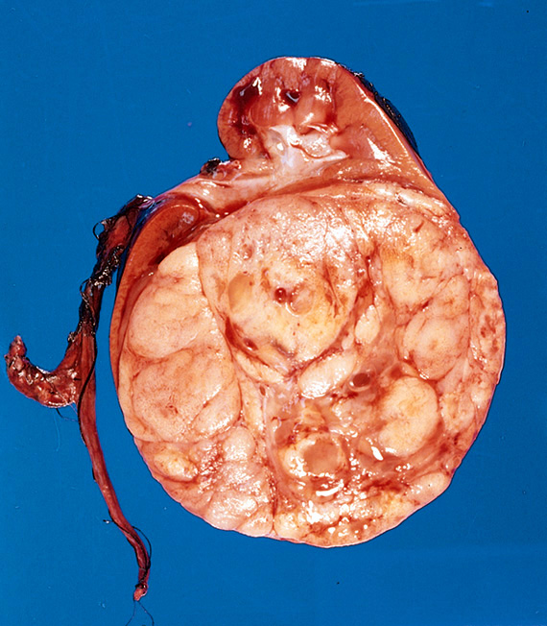

Slide 28
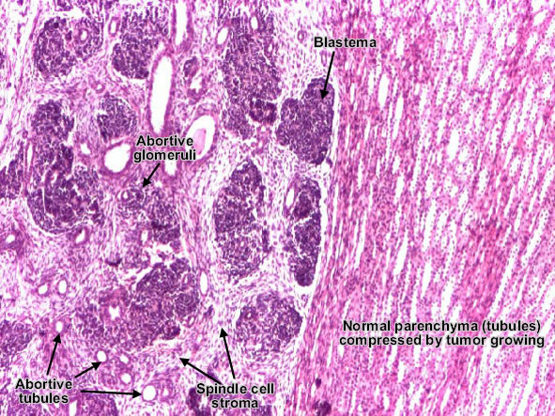

Slide 29
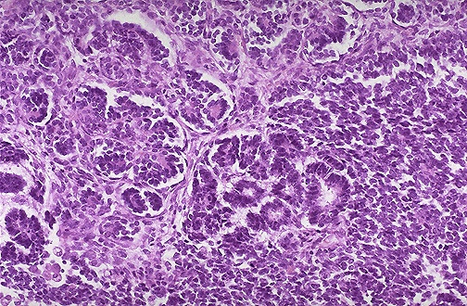
Wilm's tumor resembles fetal nephrogenic zone of the kidney.
3 major components:
Undifferentiated blastema cells ,
Epithelial tissue →attempts to form primitive glomerular &tubular structure
Mesenchymal (stromal) tissue

Slide 30
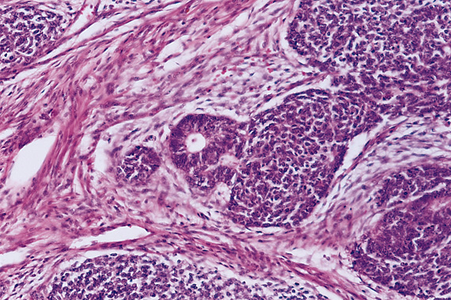

Slide 32
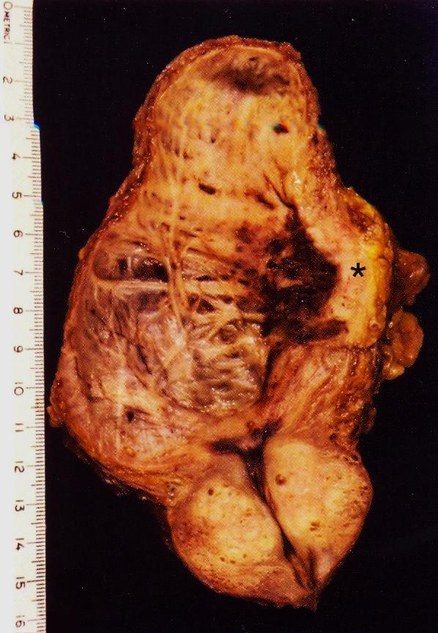
Longitudinal section of urinary bladder and prostate showing
benign prostatic hyperplasia ,
trabeculation of the urinary bladder wall and
bladder carcinoma (asterix )which is most likely proved histologically to be Transitional cell carcinoma .
Notes:
Genetic alterations in this condition: chromosome 9 monosomy, mutations in p53 and mutation of p16.
Predisposing factors include: cigarette smoking , Aniline dyes , long term use of analgesics , chronic cystitis, heavy long term exposure to cyclophosphamide.

Slide 33
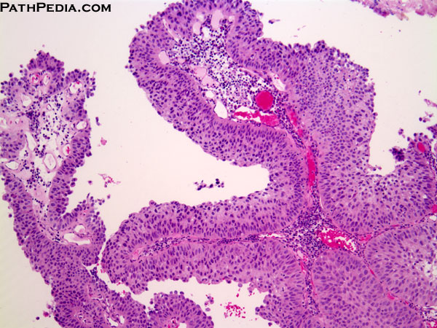
[UROTHELIAL CARCINOMA OF THE BLADER ; LOW GRADE]. Multiple papillary projections lined by multiple layers of urothelium (transitional epithelium).
These low grade tumors show overall preservation of cell polarity, few mitoses, and lack of significant morphologic atypia.

Slide 34
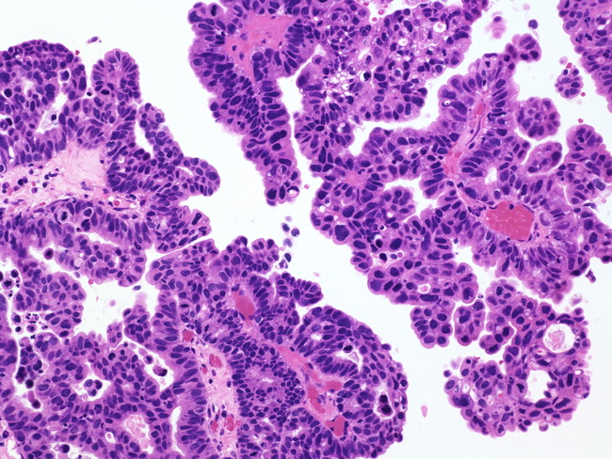
Papillary Urothelial Carcinoma, High-grade
The nuclei in this high-grade tumor are significantly enlarged and show variably increased chromatin content

