Slide 2
Kidney Function Tests
Rana Hasanato, MD, KSFCB
Clinical Biochemistry Unit, Pathology Dept.
College of Medicine, King Saud University

Slide 3
Contents:
Functional units
Kidney functions
Renal diseases
Routine kidney function tests
Serum creatinine
Creatinine clearance
Cockcroft-Gault formula for GFR estimation
Serum Urea

Slide 4
Functional units :
The nephron is the functional unit of the kidney
Each kidney contains about 1,000,000 to 1,300,000 nephrons.
The nephron is composed of glomerulus and renal tubules.
The nephron performs its homeostatic function by ultra filtration at glomerulus and secretion and reabsorption at renal tubules.

Slide 5
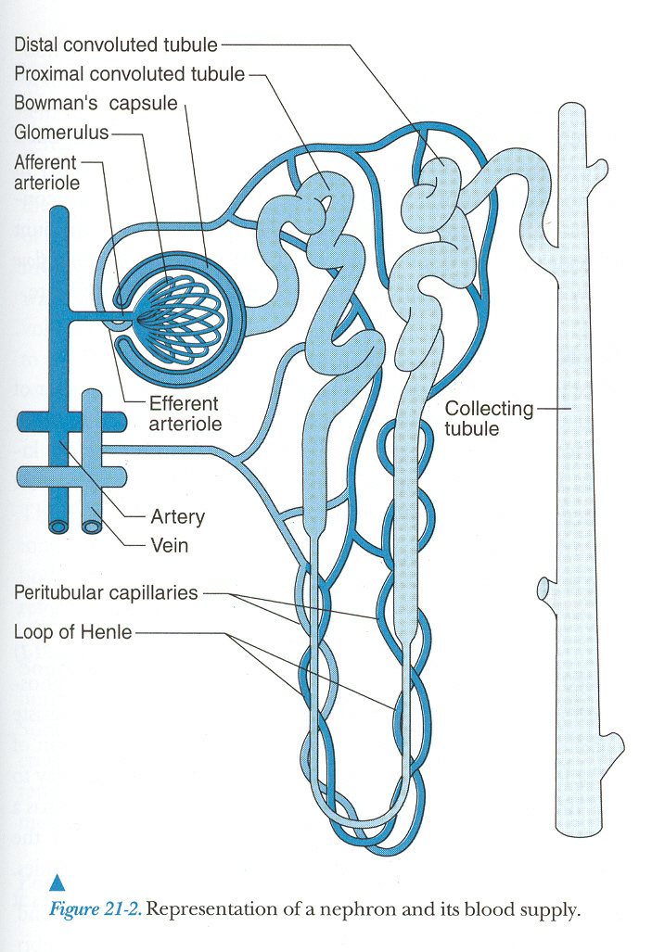
Representation of a nephron and its blood supply

Slide 6
Kidney functions :
Regulation of :
- water and electrolyte balance.
- acid base balance.
- arterial blood pressure.
Excretion of metabolic waste products and foreign chemicals.
Hormonal Function: Secretion of erythropoietin & activation of vitamin D and activation of angiotensinogen by renin
Metabolic Function: site for gluconeogenesis

Slide 7
Renal diseases:
Many diseases affect renal function.
In some, several functions are affected.
In others, there is selective impairment of glomerular function or one or more of tubular functions.
Most types of renal diseases cause destruction of complete nephron.

Slide 8
Routine kidney function test include the measurement of :
Serum creatinine.
Creatinine clearance.
Serum urea.
Both serum creatinine and creatinine clearance are used as kidney function tests to :
Confirm the diagnosis of renal disease.
Give an idea about the severity of the disease.
Follow up the treatment.

Slide 9
Normal Urea Normal Creatinine

Slide 10
Normal Urea Low Creatinine

Slide 11
High Urea High Creatinine

Slide 12
High Urea Normal Creatinine

Slide 13
Serum creatinine (55-120 μmol/L in adult):
Creatinine is the end product of creatine catabolism.
98% of the body creatine is present in the muscles where it functions as store of high energy in the form of creatine phosphate.
About 1-2 % of total muscle creatine or creatine phosphate pool is converted daily to creatinine through the spontaneous, non enzymatic loss of water or phosphate.

Slide 14
Creatinine in the plasma is filtered freely at the glomerulus and secreted by renal tubules (10 % of urinary creatinine).
Creatinine is not reabsorbed by the renal tubules.
Plasma creatinine is an endogenous substance not affected by diet.
Plasma creatinine remains fairly constant throughout adult life.

Slide 15
Creatinine clearance :
The glomerular filtration rate (GFR) provides a useful index of the number of functioning glomeruli.
It gives an estimation of the degree of renal impairment by disease.

Slide 16
Accurate measurement of GRF by clearance tests requires determination of the concentration in plasma and urine of a substance that is:
• Freely filtered at glomeruli.
• Neither reabsorbed nor secreted by tubules.
• Its concentration in plasma needs to remains constant throughout the period of urine collection.
• Better if the substance is present endogenously.
• Easily measured.
Creatinine meets most of these criteria.

Slide 17
Creatinine clearance is usually about 110 ml/min in the 20-40 year old adults.
It falls slowly but progressively to about 70 ml/min in individuals over 8o years of age.
In children, the GFR should be related to surface area, when this is done, results are similar to those found in young adults.

Slide 18
Clearance is the volume of plasma cleared from the substance excreted in urine per minute.
It could be calculated from the following equation:
Clearance (ml/min) = U × V
P
U = Concentration of creatinine in urine μmol/l
V = Volume of urine per min
P = Concentration of creatinine in serum μmol/l

Slide 19
Cockcroft-Gault Formula for Estimation of GFR
As indicated above, the creatinine clearance is measured by using a 24-hour urine collection, but this does introduce the potential for errors in terms of completion of the collection.
An alternative and convenient method is to employ various formulae devised to calculate creatinine clearance using parameters such as serum creatinine level, sex, age, and weight of the subject.

Slide 20
An example is the Cockcroft-Gault Formula:
K × (140 – age) × Body weight
GFR = ──────────────────
Serum creatinine (μmol/L)
where K is a constant that varies with sex:
1.23 for male & 1.04 for females.
The constant K is used as females have a relatively lower muscle mass.

Slide 21
Cockcroft-Gault Formula for Estimation of GFR: Limitations
It should not be used if
Serum creatinine is changing rapidly
the diet is unusual, e.g., strict vegetarian
Low muscle mass, e.g., muscle wasting
Obesity

Slide 22
Serum creatinine is a better kidney function test than creatinine clearance because :
• Serum creatinine is more accurate.
• Serum creatinine level is constant throughout adult life
Creatinine clearance is only recommended in the following conditions:
• Patients with early ( minor ) renal disease.
• Assessment of possible kidney donors.
• Detection of renal toxicity of some nephrotoxic drugs.

Slide 23
Normal adult reference values:
Urinary excretion of creatinine is 0.5 - 2.0 g per 24 hours in a normal adult, varying according to muscular weight.
- Serum creatinine : 55 – 120 μmol/L
- Creatinine clearance: 90 – 140 ml/min (Males)
80 – 125 ml/min (Females)
A raised serum creatinine is
a good indicator of impaired renal function
But a normal serum creatinine
does not necessarily indicate normal renal function as
serum creatinine may not be elevated until GFR has fallen
by as much as 50%

Slide 24
Serum Urea ( 2.5-6.6 mmol/L) in adult:
Urea is formed in the liver from ammonia released from deamination of amino acids.
As a kidney function test, serum urea is inferior to serum creatinine because:
 High protein diet increases urea formation.
Any condition of ↑ proteins catabolism (Cushing syndrome, diabetes mellitus, starvation, thyrotoxicosis) →↑ urea formation.
Severe Vomitting and Diarrhea (Dehydration) leads to high Urea and Serum Creatinine will be Normal
 50 % or more of urea filtered at the glomerulus is passively reabsorbed by the renal tubules.

Slide 25
Normal values of Internal Chemical Environment controlled by the Kidneys:
SODIUM
135 to 145 mEq/L
POTASSIUM
3.5 to 5.5 mEq/L
CHLORIDES
100 to 110 mEq/L
BICARBONATE
24 to 26 mEq/L
CALCIUM
8.6 to 10 mg/dl
MAGNESIUM
1.6 to 2.4 mg/dl
PHOSPHORUS
3.0 to 5.0 mg/dl
URIC ACID
2.5 to 6.0 mg/dl
pH
7.4
CREATININE
0.8 to 1.4 mg/dl
BUN (Blood Urea Nitrogen)
15 to 20 mg/dl

Slide 26
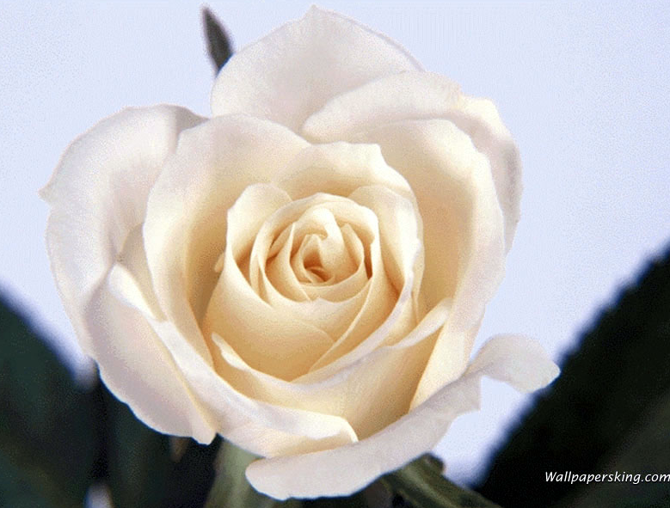
Questions?

