Slide 1
Renal practical I
Dr Shaesta Naseem

Slide 2
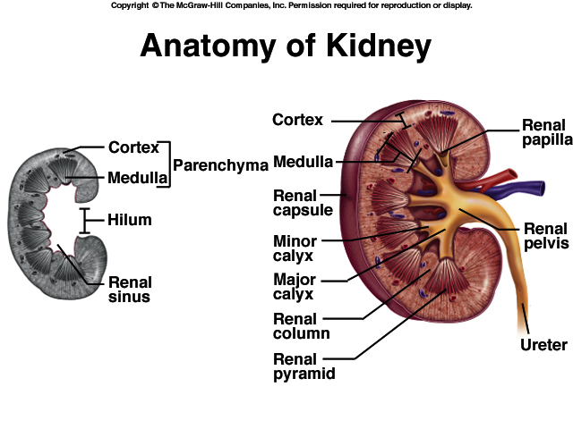

Slide 3
KIDNEY ANATOMY: NEPHRONS
NEPHRONS
FUNCTIONAL UNITS OF KIDNEY
~1.2 MILLION PER KIDNEY
THREE MAIN PARTS
BLOOD VESSELS
RENAL CORPUSCLE
RENAL TUBULE

Slide 4
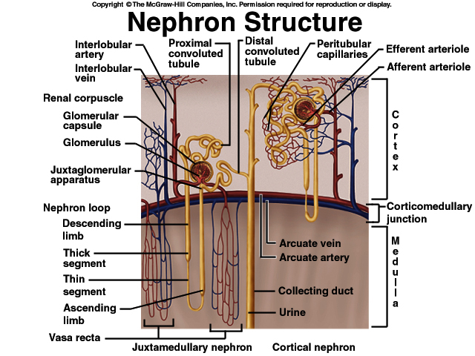

Slide 5
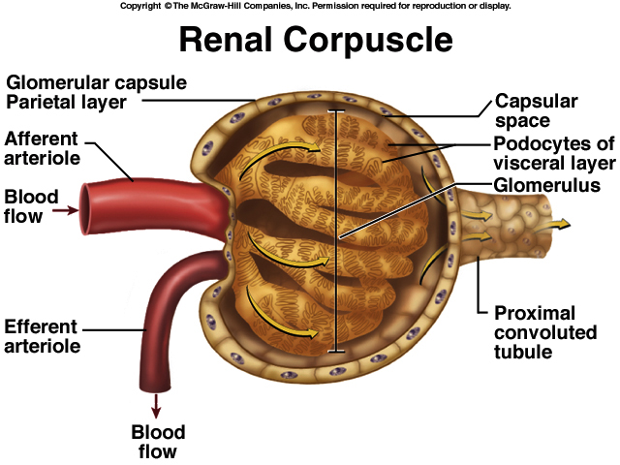

Slide 6
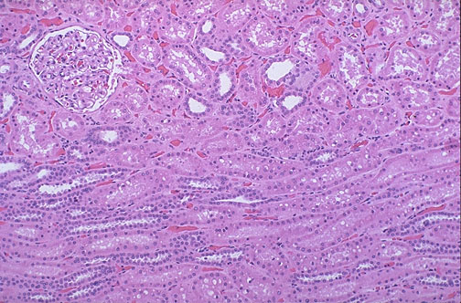

Slide 7
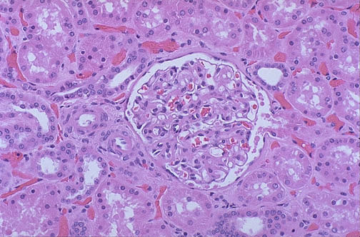
Figure 26.6

Slide 8
Gross and histopathology

Slide 9
1-Polycystic kidney

Slide 10
Adult polycystic kidney disease
The gross picture shows
markedly enlarged kidney
replacement of the renal parenchyma by numerous cysts of variable sizes .
Slide 21.9
Notes:
The pattern of inheritance for adult form is autosomal dominant and for childhood form is autosomal recessive .
Gene which is mutated in this disorder: PKD-1 gene on the short arm of chromosome 16

Slide 11
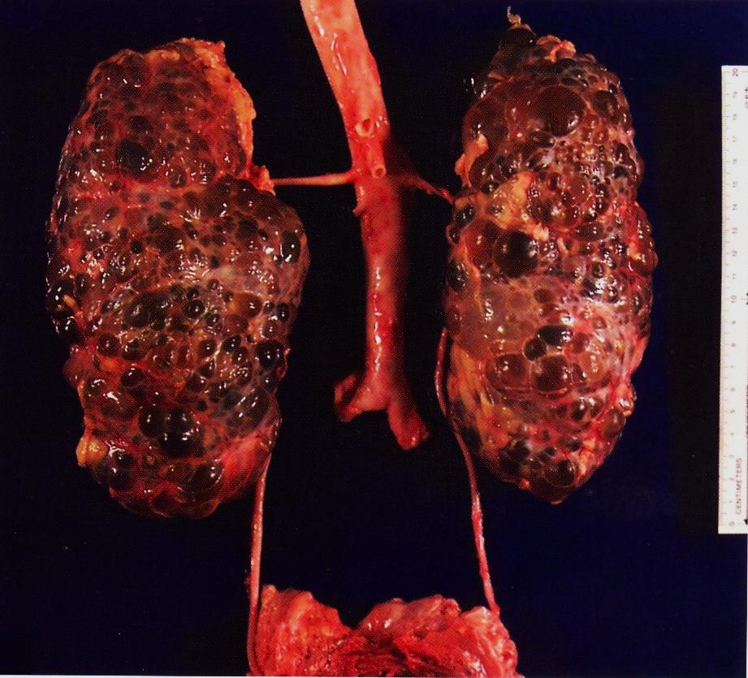
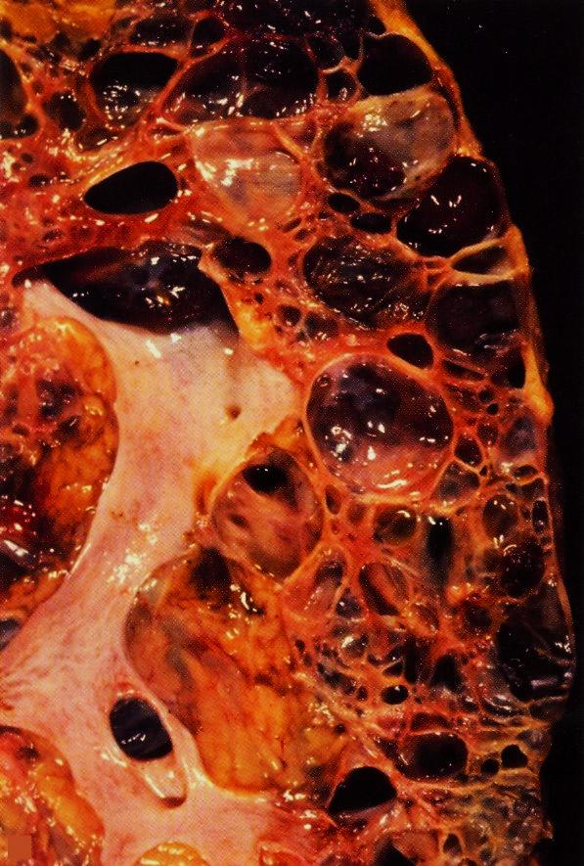

Slide 12
2-Postsreptococcal glomerulonephritis

Slide 13
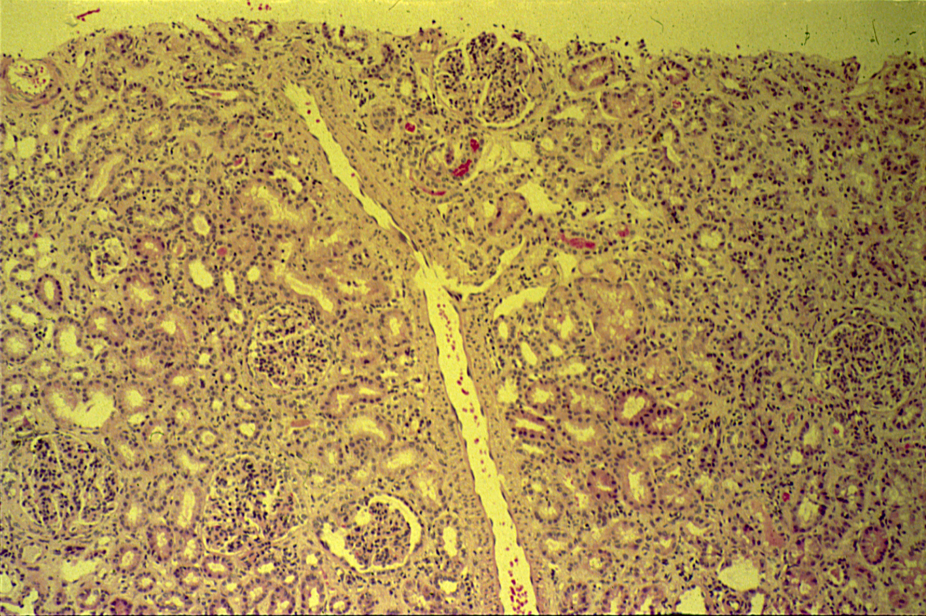
POSTSTREPTOCOCCAL GLOMERULONEPHRITIS

Slide 14
Post streptococcal
Glomerulonephritis
Normal glomerulus
Slide 21.22

Slide 15
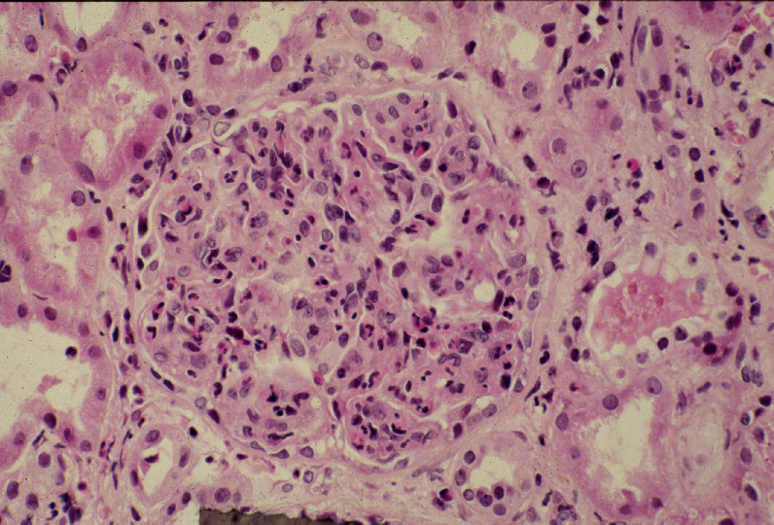
Post streptococcal glomerulonephritis:
Hypercellular glomerulus; numerous capillaries contain inflammatory cells, mostly neutrophils.
Notes:
Notice the red blood cells in a distal tubule, to the left of the glomerulus (arrow). H&E

Slide 16
Post streptococcal glomerulonephritis: Section of kidney shows:
The glomeruli are enlarged, lobulated and hypercellular with obliteration of capsular space.
Cellularity is due to proliferation of endothelial and mesangial cells with some neutrophils.
Many capillaries appear obliterated.
Tubules show degenerative changes.

Slide 17
3- Hydronephrosis

Slide 18
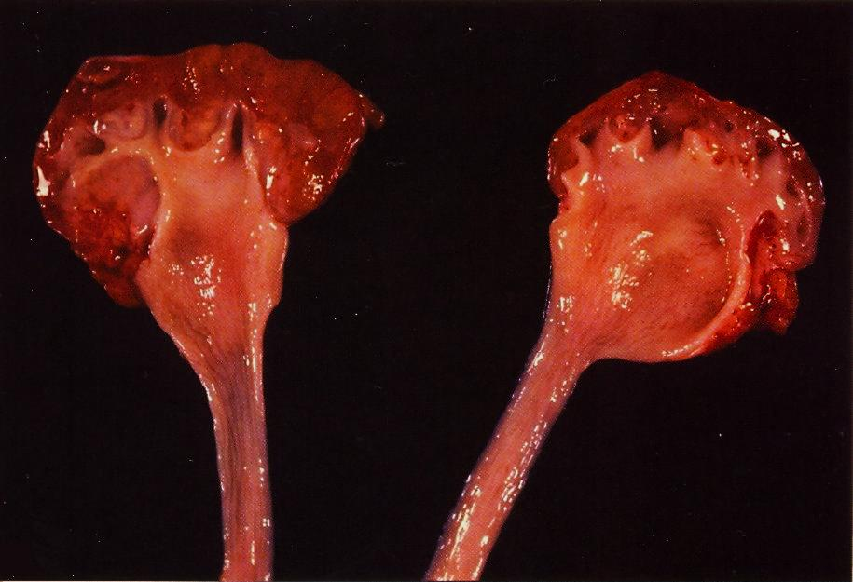
Hydronephrosis is the term used to describe dilation of the renal pelvis and calyces associated with progressive atrophy of the kidney due to obstruction to the outflow of urine

Slide 19
Hydronephrosis
The picture shows markedly dilated renal pelvis and calyces with atrophic and thin renal cortex /parenchyma
Notes:
The most common causes for hydronephrosis are foreign bodies like calculi with obstruction, atresia of the urethra , spinal cord damage with paralysis of the bladder and normal pregnancy
Other causes includes: Benign prostatic hyperplasia ,carcinoma of the prostate and bladder tumours

Slide 20
4- Pyonephrosis

Slide 21
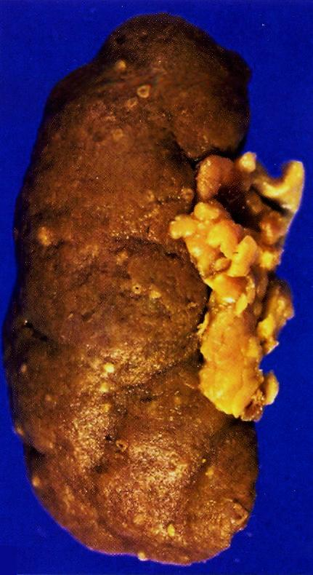
Pyonephrosis with small cortical abscesses
Pyonephrosis is seen when there is total or almost complete obstruction, particularly when it is high in the urinary tract.
The suppurative exudate is unable to drain and thus fills the renal pelvis, calyces, and ureter with pus.

Slide 22
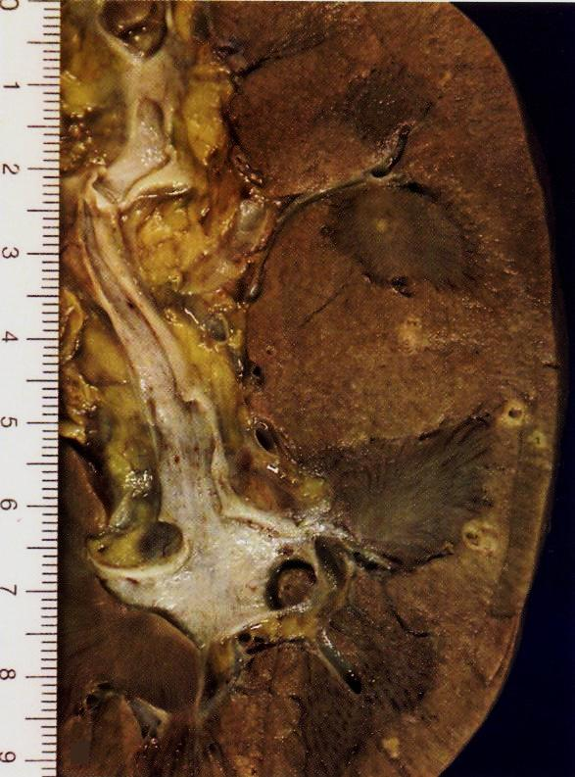
Renal cortical pyonephrosis with renal stone impacted within a calyx

Slide 23
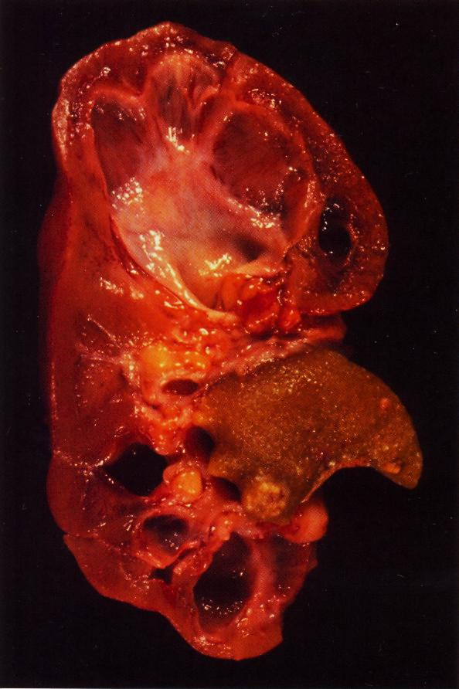
Focal hydronephrosis and pyonephrosis .

Slide 24
5- Chronic pyelonephritis

Slide 25
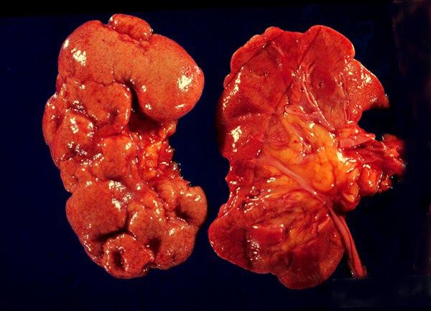
Chronic pyelonephritis
The picture shows slightly atrophic and deformed kidneys with cortical coarse scars .
It is a disorder in which chronic tubulo-interstitial inflammation and renal scarring are associated with pathologic involvement of the calyces and pelvis
Notes:
In children , the most common cause of chronic pyelo-nephritis is reflux associated nephropathy

Slide 26
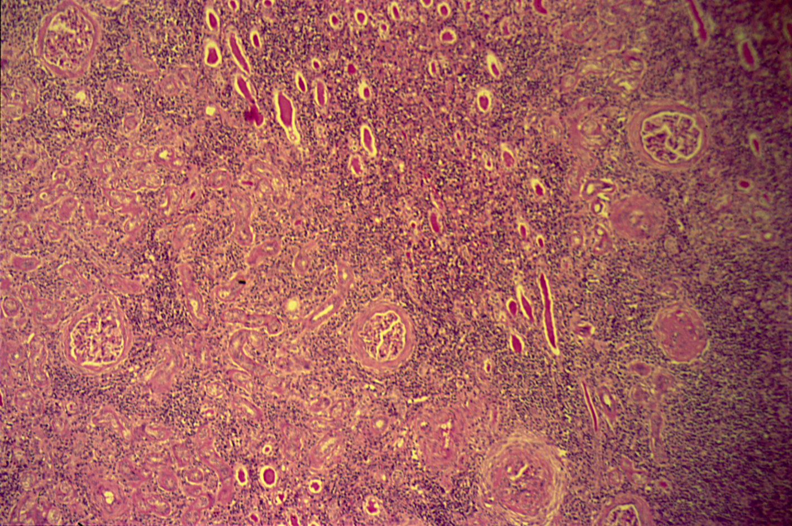
CHRONIC PYELONEPHRITIS
Low power

Slide 27
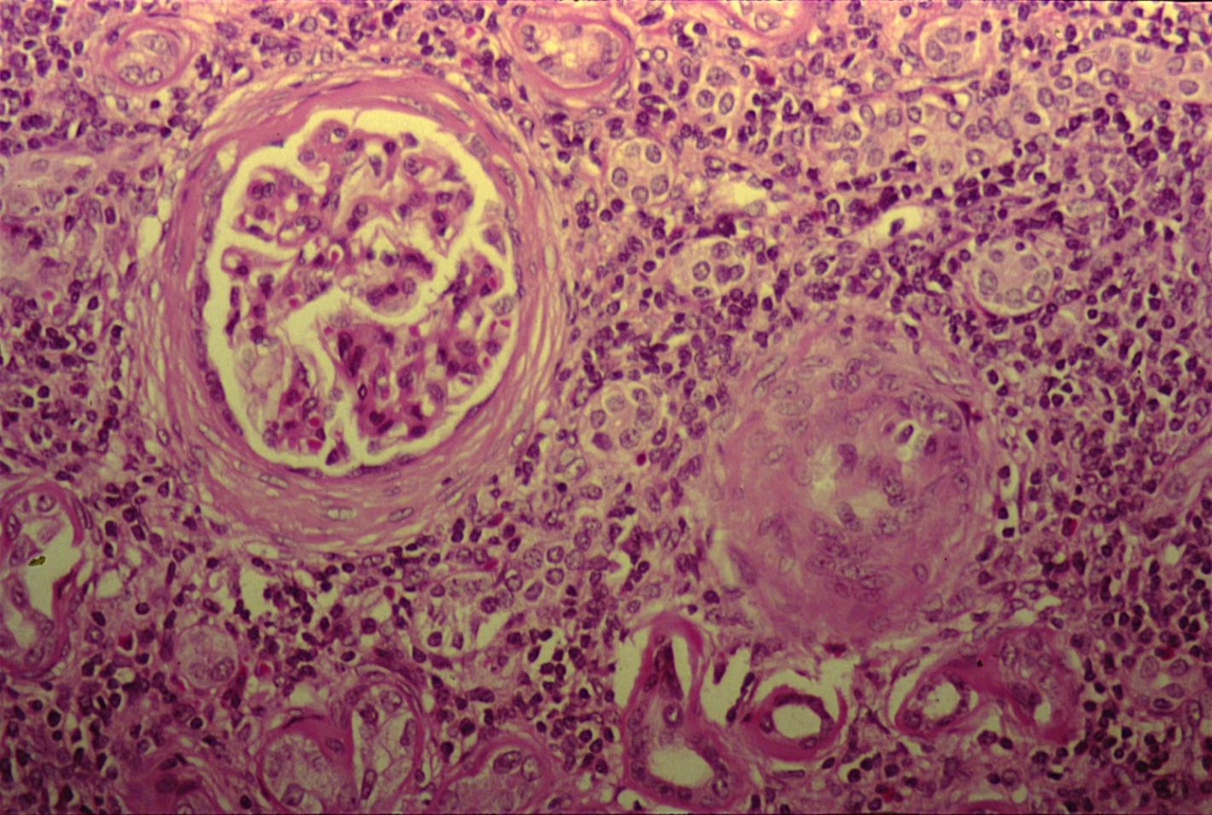
CHRONIC PYELONEPHRITIS
The higher magnification shows peri-glomerular fibrosis , glomerular sclerosis and hyalinization with marked chronic interstitial inflammation
Notes:
High power

Slide 28
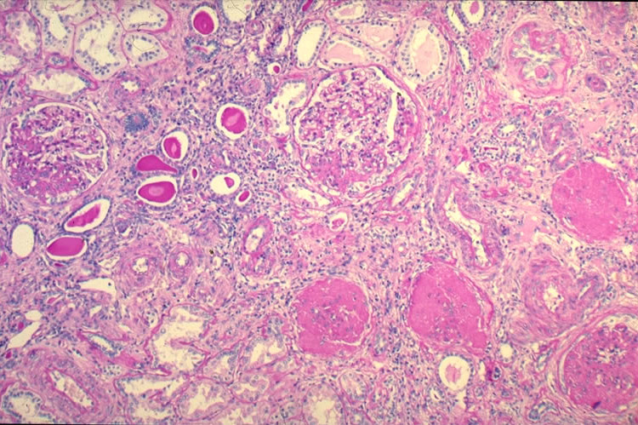

Slide 29
Chronic pyelonephritis: Section of kidney reveals that:
The glomeruli show varying degrees of sclerosis and periglomerular fibrosis.
The tubules show varying degrees of atrophy. Some tubules are dilated and filled with eosinophilic (pink) hyaline casts resembling colloid (thyroidization).
Interstitial tissue shows chronic inflammatory cells infiltrate and fibrosis.

