Slide 1
6- Renal Carcinoma

Slide 2
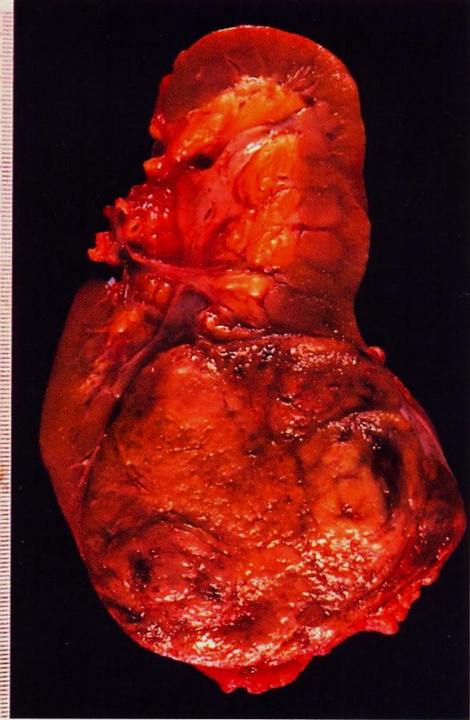
Renal cell carcinoma occupying the lower renal pole
Cross-section of kidney shows a well circumscribed yellowish tumor mass occupying lower pole of the kidney.
There is compression of the hilar blood vessels and renal pelvis (small arrow).
Notes:
Renal clear cell carcinoma may secrete erythropoietin hormone .

Slide 3
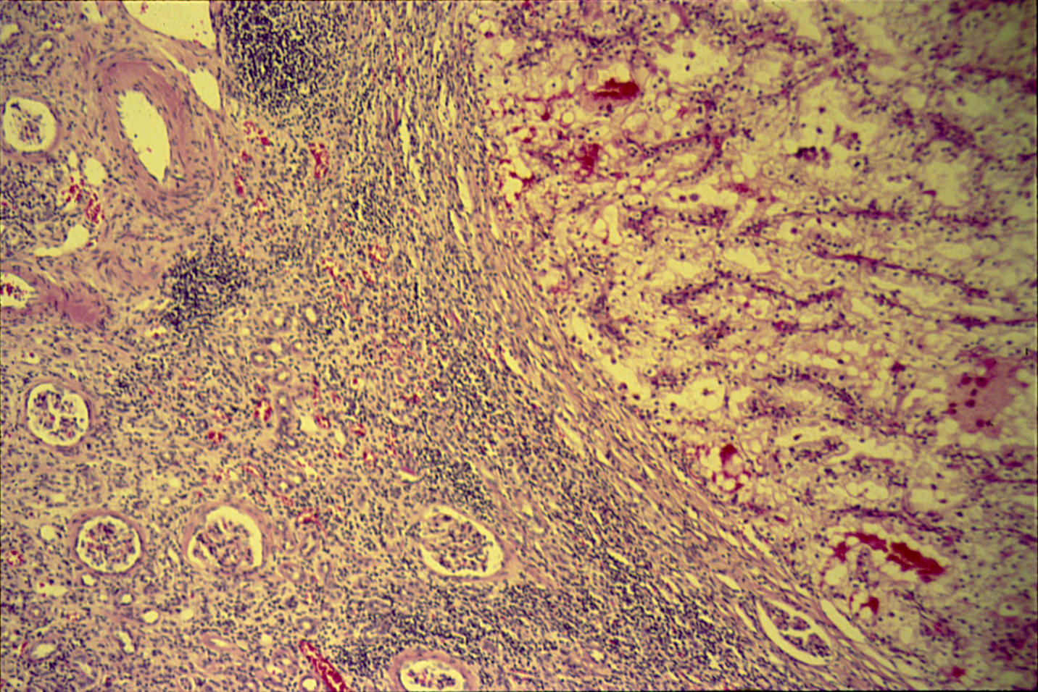
CLEAR CELL CARCINOMA (KIDNEY)
Notes:
Tumor is on the right side. Left side shows compressed renal tissue.

Slide 4
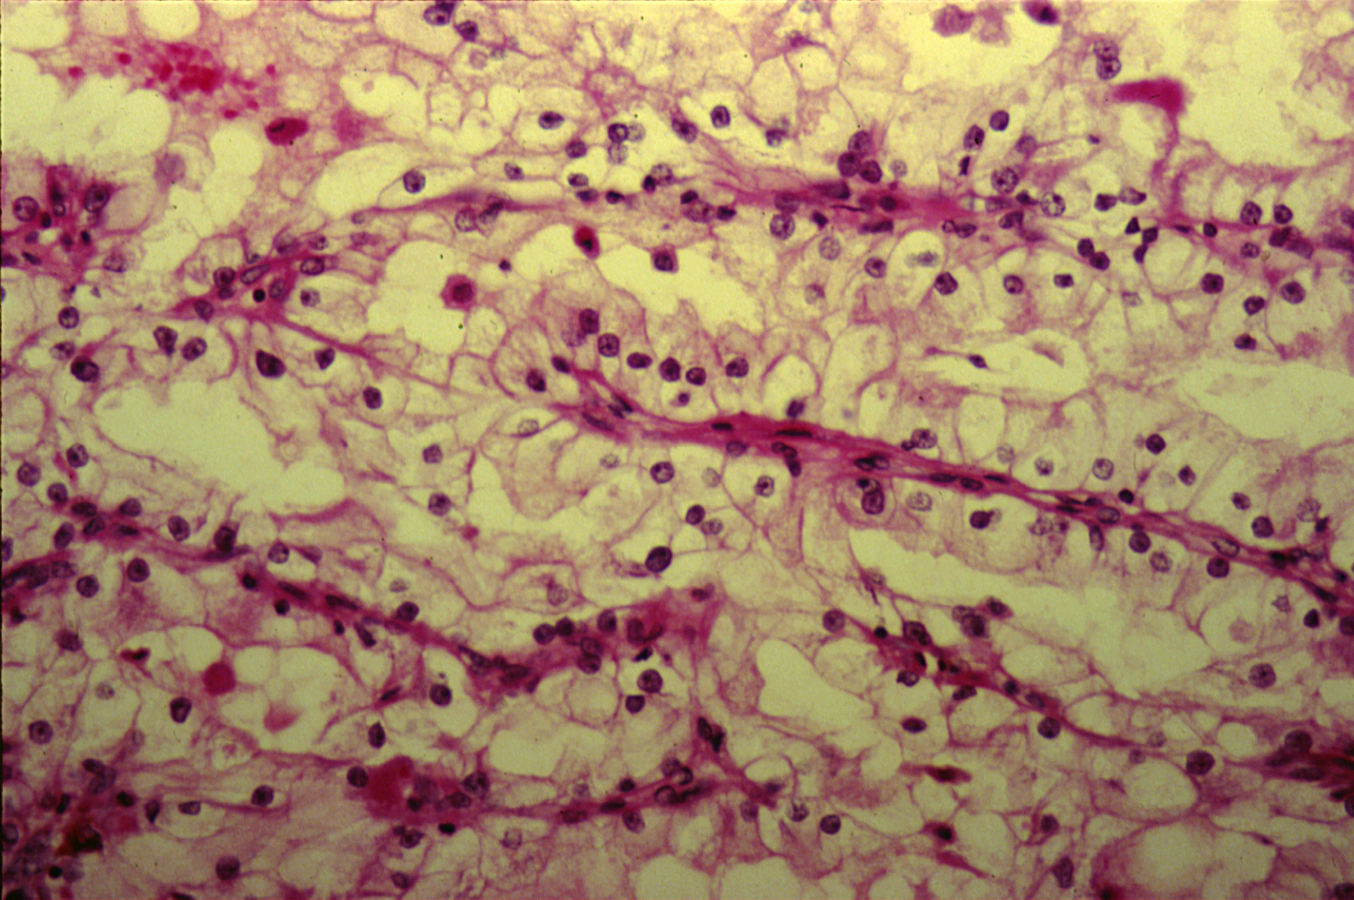
CLEAR CELL CARCINOMA (KIDNEY)

Slide 5
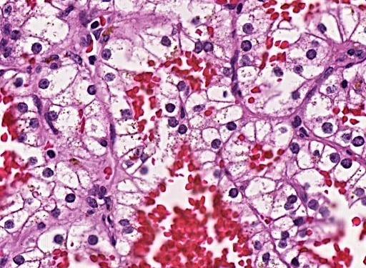
Section shows clear tumor cells with mild pleomorphic nuclei

Slide 6
Clear cell carcinoma of the kidney: Section of the kidney shows:
Compressed kidney tissue at the margin of the tumor masses.
Tumor cells are large polygonal with clear cytoplasm (dissolved glycogen and lipid) and pyknotic nuclei.
Cells are arranged as alveolar groups or tubules or papillary formations separated by thin fibro-vascular septae.
Cells show some pleomorphism and mitosis.
Areas of haemorrhage and necrosis can be seen.
Notes:
Extra-renal effects of this tumor are: Polycythemia, hypercalcemia, Cushing’s syndrome, fever.

Slide 7
7- Wilm’s tumour

Slide 8
Wilms Tumor
Gross picture shows partly pale and partly hemorrhagic solid tumour replacing almost the entire renal parenchyma and areas of necrosis also seen .

Slide 9
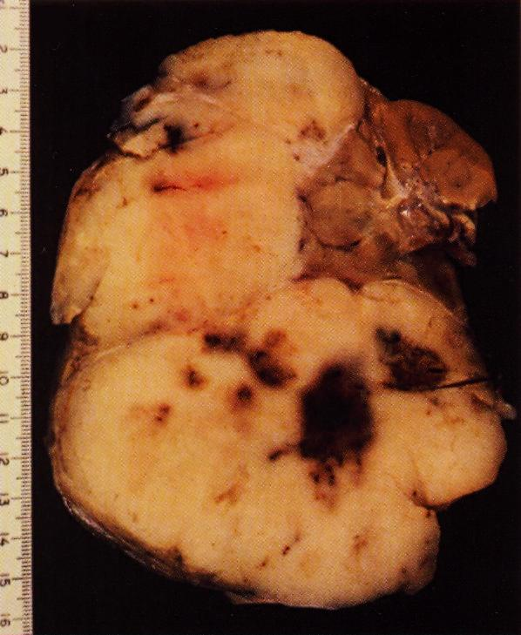
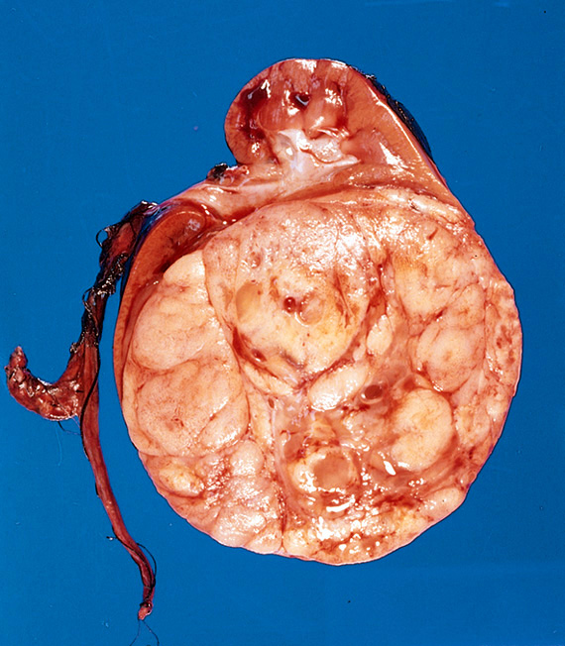

Slide 10
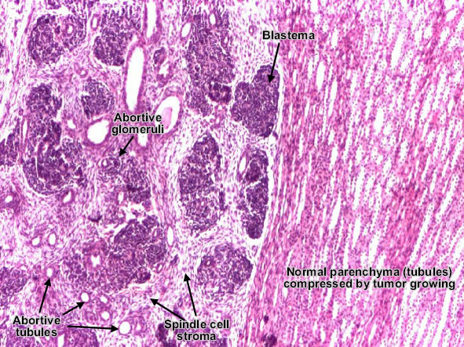

Slide 11
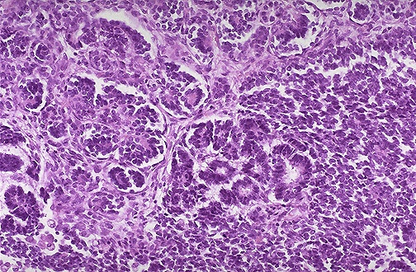
Wilm's tumor resembles fetal nephrogenic zone of the kidney.
3 major components:
Undifferentiated blastema cells ,
Epithelial tissue →attempts to form primitive glomerular &tubular structure
Mesenchymal (stromal) tissue

Slide 12
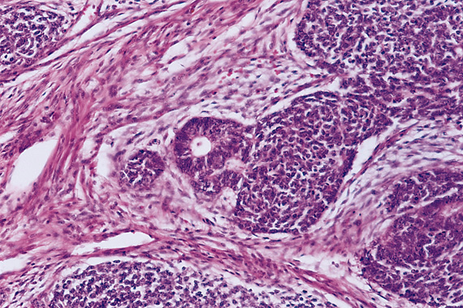

Slide 13
8- Carcinoma of the urinary bladder

Slide 14
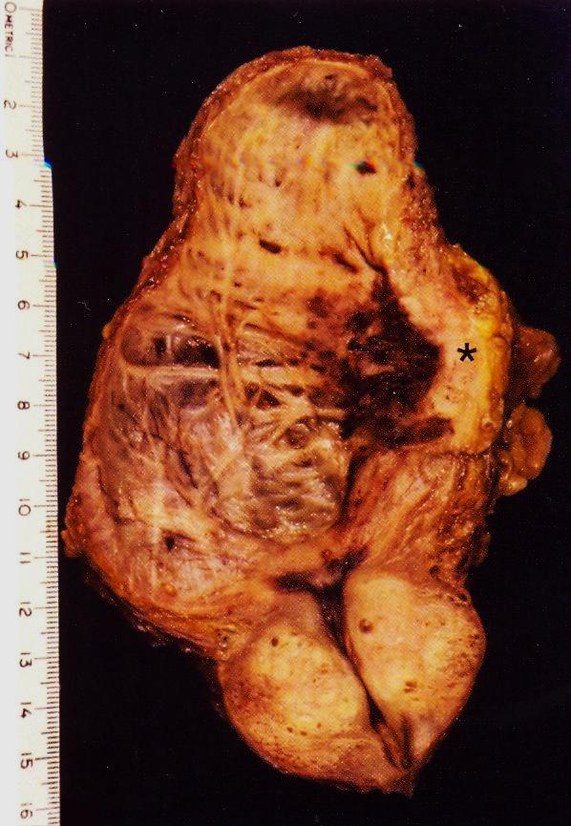
Longitudinal section of urinary bladder and prostate showing
benign prostatic hyperplasia ,
trabeculation of the urinary bladder wall and
bladder carcinoma (asterix )which is most likely proved histologically to be Transitional cell carcinoma .
Notes:
Predisposing factors include: cigarette smoking , Aniline dyes , long term use of analgesics , chronic cystitis, heavy long term exposure to cyclophosphamide.
Genetic alterations in this condition: chromosome 9 monosomy, mutations in p53 and mutation of p16.

Slide 15
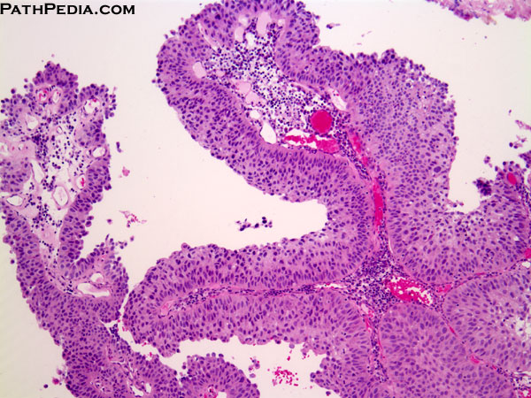
[UROTHELIAL CARCINOMA OF THE BLADER ; LOW GRADE]. Multiple papillary projections lined by multiple layers of urothelium (transitional epithelium).
These low grade tumors show overall preservation of cell polarity, few mitoses, and lack of significant morphologic atypia.

Slide 16
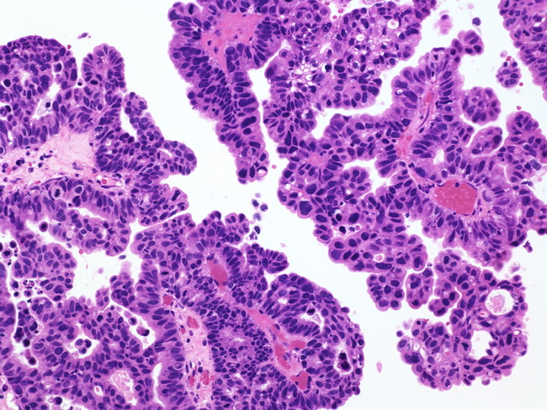
Papillary Urothelial Carcinoma, High-grade
The nuclei in this high-grade tumor are significantly enlarged and show variably increased chromatin content

