Slide 1
Renal practical block

Slide 2
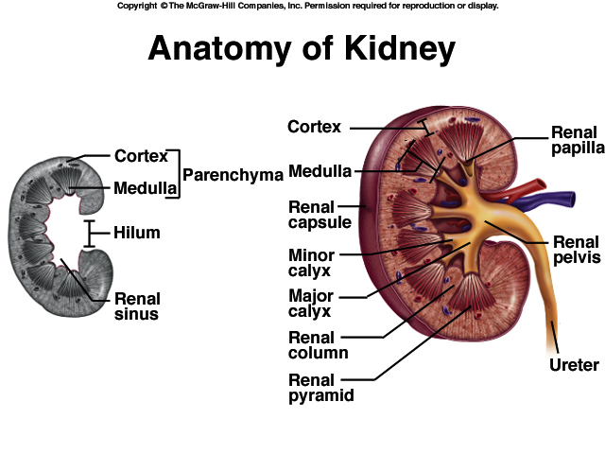

Slide 3
KIDNEY ANATOMY: NEPHRONS
NEPHRONS
FUNCTIONAL UNITS OF KIDNEY
~1.2 MILLION PER KIDNEY
THREE MAIN PARTS
BLOOD VESSELS
RENAL CORPUSCLE
RENAL TUBULE

Slide 4
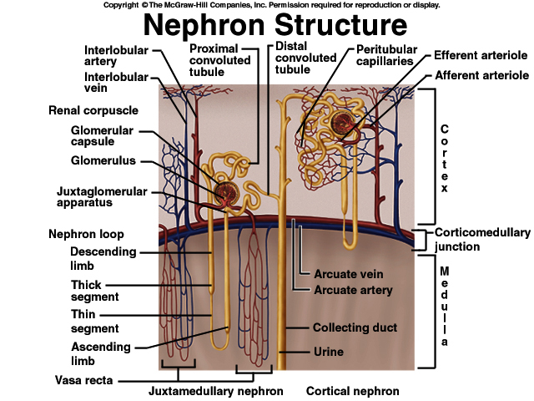

Slide 5
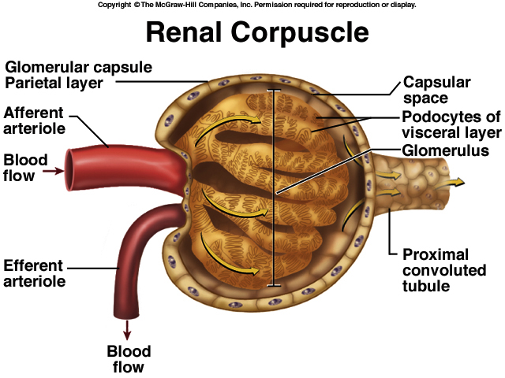

Slide 6
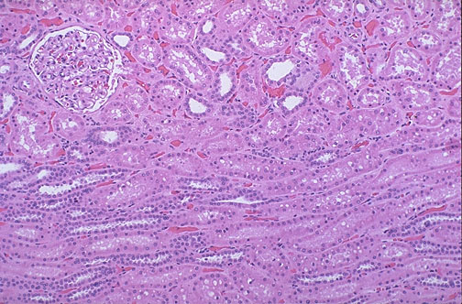

Slide 7
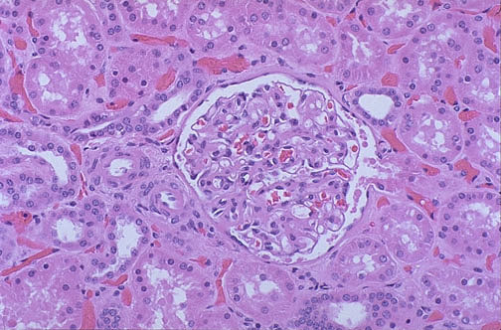
Figure 26.6

Slide 8
Gross and histopathology

Slide 9
1-Polycystic kidney

Slide 10
Adult polycystic kidney disease (APKD)
The gross picture shows markedly enlarged kidney and
Replacement of the renal parenchyma by numerous cysts of variable sizes .
the pattern of inheritance for adult form is autosomal dominant and for childhood form is autosomal recessive.
The mutated gene is: PKD-1 gene on the short arm of chromosome 16
Slide 21.9

Slide 11
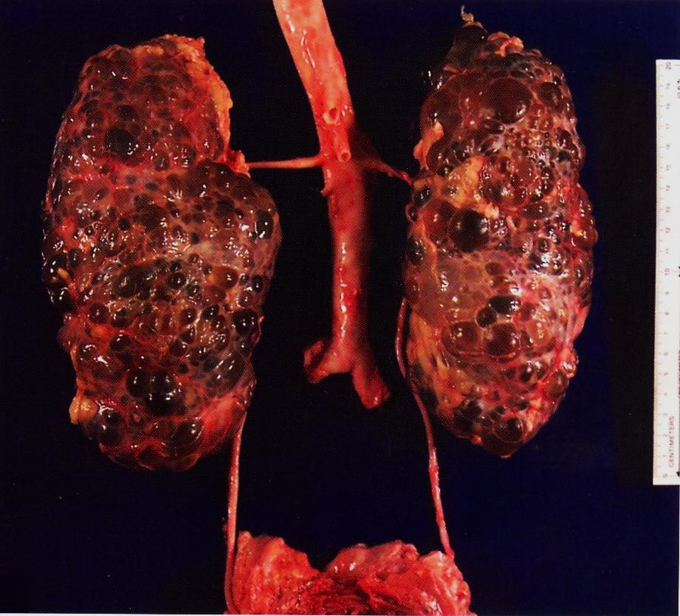

Slide 12
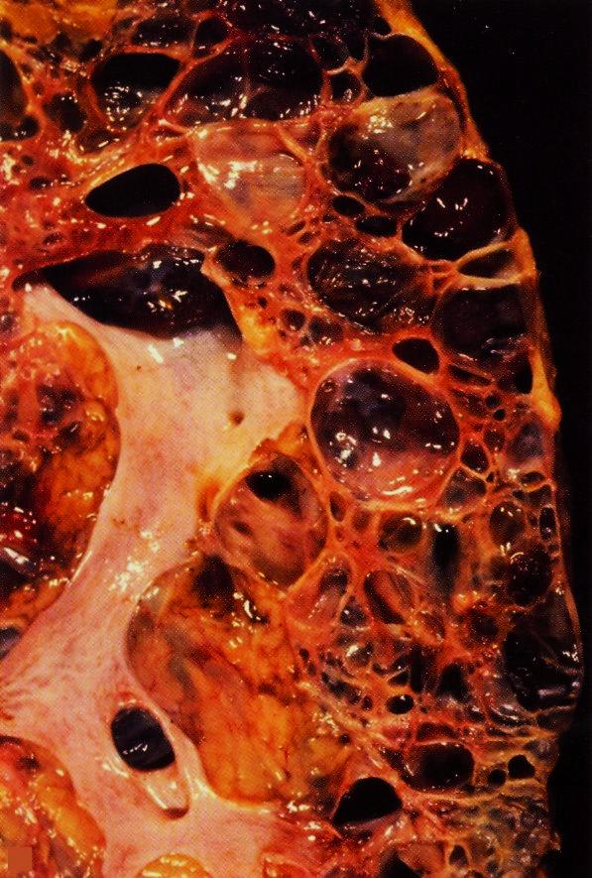

Slide 13
2-Postsreptococcal glomerulonephritis

Slide 14
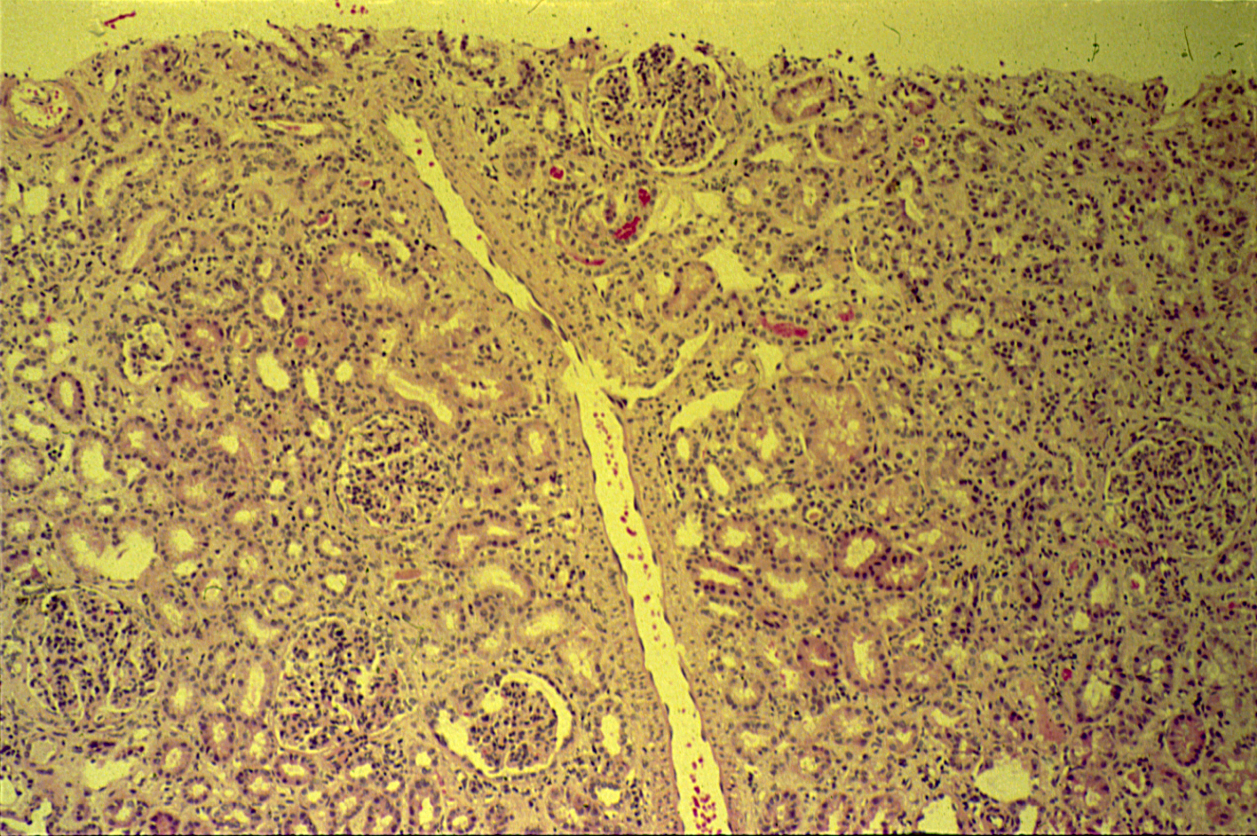
POSTSTREPTOCOCCAL GLOMERULONEPHRITIS

Slide 15
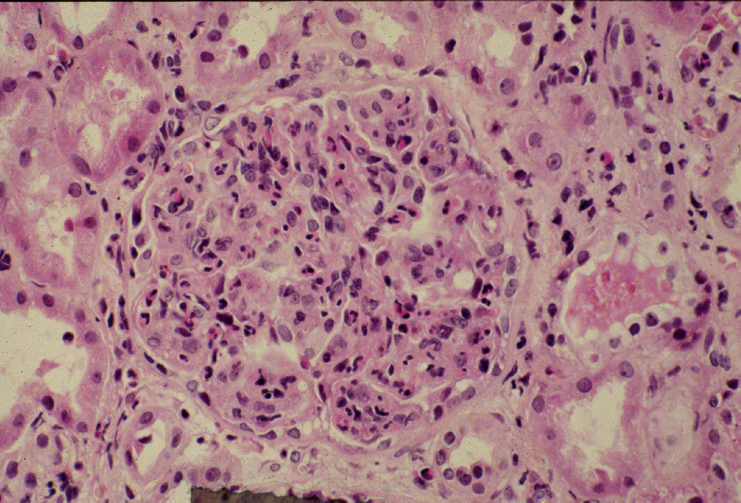
Notes:
Diffuse proliferative glomerulonephritis: High power LM of a hypercellular glomerulus; numerous capillaries contain inflammatory cells, mostly neutrophils. Notice the red blood cells in a distal tubule, to the left of the glomerulus (arrow). H&E

Slide 16
Slide 21.22

Slide 17
Post streptococcal glomerulonephritis: Section of kidney shows:
The glomeruli are enlarged, lobulated and hypercellular with obliteration of capsular space.
Cellularity is due to proliferation of endothelial and mesangial cells with some neutrophils.
Many capillaries appear obliterated.
Tubules show degenerative changes.

Slide 18
3- Hydronephrosis

Slide 19
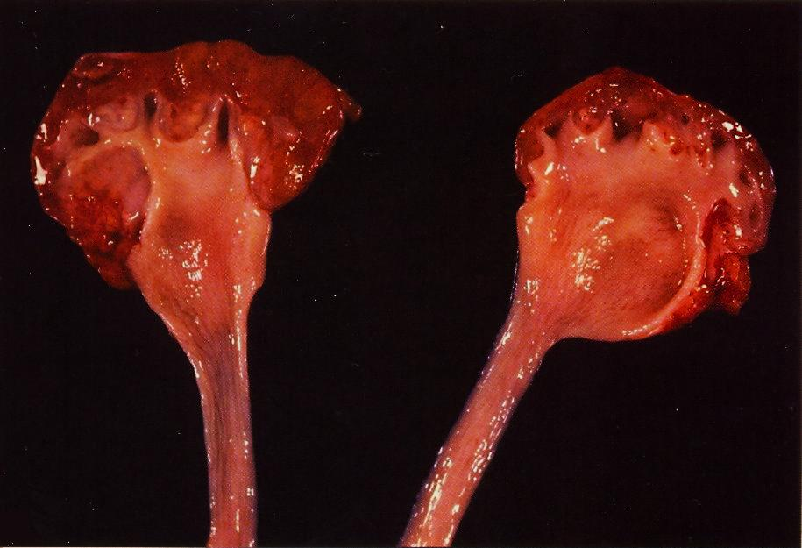
Bisected kidney shows markedly dilated renal pelvis and calyces with atrophic and thin renal cortex /parenchyma
Notes:
Bisected kidney shows markedly dilated renal pelvis and calyces with atrophic and thin renal cortex /parenchyma

Slide 20
The picture shows markedly dilated renal pelvis and calyces with atrophic and thin renal cortex /parenchyma.
The most common causes for hydronephrosis are: foreign bodies like calculi with obstruction, atresia of the urethra , Benign prostatic hyperplasia ,carcinoma of the prostate, bladder tumours, spinal cord damage with paralysis of the bladder and normal pregnancy.
Notes:
The most common causes for hydronephrosis are foreign bodies like calculi with obstruction, atresia of the urethra , Benign prostatic hyperplasia ,carcinoma of the prostate and bladder tumours and spinal cord damage with paralysis of the bladder .

Slide 21
4- Pyonephrosis

Slide 22
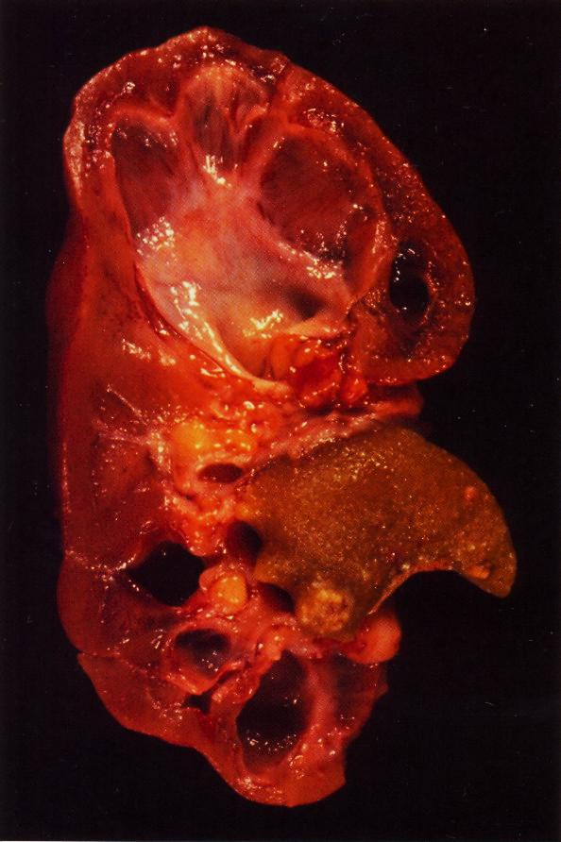
Focal hydronephrosis and pyonephrosis .
Notes:
Focal hydronephrosis and pyonephrosis .

Slide 23
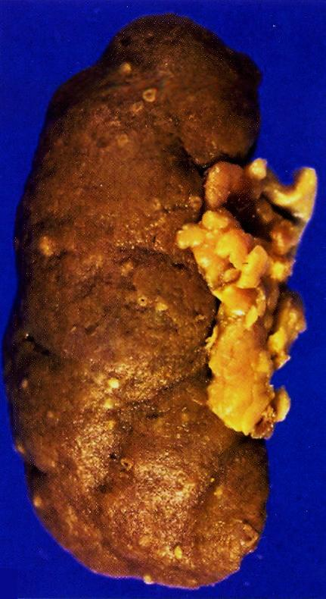
Pyonephrosis with small cortical abscesses
Notes:
Pyonephrosis with small cortical abscesses .

Slide 24
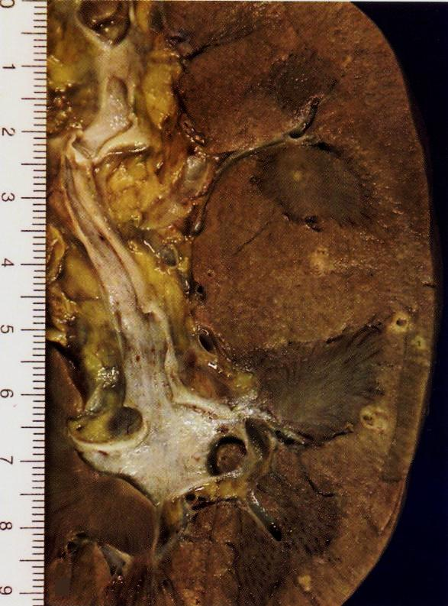
Renal cortical pyonephrosis with renal stone impacted within a calyx
Notes:
Renal cortical pyonephrosis with renal stone impacted within a calyx .

Slide 25
5- Chronic pyelonephritis

Slide 26
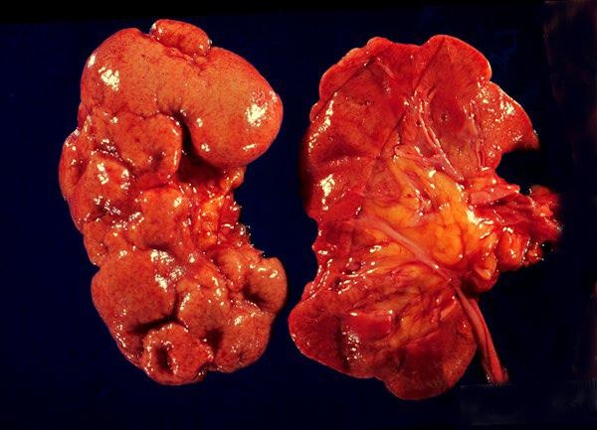
The picture shows slightly atrophic and deformed kidneys with cortical coarse scars .
Notes:
The picture shows slightly atrophic and deformed kidneys with cortical coarse scars .

Slide 27
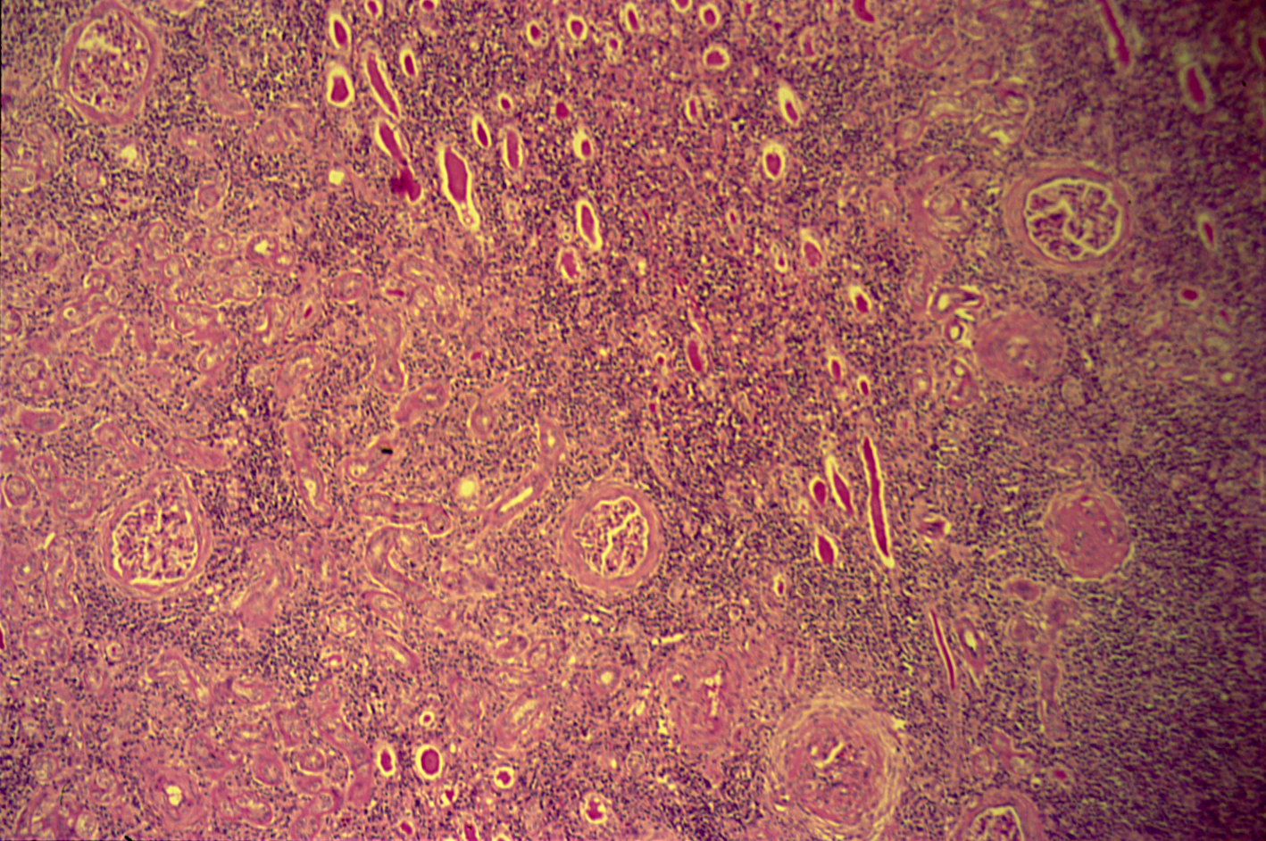
CHRONIC PYELONEPHRITIS

Slide 28
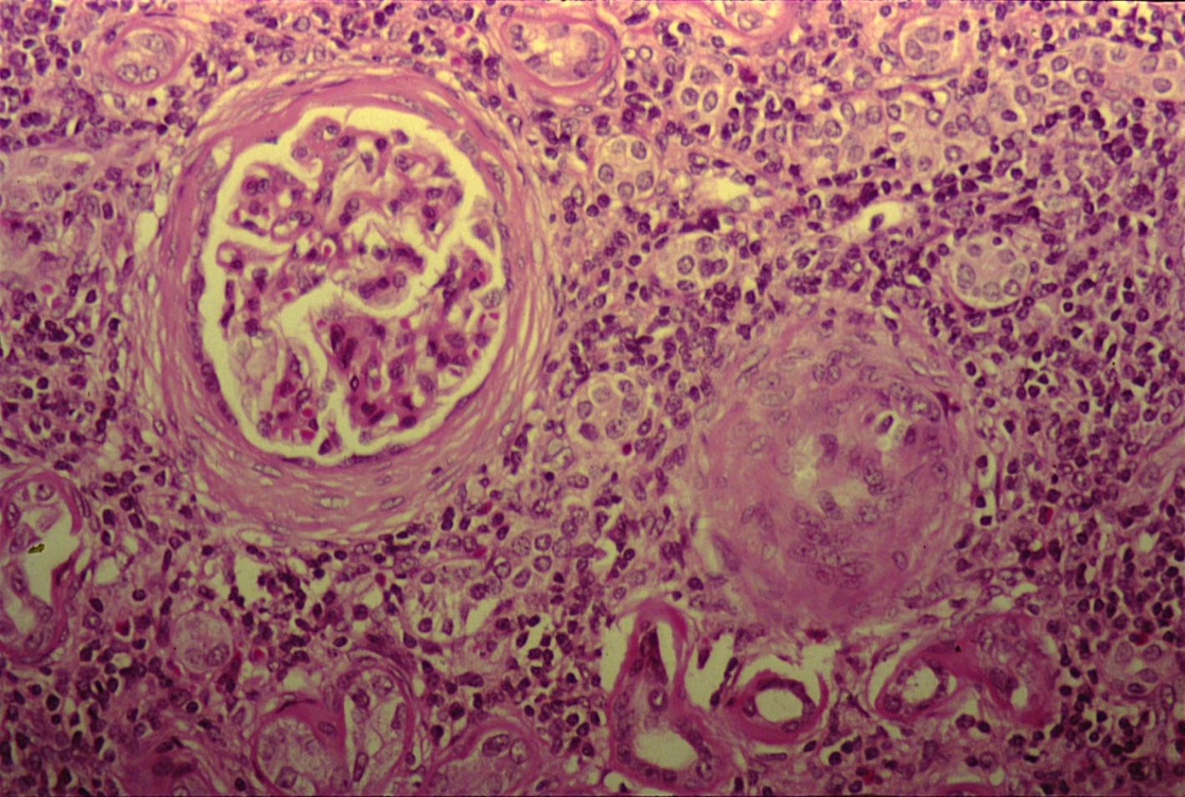
CHRONIC PYELONEPHRITIS
Notes:
The picture shows periglomerular fibrosis , glomerular sclerosis and hyalinization with marked chronic interstitial inflammation .

Slide 29
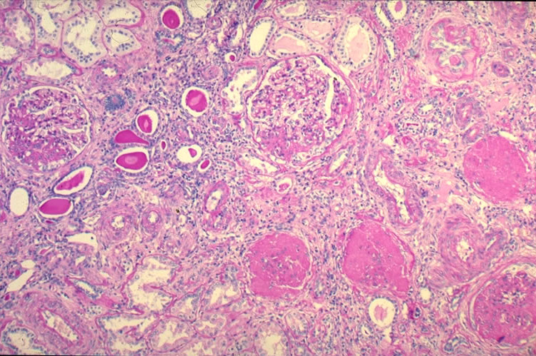

Slide 30
Chronic pyelonephritis: Section of kidney reveals that:
The glomeruli show varying degrees of sclerosis and periglomerular fibrosis.
The tubules show varying degrees of atrophy. Some tubules are dilated and filled with Eosinophilic hyaline casts resembling colloid (thyroidization).
Interstitial tissue shows chronic inflammatory cells infiltrate and fibrosis.
Reflux associated nephropathy is the most common cause in children.

Slide 31
6- Renal Carcinoma

Slide 32
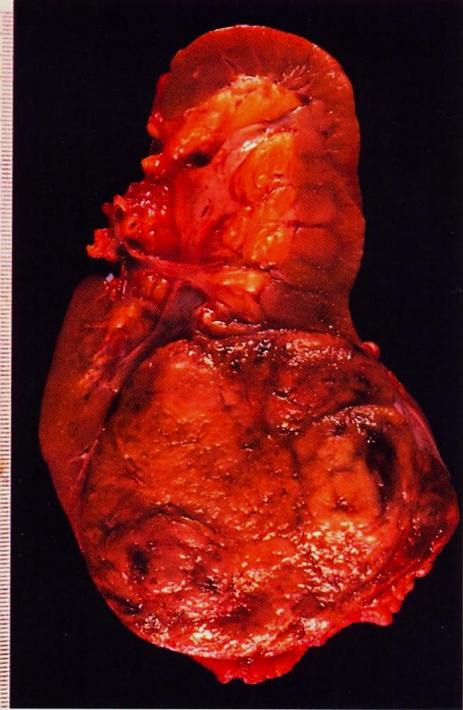
Renal cell carcinoma occupying the lower renal pole
Extra renal effects: Polycythemia, fever, hypercalcemia and Cushing’s syndrome
Renal clear cell carcinoma may secrete erythropoietin hormone.

Slide 33
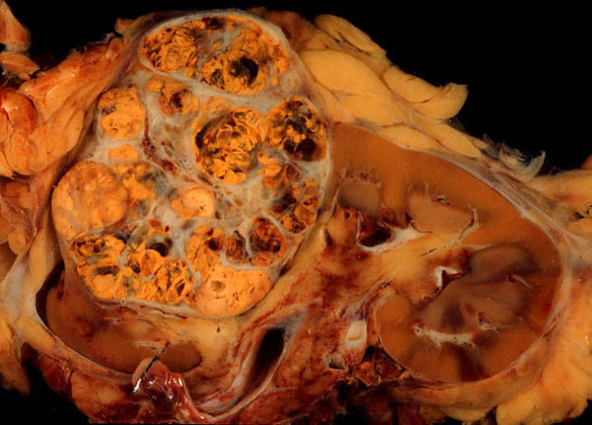
Gross picture shows a well circumscribed renal cortical mass which is partly yellow and partly hemorrhagic with lobulated cut surface .

Slide 34
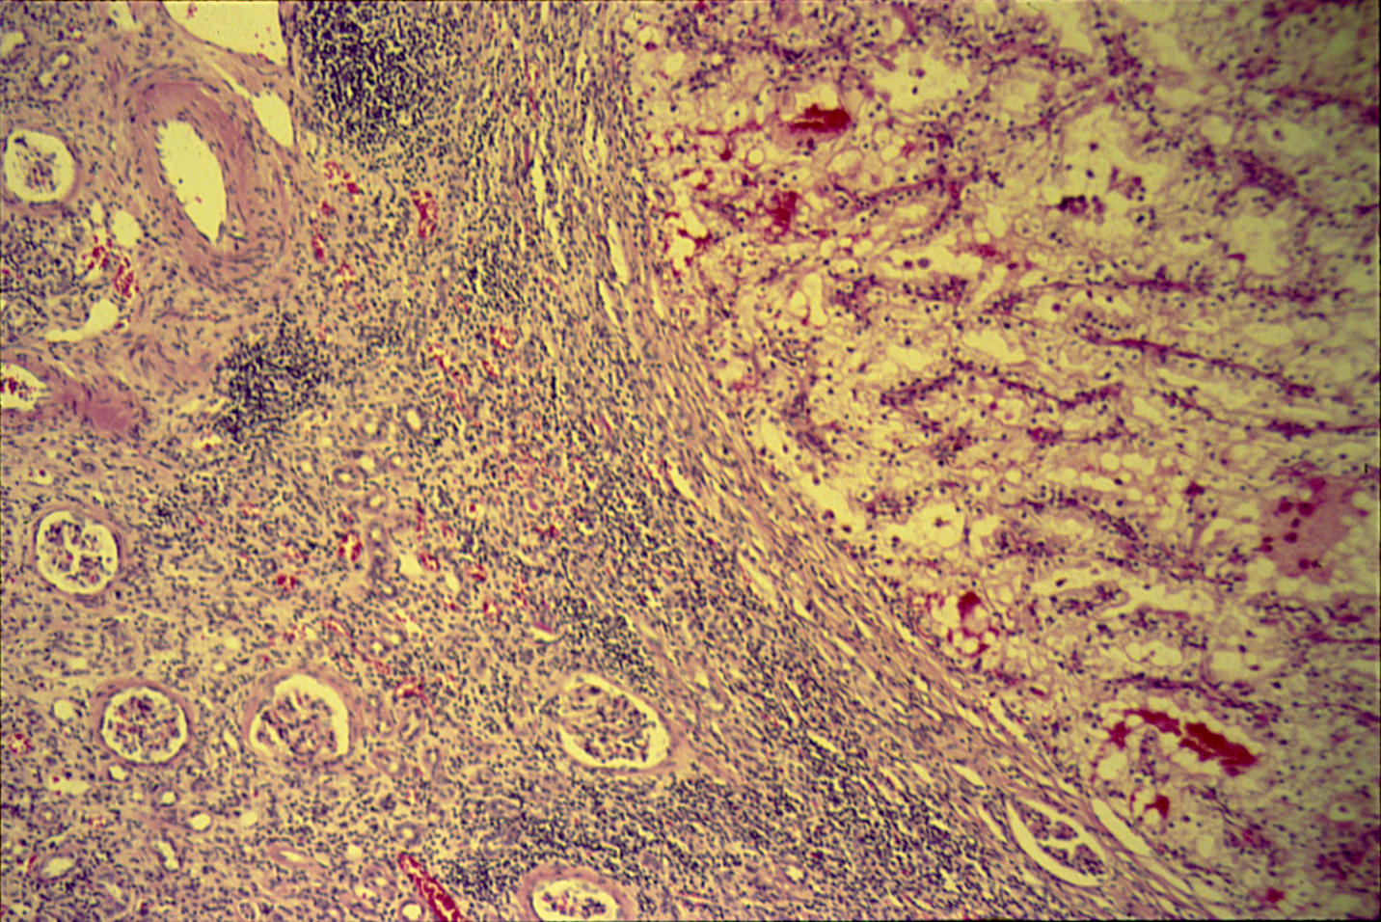
CLEAR CELL CARCINOMA (KIDNEY)

Slide 35
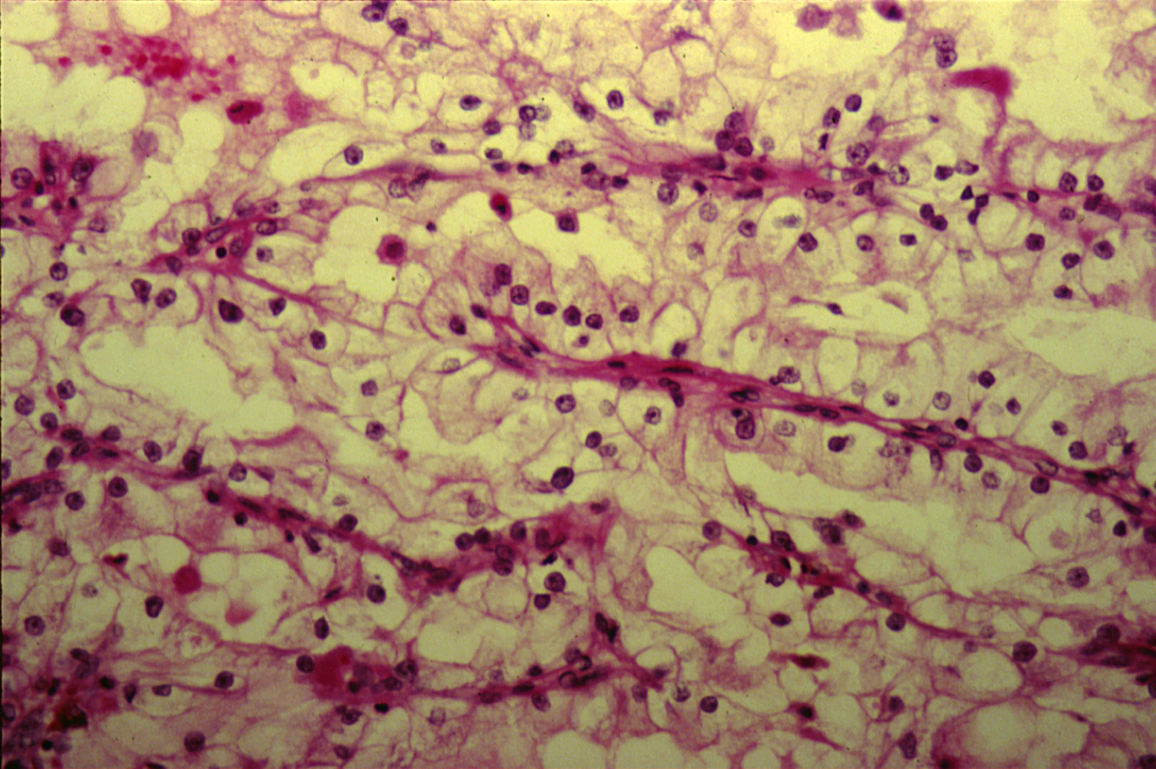
CLEAR CELL CARCINOMA (KIDNEY)

Slide 36
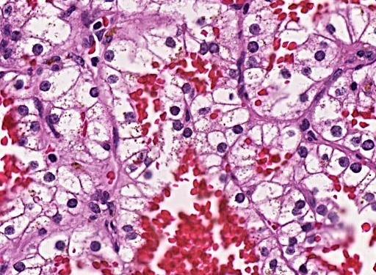
Section shows clear tumour cells with pleomorphic nuclei and areas of hemorrhage .

Slide 37
Clear cell carcinoma of the kidney: Section of the kidney shows:
Compressed kidney tissue at the margin of the tumour masses.
Tumour cells are large polygonal with clear cytoplasm (dissolved glycogen and lipid) and piknotic nuclei.
Cells are arranged as alveolar groups or tubules with papillary formations separated by thin fibrovascular septae.
Cells show pleomorphism and mitosis.
Areas of haemorrhage and necrosis are present.

Slide 38
7- Wilm’s tumour

Slide 39
Wilms Tumor
Gross picture shows partly pale and partly hemorrhagic solid tumour replacing almost the entire renal parenchyma and areas of necrosis also seen .
Notes:
Gross picture shows partly pale and partly hemorrhagic solid tumour replacing almost the entire renal parenchyma and areas of necrosis also seen .

Slide 40
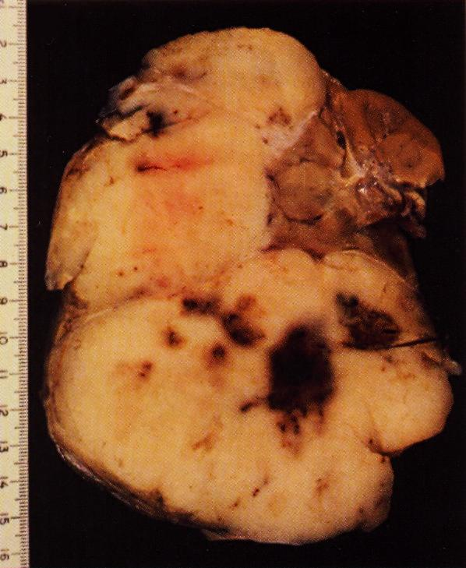

Slide 41
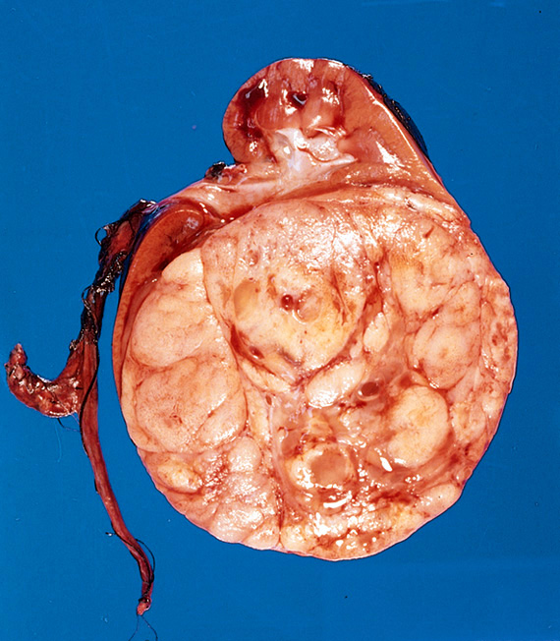
Slide 11.27

Slide 42
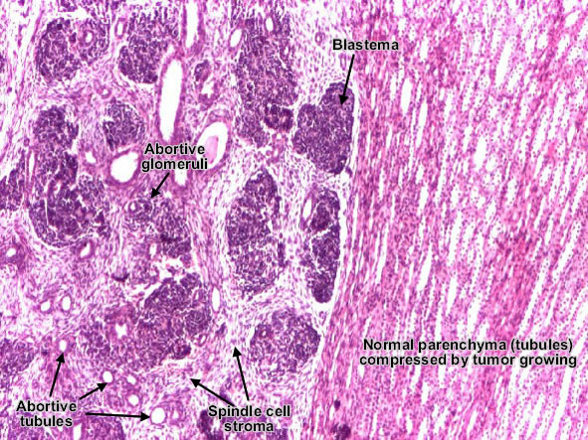

Slide 43
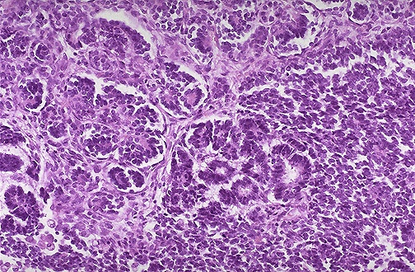
Wilm's tumor resembles the fetal nephrogenic zone of the kidney. Three major components:
undifferentiated blastema cells , epithelial tissue which shows attempts to form primitive glomerular and tubular structures and mesenchymal (stromal) tissue

Slide 44
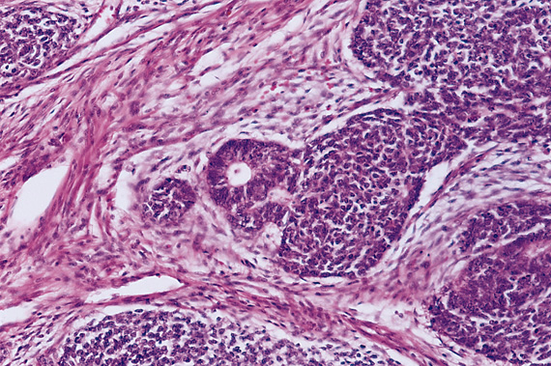
Slide 11.28

Slide 45
8- Carcinoma of the urinary bladder

Slide 46
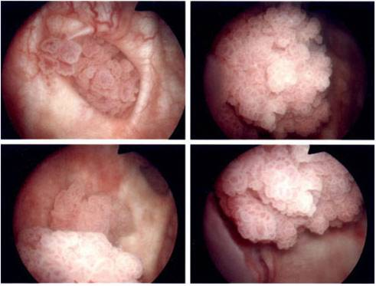
Endoscopic view of a papillary urinary bladder tumour .

Slide 47
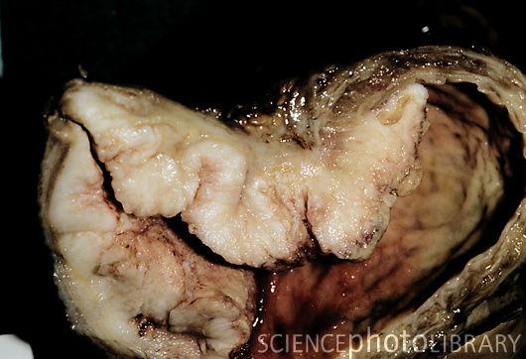
Gross specimen of a malignant (cancerous) tumour (pale area, centre to left) of the urinary bladder.

Slide 48
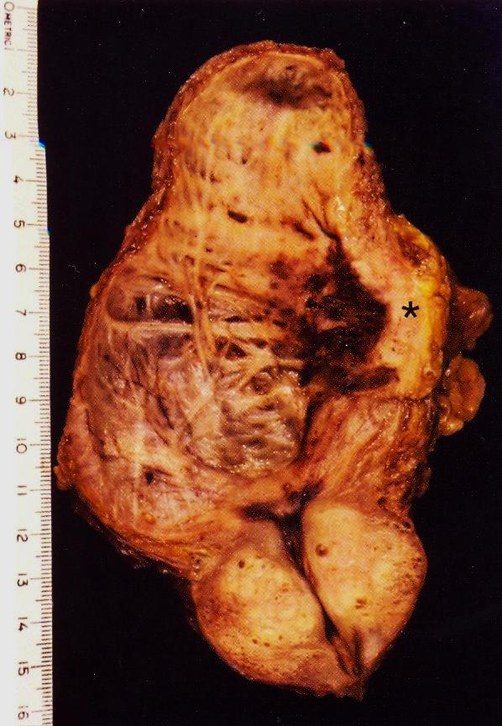
Longitudinal section of urinary bladder and prostate showing benign prostatic hyperplasia , trabeculation of the urinary bladder wall and bladder carcinoma (asterix )which is most likely proved histologically to be Transitional cell carcinoma.
Predisposing factors:
smoking , Aniline dyes , long term use of analgesics , heavy long term exposure to cyclophosphamide .
The genes can be mutated: P16, P53 and FGFR3 on chromosome 9.

Slide 49
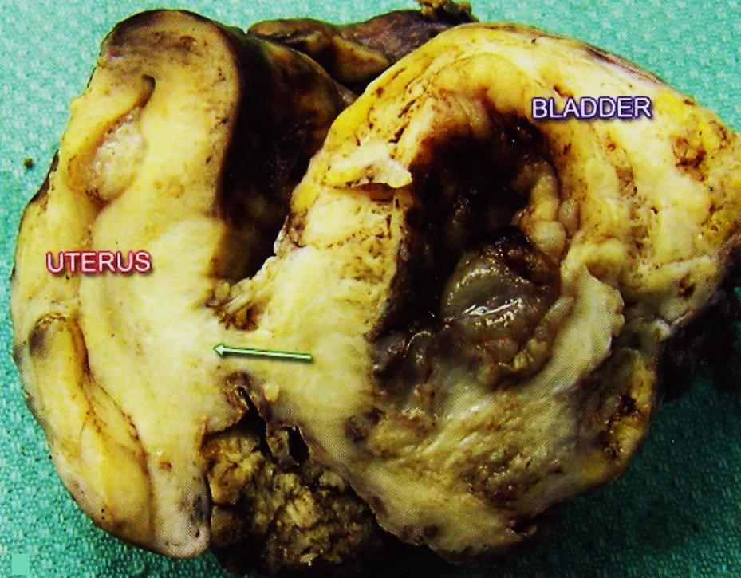
Urinary bladder carcinoma infiltrating the urinary bladder wall with extention to the uterus .
Notes:
Urinary bladder carcinoma infiltrating the urinary bladder wall with extention to the uterus through a fistula (arrow) .

Slide 50
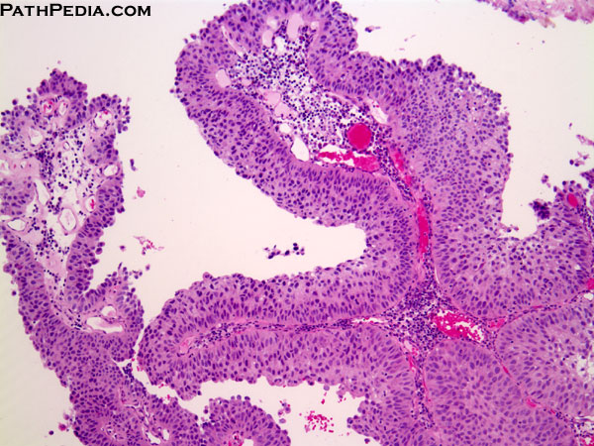
[UROTHELIAL CARCINOMA, LOW GRADE]. The low grade tumors show overall preservation of cell polarity, few mitoses, and lack of significant morphologic atypia. This exophytic papillary tumor shows multiple finger-like projections lined by multiple layers of urothelium (transitional epithelium)

Slide 51
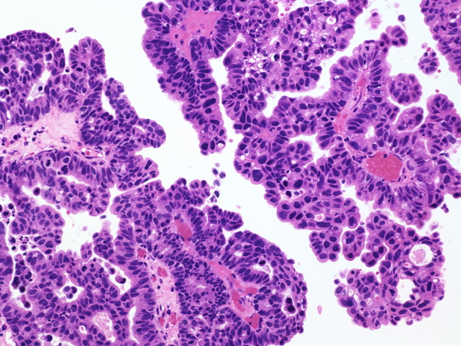
Papillary Urothelial Carcinoma, High-grade
The nuclei in this high-grade tumor are significantly enlarged and show variably increased chromatin content

