Slide 1
Granulomatous diseases
Dr Shaesta Naseem
24-10-13

Slide 2
Gross and histopathology

Slide 3
1- Tuberculosis of the lung

Slide 4
Ghon’s Complex (Lung)
Caseous necrosis
(Yellowish areas )
Ghon’s complex consist of Ghon focus in the lung and lymphadenopathy.

Slide 5
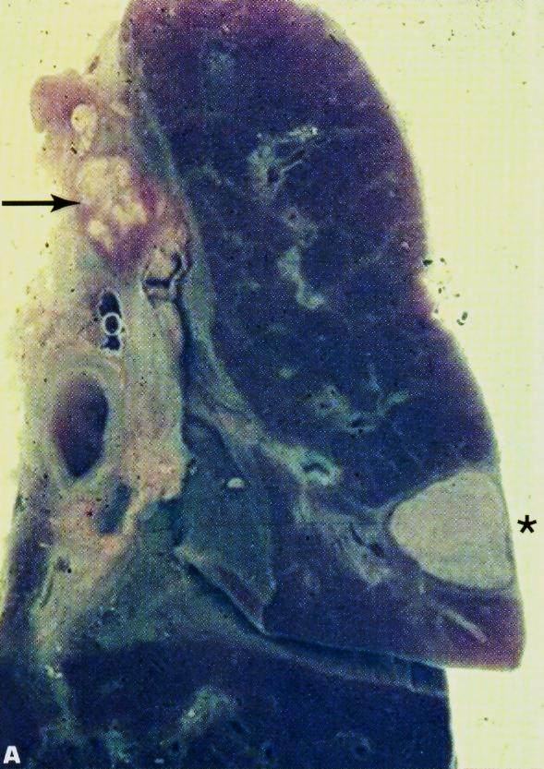
Primary necrosis
(primary: because it is down)
Miliary TB of the Lungs

Slide 6
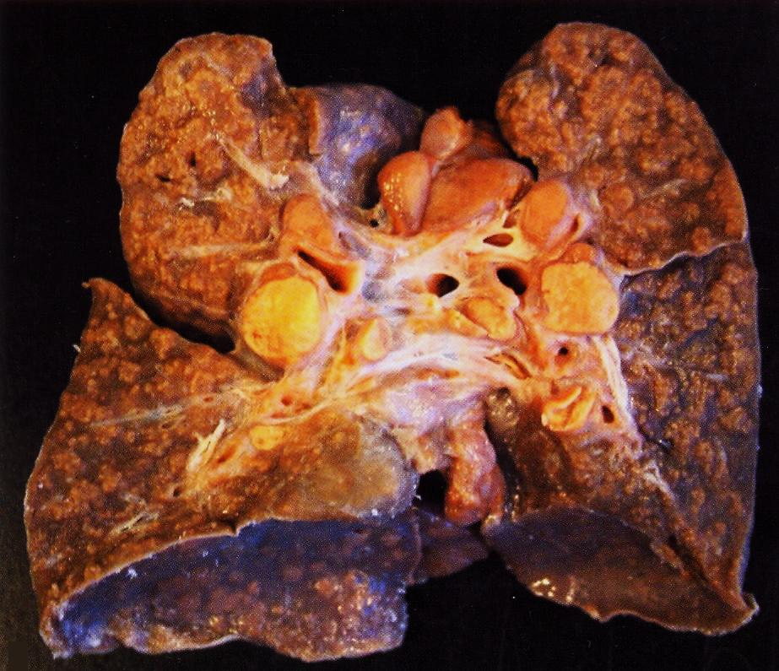
Caseous necrosis
Diagnosis: TB in the lung

Slide 7
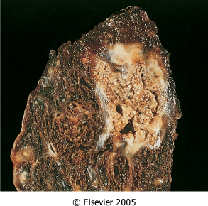
Organ: lung Dx : Caseous necrosis (tuberculosis)

Slide 8
Tuberculous Granulomas
Gaint cell
Areolar spaces in the lung.
We see under the Microscope:
1- Epithlioid histocytes “Bottle-shaped”.
2-Gaint cell.
3-centeral caseous necrosis.
4-lymphocytes and plasma cells.

Slide 9
Caseation Necrosis
Epitheloid cells

Slide 10
Epitheloid cells in Granuloma
lymphocytes
Langhan's giant cell

Slide 11
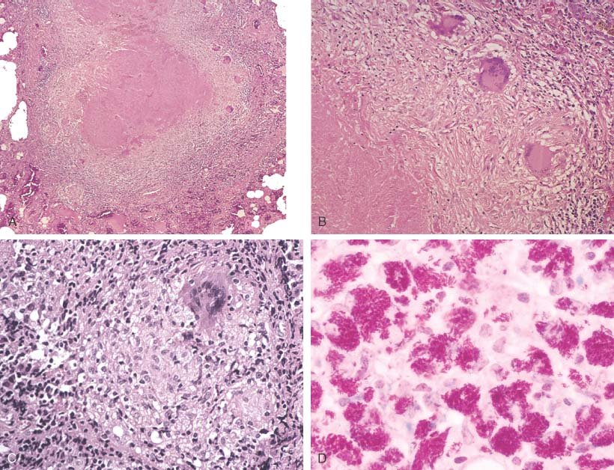
Necrotizing (i.e., caseating) granulomas filled with acid fast bacilli. This is CLASSIC for TB.

Slide 12
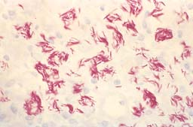
MORE ACID-FAST BACILLI, AFB
*The name of the stain (AFB).
OR Ziehl-Neelsen stain

Slide 13
tuberculosis of the lung :
Section of the lung shows : The alveolar septae contain many tubercles which consist of epithelioid cells , few langhan’s giant cells and peripheral rim of lymphocytes with or without caseation

Slide 14
2- Tuberculous lymphadenitis
Clinical features:
1-night fever.
2-rise of temperature.
3-hemoptisis.
4-cough .

Slide 15
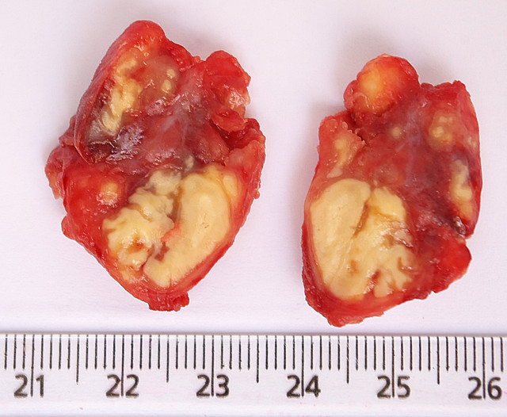
Enlarged limph node
There is no Areolar paces ,therefore it is not Lung

Slide 16
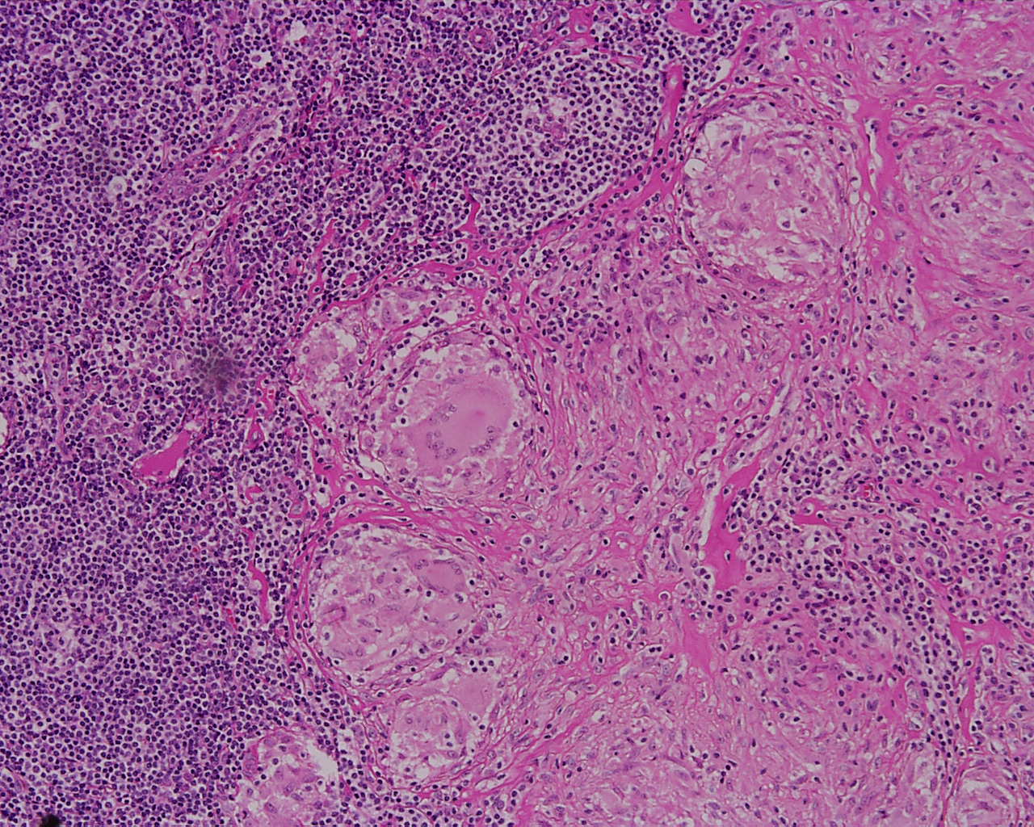
Lymphocytes
And
Plasma cells
Caseated necrosis
Epitheliod cells
Gaint cells
(Horse U shape)

Slide 17
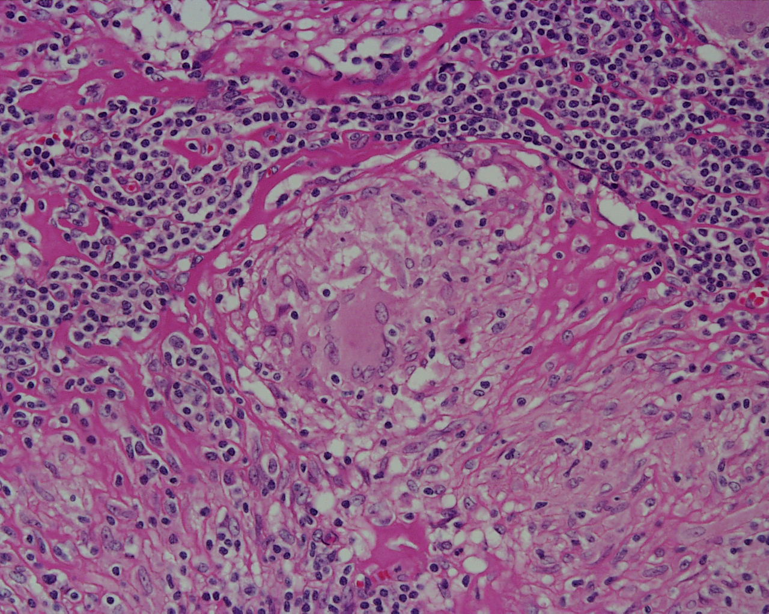
Caseated necrosis

Slide 18
Tuberculous lymphadenitis : Section of a lymph node with connective tissue capsule and lymphoid tissue shows:
Many round and oval tubercles/ granulomas with or without central caseation that appears structureless, homogenous and pink in colour.
The granulomas consists of epithelioid cells, few langhan’s giant cells (large cell with multiple peripheral nuclei) and peripheral rim of lymphocytes.

Slide 19
3- Bilharziasis of the colon
Intestine & bladder

Slide 20
Schistosomiasis or bilharzia is a disease affecting many people in developing countries. In the form of 'acute' schistosomiasis it is sometimes referred to as snail fever and cutaneous schistosomiasis
There are five species of flatworms that cause schistosomiasis. Each causes different symptoms.
Schistosomiasis may travel to different parts of the body, and its localization determines the person's symptoms.
Schistosoma mansoni and Schistosoma japonicum cause intestinal schistosomiasis.
Schistosoma haematobium causes urinary schistosomiasis.

Slide 21
Schistosomiasis life cycle.
Schistosomes have a trematode vertebrate-invertebrate lifecycle (infecting both a vertebrate and invertebrate), with humans being the definitive host
The life cycles of all human schistosomes are similar: parasite eggs are released into the environment from infected individuals. The eggs hatch on contact with fresh water to release the free-swimming miracidium

Slide 23
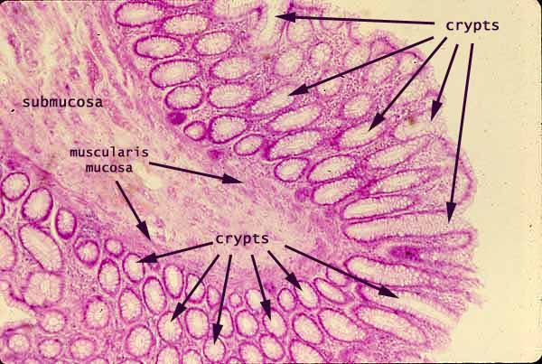
Normal colon

Slide 24
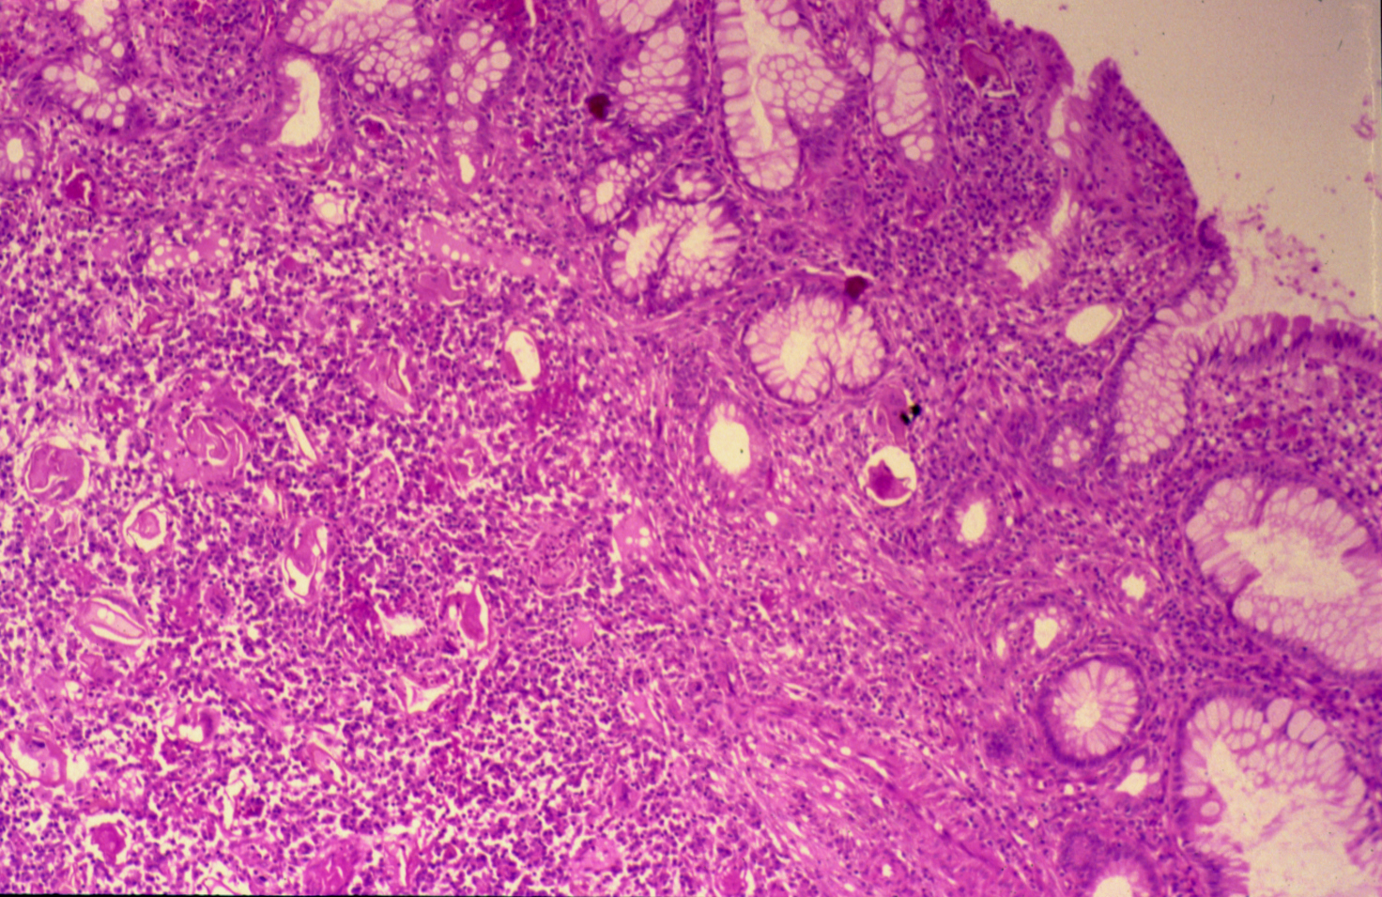
COLONIC BILHARZIASIS
Normal colon

Slide 25
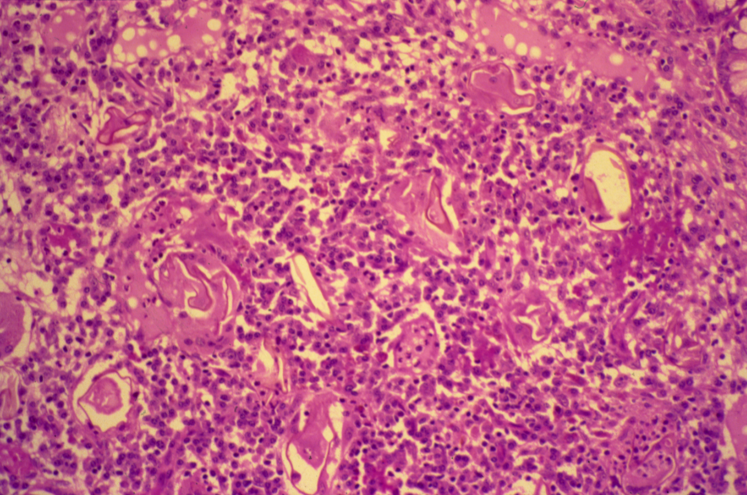
BILHARZIASIS (COLON)
Ova
Surrounded by granuloma tissue (ova=egg=shell)
Symptoms:
1-fever
2-bleeding
3-itching.

Slide 26
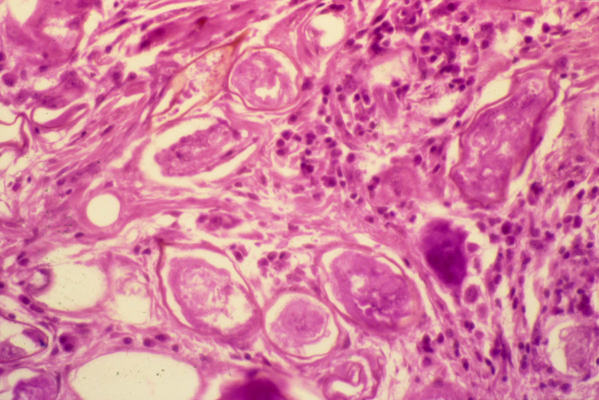
SCHISTOSOMIASIS OF THE URINARY BLADDER (Bladder cancer)
Spikes: determine the type of bilharziasis
Ova of Schistosomiasis

Slide 27
Bilharziasis of the rectum\urinary bladder: Section of fragments of rectal\urinary bladder mucosa shows:
Many Bilharzial ova with yellow brown shells in mucosa and submucosa surrounded by fibrosis and chronic inflammatory cells consisting of lymphocytes, plasma cells and many eosinophils.
Few granulomas are seen around the ova.

Slide 28
5- Cutaneous leishmaniasis

Slide 29
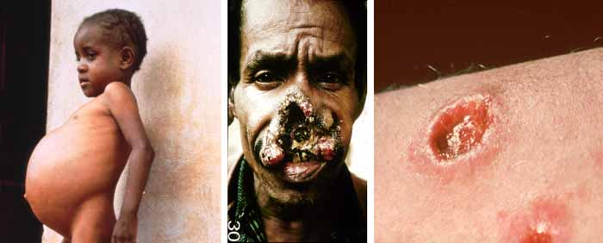
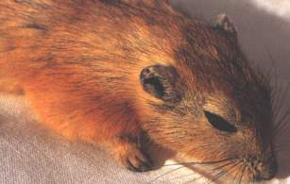
Leishmaniasis
Protozoal disease.
transmitted to human via the bite of the female sandfly
Animal reservoir is required to persist.

Slide 30
Leishmaniasis Life cycle

Slide 31
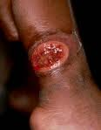
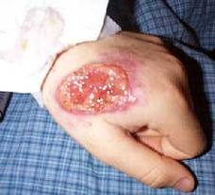
Only in the skin
Description:
-Fllcerated crusted lesion
-Also there is hemorrage

Slide 32
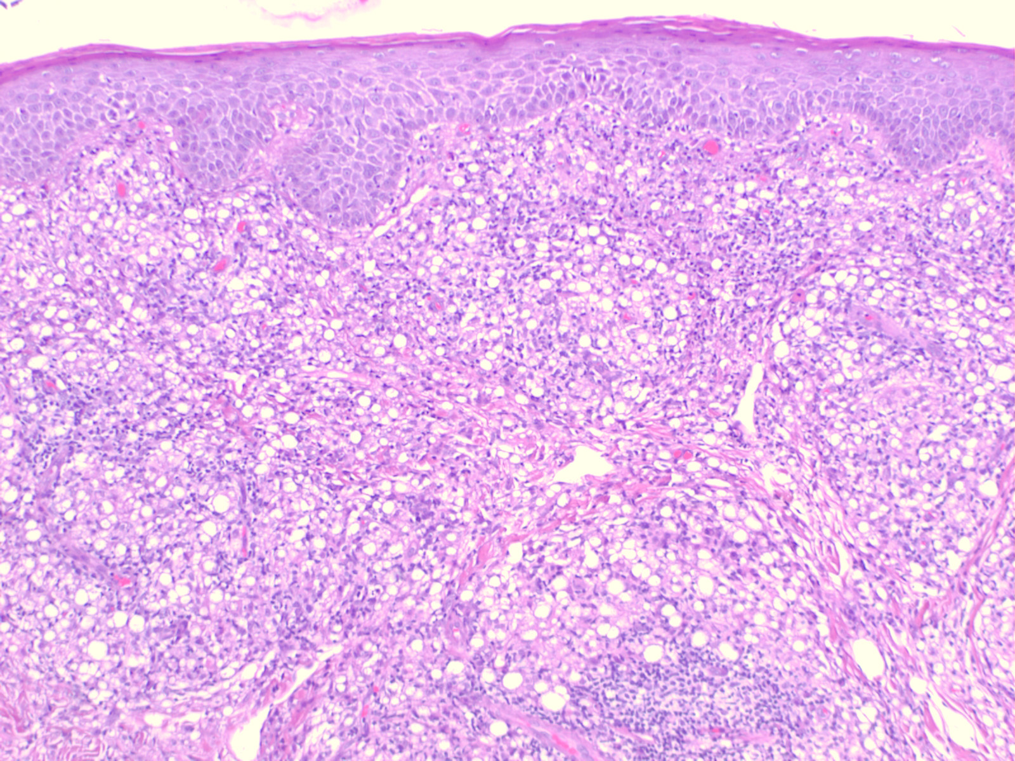
Collection of macrophages (engulf particles)
epidermis
Many macrophages with engulfed organism.

Slide 33
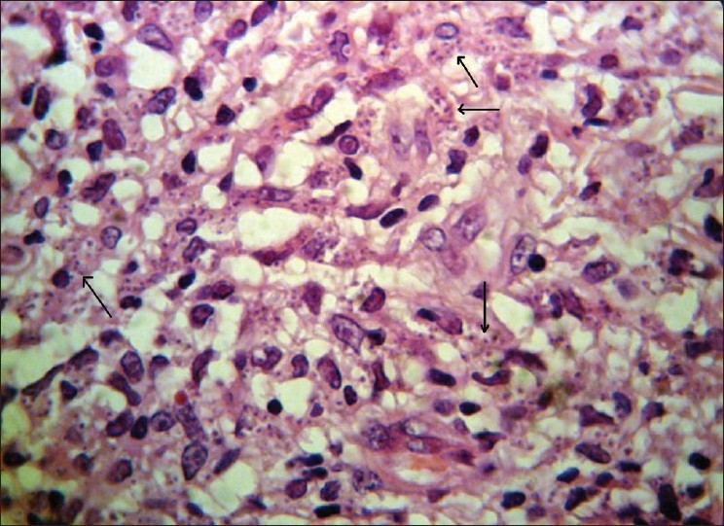
macrophages
Leishman bodies
Histological view shows marked cellular infiltration and parasites (Leishman bodies) within macrophages

Slide 34
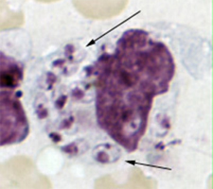
kinetoplast
Leishman bodies
Amastigotes
Picture shows a macrophage containing Leishmania amastigotes with characteristic features (round nucleus, rod-shaped kinetoplast; arrows) .

