Slide 1
Inflammation and repair
Dr Shaesta Naseem
19-09-13

Slide 2
Inflammation and repair
The inflammation
Inflammatory cells :
1. Macrophages
2. Neutrophils
3. Lymphocytes
Etc .
We see
types
Chronic:
For long time
Acute:
Short time We see neutrophils

Slide 3
CLINICAL FEATURES OF INFLAMMATION :
Tumor (swelling / EDEMA)
Rubor (Redness)
Colar (Warmth / Heat)
Dolor (Pain)
Functio Lasea (loss of function)

Slide 4
Gross and histopathology

Slide 5
1- Fibrinous pericarditis
Outer layer of the heart
Means/leads to inflammation
Fibrinous is found in the blood

Slide 6
The next slide is about this region
Organ: Pericardium Dx: Fibrinous Inflammation
Acute
Means diagnosis

Slide 7
ACUTE FIBRINOUS PERICARDITIS
مثل النقاط

Slide 8
ACUTE FIBRINOUS PERICARDITIS
غشاء التامور في القلب

Slide 9
Fibrinous Pericarditis: Section of Heart shows:
It becomes thick while the normal is thin
The pericardium is distorted by thick irregular layer of pinkish fibrinous exudate with some red cells and inflammatory cells.
The subpericardial layer is thickened by edema and shows dilated blood vessels, chronic inflammatory cells and areas of calcification.
RBC from blood outside the heart
It becomes chronic if it doesn’t treated.

Slide 10
2- Acute appendicitis

Slide 11
ACUTE APPENDICITIS
fat
Lumen
Here’s the question : What is the white junk coating the surface?

Slide 12
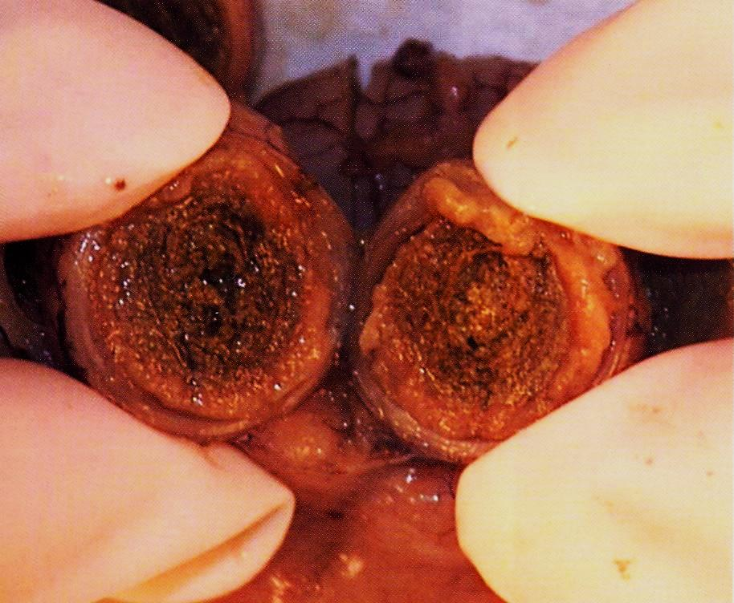
Lumen fills with dead material
(inflammatory cells)

Slide 13
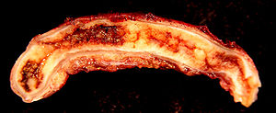
Acute appendicitis
The same appendicitis but from other side

Slide 14
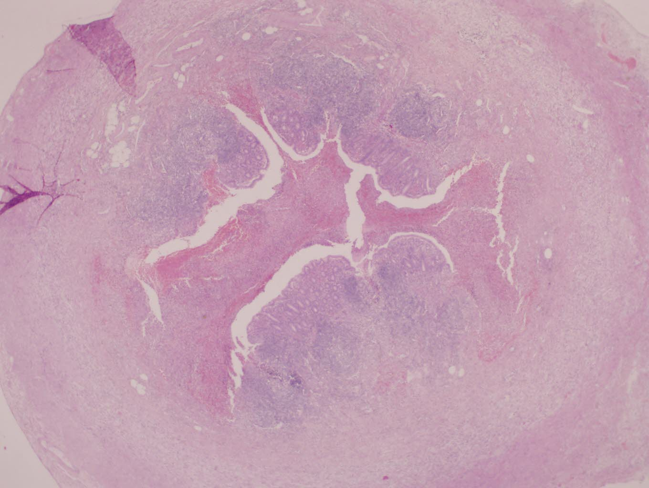
ACUTE APPENDICITIS
Mucosa ulcerated
Inflammatory cells

Slide 15
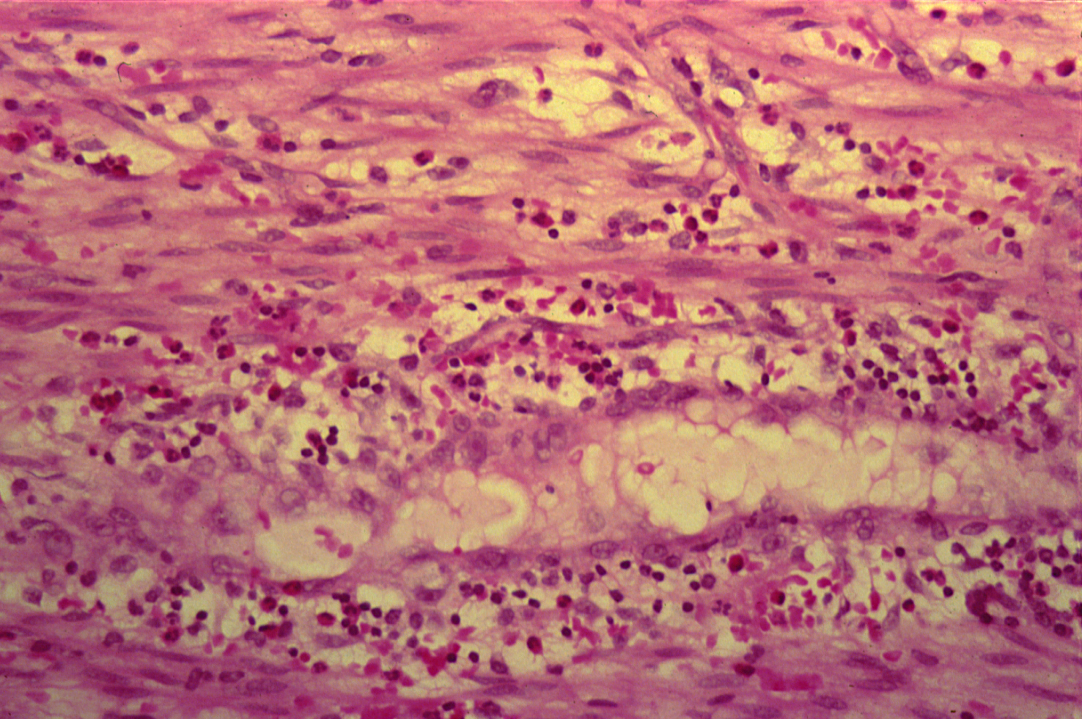
ACUTE APPENDICITIS
Edema not fat
Because it’s not a normal site for fat
neutrophils
lymphocytes
eosinophil

Slide 16
Acute Suppurative appendicitis: Cross Section of Appendix shows:
On gross, fibrino-purulent exudate is present on the serosal surface.
Accumulation of inflammatory exudate and pus cells in the lumen and the mucosa is ulcerated.
All layers of the appendix wall show edema, dilated and congested blood vessels and infiltration by many neutrophils.

Slide 17
3-Skin pilonidal sinus
Something related to the hair .
collection
Has a cavity , opening between two ends .
Sinus:
Track leading
Connection between a cavity and epithelial surface
Fistula:
Abnormal pathway that leads from internal cavity

Slide 18
3- FOREIGN BODY REACTION (PILONIDAL SINUS)

Slide 19
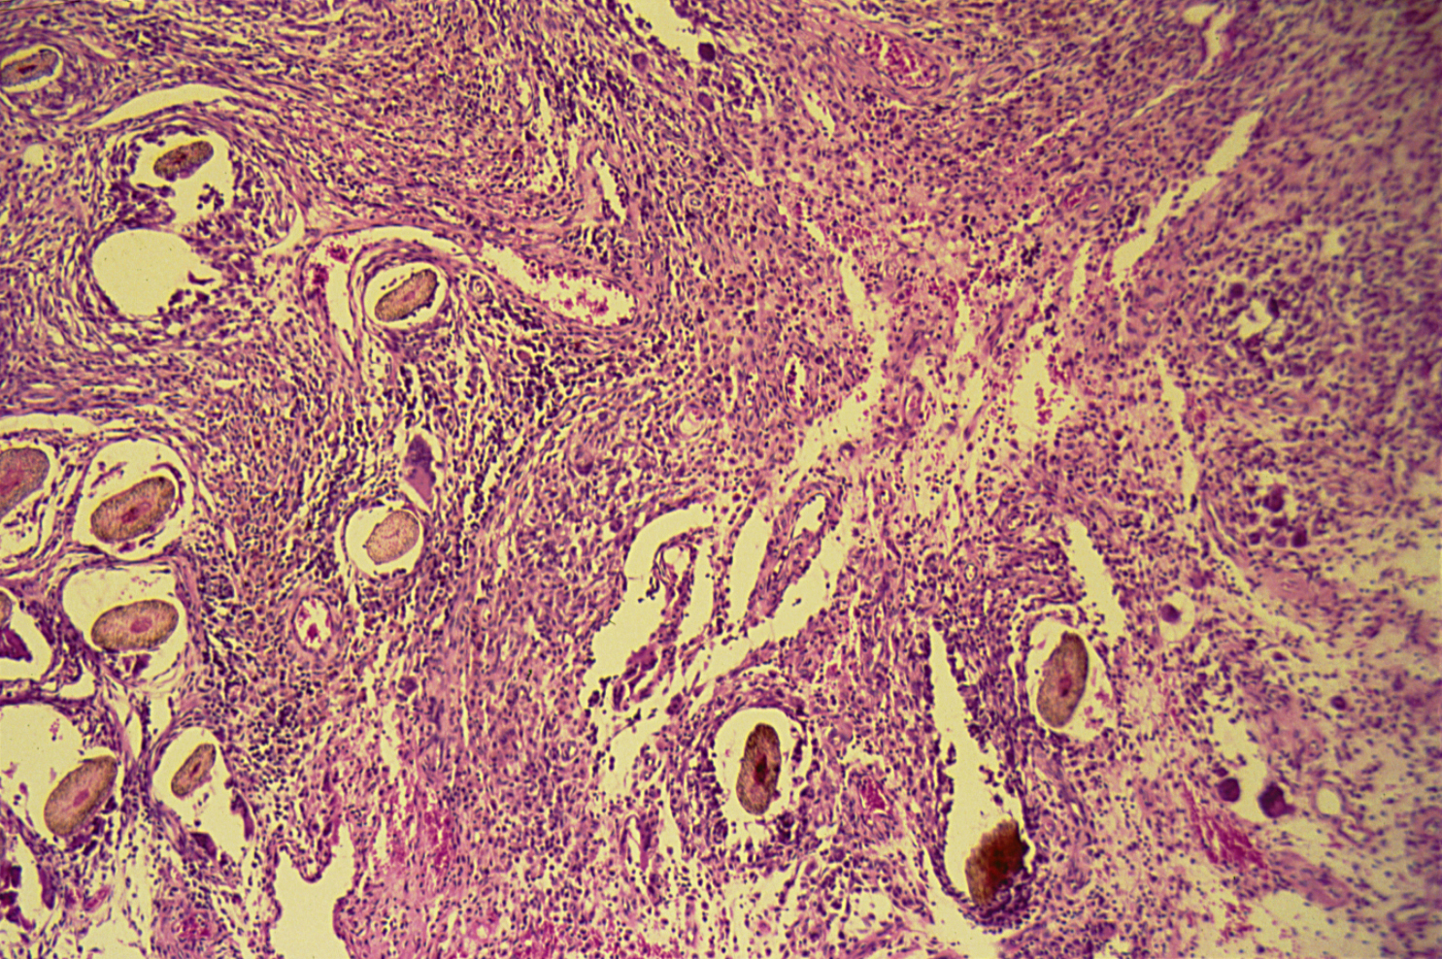
FOREIGN BODY REACTION (PILONIDAL SINUS)

Slide 20
Foreign Body reaction (Pilonidal sinus): Section of Skin Shows:
A sinus tract lined by an inflammatory granulation tissue in the dermis .
The lumen of sinus and wall contain large number of hair shafts with foreign body giant cells, lymphocytes , macrophages & neutrophils .

Slide 21
4-Chronic cholecystitis with stones
Means inflammation of gallbladder

Slide 22
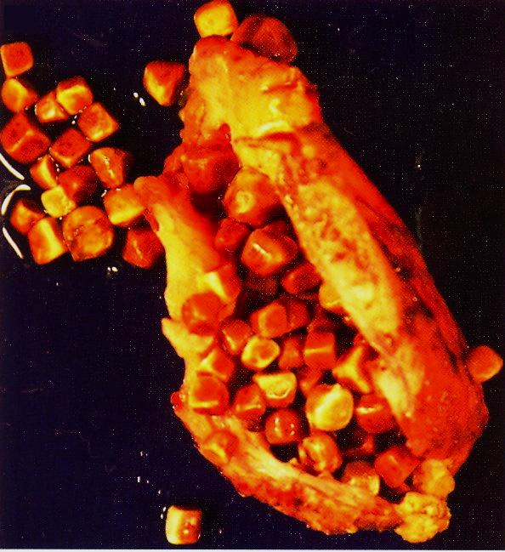
Larged gallbladder fills of stones

Slide 23
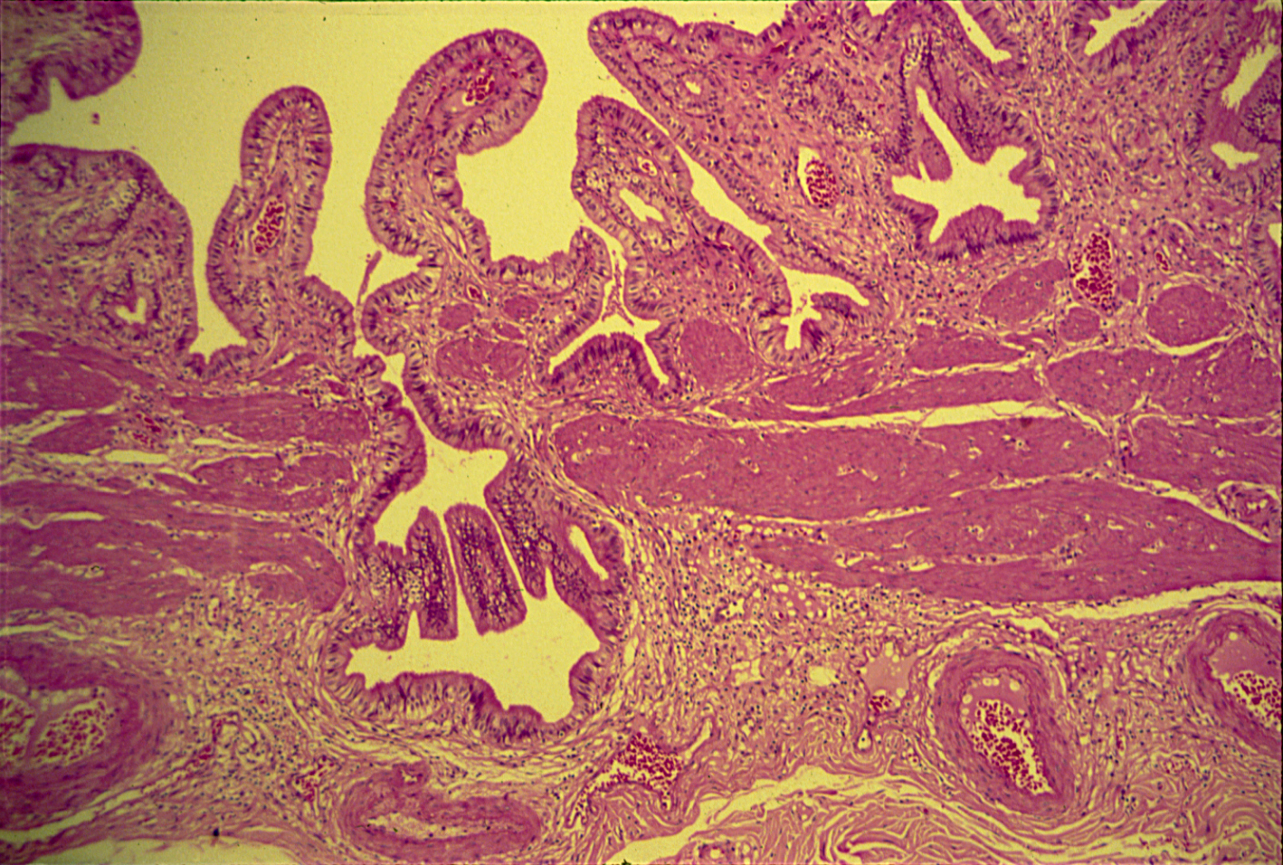
CHRONIC CHOLECYSTITIS
Abnormal cavity happens because of the stone
mucosa
submucosa
Muscle cells

Slide 24
Chronic cholecystitis: Section of gallbladder wall shows:
Irregular mucosal folds and foci of ulceration in mucosa.
Wall is penetrated by mucosal glands which are present in muscle coat ( Rokitansky- Aschoff sinuses).
All layers show chronic inflammatory cells infiltration and fibrosis.
sometimes

Slide 25
5- Brain abscess
Liquefactive necrosis

Slide 26
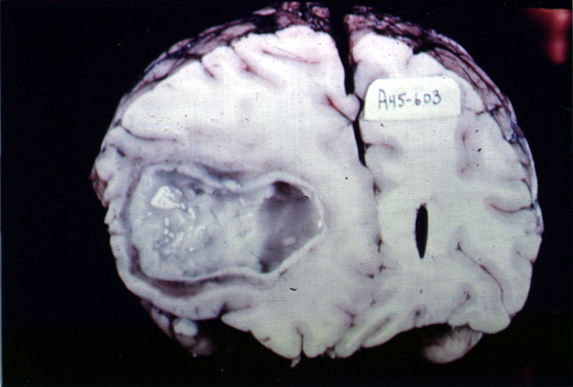

Slide 27
6- Granulation tissue

Slide 28
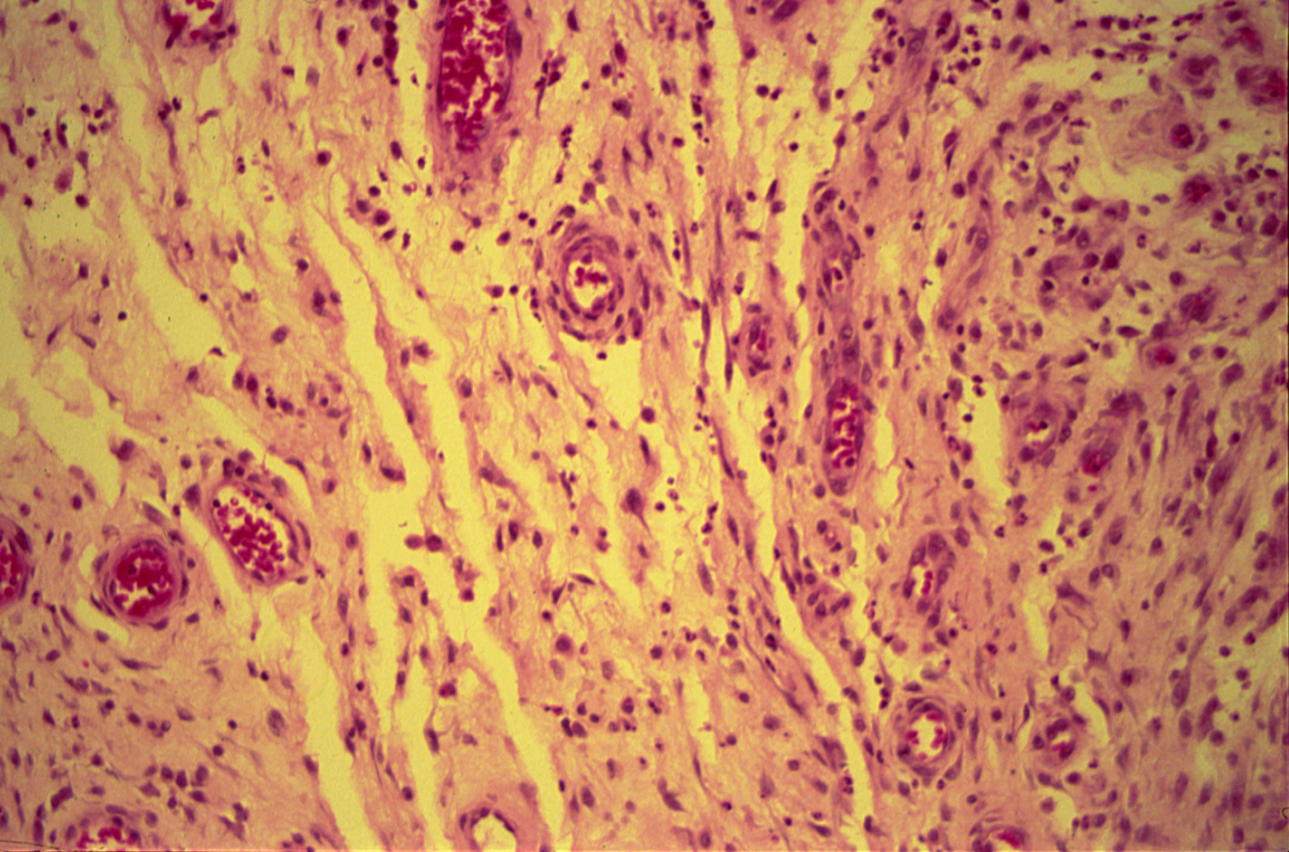
GRANULATION TISSUE
young capillaries
fibroblast

Slide 29
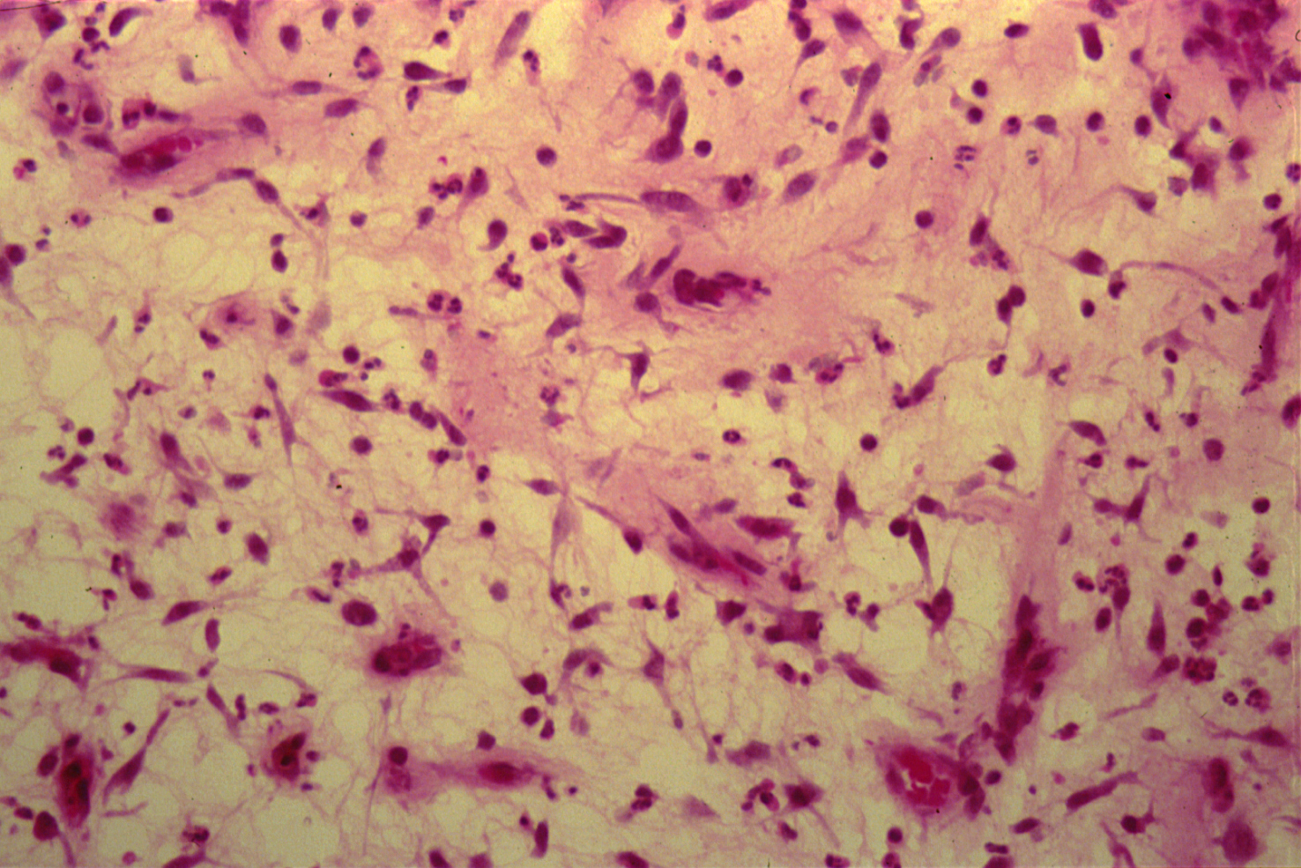
GRANULATION TISSUE
Function : healing

Slide 30
Granulation Tissue: Section of fragments of edematous, loose connective tissue shows:
Many small newly formed capillaries lined by plump endothelial cells.
Proliferation of fibroblasts is seen.
Inflammatory cells including macrophages, lymphocytes, plasma cells and neutrophils in the oedematous stroma.
Pink homogenous collagen fibres may be identified.

