Slide 1
Normal
Tumor “Adenoma”
Organ: Colon Dx: adenoma

Slide 2

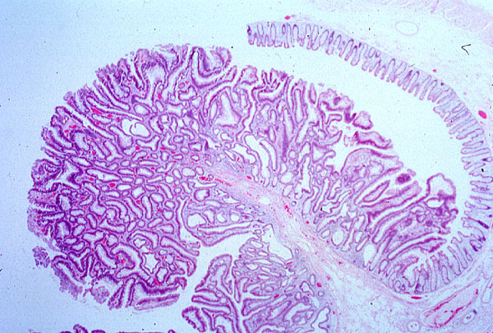
Gland
Fibro vascular chove
Tubular adenoma, colon
Colon

Slide 3
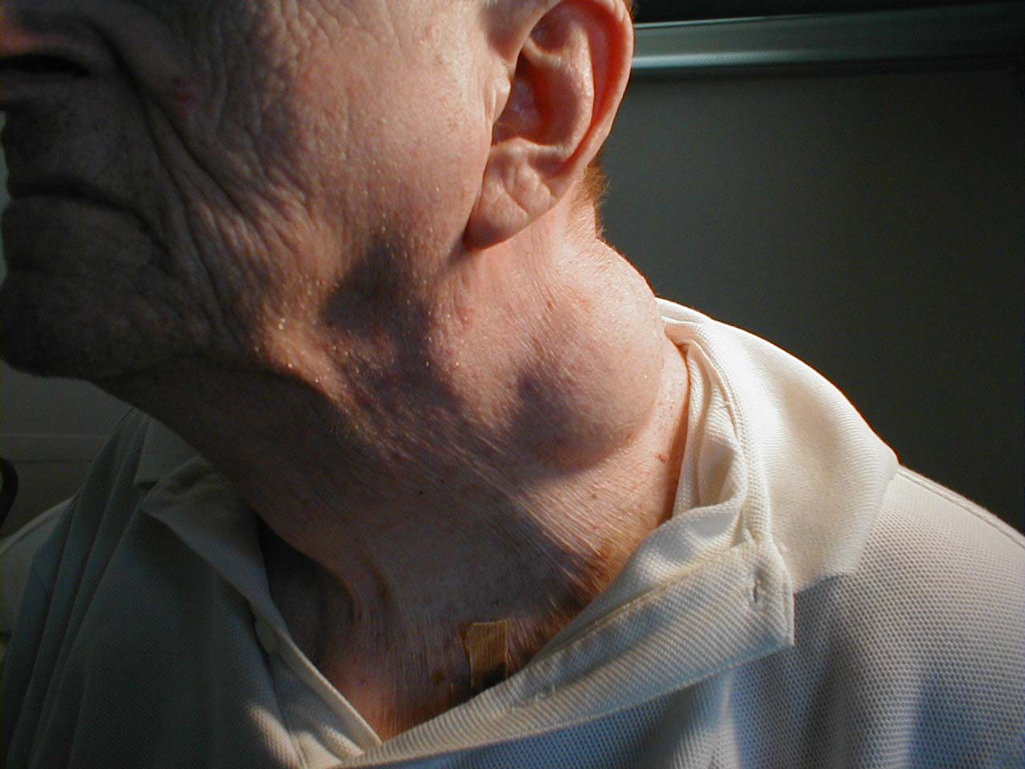
Lipoma of the neck
It could be Lymphocyte
Soft tissue and subcutaneous swelling with overlying intact skin in the neck
Benign, slow growing, subcutaneous skin growth. In this case, the lipoma is rather large and located in the neck region. On palpation, these are soft, nontender, and freely mobile.

Slide 4
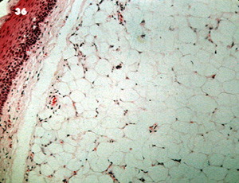
Subcutaneous lipoma
Lipoma
Skin
Fibres capsules

Slide 5
Lipoma
Benign, well-circumscribed tumor of
well-differentiated adipocytes
In adult, upper back, neck, shoulder
Usually subcutaneous, any site of
adipose tissue
Most common type of benign soft
tissue tumor
Resemble normal adipose tissue
Subtypes:angiolipoma, spindle cell lipoma

Slide 6
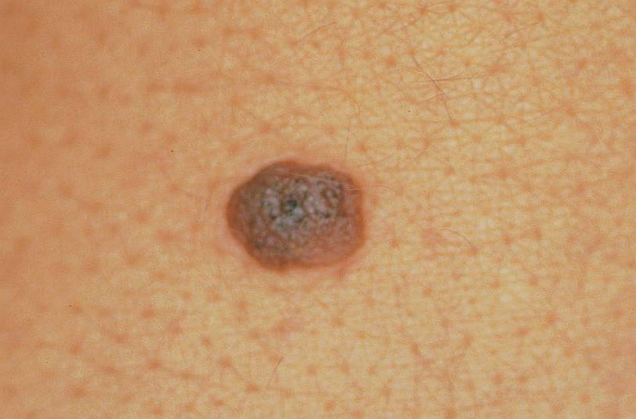
Skin nevus
Intradermal nevus

Slide 7
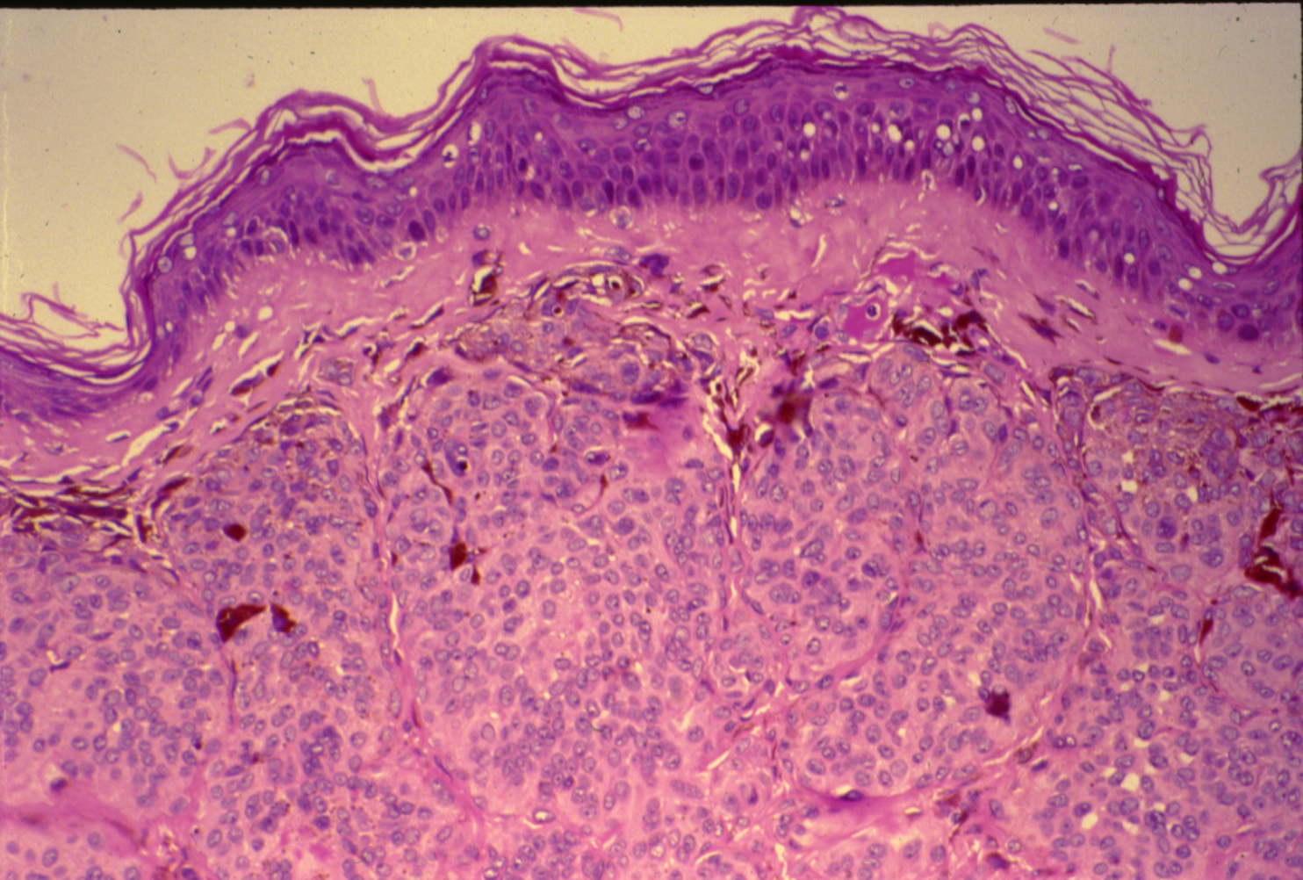
NEVUS (SKIN)
Normal Epidermis
Melanocytes
Benign tumor
“The brown melanin pigments”

Slide 8
Nevus:
Section of Skin shows:
Nests and clusters of small round or spindle shaped nevus cells containing varying amount of brown melanin pigment. with few melanophages in the upper dermis.

Slide 9

LEIOMYOMA (UTERINE )

Slide 10
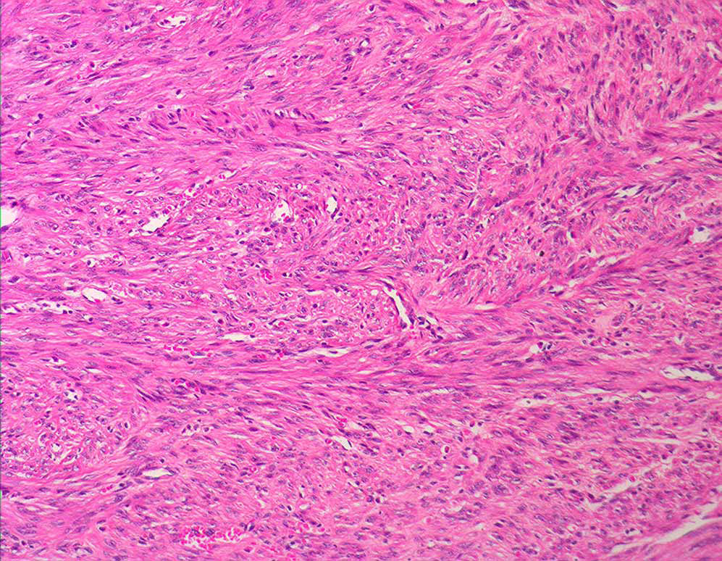
Interlacing bundles of smooth muscle cells

Slide 11
Leiomyoma:
Section of tumour shows:
A well demarcated tumour mass in the muscle coat of uterus without a definite capsule.
Tumour consists of interlacing bundles of smooth muscle and fibrous tissue.

Slide 12
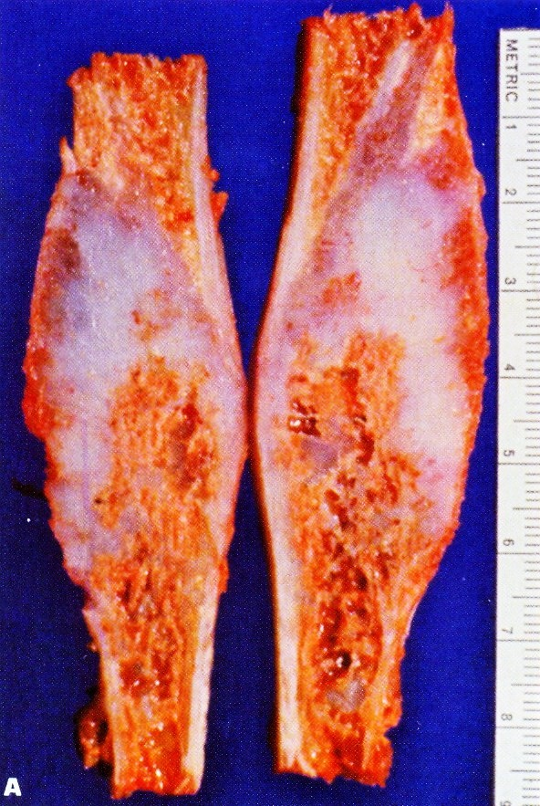
The pale blue area
The gross picture shows intramedullary bone expansion, chondromyxoid material and thin bone cortex. This lesion may be complicated by pathological fracture and malignant transformation (rare).
Enchondroma of the fibula

Slide 13
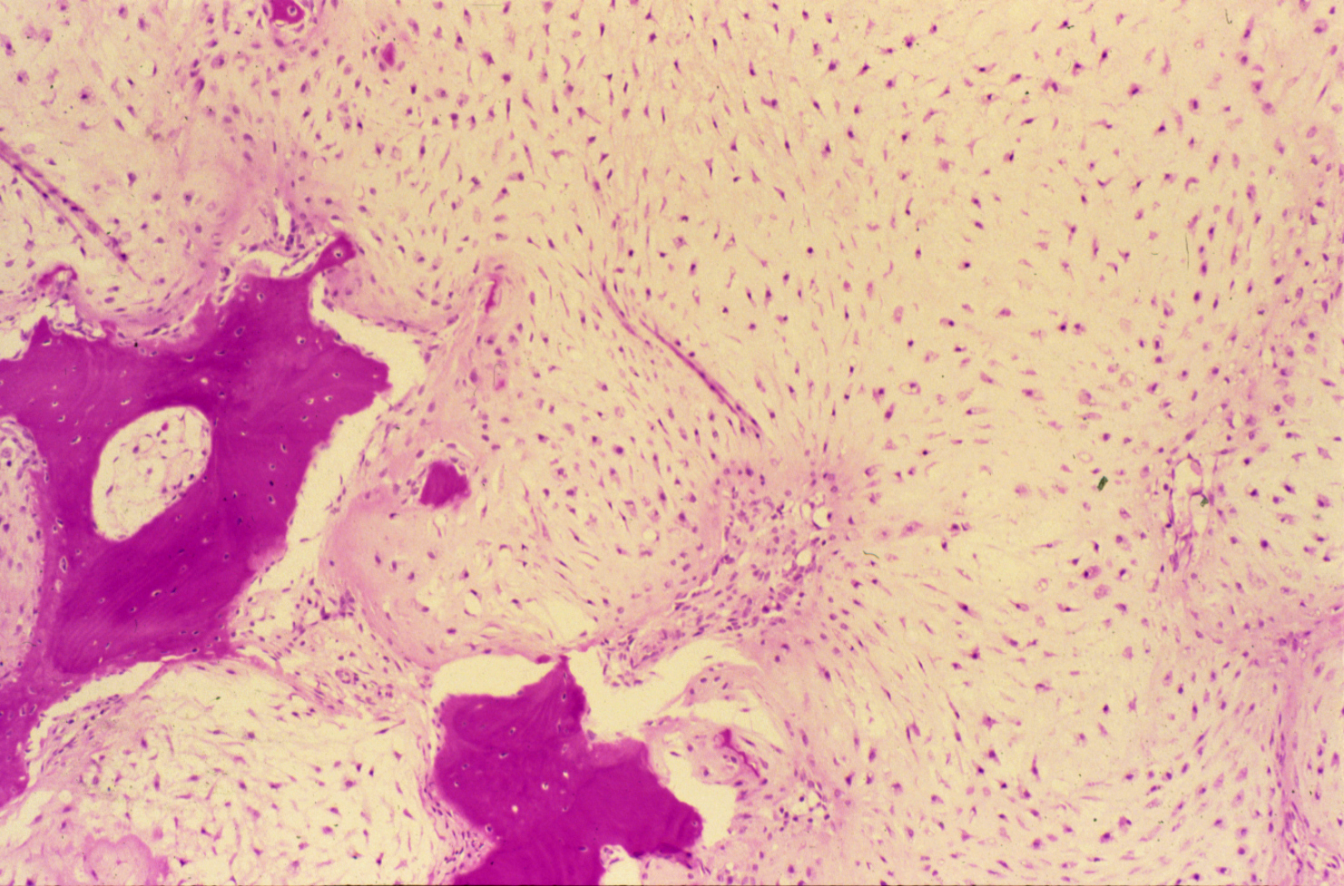
CHONDROMA OF BONE
Few bone trabeculae

Slide 14
Chondroma:
Section of tumour shows:
Lobules of mature cartilage separated by thin trabeculae of fibrous tissue with blood vessels.
Lobules consists of mature cartilage cells irregularly distributed through pale blue homogenous matrix and are contained within the lacunar spaces singly, in pairs or in tetrads.
Few bony trabeculae are included in the tumour.

Slide 15
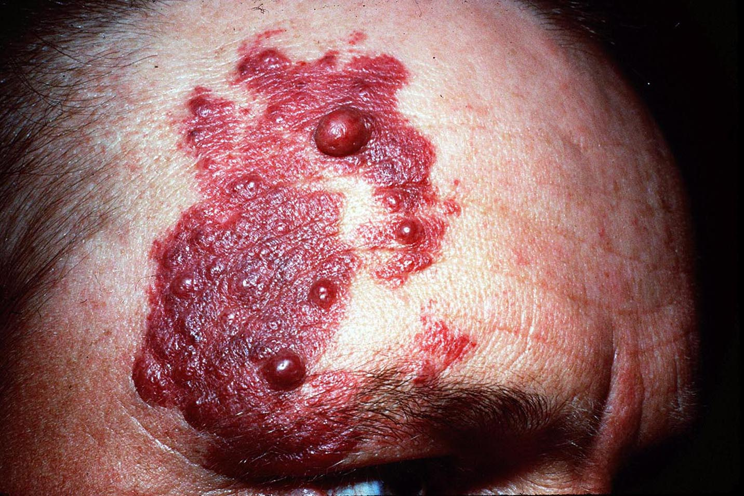
Hemangioma
Benign tumor of blood vessels
- Reddish, hemorrhage, pimples on the skin causes pain and increase in youngsters.
- Most of the time are congenital.

Slide 16
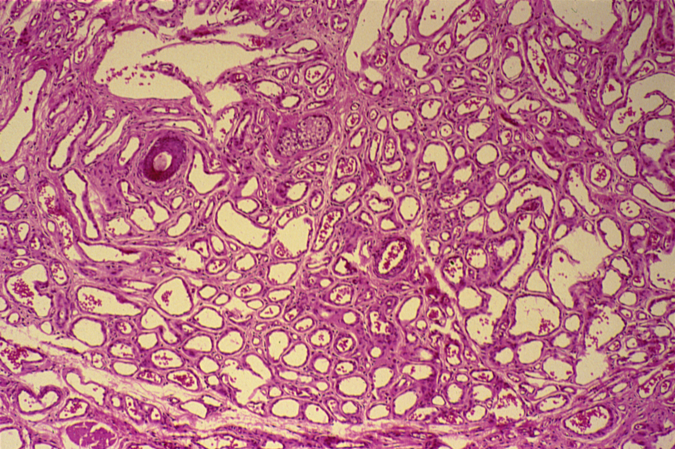
HEMANGIOMA
Flattened endothelial cells
Connective tissue

Slide 17
Hemangioma:
Section of skin shows:
A tumour mass in the dermis which consists of large number of vascular spaces of varying shapes and sizes separated by connective tissue stroma.
Vascular spaces are lined by the flattened endothelial cells and some contain blood.
Benign tumor, cured by excision.

Slide 18
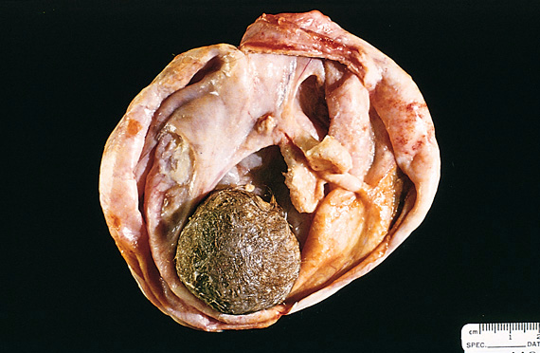
Opened mature cystic teratoma ( dermoid cyst ) shows hair (bottom ) and a mixture of tissues in the ovary.
Hair
Slide 24.52

Slide 19

Teratoma , dermoid cyst of the ovary
Teeth
Hair

Slide 20
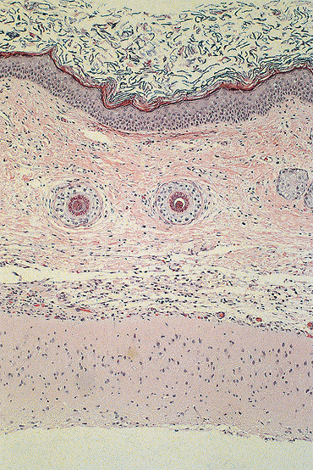
Picture shows skin tissue ( upper part ) beneath which there is brain tissue .
Slide 24.53

Slide 21

DERMOID CYST OF THE OVARY
(BENIGN CYSTIC TERATOMA OF THE OVARY)
Skin Tissue
Cartilage
Hair Follicle
Intestinal tissue
Adipose Tissue

Slide 22
Dermoid cyst of the ovary: section of the cyst wall shows:
Stratified Squamous epithelium with underlying appendages (sweat glands, sebaceous glands, hair follicles) columnar ciliated epithelium, mucous and serous glands and structures from other germ layers such as bone and cartilage, lymphoid tissue, smooth muscle and large area of brain tissue containing neurons and glial cells.
Occurs in the germ cells.
The difference between the benign and malignant is that the benign gives mature tissue, while the malignant gives immature tissue that contain stem cells.

