Slide 1
Lymphoid Tissue
Practical Pictures

Slide 2
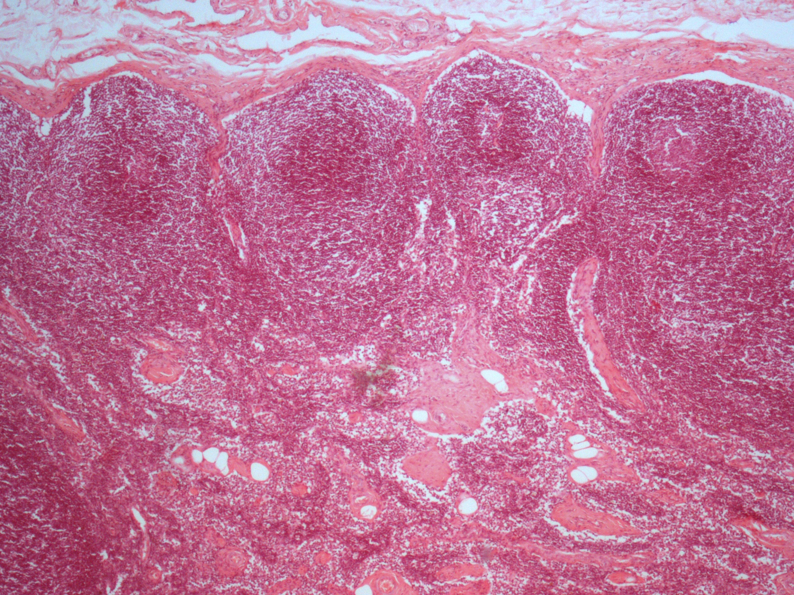
Lymph Node

Slide 3
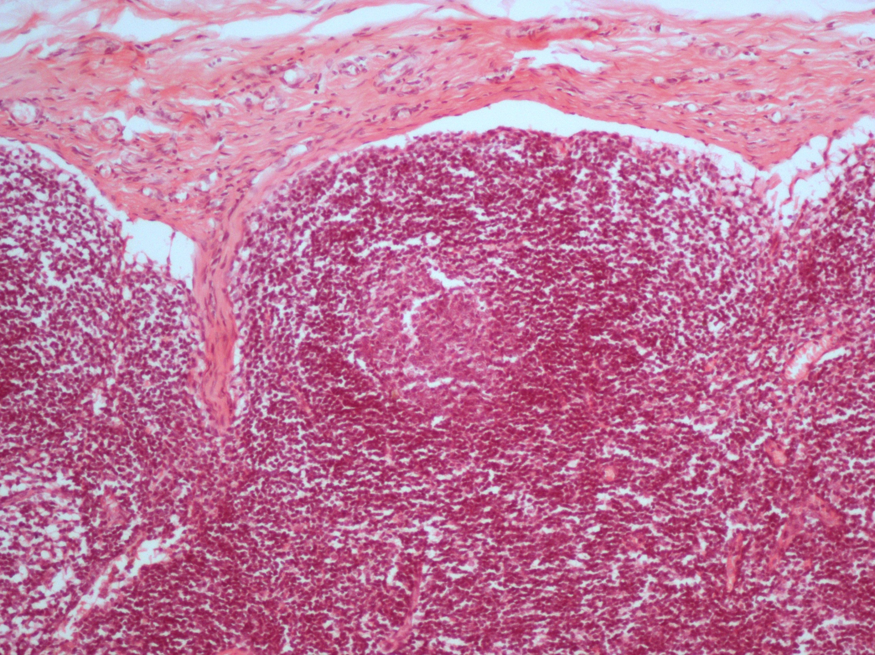
Lymph Node

Slide 4
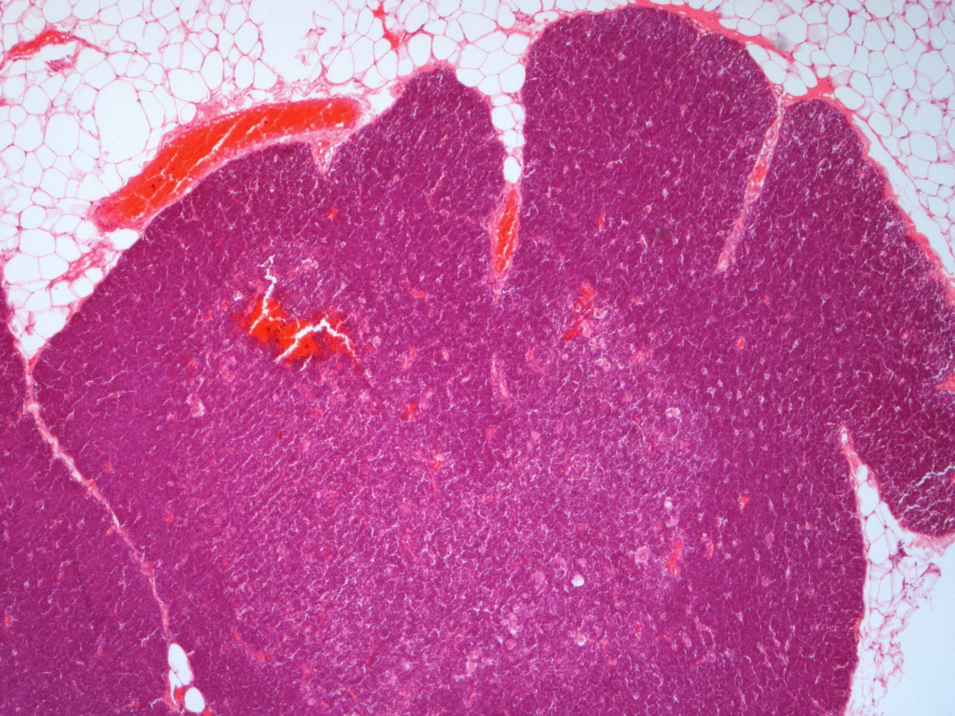
Thymus

Slide 5
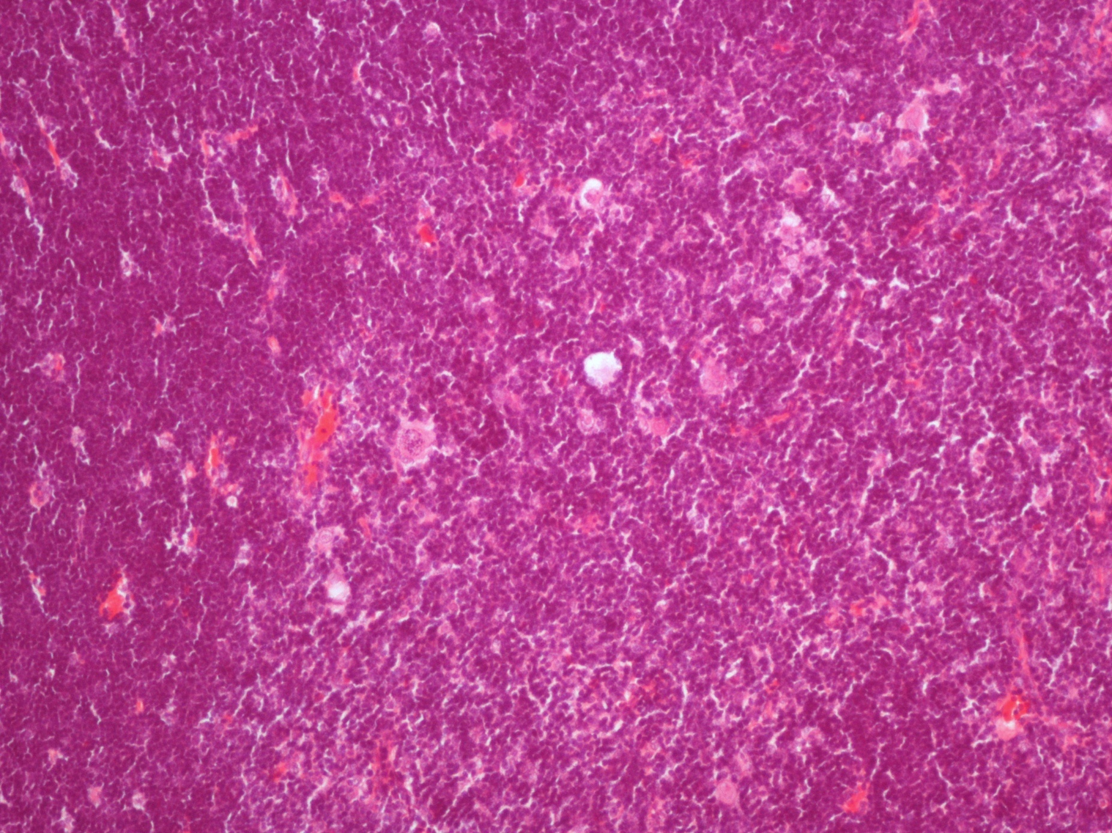
Thymus

Slide 6
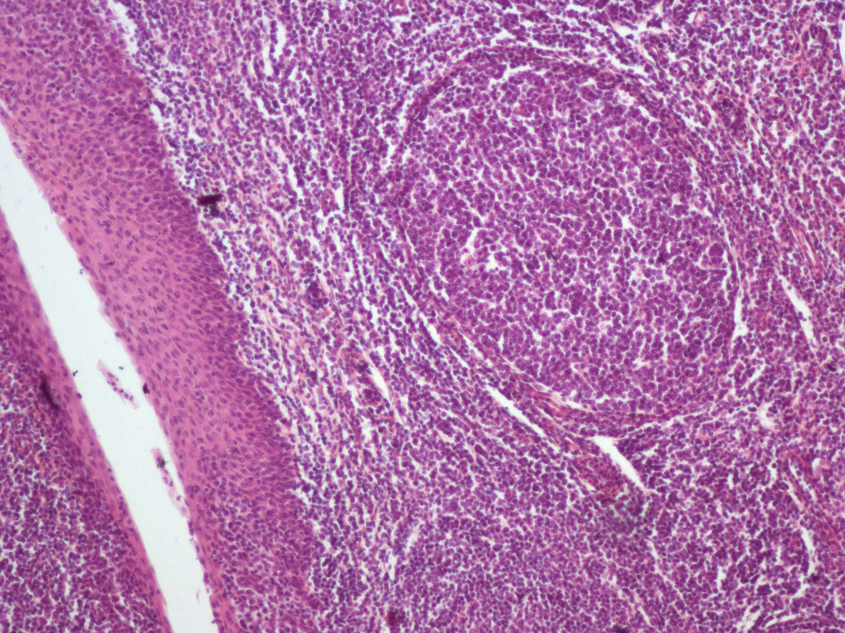
Palatine Tonsil

Slide 7
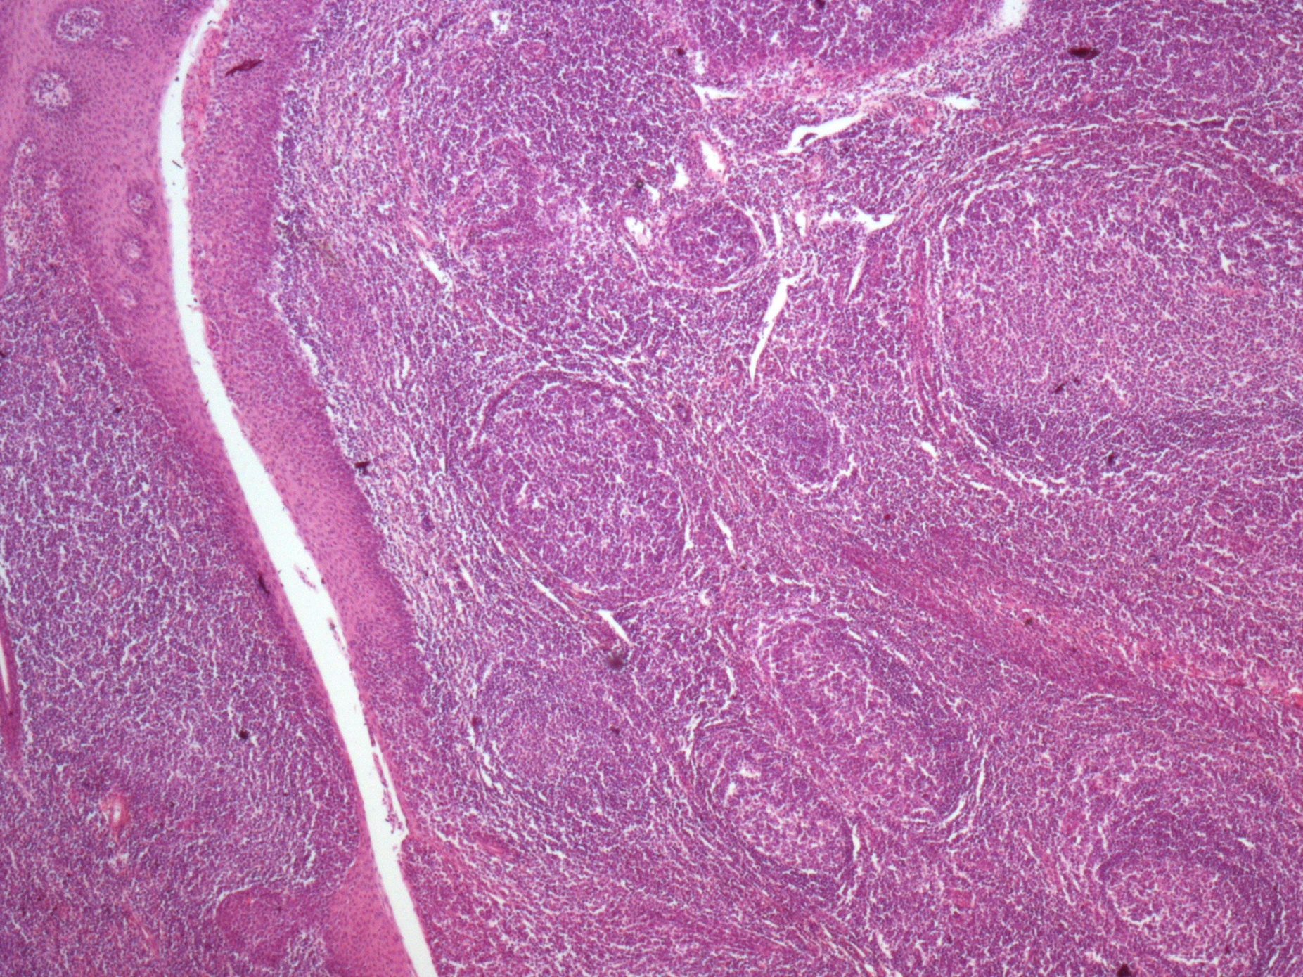
Palatine Tonsil

Slide 8
Connective Tissue
Practical Pictures

Slide 9
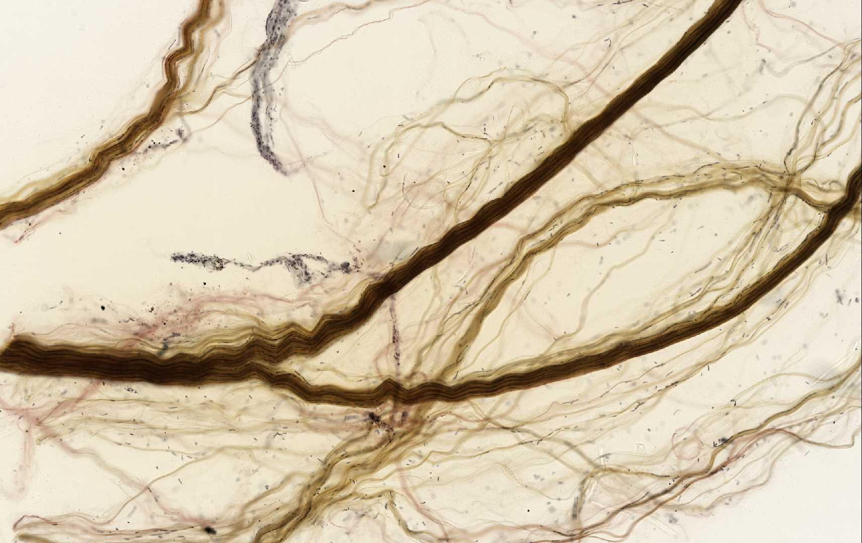
Dense collagenous connective tissue (e.g. in tendon)

Slide 10
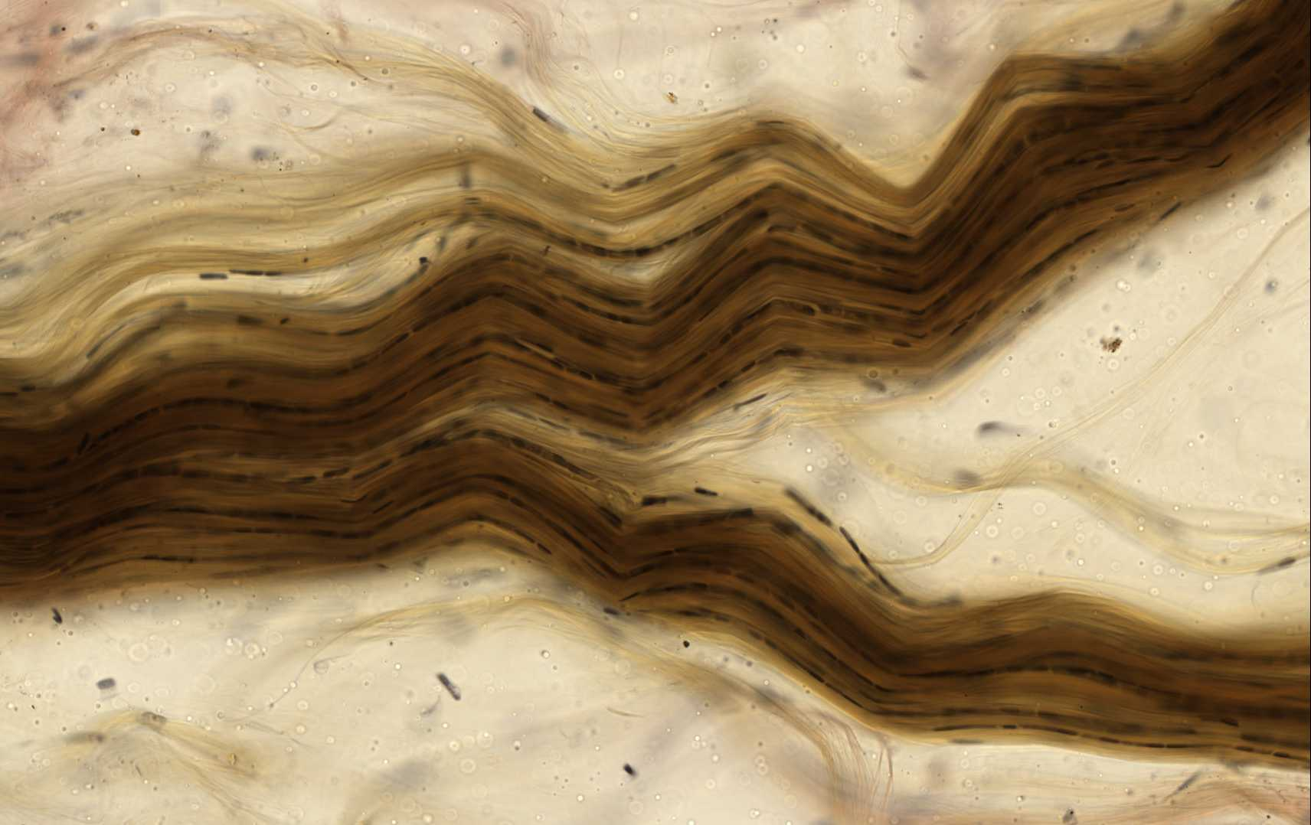
Dense collagenous connective tissue (e.g. in tendon)

Slide 11
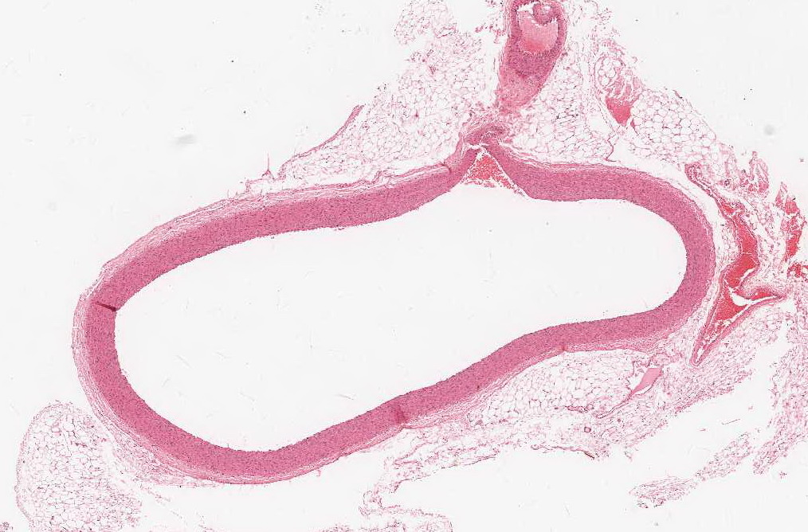
Elastic connective tissue (e.g. in wall of aorta)

Slide 12
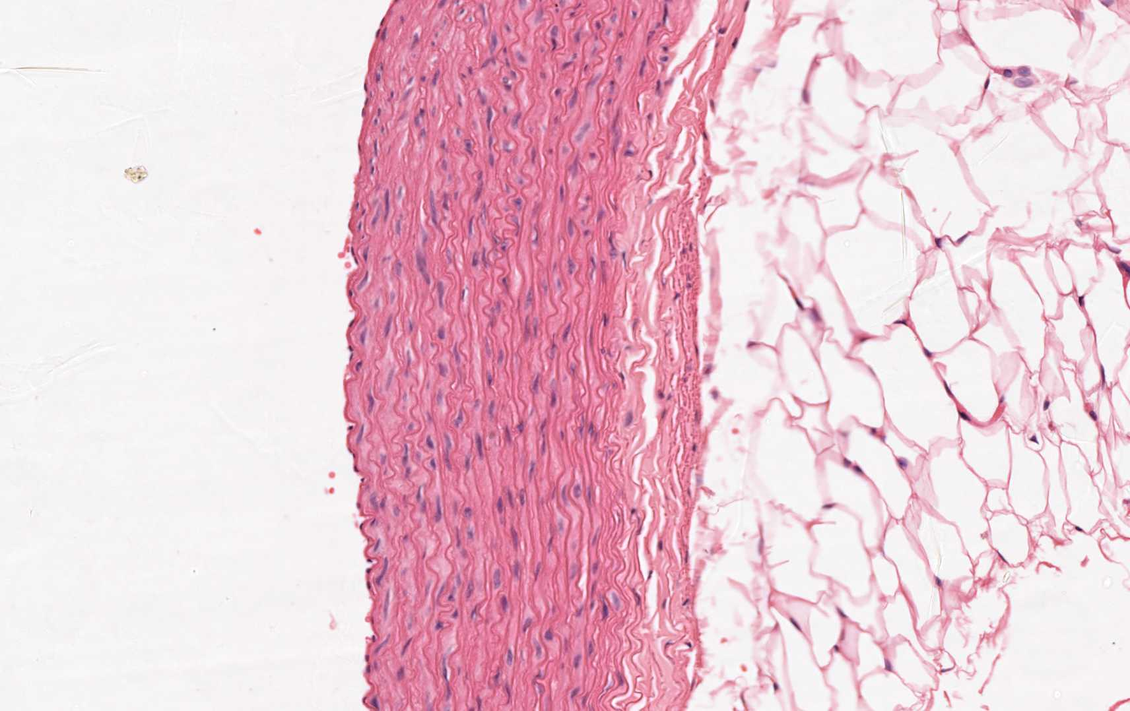
Elastic connective tissue (e.g. in wall of aorta)

Slide 13
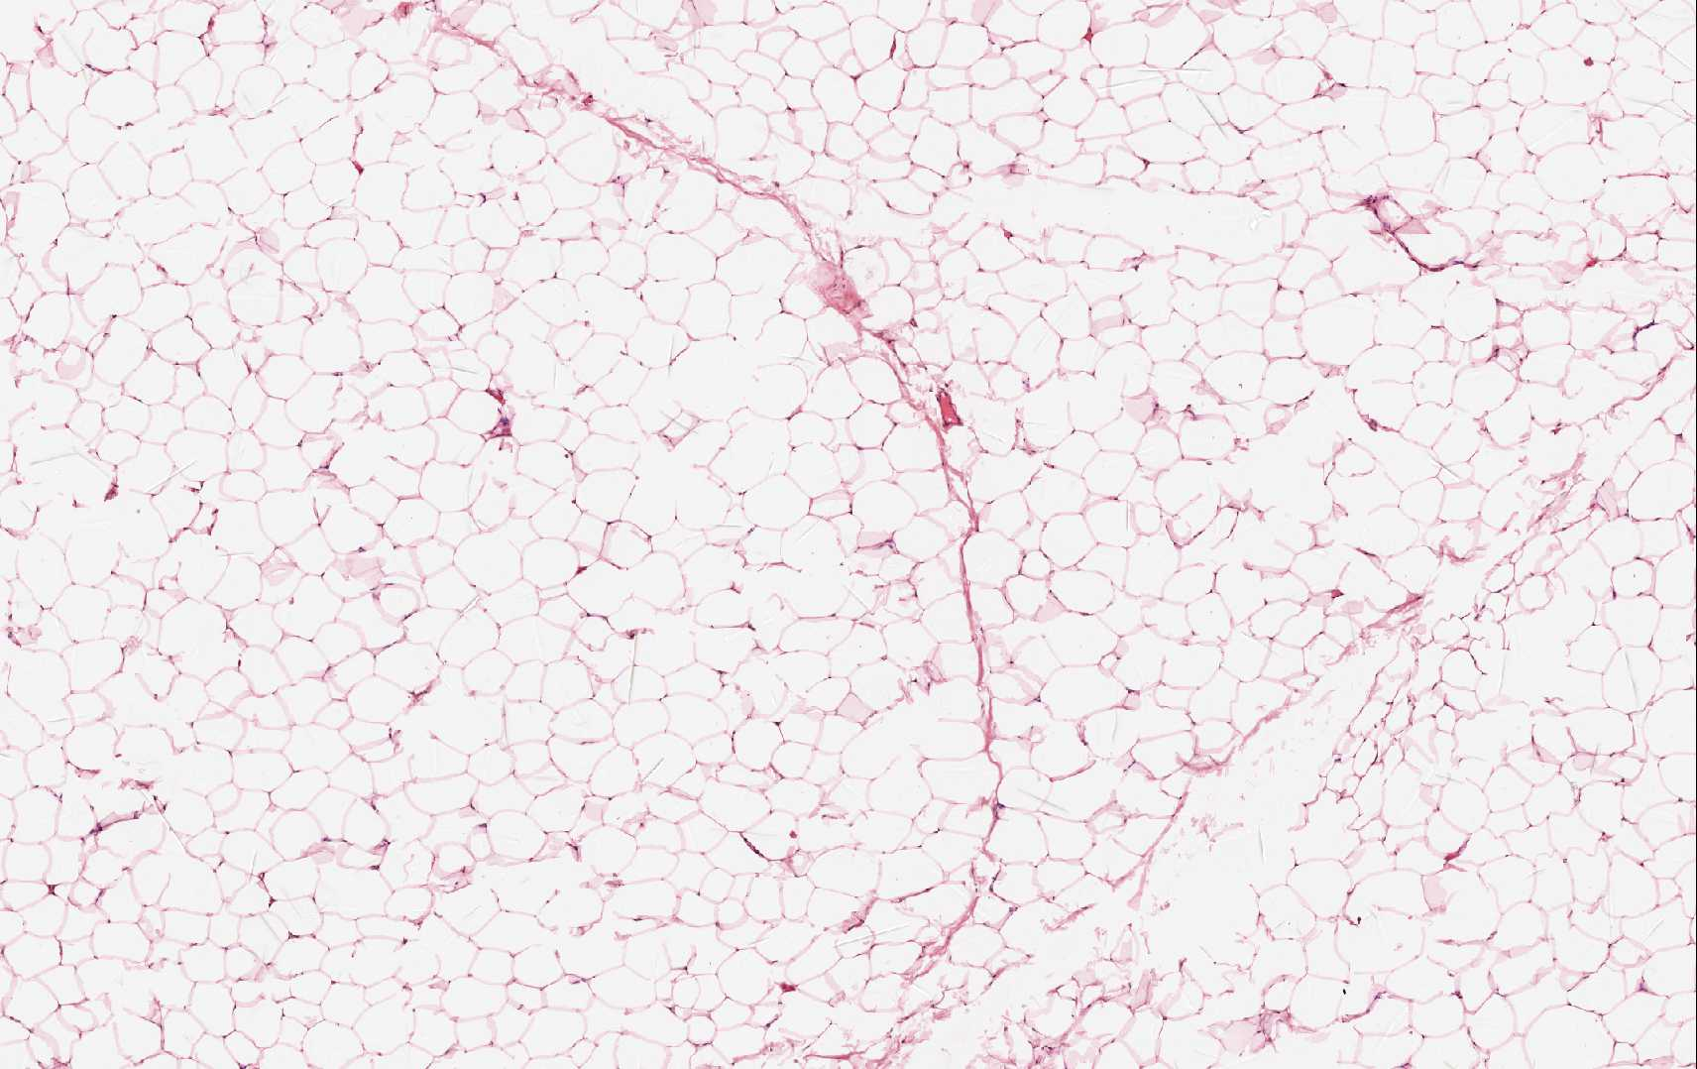
Adipose connective tissue

Slide 14
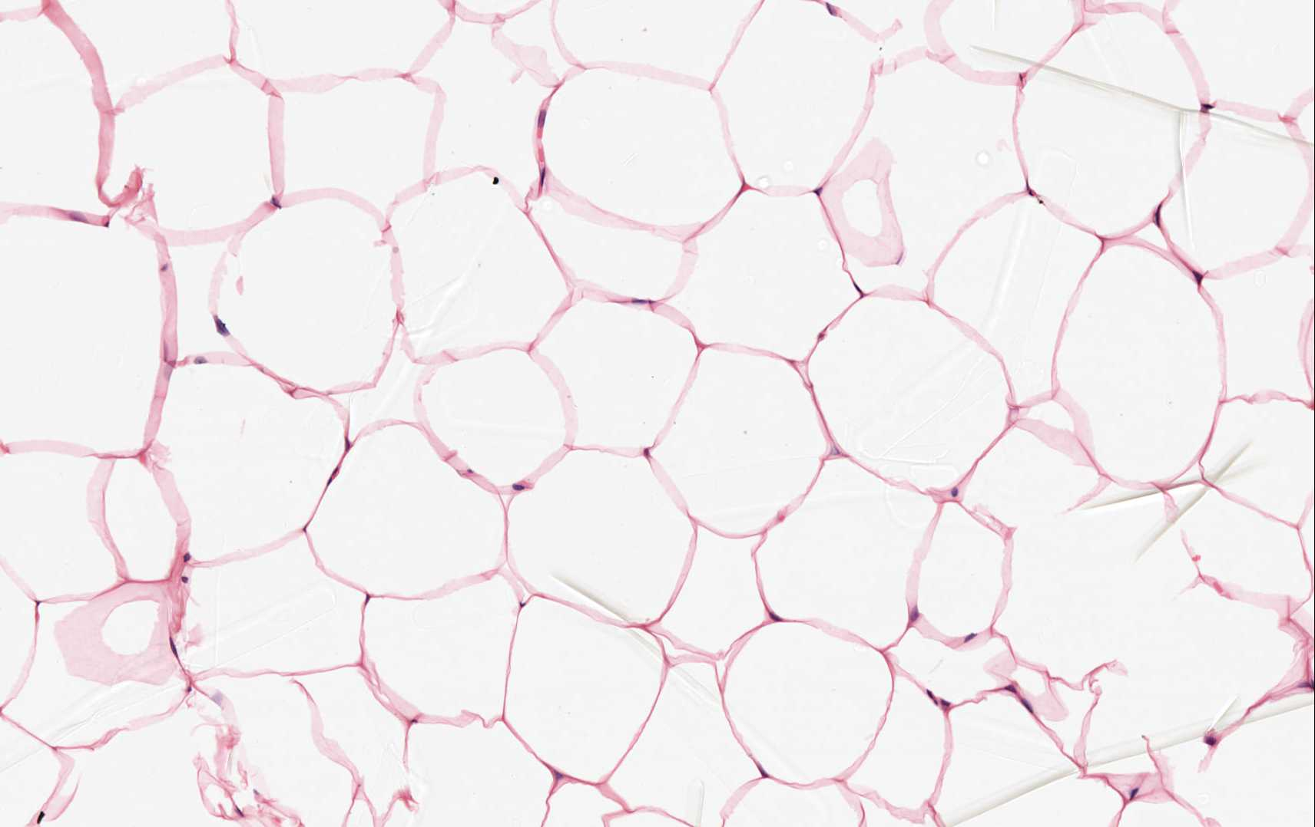
Adipose connective tissue

Slide 15
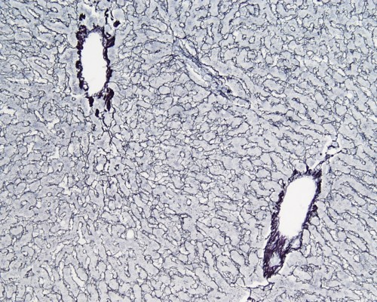
Reticular connective tissue (e.g in liver)

Slide 16
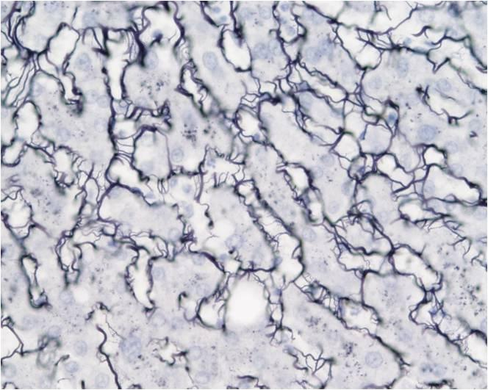
Reticular connective tissue (e.g in liver)

Slide 17
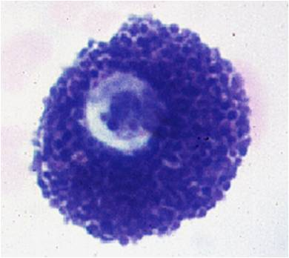
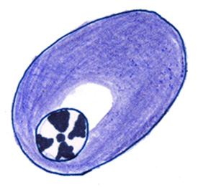
Plasma cell
Mast cell

