Slide 1
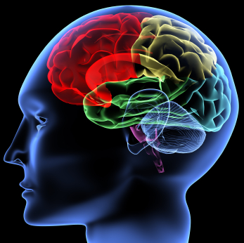
Nervous System
Khaleel Alyahya, PhD, MEd
@khaleelya

Slide 2
THINKING TIME ..!!

Slide 3
OBJECTIVES
At the end of the lecture, students should be able to:
List the subdivisions of the nervous system.
Define the terms: grey matter, white matter, nucleus, ganglion, tract and nerve.
Define neurons and neuroglia.
List the parts of the brain.
Identify the external and internal features of spinal cord.
Enumerate the cranial nerves.
Describe the parts and distribution of the spinal nerve.
Define the term dermatome.
List the structures protecting the central nervous system.

Slide 4
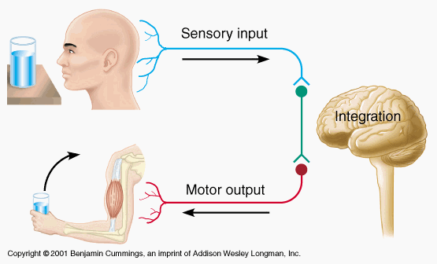
FUNCTIONS
The nervous system has 3 functions:
Collection of Sensory Input:
Identifies changes occurring inside and outside the body by using sensory receptors. These changes are called stimuli
Integration:
Processes, analyses & interprets these changes and makes decisions
Motor Output:
It then effects a response by activating muscles or glands (effectors) via motor output

Slide 5
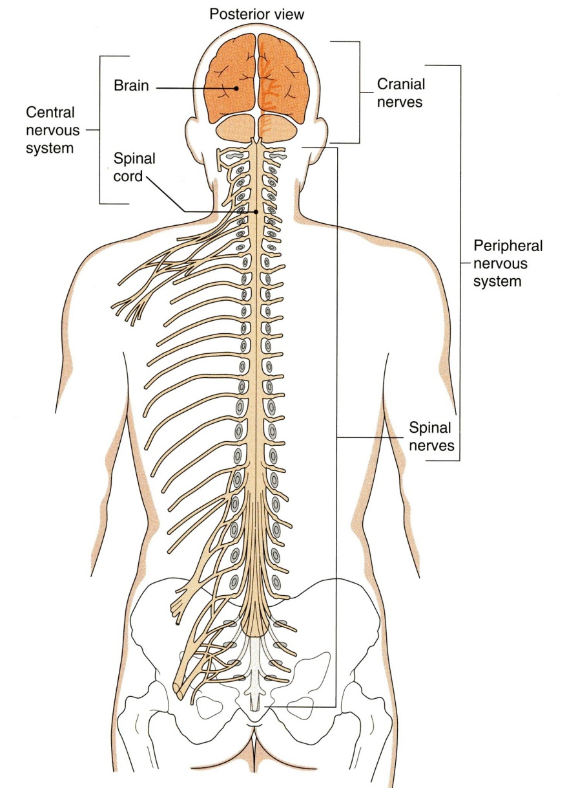
ORGANIZATION
STRUCTURAL
Central Nervous System (CNS)
Brain & Spinal Cord
Peripheral Nervous System (PNS)
Nerves & Ganglia

Slide 6
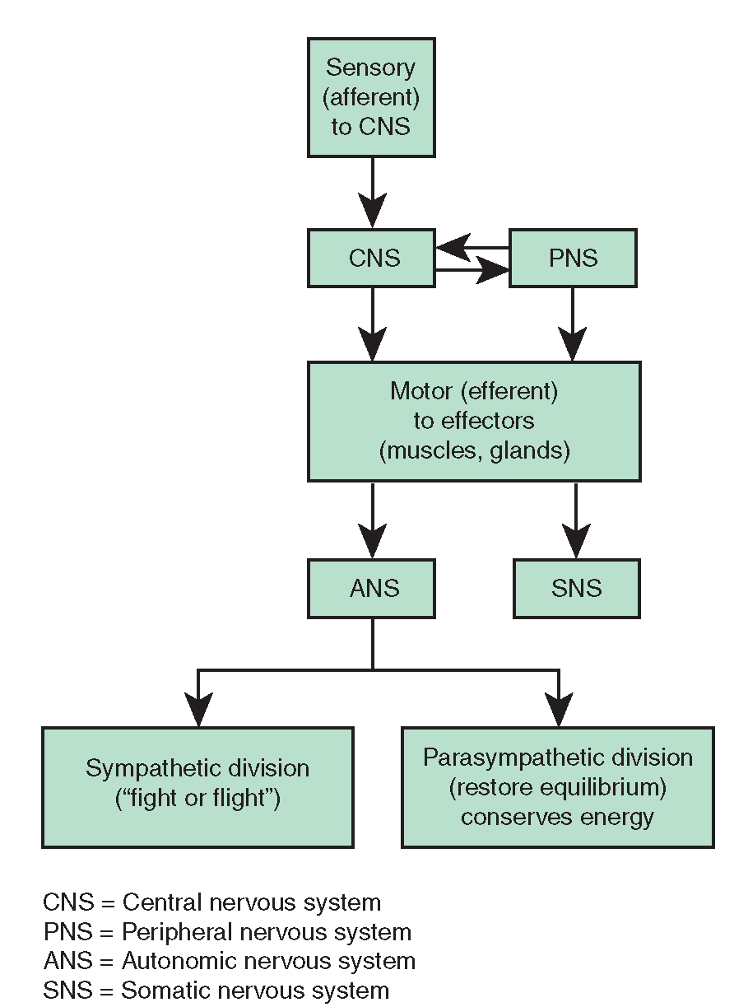
ORGANIZATION
FUNCTIONAL
Sensory Division (Afferent)
Motor Division (Efferent)
Autonomic
Somatic

Slide 7
NERVOUS TISSUE
Nervous tissue is organized as:
Grey matter: which contains the cell bodies & the processes of the neurons, the neuroglia and the blood vessels.
White matter: which contains the processes of the neurons (no cell bodies), the neuroglia and the blood vessels.

Slide 8
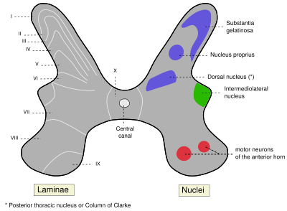
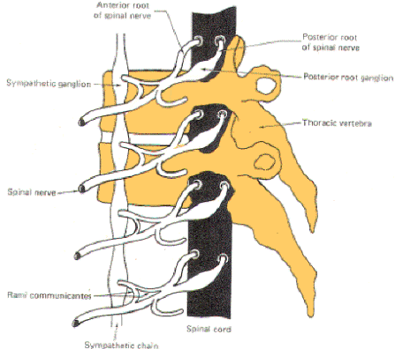
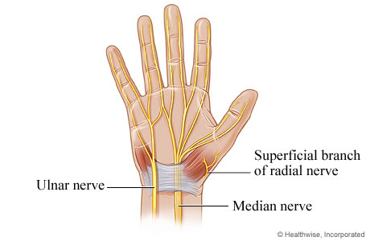
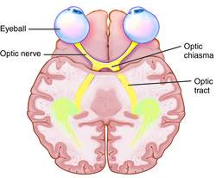
Ganglion
A group of neurons outside the CNS
Nucleus
A group of neurons within the CNS
Nerve
A group of nerve fibers (axons) outside the CNS
Tract
A group of nerve fibers (axons) within the CNS

Slide 9
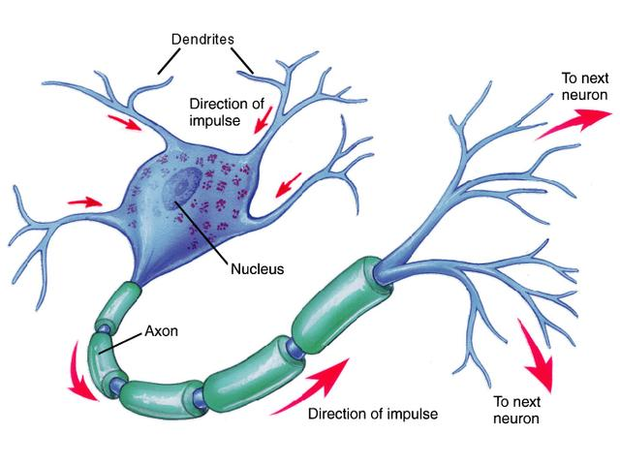
NEURONS
It is the basic structural (anatomical), functional and embryological unit of the nervous system.
The human nervous system is estimated to contain about 10¹⁰.
The functions of the neuron is to receive and integrate incoming information from sensory receptors or from other neurons and to transmit information to other neurons or effector organs.

Slide 10
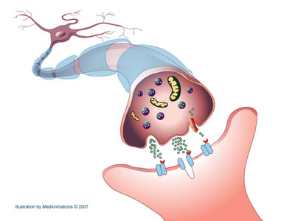
NEURONS
Information is passed between neurons at specialized regions called synapses
There is a single cell body from which a variable number of branching processes emerge.
Most of these processes are receptive in function and are known as dendrites.
One of the processes leaving the cell body is called the axon which carries information away from the cell body.
At the end of the axon, specializations called terminal buttons occur.
Here information is transferred to the dendrites of other neurons.

Slide 11
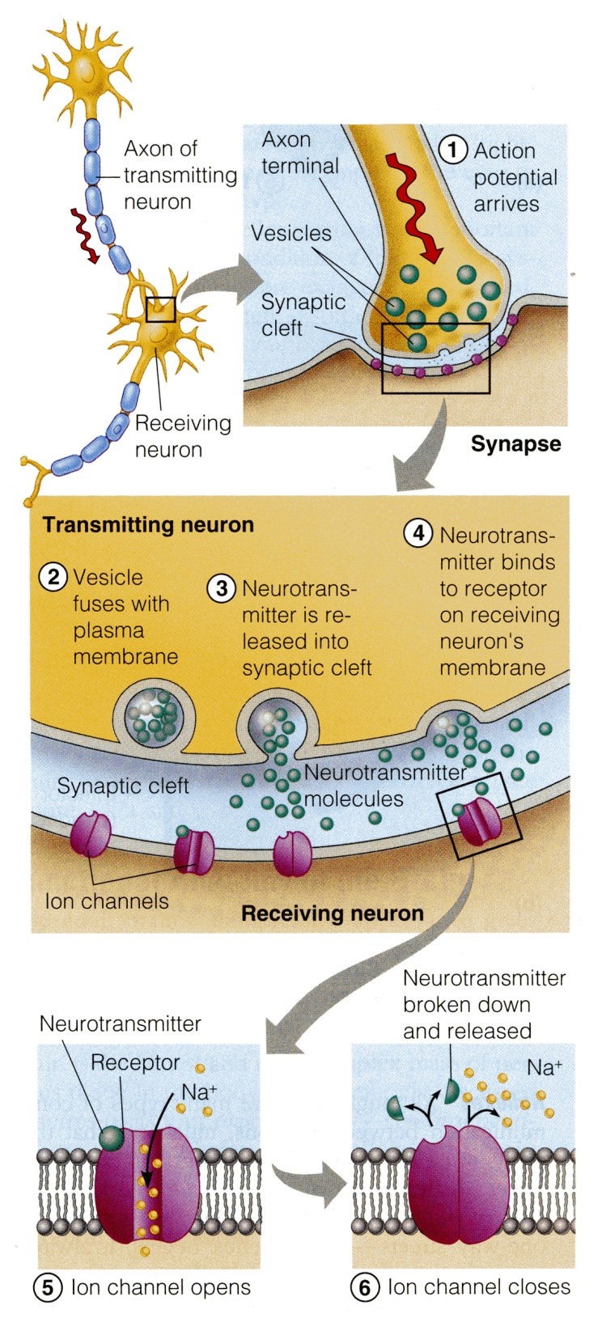
NEURONS
Transmission of information between neurons almost always occurs by chemical rather than electrical means.
Action potential causes release of specific chemical that are stored in synaptic vesicles in the presynaptic ending.
These chemicals are known as neurotransmitters and diffuse across the narrow gap between pre- and postsynaptic membranes to bind to receptors on the postsynaptic cell.

Slide 12
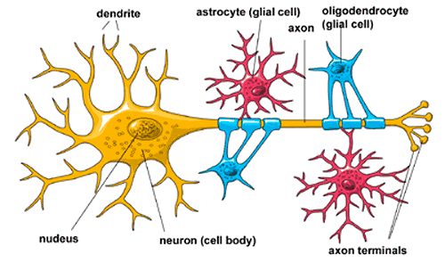
NEUROGLIA
Neuroglia, or glia cells constitute the other major cellular component of the nervous system.
It is a specialized connective tissue for the nervous system.
Unlike neurones, neuroglia do not have a direct role in information processing but they are essential for the normal functioning of nerve cells.

Slide 13
NEUROGLIA
Three main types of neuroglial cell are recognized:
Oligodendrocytes (oligodendroglia) they form the myelin sheath that surrounds many neuronal axons, which increase the rate of conduction.
Microglia have a phagocytic role in response to nervous system damage.
Astrocytes provide biochemical support for endothelial cells that form the blood–brain barrier

Slide 14
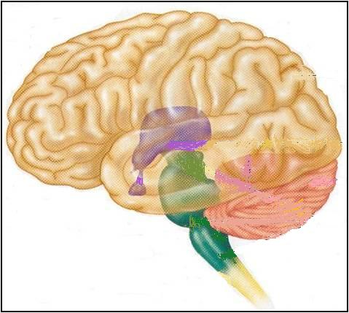
THE BRAIN
Large mass of nervous tissue located in the cranial cavity.
Has four major regions.
Cerebrum
(Cerebral hemispheres)
Diencephalon: Thalamus, Hypothalamus, Subthalamus & Epithalamus
Cerebellum
Brainstem: Midbrain, Pons & Medulla oblongata

Slide 15
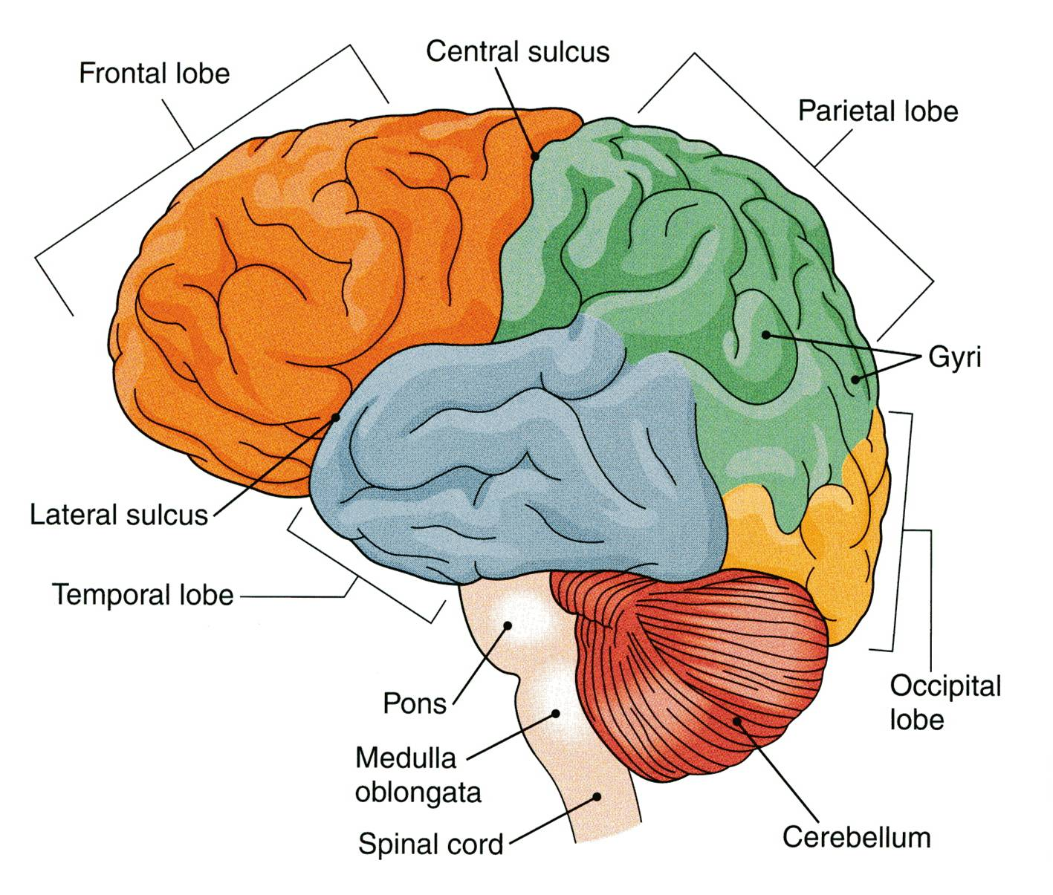
CEREBRUM
The largest part of the brain, and has two hemispheres.
The cerebral hemispheres are connected by a thick bundle of nerve fibers called corpus callosum.
The surface shows ridges of tissue, called gyri, separated by grooves called sulci.
Divided into 4 lobes by deeper grooves.

Slide 16
Tissue of Cerebral Hemispheres
The outermost layer is called gray matter or cortex.
Deeper is located the white matter, composed of fiber tracts (bundles of nerve fibers)
Carrying impulses to and from the cortex.
Located deep within the white matter are masses of grey matter called the basal nuclei .
They help the motor cortex in the regulation of voluntary motor activities

Slide 17
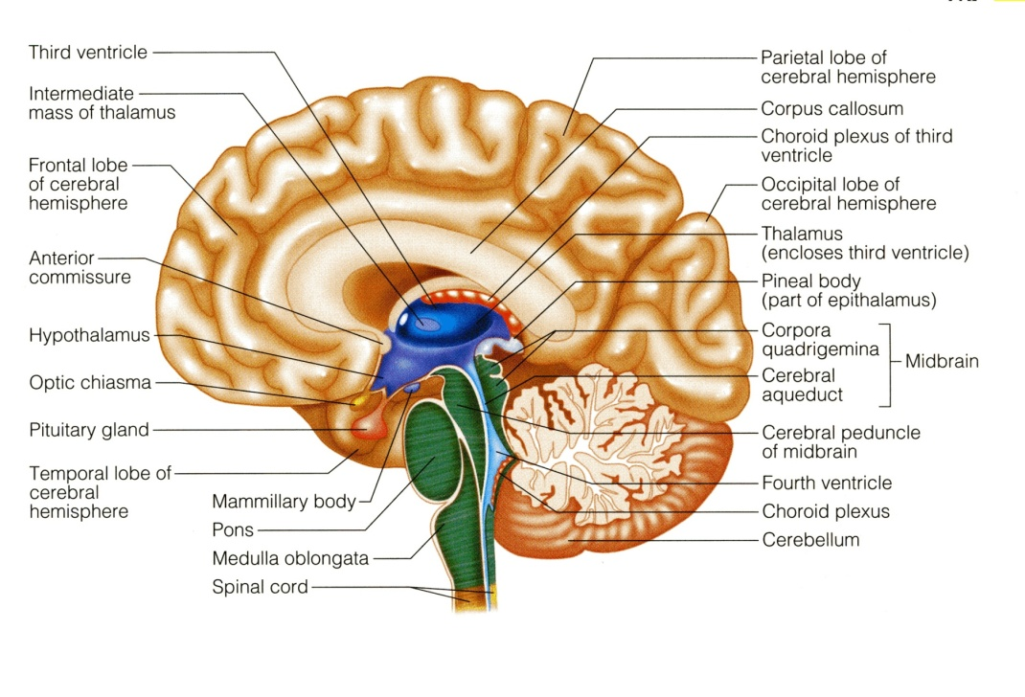
CEREBLLUM
The cerebellum has 2 hemispheres and a convoluted surface.
It has an outer cortex made from gray matter and an inner region of white matter.
It provides precise coordination for body movements and helps maintain equilibrium.

Slide 18
DIENCEPHALON
Consists of four parts;
Thalamus
Hypothalamus
Subthalamus
Epithalamus
Lies between the cerebrum and the brain stem.
Regulates visceral activities and the autonomic nervous system.

Slide 19
BRAIN STEM
Consists of three parts;
Midbrain
Pons
Medulla Oblongata
Produces the rigidly programmed, autonomic behaviors necessary.
Provides the pathway for fibers tracts running between higher and lower neuronal centers.

Slide 20
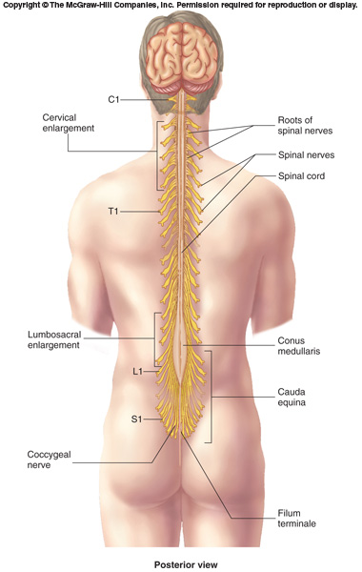
SPINAL CORD
It is a two-way conduction pathway to the brain & a major reflex center
42-45 cm long, cylindrical in shape, lies within the vertebral canal.
Extends from foramen magnum to L2 vertebra
Continuous above with medulla oblongata
Caudal tapering end is called conus medullaris
Has 2 enlargements: cervical and lumbosacral
Gives rise to 31 pairs of spinal nerves
Group of spinal nerves at the end of the spinal cord is called cauda equina

Slide 21
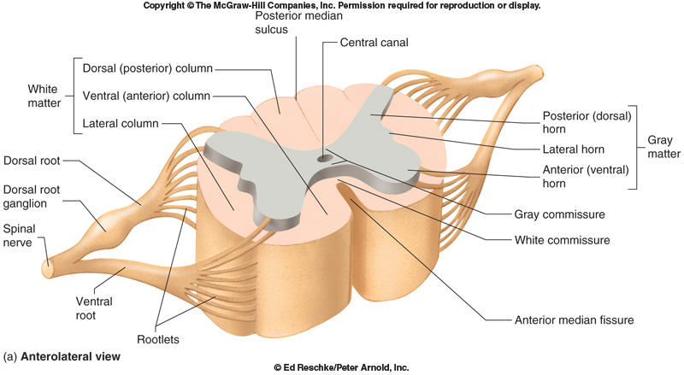
CROSS SECTION OF SPINAL CORD
The spinal cord is incompletely divided into two equal parts, anteriorly by a short, shallow median fissure and posteriorly by a deep narrow septum, the posterior median septum.
Composed of grey matter in the centre surrounded by white matter.
The arrangement of grey matter resembles the shape of the letter H, having two posterior, two anterior and two lateral horns/columns.

Slide 22
HOW WE ARE DOING ..?
Which statement(s) of the following is NOT Wrong?
Nucleus is a group of neurons within the PNS
In the Brain, grey matter located in the centre and surrounded by white matter.
Oligodendrocytes they form the myelin sheath that surrounds many neuronal axons, which increase the rate of conduction.
Diencephalon provides the pathway for fibers tracts running between higher and lower neuronal centers.
Information is passed between neurons at specialized regions called synapses
Cerebrum provides precise coordination for body movements and helps maintain equilibrium.

Slide 23
PEREPHERAL NERVES
May be sensory, may be motor or could be mixed
Two types:
Cranial: 12 pairs, attached to brain, named, and numbered from1-12
Spinal: 31 pairs, attached to spinal cord named and numbered according to the region of the spinal cord

Slide 24
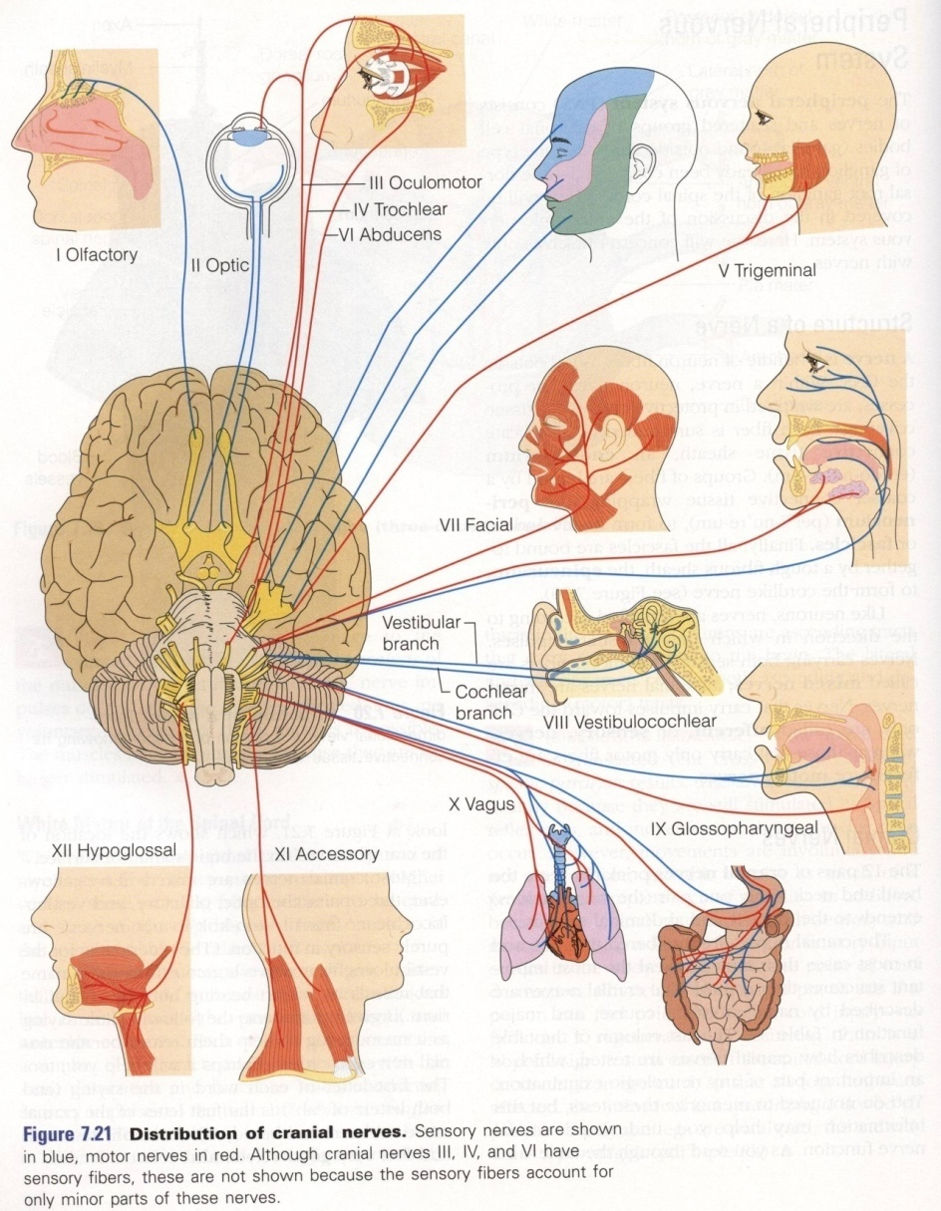
CRANIAL NERVES
12 pairs
4 pairs are mixed
trigeminal n. (5th)
facial n. (7th)
glossopharyngeal n. (9th)
vagus n. (10th)
5 pairs are motor
occulomotor n. (3rd)
trochlear n. (4th)
abducent n. (6th)
accessory n. (11th)
hypoglossal n. (12th)
3 pairs are sensory
olfactory n. (1st)
optic n. (2nd)
vestibulocochlear n. (8th)

Slide 25
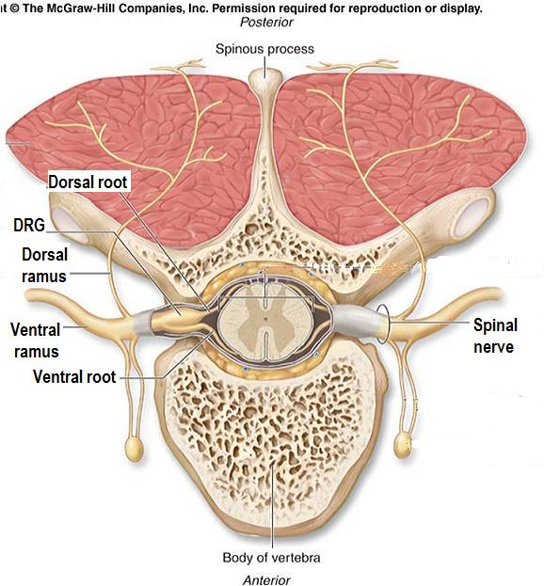
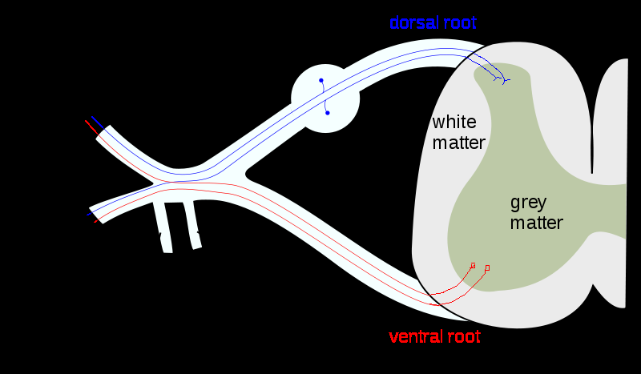
SPINAL NERVES & NERVE PLEXUES
31 pairs
Each spinal nerve is attached by two roots:
Dorsal (sensory)
Ventral (motor)
Dorsal root bears a sensory ganglion
Each spinal nerve exits from the intervertebral foramen and divides into a dorsal and ventral ramus
The rami contain both sensory and motor fibers

Slide 26
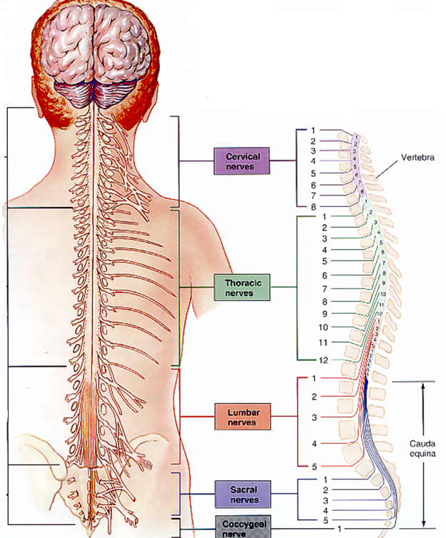
SPINAL NERVES & NERVE PLEXUES
The dorsal rami are distributed individually.
Supply the skin and muscles of the back
the ventral rami form plexuses (except in thoracic region where they form the intercostal nerves)
Supply the anterior part of the body

Slide 27
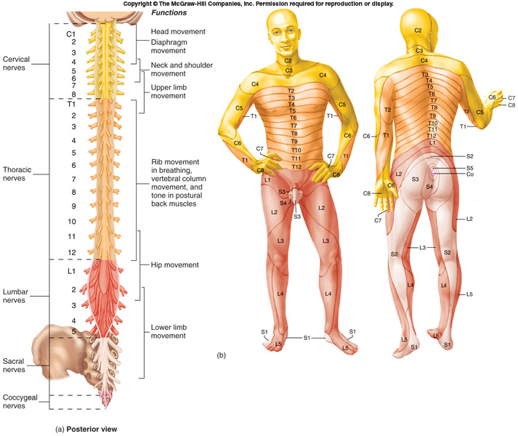
DERMATOME
Dermatome is a segment of skin supplied by one spinal nerve.

Slide 28
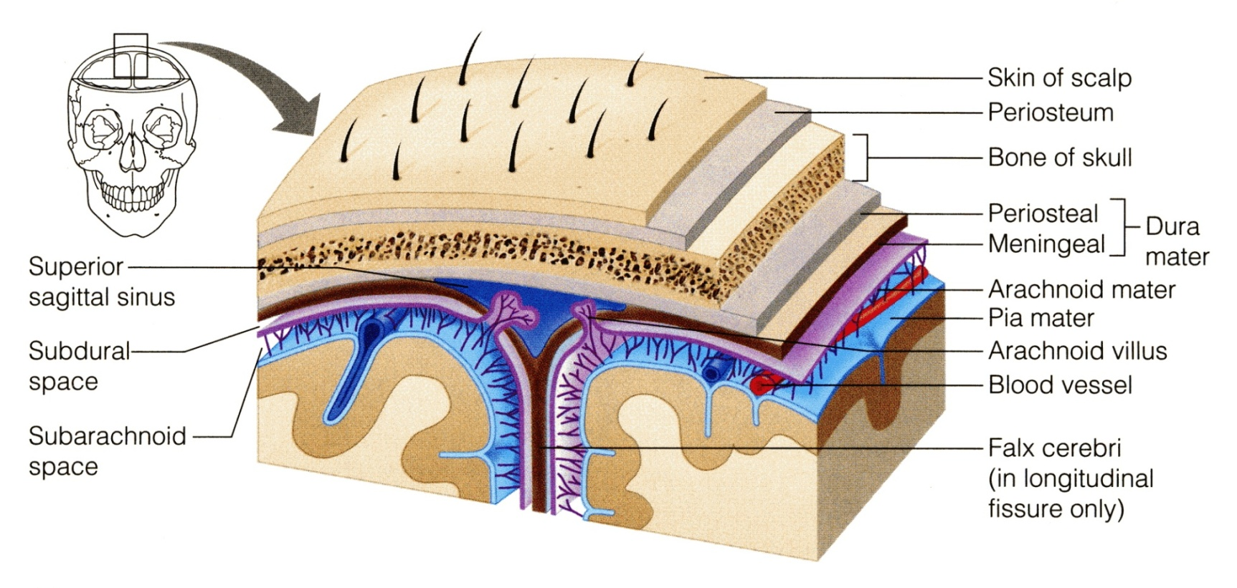
PROTECTION OF CNS
THE CNS IS PROTECTED BY:
Skull and the vertebral column (bone)
Meninges (membranes): 3 layers
dura mater (outermost)
arachnoid mater (middle
pia mater (innermost)
Cerebrospinal fluid in the subarachnoid space

Slide 29
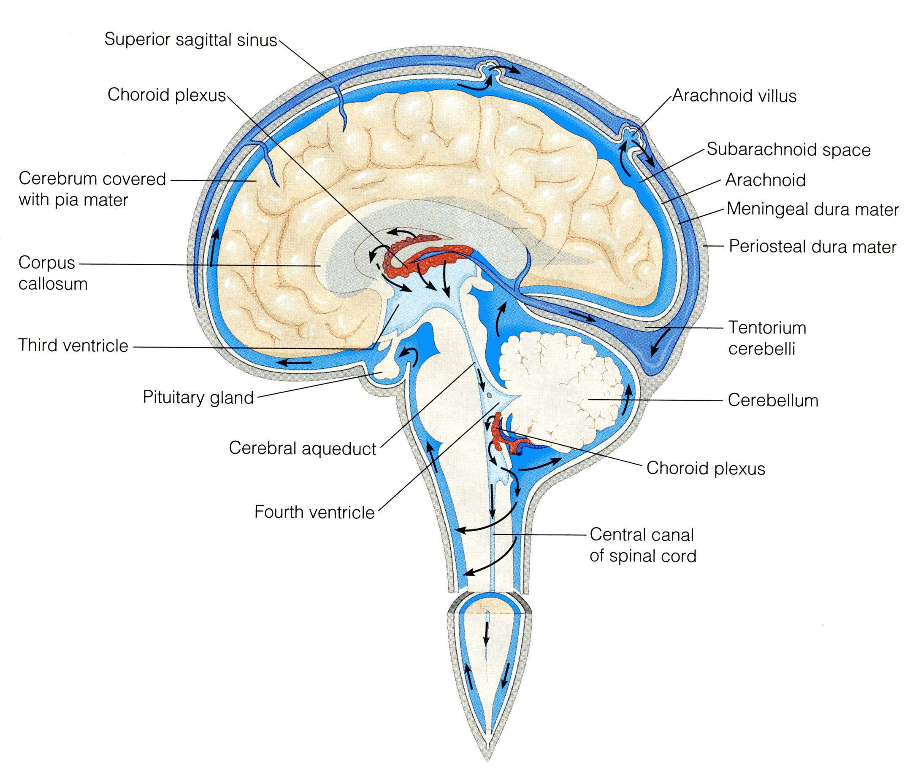
CEREBRAL FLUID
CSF is constantly produced by the choroid plexuses inside the ventricles of brain.
Most of the CSF drains from the ventricles into the subarachoid space around the brain and spinal cord. A little amount flows down in the central canal of the spinal cord.
CSF is constantly drained into the dural sinuses through the arachnoid villi.

Slide 30
QUESTION?

