Slide 1
Practical Histology of Epithelium

Slide 2
Simple squamous

Slide 3
Simple cuboidal

Slide 4
Simple columnar

Slide 5
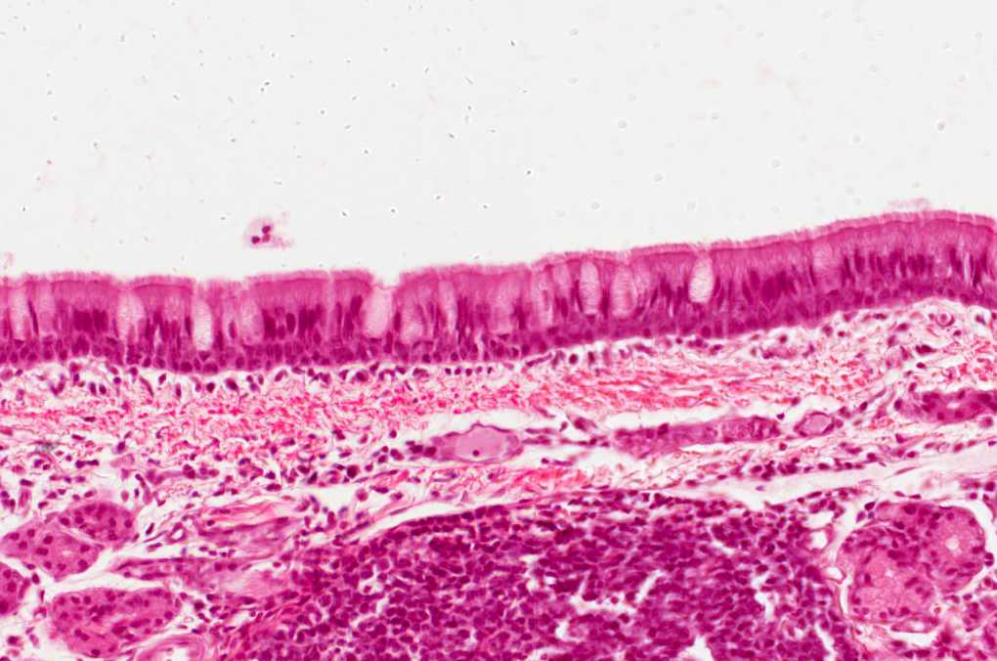
Pseudostratified ciliated with goblet cells

Slide 6
Stratified squamous-keratinized

Slide 7
Stratified squamous non-keratinized

Slide 8
Transitional epithelium

Slide 9
Squamous metaplasia

