Slide 1
Cell Mediated Immunity
Immunology Unit
Department of Pathology
College of Medicine, KSU.

Slide 2
Teaching objectives
To describe antigen recognition by T cells
To describe the pathways involved in processing endogenous and exogenous antigens
To discuss self MHC restriction in Ag presentation to T cells
To describe the induction of cell meditated immunity (Chronic Inflammation)

Slide 3
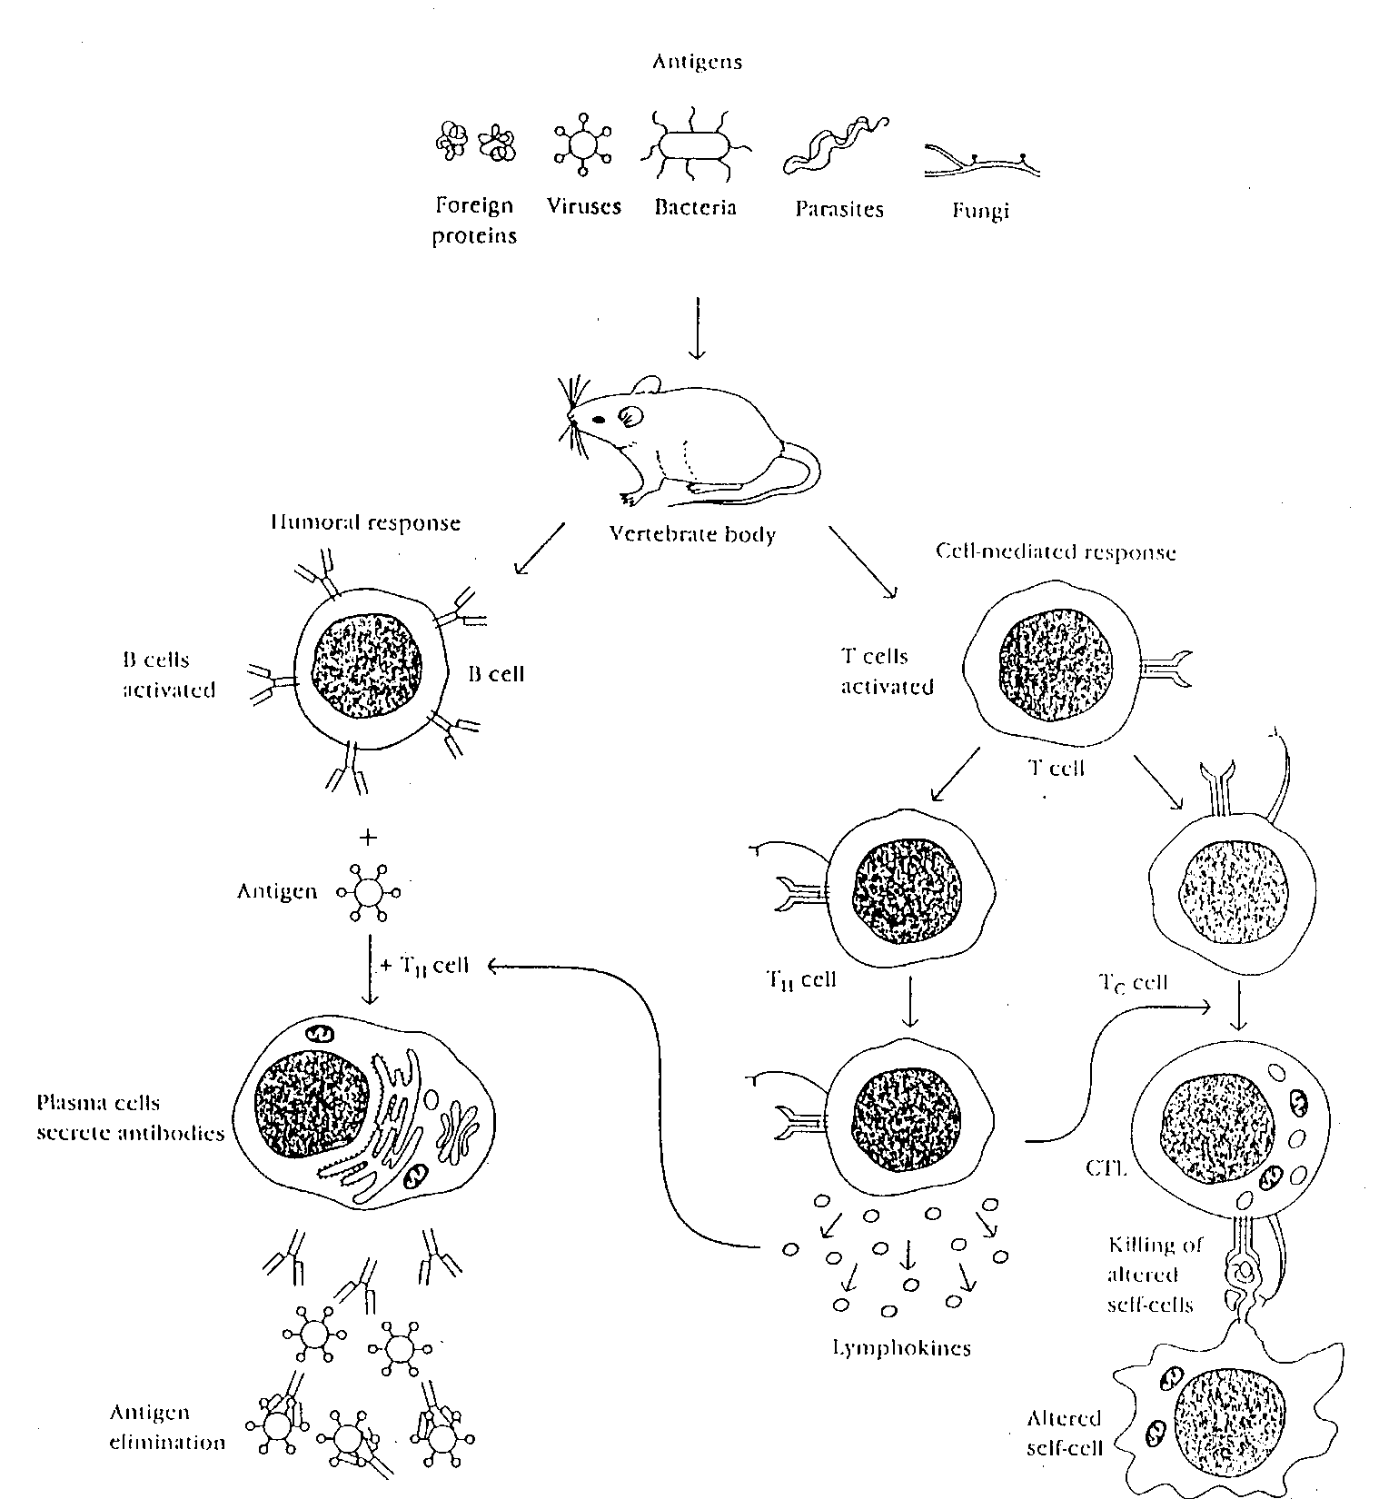
CMI
T lymphocytes
Other cells
Notes:
3

Slide 4
Cell Mediated Immunity (CMI)
T cells (lymphocytes) bind to the surface of other cells (Antigen Presenting Cells) that display the antigen and trigger a response
Mononuclear cell inflammatory process usually associated with chronic inflammations

Slide 5
Antigen Presenting cells
Monocytes : Peripheral blood
Macrophages : Tissues
Dendritic cells : Lymphoid tissues
Langerhans cells : Epidermis
B-cells : Lymphoid tissue, Blood
Notes:
5

Slide 6
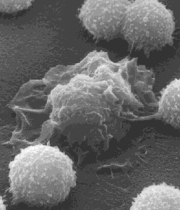
Lymphocyte
Macrophage
Lymphocyte

Slide 7
Cell-Mediated Immunity (CMI)
Antigen+MHC
(Major Histocompatibility
Complex)
T-lymphocytes
Immune responses
Notes:
7

Slide 8
Major Histocompatibility Complex (MHC)
Major histocompatibility complex (MHC) proteins were discovered for the first time with when tissue transplantation started
The success of tissue and organ transplantation depends upon the match of donor’s and recipient’s “human leukocyte antigens” (HLA) encoded by HLA genes
Genes for HLA proteins are clustered in the MHC complex located on the short arm of chromosome 6

Slide 9
MHC
Three genes code for Class I MHC molecules
HLA-A,
HLA-B
HLA-C
HLA-D loci encode for Class II MHC molecules ie,
DP
DQ
DR
Eeach group of MHC consists of several glycoproteins

Slide 10
MHC
Each individual has two “haplotypes” ie, two sets of these genes one paternal and one maternal
MHC Class I molecules are found on the surface of virtually all nucleated cells
MHC Class II molecules are normally present of the surface of antigen presenting cells such as:
Marophages,
Dendritic cells
Langerhans cells of skin
B cells

Slide 11
Biologic Importance of MHC
Antigen recognition
T cytotoxic (CD8) cells kill virus infected cells in association with class I MHC proteins
Helper T (CD4) cells recognize antigen in association with class II MHC proteins
This is called MHC restriction
Transplantation
Success of organ transplant is determined by compatibility of the MHC genes

Slide 12
Endogenous antigen
(Cytoplasm)
2. Exogenous antigen
(Membrane Bound)

Slide 13
Virus
Target cell

Slide 14
Target cell

Slide 15
Target cell

Slide 16
Target cell
Host cell
Transcription
Translation
Viral protein

Slide 17
Exogenous antigen
Microbes
Proteins
Cell-mediated immunity
Notes:
17

Slide 18
Exogenous antigen
CD4+ T-lymphocytes
(CD4+ cells)
Class II MHC
APC
CMI
(Cell Mediated Immunity)
APC
Antigen presenting cells
Monocytes/Macrophages
Dendritic cells
Langerhans cells
B-cells
Notes:
18

Slide 19
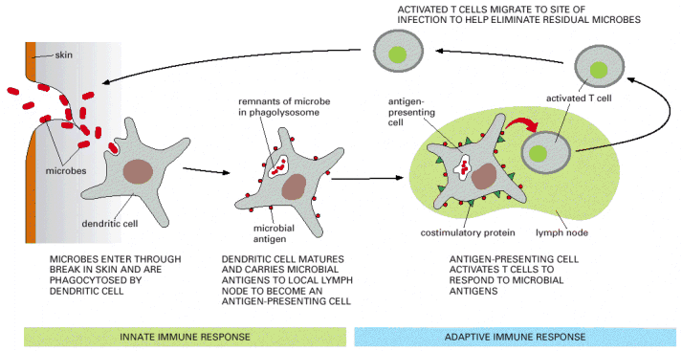
Antigen Presenting Cells
Dendritic cells and macrophages digest invading microbe and then present the antigen of the microbe to lymphocytes in lymphoid organs.

Slide 20
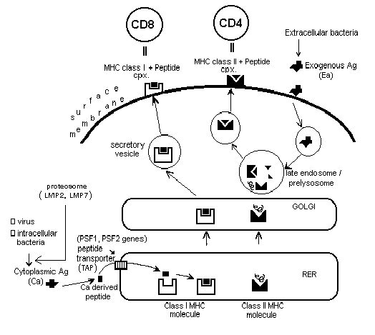
endogenous
Antigen
exogenous
Antigen processing
Antigen Presenting Cell

Slide 21
Two signals are required of activation of T cells
Two signals are required to activate T cells
First signal
Class II MHC + antigen – TCR
IL-1, LFA-1 with ICAM
Second signal (Costimulatory signal)
B7 on APC interacts with CD28 on lymphocyte

Slide 22
Vβ
HLA-DR
TcR
Ag
CD3
Vα
CD4
LFA-3
auxillary
molecules
CD2
ICAM-1
LFA-1
CD80/86(B7)
CD28
Trimolecular complex

Slide 23
T lymphocytes ("T cells"): CMI
Subsets include:
CD4+ helper T cells enhance CMI and production of antibodies by B cells
CD8+ cytotoxic T lymphocytes (CTLs) that kill virus-infected and tumor cells

Slide 24
Out come of T helper cell activation
Production of IL-2 and its receptor
IL-2 is also know as T cell growth factor
Proliferation of antigen specific T cells
Effector and regulatory cells are produced along with “memory” cells
IL-2 also stimulates CD8 cytotoxic cells
Production of Interferons
Enhances anti-microbial activity of macrophages

Slide 25
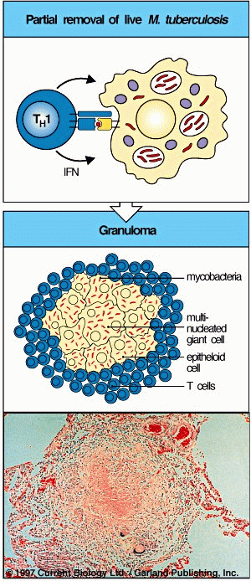
Granuloma Formation
(Chronic Inflammation, e.g., TB)

Slide 26
Out come of T helper cell activation
Memory T cells
Respond rapidly for many years after initial exposure to antigen
A large number of memory cells are produced so that the secondary response is greater than the primary
Memory cells live for many years and have the capacity to multiply
They are activated by smaller amount of antigen
They produce greater amounts of interleukins

Slide 27
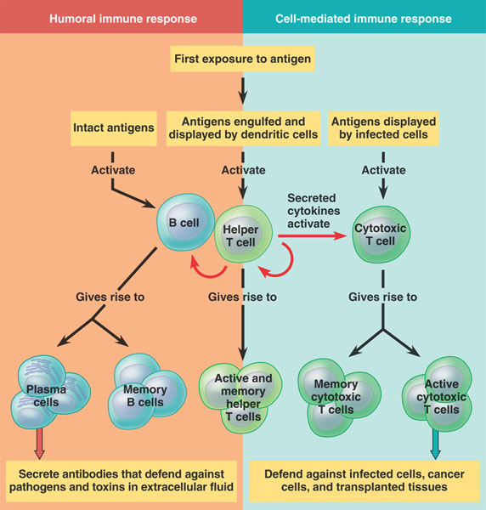

Slide 28
Examples of Cell Mediated Immunity
Delayed type of hypersensitivity (DTH) reaction:
the tuberculin test
Mediated by CD4+ T cells and takes about 72 hours to develop
2. Contact Sensitivity
Many people develop rashes on their skin following contact with certain chemicals such as nickel, certain dyes, and poison ivy plant
The response takes some 24 hours to occur and like DTH, is triggered by CD4+ T cells

Slide 29
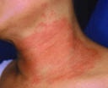
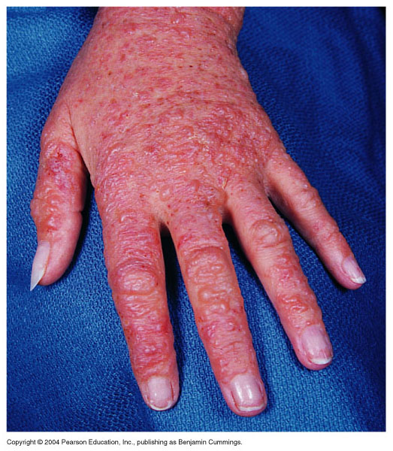
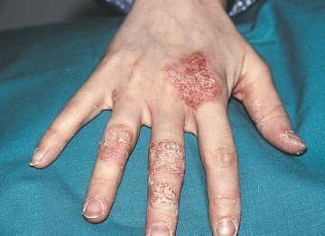
Necklace Rash
Contact Dermatitis

Slide 30
Take Home Message
Cell mediated adaptive immune response is specific and develops after exposure to a pathogen (antigen)
Initial antigen exposure results in generation of memory cells for a stronger and a quicker response against future exposures to the same pathogen
It is usually associated with chronic infections
Antibodies are not involved

