Slide 1
Antibody-mediated Immunity
Immunology Unit
Department of Pathology
College of Medicine, KSU

Slide 2
Lecture objectives
1. To describe B-cells as the mediators of humoral immunity, (antibody-mediated immunity)
2. To describe activation of B-cells which involve:
-Antigen recognition
-T-dependent & T-independent antigens
- Requirement for T-helper cells
3. To explain clonal selection, clonal expansion &
generation of plasma cells & memory cells
4. To describe primary & secondary immune responses
5. To describe the structure & function of Immunoglobulins

Slide 3
Humoral immunity is so named because it involves substances found in the:
humours or body fluids
The Humoral Immune Response is the aspect of immunity that is mediated by secreted antibodies

Slide 4
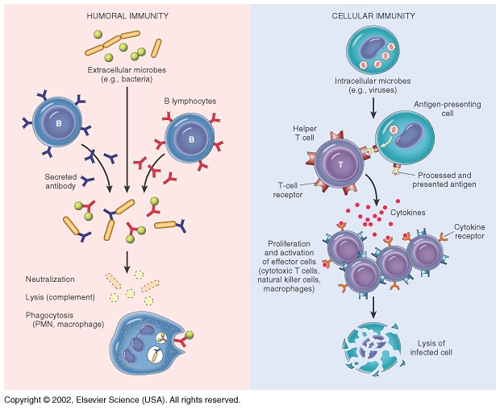
Nature of antigen determine type of response either
EXTRACELLULAR or INTERACELLUALR

Slide 5
Activation of B cells by antigens
Two types of antigens:
1. T-dependant :
- Antibody production by B-cells require T- helper cells
- Macrophages recognize antigen & present it to T-helper cells
- T-helper cells stimulate B-cells specific for that antigen to become plasma cells
- T-dependant antigens are mainly proteins on viruses, bacteria & other foreign materials.

Slide 6
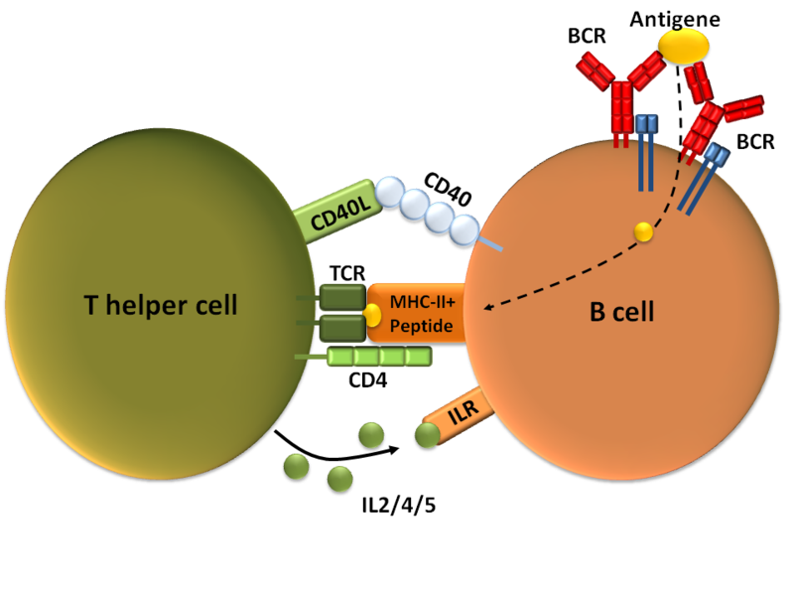
(Th2)

Slide 7
Clonal selection and clonal proliferation

Slide 8
2. T- independent antigens
  B-cells do not require T-helper cells to produce antibody.
  2. Antigens are mainly polysaccharides or
lipopolysaccrides with repeating subunits
(bacterial capsules).
3. Immune responses are weak compared to
T-dependant responses.

Slide 9
Antibodies
Antibodies are immunoglobulins with specific functions
Antibodies bind to specific sites on antigen surfaces and perform protective functions by different mechanisms
There is a SPECIFIC antibody for any one given type of an antigen

Slide 10
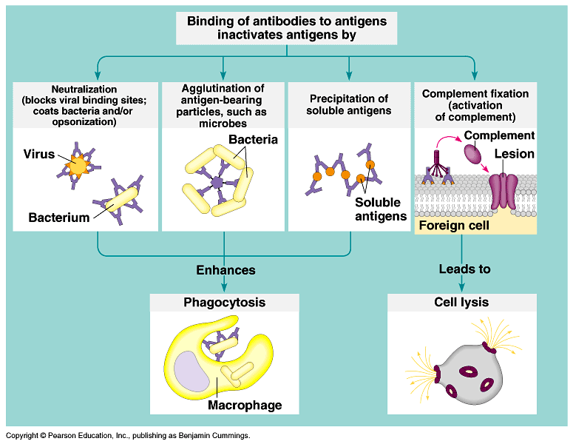
Protective functions of antibodies

Slide 11
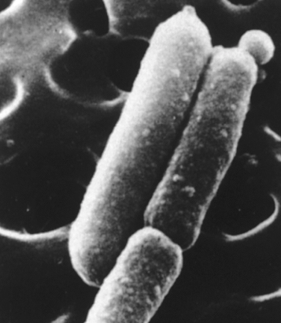
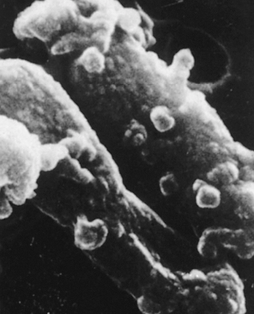
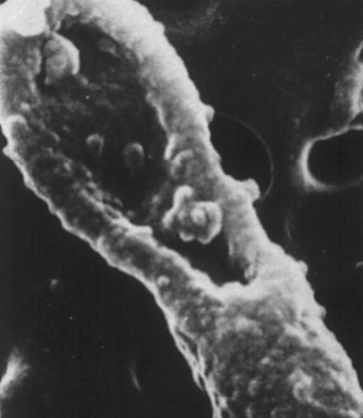
Electron micrographs of the effect of antibodies and complement upon bacteria
Antibody + complement-mediated
damage to E. coli
Healthy E. coli

Slide 12
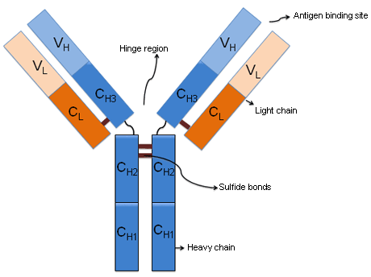
Antibody structure and functions
Made up of four polypeptides (amino acid chains).
Two longer and larger (heavy chains ) and the other two shorter and smaller (light chains)
Have the shape of a letter “Y”
Variable region
Fc Region binds to receptors on different cells

Slide 13
Variable region has the potential to bind with particular classes of antigens
    Once a raw antibody is stimulated to fit to a specific antigen, it can then react with ONLY that antigen
    This is known as SINGLE SPECIFICITY
Can fit as precisely as a lock-and-key to an antigen

Slide 14
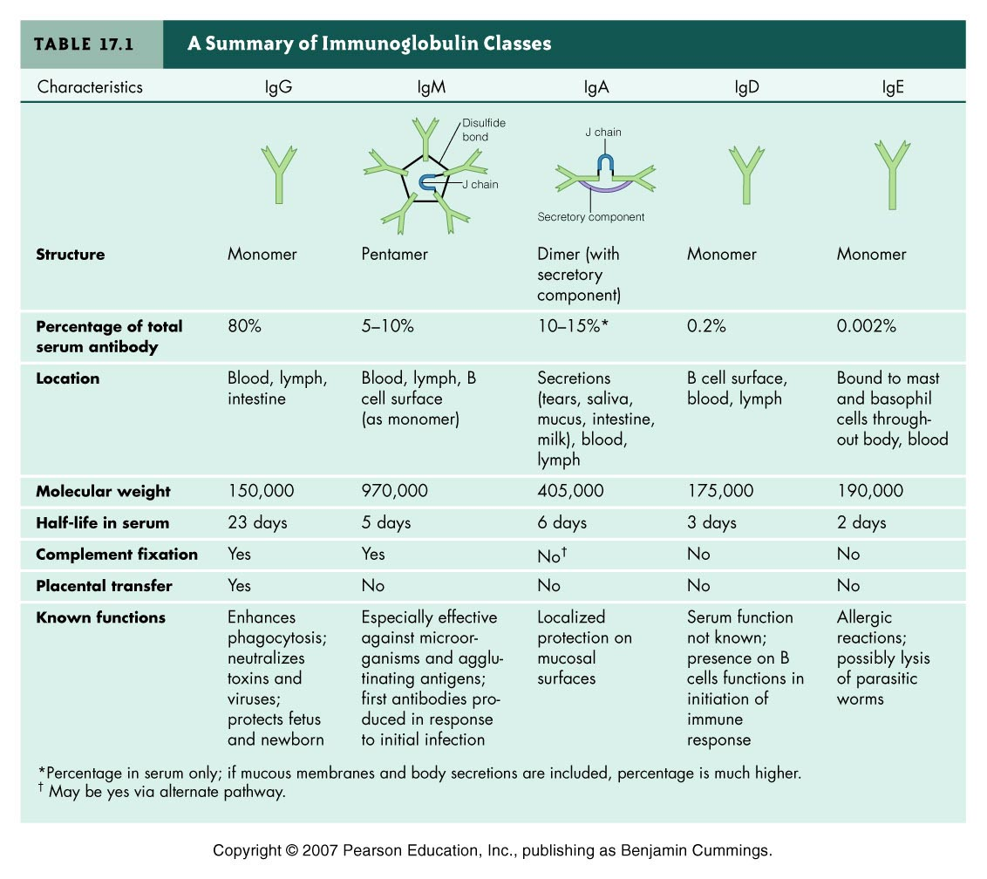

Slide 15
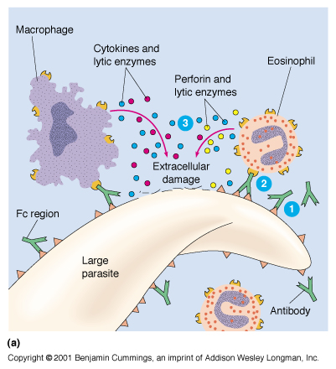
Functions of Antibodies
Antibody dependent cell-mediated cytotoxicity
  Antibodies coat infecting cell (large parasite usually) - FC facing outwards
  NK (lysing ability), Macrophage, neutrophils, and eosinophils have receptors for FC region of antibody
  Secretion of lytic enzymes to destroy parasite

Slide 16
Primary & Secondary immune responses
Initial encounter with antigen produce primary immune response
Subsequent challenge with same antigen produce secondary immune response

Slide 17
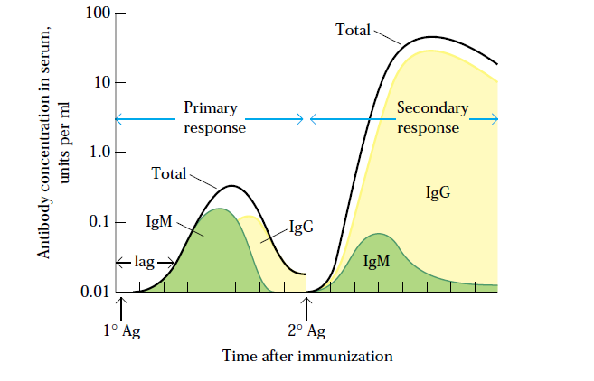
Concentration & type of antibody in primary & secondary immune responses

Slide 18
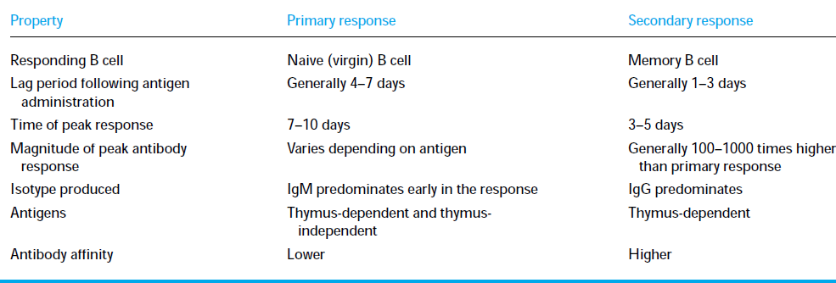
Comparison between primary & secondary responses

Slide 19
Take Home Message
B cells can be activated by antigen to produce antibodies either with the assistance of helper T cells or directly by the antigen itself
Antibodies are made up of two heavy and two light amino acid chains and have a shape of letter “Y”
Different types of antibodies are located at various sites to provide protection by agglutination, precipitation, complement fixation etc.
Secondary humoral immune response is swift and a stronger immune response mediated by IgG class of antibodies because of the memory cells.

