Slide 1
ilos
By the end of this lecture you will be able to :
Distinguish difference between tolerance and desensitization ( tachyphylaxis ) and reasons for their development
Recognize patterns of adverse drug reactions (ADR)
TOLERANCE, DESENSITIZATION &
ADVERSE DRUG REACTIONS

Slide 2
Phenomenon of variation in drug response, where by there is a gradual diminution of the response to the drug when given continuously or repeatedly
TOLERANCE and DESENSITIZATION

Slide 3
DIMINUTION OF A RESPONSE
Rapid, in the course of few minutes
Gradual in the course of few days to weeks
TACHYPHYLAXIS / DESENSITIZATION
TOLERANCE
These SHOULD BE DISTINGUISHED FROM
Loss of effectiveness of antimicrobial agent
Resistance

Slide 4
REASONS FOR DEVELOPMENT OF TOLERANCE
PRE RECEPTOR EVENTS
EVENTS AT RECEPTORS
POST RECEPTOR EVENTS
↓ drug availability at the relevant receptors due to pharmaco- kinetic variables
Nullification of drug response by a physiological adaptative homeostatic response
Drug becomes:
> metabolized or excreted
< absorbed
altered distribution to tissues
Antihypertensive effects of ACE Is become nullified by activation of renin angiotensin system by NSAIDs
eg. Barbiturates  metabolism of Contraceptive pills =  it availability
LOSS OF THERAPEUTIC EFFICACY
Refractoriness

Slide 5
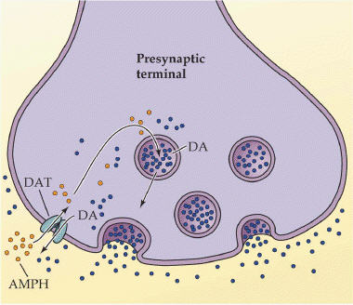
REASONS FOR DEVELOPMENT OF TOLERANCE
REASONS FOR DEVELOPMENT OF TOLERANCE
PRE RECEPTOR EVENTS
EVENTS AT RECEPTORS
POST RECEPTOR EVENTS
EXHUSTION
OF MEDIATORS
DOWN REGULATION
BINDING ALTERATION
Depletion of mediator stores by amphetamine

Slide 6
REASONS FOR DEVELOPMENT OF TOLERANCE
REASONS FOR DEVELOPMENT OF TOLERANCE
EVENTS AT RECEPTORS
BINDING ALTERATION
DOWN REGULATION
Phosphorylation of R by ß-adrenoceptors → ↓ activation of AC to related ionic channel [functional defect]
↓ number of receptors.
Isoprenaline activation to β receptors →↑ R recycling by endocytosis [structural defect]
DOWN REGULATION
BINDING ALTERATION

Slide 7
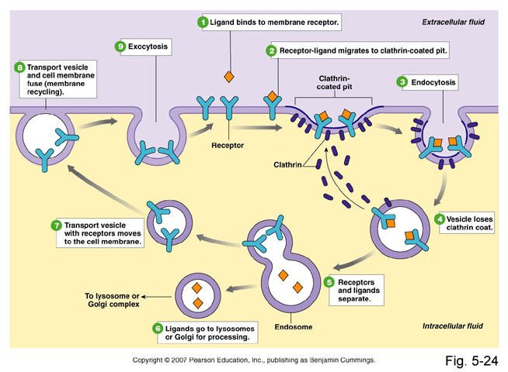
DOWN REGULATION

Slide 8
ADVERSE DRUG REACTIONS [ADR]
Harmful or seriously unpleasant effects occurring at doses intended for therapeutic effects.

Slide 9
TYPES OF ADR
Type A
Type C
Type E
Augmented
Continuous
End-of-Use
PREDICTABLE
Occurs during chronic drug administration
Occurs upon sudden stoppage of chronic drug use due to existing adaptive changes present
Occurs consequent but in excess of drug primary pharmacological effect. Of quantitative nature
Type B
Type D
Bizzar
Delayed
UNPREDICTABLE
Occurs after long period of time even after drug stoppage
Occurs different [heterogenous / idiosyncrotic ] to known drug pharmacological effect usuallydue to patient’s genetic defect or immunological response.
Of qualitative nature

Slide 10
Type C
Continuous
e.g. Patients can develop
Osteoporosis secondary to chronic corticosteroid intake
DEPENDENCE:
a. Psychological [Craving] as by cannabis
b. Psychological [Craving] + Physical withdrawal manifestations (syndrome) = ADDICTION as by morphine
Type D
Delayed
Long after patients can show:
TERATOGENICITY after retinoids
CARCINOGENICITY after smoking nicotine
Type E
End-of-Use
e.g. Patients on stoppage of
- Clonidine develop rebound hypertension
Morphine develop withdrawal syndrome

Slide 11
Comparison between typeA & B ADRs
 | Type A Augmentation | Type B Idiosyncrotic
Pharmacological predictability | Yes | No
Nature | Quantitative [ extension of pharmacology effect ] | Qualitative [ immune or genetic base]
Dose dependent | Yes (dose response relationship present) | No (dose response relationship absent)
Onset of symptoms | Usually Rapid | Usually delayed
Incidence and morbidity | High | Low
Mortality | Low | High
Treatment | Dose adjustment or Substitute by > selective + Antagonize unwanted effect of 1st drug | Stop drug + Symptomatic treatment
Example | Bradycardia β- ADR Blockers Hemorrhage Warfarin | Apnea succinylcholine Thrombocytopenia Quinine

Slide 12
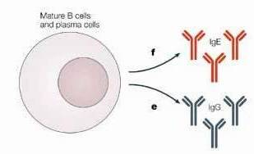
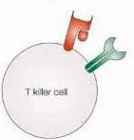
TYPE B
HYPERSENSITIVITY REACTIONS
Drug or its bi-product react as antigens & provoke immune response that results in damage to the tissue Hypersensitivity Reaction
IgE
1st exposure to a drug
IgG
Sensitization
T killer cells
Repeated exposures
HYPERSENSITIVITY REACTION

Slide 13
TYPE B
HYPERSENSITIVITY REACTION
TYPE I
Anaphylaxsis
TYPE II
Cytotoxic
TYPE III
Immune complex
TYPE IV
Cell mediated
Urticaria, rhinitis, bronchial asthma
by Penicillin.
Haemolytic
anaemia thrombocytopenia
by Quinidine
Serum sickness (fever arthritis enlarged lymph nodes, urticaria)
by Sulphonamides
Contact dermatitis by local anesthetics creams

Slide 14
Quiz?
The gradual diminution of response to the drug that occurs gradual in the course of few days to weeks is
A) anaphylaxsis B) tolerance C) tachyphylaxsis D) idiosyncrasy

Slide 15
Quiz?
Teratogenicity to retinoids is considered
A) Type C adverse drug reaction B) Type I hypersensitivity reaction C) Type C adverse drug reaction D) Type III hypersensitivity reaction

Slide 16
Quiz?
An example of drug induced cytotoxicity is
A) bronchial asthma by penicillin B) haemolytic anemia by quinidine
C) serum sickness by sulphonamides
D) contact dermatitis by local anaes- thetic creams

