Slide 1
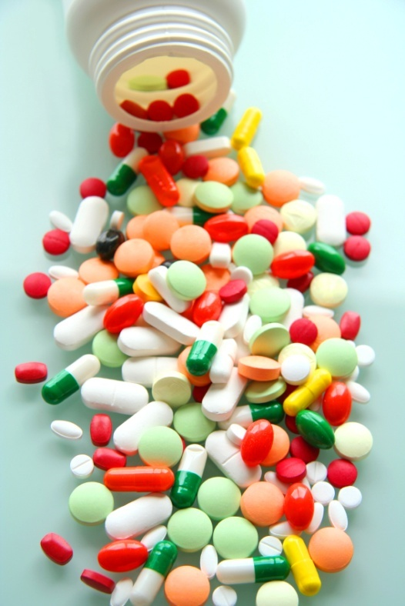
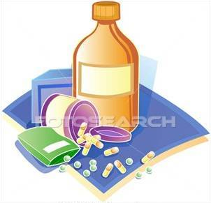
PHARMACOLOGY
PHARMACOLOGY

Slide 2
PHARMACOKINETICS
Exceptions
Absorb
Distribute
Metabolize
Excrete
Osmotic Diuretics
Purgatives
Antacids
The body
Interacts with body’s biological molecules
TARGETS Of Drug Action
To alter their biochemical &/or biophysical activity
Depress
Activate
Replace
Irritate
Destroy
The DRUG
RESPONSE
PHARMACODYNAMICS

Slide 3
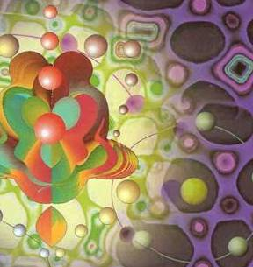
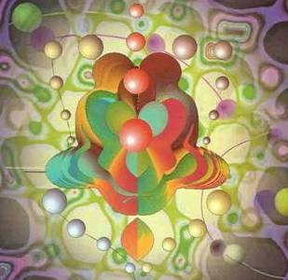
ilos
By the end of this lecture you will be able to :
Identify different targets of drug action
Differentiate between their patterns of action; agonism versus antagonism
Elaborate on drug binding to receptors
MOLECULAR MECHANISMS OF DRUG ACTION
By
Prof. Omnia Nayel
Assoc. Prof. Osama Yousif

Slide 4
PHARMACODYNAMICS
TARGETS
> Proteins
STRUCTURAL
REGULATORY
ENZYME
CARRIER MOLECULE
ION CHANNEL
RECEPTOR

Slide 5
TARGETS
STRUCTURAL PROTEIN
Tubulin is target for:
Vincristine
Colchicine
Tubulin
Structure

Slide 6
TARGETS
REGULATORY PROTEIN
ENZYME
The drug competes with the natural substrate
for the enzyme
REVERSIBLE
Neostigmine reversibly compete with ACH for cholinestrase at MEP
IRREVERSIBLE
Organophosphates irreversibly competes with ACH for cholinestrase

Slide 7
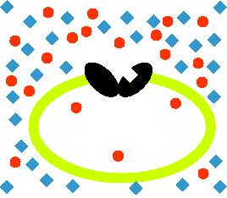
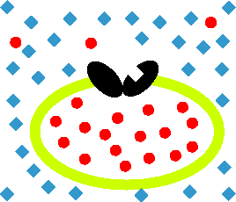
TARGETS
REGULATORY PROTEIN
Responsible for transport of ions and small organic molecules between intracellular compartments, through cell membranes or in extracellular fluids.
CARRIER MOLECULE
Passive Transporter
The drug binds to such molecules altering their transport ability
Antiporter
Symporter
Cocaine blocks transport of catecholamines at synaptic cleft in CNS

Slide 8
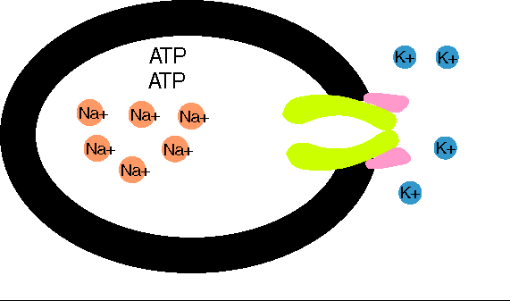
TARGETS
REGULATORY PROTEIN
CARRIER MOLECULE
Digitalis blocks efflux of Na by Na pump
Active
Transporter
Digitalis
Notes:
8

Slide 9
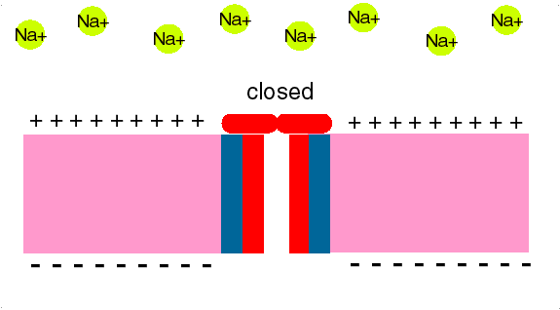
ION CHANNEL
TARGETS
REGULATORY PROTEIN
Responsible for influx or out-flux of ions through cell membranes along their concentration gradients.
They are activated by alteration in action potential and are controlled by gating machinery.
Drugs bind to alter channel function by block or modulation
Local Anesthetics block Na influx through Na channel in nerve fibers.
They are Na channel Blockers.
.Anaesthesia

Slide 10
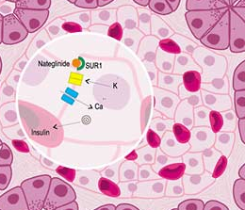
ION CHANNEL
TARGETS
REGULATORY PROTEIN
Sulfonylurea drugs block K⁺ out flux via the K channels in pancreatic cells .
They are K Channel Modulator

Slide 11
TARGETS
REGULATORY PROTEIN
RECEPTOR
Responsible for selectively sensing & binding of a stimulus (ligand) & its coupling to a response via a set of signal transduction machinery
Drugs bind and alter R signal transduction machinery.
Bind
Occupy
Initiate
Activate
L
Physiological
RESPONSE
L
R
LR*
ENDOGENOUS
LIGAND
AFFINITY
EFFICACY
Agonist
R
Pharmacological
RESPONSE
A
A
R
AR*
ACh
A drug that possesses both affinity and efficacy
Antagonist
NO RESPONSE
B
B
R
Tubocurarine
A drug that possesses an affinity but no efficacy

Slide 12
The tendency of a drug to bind to the receptors is governed by its affinity.
AFFINITY
The ability for it, once bound, to activate the receptor is denoted by its efficacy.
EFFICACY
Agonist
A drug that possesses both affinity and efficacy
Is that inherent property intrinsic to the agonist that determines how "good" an agonist is.
high intrinsic efficacy
↓
a full agonist
low intrinsic efficacy ↓
a partial agonist.
Antagonist
A drug that possesses an affinity but no efficacy
Notes:
12

Slide 13
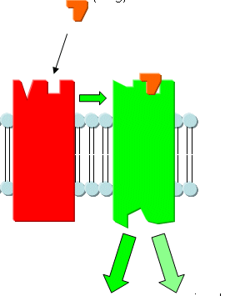
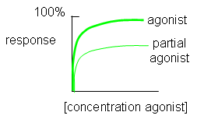
Ligand
Agonist
Ligand
High intrinsic efficacy
↓
Max response
low intrinsic efficacy
↓
Submax response agonist.
A Full Agonist
A Partial
Agonist
Agonistic-Antagonistic
Potentials
Pindolol, a beta blocker which is a partial agonist, produces less decrease in heart rate than pure antagonists such as propranolol.
Notes:
13

Slide 14
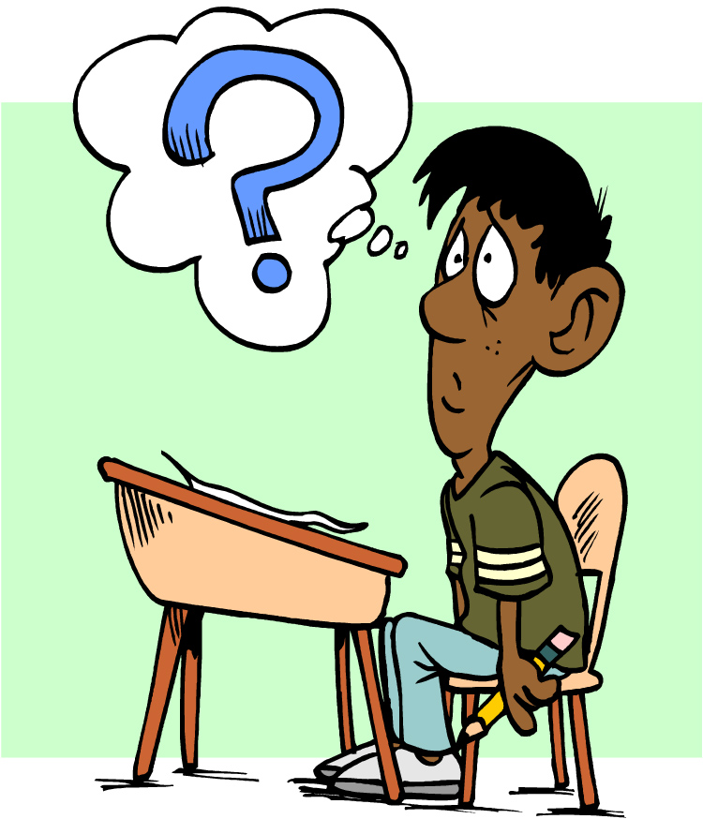
Quiz?
Vincristine binds to:
A) a structural protein B) an ion channel C) an enzyme D) a carrier molecule

Slide 15
Quiz?
Local anaesthetics are:
A) Reversible enzyme inhibitors B) Irreversible enzyme inhibitors C) Channel blockers D) Channel modulators

Slide 16
Quiz?
An agent that can bind and maximally activate the receptor .
A) Reversible antagonist B) Full agonist C) Partial agonist D) Irreversible antagonist

Slide 17
Quiz?
Tubocurarine is a drug that possesses
A) Affinity and efficacy B) Affinity but no efficacy C) No affinity but efficacy D) No affinity and efficacy

Slide 18
ilos
By the end of this lecture you will be able to :
Determine quantitative aspects of drug receptor binding
Recognize different dose response curves
Distinguish the therapeutic utility of each of these curves
Classify different types of antagonism
QUANTITATIVE ASPECTS OF DRUG ACTION

Slide 19
The tendency of a drug to bind to the receptors is governed by its affinity.
AFFINITY
The ability for it, once bound, to activate the receptor is denoted by its efficacy.
EFFICACY
Bind
Occupy
Initiate
Activate
D
+
R
D
R
DR*
RESPONSE[R]
Relate concentration [C] of D used (x- axis) to binding capacity [B] at receptors (y-axis)
Relate [C] of D used (x- axis) to the response [R] produced (y-axis)
AFFINITY
EFFICACY
Concentration-Binding Curve
Dose Response Curve
POTENCY

Slide 20
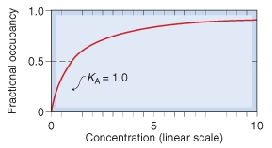
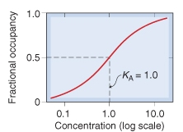
Concentration-Binding Curve
(B_{max}): Total density of receptors in the tissue
K_{D}
K_{D}
(k_{D} )= [C] of D required to occupy 50% of receptors at equilibrium
?
Concentration-Binding curves are used to determine:
The binding capacity (B_{max}) → total density of receptors in the tissues.
The affinity of D for receptor
The higher the affinity of D for receptor the lower is the K_{D} i.e. inverse relation
?

Slide 21
DOSE RESPONSE CURVE
How does response vary with C?
A continuous response
BP, HR, FBG, Cholesterol,…
GRADED DOSE RESPONSE CURVE
An all-or-non response prevention of convulsion, arrhythmias or death…..
Relate C to % of patients eliciting the :
* specified therapeutic response
* adverse response
* lethal outcome
QUANTAL DOSE RESPONSE CURVE
How the therapeutic window of a drug is defined ?

Slide 22
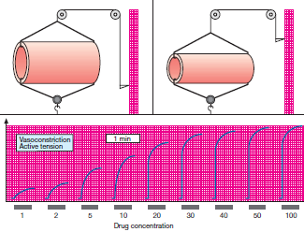
GRADED DOSE RESPONSE CURVE
A continuous response
BP, HR, FBG, Cholesterol,…

Slide 23
100
Max effect = E_{max}
Effect when all the receptors are occupied by D
80
As C ↑ response increment ↓
100
60
% of Maximal Effect
80
40
% of Maximal Effect
60
20
40
[C]
0
20
0
200
400
600
800
EC₅₀
EC₅₀
C that gives the half-maximal effect
[C]
0
1
10
100
1000
Graded dose-response curves are used to determine:
The max efficacy (E_{max}) → highest limit of dose-response relationship on response axis.
The potency = The concentration of drug required to produce a specified response
The smaller the EC₅₀ , the greater the potency of the agonist i.e. the lower C needed to elicit the maximum biological response.
3. Compare the relative potency and efficacy of drugs that produce the same effect.

Slide 24
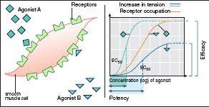
GRADED DOSE RESPONSE CURVE
EFFICACY
B Partial Agonist
A > efficacy than B
POTENCY
A > potent B

Slide 25
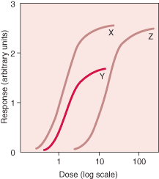
GRADED DOSE RESPONSE CURVE
X & Z are equal efficacy
X & Z > efficacy than Y
Y > potent but
< efficacious than Z
X > potent than Y & Z
Y> potent than Z

Slide 26
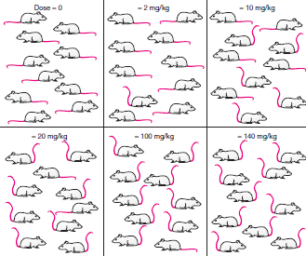
QANTAL DOSE RESPONSE CURVE
All-non responses
% subjects responding
Dose-frequency relationship

Slide 27
QANTAL DOSE RESPONSE CURVE: used to determine
100
Lethal Effect
80
Toxic Effect
Therapeutic Effect
60
Predict the safety profile
% subjects responding
40
20
[Dose]
0
1
10
100
1000
Median Effective Dose
ED₅₀
TD₅₀
Median toxic dose
LD₅₀
Median lethal dose
at which 50% of individuals exhibit the specified therapeutic response
Therapeutic Index
TD₅₀
The relation between dose to induce a desired effect versus that producing the unwanted effect.
ED₅₀
When high → the drug has a safe profile diazepam
When low → the drug has a narrow margin of safety digoxin

Slide 28
ANTAGONISM
It is the diminution or the complete abolishment of the effect of one drug in the presence of another.
Types
1. Chemical
Two drugs react chemically resulting in loss of activity of active drug.
Dimercaprol reduces heavy metal toxicity [ lead]
2.Physiological
Two drugs possess opposing actions in body, so tend to cancel each other’s effect.
Omeprozole & histamine
3. Pharmacokinetic
The antagonist effectively reduces the concentration of the active drug at the site of action
Phenobarbitone accelerates hepatic metabolism warfarin
4. Receptor Blockade (Competitive )
Reversible
Irreversible
5. Non-Competitive

Slide 29
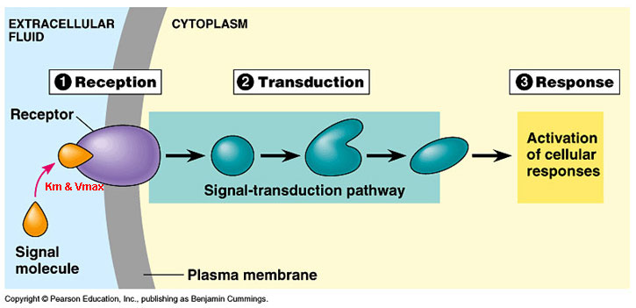
ANTAGONISM
Non-Competitive
Antagonist block at some point the chain of events that ignite the response of agonist
Receptor Blockade
(Competitive)
Agonist and Antagonist can be bound simultaneously
Antagonist prevents binding of agonist to the receptor at the same binding site ( = competes with it at same occupancy site )
Agonist and Antagonist compete ( only one is bound)
Reversible
Irreversible

Slide 30
COMPETATIVE ANTAGONISM
Antagonist readily dissociate from binding site of agonist to the receptor
Reversible
Antagonism can be overcomed by increasing concentration of agonist = Surmountable
Atropine vs Ach
Irreversible
Antagonist form stable, permanent / near permanent chemical bond with receptor.
Inactivation lasts for duration of receptor turnover or its de- novo synthesis → explains its longevity of action
Phenoxybenzamine & Noradrenaline

Slide 31
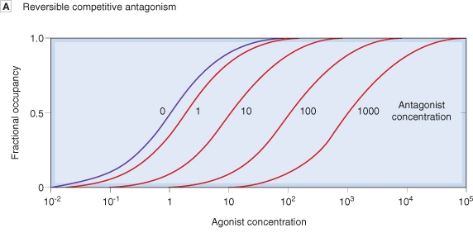
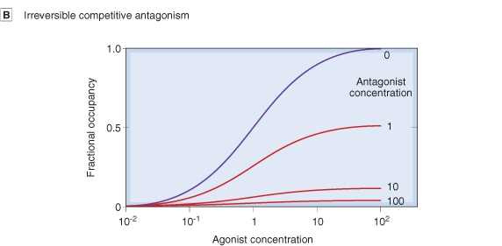
Competitive Antagonism
Reversible
Parallel shift to the right, without any change in slope or maximum
Irreversible
No parallel shift
But both a decrease in slope and a reduced maximum are obtained.

Slide 32
Competitive vs Noncompetative Antagonism
Antagonism can be overcomed by increasing concentration of agonist = SURMOUNTABLE
% of Maximal Effect
Agonist + reversible competitive antagonist
100
Agonist
80
Agonist + irreversible competitive antagonist
60
Agonist + non-competitive antagonist
Depression of maximal response +/- rightward shifts ( if some R are spare )
40
20
Verapamil vs noradrenaline
0
[C]
1
10
100
1000
Antagonism cannot be overcomed by increasing concentration of agonist = NON-SURMOUNTABLE

Slide 33
Quiz?
Concentration-binding-curves are used to detect:
A) highest limit of dose-response relationship B) concentration of drug required to produce a specified response C) affinity of a drug for its receptor D) therapeutic index of a drug

Slide 34
Quiz?
Drug A has a smaller EC₅₀ than drug B. This means that drug B is:
A) more potent than A B) less potent than A C) more efficacious than A D) less efficacious than A

Slide 35
Quiz?
An example of a reversible competitive antagonist is:
A) phenoxybenzamine to noradrenaline. B) omeprazole to histamine C) dimercaprol to lead D) atropine to acetylcholine

Slide 36
Quiz?
Antagonism can be overcomed by increasing concentration of agonist in:
A) irreversible competitive antagonism. B) non-competitive antagonism C) reversible competitive antagonism D) pharmacokinetic antagonism

Slide 37
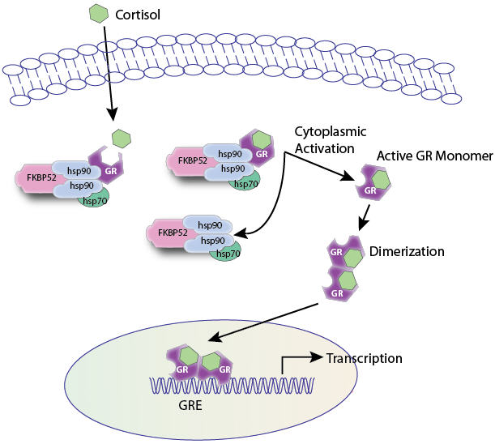
RECEPTOR FAMILIES
RECEPTOR FAMILIES

Slide 38
ilos
By the end of this lecture you will be able to :
Classify receptors into their main superfamilies
Recognize their different transduction mechanism
Identify the nature & time frame of their response

Slide 39
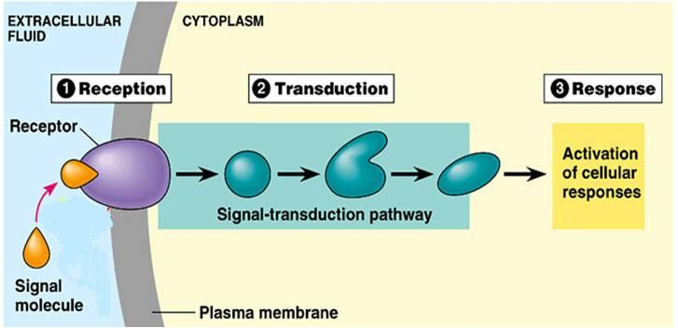
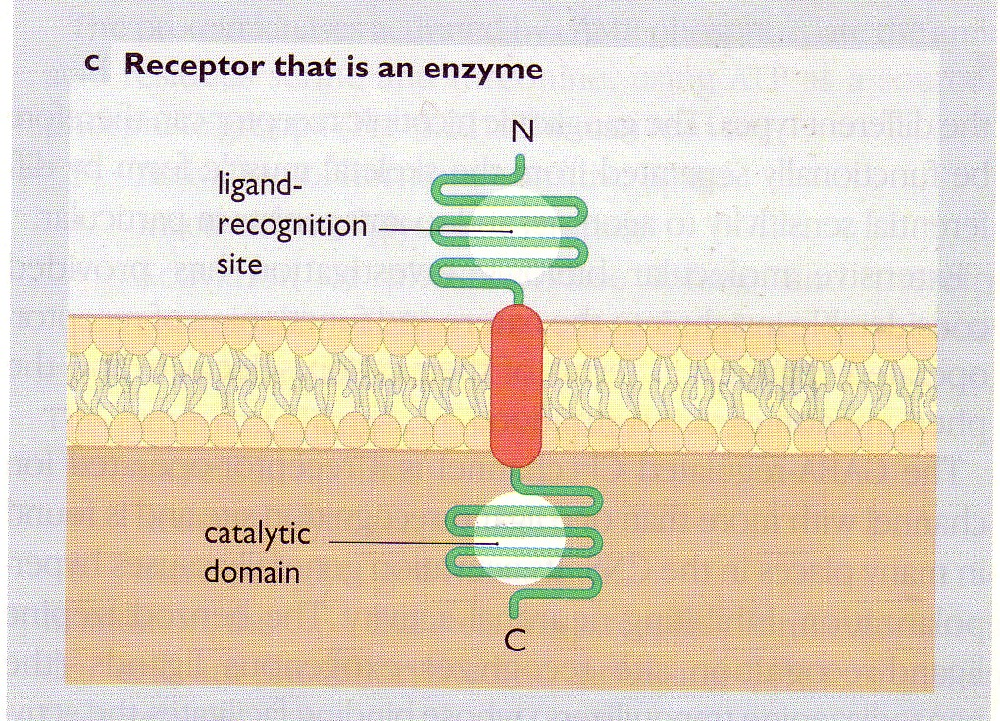
Responsible for selectively sensing & binding of a stimulus (ligand) & its coupling to a response via a set of signal transduction machinery
A RECEPTOR
2
3
4
2. Reception
3. Transduction
4. Response
1
1. Recognition
Its Structure:
1. N terminal
2. C terminal
Direct
◉
Coupler Transduction

Slide 40
RECEPTOR FAMILIES
Classified according to their
Location
Structure
Transduction Mechanism
Nature of Response
Time scale of Response
 4 Main SUPERFAMILIES
Channel-Linked Receptor
G-Protein Coupled Receptors
Enzyme-Linked Receptors
Nuclear Receptors

Slide 41
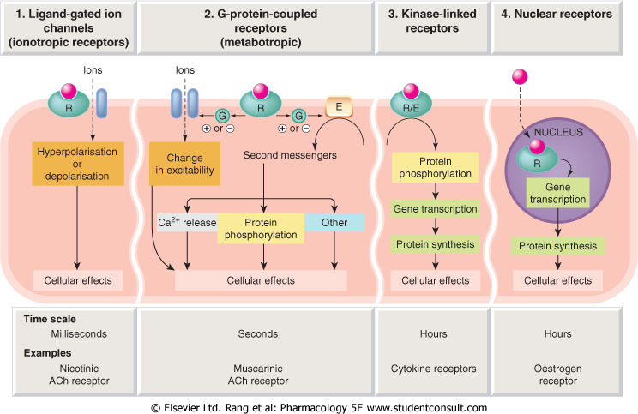
1
2
3
4
Channel-Linked
G-Protein Coupled
Enzyme-Linked
Nuclear
Conductance
Cell Signal  
Cell Signal 
Transcription
& Translation
Minutes / Hours
Hours / Days

Slide 42
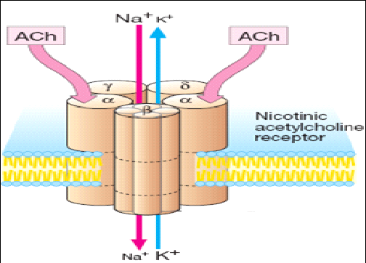
Channel-Linked Receptor
1
Ionotropic Receptor
Ligand-Gated-Ion Channel
Involved in fast synaptic neurotransmission occurring over milliseconds
It is activated directly when a ligand binds to the receptor to open the channel that is incorporated as part of its structure.
Examples;
Nicotinic Ach receptor activated by Acetylcholine
Different from Voltage-Gated Ion Channel
Is activated by a change in action potential not by occupancy of a ligand

Slide 43
G-Protein
Composed of 3 subunits [α β γ] & GDP
◉
G-Protein-Coupled Receptor
2
Metabotropic Receptor
Agonist
Involved in less rapid transmission of
Transmitters: Adrenaline at Adr R, Ach at mAch R …etc
Hormones; Glucagon
Others; Peptides, Purines, …etc
Go-between proteins
= Coupler
G-Protein
1. Agonist occupancy dissociates [α], replaces GDP by GTP, activates effector
2. Agonist loss cleaves GTP by GTPase binds [α β γ] again and GDP
An enzyme coupled to a  2nd messenger   
1. Adenyl cyclase (AC)  cAMP  PKA
2. Phospholipase C (PLC)IP₃ Ca⁺⁺ intracellular Ca²⁺/CaMCAMPK
DAG  PKC
?
?
RESPONSE
PHOSPHORYLATES A TARGET PROTEIN

Slide 44
G-Protein-Coupled Receptor
No receptor activation
Adenyle cyclase
R
G-Protein
E
α
GTP
β
γ
ATP
ATP
GDP
ATP
ATP
Ligand binding activates it
R
Channels
E
α
P
β
γ
ATP
ATP
GDP
GTP
ATP
ATP
P
Phosphorylate Proteins
cAMP
PKA
P
P

Slide 45
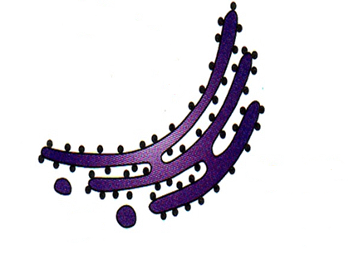
G-Protein-Coupled Receptor
Phospholipase C
E
α
α
PIP₂
DAG
Channels
β
γ

Phosphatidic a
Inositol
↑
P
IP₃
PKC
?
?
Ca⁺⁺
+CaM
CAMPK
P
P
P
Enzymes
P
Cytoskeletal Proteins

Slide 46
G-Protein-Coupled Receptor
Are the Most Abundant Type
They Have Different G-Protein Classes
Divided according to their α-subunits into G_{s}, G_{i} and G_{q}
G_{s} and G_{i} produce, respective, stimulation and inhibition of AC
G_{q} is linked to activation of PLC-IP₃ -Ca⁺⁺ CaM & PKC
Receptors are selective to α subunit & effector with which they couple

Slide 47
ADRENOCEPTORS
a₁ Adrenoceptors couple to G_{q} to stimulate PLC.
α₂ Adrenoceptors couple to G_{i} to inhibit AC.
β_{1&2} Adrenoceptors couple to G_{s} to stimulate AC
Adr
Adr
Inhibitory Receptor
Stimulatory Receptor
G_{i}
G_{s}
AC
α₂ Adrenoceptor
β Adrenoceptor
+
cAMP
↑cAMP

Slide 48
CHOLINERGIC RECEPTORS
M₁ & M₃ Ach receptors couple to G_{q} to stimulate PLC
M₂ & M₄ Ach receptors couple to G_{i} to inhibit AC
Ach
Adr
Stimulatory Receptor
Stimulatory Receptor
G_{q}
G_{q}
PLC
PLC
M₃ Ach receptor
α₁ Adrenoceptor
+
+
Bronchi
↑Ca ⁺⁺
↑Ca ⁺⁺
Blood Vessel

Slide 49
Enzyme-Linked Receptors
3
Involved in slow action of; hormones (insulin), growth factors, cytokines, …..
Their cytosolic domain either:
1. Associate directly with an enzyme GC (guanyl cyclase) as in ANP receptor.
2. Possess intrisic kinase activity (as tyrosine or serine/threonine kinase) that can phosphorylate itself (autophosphorylation) & / or other proteins that they dock as in insulin receptor
They control many cellular functions as motility, growth, different-iation, division & morphogenesis.
This usually require many intracellular signaling steps that take time to process.

Slide 50
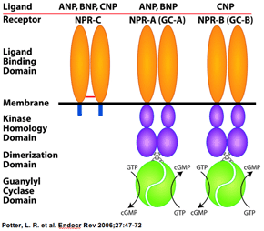
Enzyme-Linked Receptors
3
1. Guanyle cyclase-Linked Receptors
They have a single transmembrane spanning element.
These have integral intrinic GC activity .
Their 2nd messenger is cGMP
→ activates PKG
→ phosphorylate down stream
protein signaling molecules.
Example:
Atrial Natriueretic Peptide [ANP] receptor
↑cGMP

Slide 51
3
Enzyme-Linked Receptors
2. Tyrosine Kinase-Linked Receptors
Ligands cross link or dimerize receptors
Activated Receptor autophosphorylates
Phosphorylate other proteins that it docks
Phosphorylated docked proteins
Example
Insulin R
Growth factors R
Phosphorylates other targets RESPONSE

Slide 52
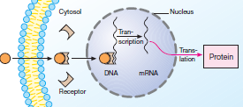
Are intra-cellularly located whether in cytosol or the nucleus.
Nuclear Receptors
4
Their ligands are usually either:
Extracellular lipophylic hormones; steroids, thyroids, …etc
Extracellular lipids; linolinic a., retinoic a.
Phosphorylated protein end product of 2nd messenger signaling
◆ Involved in regulation of PROTEIN SYNTHESIS →most slowest in action.
They possess a conserved area that recognizes specific DNA sequence in the nucleus which is called a Responsive Element
◆ They react as
TRANSCRIPTION FACTORS
expressing or repressing
target genes.
Protein
Translation
Transcription

Slide 53
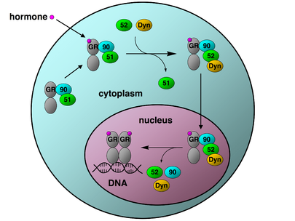
Nuclear Receptors
4
In Cytosol
GLUCOCORTICOID RECEPTOR
proteins
The activated GR complex
◆ Up-regulates expression of anti-inflammatory proteins
◆ Represses expression of pro-inflammatory proteins in cytosol ( preventing the translocation of other transcription factors from the cytosol into the nucleus).

Slide 54
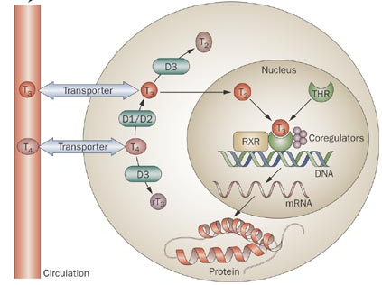
Nuclear Receptors
4
Intra nuclear
THYROID HORMONE
RECEPTOR

Slide 55
Quiz?
An agent that mainly activates an intracellular receptor and the complex formed acts as a transcription factor that binds DNA and expresses or represses proteins:
A) acetylcholine B) insulin C) corticosteroids D) glucagon

Slide 56
Quiz?
A ligand that activates a receptor to open an ion channel incorporated within:
A) acetylcholine B) insulin C) corticosteroids D) glucagon

Slide 57
Quiz?
A receptor that possesses intrinsic guanyl cyclase activity is that of
A) Atrial Natriueretic Peptide B) Adrenaline C) Acetylcholine D) Insulin

Slide 58
Quiz?
A receptor that is coupled to G_{s} to stimulate AC is that of
A) Atrial Natriueretic Peptide B) Adrenaline C) Acetylcholine D) Insulin

