Slide 1
BLOOD PRACTICAL – 1
CBC, DLC, TLC
(Complete Blood Count, Differential Leukocyte Count, Total Leukocyte Count)
Dr. Taj

Slide 2
Complete Blood Count (cbc)

Slide 3
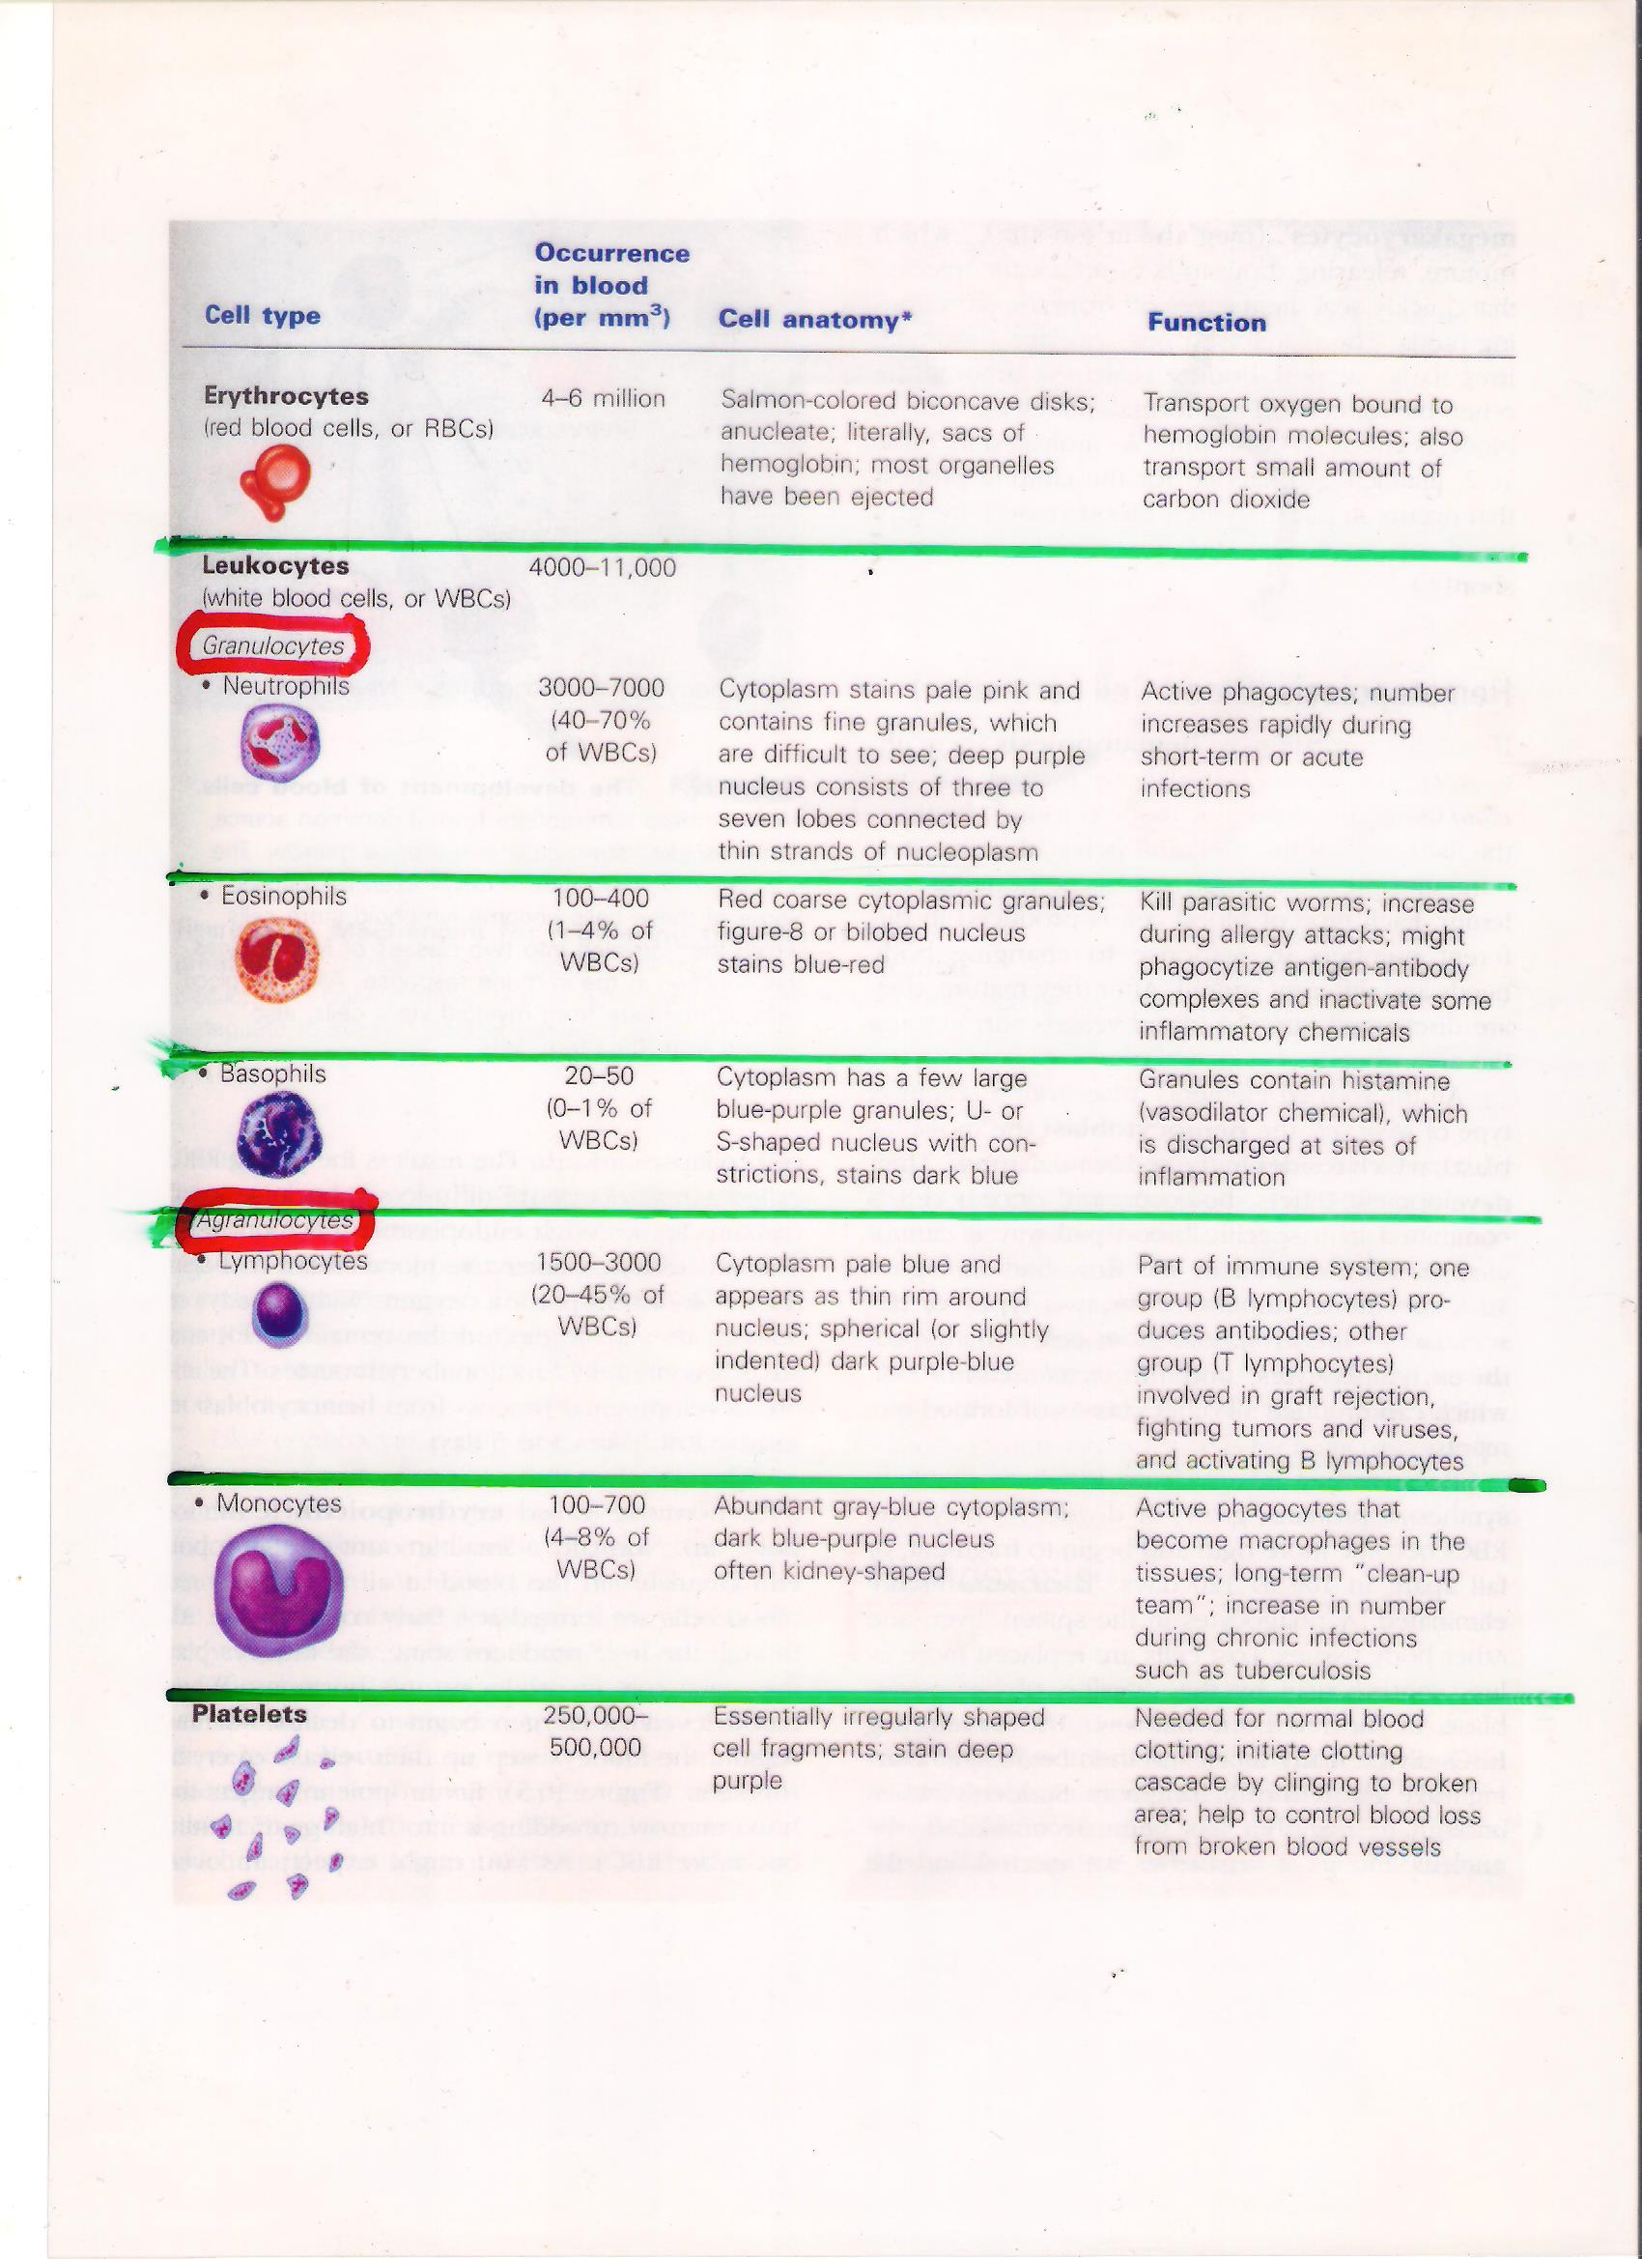
(DLC & TLC) Differential Leukocyte Count, Total Leukocyte Count

Slide 4
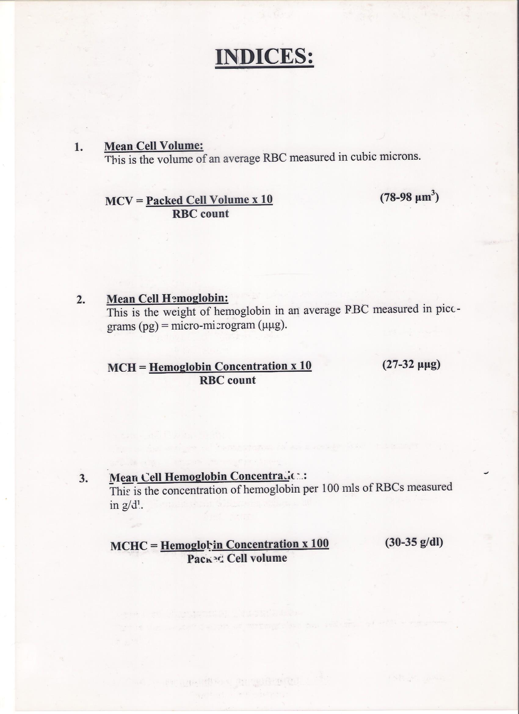
Indices

