Slide 1
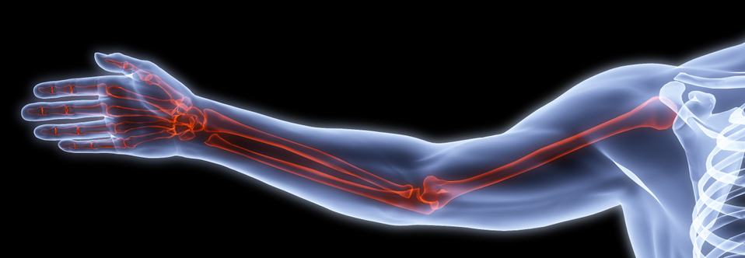
BONES OF THE UPPER LIMB
Khaleel Alyahya, PhD, MEd
@khaleelya

Slide 2
OBJECTIVES
At the end of the lecture, students should be able to:
List the different bones of the Upper Limb.
List the characteristic features of each bone.
Differentiate between bones of right and left sides.
List the articulations between the different bones.

Slide 3
Bones of Upper Limb
It consists of the following:
Pectoral Girdle
Arm
Humerus
Forearm
Radius & Ulna
Wrist
Carpal bones
Hand
Metacarpals & Phalanges

Slide 4
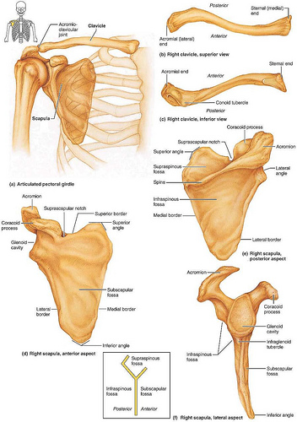
Pectoral Girdle
It composed of Two bones:
Clavicle
Scapula
It is very light and it allows the upper limb to have exceptionally free movement.

Slide 5
Clavicle
It is a long bone lying horizontally across the root of the neck
It is subcutaneous throughout its length.
Functions:
It serves as a rigid support from which the scapula and free upper limb are suspended keeping them away from the so that the arm has maximum freedom of movement.
Transmits forces from the upper limb to the axial skeleton.
Provides attachment for muscles.
It forms a boundary of the cervicoaxillary canal for protection of the neurovascular bundle of the UL.
If the clavicle is broken, the whole shoulder region caves in medially.

Slide 6
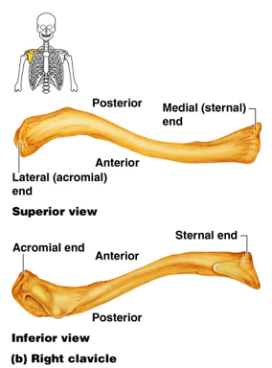
Clavicle
It is considered as a long bone but it has no medullary (bone marrow) cavity.
Its e medial (Sternal) end is enlarged & triangular.
Its lateral (Acromial) end is flattened.
The medial 2/3 of the body (shaft) is convex forward.
The lateral 1/3 is concave forward.
These curves give the clavicle its appearance of an elongated capital (S)
It has two surfaces:
Superior: smooth as it lies just deep to the skin.
Inferior: rough because strong ligaments bind it to the 1st rib.

Slide 7
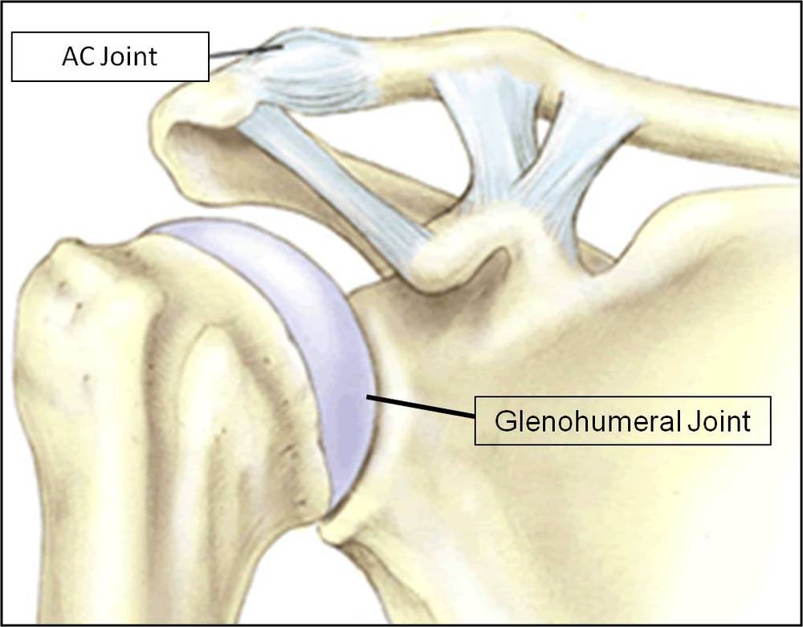
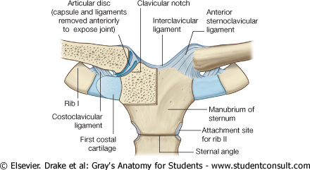
Articulations
Medially, sternoclavicular joint
with the Manubrium
Laterally, Acromioclavicular joint
with the Acromial end of the scapula
Inferiorly, costoclavicular Joint
with the 1st rib

Slide 8
Fractures of the Clavicle
The clavicle is commonly fractured especially in children as forces are impacted to the outstretched hand during falling.
The weakest part of the clavicle is the junction of the middle and lateral thirds.
After fracture, the medial fragment is elevated (by the sternomastoid muscle), the lateral fragment drops because of the weight of the UL.
It may be pulled medially by the adductors of the arm.

Slide 9
Scapula
It is a triangular flat bone.
Extends between the 2nd _ 7th ribs.
It has:
Three Processes:
Spine: a thick projecting ridge of bone that continues laterally as the flat expanded
Acromion : forms the subcutaneous point of the shoulder.
Coracoid: a beaklike process. It resembles in size, shape and direction a bent finger pointing to the shoulder.
Three Borders:
Superior
Medial (vertebral)
Lateral (axillary)

Slide 10
Scapula
Three Angles :
Superior
Lateral
forms the Glenoid cavity: a shallow concave oval fossa that receives the head of the humerus
Inferior
Two Surfaces
Convex Posterior surface is divided by the spine of the scapula into the smaller Supraspinous Fossa - above the spine and the larger Infraspinous Fossa - below the spine.
Concave Anterio (Costal) Surfacer , it forms the large Subscapular Fossa.
Suprascapular notch: It is a nerve passageway, medial to coracoid process.

Slide 11
Functions
Gives attachment to muscles.
Has a considerable degree of movement on the thoracic wall to enable the arm to move freely.
The glenoid cavity forms the socket of the shoulder joint.
Because most of the scapula is well protected by muscles and by its association with the thoracic wall , most of its fractures involve the protruding subcutaneous acromion.

Slide 12
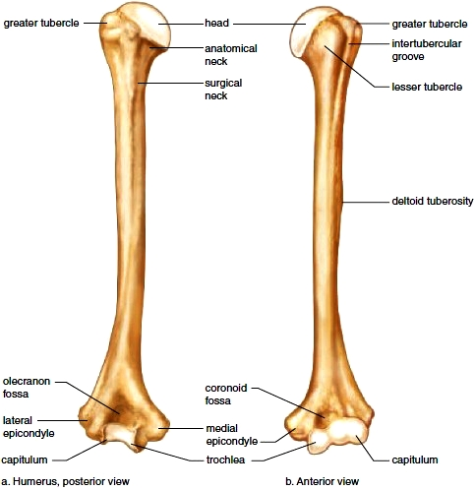
Arm (Humerus)
A typical long bone.
It is the largest bone in the UL
Proximal End:
Head, Neck, Greater & Lesser Tubercles.
Head: Smooth & forms 1/3 of a sphere, it articulates with the glenoid cavity of the scapula.
Anatomical neck: formed by a groove separating the head from the tubercles.
Greater tubercle: at the lateral margin of the humerus.
Lesser tubercle: projects anteriorly.
The two tubercles are separated by
Intertubercular Groove.
Surgical Neck: a narrow part distal to the tubercles. It is a common fracture site of the humerus.

Slide 13
Arm (Humerus)
Shaft (Body): it has two prominent features:
Deltoid tuberosity:
A rough elevation laterally for the attachment of deltoid muscle.
Spiral (Radial) groove:
Runs obliquely down the posterior aspect of the shaft.
It lodges the important radial nerve & vessels.
surgical

Slide 14
Arm (Humerus)
Distal End:
Widens as the sharp medial and lateral Supracondylar Ridges form and end in the medial and lateral Epicondyles providing muscular attachment.
Trochlea: (medial) for articulation with the ulna
Capitulum: (lateral) for articulation with the radius.
Coronoid fossa: above the trochlea (anteriorly)
Radial fossa: above the capitulum
Olecranon fossa: above the trochlea (posteriorly).
surgical

Slide 15
Fractures of Humerus
Most common fractures of the surgical neck especially in elder people with osteoporosis.
The fracture results from falling on the hand (transmittion of force through the bones of forearm of the extended limb).
In younger people, fractures of the greater tubercle results from falling on the hand when the arm is abducted .
The body of the humerus can be fractured by a direct blow to the arm or by indirect injury as falling on the oustretched hand.

Slide 16
Nerves affected in fractures of Humerus
Surgical neck: Axillary nerve
Radial groove: Radial nerve
Distal end of humerus: Median nerve
Medial epicondyle: Ulnar nerve

Slide 17
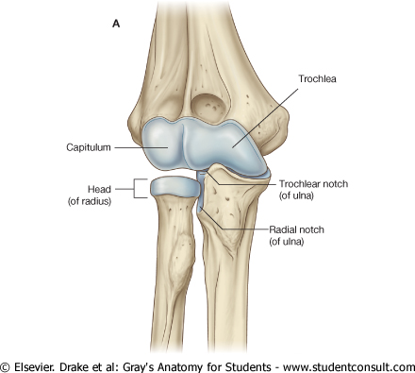
Articulations
Head of the humerus with the glenoid cavity of the scapula form the Shoulder joint.
Lower end (Trochlea & Capitulum) with the upper ends of the radius & ulna form the Elbow joint.

Slide 18
Forearm
Formed of two bones:
The Radius is the lateral bone.
The Ulna is the medial bone.

Slide 19
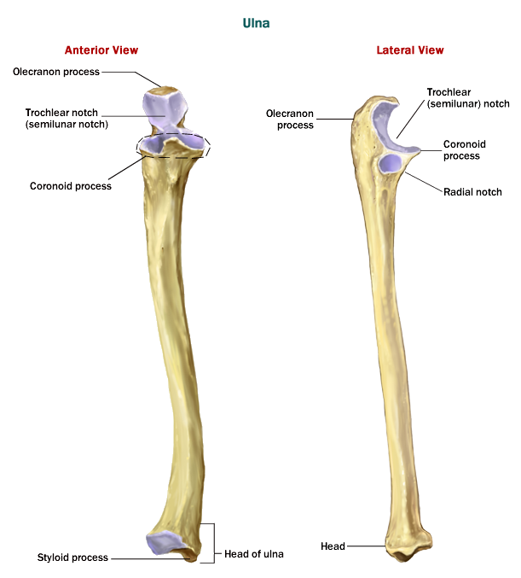
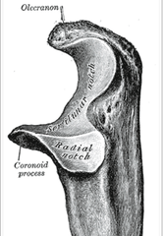
Ulna
It is the stabilizing bone of the forearm.
It is the medial & longer of the two bones of the forearm.
Proximal End:
It has two prominent projections:
Olecranon process: projects proximally from the posterior aspect (Forms the prominence of the elbow).
Coronoid process: projects anteriorly.
Trochlear notch: articulates with trochlea of humerus.
Radial notch: a smooth rounded concavity lateral to coronoid process.
Tuberosity of ulna: inferior to coronoid process.

Slide 20
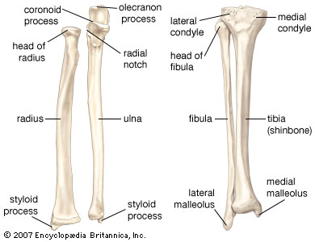
Ulna
Shaft :
Thick & cylindrical superiorly but diminishes in diameter inferiorly
Three surfaces (Anterior, Medial & Posterior).
Distal end:
Small rounded Head: Styloid process
The head lies distally at the wrist.
The articulations between the ulna & humerus at the elbow joint allows primarily only flexion & extension (small amount of abduction & adduction occurs).

Slide 21
Radius
It is the shorter and lateral of the two forearm bones.
Proximal (Upper) End:
Consists of:
Head: small, circular and its upper surface is concave for articulation with the capitulum.
Neck
Radial (Biciptal) Tuberosity: medially directed and separates the proximal end from the body.

Slide 22
Radius
Shaft:
Has a lateral convexity.
It gradually enlarges as it passes distally.
Distal (Lower) End:
It is rectangular.
Its medial aspect forms a concavity : Ulnar notch to accommodate the head of the ulna.
Radial Styloid process: extends from the lateral aspect.
Dorsal tubercle: projects dorsally.

Slide 23
Articulations of Radius & Ulna
Distal end of Humerus with the proximal ends of Radius & Ulna Elbow joint
Proximal Radioulnar joint
Distal Radioulnar joint
The two bones are connected by the flexible interosseous membrane
Proximal
Radioulnar joint.

Slide 24
Fractures of Radius & Ulna
Because the radius & ulna are firmly bound by the interosseous membrane, a fracture of one bone is commonly associated with dislocation of the nearest joint.
Colle’ s fracture (fracture of the distal end of radius) is the most common fracture of the forearm.
It is more common in women after middle age because of osteoporosis.
It results from forced dorsiflexion of the hand as a result to ease a fall by outstretching the upper limb.
The typical history of the fracture includes slipping. Because of the rich blood supply to the distal end of the radius, bony union is usually good.

Slide 25
Hands
The skeleton of the hand consists of the:
Carpals for the carpus (wrist)
Metacarpals for the palm
Phalanges for the fingers

Slide 26
Wrist (Carpus)
Compose of eight carpal bones arranged in two irregular rows, each of four.
These small bones give flexibility to the wrist.
The Carpus presents Concavity on their Anterior surface & convex from side to side posteriorly.
Proximal row (from lateral to medial):
Scaphoid
Lunate
Triquetral
Pisiform
Distal row (from lateral to medial):
Trapezium
Trapezoid
Capitate
Hamate

Slide 27
Fracture of Scaphoid
It is the most commonly fractured carpal bone and it is the most common injury of the wrist.
It is the result of a fall onto the palm when the hand is abducted.
Pain occurs along the lateral side of the wrist especially during dorsiflexion and abduction of the hand.
Union of the bone may take several months because of poor blood supply to the proximal part of the scaphoid.

Slide 28
Metacarpals
It is the skeleton of the hand between the carpus and phalanges.
It is composed of Five Metacarpal bones, each has a Base, Shaft, and a Head.
They are numbered 1-5 from the thumb.
The distal ends (Heads) articulate with the proximal phalanges to form the knuckles of the fist.
The Bases of the metacarpals articulate with the carpal bones. The 1st metacarpal is the shortest and most mobile. 3rd metacarpal has a styloid process on the lateral side of the base.

Slide 29
Digits (Phalanges)
Each digit has Three Phalanges
Except the Thumb which has only two
Each phalanx has a base proximally, a head distally and a body between the base and the head.
The proximal phalanx is the largest.
The middle ones are intermediate in size.
The distal ones are the smallest, its distal ends are flattened and expanded distally to form the nail beds.

Slide 30
Articulations
Bases of the Metacarpal bones articulate with the distal row of the carpal bones
Carpometacarpal joints
Heads (knuckles) articulate with the Proximal Phalanges
Metacarpophalangeal joints
The phalanges articulate with each other
Interphalangeal joints
Distal end of Radius with the Proximal Raw of Carpal bones
Wrist joint

Slide 31
QUEST!ON?

