Slide 1
ANTERIOR, LATERAL COMPARTMENTS OF THE LEG & DORSUM OF THE FOOT
Dr JAMILA EL MEDANY
&
Dr SAEED VOHRA

Slide 2
OBJECTIVES
At the end of the lecture, student should be able to
Identify the deep fascia of leg
Identify the fascial compartments of the leg
Describe the anatomy of the anterior & lateral compartments
List the contents of each compartment (muscles, vessels & nerves)
Describe the anatomy and contents of the dorsum of the foot

Slide 3
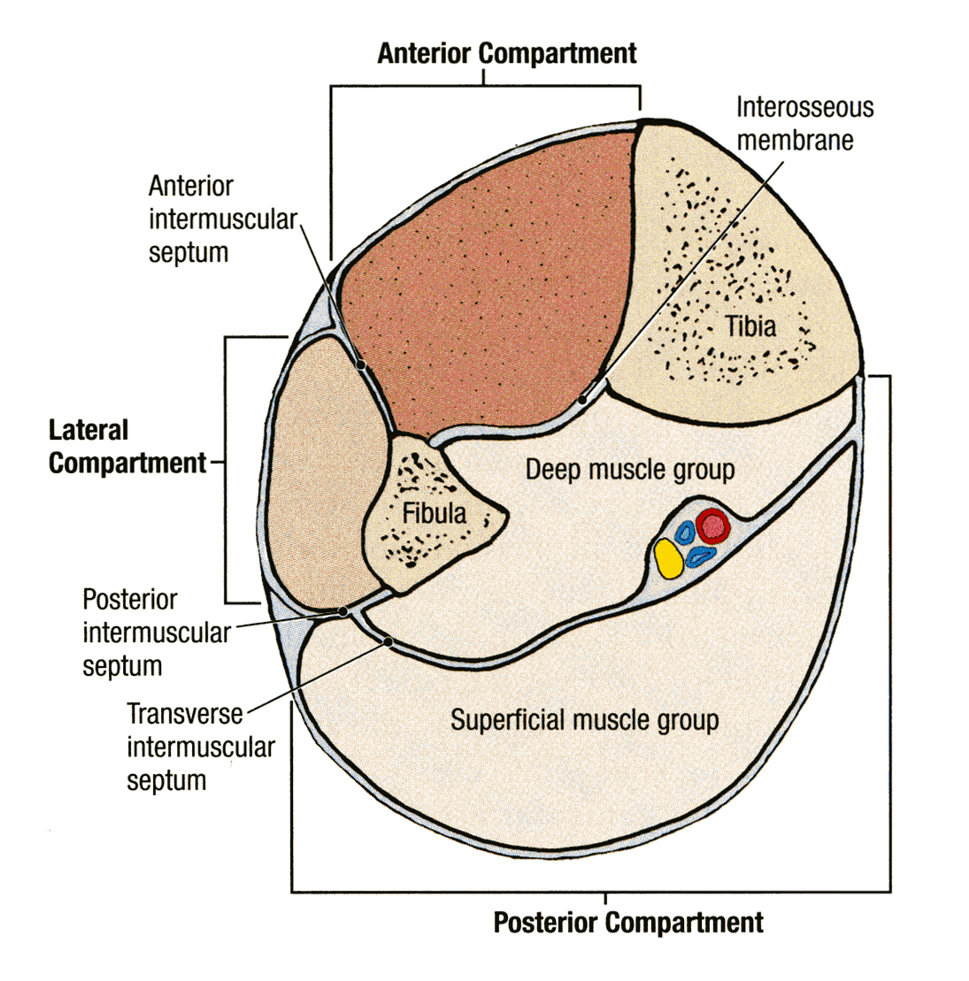
Fascia of the Leg
The deep fascia surrounds the leg and attached to Anterior & Medial borders of Tibia.
Two Intermuscular Septa
Pass from the deep aspect of this fascia to be attached to :
Anterior border of fibula (Anterior fascial septum)
Posterior border of fibula (Posterior fascial septum)
Interosseous membrane:
A thin & strong membrane, that binds the interosseous borders of tibia & fibula. It binds the two bones and provides attachment for muscles.

Slide 4
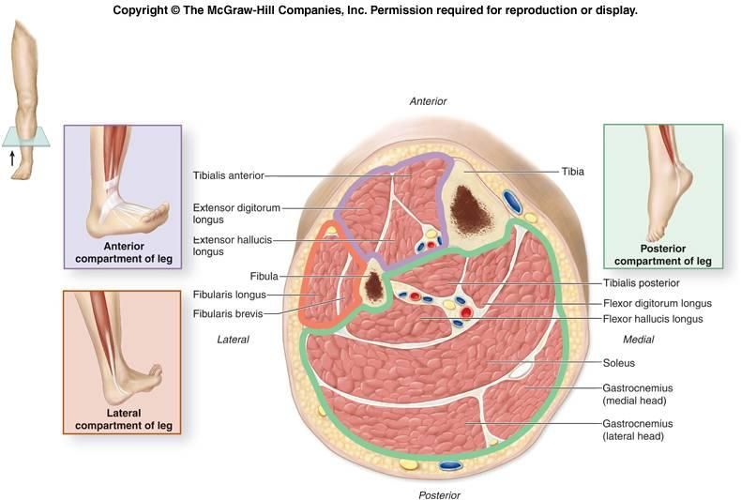
Fascial Compartments of Leg
Together with the interosseus membrane, the septa divide the leg into
(3) Compartments : Anterior
2-Lateral (peroneal)
3-Posterior
Each has its own Muscles, Blood and Nerve supply and its specific action.

Slide 5
Anterior Compartment
MUSCLES | BLOOD SUPPLY | NERVE SUPPLY
TIBIALIS ANTERIOR | ANTERIOR TIBIAL | DEEP PERONEAL
Extensor DigitorumI Longus
PERONEUS TERTIUS
Extensor Hallucius LONGUS

Slide 6
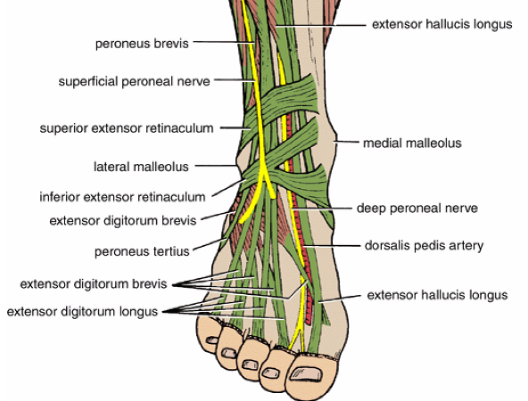
Extensor Retinacula
A thickening of deep fascia that keeps the long tendons around ankle joint in position
Superior Extensor retinaculum :
Attached to anterior borders of tibia & fibula above ankle
Inferior Extensor retinaculum:
Y-shaped band located inferior to ankle

Slide 7
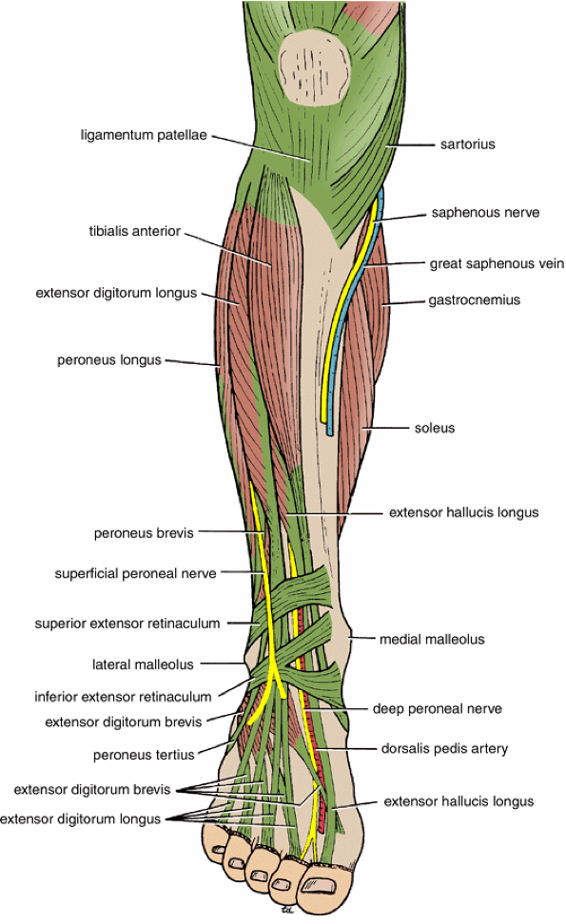
Structures Passing Deep to Extensor Retinacula
From medial to lateral:
1.Tom: Tibialis Anterior
2.Has: Extensor hallucis longus tendon
3.Very: Anterior tibial artery
4.Nice: Deep peroneal nerve
5.Dog: Extensor digitorum longus tendons
6.& Pigion: Peroneus tertius
1
2
3
Anterior tibial artery
4
6
5

Slide 8
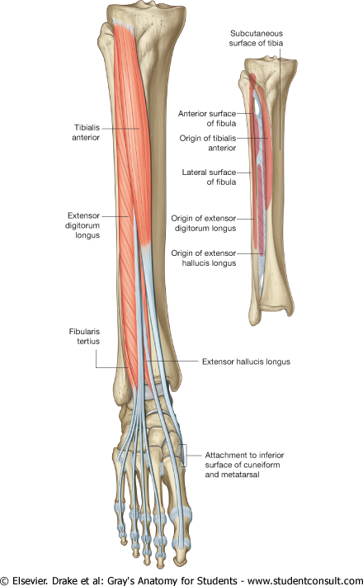
Tibialis Anterior & Extensor Digitorum Longus
Muscle | Origin | Insertion | Action
Tibialis anterior | Lateral surface of shaft of tibia and interosseous membrane | Medial cuneiform and base of first metatarsal bone | Extends foot at ankle joint; Inverts foot at subtalar & transverse tarsal joints & Holds up medial longitudinal arch of foot
Extensor digitorum longus | Anterior surface of shaft of fibula | Extensor expansion of lateral four toes | Extends toes; Extends foot at ankle joint

Slide 9
Peroneus Tertius, & Extensor Hallucis Longus
Muscle | Origin | Insertion | Action
Peroneus tertius | Anterior surface of shaft of fibula | Base of 5th metatarsal bone | Extends foot at ankle joint; Everts foot at subtalar and transverse tarsal joints
Extensor hallucis longus | Anterior surface of shaft of fibula | Base of distal phalanx of great toe | Extends big toe, Extends foot at ankle joint; Inverts foot at subtalar and transverse tarsal joints

Slide 10
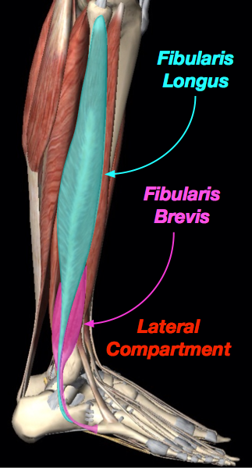
Lateral Compartment of Leg
MUSCLES | NERVE | BLODD SUPPLY
PERONEUS LONGUS | Superficial Peroneal | Peroneal A
PERONEUS BREVIS

Slide 11
Peroneus Longus
Origin Lateral surface of shaft of fibula | Insertion Base of first metatarsal and the medial cuneiform | Action Plantar flexes foot at ankle joint; Everts foot at subtalar and transverse tarsal joints; Supports Lateral longitudinal & Transverse arches

Slide 12
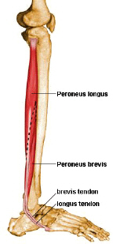
Peroneus Brevis
Origin Insertion Action
Lateral surface of shaft of fibula | Base of fifth metatarsal bone | Plantar flexes foot at ankle joint; Everts foot at subtalar and transverse tarsal joint; Supports Lateral longitudinal arch of foot

Slide 13
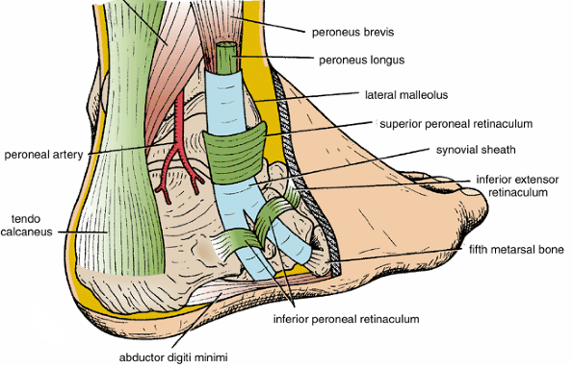
Peroneal Retinacula
Superior peroneal retinaculum
Connects the lateral malleolus to calcaneum & holds the tendons of peroneus longus & brevis
Inferior peroneal retinaculum
Synovial Sheaths of Peroneal Longus & Brevis:
Tendons of peronei are surrounded by a single common tubular synovial sheath,
deep to inferior peroneal retinaculum, they have separate sheaths

Slide 14
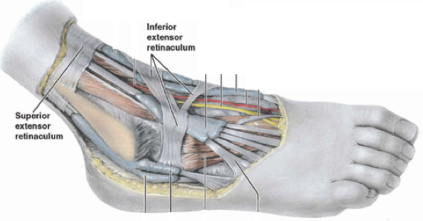
Deep Fascia of Dorsum of Foot
It is very thin, but just distal to ankle joint, it is
thickened to form Inferior extensor retinaculum

Slide 15
Dorsum of Foot
MUSCLE | BLODDD VESSEL | NERVE
Extensor Digitorum Brevis | Dorsalis Pedis | DEEP & Superficial Peroneal

Slide 16
Extensor Digitorum Brevis
Origin | Insertion | Action
Anterior part of upper surface of the Calcaneum and from the Inferior extensor retinaculum | By four tendons into the proximal phalanx of big toe and long extensor tendons to second, third, and fourth toes | Extend toes

Slide 17
Insertion of Long Extensor Tendons
The tendons of Extensor digitorum longus pass to the lateral four toes.
Each tendon to the 2nd , 3rd & 4th toes is joined on its lateral side by a tendon of Extensor digitorum brevis.
The extensor tendons form
a Fascial Expansion (Extensor Expansion) on the dorsum of each toe.
The expansion divides into (3) parts.
Central part: inserted into the Base of Middle ph.
Two Lateral parts: inserted into the Base of Distal ph.
The (Extensor Expansion) receives insertion of :
Interossei & Lumbrical muscles.

Slide 18
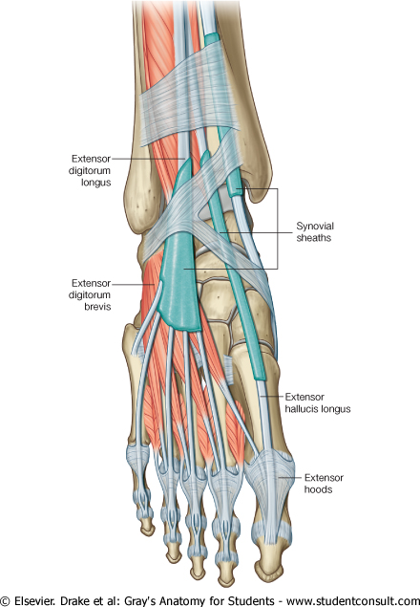
Synovial Sheaths of Extensor Tendons on the Dorsum of Foot
Tibialis anterior
Extensor hallucis longus
(Both have their own synovial sheath)
Extensor digitorum longus &
peroneus tertius : have a common sheath, it extends to the level of Base of 5th Metatarsal bone.

Slide 19
THANK YOU & BEST WISHES

