Slide 1
* KNEE JOINT * ANKLE JOINT * HIP JOINT
Prof. Ahmed Fathalla Ibrahim
Professor of Anatomy
College of Medicine
King Saud University
E-mail: ahmedfathala@hotmail.com

Slide 2
KNEE JOINT

Slide 3
OBJECTIVES
At the end of the lecture, students should be able to:
List the type & articular surfaces of knee joint.
Describe the capsule of knee joint, its extra- & intra-capsular ligaments.
List important bursae in relation to knee joint.
Describe movements of knee joint.
Apply Hilton’s law about nerve supply of joints.

Slide 4
KNEE JOINT

Slide 5
IDENTIFY

Slide 6
TYPES & ARTICULAR SURFACES
Knee joint is formed of:
Three bones.
Three articulations.
Femoro-tibial articulations: between the 2 femoral condyles & upper surfaces of the 2 tibial condyles (Type: synovial, modified hinge).
Femoro-patellar articulations: between posterior surface of patella & patellar surface of femur (Type: synovial, plane).

Slide 8
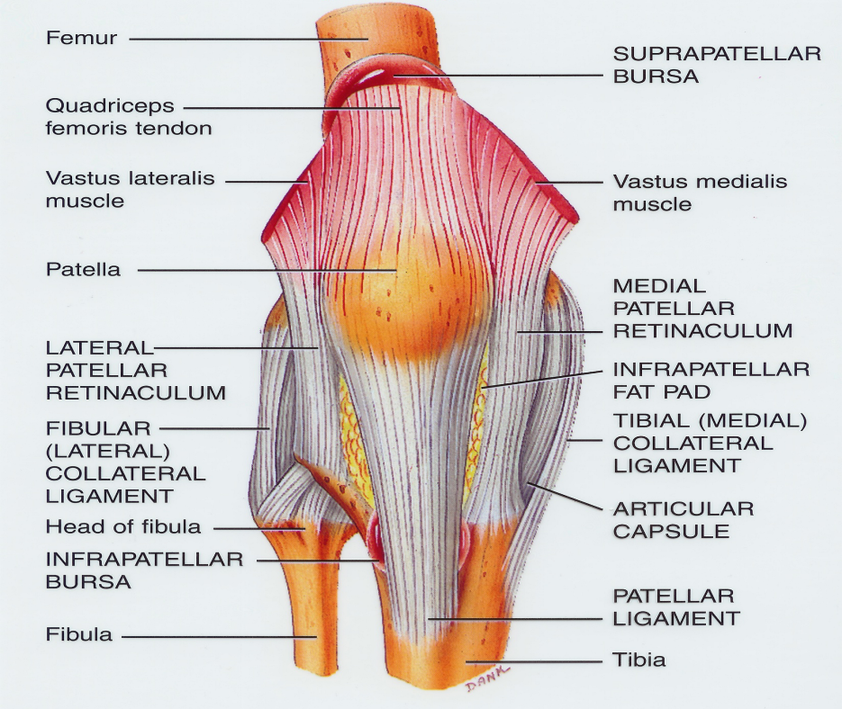
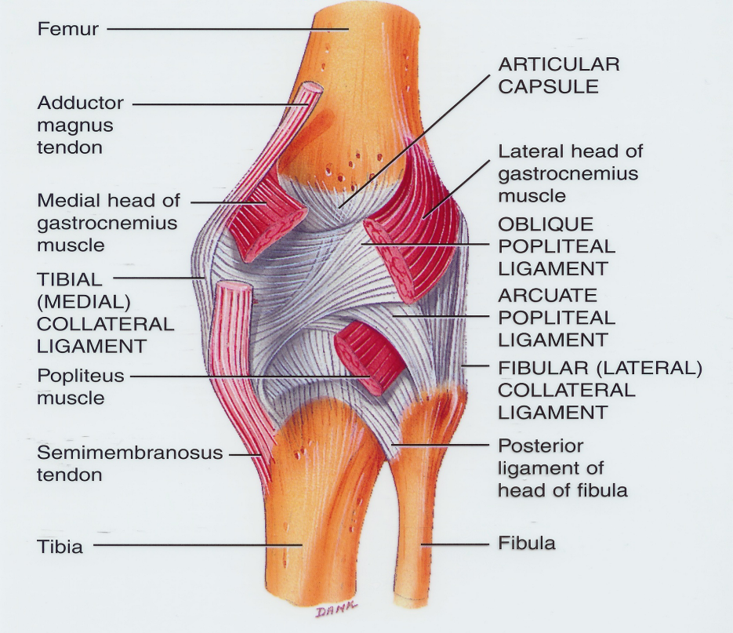
CAPSULE
Is deficient anteriorly & is replaced by: quadriceps femoris tendon, patella & ligamentum patellae.
Possesses 2 openings: one for popliteus tendon & one for communication with suprapatellar bursa.

Slide 9
EXTRA-CAPSULAR LIGAMENTS
Ligamentum patellae (patellar ligament): from patella to tibial tuberosity.
Medial (tibial) collateral ligament: from medial epicondyle of femur to upper part of medial surface of tibia (firmly attached to medial meniscus).
Lateral (fibular) collateral ligament: from lateral epicondyle of femur to head of fibula (separated from lateral meniscus by popliteus tendon).
Oblique popliteal ligament: extension of semimembranosus tendon.

Slide 12
INTRA-CAPSULAR LIGAMENTS
ATTACHMENTS:
Each meniscus is attached by anterior & posterior horns into upper surface of tibia.
The outer surface of medial meniscus is also attached to capsule & medial collateral ligament: medial meniscus is less mobile & more liable to be injured.
FUNCTIONS:
They deepen articular surfaces of tibial condyles.
They serve as cushions between tibia & femur.
MENISCI
They are 2 C-shaped plates of fibro-cartilage.
The medial meniscus is large & oval.
The lateral meniscus is small & circular.

Slide 13
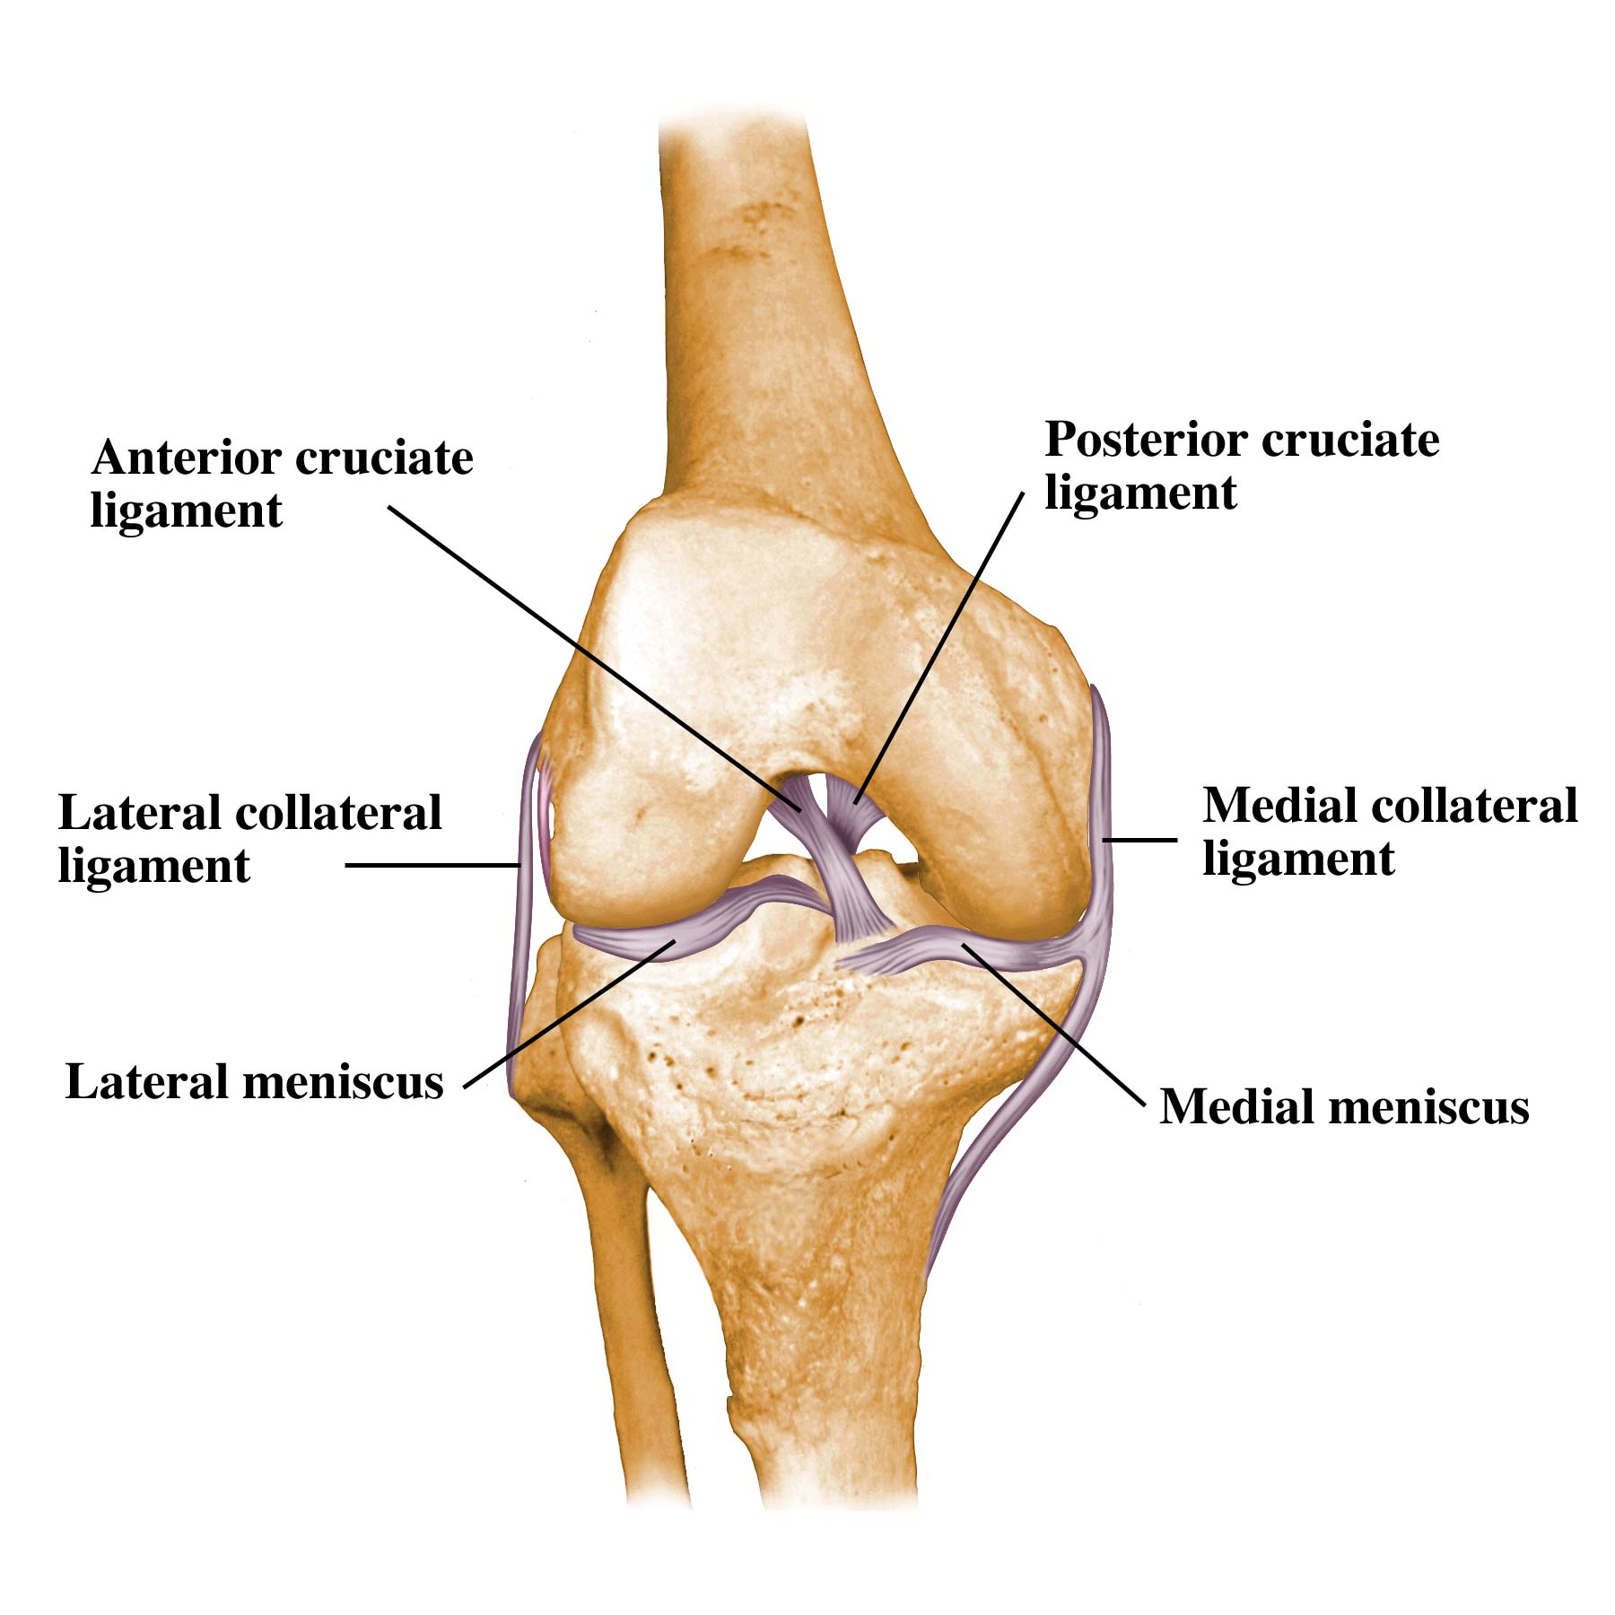
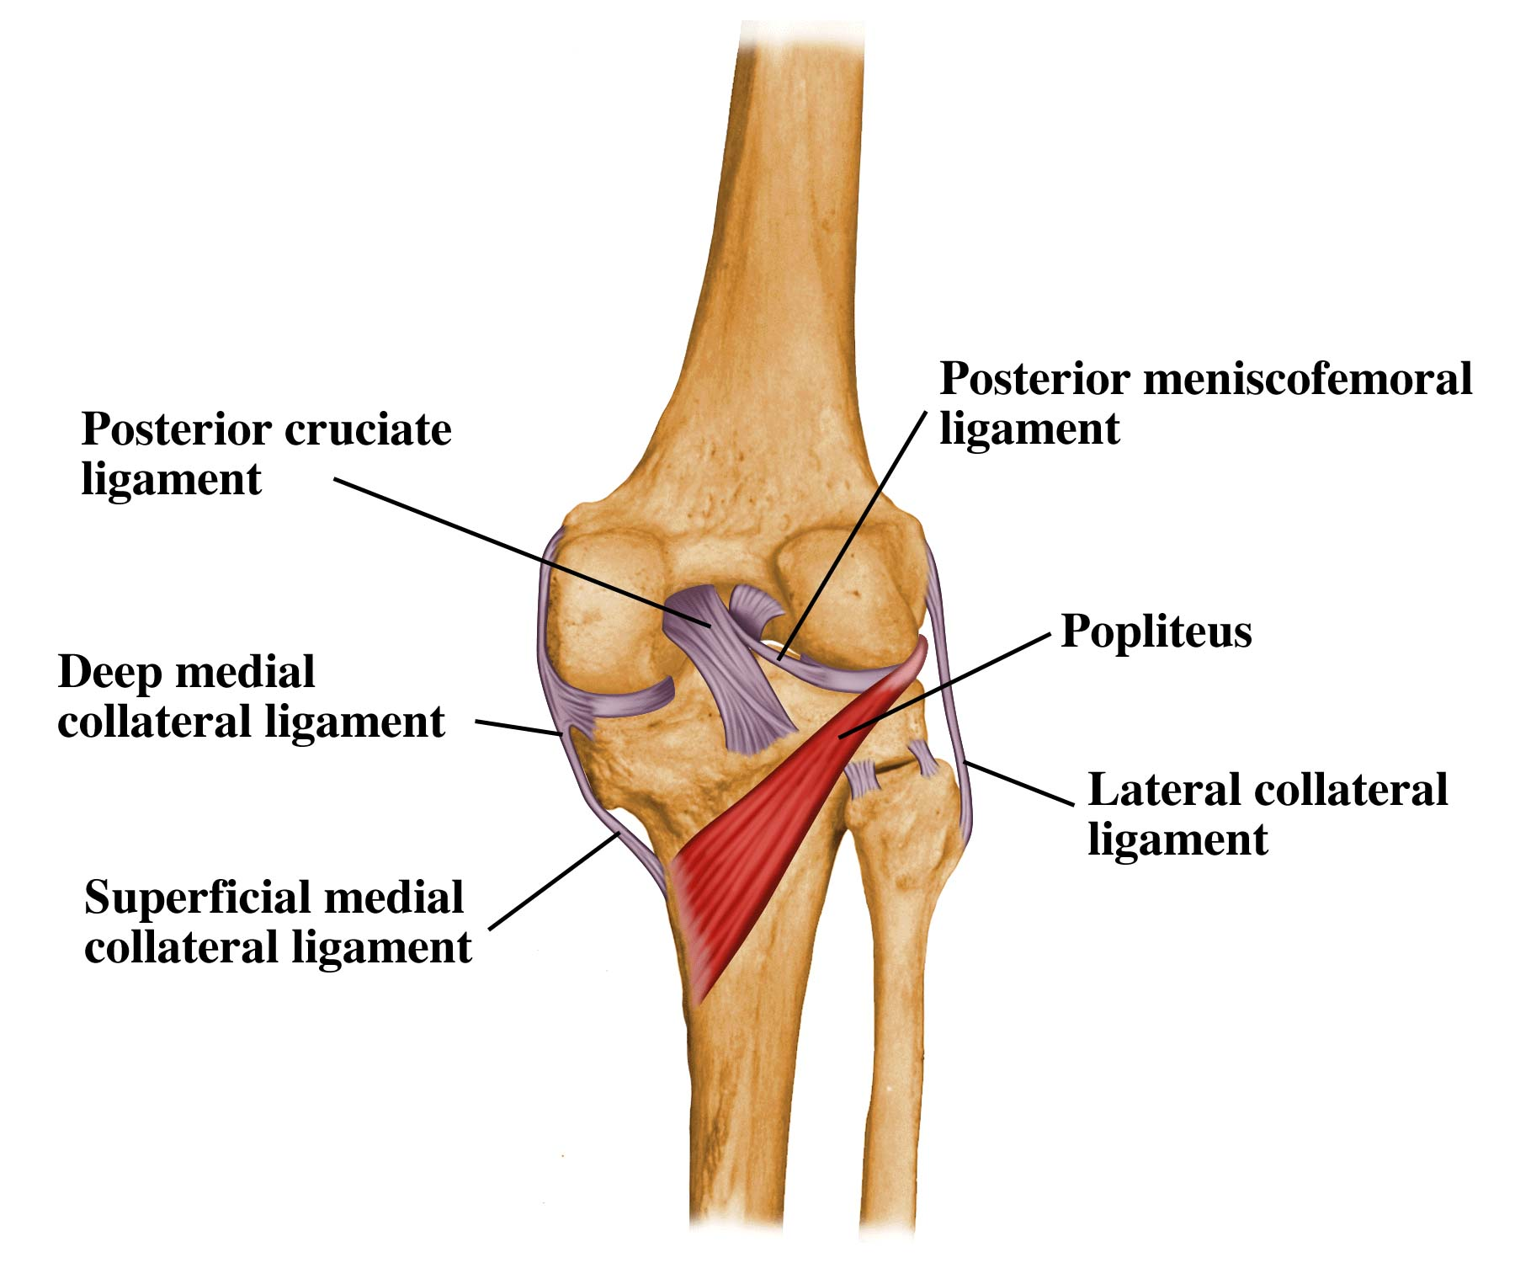
INTRA-CAPSULAR LIGAMENTS
ANTERIOR & POSTERIOR CRUCIATE LIGAMENTS
ATTACHMENTS:
Anterior cruciate: from anterior part of intercondylar area of tibia to posterior part of lateral condyle of femur.
Posterior cruciate: from posterior part of intercondylar area of tibia to anterior part of medial condyle of femur.
FUNCTIONS:
Anterior cruciate: prevents posterior displacement of femur on tibia.
Posterior cruciate: prevents anterior displacement of femur on tibia.

Slide 16
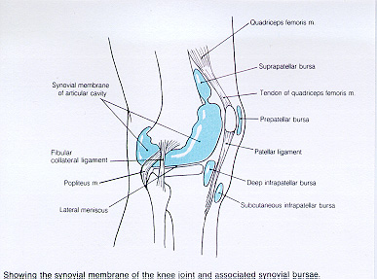
IMPORTANT BURSAE RELATED TO KNEE
Suprapatellar bursa: between femur & quadriceps tendon, communicates with
synovial membrane of knee joint (Clinical importance?)
Prepatellar bursa: between patella & skin.
Deep infrapatellar bursa: between tibia & ligamentum patella.
Subcutaneous infrapatellar bursa: between tibial tuberosity & skin.
Popliteal bursa (not shown): between popliteus tendon & capsule, communicates with synovial membrane of knee joint.

Slide 17
MOVEMENTS
FLEXION:
Mainly by hamstring muscles: biceps femoris , semitendinosus & semimembranosus.
Assisted by sartorius , gracilis & popliteus.
EXTENSION:
Quadriceps femoris.
ACTIVE ROTATION (PERFORMED WHEN KNEE IS FLEXED):
A) MEDIAL ROTATION:
Mainly by semitendinosus & semimembranosus.
Assisted by sartorius & gracilis.
B) LATERAL ROTATION:
Biceps femoris.

Slide 18
MOVEMENTS (cont’d)
INACTIVE (DEPENDANT) ROTATION:
A) LOCKING OF KNEE:
Lateral rotation of tibia, at the end of extension
Results mainly by tension of anterior cruciate ligament.
In locked knee, all ligaments become tight.
B) UNLOCKING OF KNEE:
Medial rotation of tibia, at the beginning of flexion.
Performed by popliteus to relax ligaments & allow easy flexion.

Slide 20
NERVE SUPPLY
REMEMBER HILTON’S LAW:
“The joint is supplied by branches from nerves supplying muscles acting on it”.

Slide 21
IDENTIFY

Slide 22
ANKLE JOINT

Slide 23
OBJECTIVES
At the end of the lecture, students should be able to:
List the type & articular surfaces of ankle joint.
Describe the ligaments of ankle joints.
Describe movements of ankle joint.

Slide 24
SKELETON OF FOOT

Slide 25
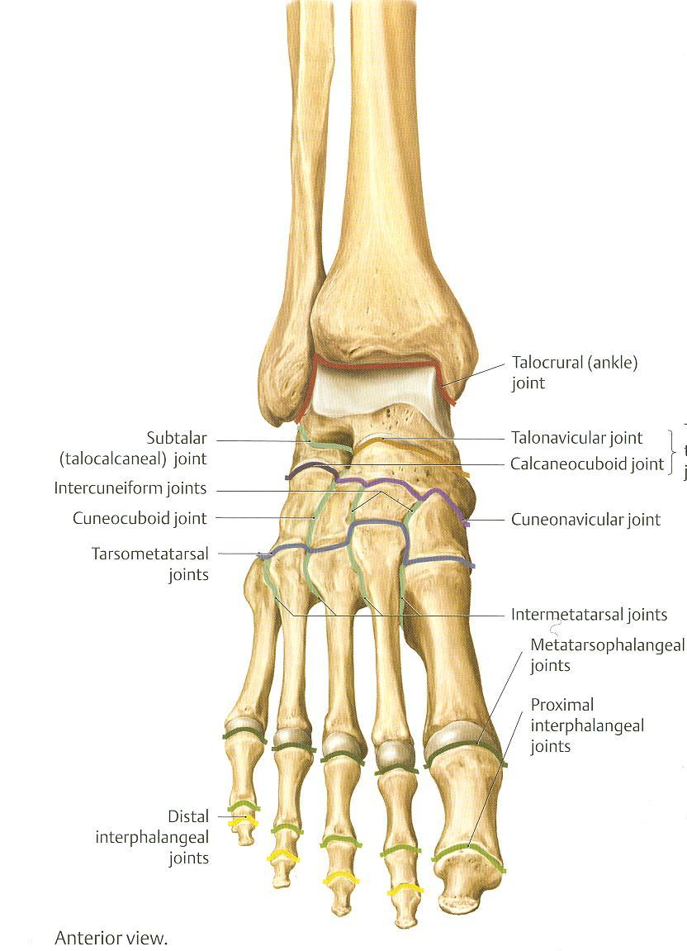
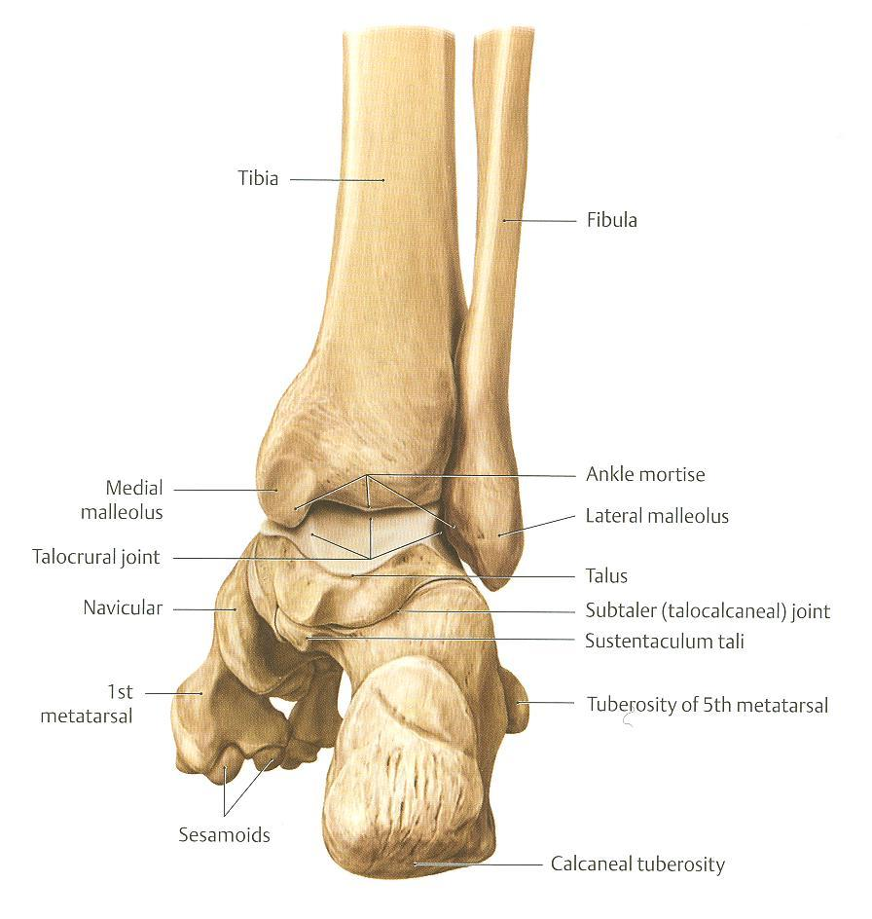
TYPES & ARTICULAR SURFACES
TYPE:
It is a synovial, hinge joint.
ARTICULAR SURFACES:
UPPER:
A socket formed by: the lower end of tibia, medial malleolus & lateral malleolus.
LOWER:
Body of talus.

Slide 26
LIGAMENTS
LATERAL LIGAMENT:
Composed of 3 separate ligaments (WHY?).
Anterior talofibular ligament.
Calcaneofibular ligament.
Posterior talofibular ligament.
MEDIAL (DELTOID) LIGAMENT:
A strong triangular ligament.
Apex: attached to medial malleolus.
Base: subdivided into 4 parts:
Anterior tibiotalar part.
Tibionavicular part.
Tibiocalcaneal part.
Posterior tibiotalar part.

Slide 27
MOVEMENTS
DORSIFLEXION:
Performed by muscles of anterior compartment of leg (tibialis anterior, extensor hallucis longus, extensor digitorum longus & peroneus tertius).
PLANTERFLEXION:
Initiated by soleus.
Maintained by gastrocnemius.
Assisted by other muscles in posterior compartment of leg (tibialis posterior, flexor digitorum longus & flexor hallucis longus) + muscles of lateral compartment of leg (peroneus longus & peroneus brevis).

Slide 28
N.B.
INVERSION & EVERSION MOVEMENTS occur at the talo-calcaneo-navicular joint.

Slide 29
HIP JOINT

Slide 30
OBJECTIVES
At the end of the lecture, students should be able to:
List the type & articular surfaces of hip joint.
Describe the ligaments of hip joints.
Describe movements of hip joint.

Slide 31
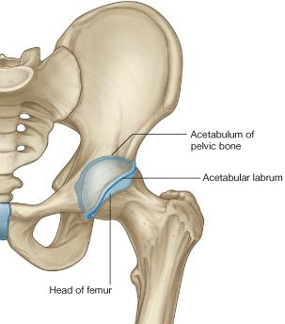
TYPES & ARTICULAR SURFACES
TYPE:
It is a synovial, ball & socket joint.
ARTICULAR SURFACES:
Acetabulum of hip (pelvic) bone
Head of femur

Slide 32
LIGAMENTS (3 Extracapsular)
Intertrochanteric line
Iliofemoral ligament: Y-shaped, anterior to joint, limits extension
Pubofemoral ligament: antero-inferior to joint, limits abduction & lateral rotation
Ischiofemoral ligament: posterior to joint, limits medial rotation

Slide 33
LIGAMENTS (3 Intracapsular)
Acetabular labrum: fibro-cartilaginous collar attached to margins of acetabulum
to increase its depth for better retaining of head of femur.
Transverse acetabular ligament: converts acetabular notch into foramen through
which pass acetabular vessels
Ligament of femoral head: carries vessels to head of femur

Slide 34
MOVEMENTS
FLEXION: Iliopsoas (mainly), sartorius, pectineus, rectus femoris.
EXTENSION: Hamstrings (mainly), gluteus maximus (powerful extensor).
ABDUCTION: Gluteus medius & minimus, sartorius.
ADDUCTION: Adductors, gracilis.
MEDIAL ROTATION: Gluteus medius & minimus.
LATERAL ROTATION: Gluteus maximus, quadratus femoris, piriformis, obturator externus & internus.

Slide 35
QUESTION 1
The muscle that extends the hip & flexes the knee joint is:
Gluteus maximus.
Quadriceps femoris.
Sartorius.
Semitendinosus.

Slide 36
QUESTION 2
The bursa that communicates with the synovial membrane of knee joint is:
Suprapatellar.
Prepatellar.
Subcutaneous infrapatellar.
Deep infrapatellar.

Slide 37
QUESTION 3
The muscle that dorsiflexes the ankle is:
Flexor digitorum longus.
Tibialis anterior.
Peroneus brevis.
Gastrocnemius.

Slide 38
THANK YOU

