Slide 1
Microbiology of Bone and Joint Infections
Musculoskeletal block
Prof. hanan habib & PROF A.M.KAMBAL
Department of pathology
ksu

Slide 2
Introduction
Bone & joint infections may exist separately or together.
Both are more common in infants and children.
Usually caused by blood borne spread ,but can result from local trauma or spread from contiguous soft tissue infection.
Often associated with foreign body at the primary wound site.
If not treated lead to devastating effect.

Slide 3
Acute Oesteomyelitis
Acute oesteomyelitis is acute infectious process of the bone and bone marrow .
How the pathogen can reach the bone ?
1- Hematogenous route
2- Contiguous soft tissue focus ( post operative infection, contaminated open fracture, soft tissue infection , puncture wounds)
3- In association with peripheral vascular disease (diabetes mellitus ,severe atherosclerosis, vasculitis)
Can have a short duration ( few days for hematogenously acquired infection) or may last several weeks to months( if secondary to contiguous focus of infection).

Slide 4
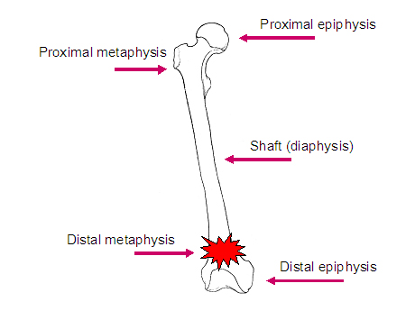
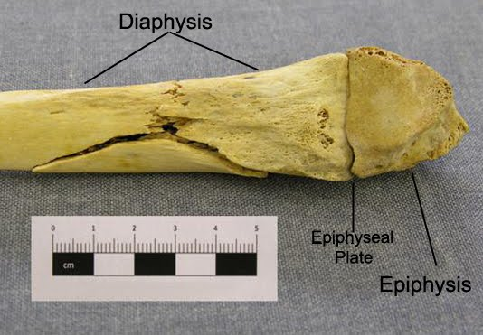

Slide 5
Etiology, Epidemiology & Risk Factors
Primary hematogenous is most common in infants & children.
Infants: S.aureus, group B streptococci, E.coli.
Children: S.aureus, group A streptococci, H.influenzae.
Site : Metaphysis of long bones ( femur, tibia, humerus)
Adults: Hematogenous cases less common, but may occur due to reactivation of a quiescent focus of infection from infancy or childhood. Most cases due to S.aureus.
Septic arthritis common as the infection begins in diaphysis.

Slide 6
continue-special clinical situations
Streptococci and anaerobes in fist injuries, diabetic foot and decubitus ulcers.
Salmonella or Streptococcus pneumoniae in sickle cell patients;
Mycobacterium tuberculosis ( MTB) or Mycobacterium avium in AIDS patients.

Slide 7
Diagnosis
Blood culture
Blood culture or aspiration of overlying abscess if blood cultures are negative.
Leukocytosis may or may not occur.
Erythrocyte sedimentation rate ( ESR) elevated or normal.
Imaging:
X-RAY, MRI, CT-SCAN

Slide 8
Treatment & Management
MSSA( methicillin sensitive S.aureus) : Cloxacillin, or Clindamycin .
MRSA( methicillin resistant S.aureus): Vancomycin followed by Clindamycin, Linezolid, or TMP-SMX.
Polymicrobial infection: Piperacillin-Tazobactam or Quinolone with Metronidazole.

Slide 9
Chronic Oesteomyelitis
A chronic infection of the bone and bone marrow usually secondary to inadequately treated or relapse of acute oesteomyelitis.
Management difficult , prognosis poor.
Infection may not completely cured.
May recur many years, decades, after initial episode.
Most infections are secondary to a contiguous focus or peripheral vascular disease.
chronic infection due to hematological spread is rare.
TB and fungal oesteomyelitis clinically have indolent “chronic” course.

Slide 10
S.aureus is the most common pathogen
Other microorganisms: S.epidermidis, Enterococci, streptococci, Enterobactericae, Pseudomonas, anaerobes.
Polymicrobial infection common with decubitus ulcers and diabetic foot infections.

Slide 11
Mycobacteria and fungi may be seen in immunosuppressed patients.
MTB oesteomyelitis primarily results from hemtogenous spread from lung foci or as an extension from a caseating lymph bone ( 50% in spine). It resembles Brucella oesteomyelitis .
TB & Brucella are common in KSA.
Hematogenous oesteomyelitis due to fungi eg. Candida spp., Aspergillus spp. and other fungi may occur.

Slide 12
Diagnosis
Blood culture not very helpful- because bacteremia is rare.
WBC normal, ESR elevated but not specific.
Radiologic changes complicated by the presence of bony abnormalities
MRI helpful for diagnosis and evaluation of extent of disease.

Slide 13
Treatment and Management
Extensive surgical debridement with antibiotic therapy. Parenteral antibiotics for 3-6 weeks followed by long term oral suppressive therapy.
Some patients may require life long antibiotic ,others for acute exacerbations.
MSSA: Cloxacillin
MRSA & S.epidermidis: Vancomycin then oral Clindamycin or TMP-SMX.
Other bacteria treat as acute oesteomyelitis.
MTB: 4 drugs : INH,RIF ,Pyrazinamide & Ethambutol for 2 months followed by RIF + INH for additional 4 months. Brucella is treated with tetracycline and rifampicin for 2 to 3 months.

Slide 14
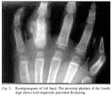
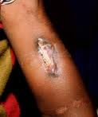
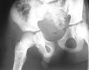
Blood culture & Bone images and cases

Slide 15
Arthritis
Infectious Arthritis is inflammation of the joint space secondary to infection.
Generally affects a single joint and result in suppurative inflammation.
Hematogenous seeding of joint is most common.
Pain, swelling, limitation of movement common symptoms
Diagnosis by Arthrocentesis to obtain synovial fluid for analysis.
Gram stain, culture & sensitivity
Drainage & antimicrobial therapy important management.

Slide 16
Etiology, Epidemiology& Risk factors
Gonococcal infection most common cause in young, sexually active adults caused by Neisseria gonorrheae . Leads to disseminated infection secondary to urethritis/cervicitis. Initially present with polyarthralgia, tenosynovitis, fever, skin lesions. If untreated leads to suppurative monoarthritis.
Nongonococcal arthritis occurs in older adults. Results from introduction of organisms into joint space as a results of bacteremia or fungemia from infection at other body sites.

Slide 17
Occasionally results from direct trauma, procedures (arthroscopy) or from contiguous soft tissue infection.
S.aureus is most common cause. Other organisms : streptococci and aerobic Gram negative bacilli.
Lyme disease in endemic areas. Uncommon in KSA.
In sickle cell disease patients and like oesteomyelitis it is caused by Salmonella species.
Chronic arthritis may be due to MTB or fungi.

Slide 18
Diagnosis of Infectious Arthritis
History/examination to exclude systemic illness. Note history of tick exposure in endemic areas
Arthrocentesis should be done as soon as possible; 1-Synovial fluid is cloudy and purulent
2- Leukocyte count generally > 50,000/mm3,with > 75 % PMN
3- Gram stain and culture are positive in >90% of cases
4-Exclude crystal deposition arthritis or noninfectious inflammatory arthritis.

Slide 19
Blood cultures indicated
If gonococcal infection suspected, take specimen from cervix, urethra, rectum & pharynx for culture or DNA testing for N.gonorrheae.
-
- Culture of joint fluid, skin lesions and blood culture also indicated.

Slide 20
Treatment & Management
Arthrocentesis with drainage of infected synovial fluid.
Repeated therapeutic arthrocentesis often needed
Ocassionally, arthroscopic or surgical drainage/debridement
Antimicrobial therapy should be directed at the suspected organism and susceptibility results:
Gonococcal arthritis: IV Ceftriaxone ( or Ciprofloxacin or Ofloxacin) then switch to oral Quinolone or Cefixime for 7-10 days.

Slide 21
Nongonococcal infectiuos arthritis:
MSSA: Cloxacillin or Cefazolin
MRSA: Vancomycin
Streptococci: Penicillin or Ceftriaxone or Cefazolin
Enterobacetriacae: Ceftriaxone or Fluroquinolone
Pesudomonas: Piperacillin and Aminoglycoside
Animal bite : Ampicillin-Sulbactam
Lyme disease arthritis: Doxycycline for 1 month.

Slide 22
Prognosis & Complications
Gonococcal arthritis has an excellent outcome
Nongonococcal arthritis: can result in scarring with limitation of movement, ambulation is affected in 50% of cases.
Risk factors for long –term adverse sequellae include:
Age, prior rheumatoid arthritis, polyarticular joint involvement, hip or shoulder involvement, virulent pathogens and delayed initiation or response to therapy.

Slide 23
Arthritis

Slide 24
Infections of Joint Prosthesis
Occurs in 1 - 5 % of total joint replacement.
Most infections occur within 5 years of joint replacement.
Often caused by skin flora.
Diagnostic aspiration of joint fluid necessary .
Result in significant morbidity and health care costs.
Successful outcomes results from multidisciplinary approach.

Slide 25
Diagnosis of Prosthetic Arthritis
Aspiration & surgical exploration to obtain specimen for culture & sensitivity testing & histopathology.
Skin flora regarded as pathogens if isolated from multiple deep tissue cultures.
Plain X-ray may not be helpful
Arthrography may help define sinus tracts
Bone scan-not specific for infection
ESR and C-reactive protein( CRP ) may be high.

Slide 26
Treatment & Management
Surgical debridement and prolonged antimicrobial therapy
Surgery: removal of prosthesis
Antibiotic –impregnated cement during re-implantation
Antimicrobial for 6 weeks:
Begin empiric IV antibiotic to cover MRSA and Gram negative rods ( Vancomycin+ Cefepime, Ciprofloxacin, or Aminoglycoside)
Chronic therapy with oral drug if removal of prosthesis not possible.

