Slide 1
Non-steroidal anti-inflammatory drugs

Slide 2
OBJECTIVES
At the end of the lecture the students should :
Define NSAIDs
Describe the classification of this group of drugs
Describe the general mechanism of actions
Define the following terms :
Analgesic
Antipyretics

Slide 3
Objectives ( continue)
Anti-inflammatory
Anti-platelet
Describe the general pharmacological actions
Describe the general therapeutic uses
Describe the general adverse effects
Describe the general contraindications
Know some examples of each group of NSAIDs
Know the difference between the selective & non-selective NSAIDs

Slide 4

MECHANISM OF ACTION OF NSAIDS

Slide 5
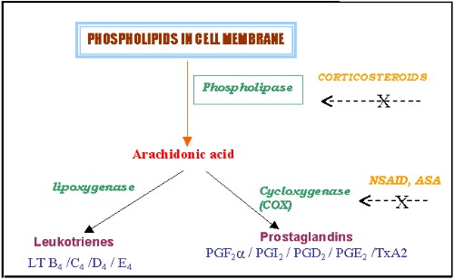

Slide 6
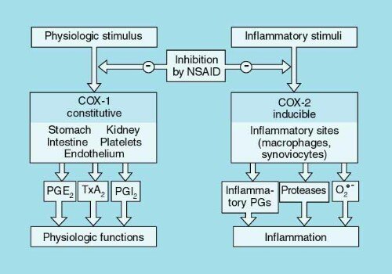
Cycl-oxygenase Isozymes

Slide 7
Classification of COX inhibitors
Nonselective
COX-1/COX-2
inhibitors
NSAIDs
  COX-2
  inhibitors
  Selective (coxibs)
  Preferential
COX-3
inhibitors
Antipyretic
analgesics
Paracetamol

Slide 8
Pharmacodynamic Effects

Slide 9
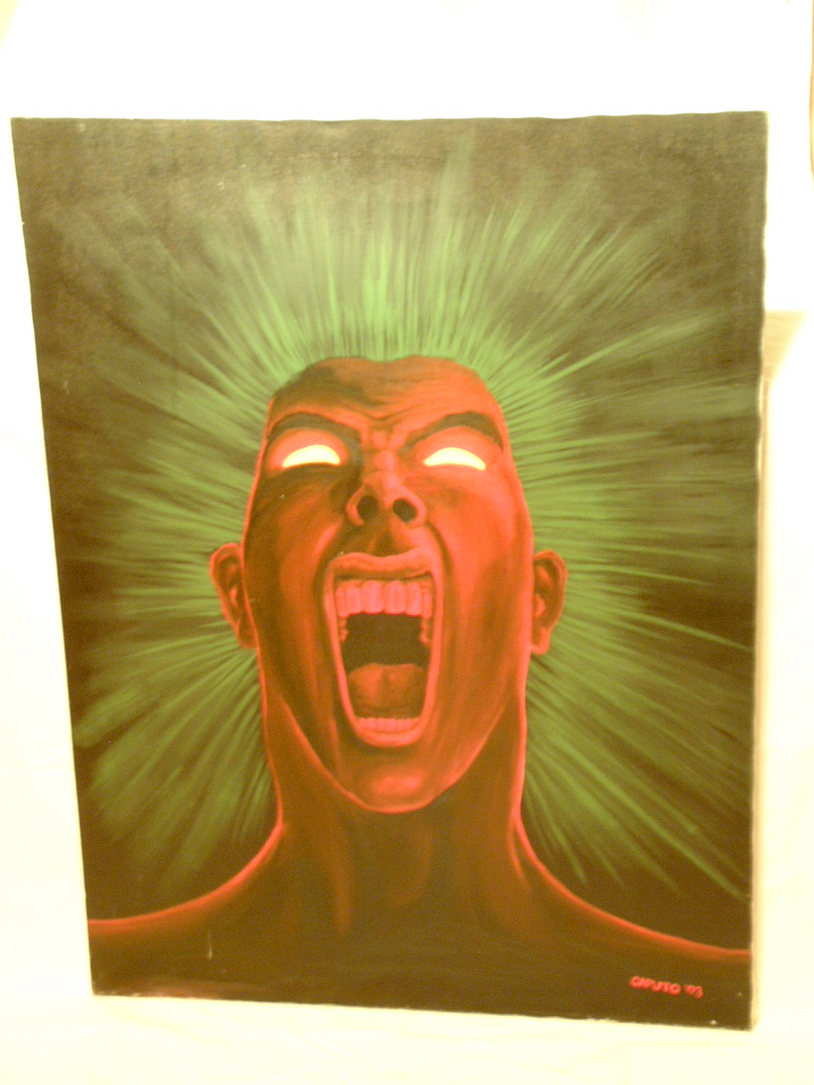
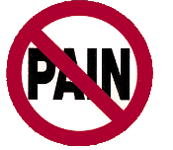
ANALGESIC
Drug that relieve pain.

Slide 10
ANTIPYRETIC
Drug that
lower the
elevated body temperature to normal.

Slide 11
Antiinflammatory
NSAIDs ↓ components
of the inflammatory
response → COX-2.
vasodilatation
oedema
pain

Slide 12
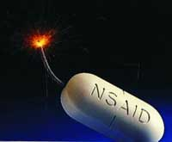
PharmacokineticS
Oral administration
Most metabolized in liver (oxidation & conjugation)
95% bound to plasma-protein (high bioavailability)
Most NSAIDs are weak acid (absorbed well in stomach and intestinal mucosa)

Slide 13
THERAPEUTIC USES SHARED BY NS-NSAIDs

Slide 14
Fever.
Analgesic (Type of pain?)
Headache, Migraine,
Dental pain
Common cold.

Slide 15
Continue
Rheumatic / Rheumatoid arthritis / myositis or other forms of inflammatory conditions.
Dysmenrrhea

Slide 16
SHARED ADVERSE EFFECTS
GIT upsets ( nausea, vomiting)
GIT bleeding & ulceration
Bleeding
Hypersensitivity reaction
Inhibition of uterine
contraction
Salt & water retention

Slide 17
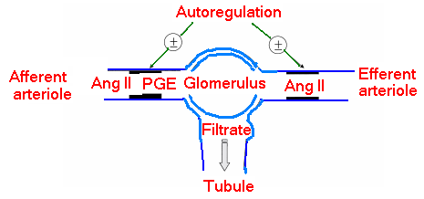

Adverse renal effects

Slide 18

Quiz?
Cyclooxygenase-1 and-2 are responsible for
(A) The synthesis of prostaglandins from arachidonate
(B) The synthesis of leukotrienes from arachidonate
(C) The conversion of ATP to cAMP
(D) The metabolic degradation of cAMP

Slide 19
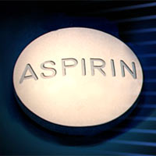
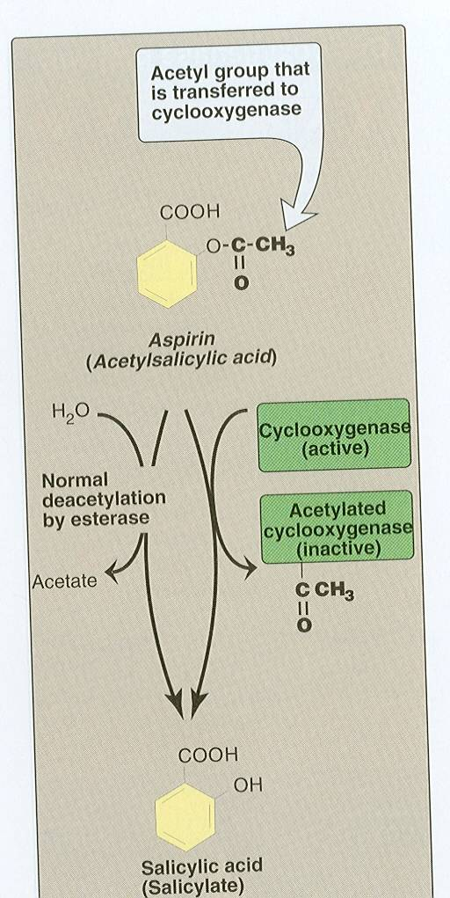
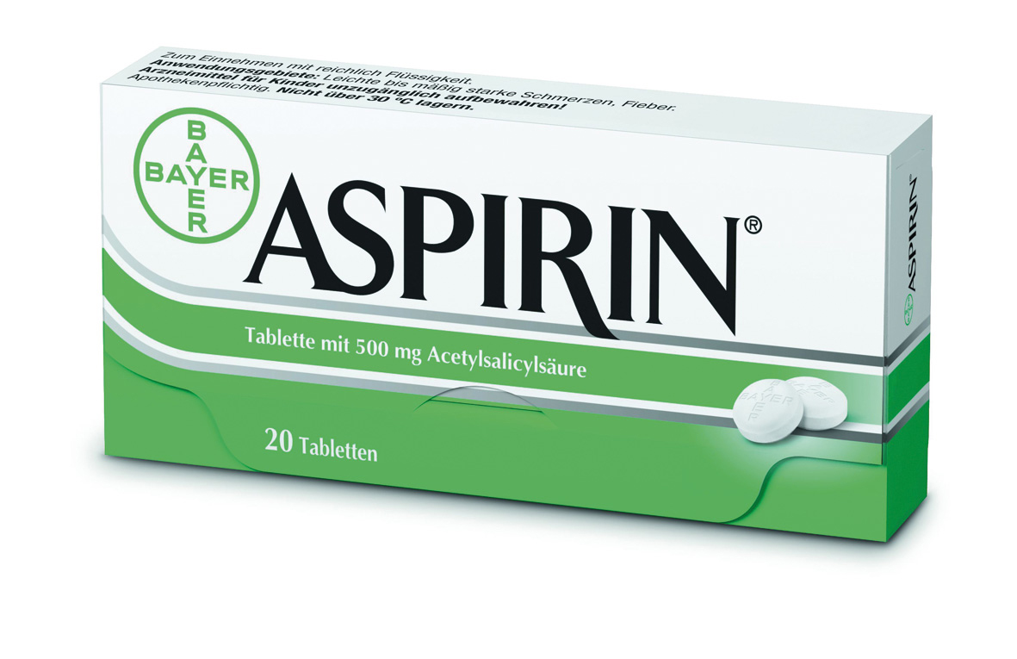

Slide 20
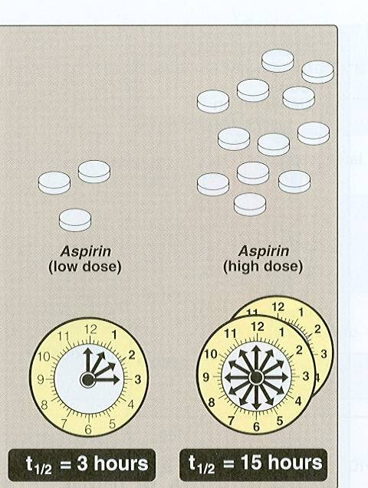
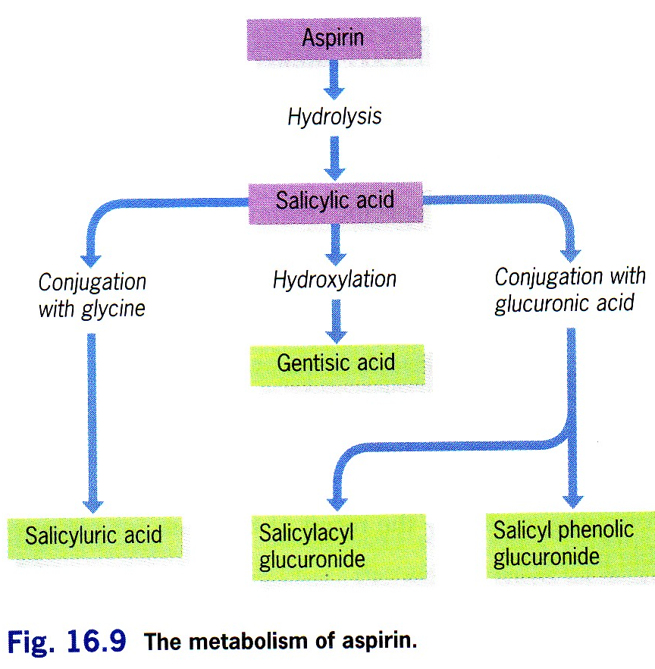
Pharmacokinetics

Slide 21
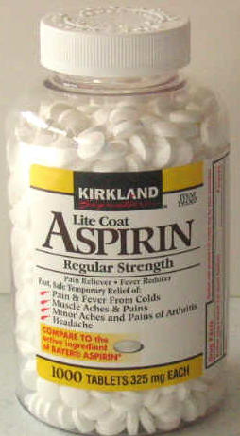
Clinical uses
Acute rheumatic fever
Reducing the risk of myocardial infarction ( cardioprotective)
Prevention of pre-eclampsia

Slide 22
CLINICAL USES ( continue)
Chronic gouty arthritis with
large doses
Chronic use of small doses , reduce the incidence of colon cancer

Slide 23
Adverse Effects Related to Therapeutic Doses Of Aspirin
Hypersensitivity
Acute Gouty arthritis
Reye's syndrome
Impaired
haemostasis

Slide 24
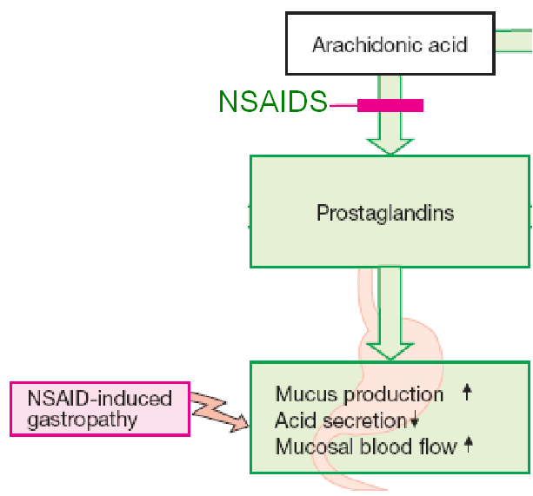
GIT side effects, dyspepsia, nausea,
vomiting, mucosal damage→ hemorrhage

Slide 25
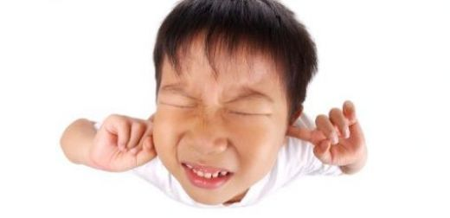
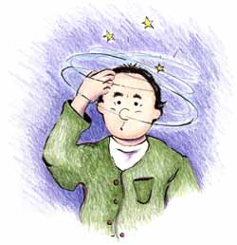
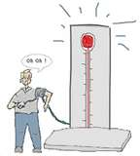
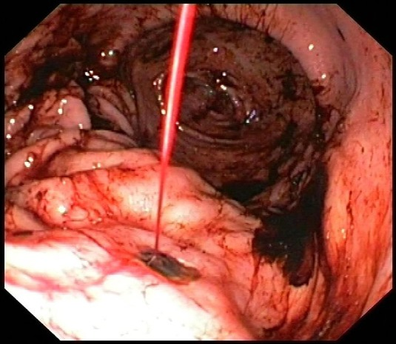
ADVERSE EFFECTS RELATED TO TO LARGE DOSES OF ASPIRIN
Salicylism ( ringing of ear ,
vertigo)
Hyperthermia
Gastric ulceration & bleeding

Slide 26
Contraindications
Peptic ulcer
Pregnancy
Hemophilic patients
Patients taking anticoagulants
Children with viral infections
Gout ( small doses )

Slide 27
Quiz?
The effects of aspirin do not include
(A) Reduction of fever
(B) Reduction of prostaglandin synthesis in inflamed tissues
(C) Impaired autoregulation of kidney function
(D) Reduction of bleeding tendency
(E) Tinnitus and vertigo

Slide 28

PARACETAMOL
Pharmacokinetics:-given orally , well absorbed, peak plasma concentration reached in 30-60min , variable proportion is bound to plasma protein
Drug is inactivated in the liver, conjugated with glucuronic & sulphuric acid ,t½=2-4h

Slide 29
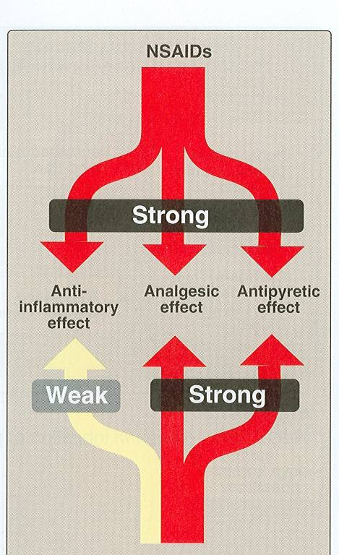

Slide 30
Commonly used analgesic antipyretic
instead of aspirin in cases of:-
Peptic or gastric ulcers.
Bleeding tendency.
Allergy to aspirin.
Viral infections in children .
Pregnancy.

Slide 31
Adverse Effects
Mainly on liver due to
its active metabolite
( N-acetyl-p-benzoquinone)
Therapeutic doses
elevate liver enzymes
Large doses cause
liver & kidney necrosis
Treatment Of toxicity of paracetamol by :
N- acetylcysteine to neutralize the toxic metabolite

Slide 32
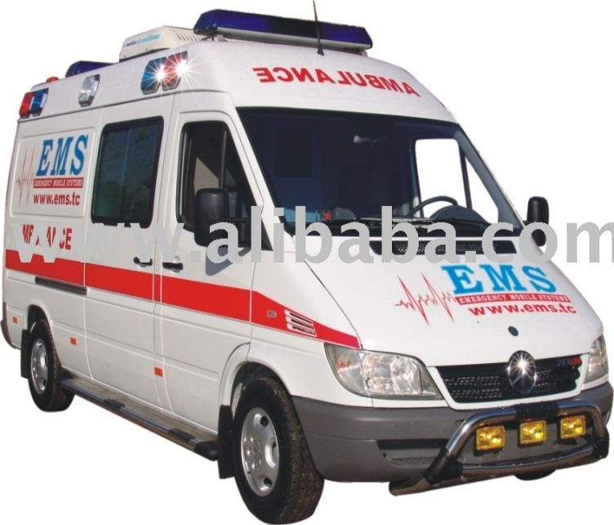
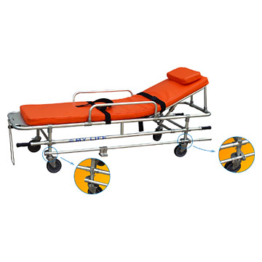
Case
A 25 –year-old male is seen in the emergency department. He is disoriented but he states that he has nausea ,vomiting ,abdominal pain and diarrhoea since he took “too many pain pills”. Before he can tell you more , he loses consciousness. Liver function test was as follows:-
Alanine aminotransferase 243 IU/L normal (5-40)
Aspartate aminotransferase 317 IU/l normal (10-40)
Notes:
<procedure, surgery> General term for abdominal surgery

Slide 33
Q1
The pain pills are most likely:-
Aspirin
Ibuprofen
Paracetamol
A combination of codeine and aspirin

Slide 34
Q2
What non specific measures could be taken:-
Emesis
Gastric lavage
Activated charcoal
Cathartic
Forced diuresis

Slide 35
Q3
The specific antidote is:-
Naloxone
Diphenoxylate
N-acetyle-L-cysteine
Neostigmine
pralidoxime

Slide 36
Non- selective NSAIDs
DICLOFENAC
Clinical uses
Anti-inflammatory
Analgesic
Antipyretic
Acute gouty arthritis
Locally to prevent post-opthalmic inflammation

Slide 37
Preparations of Diclofenac
Oral preparation
Oral preparation with misoprostol to decrease upper gastrointestinal ulceration
0.1% opthalmic preparation to decrease postoperative opthalmic inflammation.
A topical gel 3% .
Rectal suppository
Oral mouth wash.
Intramuscular preparations.

Slide 38
Selective COX-2 inhibitors
General advantages :
Potent anti-inflammatory
Antipyretic & analgesic
Lower incidence of gastric upset
No effect on platelet aggregation ( COX-1)

Slide 39
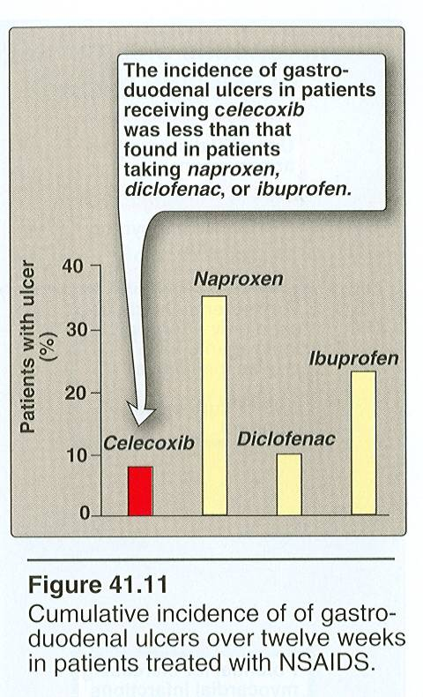

Slide 40
General adverse effects
Renal toxicity
Dyspepsia & heartburn
Allergy
Cardiovascular ( do not offer the cardioprotective effects of non-selective group).

Slide 41
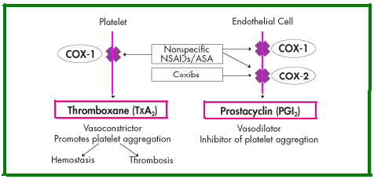

Slide 42
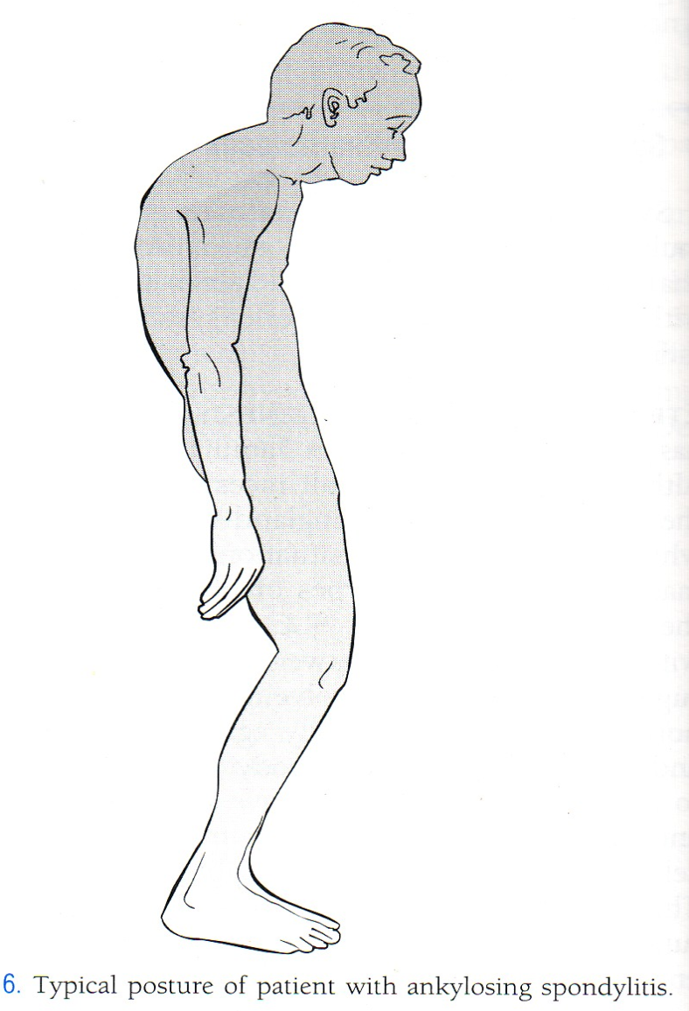
GENERAL CLINICAL USES
Short-term use in postoperative patients
Acute gouty arthritis
Acute musculoskeletal
pain
Ankylosing spondylitis

Slide 43
Quiz?
The primary objective for designing drugs that selectively inhibit COX-2 is to
(A) Decrease the risk of nephrotoxicity
(B) Improve anti-inflammatory effectiveness
(C) Lower the risk of gastrointestinal toxicity
(D) Reduce the cost of treatment of rheumatoid arthritis
(E) Selectively decrease thromboxane
A2 without effects on other
eicosanoids

Slide 44
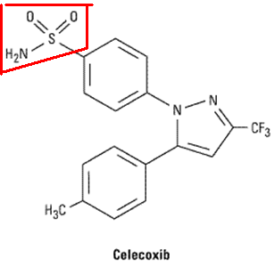
Celecoxib
Half-life 11 hours
Food decrease its absorption
Highly bound to plasma proteins

Slide 45
Summary
NSAIDs are group of drugs that have analgesic , antipyretic , anti-platelet & anti-inflammatory effects.
They are classified according to their action on COX-enzymes into non-selective that inhibit both COX-1 & COX-2 & selective that inhibit only COX-2 enzymes.
They are sharing in common therapeutic uses as analgesic to relief mild to moderate pain not visceral pain , reducing high body temperature, preventing clot formation , so aspirin can be used as prophylaxis in ischemic heart disease.

Slide 46
Summary ( Continue)
As anti-inflammatory in rheumatic , rheumatoid arthritis, desmenrrhea and other inflammatory conditions including muscles or bones.
The common adverse effects includes : gastric upset ( nausea, vomiting ,gastric ulceration or bleeding).
Allergy
Edema
They are contraindicated mainly in patients with peptic ulcer , bleeding tendency or in pregnancy .

Slide 47
Summary ( Continue)
Selective COX-2 inhibitors as celecoxib are potent anti-inflammatory & analgesic ,but have no anti-platelet effect & less gastric upset.
They can be used in patients with gastric ulcer , haemophilia .
Their common adverse is mainly on kidney & cardiovascular system.

Slide 48

Thank You

