Slide 1
Direct cholinomimetic (Parasympathomimetics) Drugs
Prof. Alhaider 1435 H
College of Medicine
Department of Pharmacology

Slide 2
By the end of this lecture the student should know
Classification of nervous system.
Describe the various steps in cholinergic transmission.
Mention the different types, locations and actions of cholinergic receptors.
Describe the effects of acetylcholine on major organs
Classify cholinomimetic drugs.
Describe the kinetics, actions and uses of direct acting cholinomimetic drugs.

Slide 3
Nervous system
Peripheral nervous
system
Central nervous
system
Efferent Division
Afferent Division
Autonomic nervous
system
Somatic
system
Enteric nervous system
Parasympathetic nervous system
Sympathetic nervous system

Slide 4
Why Acetylcholine is very important neurotransmitter?
See the Next Figure

Slide 5
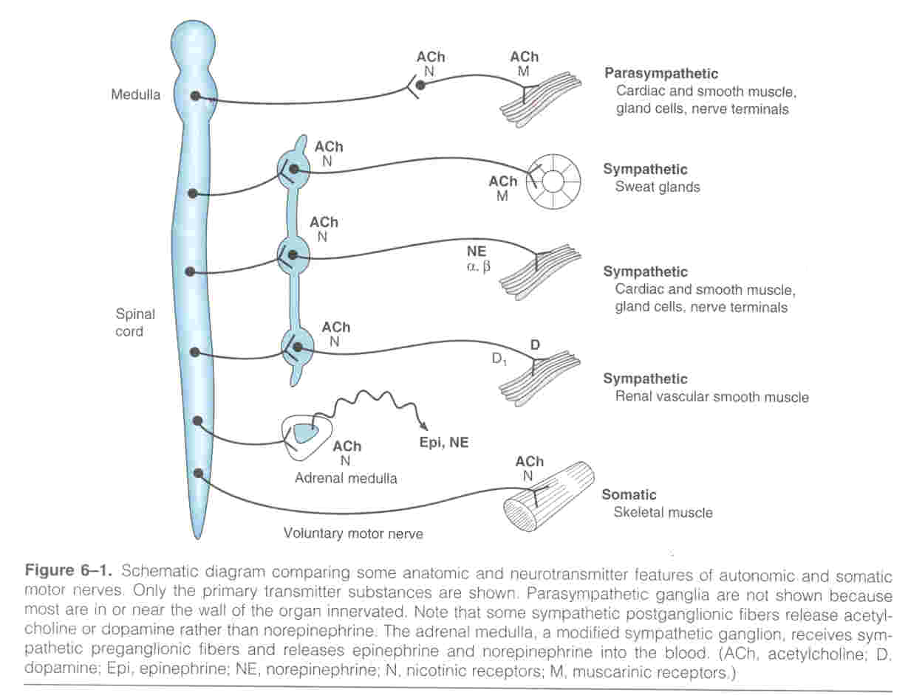

Slide 6
Parasympathetic Nervous System
(craniosacral outflow)

Slide 8
Biosynthesis and pathway of Acetylcholine
(Cholinergic Transmission)

Slide 9
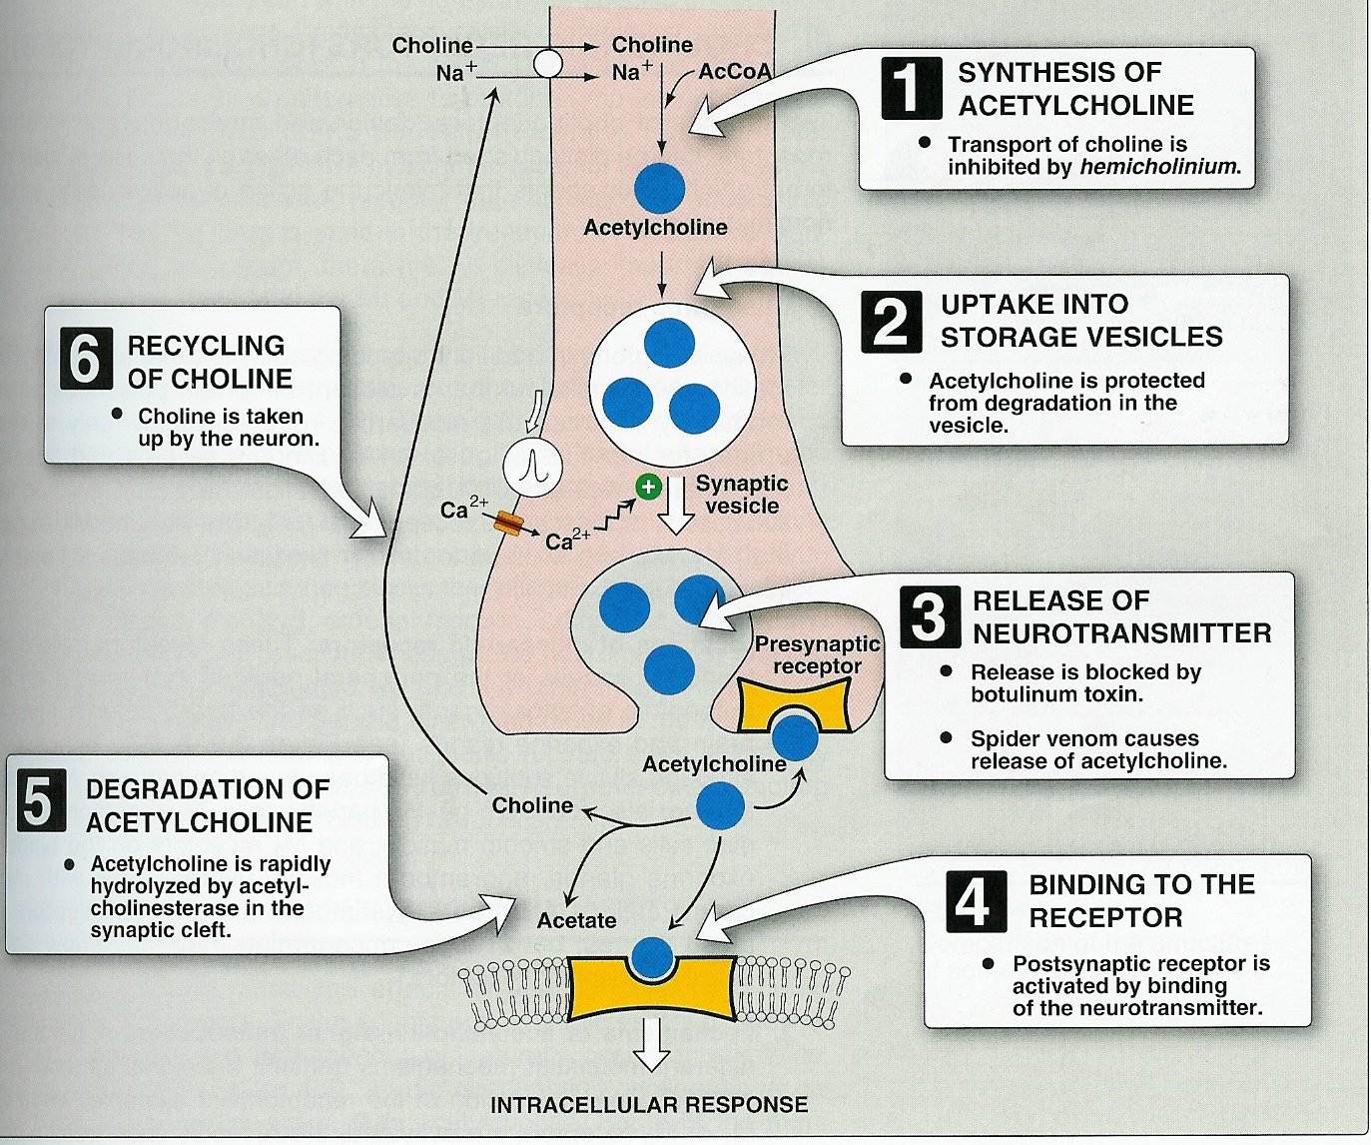
Cholinergic transmission

Slide 10
Cholinergic or parasympathetic receptors
Nicotinic (N, central) receptors.
Muscarinic (M, peripheral) receptors.
Central nicotinic receptor
Peripheral muscarinic receptor

Slide 11
Muscarinic receptors
Type II receptors : G-protein linked receptors
Located at all target organs that are innervated by parasympathetic fibers (e.g, heart, CVS, eye, bladder, etc).
Five subclasses exist (M1 - M5)
M1, M3, M5 are excitatory in function (stimulation).
M2, M4 are inhibitory in function (inhibition).

Slide 12
Pharmacological actions | Locations | Receptor
CNS excitation Gastric acid secretion Activation of phospholipase C ↑ IP3 &DAG → ↑ Ca | CNS Autonomic ganglia gastric parietal cells | M1 (Neural) Excitatory
Cardiac inhibition Presynaptic inhibition Inhibition of adenyl cyclase (↓ cAMP) Opening of K channels | Heart Presynaptic cholinergic fibers | M2 (Cardiac) Inhibitory
Secretion of glands Smooth muscle contraction Vasodilatation (via NO) Activation of phospholipase C ↑ IP3 & DAG. | Exocrine glands Smooth muscles Vascular endothelium | M3 Glandular Excitatory

Slide 13
Subtypes and characteristics of Cholinergic Receptors (Both the Muscarenic and Nicotinic)
Postrecptor mechanism | Structural features | Location | Other Name | Receptor type
IP₃,DAG cascade | 7 transmembrane segments,G protein linked | Nerves | M_{1a} | M₁
Inhibition of cAMP production, activation of K channels | 7 transmembrane segment,Gprotein-linked | Heart, nerves, smooth muscle | M_{2a},cardiac _{M2} | M₂
IP₃,DAG casaded→cytosolic calcium →↑released | 7 transmembrane segment ,G-protein linked | Glands,smooth muscle,endothelium | M_{2b} glandular M2 | M₃
Inhibition of cAMP producation | 7membrane segment Gprotein linked | ? CNS |  | m₄
IP3 ,DAG,cascade | 7membrane segment Gprotein linked | ? CNS |  | m₅¹
Na⁺,K⁺depolarizing ion channel | Pentamer(αβδγ)² | Skeletal muscle neuromuscular junction | Muscle type,end plate receptor | N_{M}
Na⁺,K⁺depolarizing ion channel | αandβsubunitss only as α₂β₂α₃β₃ | Postganglionic cell body,dendrites | Neuronal type , ganglion receptor | N_{N}

Slide 14
Muscarinic receptors Peripheral cholinoceptor | Nicotinic receptors Central cholinoceptor
G protein linked receptors | Ion channel linked receptors
On all peripheral organs that receive postganglionic parasympathetic fibers | Autonomic ganglia (sympathetic & parasympathetic) stimulation ( Nn )
Heart (M2) inhibition exocrine glands (M3) contraction | Adrenal medulla (Nn) release of catecholamines (Adrenaline & Noradrenaline)
Smooth muscles (GIT, urinary tract, bronchial muscles) (M3) contraction | Skeletal muscle (Neuromuscular junction) (Nm) Contraction
Excitatory or inhibitory | Almost excitatory

Slide 15
Nicotinic receptors
Type I receptors : ion channel linked receptors
1. Autonomic ganglia (Nn).
2. Adrenal medulla (Nn).
3. CNS (Nn)
3.Neuromuscular junction (Nm)

Slide 16
Based on the receptor type, Acetylcholine has two main effects:
1) Cholinergic (cholinomimetics) actions
2) Nicotinic Actions

Slide 17
Nicotinic Actions
Skeletal muscles:
Low conc.→ muscle contraction
High conc. → persistent depolarization & paralysis.
Ganglia: stimulation of sympathetic & parasympathetic ganglia.
Adrenal medulla release of catecholamines (A & NA).

Slide 18
Muscarinic actions
Cholinergic actions | Organs
Contraction of circular muscle of iris (miosis)(M3) Contraction of ciliary muscles for near vision (M3) | Eye
bradycardia ( heart rate ) (M2) Release of NO (EDRF) | Heart endothelium
Constriction of bronchial smooth muscles Increase bronchial secretion M3 | Lung
Increased peristalsis Increased secretion Contraction of sphincter M3 | GIT
Contraction of muscles Relaxation of sphincter M3 | Urinary bladder
Increase of sweat, saliva, lacrimal, bronchial, intestinal secretions M3 | Exocrine glands

Slide 20
Types of cholinomimetics (Parasympathomimetics)
Direct cholinomimetics
cause direct stimulation of cholinergic receptors.
Indirect cholinomimetics (anticholinesterases)
increase action of Ach indirectly by inhibiting acetylcholinesterase thus prevent the degradation of Ach (This will be the title of our lecture)

Slide 21
Features of Good Directly Acting Cholinergic Drugs
Since Ach is not specific and easily destroyed by Cholinesterase, thus it is very essential to obtain Cholinergic Drug that has low nicotinic activity, high muscarenic selectivity but with low susceptibility to cholinesterase. (See Figure)
Which drug that has such features?

Slide 22
Direct cholinomimetics
1) Cholinesters (Quaternary)
Acetylcholine (M,N)
Carbachol (M,N)
Bethanechol (M)
2) Natural Alkaliods (Tertiary)
Pilocarpine (M)
Direct Cholinomimetics

Slide 23
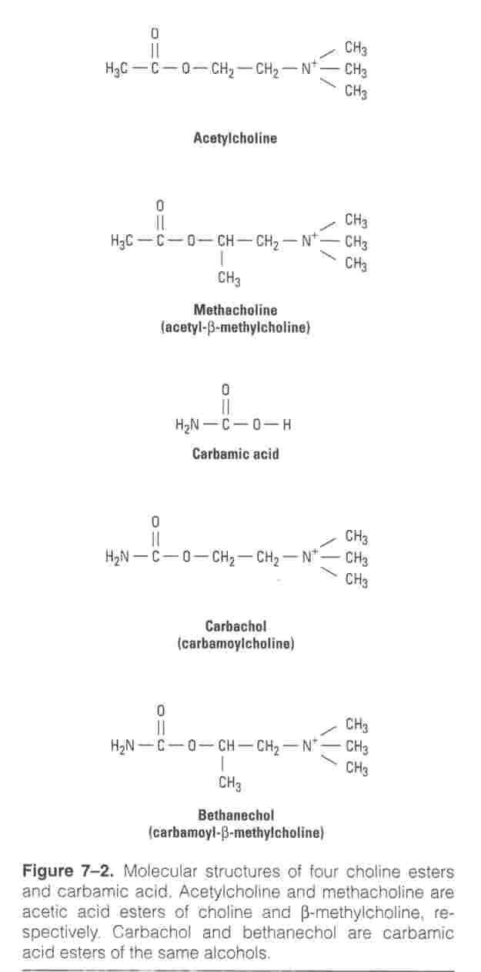

Slide 24
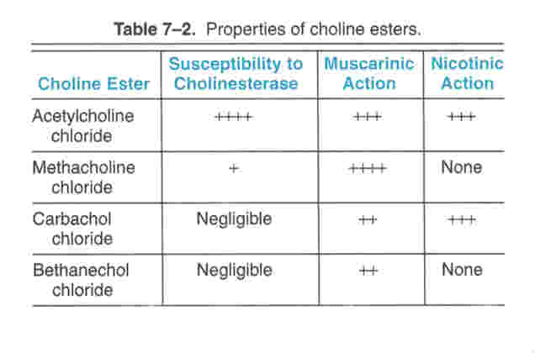

Slide 25
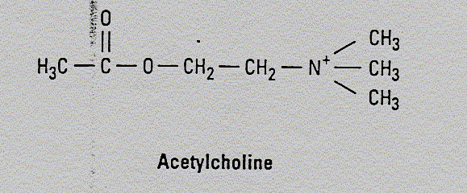
Acetylcholine (Ach)
Muscarinic and nicotinic agonist
Not used clinically because Ach
Is not selective (N, M)
Has short duration of action. Why?
Due to rapid metabolism by acetycholinesterase

Slide 26
Synthetic choline esters
include drugs as bethanechol, carbachol
Quaternary ammonium compounds (polar)
Poor distribution
can not cross BBB (No CNS effects)
Not metabolized by cholinesterase.
Have longer duration of action than Ach.
Never given I.V. or I.M BUT S.C.

Slide 28
Carbachol
Orally-S.C.
Not metabolized by cholinesterases.
Longer duration of action than Ach
Muscarinic actions on Eye, GIT, UT. (Table
Has nicotinic actions (what are these actions?).
Used for
Mainly in glaucoma
Urinary retention & paralytic ileus (rarely used due to its nicotinic actions)

Slide 29
Bethanechol
Orally-SC
Prominent muscarinic actions on GIT, UT.
No nicotinic action
Not metabolized by cholinesterases.
Longer duration of action than Ach
Used for
In paralytic ileus
In urinary retention (in cases of post-operative atony, neurogenic bladder)

Slide 30
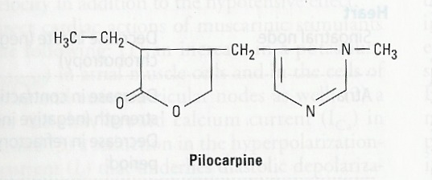
Pilocarpine
Natural alkaloids
Tertiary amine lipophilic
Pharmacokinetics
It is well absorbed
Good distribution
Cross BBB (has central effects).
Long duration of action
Direct muscarinic agonist
(mainly on eye & secretion).

Slide 31
Pilocarpine | Bethanechol | Carbachol | ACh
Tertiary non polar | Quaternary Polar | Quaternary Polar | Quaternary Polar | Chemistry
Complete | better absorbed than Ach | better absorbed than Ach | NOT | Absorption
NOT | NOT | NOT | metabolized by cholinesterase | Metabolism by cholinesterase
Longer (++) | Longer (++) | Longer (++) | Very short | Duration
oral, eye drops | Oral S.C. | Oral, eye drops S.C. | I.V. eye drops | Administ.

Slide 32
Pilocarpine | Bethanechol | Carbachol | ACh
Muscarinic | Muscarinic | Muscarinic Nicotinic | Muscarinic Nicotinic | Receptors
+++ | +++ | +++ | +++ | Muscarinic
More on eye, secretion | GIT, Urinary bladder | Eye, GIT Urinary bladder | NOT | Selectivity
NO | NO | +++ | +++ | Nicotinic
Glaucoma Xerostomia | Paralytic ileus Urinary retention | Glaucoma | NO | Uses

Slide 33
Bethanechol | Carbachol | Pilocarpine | ACh
Complete | Complete | Complete | NOT | Absorption
NOT hydrolyzed by cholinesterase | NOT hydrolyzed by cholinesterase | NOT hydrolyzed by cholinesterase | Hydrolyzed by cholinesterase | Metabolism
Longer (++) | Longer (++) | Longer (++) | Very short | Duration
Oral, S.C. | Oral, eye drops | oral, eye drops | I.V. | Administ.

Slide 34
Bethanechol | Carbachol | Pilocarpine | ACh
Muscarinic | Muscarinic Nicotinic | Muscarinic | Muscarinic Nicotinic | Receptors
+++ | +++ | +++ | +++ | Muscarinic
GIT, Urinary bladder | Eye, GIT Urinary bladder | More on eye, secretion | NOT | Selectivity
NO | +++ | NO | +++ | Nicotinic
Urinary retention Paralytic ileus | Glaucoma Urinary retention Paralytic ileus | Xerostomia Glaucoma | NO | Uses

Slide 35
Cevimeline
Direct acting muscarinic agonist at Glandular M3
Used orally for treatment of dry mouth symptom
associated with Sjogren's syndrome.

Slide 36
Contraindications of cholinomimetics
Bronchial asthma.
Peptic ulcer.
Angina pectoris
Intestinal obstruction
Incontinence

Slide 37
Practice for Home:
What are the the naturally occuring alkaloids (e.g: Pilocarpine and Oxotremorine and Muscarine) ?
What is mushrooms poisoning?
What are the differences between pilocarpine and bethanechol?.

