Slide 1
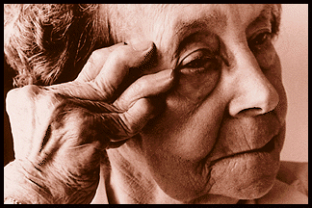
Disease –Modifying Antirheumatic drugs
( Slow Acting
Anti-inflammatory Drugs )

Slide 2
OBJECTIVES
At the end of the lecture the students should
Define DMARDs
Describe the classification of this group of drugs
Describe the general advantages & criteria of this group of drugs
Describe the general clinical uses

Slide 3
OBJECTIVES ( Continue)
Know some examples of drugs related to DMARDS.
Describe the mechanism of action , specific clinical uses , adverse effects &
contraindications of individual drugs.

Slide 4
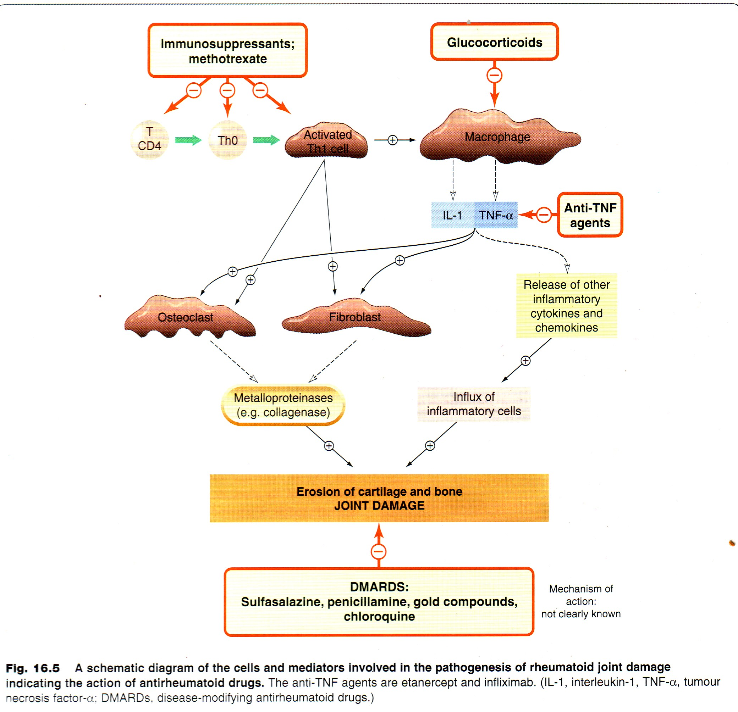

Slide 5
General Features
Low doses are commonly used early in the course of the disease
Used when the disease is progressing & causing deformities
Can not repair the existing damage , but prevent further deformity
Have no analgesic effects
Their effects take from 6 weeks up to 6 months to be evident

Slide 6
Q
What is false of rheumatoid arhritis disease modifying drugs?
(A) their beneficial effect is manifested only after 1-3 month of therapy
(B) are a chemically diverse class of agents
(C) slow progression of bone and cartilage destruction
(D) concurrent use of more than one disease modifying drug is not recommended
(E) they are slow acting compared with NSAIDs.
Ans:D

Slide 7
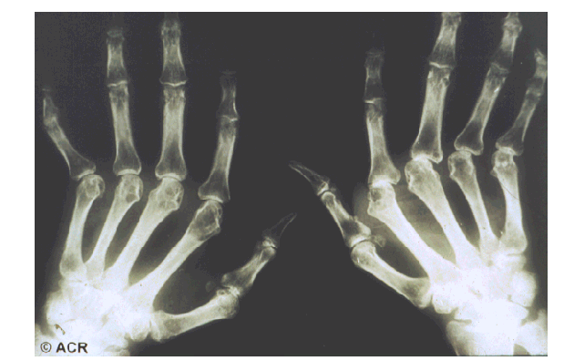
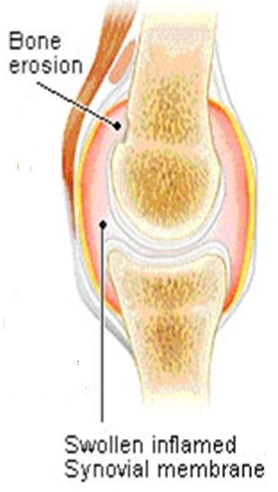
General Clinical Uses
Treatment of
rheumatoid
arthritis
Joint Destruction

Slide 8
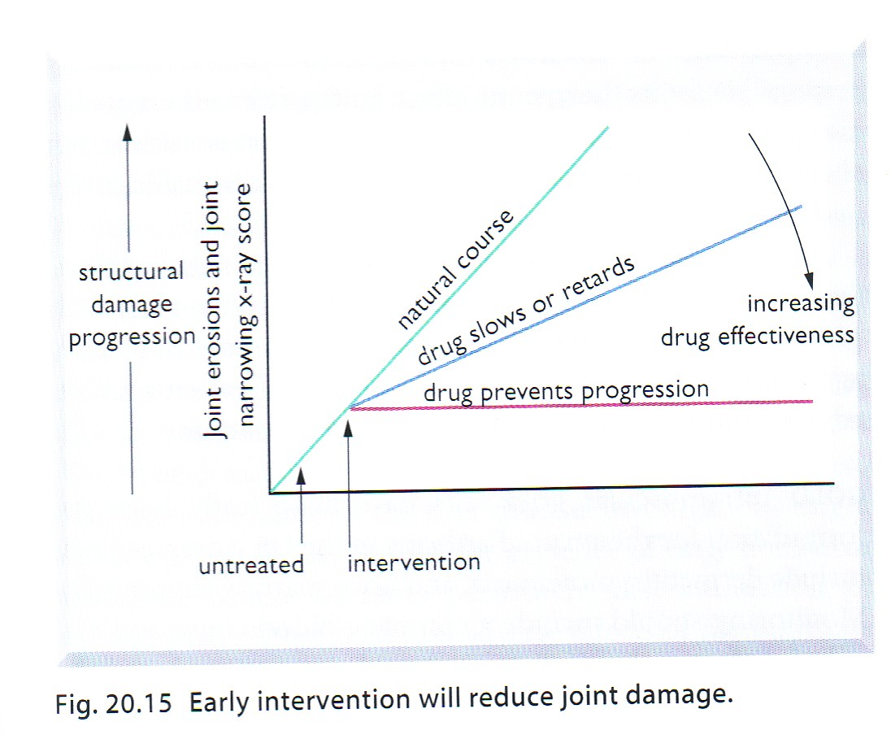

Slide 9

It’s like an Iceberg

Slide 10

It’s what you don’t see!

Slide 11


A Fire in the Joints
If there’s a fire in the kitchen do you wait until it spreads to the living room or do you try and put it out?

Slide 12
Hydroxychloroquine
Mechanism of action :
Stabilization of lysosomal enzyme activity
Trapping free radicals
Suppression of T lymphocyte cells

Slide 13
Nausea & vomiting
Irreversible retinal damage
ADVERSE EFFECTS
Corneal deposits

Slide 14
Q
Which of the following drugs is used for the treatment of severe chronic inflammatory disorders, with special precautions to guard against the development of irreversible retinopathy:
A. Methotrexate
B. Hydroxychloroquine
C. Infiximab
D. Celecoxib
Ans:B

Slide 15
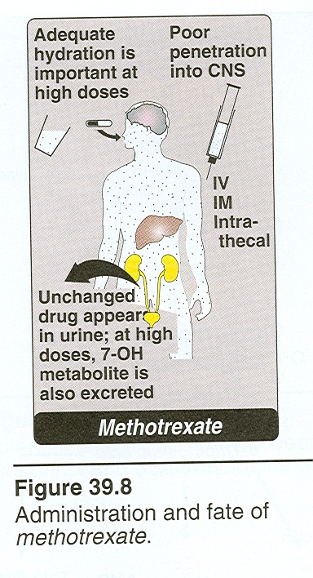
Methotrexate
Mechanism of action :
Inhibition of polymorphonuclear
chemotaxis
Inhibition of T-Cells
( cell-mediated immune reactions)

Slide 16
Bone marrow depression
Mucosal ulcers
ADVERSE EFFECTS
Hepatotoxic-ity

Slide 17
Q1
What is the likely mechanism of action of methotrexate in rheumatoid arthritis?
(A) Stabilization of lysosomes
(B) Neutralizing tumour necrotic factor α (C) Trapping of free radicals
(D) inhibition of polymorphnuclear chemotaxin
Ans:D

Slide 18
Biologic disease modifiers
Genetically engineered drugs that are used to modify imbalances of the immune system in autoimmune diseases.
Some of these agents block, or modify the activity of selected cells in the immune system, while others –including tocilizumab work by blocking certain messenger proteins known as cytokines , that send signals between those cells.

Slide 19
Classification of biologic disease modifiers
T-cell modulating drug ( abatacept )
B-cell cytotoxic agent ( rituximab )
Anti-IL-6 receptor antibody ( tocilizumab)
TNF- blocking agents ( infliximab)

Slide 20
Tocilizumab
IL-6 receptor inhibitor
Binds to membrane IL-6 receptors ,blocking the activity of IL-6 in mediating signals
Half-life is dose dependent
Dose is adjusted according to patient,s weight
Given as monthly IV
Used as monotherapy in adult with rheumatoid arthritis or in children over 2 years with systemic juvenile arthritis

Slide 21
Cont.
In combination with methotrexate or other non biologic anti-rheumatic drugs in patients with active rheumatoid arthritis not responding to TNF blockers or other biologic drugs

Slide 22
Side effects
Infusion reactions
Serious infections ( bacterial, tuberculosis ,fungal )
Increase in cholesterol level
Increase in liver enzymes
Decrease in WBCs
Blood tests will be used monthly for increase in cholesterol, liver enzymes & decrease in WBCs

Slide 23
Drug Interaction
IL-6 inhibits CYP450
Tocilizumab restore the activity of the enzyme ( essential for the metabolism of some drugs such as cyclosporine, warfarrin ).

Slide 24
Tumor necrosis factor –α( TNF-α) blocking agents
Infliximab
A chimeric antibody ( 25% mouse, 75% human)

Slide 25
Monoclonal Antibody directed against TNF-alpha: Infliximab (Remicade ®), Adalimumab (Humira®)
Soluble TNF-Receptors serve as a balance to TNF
Engineered Soluble TNF Receptor Etanercept (Enbrel®)
TNF
SIGNAL

Slide 26
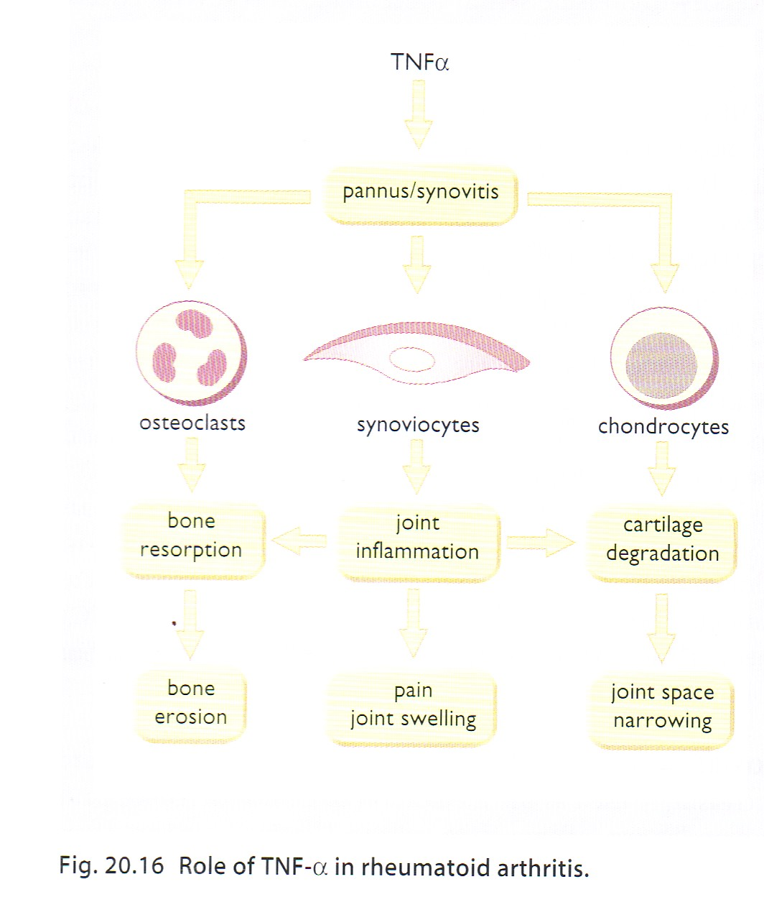
Notes:
Pannus:Vascularised granulation tissue rich in fibroblasts, lymphocytes and macrophages, derived from synovial tissue, overgrows the bearing surface of the joint in rheumatoid arthritis and is associated with the breakdown of the articular surface.

Slide 27
Role of Tumor Necrosis Factor in
Rheumatoid Arthritis
TNFα
bone resorption
joint
inflammation
cartilage
degradation
bone erosion
pain/joint
inflammation
joint space
narrowing

Slide 28
Mechanism of action
Binds to human TNF-α resulting in inhibition of macrophage & T cell function

Slide 29
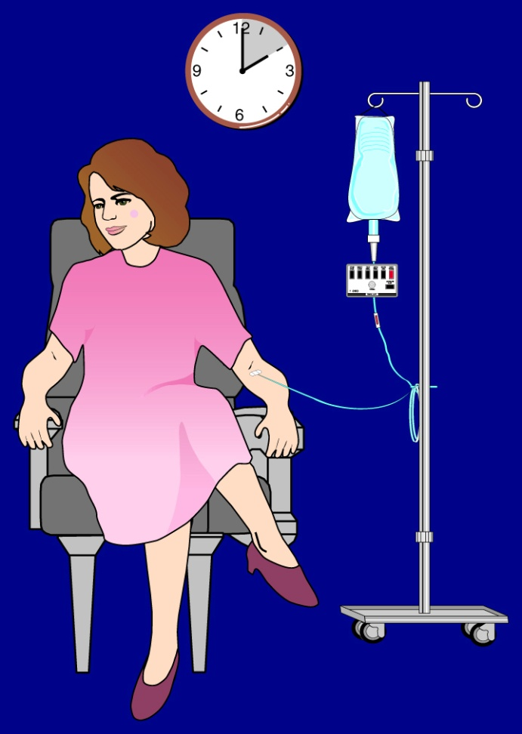
Infliximab ( continue)
Given by IV infusion
Half-life 8-12 days
Concurrent therapy with methotrexate decreases the prevalence of human antichimeric antibodies

Slide 30
Upper respiratory tract infections
Headache
Adverse effects
Cough
Activation of latent tuberculosis
Infusion site reaction

Slide 31
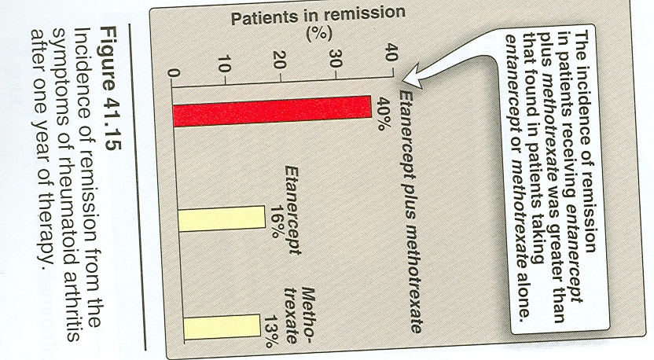

Slide 32

Quiz?
Infliximab produces its antirheumatic effects by direct
(A) Inhibition of cAMP phosphodiesterase in monocytic leukocytes
(B) Selective inhibition of COX-2
(C) Enhancement of leukotriene synthesis at the expense of prostaglandin synthesis
(D) Reduction of circulating active TNF-α levels
(E) Inhibition of the production of autoantibodies
Ans:d

Slide 33
Comparison between NSAIDs & DMARDs
DMARDs
NSAIDs
Slow onset of action
Arrest progression of the disease
Prevent formation of new deformity
Used in chronic cases when deformity is exciting
Rapid onset of action
No effect
Can not stop formation of new deformity
Used in acute cases to relief inflammation & pain

Slide 34

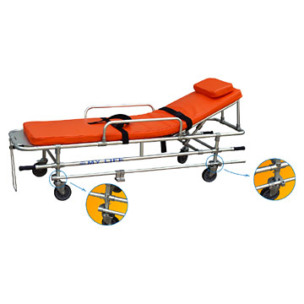
Case
A 54-year-old woman presented with signs and symptoms consistent with an early stage of rheumatoid arthritis. The decision was made to initiate NSAID therapy.
Notes:
<procedure, surgery> General term for abdominal surgery

Slide 35
Q1
Which of the following patient characteristics is a possible reason for the use of celecoxib in the treatment of her arthritis?
(A) A history of a severe rash after treatment with a sulfonamide antibiotic
(B) A history of gout (C) A history of peptic ulcer disease
(D) A history of sudden onset of bronchospasm after treatment with aspirin
(E) A history of type 2 diabetes
Ans: c

Slide 36

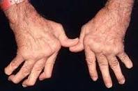
Case
Although the patient's disease was adequately controlled with an NSAID and methotrexate for some time, her symptoms began to worsen and radiologic studies of her hands indicated progressive destruction in the joints of several fingers. Treatment with a new second-line agent for rheumatoid arthritis was considered. This drug is available only in a parenteral formulation; its mechanism of anti-inflammatory action is antagonism of tumor necrosis factor.
Notes:
<procedure, surgery> General term for abdominal surgery

Slide 37
Q2
The drug being considered is:-
(A) hydroxychloroquine
(B) infliximab
(C) methotrexate
(D celecoxib
Ans:b

Slide 39
SUMMARY
DMARDs are used mainly in chronic cases of rheumatoid arthritis , when the disease is progresssing and forming deformity.
They do not remove the existing damage but prevent further formation of deformities.
They have no analgesic effect.

Slide 40
SUMMARY ( Continue)
They are slow in onset needs weeks to manifest their effects .
Hydroxychloroquine acts mainly through suppression of the activity of lysosomal enzymez and trapping free radicals .
Its main adverse effects is irreversible retinal damage & hepatic toxicity.

Slide 41
CONTINUE
Methotrexate acts mainly through suppression of phagocytic cells & T cells
Its adverse effects are bone marrow depression & mucosal ulceration
Infliximab is a chimeric TNF-α blocking agent.
Given with methotrexate to reduce antichimeric effect

Slide 42
CONTINUE
Its main adverse effects are upper respiratory tract infections & reactivation of latent TB,

Slide 43
CONTINUE
Methotrexate acts mainly through suppression of phagocytic cells &

