Slide 1
Physiology of Skeletal Muscle Contraction
Dr.Mohammed Alotaibi
MRes, PhD (Liverpool, England)
Department of Physiology
College of Medicine
King Saud University

Slide 2
Physiologic Anatomy of Skeletal Muscle
About 50% of the body are muscles: 40% is composed of skeletal and 10% is smooth and cardiac muscles.
Muscle RMP = -90 mV ( same as in nerves ) .
All skeletal muscles are composed of numerous fibers ranging from 10-80 μM in diameter.
Skeletal muscle can be hundreds of centimeters long & is covered by a cell-membrane called Sarcolemma.
The whole muscle is composed of fasciculi »»»»» muscle fiber »»»»» myofibril

Slide 3
Sarcoplasm
Matrix inside muscle fiber in which myofilaments suspended, it is filled with ICF and contains K, Mg, Phosphate, and proteins. Also present are large number of mitochondria to supply ATP.
Sarcoplasmic reticulum (SR)
Surrounding each myofibril is an extensive membrane-enclosed intracellular compartment called the SR, which plays a key role in activating muscle contraction
Transverse tubules (T-tubule)
The T-tubule membrane is continuous with the surface membrane.

Slide 4
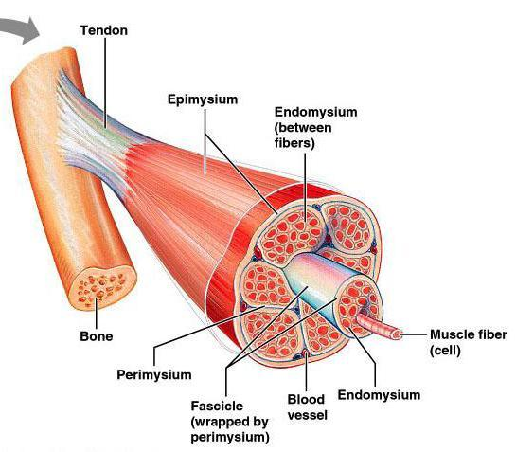
Physiologic Anatomy of Skeletal Muscle

Slide 5
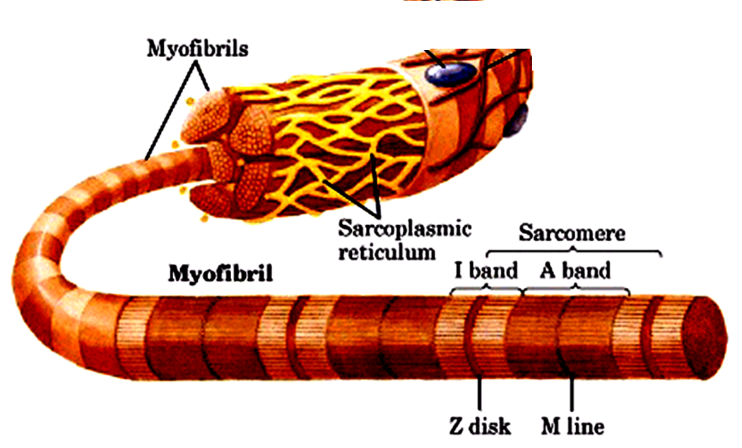
Each muscle fiber contains between several hundreds to several thousands Myofibrils, the myofibril is striated
Dark bands → (called A-bands)
Light bands → (called I-bands)
Each Myofibril is made of 3000 Actin filaments and 1500 Myosin filaments .

Slide 6
Each Myofibril contains Actin filaments (thin) & Myosin (thick) filaments which are partially interdigitated.
Each myofibril is striated: consisting of dark bands (called A-bands) and light band (I-bands).
Actin
Myosin

Slide 7
Sarcomere:
Contractile unit of muscle, it is the zone between two Z lines ( discs)= 2 micrometer in length in resting state.
Z discs (lines) = lines extend all the way across myofibrils
Inside each sarcomere there are 3 bands:
I band = of actin only
H band = of myosin only
A band = formed of actin & myosin filaments

Slide 8
Muscle Proteins
There are four important muscle proteins :
Two contractile proteins that slide upon each other during contraction :
Actin
Myosin
Two regulatory proteins :
Troponin → excitatory to contraction
Tropomyosin → inhibitory to contraction

Slide 9
Molecular Characteristics of Contractile Filaments
Myosin
Actin

Slide 10
Myosin (Thick Filament)
Each Myosin molecule has
(1) Head
( 2 ) Tail
(3) Hinge (joint )
Furthermore , each myosin head contains
(1) Actin binding site
(2) ATPase site .

Slide 11
- Actin is made of globular protein callled G-actin - G-actins are attached together to form F-actin strand ( chains ) - Each two strands wind together to form double helix called Actin Filament - Tropomyosin lies in the groove between the F-actin strands to cover the active sites on actin that bind the head of myosin - Troponin is attached to tropomyosin and to actin
Actin (Thin Filament)
G-actin
F-actin strand

Slide 12
MOLECULAR MECHANISM OF MUSCLE CONTRACTION

Slide 13
Sliding Filament Mechanism
When contraction takes place: Actin & Myosin slide upon each other & the distance between two Z-lines decreases. This is called Sliding Filament . Z-lines come closer to each other, I-band gets smaller , and eventually may disappear, A-band does not become smaller or bigger

Slide 14
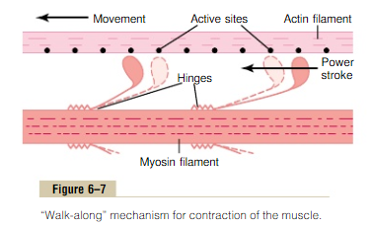
Walk-along Theory
Attachment of Myosin to Actin activates the enzyme ATPase in the Myosin Head → ATPase breaks down ATP releasing energy
This energy is used in the “Power Stroke ” to move the myosin head → leading to pulling & dragging of actin → sliding of actin on myosin
The “ power stroke ” means tilting of the Myosin cross-bridge and dragging ( pulling ) of actin filament

Slide 15
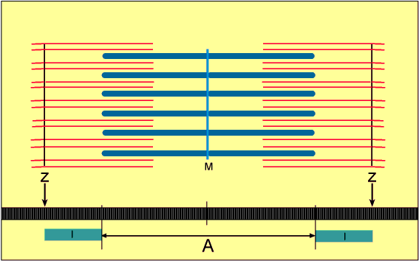
Sliding Filament Mechanism

Slide 16
Role of Calcium in turning on Cross bridges

Slide 17
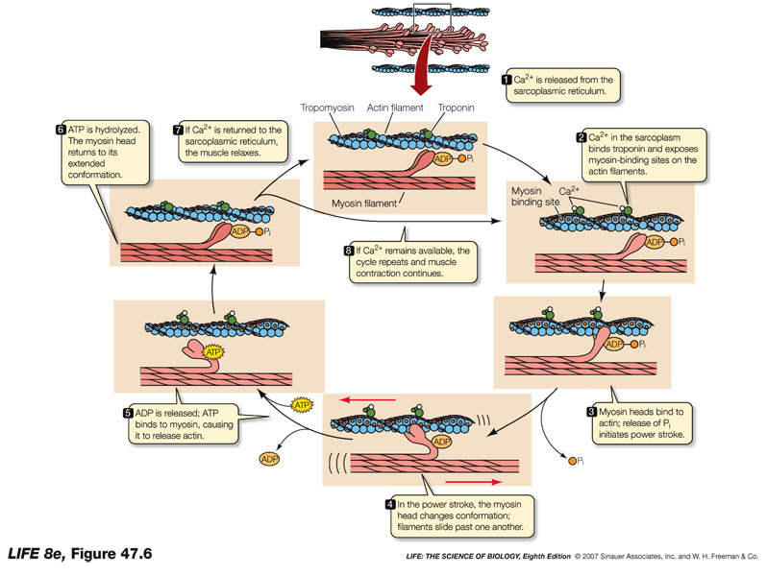

Slide 18
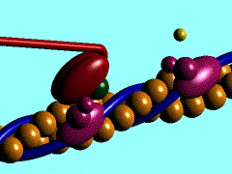

Slide 19
Excitation of Skeletal Muscle:
Neuromuscular Transmission and
Excitation –Contraction Coupling

Slide 20
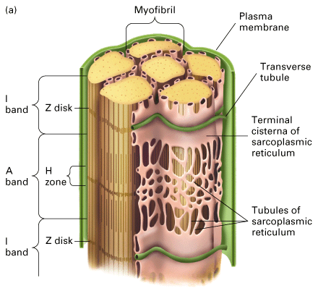

Slide 21
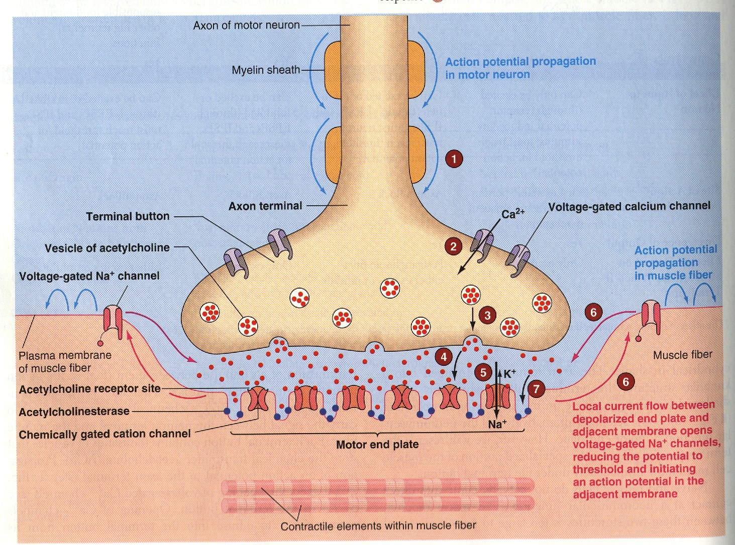
Neuromuscular Junction
125

Slide 22
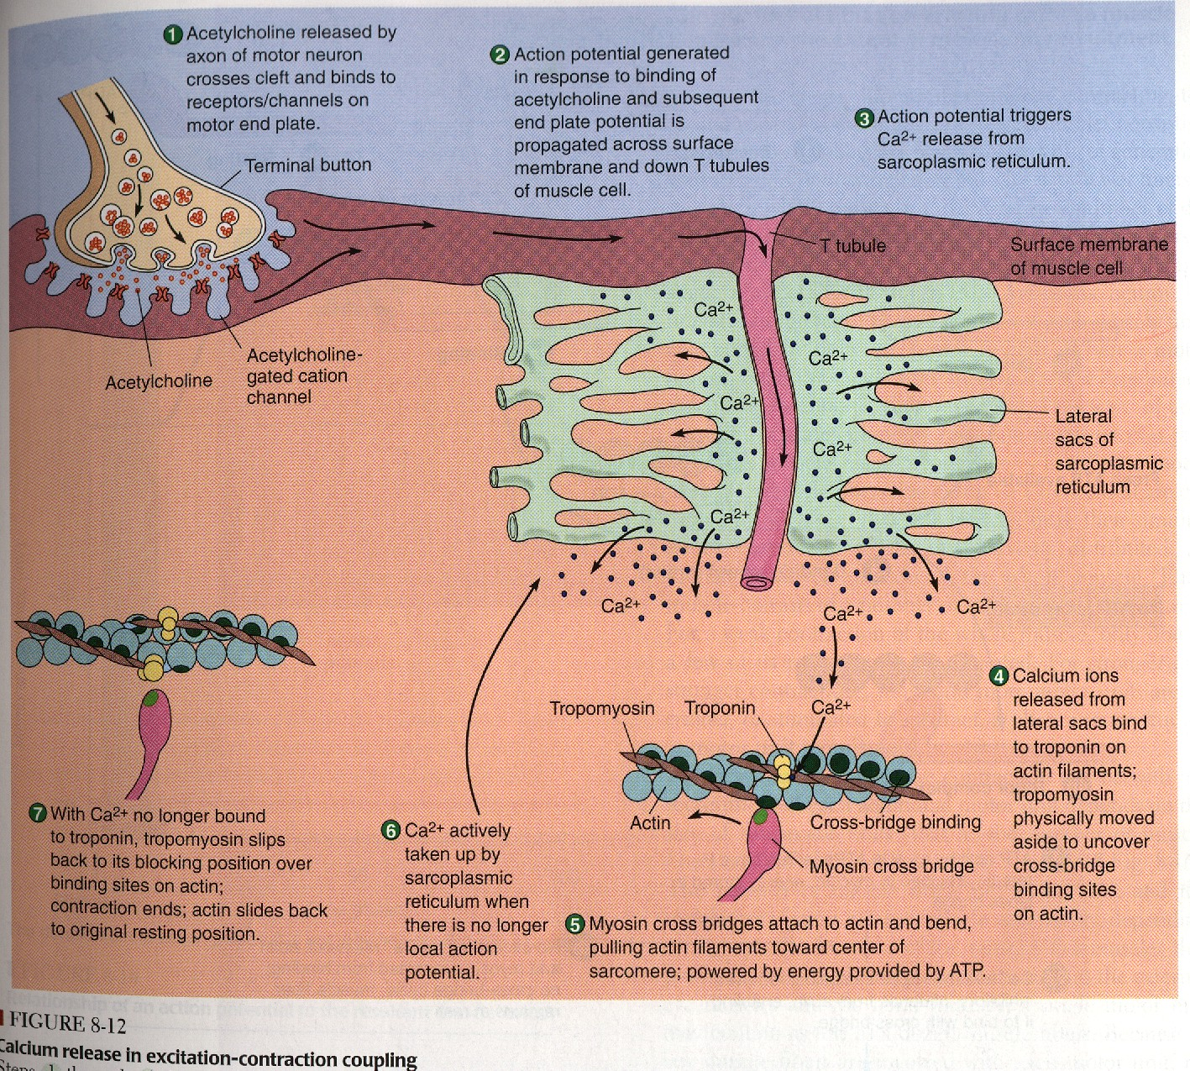

Slide 23
Events of muscle contraction:
Acetylcholine is released from α-motor neuron »»»»» End Plate potential (EPP) »»»»» depolarization of CM (muscle AP) »»»»»
Spread of AP into T tubule »»»»»release of Ca from sarcoplasmic reticulum into the cytoplasm
»»»»» Ca combines with troponin »»»»» troponin pull tropomyosin sideway »»»»» exposing the active site on actin »»»»» myosin heads with ATP on them, attached to actin active site
»»»»» myosin cross bridges bend pulling actin toward center of sarcomere (Power stroke) using energy of ATP»»»»»ADP & P released »»»»» Linkage between actin & myosin broken as new ATP binds to myosin cross bridge >>> ATP hydrolyzed and cross bridge go back to its original conformation.

Slide 24
Events of muscle contraction:
When a new ATP occupies the vacant site on the myosin head, this triggers detachment of myosin from actin
The free myosin swings back to its original position & attaches to another actin & the cycle repeats its self

Slide 25
Events of muscle relaxation:
The calcium is pumped back into sarcoplasmic reticulum
»»»»» Calcium is detached from troponin »»»»» tropomyosin return to its original position »»»»» Covering active site on actin »»»»» prevent formation of cross bridge »»»»» relaxation

Slide 26
Summary
Muscle AP spreads through T-tubules
It reaches the sarcoplasmic reticulum → opens calcium channels → calcium diffuses out of the sarcoplasmic reticulum into the cytoplasm → increased calcium concentration in the sarcoplasm.
Calcium combines with Troponin , activating it
Troponin pulls away Tropomyosin
This uncovers the active sites in Actin for Myosin
Myosin combines with these sites
This causes cleavage (breakdown ) of ATP and the release of energy
This released energy is used to produce Power Stroke
Myosin and Actin slide upon each other → contraction
A new ATP comes and combines with the Myosin head → this causes detachment (separation )of Myosin from Actin .

Slide 27
On order to release the head of Myosin from Actin, a new ATP is needed to come and combine with the head of Myosin .
Q: What is Rigor Mortis ?
The stiffening of skeletal muscles that begins several hours after death
Q: ATP is needed for 3 things : what are they ?
ATP is needed for 3 things :
(1) Power stroke .
(2) Detachment of myosin from actin active sites
(3) Pumping Calcium back into the Sarcoplasmic reticulum .
Q: Is muscle relaxation a passive or active process ?
A : it is active ; Why ? Because it needs ATP .

Slide 28
Q: What happens to A-band and I-band during contraction ?
I-band becomes shorter, and A-band does not change
Q: Calcium is needed in nerve & muscle : when and where ?
A : In nerve → needed for exocytosis (release of Ach)
In Muscle → needed for contraction .

Slide 29
Recommended Resourses
http://highered.mcgraw-hill.com/sites/0072495855/student_view0/chapter10/animation__action_potentials_and_muscle_contraction.html
http://highered.mcgraw-hill.com/sites/0072495855/student_view0/chapter10/animation__breakdown_of_atp_and_cross-bridge_movement_during_muscle_contraction.html
http://highered.mcgraw-hill.com/sites/0072495855/student_view0/chapter10/animation__function_of_the_neuromuscular_junction__quiz_1_.html
http://highered.mcgraw-hill.com/sites/0072495855/student_view0/chapter10/animation__myofilament_contraction.html
http://highered.mcgraw-hill.com/sites/0072495855/student_view0/chapter10/animation__sarcomere_contraction.
html

Slide 30
The End

